Slide 1
Password Encryption
Exploring Encryption and its Vulnerabilities

Slide 2
Securing Passwords – Hashes and salts
Encryption V. Hashing?
INPUT
HASH
Encryption is a two-way mechanism. You start with a plaintext, encrypt it to cyphertext and send to it to a recipient with a key. The recipient can use the key to decipher the message back into plaintext. Cyphertext can be cracked with enough time and computing power
Hashing is a one-way, irreversible mechanism. Plaintext passes through an algorithm and leaves as a series of characters. Starting from the digest or hash, you will never be able to re-create the original data. You can (using the same data and algorithm) always generate the same digest.
Hash with Salt: The random bits of data that are added to the hash algorithm, like a key for computations, is called the salt. A salt can be used to help create the hash value when combined with the original password, since it adds additional levels of complexity to the answer key. All this hashing and salting creates a one-way hash value. A salt is usually a string of random data from 48 to 128 bits long. The longer the salt, the higher the level of complexity and difficulty to crack.

Slide 3
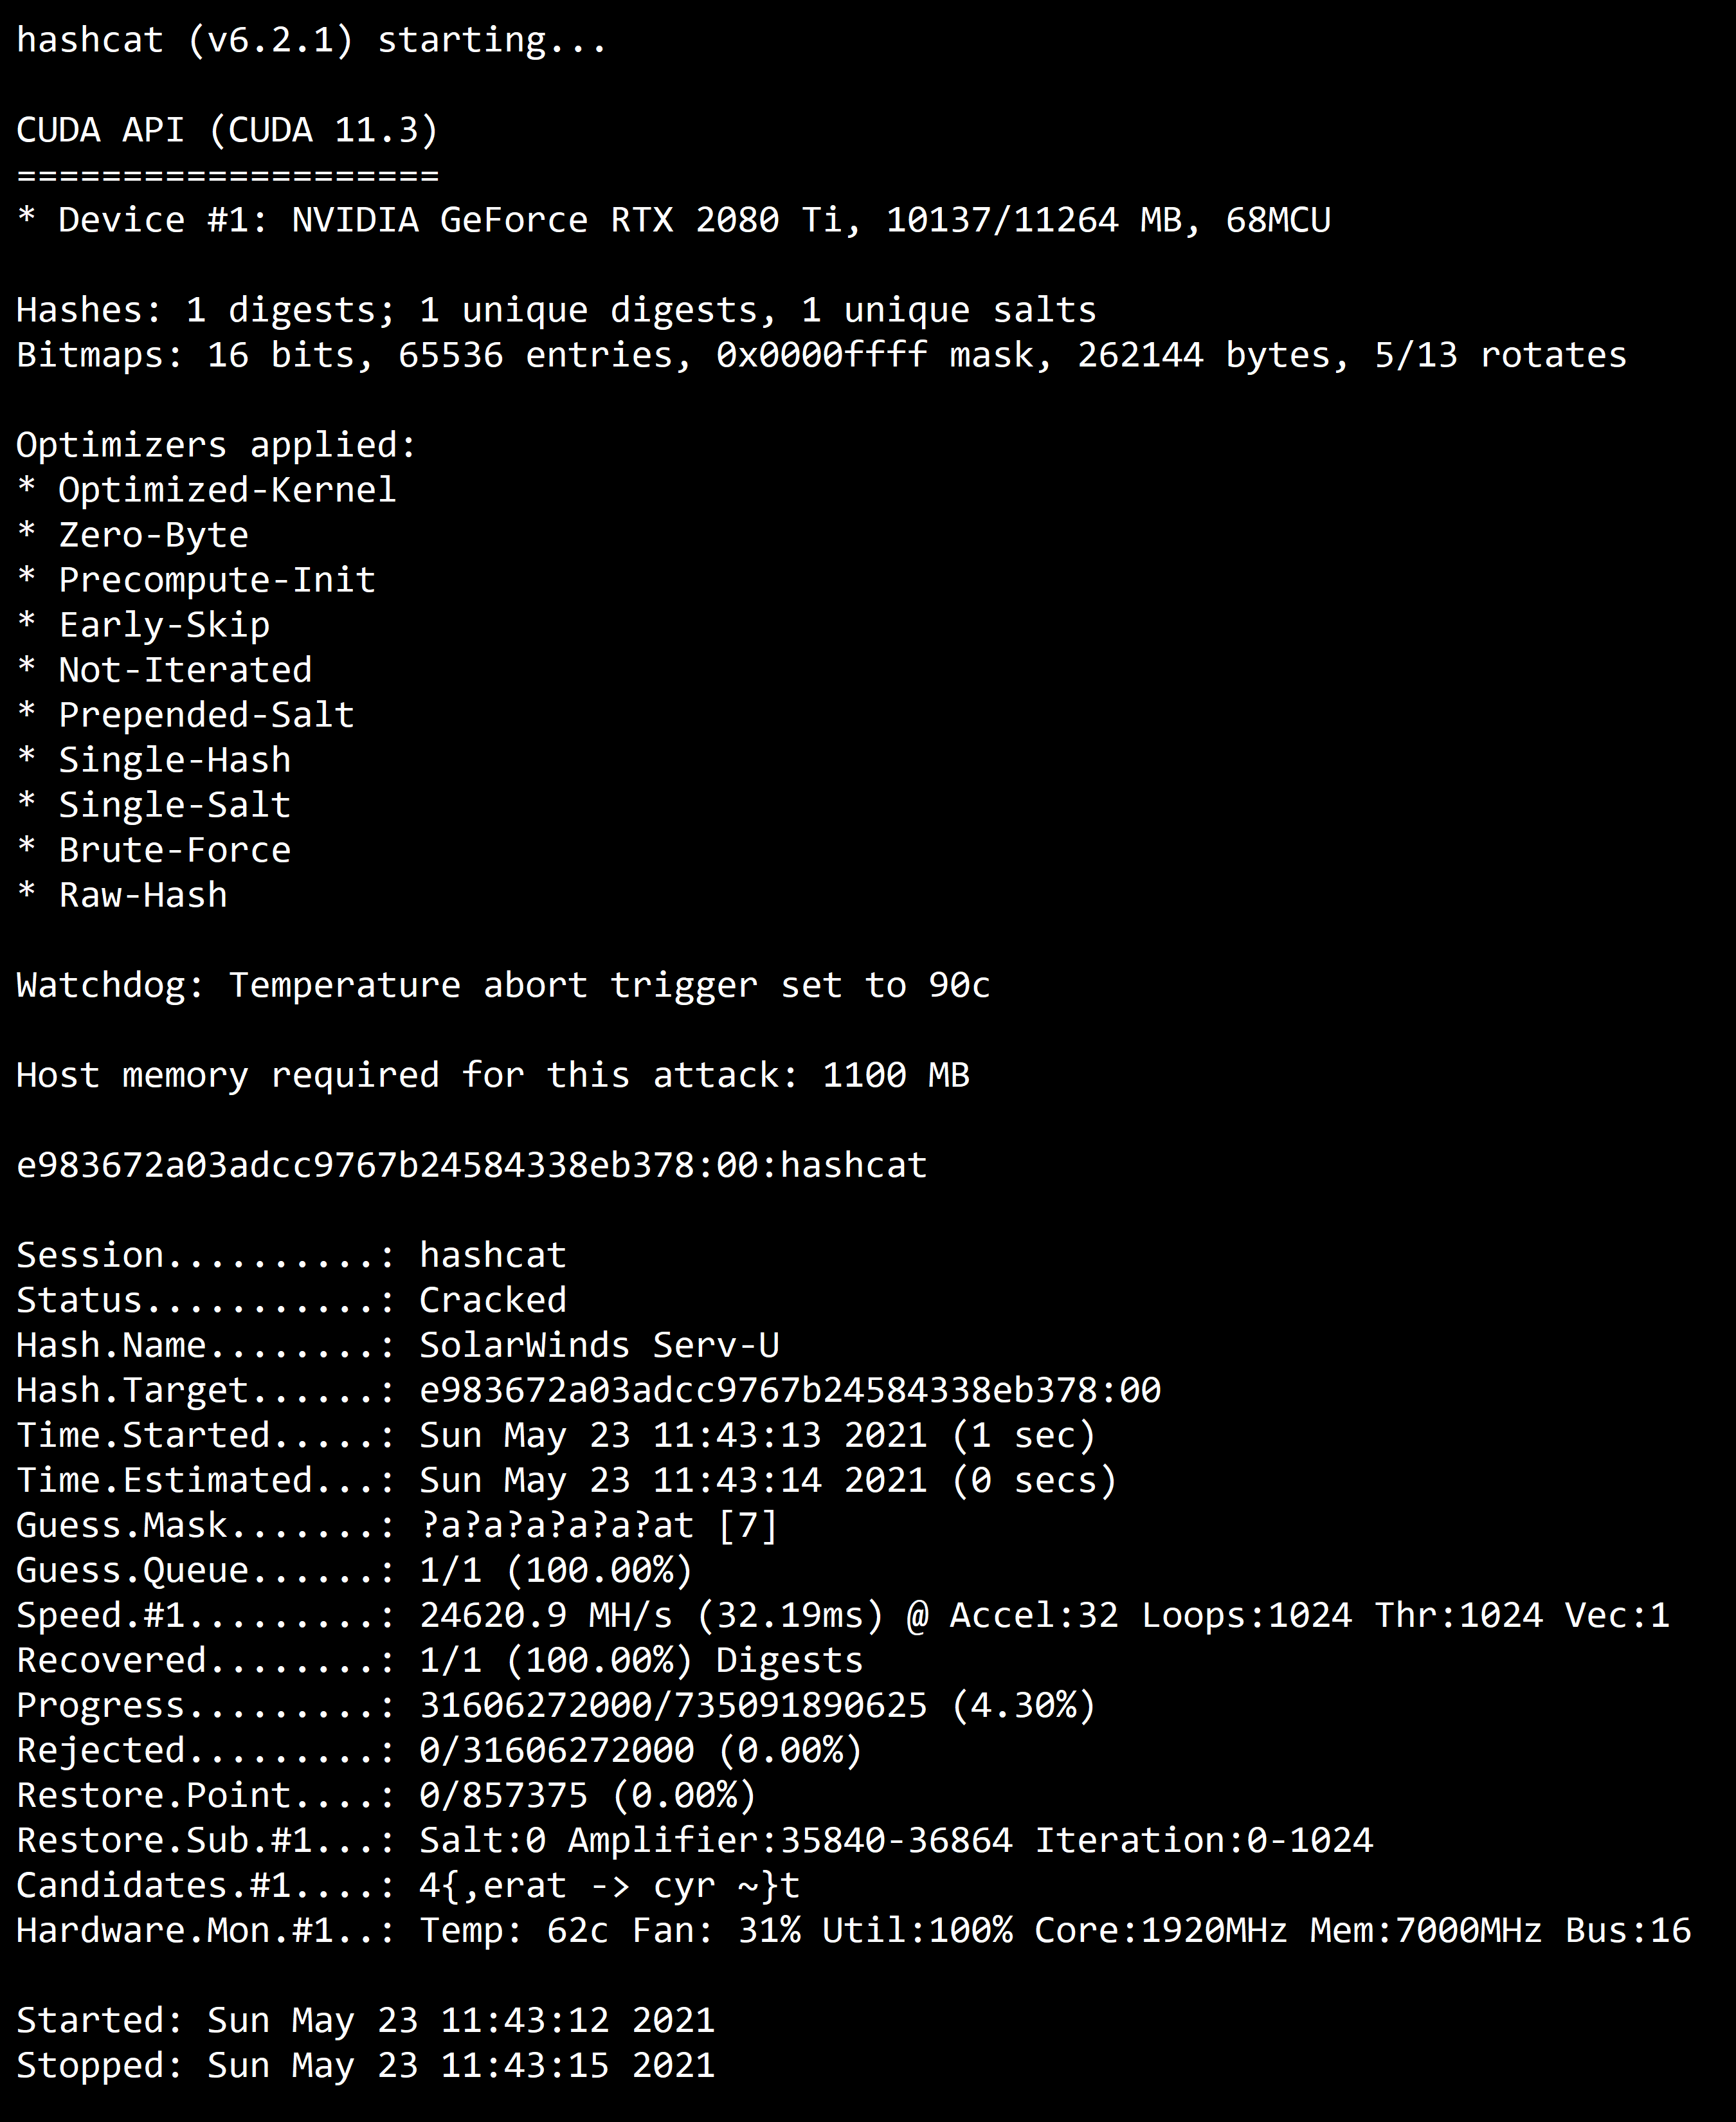
Hashcat
Hashcat is a particularly fast, efficient, and versatile hacking tool that assists brute-force attacks by conducting them with hash values of passwords that the tool is guessing or applying
Dictionary Attack or “straight mode,” is a very simple attack mode. It is also known as a “Wordlist attack”. All that is needed is to read line by line from a textfile (aka “dictionary” or “wordlist”) and try each line as a password candidate. A common teaching word list is rockyou.txt and is found in kali dir: /usr/share/wordlists
Output of hashcat –help:
The command we’ll use
hashcat –a 0 –m 1400 {hash.file} {example.dict} > cracked.txt
-a : mode, 0 = dictionary mode
-m : hash type (ex. Sha256, md5 etc…) (Search for online tools to lookup hash types from your list)

Slide 4
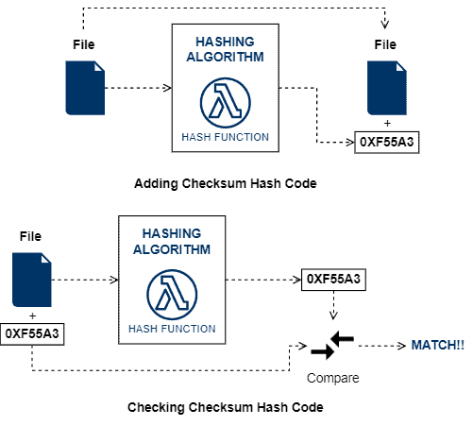
Checksum and File Validation
Checksums are also hash codes. Checksums are mainly focused on checking data integrity.
We can understand checksums as a fingerprint of some data. Thus, once provided the original data, we can take its fingerprint and compare it to an also provided one. If the fingerprints (checksums) match, we can say with high reliability that the data integrity is not compromised.
Good hashing functions to checksums must be able to change their generated hash code given minimal changes in the input data -- change a single bit in the data, and recalculate the checksum, the results should be different.
Checksums are employed in multiple contexts, from the most traditional integrity check of stored data to error detection in network transmission and as part of a digital signature
The Commands:
Generating:
sha256sum {some file} > checksum
Validating:
sha256sum --check checksum

Slide 5
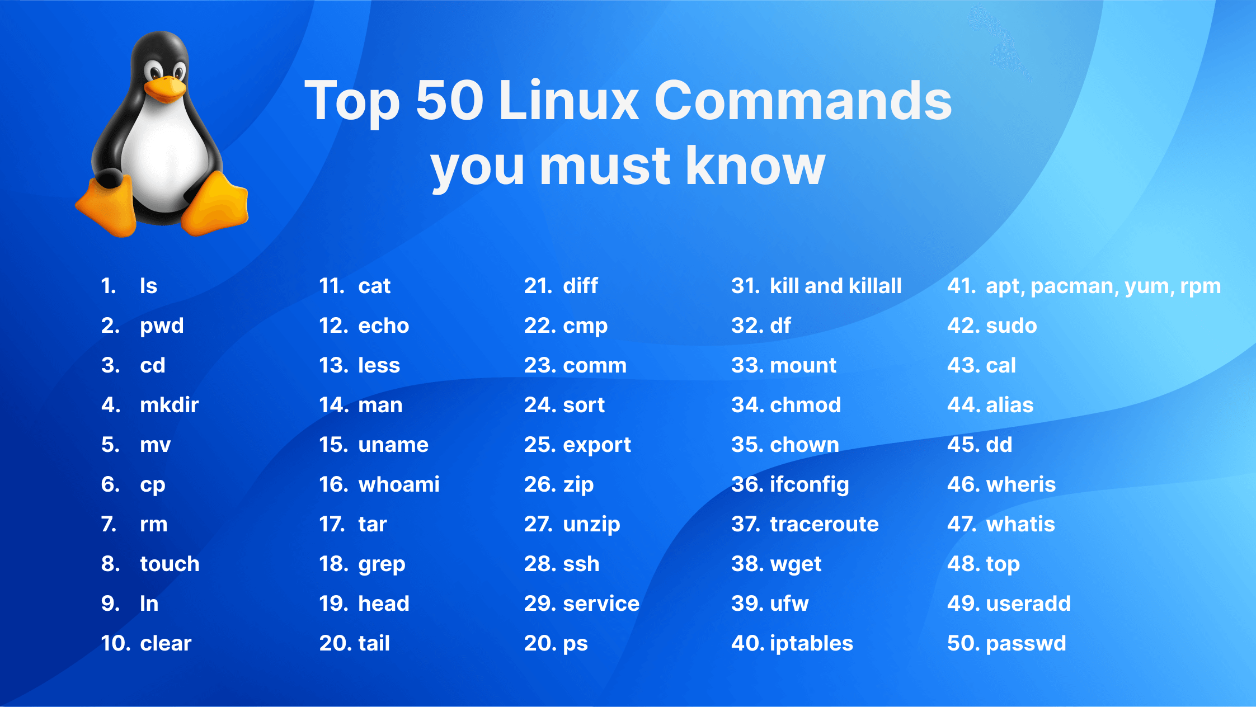
Linux Cmd Ref
ls - The most frequently used command in Linux to list directories
pwd - Print working directory command in Linux
cd - Linux command to navigate through directories
mkdir - Command used to create directories in Linux
mv - Move or rename files in Linux
cp - Similar usage as mv but for copying files in Linux
rm - Delete files or directories
touch - Create blank/empty files
clear - Clear the terminal display
cat - Display file contents on the terminal
echo - Print any text that follows the command
whoami - Get the active username
tar - Command to extract and compress files in linux
grep - Search for a string within an output
zip - Zip files in Linux
unzip - Unzip files in Linux
ssh - Secure Shell command in Linux
chmod - Command to change file permissions
ifconfig - Display network interfaces and IP addresses
wget - Direct download files from the internet
iptables - Base firewall for all other firewall utilities to interface with
apt install - Package managers depending on the distribution
sudo - Command to escalate privileges in Linux
useradd and usermod - Add a new user or change existing user data
passwd - Create or update passwords for existing users

