Slide 1
Monday October 7, 2019 @7PM in Swearingen 2A14
Notes:
James

Slide 2
Scenario
Notes:
Noemi

Slide 3

Scenario
Alice
Notes:
Noemi

Slide 4

Scenario
Bob
Alice
Notes:
Noemi

Slide 5
Scenario
Bob
Alice
message m
Notes:
Noemi

Slide 6

Scenario
Bob
Alice
message m
Eve
Notes:
Mayo

Slide 7
Scenario
Bob
Alice
message m
Eve
Notes:
Mayo

Slide 8
Scenario
Bob
Alice
message m
message m’
Eve
Notes:
Mayo

Slide 9
What is encryption?
The Goal:
Exchange information confidentially and with integrity
How do we do this?
Relies on established and followed protocol between parties
Plaintext ----(encryption)----> Ciphertext
Ciphertext ----(decryption)----> Plaintext
Notes:
William

Slide 10
Classic Example: Caesar Cipher
a b c d e f g h i j k l m n o p q r s t u v w x y z | F G H I J K L M N O P Q R S T U V W X Y Z A B C D E
Message: CRYPTOGRAPHYCANBESIMPLE Shift: 5 (a = F)
C R Y P T O G R A P H Y C A N B E S I M P L E + 5 5 5 5 5 5 5 5 5 5 5 5 5 5 5 5 5 5 5 5 5 5 5 H W D U Y T L W F U M D H F S G J X N R U Q J
H W D U Y T L W F U M D H F S G J X N R U Q J - 5 5 5 5 5 5 5 5 5 5 5 5 5 5 5 5 5 5 5 5 5 5 5 C R Y P T O G R A P H Y C A N B E S I M P L E
Notes:
William

Slide 11
Classic Example: Vigenère Cipher
Message: CRYPTOGRAPHYCANBESIMPLE Key: LEMONDROP
C R Y P T O G R A P H Y C A N B E S I M P L E + L E M O N D R O P L E M O N D R O P L E M O N N V K D G R X F P A L K Q N Q S S H T Q B Z R
N V K D G R X F P A L K Q N Q S S H T Q B Z R - L E M O N D R O P L E M O N D R O P L E M O N C R Y P T O G R A P H Y C A N B E S I M P L E
Notes:
William

Slide 12
Classic Example: Vigenère Cipher
Message: CRYPTOGRAPHYCANBESIMPLE Key: LEMONDROP
C R Y P T O G R A P H Y C A N B E S I M P L E
2 17 24 15 19 14 6 17 0 15 7 24 2 0 13 1 4 18 8 12 15 11 4
+ 11 4 12 14 13 3 17 14 15 11 4 12 14 13 3 17 14 15 11 4 12 14 13 13 21 10 3 6 17 23 5 15 0 11 10 16 13 16 18 18 7 19 16 1 25 17
N V K D G R X F P A L K Q N Q S S H T Q B Z R
N V K D G R X F P A L K Q N Q S S H T Q B Z R
13 21 10 3 6 17 23 5 15 0 11 10 16 13 16 18 18 7 19 16 1 25 17
- 11 4 12 14 13 3 17 14 15 11 4 12 14 13 3 17 14 15 11 4 12 14 13
2 17 24 15 19 14 6 17 0 15 7 24 2 0 13 1 4 18 8 12 15 11 4
C R Y P T O G R A P H Y C A N B E S I M P L E
Notes:
William

Slide 13
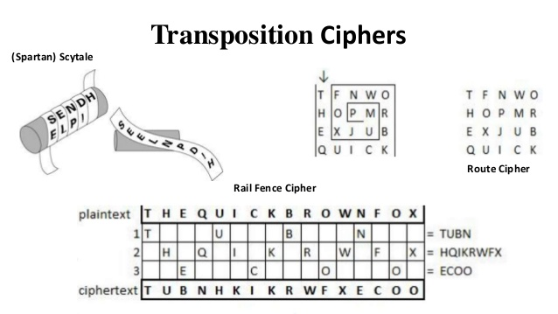
Classic Example: Scytale
Works by rearranging letters
Notes:
James

Slide 14
Substitution vs Transposition
Substituting one letter for another
Unrelated to contents of the plaintext
Ex. Caesar Cipher
“Shuffling” of letters in the plaintext
Ex. Scytale
Most modern ciphers utilize both
Notes:
James

Slide 15
Questions?
Notes:
James

Slide 16
Overview
Methods of encryption
Block
Stream
Asymmetric
Symmetric
Hashes
Signing
Cryptographic systems you will see
RSA
DES
AES (Rijndael)
SSL/TLS
WEP/WPA/WPA2
ASK QUESTIONS THROUGHOUT
Some of the material builds on itself
Notes:
James

Slide 17
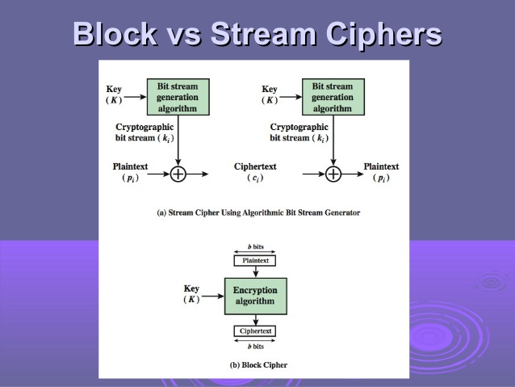
Block vs Stream
Encrypts groups of plaintext at a time
Error propagation
Vulnerable due to repetition of key
Like Caesar cipher
Character for character conversion from plaintext to ciphertext based on the key
Very fast, little error propagation
Lots of character repetition
Vulnerable to insertion and modification
Like Vigenère with an infinite length key
Notes:
Noemi

Slide 18
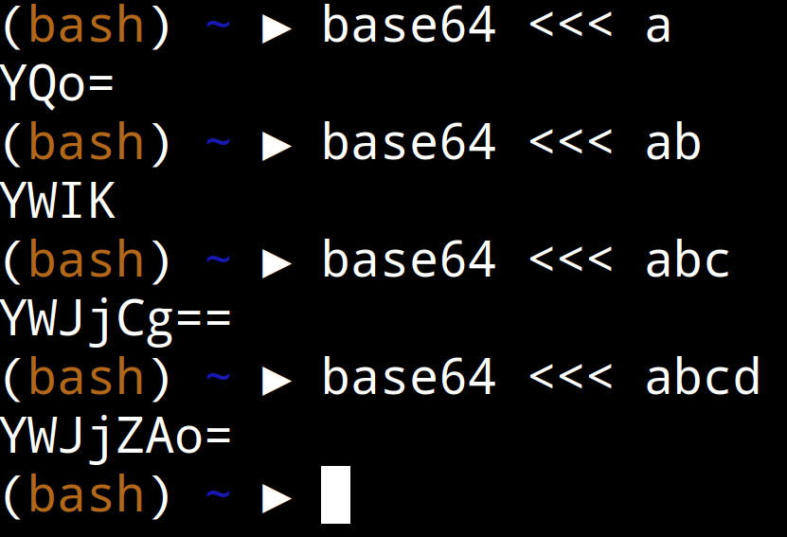
Padding
How do we apply block cipher to arbitrarily sized inputs?
Pad the input with arbitrary data so it’s a multiple of the block size
Notes:
William

Slide 19
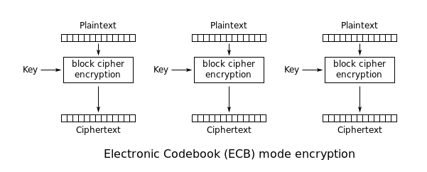
Block Cipher Modes
How do we apply block cipher to arbitrarily sized inputs?
Naive Option: Electronic Code Book - Divide the plaintext into appropriately sized blocks and apply block cipher to each.
Notes:
William

Slide 20
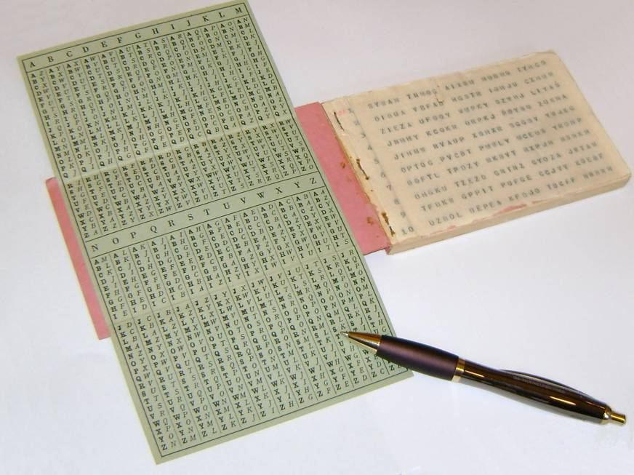
Classic Example: Vernam One Time Pad
Only truly unbreakable cipher*
Like Vigènere, but key is random and never repeats.
Only info given away is max length of message.
Works on the principle that:
RANDOM + CONSTANT=RANDOM
Commonly utilizes atmospheric background radiation or a radioactive sample
*Requires perfectly random data… good luck with that
Notes:
James

Slide 21
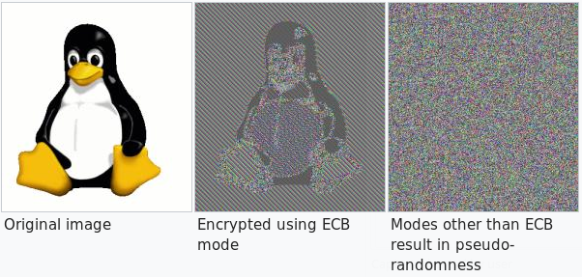
Block Cipher Modes
Problem with ECB: identical blocks of plaintext encrypt to identical blocks of ciphertext
Notes:
William

Slide 22
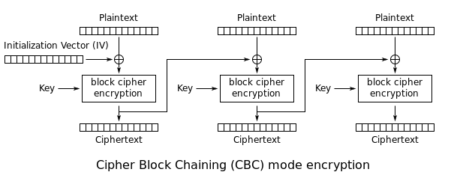
Block Cipher Modes
Another Option: Cipher-Block Chaining
Notes:
William

Slide 23
Symmetric
Same key used for encryption and decryption.
Plaintext
Ciphertext
Encrypt
Decrypt
Key
Key
Ciphertext
Plaintext
Notes:
Noemi

Slide 24
Asymmetric
Also known as public and private key.
Encryption with one key can only be decrypted with the other key.
Public keys are public, if you want to send someone a message you use their public key and send it. It is secure because the message can only be decrypted with the private key
https://youtu.be/GSIDS_lvRv4?t=59
Plaintext
Ciphertext
Encrypt
Decrypt
Public Key
Private Key
Ciphertext
Plaintext
Notes:
Handcuffs, Edward Snowden, prime factorization

Slide 25
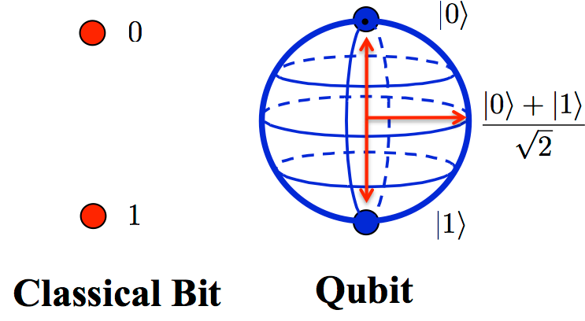
Asymmetric
How does it work?
Multiply two big (1000s of digits) prime numbers together (p, q)
Public key is first prime number, private key is second prime number (roughly)
Factoring numbers is hard
This is why quantum computing is scary
(Shor’s Algorithm)

Slide 26
Asymmetric - Applications
Encrypted email - how does Snowden leak data to the media?
PGP: https://www.openpgp.org/
Encrypted chat - talk without Facebook or NSA snooping
Riot: https://about.riot.im/
Signal: https://www.signal.org/
Encrypted websites - buy things from Amazon without giving away your credit card

Slide 27
Hashes
Input of arbitrary size mapped to fixed size “hash”
Deterministic (same message always yields same hash)
Fast
Collision-resistant (Infeasible for two messages to map to the same hash)
One-way (very difficult to reconstruct input from hash)
Small changes in input produce completely different output (probably).
“Hello world.” --SHA-256→ “aa3ec16e6acc809d8b2818662276256abfd2f1b441cb51574933f3d4bd115d11”
“Hello World.” --SHA-256→ “f4bb1975bf1f81f76ce824f7536c1e101a8060a632a52289d530a6f600d52c92”
Notes:
Noemi

Slide 28
Hashes - Applications
Passwords: don’t care what the password is, just that it’s the same
Software downloads: want to make sure you downloaded without changes

Slide 29
Signing
Ensure message integrity.
Send a message along with a signature of:
Message hash encrypted with sender’s private key
Recipient decrypts encrypted hash using sender’s public key
Take hash of message and compare to decrypted hash (they should be the same)
Notes:
William

Slide 30
Symmetric vs Asymmetric
Very fast
Difficult to distribute keys in secure manner (must meet in park at night)
Requires unique key for each recipient:
(n*(n-1) /2) keys for n parties communicating with each other
Slower processing
No need for established secure channel
Only need to keep n (public) keys for n parties communicating with each other
In practice, asymmetric is generally used to distribute symmetric keys for a communication session.
This prevents huge storage, and keeps it fast
Notes:
James

Slide 31
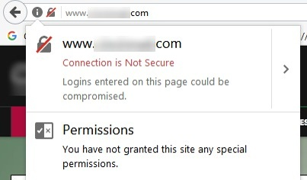

SSL / TLS
(Secure Socket Layer) old
(Transport Layer Security) new
Separates HTTP from HTTPS
A protocol of existing encryption systems
Client initiates secure session
Server responds with certificate signed by private key of trusted 3rd party
Certificate guarantees identity (Server is who it says it is)
Client gives (symmetric) session key to server, encrypted with server’s public key
Server decrypts with private key and acknowledges using (symmetric) session key
Notes:
Wireshark demo

Slide 32
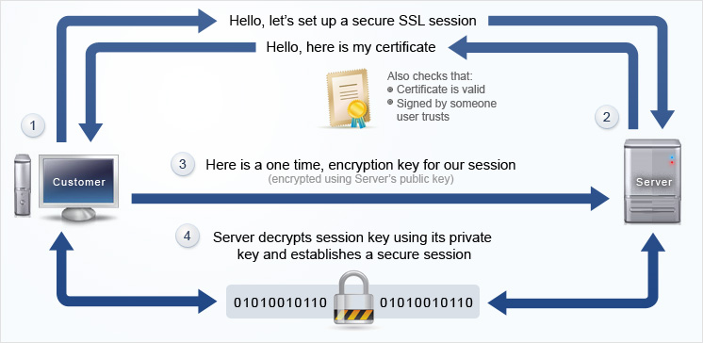
SSL / TLS cont.
Notes:
Nginx demo

Slide 33
WEP/WPA/WPA2
WEP (Wired Equivalent Privacy)
Uses pre-shared secret (Wi-Fi password) to encrypt packets. Uses RC4 with 24-bit initialization vector (IV).
RC4 is a stream cipher
Initialization vector is a seed, to prevent packets starting with the same key stream
Small IV ensures some packets will have same IV. Allows for statistical attacks.
Simple way of determining IV allows for related-key attacks.
WPA (Wi-Fi Protected Access)
WPA-Personal (Pre-shared Key) or WPA-Enterprise (User Accounts)
Still uses RC4 for legacy reasons, but adds TKIP (Temporal Key Integrity Protocol) to solve weaknesses with IV in RC4.
WPA2 (Wi-Fi Protected Access 2)
Replace RC4 with AES for better security.
Notes:
Hashcat practice

Slide 34
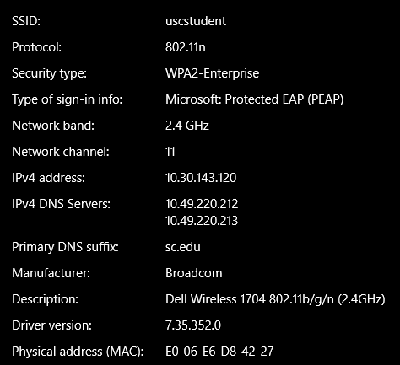
WEP/WPA/WPA2 cont.
Notes:
William/James

Slide 35
Additional Resources
Introduction to Cryptography (MATH 587 is offered rarely)
Wikipedia and YouTube do a great job of explaining both algorithms and general concepts
Higher math education (Group Theory, Number Theory) for understanding algorithm details
Cipher decoder: https://www.dcode.fr/caesar-cipher
Hashcat breaks passwords: https://hashcat.net/hashcat/
PDFC resources: https://drive.google.com/drive/folders/1qPfGxllBbQmpbV8dFSlyGMJIRLGqbJXM
Notes:
James

Slide 36

Take-aways
These algorithms are all open source
They’re hard as sh*t
Experts/smart people come up with these
You don’t need to understand all the nitty gritty details in order to use it
Don’t use some proprietary algorithm that someone says is secure: encryption algorithms have to be reviewed by experts and should be open source
“Anyone, from the most clueless amateur to the best cryptographer, can create an algorithm that he himself can't break.”
---Bruce Schneier
Notes:
EVERYBODY YAY

Slide 37
Image Credits
Title Slide: Clay Norris
Alice: https://www.disneyclips.com/imagesnewb/images/clipalicewonder.gif
Bob: https://t5.rbxcdn.com/1059222f8826addbd6c4ef0bf6390fbf
Eve: https://orig00.deviantart.net/65f2/f/2011/201/2/0/wall_e_eve_by_anabaric-d413lej.png
OTP: https://www.google.com/url?sa=i&rct=j&q=&esrc=s&source=images&cd=&cad=rja&uact=8&ved=0ahUKEwivurCkuefWAhUK5SYKHR Y1D9MQjRwIBw&url=http%3A%2F%2Fusers.telenet.be%2Fd.rijmenants%2Fen%2Fonetimepad.htm&psig=AOvVaw2dWMy2-58NiytEwFrc0Qg4&ust=1507772727240900
Scytale
Stream/Block Ciphers: https://image.slidesharecdn.com/ch03-block-cipher-and-data-encryption-standard-130509135516-phpapp01/95/ ch03-blockcipheranddataencryptionstandard-5-638.jpg
ECB: https://en.wikipedia.org/wiki/Block_cipher_mode_of_operation#/media/File:ECB_encryption.svg
CTR, CBC
DES
AES
SSL: https://www.google.com/url?sa=i&rct=j&q=&esrc=s&source=images&cd=&cad=rja&uact=8&ved=0ahUKEwjHiovMzufWAhUEySYKHa KRBhQQjRwIBw&url=https%3A%2F%2Fwww.awardspace.com%2Fweb-hosting%2Fssl-certificates%2F&psig=AOvVaw3zLTvH7mspLZkbvoQbCyXJ&ust=1507778220394174
Meme: https://goo.gl/images/Wji9hP
http://qoqms.phys.strath.ac.uk/figures/qubit.png
Notes:
No one because who cares

