Slide 1
Metis

Slide 2
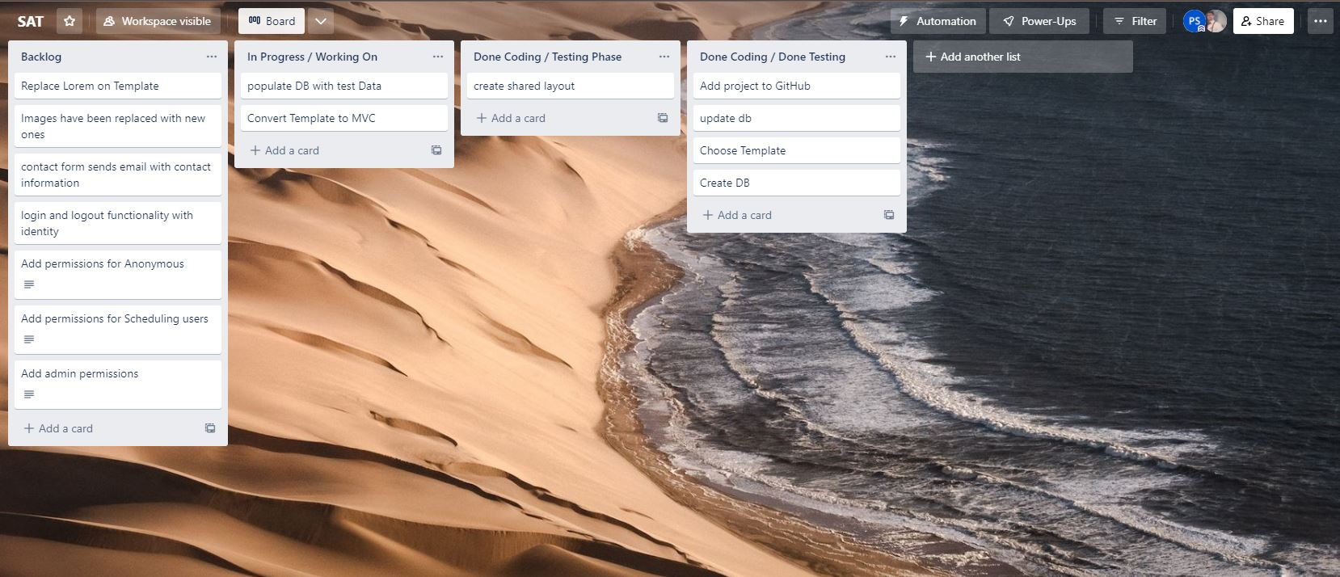

Slide 3
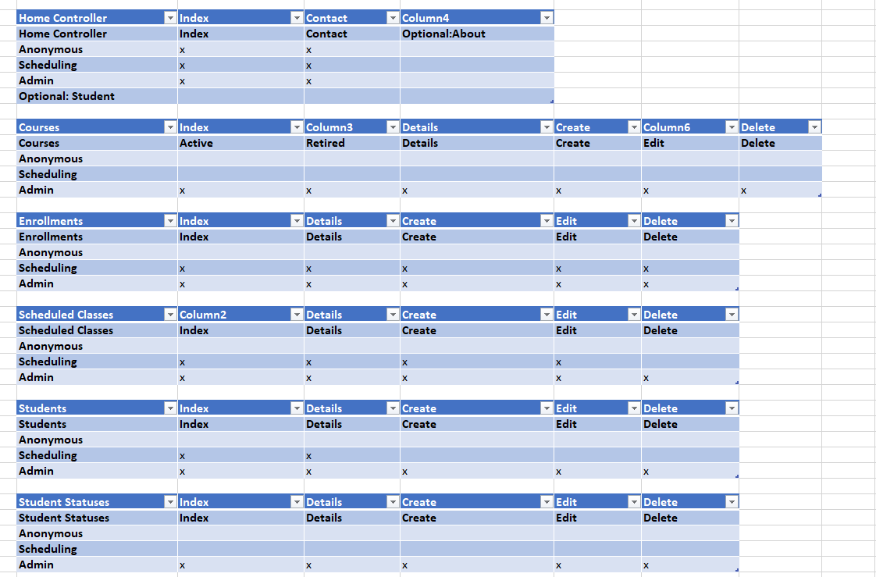

Slide 4
Daily Standups
Day 1
- Choosing our Template we choose something that had a lot of options and we could just remove what we didn't need
- We created the project without identity so we had to recreate the project using an authentication type
- Our template came with a blank page that we called home
- we were deciding what we want on our dashboard and we decided on a table that we could collapse
- ran into some git problems
- scaffolding and creating controllers is done
Day 2:
goal: get information from our database showing on our website with the correct styling and finish our contact page
-scaffolding issue
-we finished styling our data from our databases.
-added roles
-finished contact page
Day 3:
- controllers locked down for users
-crud locked down for users
- home page created

Slide 5
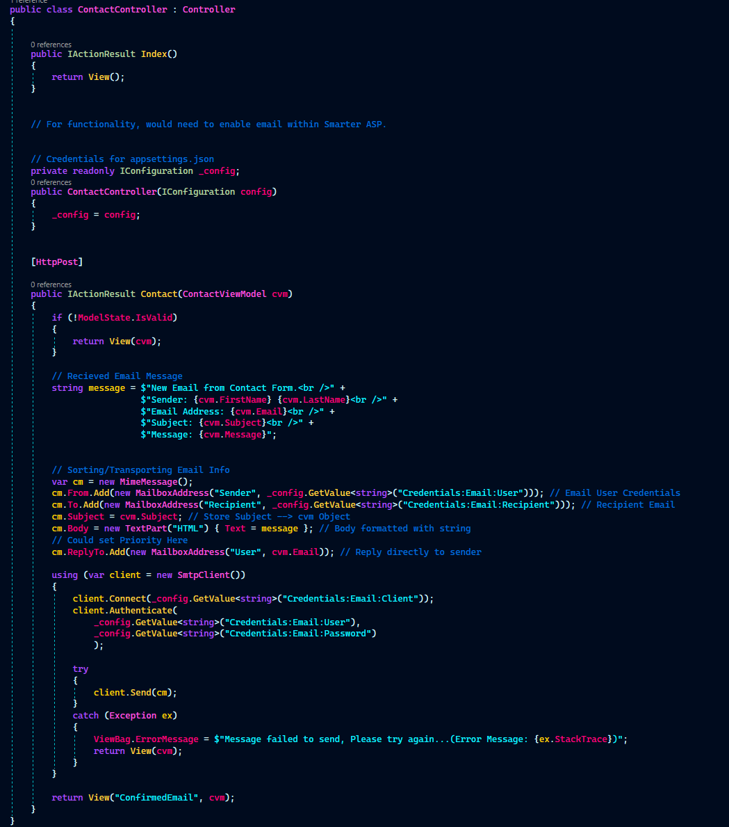
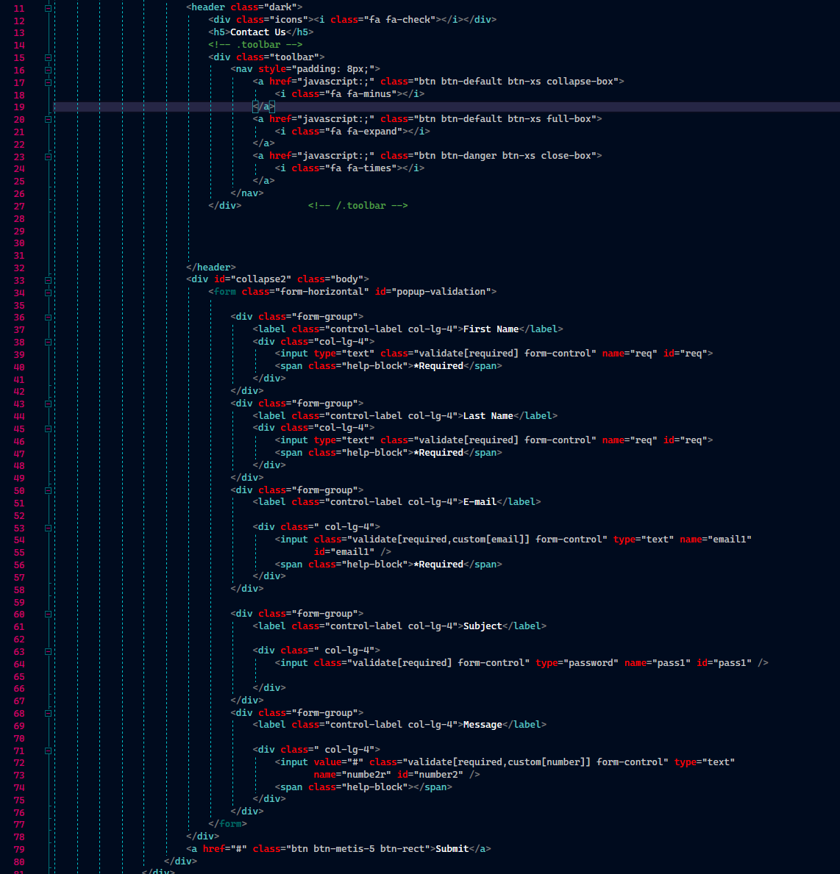
Contact Form

Slide 6
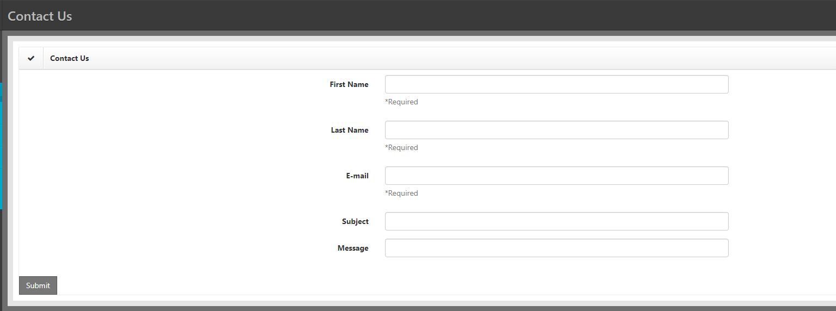

Slide 7
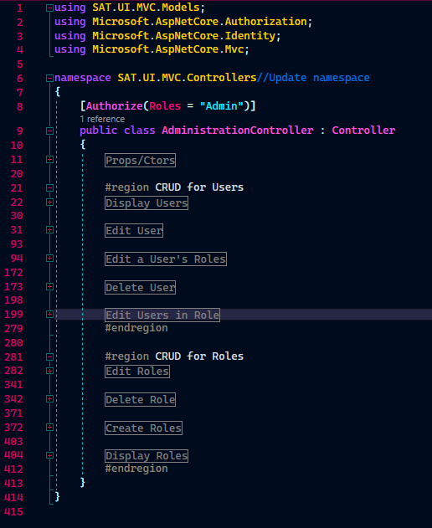
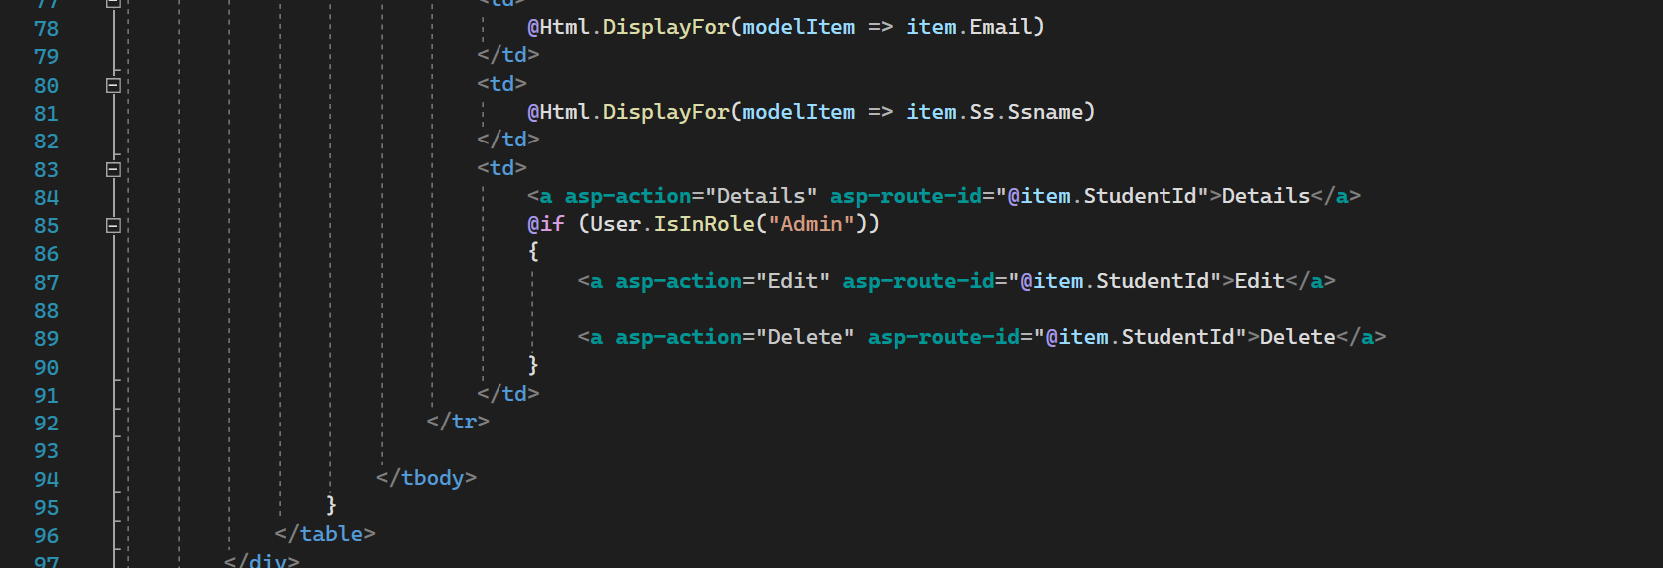
User and Role management with Identity Add-ons

Slide 8
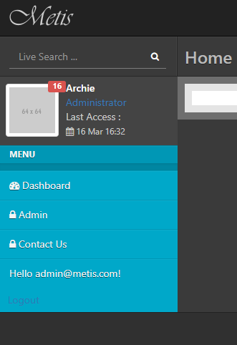
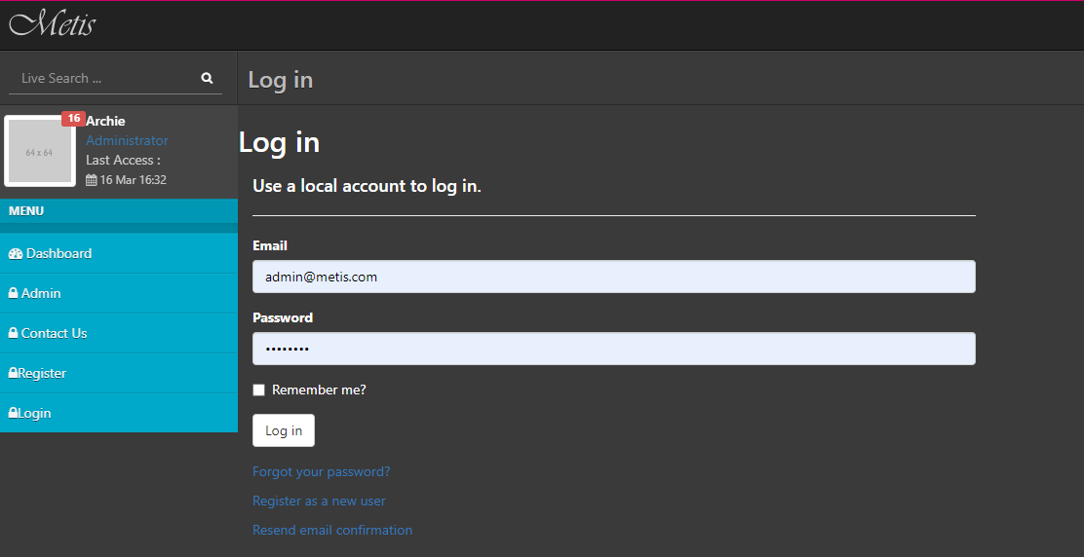
Register a user and login

Slide 9
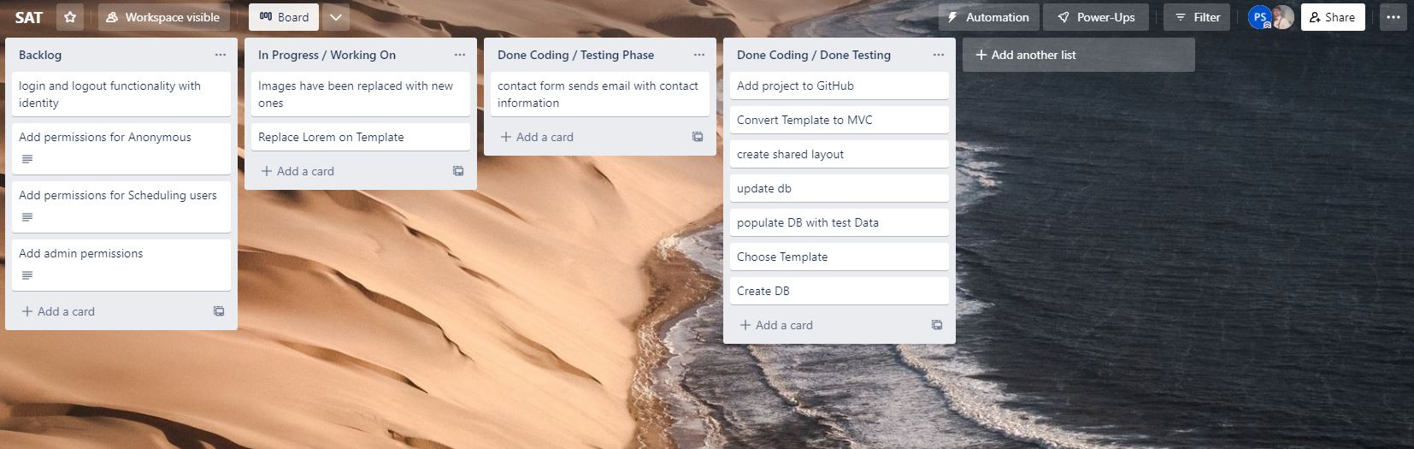
halfway

Slide 10
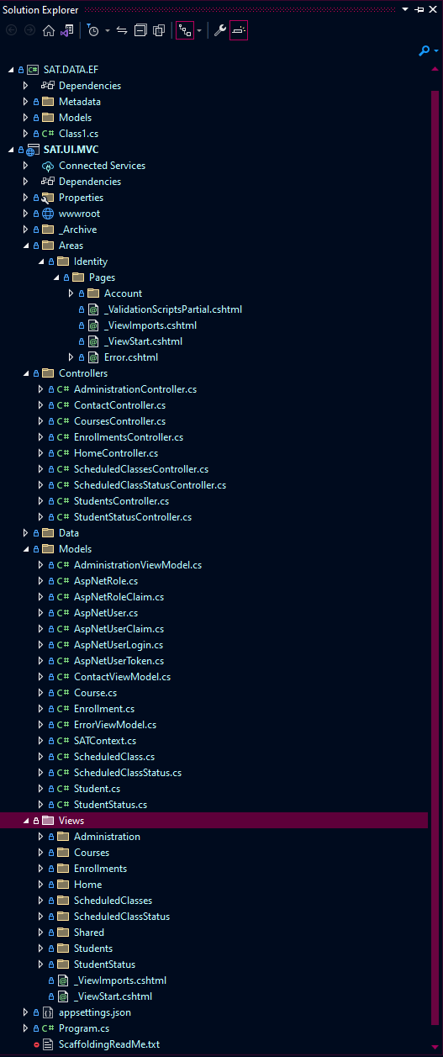
Create the data layer and utilize Entity Framework to create domain models for your database objects.

Slide 11
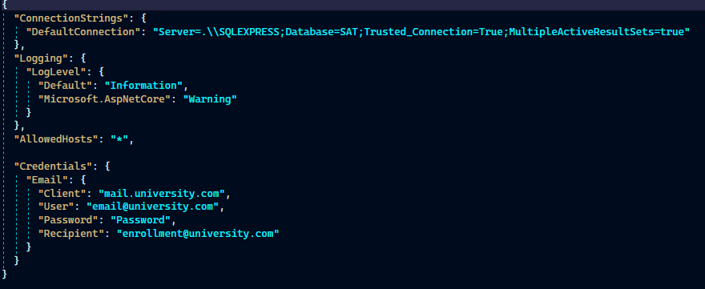

Slide 12
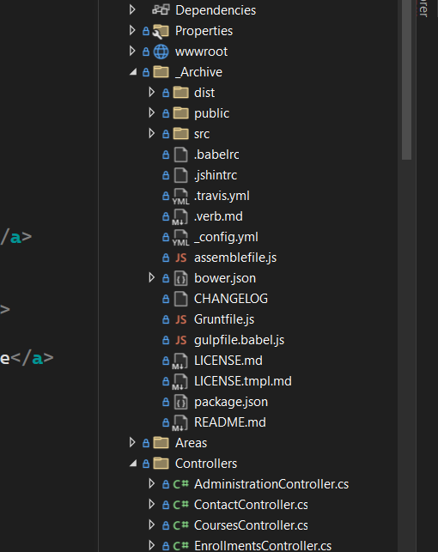
Archive
Biggest template EVER
Nav bar was 500 lines of code alone

Slide 13
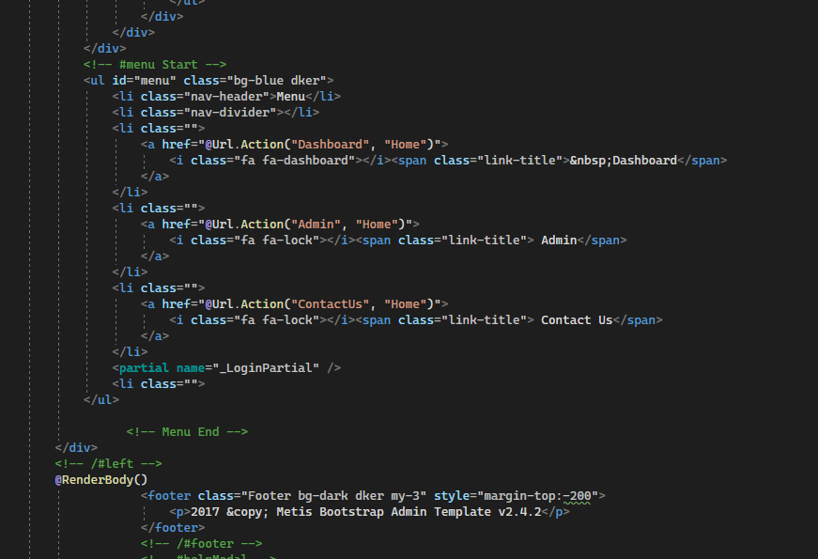
Kept the Side menu
Removed a top menu

Slide 14
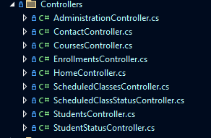
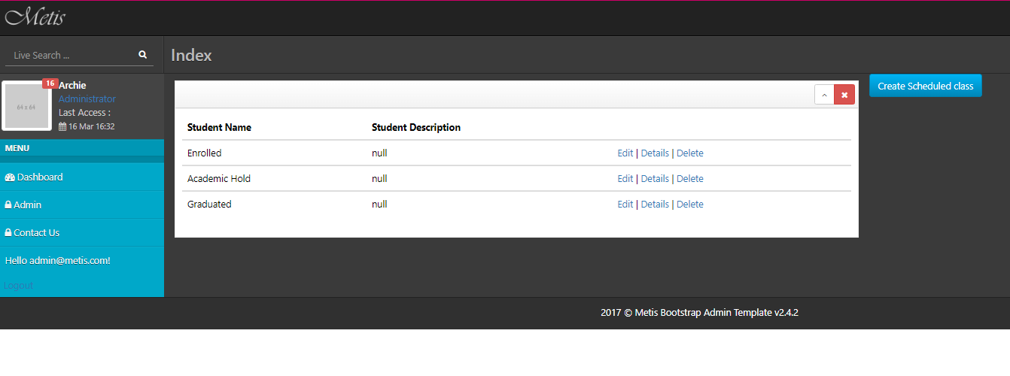
Scaffold all controllers and views in the UI layer.
Add functionality to allow the user to view the index of the Student Status controller in a table layout

Slide 15
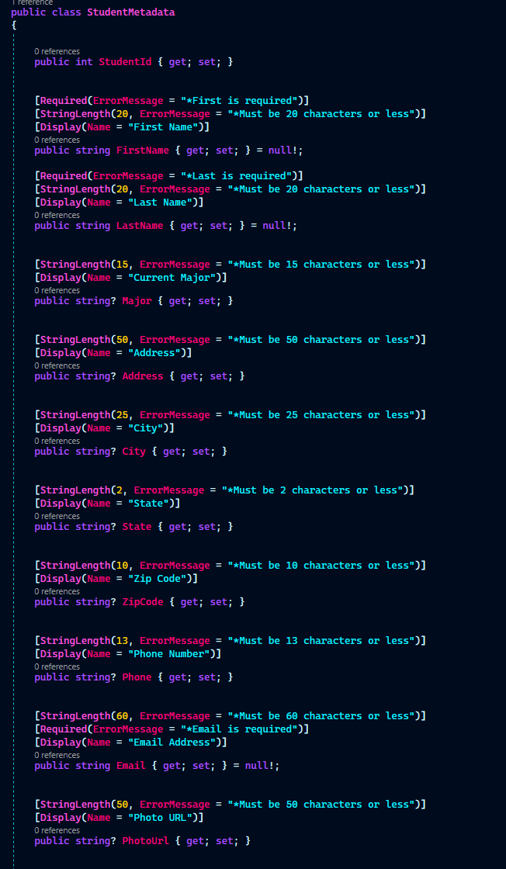
Buddy classes
Data layer metadata

Slide 16
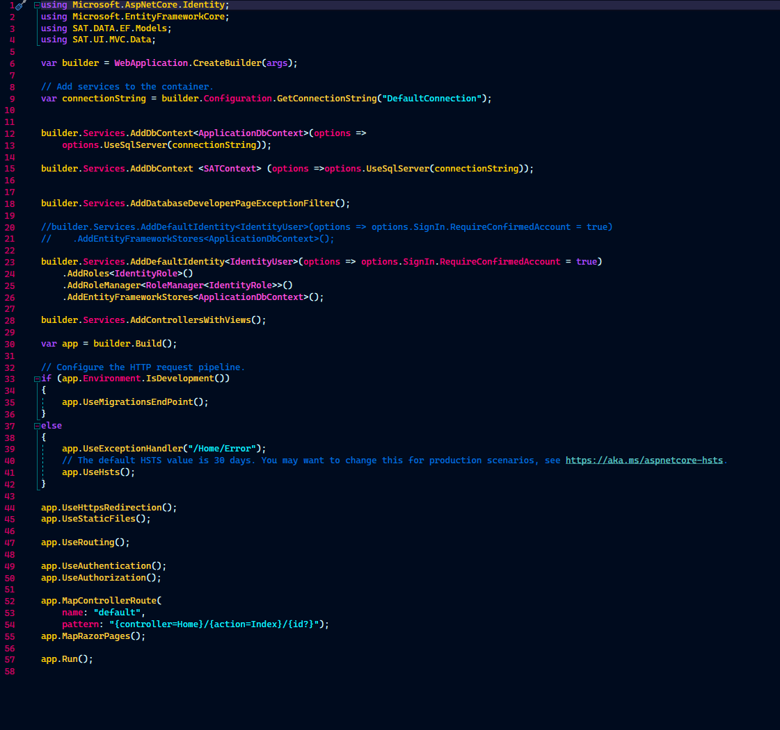
Program.cs
Connected to database, SatContext, and Identity User and Role Manager

Slide 17
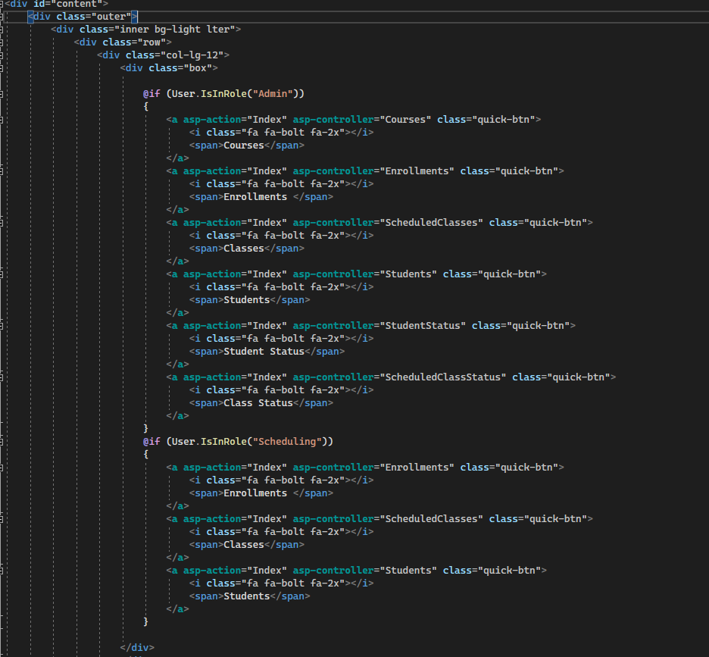
Admin dashboard ->
Students index

Slide 18
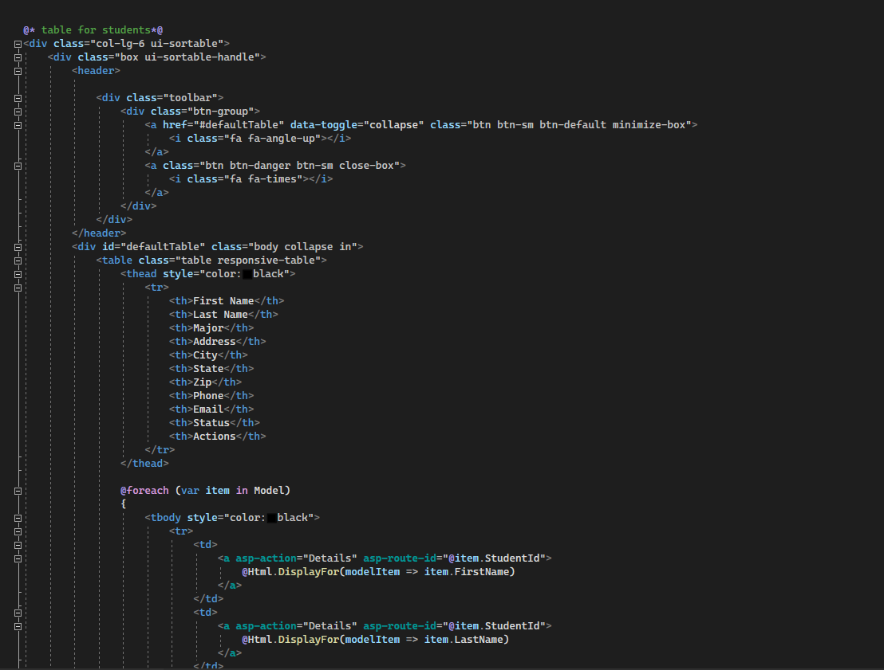
Student index ->
CRUD functionality

Slide 19
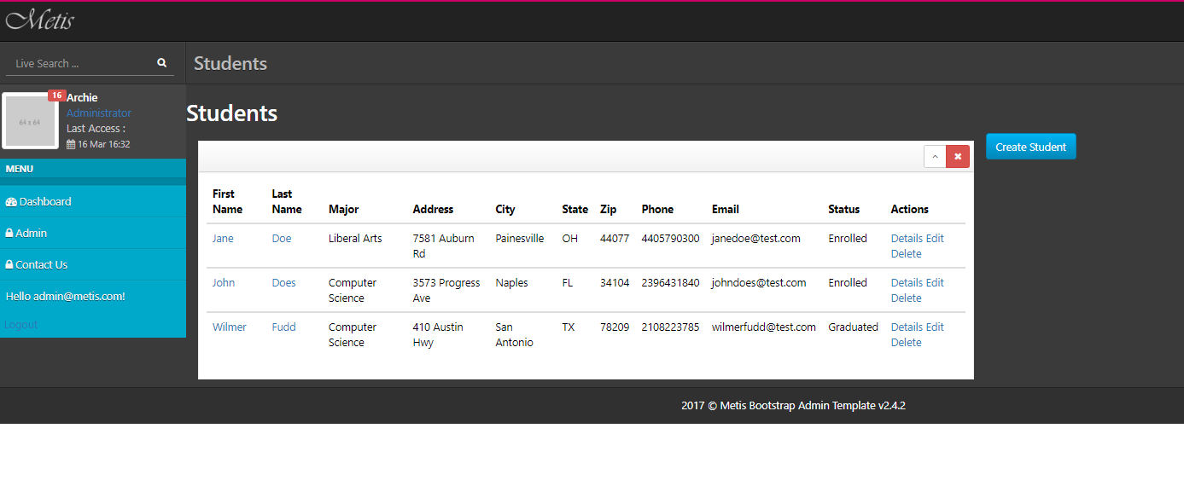

Slide 20
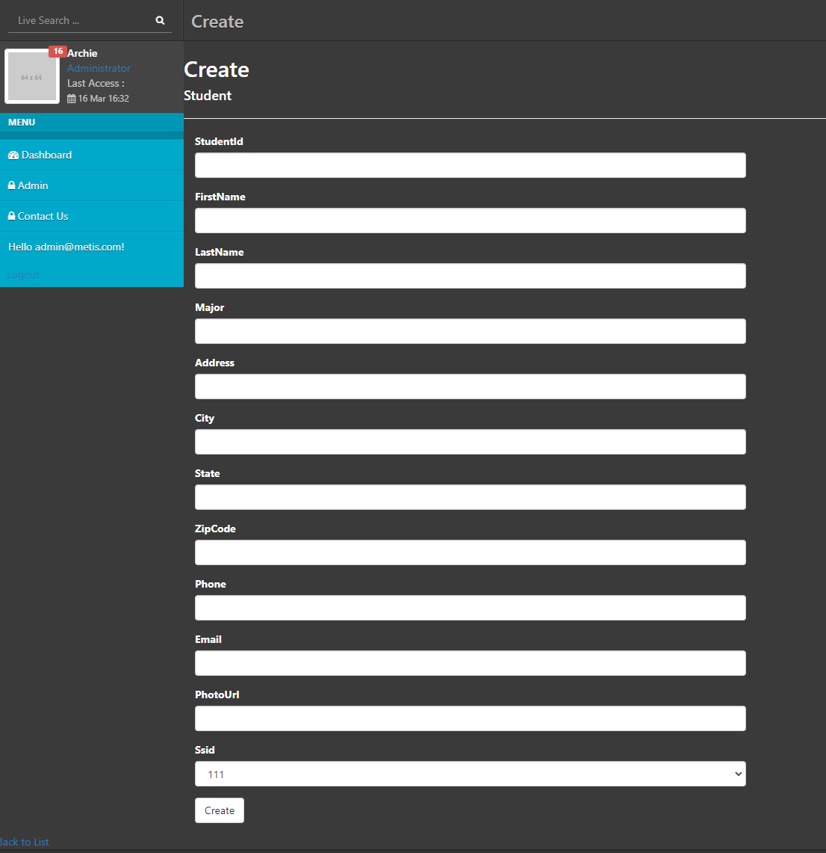

Slide 21
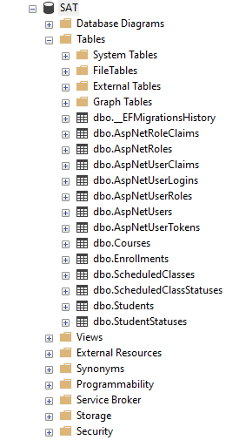
Database

Slide 22
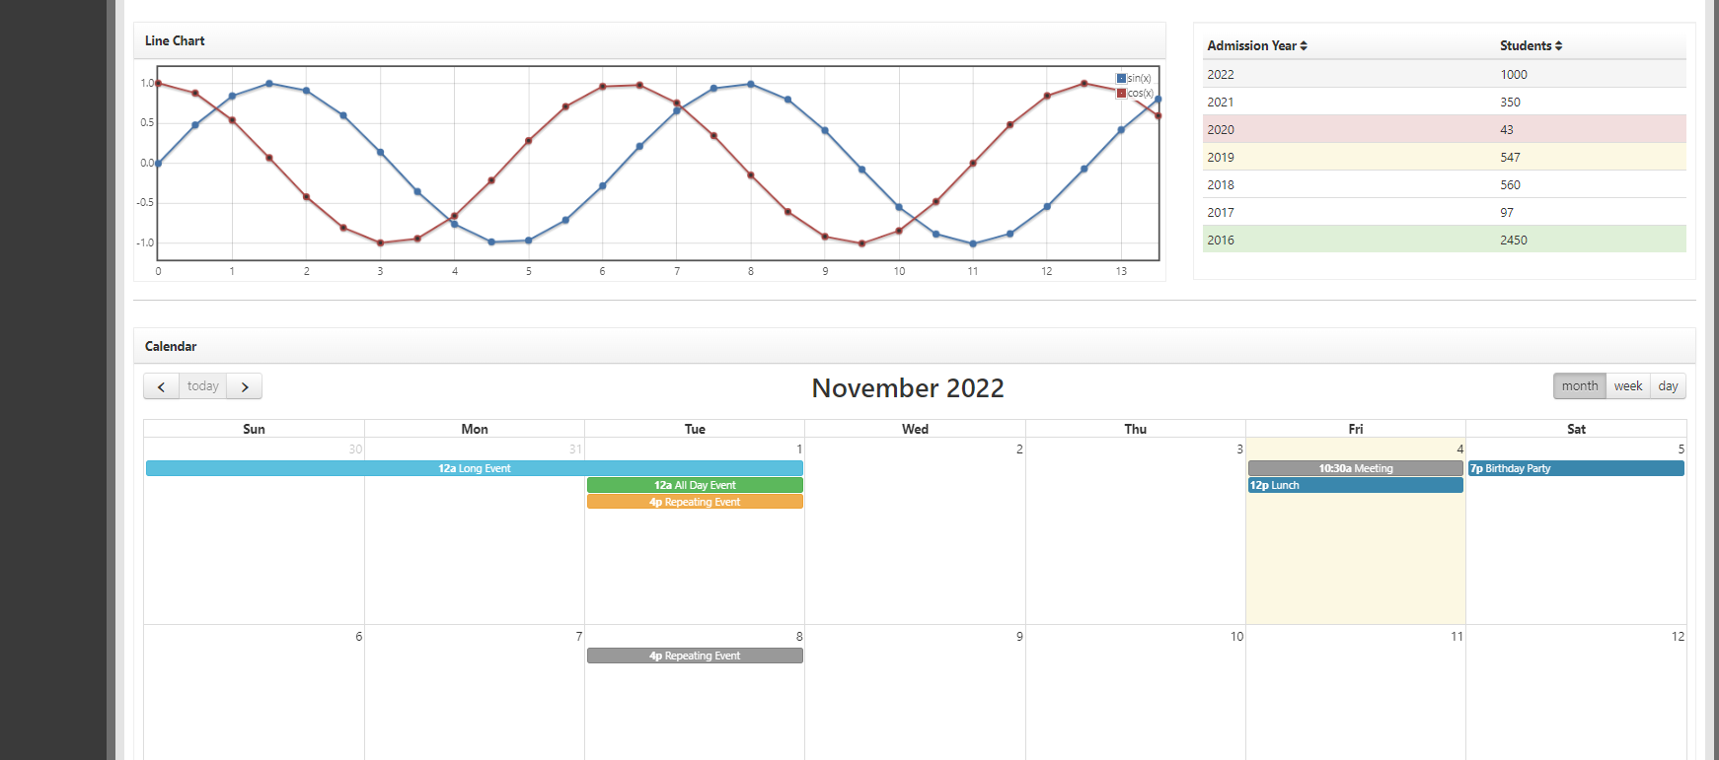
Future and Beyond

