Slide 1
Building a Working
SIEM Lab
SOC Analyst Training Project Wazuh 4.14.6
Presented by: Tife
Date: July, 2026.

Slide 2
Objective
What I set out to build, and why it matters
Build a working SIEM ingesting logs from 3+ sources
Give a SOC analyst real visibility through 3+ live dashboards
Detect suspicious activity with 2+ custom correlation rules
Do it all on a single resource-constrained laptop no cloud budget, no lab hardware
Why it matters
This project demonstrates how a SOC analyst monitors an organization's systems. I collected logs from different devices, organized them in Wazuh, created dashboards to monitor important activities, and built detection rules to identify suspicious behavior such as repeated failed logins. This shows how security teams use SIEM tools to detect and investigate potential threats.

Slide 3
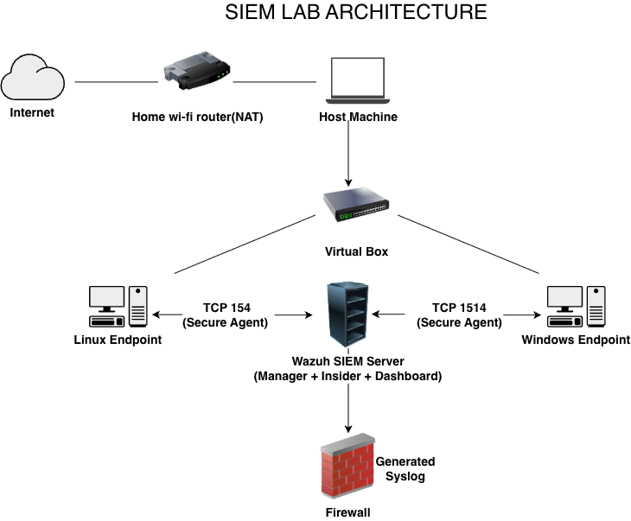
Lab Environment

Slide 4
Three Log Sources
Linux, Windows + Sysmon, and a simulated firewall
Source | What it provides | Key detail
Linux Endpoint | SSH / sudo auth events via Wazuh agent | Base for the brute-force correlation rule
Windows + Sysmon | Process creation, parent-child chains | SwiftOnSecurity baseline config
Simulated Firewall | Allow/deny traffic, source/destination IPs | Custom decoder over UDP syslog

Slide 5
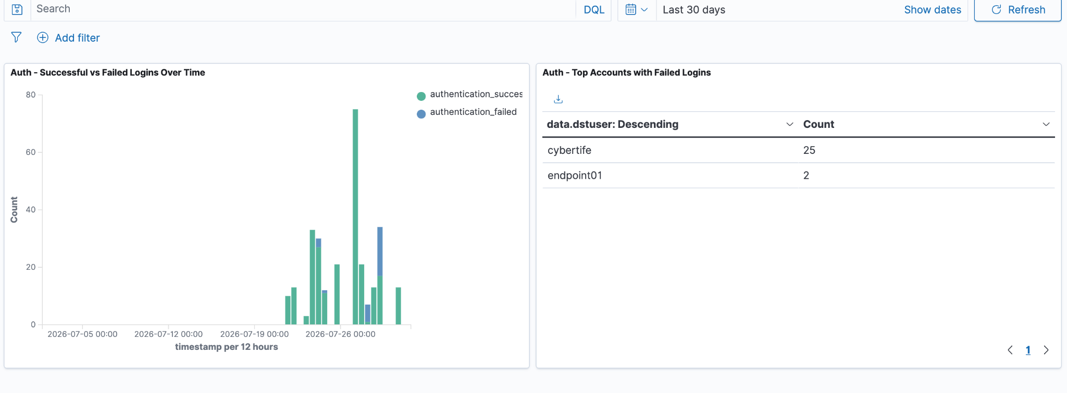
Dashboard: Authentication Activity
Successful vs. failed logins, and top offending accounts

Slide 6
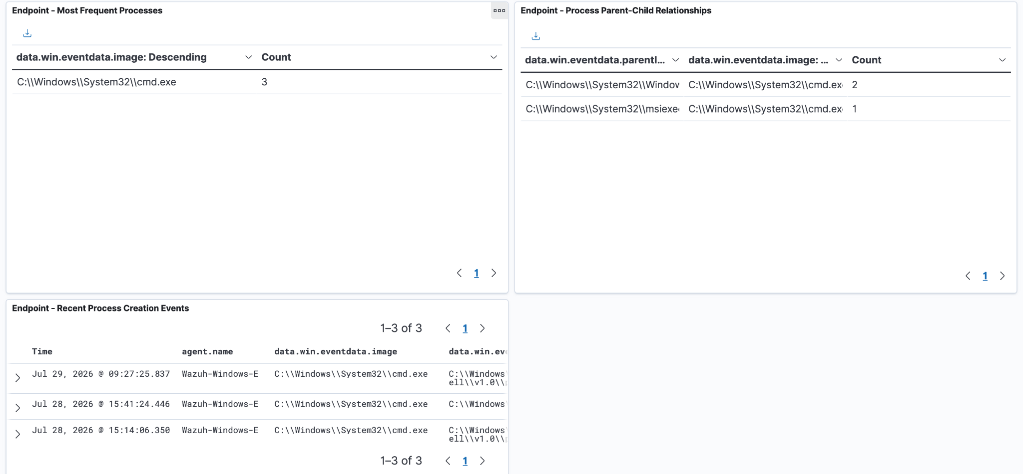
Dashboard: Endpoint Process Activity
Most frequent processes, parent-child chains, live feed

Slide 7
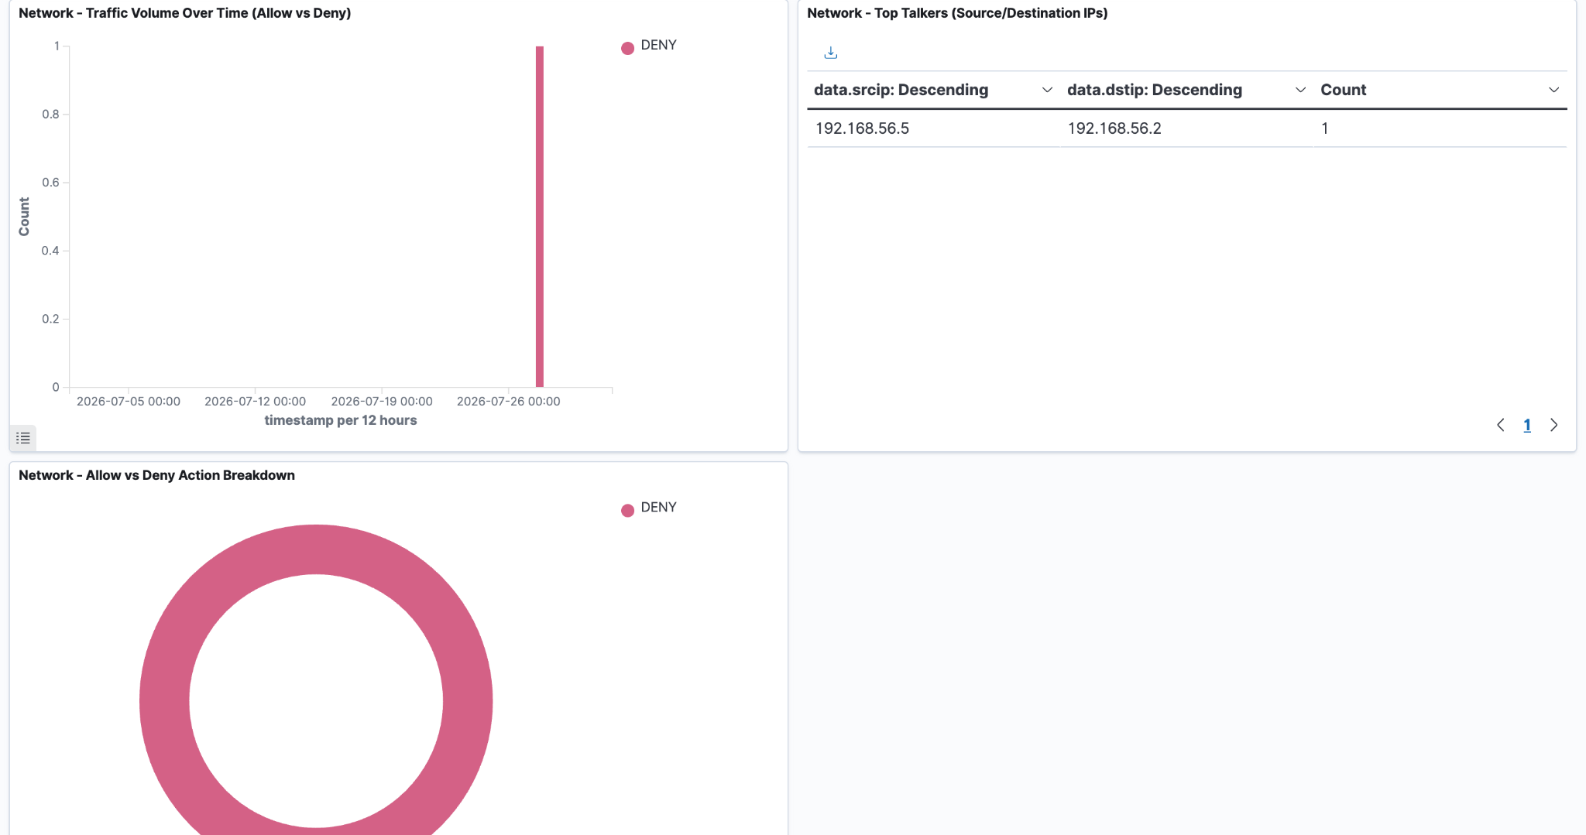
Dashboard: Network Traffic Overview
traffic volume over time, top talkers

Slide 8
Correlation Rule Firing End-to-End
Rule 100200 — 5+ failed logins in 5 minutes
"level":10, "id":"100200",
"description":"Multiple authentication failures
(possible brute force attack) - 5+ failed logins in 5 minutes",
"frequency":5, "firedtimes":1
A user attempts to log in and fails.
Wazuh records each failed login event.
The correlation rule counts the failed attempts.
When the count reaches 5 within 5 minutes, Rule 100200 is triggered.
Wazuh generates a Level 10 High Severity alert.
The SOC analyst can investigate whether the activity is a legitimate user making mistakes or an attacker attempting a brute-force attack.

Slide 9
Challenges
Solutions
My machine had limited resources running multiple virtual machines simulating. Which was causing noticeable shutdowns.
Custom rules were not triggering because the decoder was not passing the fields correctly
Allocated 4GB ram to Wazuh Server, 2G to Windows Endpoint, 2G to Linux Endpoint
Corrected the decoder and created rule 100100 and 100101

Slide 10
Recommendations / Next Steps
What I'd build next with another week
Add genuine DNS query logging to close a real visibility gap
Broaden the brute-force rule to catch credential-spraying across multiple accounts

Slide 11
Thank you
Questions?

