Slide 1
Threat Intelligence Integration with OpenCTI
OpenCTI • Wazuh • Sysmon • MITRE ATT&CK
Presented by: Makinde Boluwatife

Slide 2
Project Goal
Why threat intelligence was added to the SOC lab
COLLECT
CONTEXTUALIZE
OPERATIONALIZE
Bring external threat intelligence into a central platform.
Use STIX/MITRE ATT&CK to understand indicators and behaviors.
Use CTI to enrich SOC alerts and improve detection.
Deploy OpenCTI and connect it to live external threat intel feeds
Build a working OpenCTI ↔ Wazuh integration — both a batch export and a live enrichment path
Validate the integration end-to-end using genuine, live telemetry — not synthetic logs
Apply CTI/ATT&CK context to measurably improve a real Wazuh detection rule
Document architecture, obstacles, and lessons learned honestly
Threat Intelligence Integration with OpenCTI
2

Slide 3
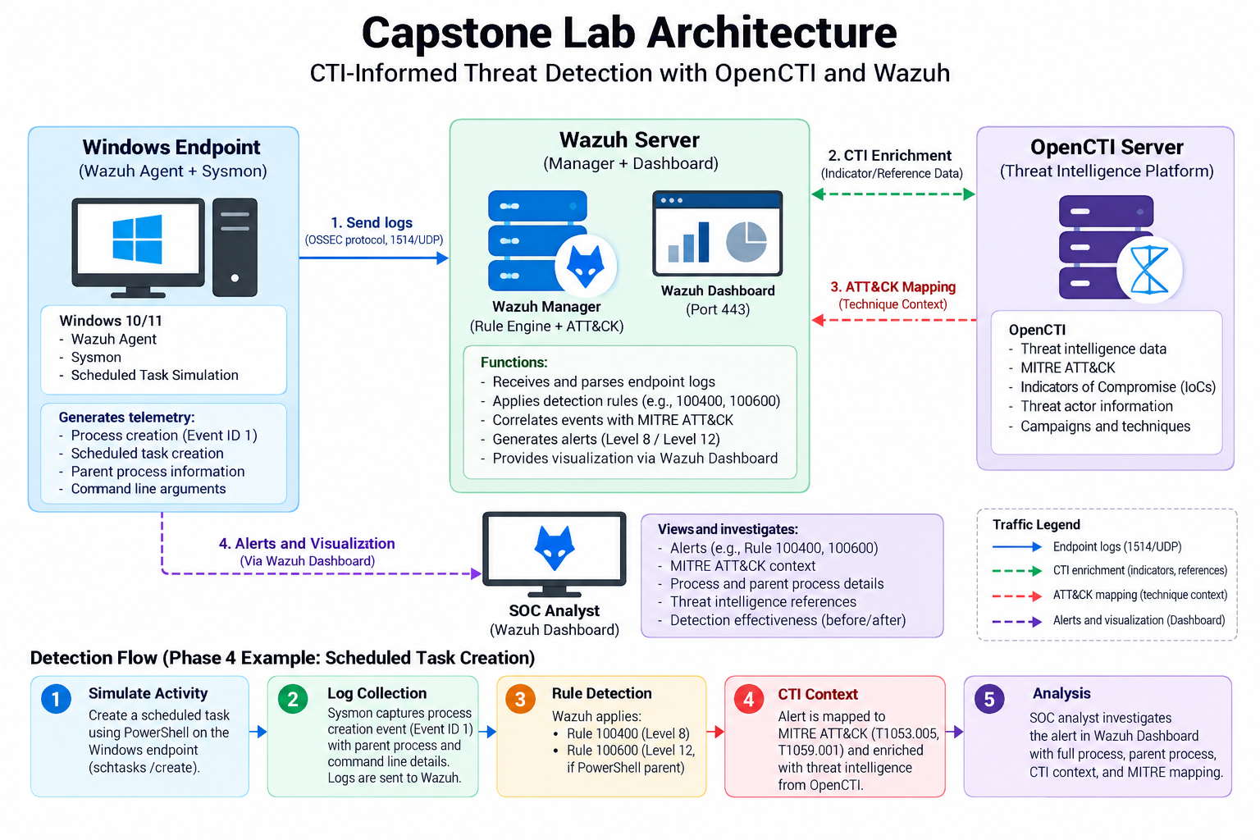
Lab Architecture
How CTI, endpoint telemetry and detection were connected
Threat Intelligence Integration with OpenCTI
3

Slide 4
Two Integration Paths
Batch export — CDB list
  Indicators periodically exported from OpenCTI into a Wazuh CDB list (opencti-ips)
  analysisd checks this list directly against live Sysmon Event ID 3 fields — no external call needed at alert time
Live enrichment lookup
  When a rule fires, wazuh-integratord invokes a custom script (custom-opencti-enrich.py)
  Queries OpenCTI in real time, writes back actor, campaign, ATT&CK technique, confidence
  Verified the enrichment workflow using a controlled test alert and a real OpenCTI indicator match.
Threat Intelligence Integration with OpenCTI
3

Slide 5
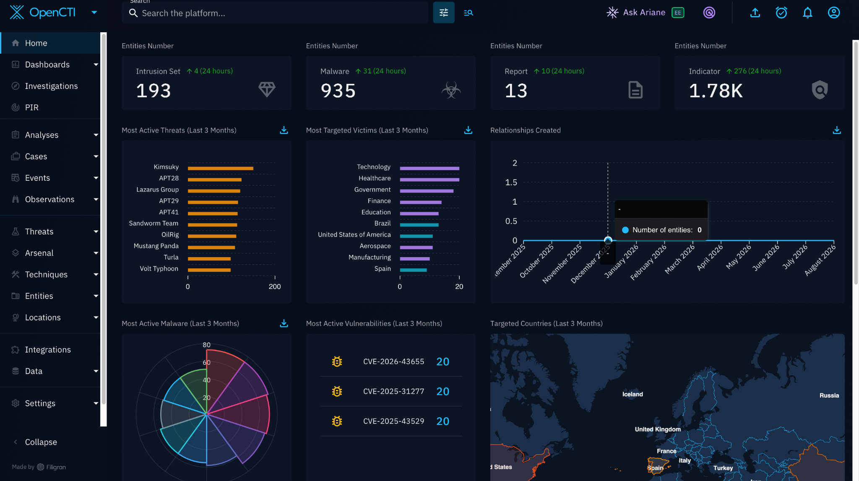
OpenCTI Deployment
Central platform for threat intelligence
OPENCTI
Central repository for indicators, observables, relationships and threat context.
MITRE ATT&CK
Imported to provide technique and tactic context for SOC analysis.
OPERATIONAL RESULT
OpenCTI was running and populated with threat-intelligence data.
Threat Intelligence Integration with OpenCTI
4

Slide 6
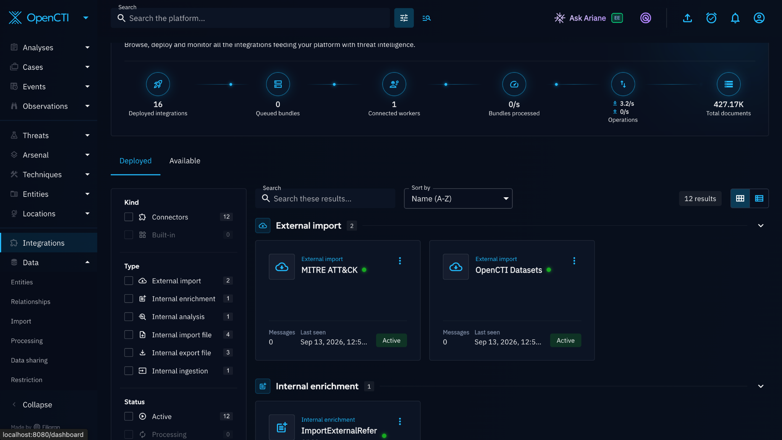
Threat Intelligence Ingestion
External feeds used in the lab
AlienVault OTX
External threat-intelligence source used to ingest indicators.
Abuse.ch ThreatFox
Indicator source used for malicious infrastructure context.
MITRE ATT&CK
Imported knowledge base for adversary behavior and techniques.
Threat Intelligence Integration with OpenCTI
5

Slide 7
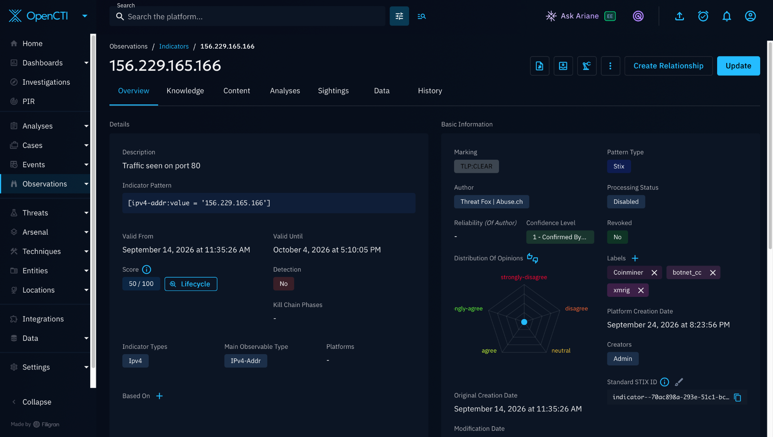
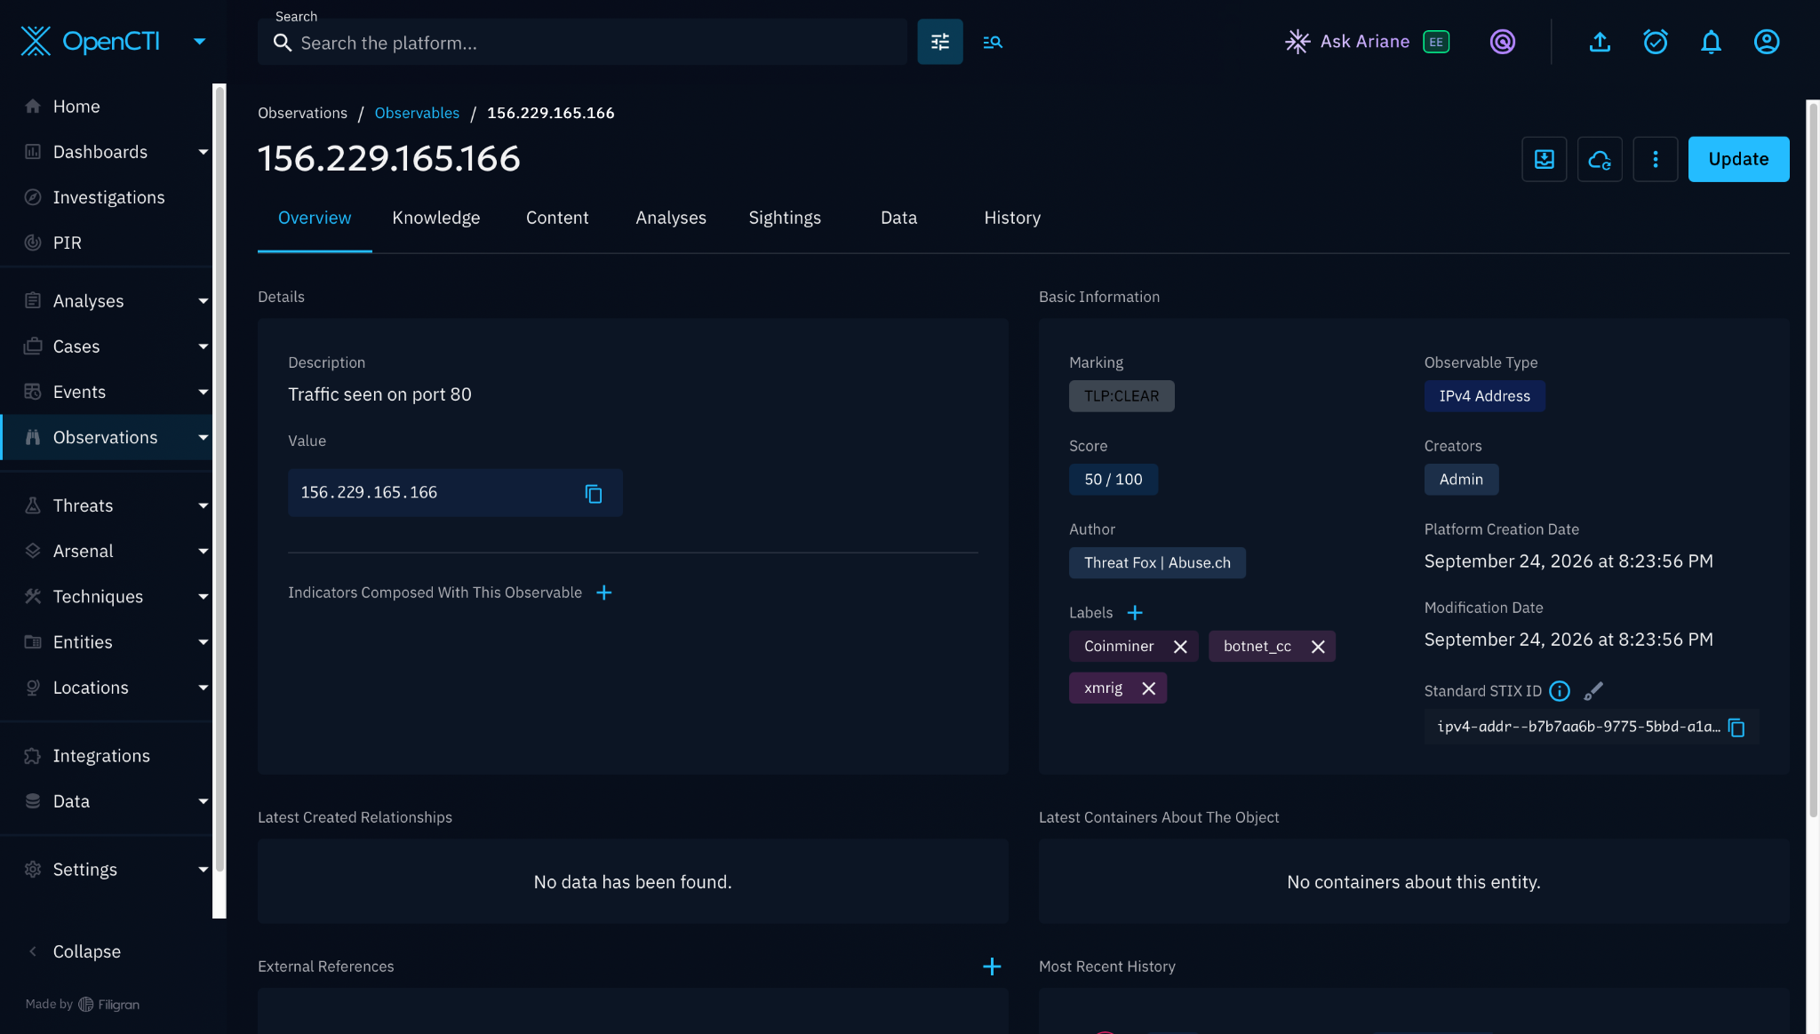
Indicator Analysis
Example intelligence: 156.229.165.166
Observed context: score 50/100 • ThreatFox | Abuse.ch • TLP:CLEAR • labels: Coinminer, botnet_cc, xmrig
Threat Intelligence Integration with OpenCTI
6

Slide 8
OpenCTI → Wazuh Enrichment
Turning CTI into analyst context
1
2
3
4
5
OpenCTI
Wazuh
Integrator
OpenCTI API
Analyst
Indicators + context
Alert/event
Enrichment script
Lookup
CTI-enriched result
• Controlled alert test successfully queried OpenCTI and returned CTI context for 156.229.165.166.
• Enrichment output included source/context, labels and score.
• Live custom IOC alerting remained a documented limitation; no live IOC match is claimed.
Threat Intelligence Integration with OpenCTI
7

Slide 9
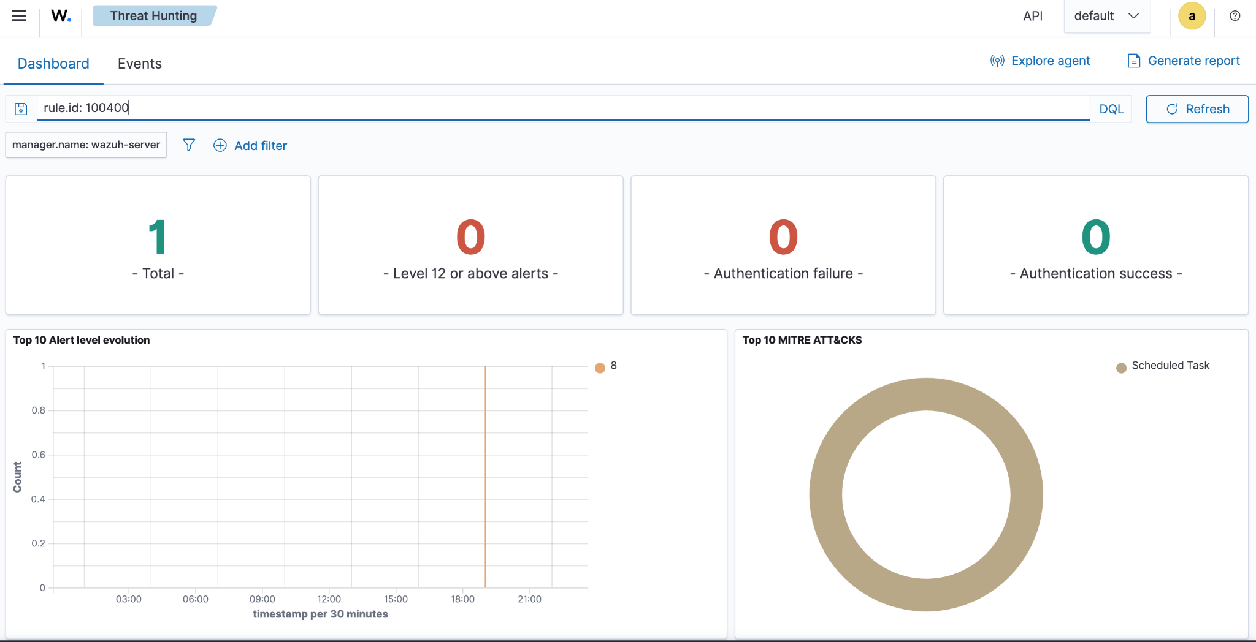
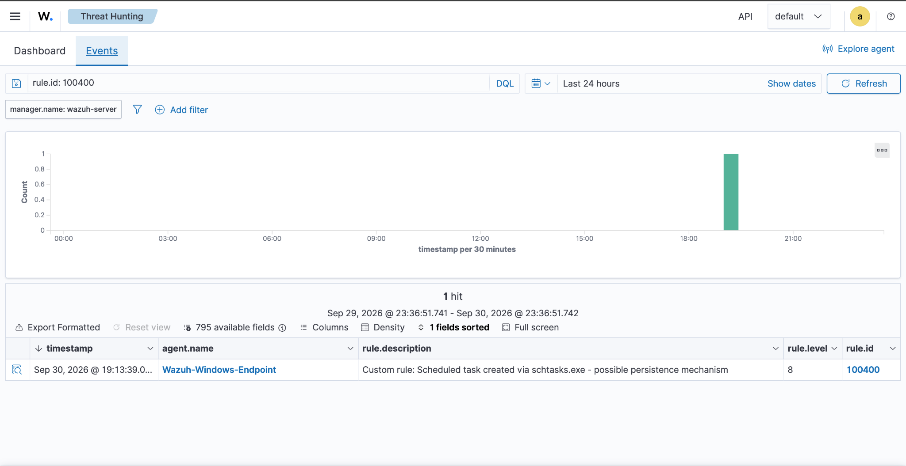
Baseline Detection
Scheduled Task detection before improvement
Rule 100400 • Level 8 • schtasks.exe + /create • MITRE T1053.005
Threat Intelligence Integration with OpenCTI
8

Slide 10
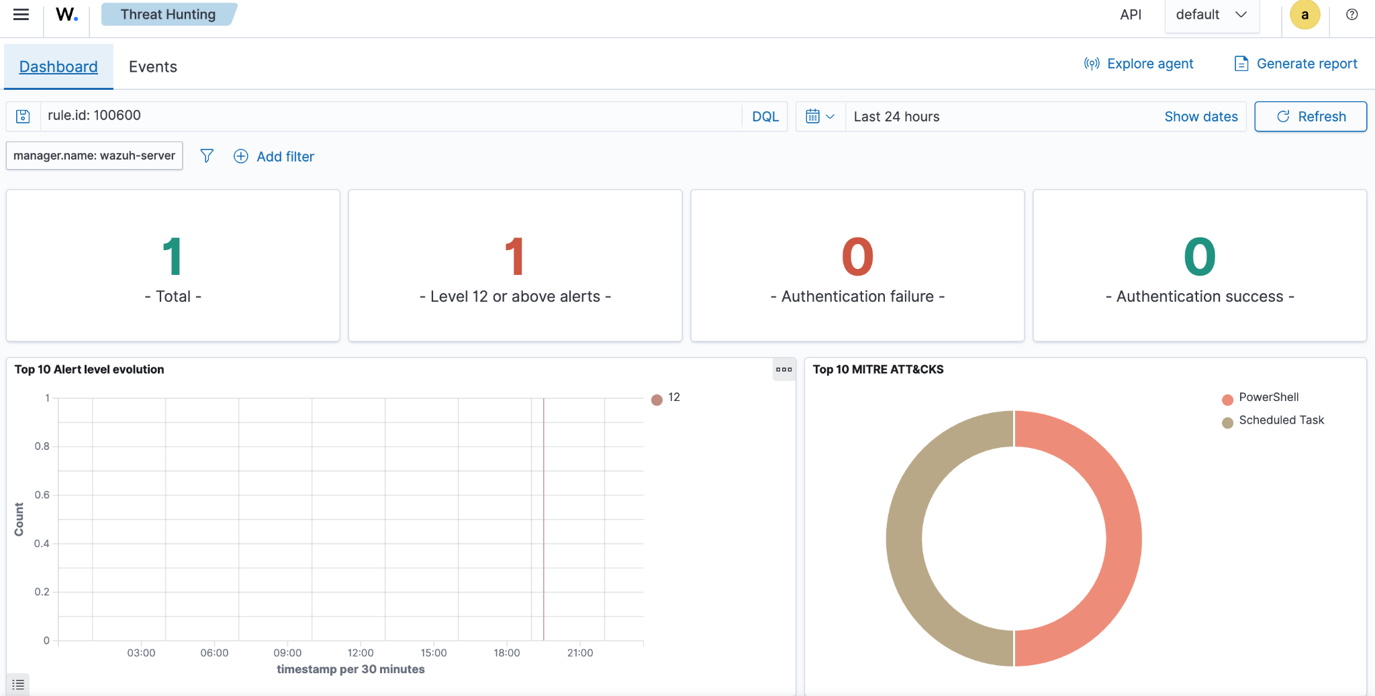
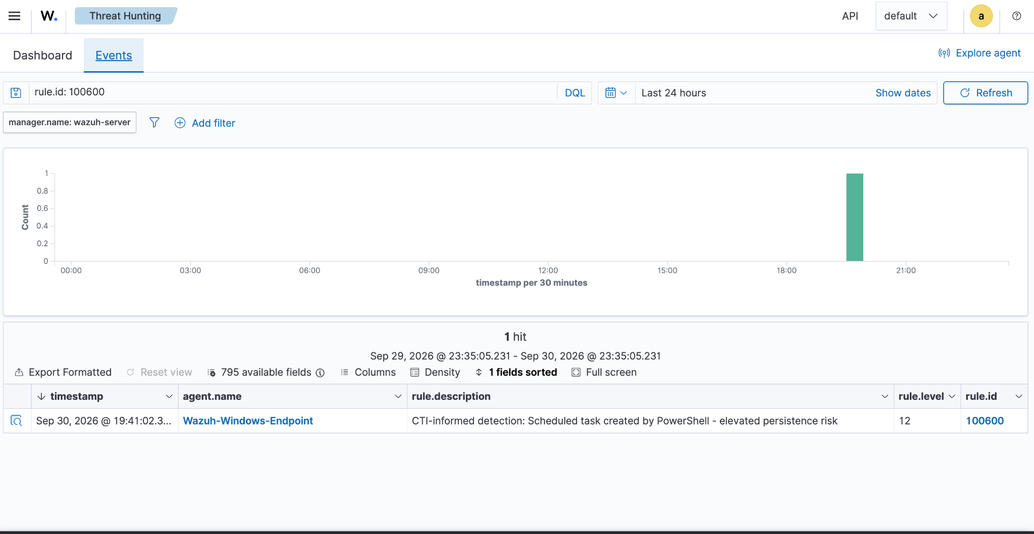
CTI/ATT&CK-Informed Improvement
Adding PowerShell parent-process context
100400 → 100600
ATT&CK
LEVEL
Higher-context detection
T1053.005 + T1059.001
8 → 12
Threat Intelligence Integration with OpenCTI
9

Slide 11
Detection Engineering — Before vs After
What changed and why it matters
BASELINE
IMPROVED
Rule
100400
100600
Level
8
12
Trigger
schtasks.exe /create
schtasks.exe /create + PowerShell parent
ATT&CK
T1053.005
T1053.005 + T1059.001
Context
Scheduled task
Scheduled task + PowerShell
• The improvement adds parent-process context instead of treating every scheduled task as equally suspicious.
• Validation used controlled manual scheduled-task simulation; Atomic Red Team was not used for the final test.
Threat Intelligence Integration with OpenCTI
10

Slide 12
Results, Challenges & Lessons
What the project demonstrated
RESULT
RESULT
RESULT
OpenCTI deployed and populated with external CTI and MITRE ATT&CK.
Controlled OpenCTI → Wazuh enrichment demonstrated successfully.
Rule 100600 generated a Level 12 alert with added ATT&CK context.
CHALLENGE
LESSON
LESSON
Live custom IOC network rules did not consistently trigger despite valid telemetry.
Separate telemetry receipt, decoding, rule loading and alert generation during troubleshooting.
Use evidence-driven validation and clearly distinguish controlled tests from live behavior.
Threat Intelligence Integration with OpenCTI
11

Slide 13
Conclusion
• OpenCTI gave the SOC lab a central place to collect and understand threat intelligence.
• Wazuh connected endpoint telemetry to detection and investigation.
• MITRE ATT&CK provided a common language for describing attacker behavior.
• The Phase 4 detection improvement demonstrated how context can make an alert more useful for analysts.
Thank you
Threat Intelligence Integration with OpenCTI
12

