Slide 1
TRACEY SCOTT

Slide 2
ABOUT ME
PORTFOLIO OVERVIEW
5+ years building and securing enterprise cloud and hybrid infrastructure.
Currently leading IT Operations at RightPath Insurance, Bachelor of IT, Cybersecurity and CISSP-certified.
Cybersecurity and CISSP-certified.
Cybersecurity-focused IT leader with 5+ years building and securing enterprise cloud and hybrid infrastructure in fast-paced startup environments.
I translate business risk into actionable security strategy — architecting frameworks, governance, and monitoring that protect data while enabling growth.
Currently leading IT Operations at RightPath Insurance, Bachelor of IT, Cybersecurity and CISSP-certified.
Greenville, SC | traceysscott82@gmail.com | linkedin.com/in/traceysscott

Slide 3


HELLO!
I am Tracey Scott
IT Operations Manager & Business Analyst
Greenville, SC | traceysscott82@gmail.com

Slide 4
1 SKILLS & EXPERTISE
Core competencies across cybersecurity, cloud, and analytics

Slide 5
“I translate business risk into actionable security strategy — architecting frameworks, governance, and monitoring that protect data while enabling growth.”

Slide 6
CORE COMPETENCIES
IDS/IPS & Firewall Administration
Endpoint / EDR & MDM Management
Incident Response & IR Playbooks
Org-wide Security Training via KnowBe4
IAM / RBAC / Azure AD Controls

Slide 7
5+ YEARS
Building and securing enterprise cloud and hybrid infrastructure across AWS, Azure, and GCP

Slide 8
SECURITY & CLOUD
Security Operations
IDS/IPS, Firewall Admin, Endpoint/EDR, MDM, Incident Response, and org-wide KnowBe4 security awareness training.
Cloud & Infrastructure
AWS, Azure, GCP administration. IAM/RBAC/Azure AD, VMware, Hyper-V, Docker, M365 & SaaS management.

Slide 9
GOVERNANCE, RISK & AUTOMATION
Governance & Risk
GDPR, SOX, ITIL compliance. Risk assessment, vulnerability management, and security policy design.
Analytics & Automation
PowerShell, Python, SQL scripting. Excel, Power BI, Tableau, LLMs, Power Automate & AI Agents.
Predictive Modeling
88% predictive model accuracy. Automated reporting with +10% accuracy gain through data validation.

Slide 10
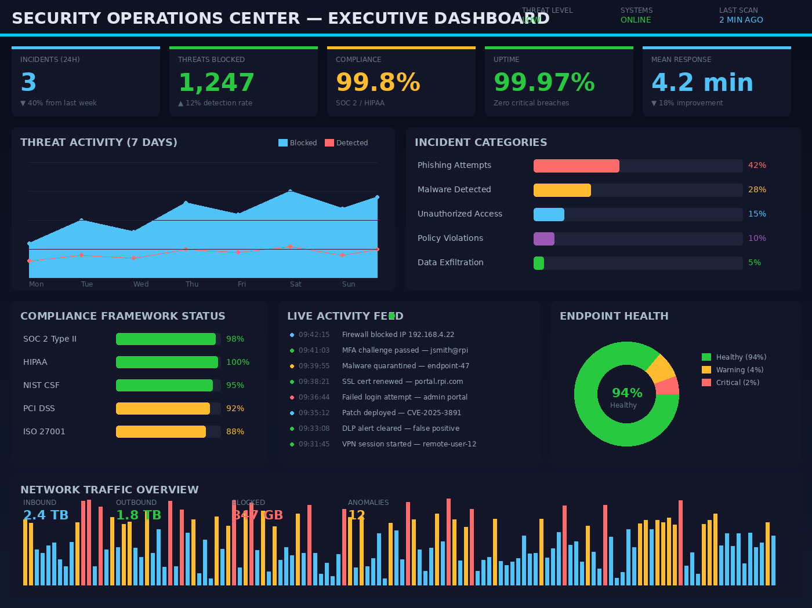
SECURITY OPERATIONS DASHBOARD
Executive view built at RightPath Insurance to monitor security posture, incidents, and compliance across the enterprise.

Slide 11

99.8% Uptime
ZERO CRITICAL BREACHES

Slide 12
SECURITY FRAMEWORK
Data Loss Prevention
Access Governance
Endpoint Protection
Threat Monitoring

Slide 13
DASHBOARD METRICS
 | Metric | Value | Status
Uptime | 99.8% | Achieved | 7
Threats Mitigated | 24 | Resolved | 10
RBAC Coverage | 100% | Complete | 16

Slide 14
EXPERIENCE
RightPath Insurance
Greenville, SC | IT Operations Manager & Business Analyst

Slide 15
99.8%
Enterprise uptime maintained across hybrid cloud infrastructure

Slide 16
6 MO
88%
100%
Full security framework stood up from zero
Predictive model accuracy delivered to stakeholders
RBAC / least-privilege coverage across hybrid environment

Slide 17
KEY PROJECTS
01
02
03
Enterprise Security Framework — Architected endpoint, IDS/IPS, MDM, and access governance for startup in 6 months.
CRM Secure Deployment — Complete CRM build with coding, development, maintenance, secure auth, encryption, RBAC.
Secure Multi-Cloud Deployment — AWS + Azure infrastructure with IAM, RBAC, encryption, and least-privilege controls.

Slide 18
MORE PROJECTS & ACHIEVEMENTS
04 Executive Dashboards
Power BI dashboards for incidents, compliance, and sales metrics.
05 Incident Response
IR playbooks, remediation workflows, and KnowBe4 training.
06 IT Ticketing System
Built ticketing system for org-wide issue reporting and triage.
07 AI Agents
Power Automate AI Agents for HR, IT, and Sales departments.
Technical Proficiency
Cloud Security 92%, IAM/RBAC 95%, Power BI 93%, Excel 95%.
Goals Surpassed
Zero critical incidents. 3 public clouds secured and administered.

Slide 19
4000
3000
2000
1000
0
Self-assessed proficiency across the production stack

Slide 20
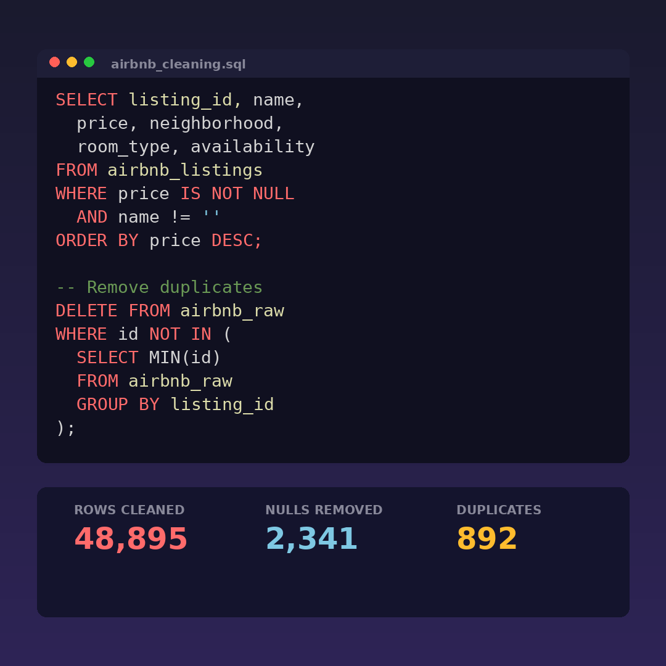
DATA CLEANING IN SQL
Cleaned Airbnb housing data in SQL. Standardized formats, removed duplicates, and parsed address fields for analysis.

Slide 21
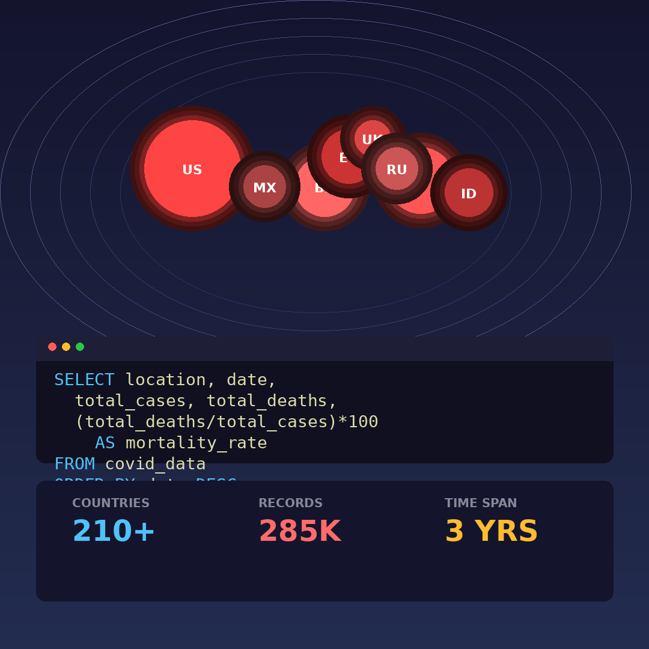
DATA EXPLORATION IN SQL
Explored Covid-19 dataset using SQL. Analyzed infection rates, mortality trends, and vaccination data across regions.

Slide 22
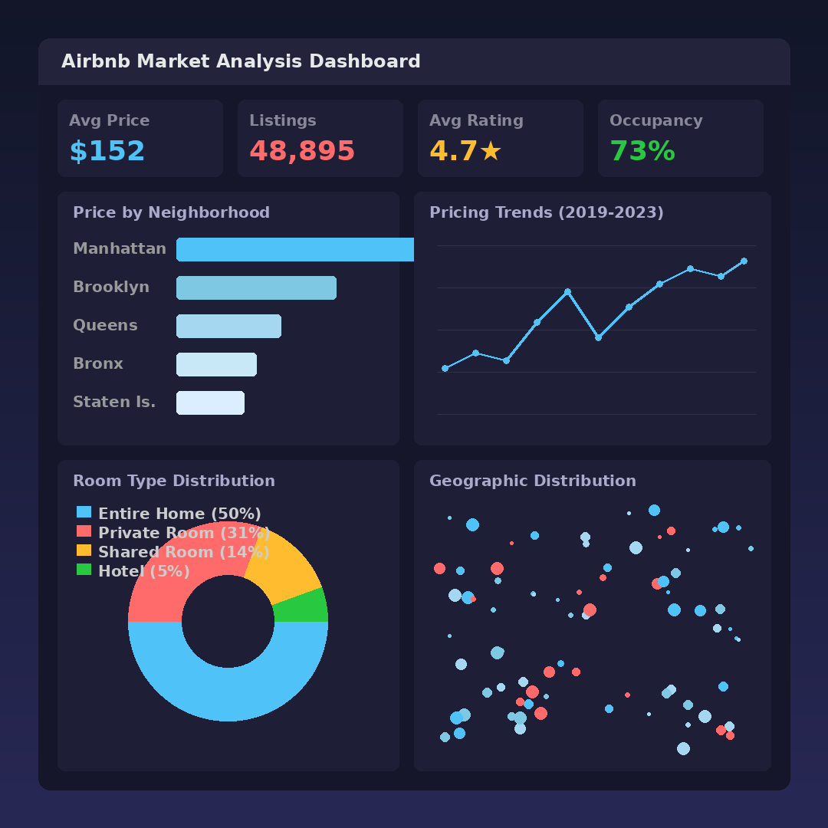
TABLEAU DASHBOARDS
Interactive Tableau dashboards for Airbnb market analysis including pricing trends, location insights, and revenue visualization.

Slide 23
THANKS!
Tracey Scott (864) 775-2929 traceysscott82@gmail.com linkedin.com/in/traceysscott cybertrace777.github.io

