Slide 1

Operation Diamondhouse

Slide 2
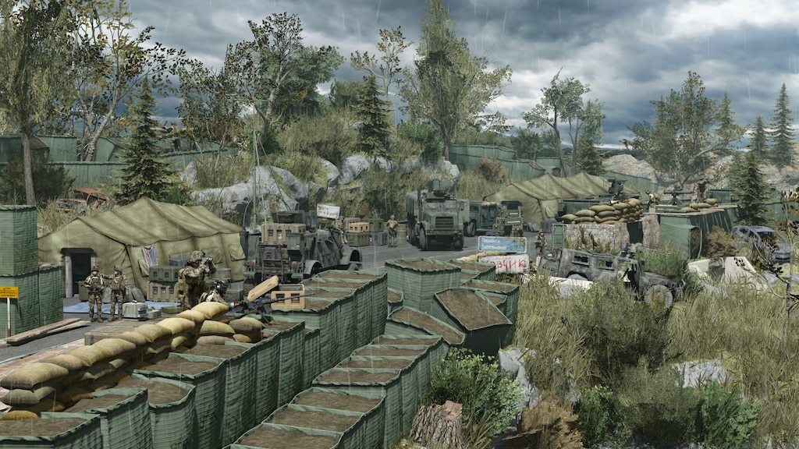

Mission
FOB Bravo has been established along the border of a near-peer nation. However, numerous weaknesses in the defense have been identified, both physical and digital.
Your team has been deployed to boost physical security around the two ECPs, and configure the firewalls on two sensitive devices within the FOB’s network.

Slide 3


Mission
One firewall can be configured directly on the device. The other, you must login via SSH to configure. Both use the iptables firewall.
Intel states that three ports are considered highly vulnerable and must drop traffic to:
HTTP (Port 80) - Unencrypted web traffic
POP3 (Port 110) - Unencrypted mail traffic
Telnet (Port 23) - Unencrypted version of SSH
local
$ ssh

Slide 4
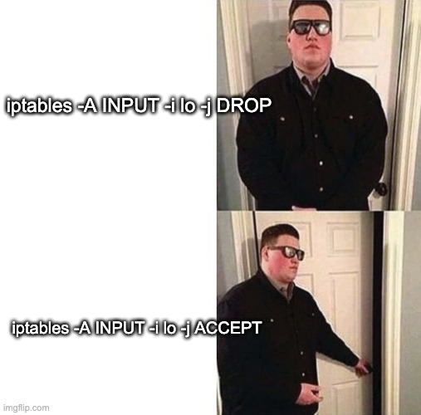

Slide 5
Rules of Engagement
FOB Bravo has pre-established challenge/response phrases
Challenge: Wire
Normal Response: Chip
Duress Response: Port
Check your fire. Friendly forces (military AND civilian) on foot or in vehicles may be moving in and out of the FOB.
Maintain OPSEC at all times, including with all friendly personnel. Only your team is authorized to work with cyber defense assets.

