Slide 1
Heart Failure Prediction (A Data Science Case Study)
As part of “Applied Data Science Capstone” Assignment

Slide 2
Introduction
Cardiovascular diseases (CVDs) are the primary cause of death globally.
An estimated 17.9 million lives each year, which accounts for 31% of all deaths worlwide.
Several factors may lead to heart failures due to CVDs.
Some factors are suspected to be due to smoking, hypertension, tobacco use, unhealthy diet and obesity, physical inactivity and harmful use of alcohol.

Slide 3
Introduction (Conti..)
Medical records provide information to unveil hidden and non-obvious correlations and relationships between patients’ data.
Hence, Machine learning applied to medical records, in particular, can be an effective tool.
It can predict the survival of each patient having heart failure symptoms
It can help detect the most important clinical features (or risk factors) that may lead to heart failure.

Slide 4
Dataset
We analyzed a dataset containing the medical records of 299 heart failure patients derived from a recent study:-
Chicco, D., Jurman, G. Machine learning can predict survival of patients with heart failure from serum creatinine and ejection fraction alone. BMC Med Inform Decis Mak 20, 16 (2020). https://doi.org/10.1186/s12911-020-1023-5
The dataset contains 13 features, which report clinical, body, and lifestyle, that is briefly described in next slide.
Some features are binary: anaemia, high blood pressure, diabetes, sex, and smoking.

Slide 5
Dataset Features
1) Age: Age of the patient
2) Anaemia: Decrease of red blood cells or hemoglobin (boolean)
3) CPK: Creatine phosphate kinase level in the blood (mcg/L)
4) diabetes: If the patient has diabetes (boolean)
5) ejection_fraction: Percentage of blood leaving the heart at each contraction (%)
6) high_blood_pressure: If the patient has hypertension (boolean)
7) Platelets: Platelets in the blood (kiloplatelets/mL)
8) Creatinine: Level of serum creatinine in the blood (mg/dL)
9) Sodium: Level of serum sodium in the blood (mEq/L)
10) Sex: Woman or man (binary)
11) Time: Follow up period (days)
12) Event: Whether the patient survived or not (binary)
13) Smoking: If the person smokes (binary)

Slide 6
Methodology
Data was obtained
Data was checked for null values
Distribution of the samples (i.e patients) was plotted
Correlation analysis was done to get relevant features
Several Machine learning Models were built and tested

Slide 7
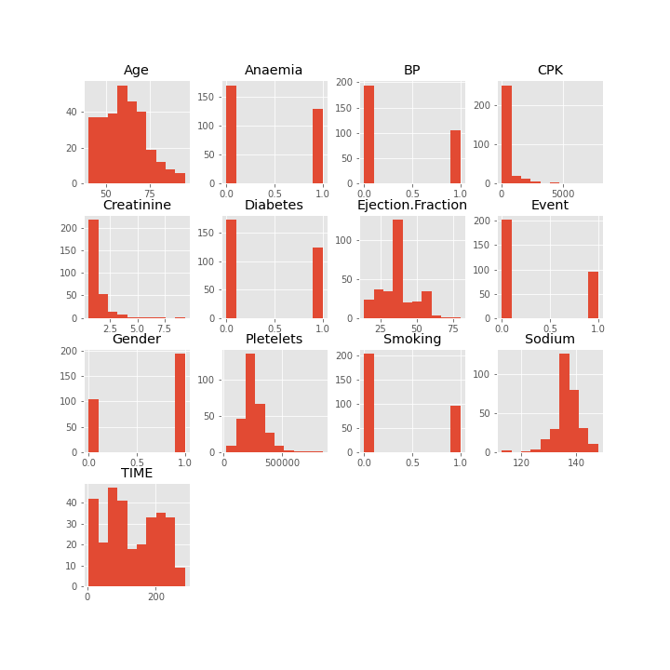
Results
1) Sample Distribution Analysis

Slide 8
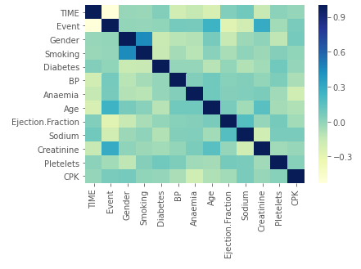
2) Feature Correlation Analysis
Data Attribute (Feature) | Pearsons Correlation Value
Time | -0.52
Creatinine | 0.294
Age | 0.25
Ejection Fraction | -0.268
Sodium | -0.195
Relevant features
(Absolute Pearson
Correlation Value is
greater than 0.1)

Slide 9
3) Machine Learning Model testing
K-Nearest Neighbor gives the best accuracy
Machine Learning Approach | Accuracy
Linear Regression | 78.33%
Random Forest Classifier | 68.33%
K-Nearest Neighbor | 81.67%
Support Vector Machine | 75%
These Models were made from the dataset, using features that were relevant (determined from correlation analysis)

