Slide 1


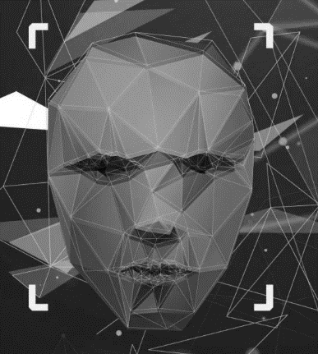
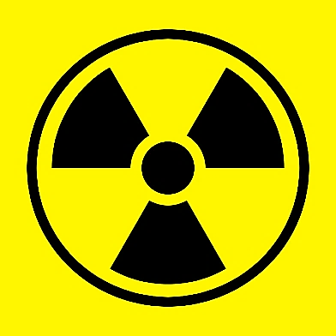
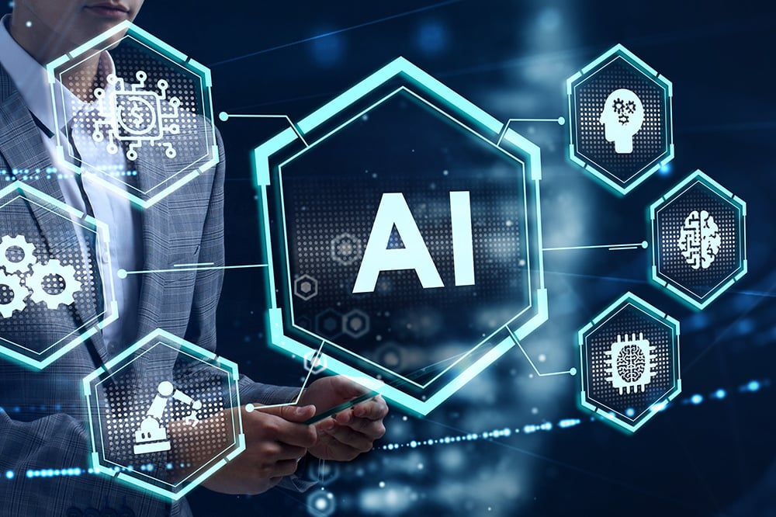
OT and Siber güvenlik NGS»lerde
Nükleer güç santralleri daha bağlantılı ve dijital hale geliyor, bu da onları tehditlere karşı daha duyarlı hale getiriyor.
Siber güvenlik
Güvenlik Duvarları,
İzinsiz giriş tespit sistemleri,
Erişim kontrolleri ve rutin siber güvenlik denetimleri
Amaç, OT sistemlerinin ve diğer kritik sistemlerin potansiyel olarak güvenliklerini tehlikeye atabilecek ve ciddi bir kazaya neden olabilecek siber saldırılardan korunmasını sağlamaktır.
Image credit: Slidesgo. (n.d.). AI Tech Agency PowerPoint template. Retrieved from https://slidesgo.com/theme/ai-tech-agency#search-Business&position-26&results-3547
Image credit: Baird, C. (2015, January 5). Is Ionizing Radiation Always Harmful? Science Questions with Surprising Answers. Retrieved from https://www.wtamu.edu/~cbaird/sq/2015/01/05/is-ionizing-radiation-always-harmful/
Yapay Zeka ile Nükleer Endüstride Güvenliği Artırmak mı?
Source:https://emeritus.org/in/learn/what-is-m-tech-in-artificial-intelligence/
Notes:
Human operators are overwhelmed by the vast amounts of information to analyze and cannot effectively handle the magnitude and complexity of the task. This makes it essential to leverage AI technology to automate the process and enhance threat detection capabilities

Slide 2
OT and Cybersecurity in NPP
Nuclear power facilities are becoming more connected and digital, making them more susceptible for threats.
Cybersecurity
Firewalls,
Intrusion detection systems,
Access controls and routine cybersecurity audits
The goal is to ensure that the OT systems and other critical systems are protected from cyber-attacks that could potentially compromise their safety and cause a serious accident.
Image credit: Slidesgo. (n.d.). AI Tech Agency PowerPoint template. Retrieved from https://slidesgo.com/theme/ai-tech-agency#search-Business&position-26&results-3547
Image credit: Baird, C. (2015, January 5). Is Ionizing Radiation Always Harmful? Science Questions with Surprising Answers. Retrieved from https://www.wtamu.edu/~cbaird/sq/2015/01/05/is-ionizing-radiation-always-harmful/
Enhancing Safety in the Nuclear Industry with Artificial Intelligence?
Source:https://emeritus.org/in/learn/what-is-m-tech-in-artificial-intelligence/
Notes:
Detecting cyberattacks using AI is a critical problem that arises due to the sheer volume of logs and data generated. Human operators are overwhelmed by the vast amounts of information to analyze and cannot effectively handle the magnitude and complexity of the task. This makes it essential to leverage AI technology to automate the process and enhance threat detection capabilities

