Slide 1
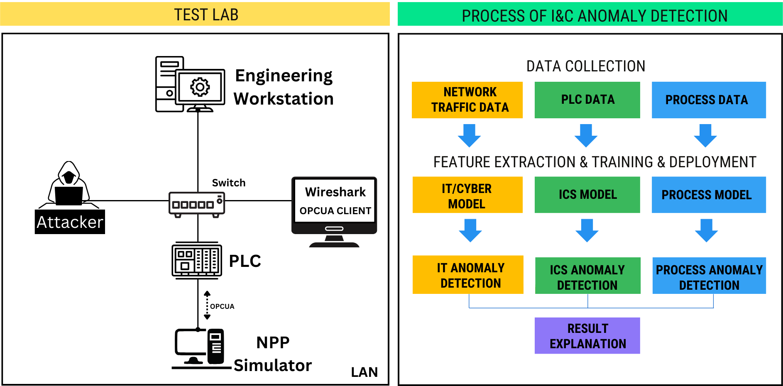
Siemens S71500
Python-based application
PLCSIM Advanced
Network traffic monitoring

