Slide 1
Introduction to Climate Change
CE1101N

Slide 2
Weather is the state of the atmosphere at a given place and time. For example, right now, the temperature in IIEST is 31 degree centigrade with Partly Sunny skies.
The term “weather” refers to the temporary conditions of the atmosphere, the layer of air that surrounds the Earth.

Slide 3
We usually think of weather in terms of the state of the atmosphere in our own part of the world.
But weather works like dropping a pebble in water—the ripples eventually affect water far away from where the pebble was dropped.
The same happens with weather around the globe. Weather in your region will eventually affect the weather hundreds or thousands of kilometers away.

Slide 4
There are six main components, or parts, of weather.
They are temperature, atmospheric pressure, wind, humidity,
precipitation, and cloudiness.
Together, these components describe the weather at any given time.

Slide 5
Weather doesn’t just stay in one place. It moves, and changes from hour to hour or day to day.
Over many years, certain conditions become familiar weather in an area.
The average weather in a specific region, as well as its variations and extremes over many years, is called climate.

Slide 6
Climate is the average condition of the atmosphere (such as temperature or precipitation) over a long period of time.
For example, the average annual temperature over the past 30 years for Kolkata is 27.1°C. The average annual precipitation is 1836.5 cm.
Climate is the average of weather conditions in a place.

Slide 7
Just as the weather differs from day to day, the climate differs from place to place.
Climate do changes, just like weather.
However, climate change can take decades or even thousands of year
Today, the Sahara Desert in northern Africa is the largest desert in the world. However, several thousand years ago, the climate in the Sahara was quite different. This “Green Sahara” experienced frequent rainy weather.

Slide 8
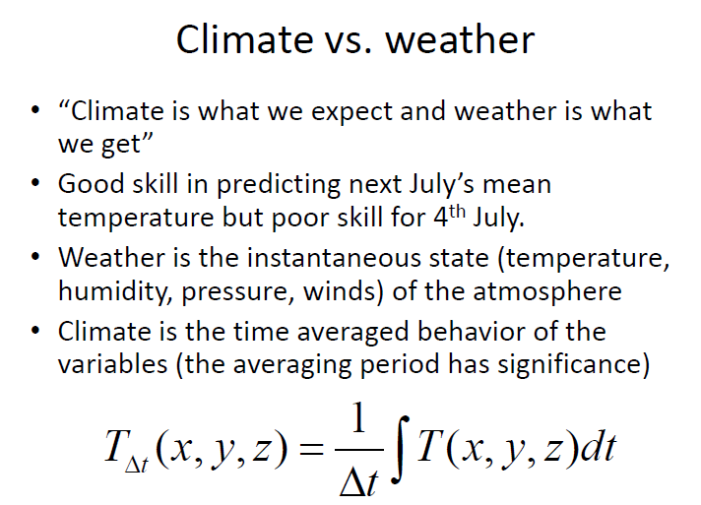

Slide 9
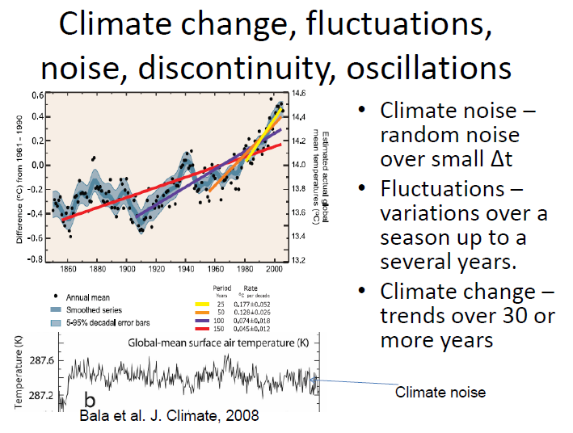

Slide 10

Climate Change v. Climate Variability
Climate change (e.g. warming trend)
Climate variability (e.g. Natural swings)
We see the sum of both
"climate"
Time (years)

Slide 11
Factors that influence climate
Three factors influence Earth’s climate more than all others combined:
  1.The sun, which provides most of Earth’s energy
  2.The atmosphere, which both absorbs energy from the sun and reflects it back into space
  3. The oceans, which stores and transports heat and moisture

Slide 12
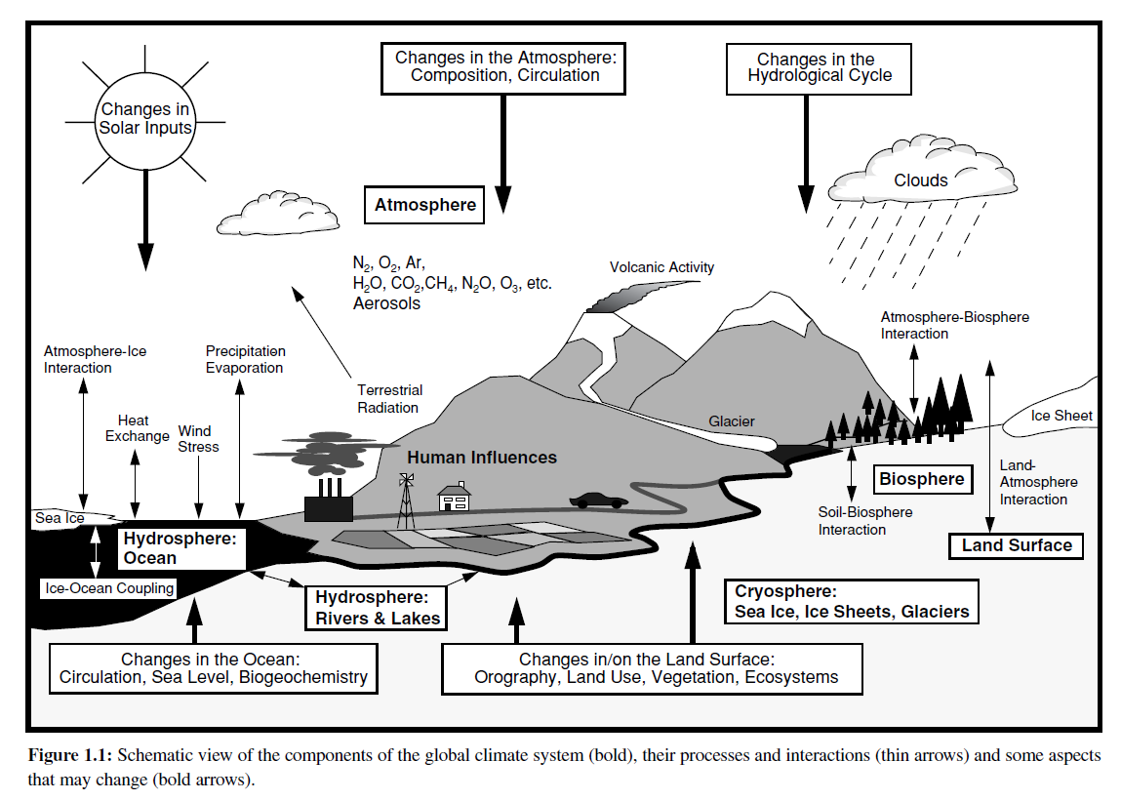

Slide 13
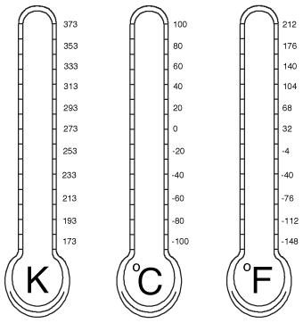
Temperature Basics
Temperature – measure of average kinetic energy (motion) of individual molecules in matter
Temperature is measured with a thermometer and refers to how hot or cold the atmosphere is
Three temperature scales (units): Kelvin (K), Celsius (C), Fahrenheit (F)
  All scales are relative
  degrees F = ⁹⁄₅ degrees C + 32
  degrees K = degrees C + 273.15
The United States uses the Fahrenheit system; in other parts of the world, Celsius is used. Almost all scientists measure temperature using the Celsius scale.

Slide 14
Pressure
Atmospheric pressure is the weight of the atmosphere overhead.
Changes in atmospheric pressure signal shifts in the weather.
A high-pressure system usually brings cool temperatures and clear skies.
A low-pressure system can bring warmer weather, storms, and rain.

Slide 15
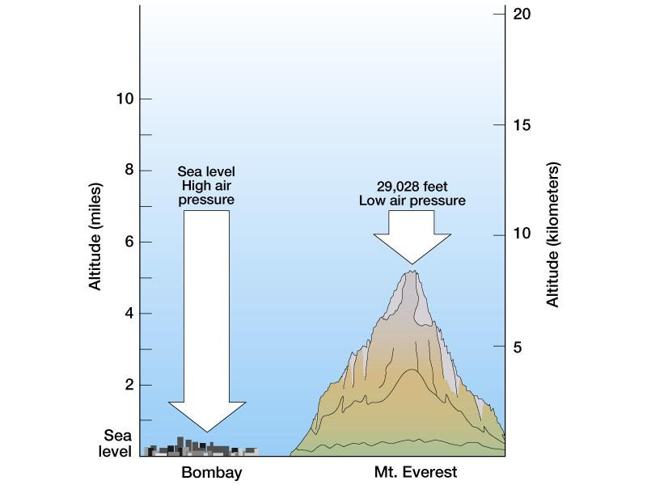
What is atmospheric pressure?
Weight of the overlying air
Taller the column of air above an object, the greater the air pressure exerted on that object

Slide 16
Standard Atmospheric Pressure
1013.25 mb
1013.25 hPa
29.92 inches of Hg

Slide 17
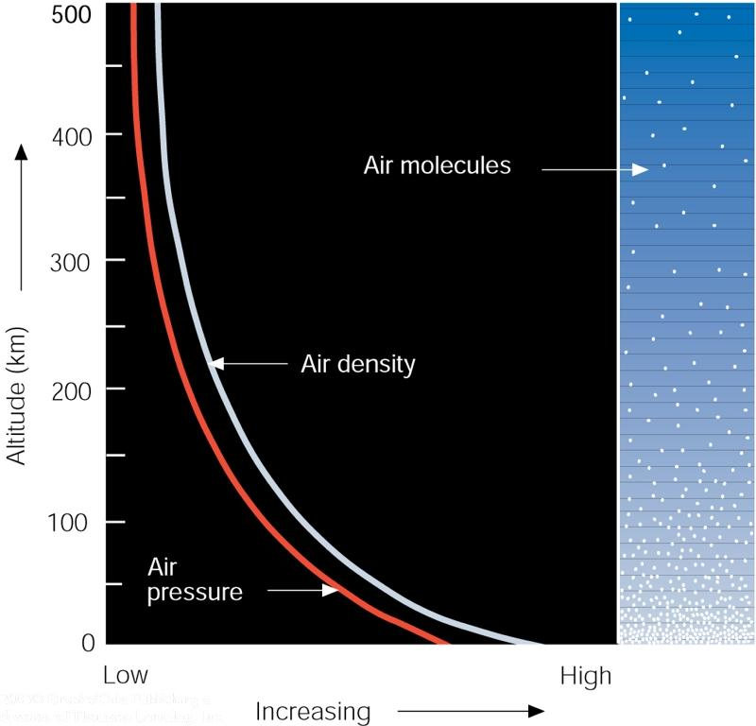
Density & Pressure

Slide 18
WIND
Wind is the movement of air.
Wind forms because of differences in temperature and atmospheric pressure between nearby regions.
Winds tend to blow from areas of high pressure, where it’s colder, to areas of low pressure, where it’s warmer.

Slide 19
Wind can be influenced by human activity.
Chicago, Illinois, is nicknamed the “Windy City.” After the Great Chicago Fire of 1871 destroyed the city, city planners rebuilt it using a grid system.
This created wind tunnels. Winds are forced into narrow channels, picking up speed and strength. The Windy City is a result of natural and manmade winds.

Slide 20
Humidity
Humidity refers to the amount of water vapor in the air.
Water vapor is a gas in the atmosphere that helps make clouds, rain, or snow.
Humidity is usually expressed as relative humidity, expressed as a percentage, indicates a present state of absolute humidity relative to a maximum humidity given the same temperature.
Absolute humidity describes the water content of air and is expressed in either grams per cubic metre or grams per kilogram

Slide 21
Cool air holds less water than warm air.
At a relative humidity of 100 percent, air is said to be saturated, meaning the air cannot hold any more water vapor.
Excess water vapor will fall as precipitation.
precipitation occur when air cools below its saturation point.
This usually happens when warm, humid air cools as it rises.

Slide 22
The most humid places on Earth are islands near the Equator.
Singapore, for instance, is humid year-round. The warm air is continually saturated with water from the Indian Ocean.

Slide 23
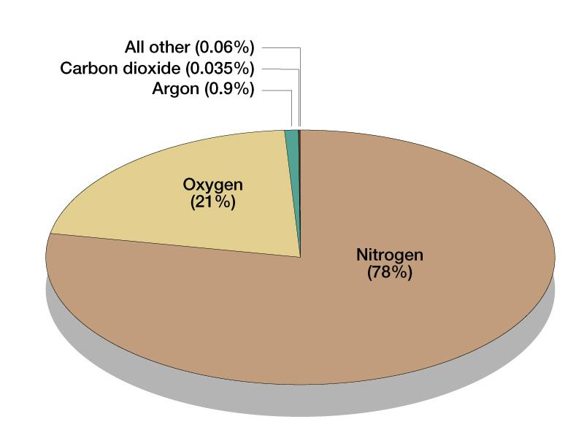
What makes up the atmosphere?

Slide 24
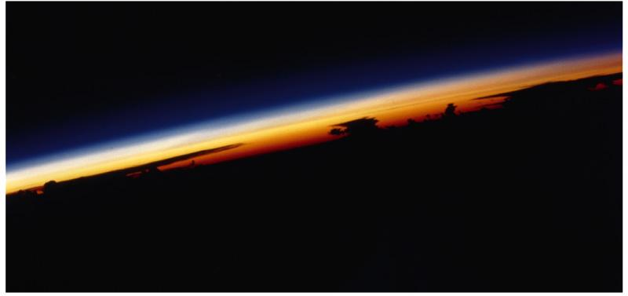
Atmospheric Thickness
No defined top to the atmosphere
The atmosphere is very shallow—and is less than 2% of the Earth’s thickness
Over 90% of
atmosphere in
the lowest 16km
& is where nearly
all weather occurs

Slide 25
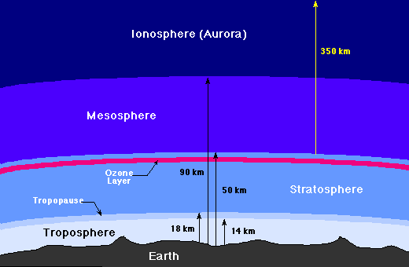
The Layers of the Atmosphere
Thermosphere

Slide 26
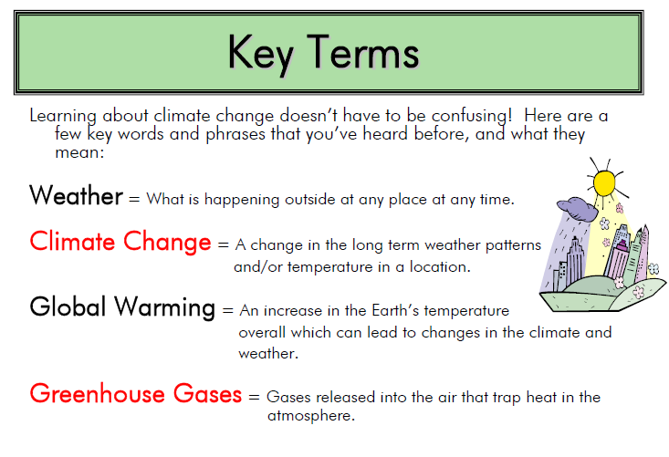

Slide 27
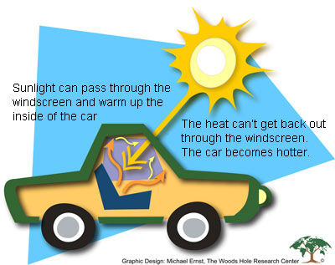

Slide 28
Greenhouse gases
Atmospheric gases that absorb the emanating radiation are greenhouse gases.
By absorbing and re-emitting this radiation, they warm Earth’s atmosphere and surface, like a greenhouse.
This is popularly called the greenhouse effect.
Global warming potential = the relative ability of one molecule of a given greenhouse gas to contribute to global warming. Global warming potential (GWP) is the heat absorbed by any greenhouse gas in the atmosphere, as a multiple of the heat that would be absorbed by the same mass of carbon dioxide (CO2)

Slide 29
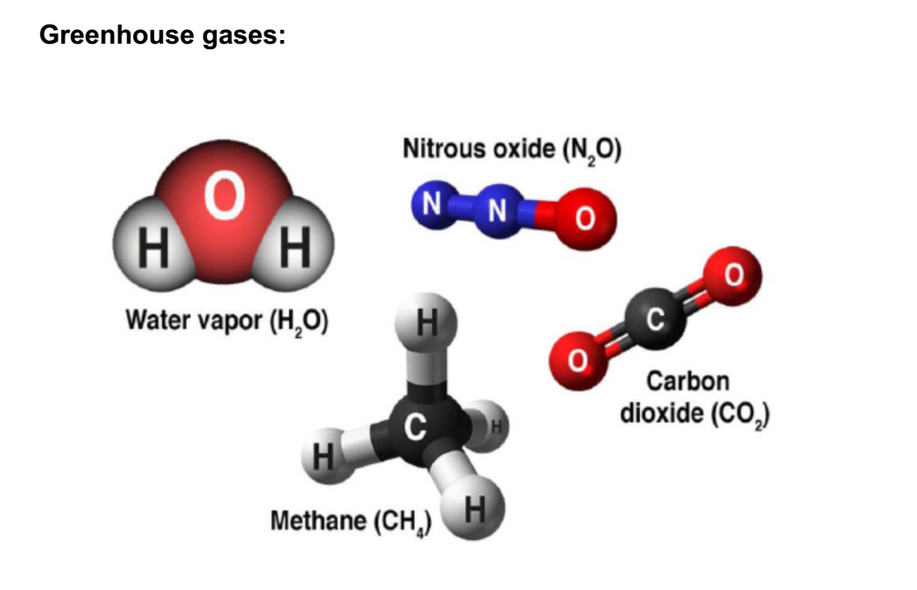

Slide 30
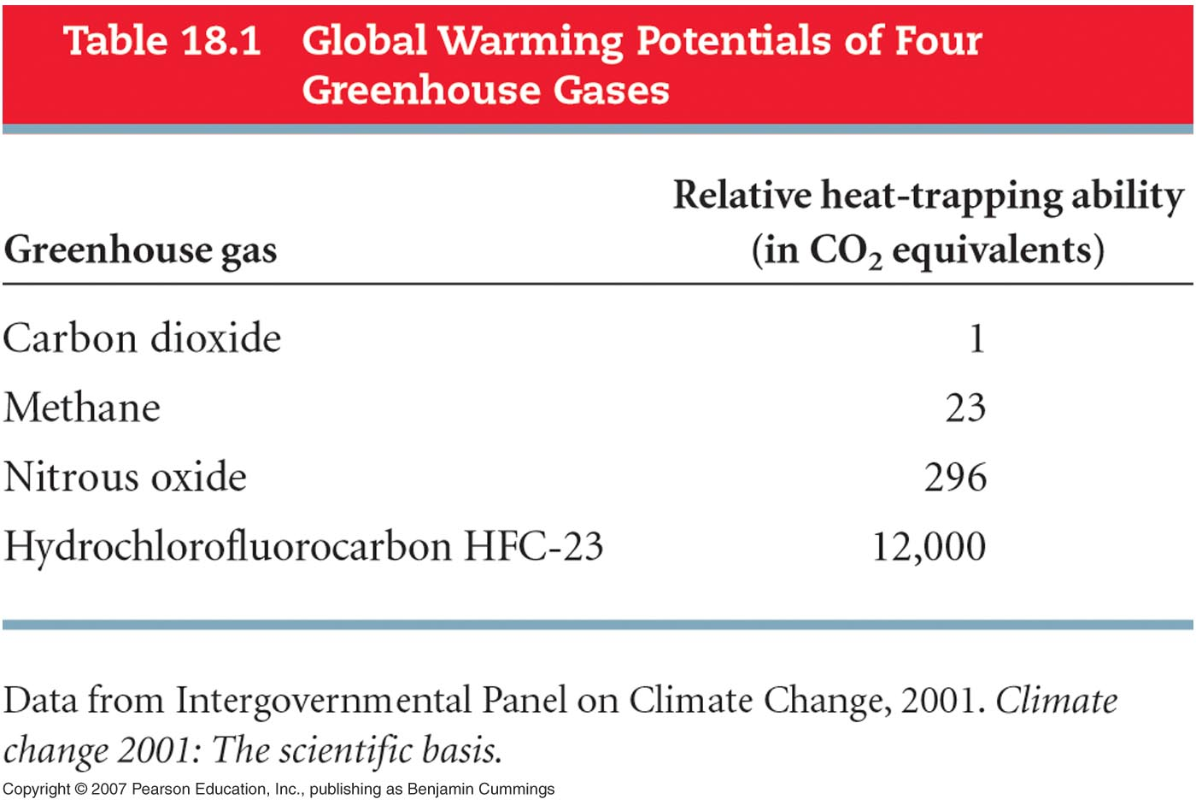
molecule for molecule,
    methane traps 23 times the heat of CO₂
    nitrous oxide traps 296 times the heat of CO₂
    HFC-23 traps 12,000 times the heat of CO₂

Slide 31
Without greenhouse gases, the average temperature of Earth's surface would be about −18 °C (0 °F), rather than the present average of 15 °C (59 °F).
Human activities since the beginning of the Industrial Revolution (around 1750) have produced a 45% increase in the atmospheric concentration of carbon dioxide, from 280 ppm in 1750 to 415 ppm in 2019. The last time the atmospheric concentration of carbon dioxide was this high was over 3 million years ago

Slide 32
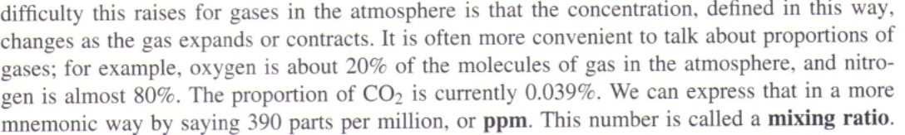

Slide 33
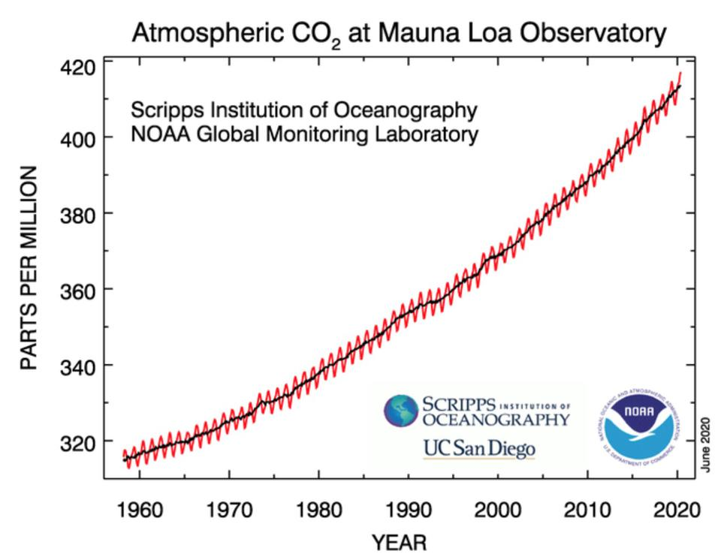
Carbon dioxide increase
At current emission rates, temperatures could increase by 2 °C (3.6°F), which the United Nations' Intergovernmental Panel on Climate Change (IPCC) designated as the upper limit to avoid "dangerous" levels, by 2036.

Slide 34
Carbon dioxide increase
Due mainly to:
Burning of fossil fuels: We remove and combust carbon-rich fuels from the ground where they have been stored for millions of years, sending CO₂ into the atmosphere.
Deforestation: Cutting down trees, removing vegetation from the land, decreases the sink for carbon.

Slide 35
Methane and other greenhouse gases
Generally present at lower concentrations than CO₂.
More complicated molecules with more polar bonds have more and stronger IR absorption bands – global warming potential (GWP).
Relative importance is given by the product of concentration and GWP.
Atmospheric lifetime is important – of the long-lived greenhouse gases (LLGHGs), methane has the shortest lifetime, being susceptible to reaction with •OH.

Slide 36
Methane
40% from natural sources
Decaying vegetation, marsh gas.
Agriculture, especially rice paddies with anaerobic bacteria.
Ruminants (cattle and sheep) – you don’t want to know where it comes from! 500L cow⁻¹ day⁻¹
Termites (same chemistry)

Slide 37
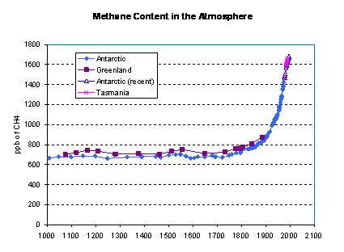

Slide 38
Nitrous oxide (NO₂) “laughing gas”
Bacterial conversion of nitrate (NO⁻₃) from soils
Catalytic converters
Ammonia fertilizers
Biomass burning
Nylon and nitric acid manufacture

Slide 39
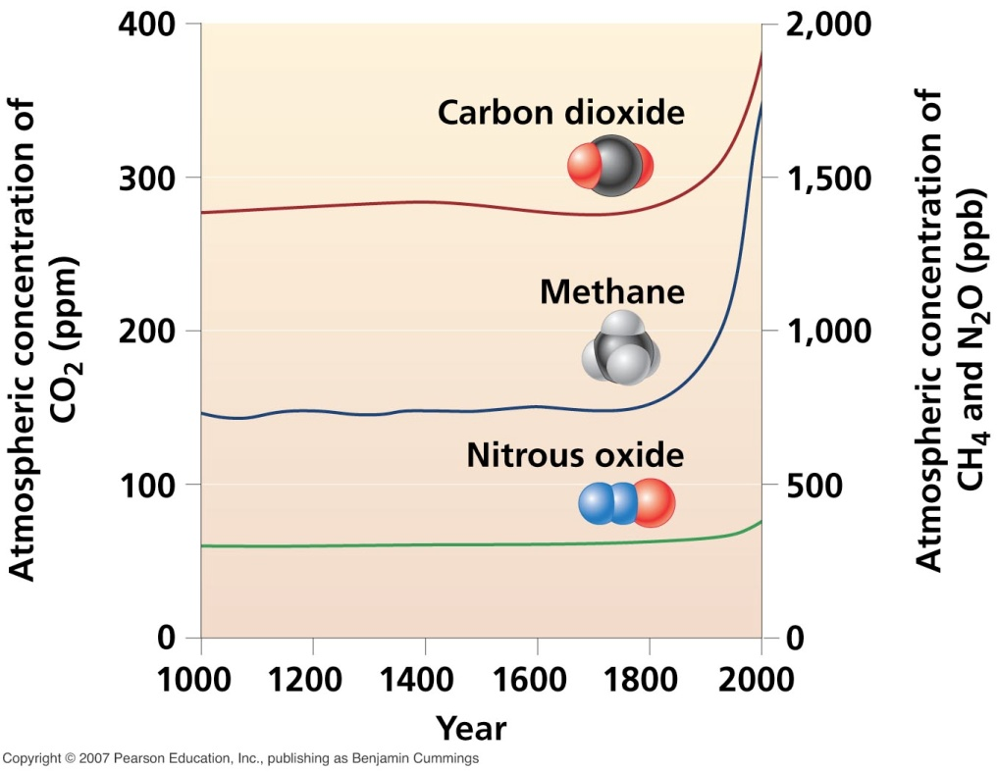
Increase of other greenhouse gases
Methane:
Up 151% since 1750
From fossil fuels, landfills, cattle, rice crops
Nitrous oxide:
Up 17% since 1750
From chemical plants, auto emissions, agricultural practices

Slide 40
Increase of other greenhouse gases
Halocarbon gases (which include CFCs) are powerful greenhouse gases.
But their effects are slowing due to the Montreal Protocol.
Water vapor is the most abundant greenhouse gas. Its future changes, if any, remain uncertain.

Slide 41







GHE#1 - natural
Earth’s Natural Greenhouse Effect
Notes:
Animation by Sandra Penny

Slide 42




Human-caused Global Warming

