Slide 1
Historical Background of Bangladesh
Bangla Language Movement

Slide 2
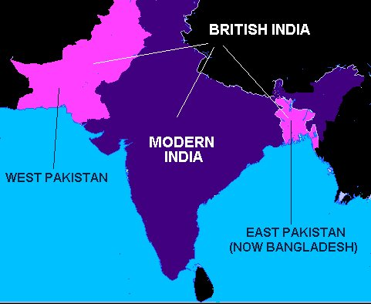

Slide 3
The Bangla Language Movement
The Bangla Language movement is a unique event in the history of the political Movement of Bangladesh. Bengali was the mother tongue of about 56 percent of the people of Pakistan. On the other hand, Urdu was the mother tongue of only 6 percent people of the whole of Pakistan. Although 56 percent of the people of Pakistan were Bengalis, the West Pakistani didn’t want Bengali to become the state language.
But, Bengalis wanted to make their language the state language along with Urdu and had no objections against that language’ (Rahman, 2012. P. 198). On 6 and 7 September 1947 the youth workers of East Pakistan held a Conference in Dhaka which was presided over by Tasadduk Hossain. This Conference, for the first time took a resolution demanding Bengali as the language of the offices and the courts and also as the medium of instruction in East Pakistan.
Various Stages of Language Movement

Slide 4
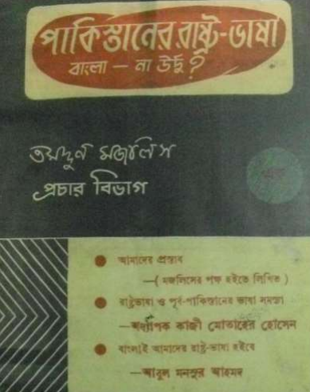
First Stage of the Language Movement
Formation of Tamaddun Majlish: On 15 September 1947 Tamaddun Majlish published the booklet on the Language Movement entitled “Pakistaner Rastrabhasha Bangla Na Urdu.” Prof. Abul Kashem, Dr. Qazi Motahar Hossain and Abul Mansur Ahmed were the authors of this booklet.
In October 1947, Tamaddun Majlish formed Rastrabhasa Sangram Parishad to give the Language Movement an organizational structure.
Education Conference in Karachi: In December 1947, an Educational Conference was held in Karachi sponsored by the Government of Pakistan. In this Conference, the decision was taken to make Urdu the state language of Pakistan.
Formation of Sangram Parishad: In January 1948 the Rastrabhasa Sangram Parishad was reconstituted with a view to making Bengali a state language. The Sangram Parishad raised the following demands
1. Bengali shall be the medium of instruction and the language of the offices and law Courts of East Bengal;
2. There will be two state languages of Pakistan Bengali and Urdu.

Slide 5
First Stage of the Language Movement
Demand by Dhirendra Nath Dutta: In February 1948 when the first Assembly of Pakistan started to record its proceedings in Urdu side by side with English, Dhirendra Nath Dutta of Comilla, a member of Assembly, protested it and demanded that Bengali be accorded official recognition as one of the languages of the Constituent Assembly.
All-Party Rastrabhasa Sangram Parishad and Protest on 11 March 1948: On 2 March 1948 formed the All-Party Rashtrabhasha Sangram Parishad. The Sangram Parishad called a general strike on 11 March 1948 to resist the conspiracy of the Government in the language issue. On that day, many students were injured and many leaders including Sheikh Mujibur Rahman, Shamsul Huq and Oli Ahad were arrested. It was decided that 11 March would be declared ‘Bengali Language Demand Day’.
In such a situation, the Chief Minister Khwaja Nazimuddin met the Sangram Parishad on 15 March and signed an agreement with them. By this agreement, he agreed to release the arrested students, to investigate police excesses, to move a Bill in the Assembly for making Bengali a state language.

Slide 6
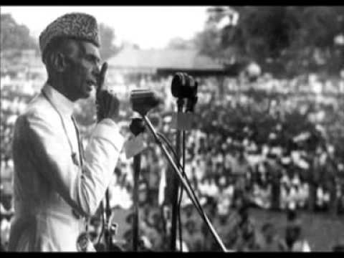
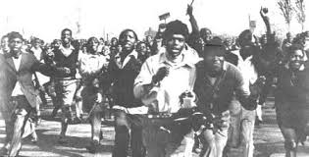
First Stage of the Language Movement
Announcement of Muhammad Ali Jinnah: On 21 March 1948, Muhammad Ali Jinnah visited Dhaka and addressed a public meeting at the then Racecourse Maidan. In that meeting, he declared, "Urdu and only Urdu shall be the state language of Pakistan". When he repeated these words at the Dhaka University Convocation Ceremony held on 24 March at the Curzon Hall, the students protested vehemently by shouting 'No, No'. On that day, Rastrabhasha Parishad submitted a memorandum to Muhammad Ali Jinnah.
8
Mohammad Ali Zinnah
on 21 March 1948
Protest of the students

Slide 7
First Stage of the Language Movement
8
From this time (March’1948) on till he died Jinnah never again said that he wanted Urdu as the only state language of Pakistan (Rahman 2012. P. 99). Those who wanted Urdu as the only state language had just one argument to back them: it was, they said, an ‘Islamic language’. But we could not figure out how Urdu had ended up becoming as Islamic language’ (Rahman 2012. P. 98).
Proposed of the introduction of Arabic script: In 1948, It is proposed that introduction of Arabic script or Urdu letters for writing Bengali. Dr. Shahidullah was proposed to be appointed for the purpose of introducing the Arabic script. But he rejected the proposal.
In April 1949 the students of Bengali Department, DU submitted a memorandum to Pakistan Education Advisory Board protesting this objectionable proposal.

Slide 8
Last Stage of the Language Movement
Formation of Purbo Bangla Bhasha Committee: On 9 March 1949, the Government of East Bengal formed the Purbo Bangla Bhasha Committee for reforming the Bengali language. Maulana Akram Khan was the President of this Committee.
Announcement of Liaquat Ali Khan: In September 1950, The Prime Minister Liaquat Ali Khan declared in the Constituent Assembly that only Urdu would be the state language of Pakistan. But in the face of strong protest from the people of East Bengal, the Constituent Assembly postponed the discussion.
Announcement of Khawaja Nazimuddin: On 26 January 1952 at a public meeting in Dhaka, Khwaja Nazimuddin declared that Urdu would be the only state language of Pakistan. This declaration created a strong resentment and as a mark of protest, a call for hartal throughout the province was given.
Meeting of All-Party Rashtrabhasha Sangram Committee: The Committee decided to call a strike on 4 February and observe 21 February as the State Language Day and to observe hartal in the country. February 21 had been chosen as the State Language Day since the East Pakistan Provincial Assembly was scheduled to sit on that day.

Slide 9
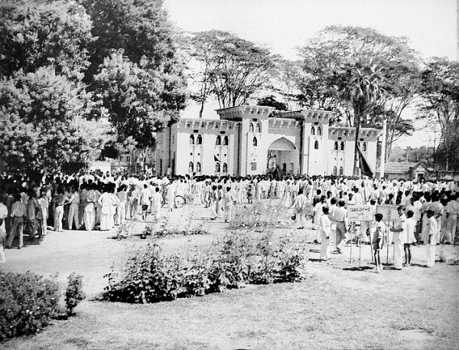
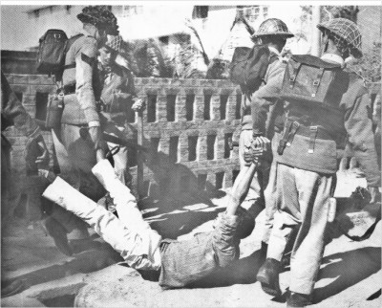
Final Stage
144 Section: On 20 February, the Government of Nurul Amin, fearing the student Movement imposed section 144 at 3 p.m., and banned the processions and the meetings.
21 February: On 21 February, the students at Dhaka University in an organized way defied section 144 and leading a procession from the University campus proceeded towards the Provincial Assembly which was in session, chanting the slogan "Rashtrabhasha Bangla Chai". In a tense situation, the students assembled on the campus. The police used tear gas to disperse the students. And clashes occurred between the police and the students.
At one stage, the police opened fire. Several people and students including Jabbar, Rafiq, Barkat and Salam were martyred, and many students and people were injured.

Slide 10
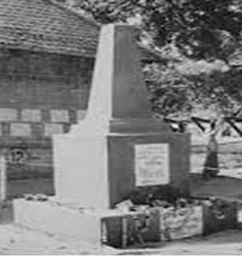
Major Events after 21st February
On 22 February: “Gayebana Janaza” held for Ekushey martyrs. Then a big rally, came out on the street as a mark of protest. Police opened fire on this rally too. As a result, Safiur Rahman was killed. On the same day, in a meeting of the students held at the Dhaka Medical College hostel, it was decided to build a Shaheed Minar. Accordingly, the Students erected a 12-feet high Shaheed Minar in front of DMC.
On 23 February: The father of Shaheed Safiur Rahman formally inaugurated the Shaheed Minar. But in the evening of 24 February, police demolished this Shaheed Minar. In memory of that, another Shaheed Minar was built later the same site and that is the present Central Shaheed Minar.

Slide 11
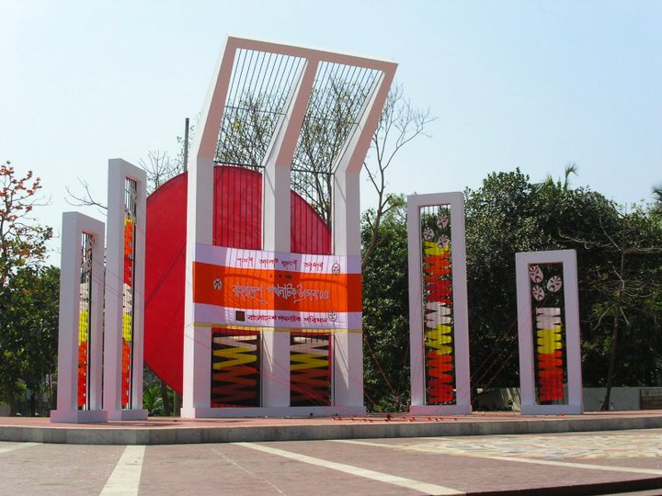
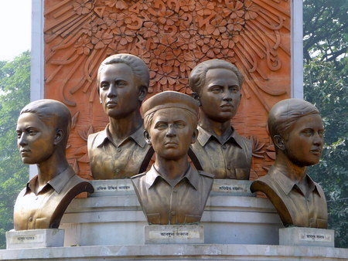
Bangla as State language
At last, the Government of Nurul Amin adopted a resolution in the Provincial Assembly to the effect that a proposal would be raised at the Constituent Assembly containing the demand to accord Bengali the status of one of the state languages of Pakistan. In the face of continuous student's and people's Movements the Pakistan Government was compelled to give Bengali the status of one of the state languages.
Finally, Bengali was given the status of one of the state languages in the Constitution of Pakistan of 1956.

Slide 12
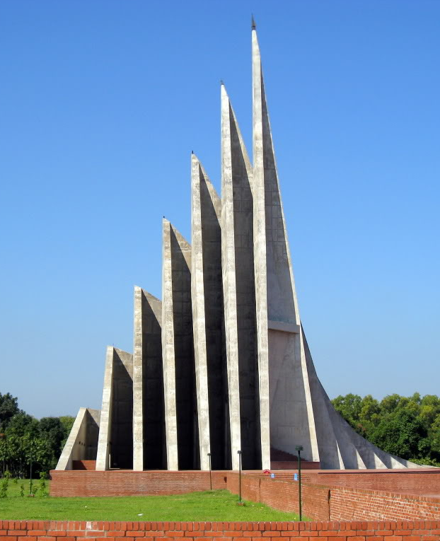
Significance and Achievements
The Language Movement of 1952 was the first organized expression of the consciousness of the exploited and deprived masses of Bangladesh. This consciousness born out of the Language Movement inspired all the subsequent Movements and helped to achieve the political, the cultural and the economic freedom leading to independence.
This movement laid a major foundation of our liberation war.
On February 29, 1956: Recognition made on the Pakistan constitution that “The state language of Pakistan shall be Urdu and Bengali.”
UNESCO recognized 21st February as International Mother Language Day in 1999.
International Status of Bangla Language (Sierra Leone)
This movement acted as the inspirational for the following movements:
Landslide victory in the provincial election in 1954 (In the East Bengal Legislative Assembly the United Front got 236 out of 309 seats)
Constitutional Movement in 1956
Education Movement in 1962
Six-points Movement in 1966
Mass-uprising in 1969
Great victory in 1971

Slide 13
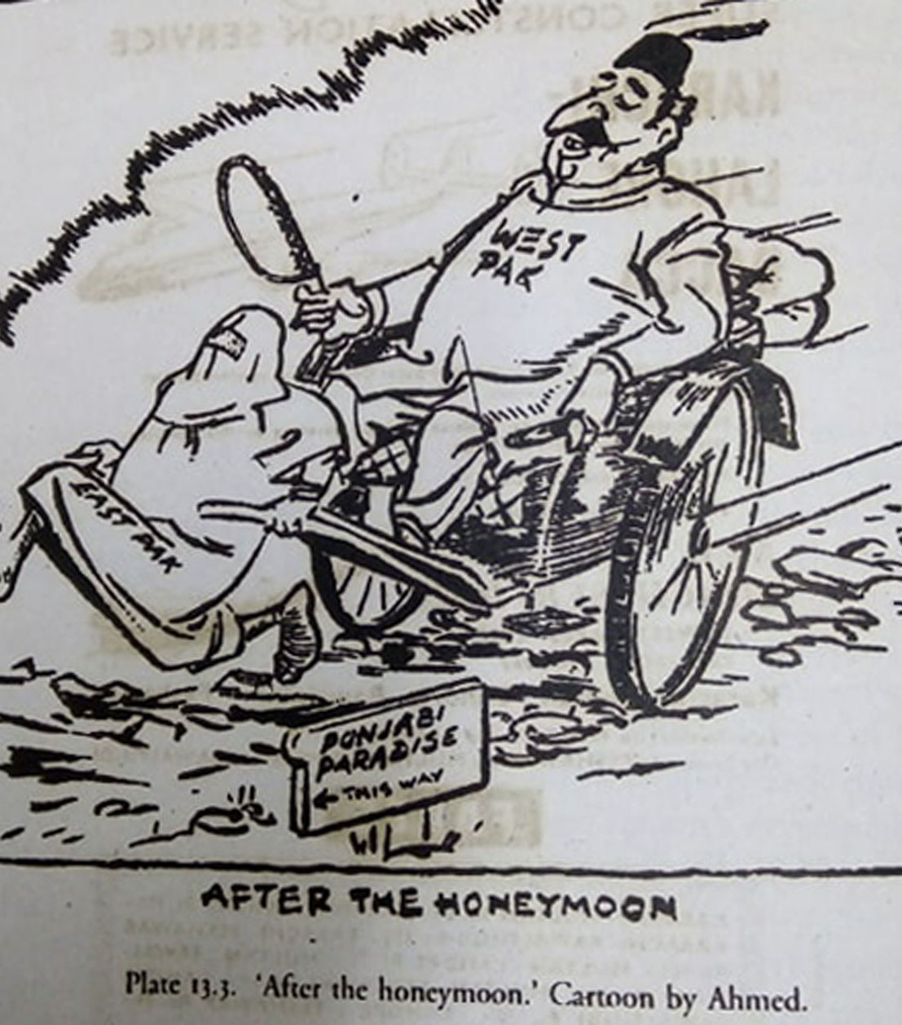
Discriminations against East Pakistan
Form the very beginning, Pakistan had been following a policy of partition against East Pakistan. Political, military, administrative and economic discrimination had been increasing gradually. Bengalis were beginning to perceive that they were being discriminated against in business, government service and all spheres of trade and commerce. Because Karachi was the capital of Pakistan, Bengalis were being deprived of all sorts of advantages.
“…, food scarcity was recorded in many places. People of Faridpur, Comilla and Dhaka districts were facing a calamity due to acute shortage of food grain. On that time, government introduced the ‘Cordon System’. This meant that there was to be no movement of food from one district to another.” (Rahman 2012. P. 103)
The disparities between West Pakistan and East Pakistan will be described in the next slides.

Slide 14
Socio-Cultural Disparity
Bengali was the mother tongue of 56 percent of the people of Pakistan. On the other hand, Urdu was the mother tongue of only 6 percent people of the whole of Pakistan (Census 1951). Thus Bengali, despite being the language of most of the people of Pakistan, was ignored by the Pakistani ruling group as a state language which was a substantial discrimination against the people of East Pakistan. On the other hand, East Pakistan also deprived from getting reasonable facilities in various social sectors.
[Source: M.A. Rahim, Bangladesher Itihas, P. 480]
Sl. No | Areas | West Pakistan | East Pakistan
1 | Total Population | 5.50 Crore | 7.50 Crore
2 | Number of Doctors | 12400 | 7600
3 | Rural Health Complex | 325 | 88
4 | Social Development Centre | 81 | 52

Slide 15
Political Disparity
East Pakistan became subjected to political discrimination immediately after the birth of the state of Pakistan. From 1947 to 1958, among all the presidents of Pakistan, one was from East Pakistan who spoke in Urdu.
In reality, East Pakistan was politically neglected by Pakistan from the very beginning. For example, United Front got 236 seats out of 309 in the provincial election in 1954 but this government could not continue more then two years.
During the regime of Liaquat Ali & Nurul Amin, ‘the kind of torture and harassment of political prisoners that was going on had no precedence in any civilized country at any stage of history. Political prisoners appealed time and again for their rights and privileges people in their position enjoyed in British period. Unfortunately, their petitions were ignored.’ (Rahman 2012. P. 172)
In the general elections held on 7 December 1970, the Awami League acquired an absolute majority. The Awami League secured 167 seats out of 169 National Assembly seats in East Pakistan and won 288 out of 300 seats in the Provincial Assembly. But Awami League did not form the government. In protest against these discriminatory policies of West Pakistan, the people of East Pakistan raised the demands for their rights of self-determination and autonomy. At this, the West Pakistani ruling clique forgot the principles of democracy and perused a policy of suppressing the just demands of the people of East Pakistan. They did not even hesitate to term Sheikh Mujibur Rahman and other patriotic leaders of this region as traitors.

Slide 16
Employment or Military Disparity
While the security of East Pakistan was uncertain, the province was also subjected to serious discrimination in military matters. The headquarters of the three Defense Services were established in West Pakistan. No Bengali could be found in the high posts in the Defense Services as those posts were monopolized by the West Pakistanis. In the army, 95 percent posts were held by the West Pakistanis and East Pakistan had a share of only 5 percent.
In administrative arena, within 1966, 77% 1st class jobs belonged to the west Pakistani whereas only 23% filled up by the East Pakistani, On the other hand, 74% for 2nd Class, 73% for 3rd Class and 70% for 4th Class jobs went to west Pakistan while remaining were for East Pakistan.
[Source: M.A. Rahim, Bangladesher Itihas, P. 479]
SL No. | Areas | West Pakistan | East Pakistan
1 | Central Civil Jobs | 84% | 16%
2 | Foreign Jobs | 85% | 15%
3 | Army | 95% | 5%

Slide 17
Economic or Financial Disparity
During the Pakistani rule, East Pakistan was subjected to severe economic disparity. As a result, East Pakistan could never be self- sufficient economically. The provincial government did not have any control over its currency and economy. As everything was controlled by the Centre, all the income of East Pakistan flew away to West Pakistan.
Head offices of the State Bank and other banks, insurance companies, trading concerns and foreign missions were established in West Pakistan. About two thirds of the foreign exchange of Pakistan was earned by selling the jute of East Pakistan. But the jute farmers could never get the fair price for their products.
[Source: M.A. Rahim , Bangladesher Itihas, P. 480]
SL. No | Areas | West Pakistan | East Pakistan
1 | Foreign Currency for Development | 80% | 20%
2 | USA Aid | 56% | 34%
3 | House Building | 88% | 12%
4 | Industrial Bank | 76% | 24%

Slide 18
Disparity in Educational facility
There were huge disparities in education sector also. The discrimination was prevailing in the area of education facility mentioned here:
Source: Bangladesh documents, Ministry of External Affairs, India, 1971 (p:17)
West Pakistan 1968-69 | East Pakistan 1968-69 | Grade
09 | 04 | University
17 | 09 | Medical, Engineering College
39418 | 28307 | Primary School

