Slide 1
How computer works
CSE 1110: Introduction to Computer Systems
Course teacher: Minhajul Bashir

Slide 2
What makes a computer, a computer?

Slide 3
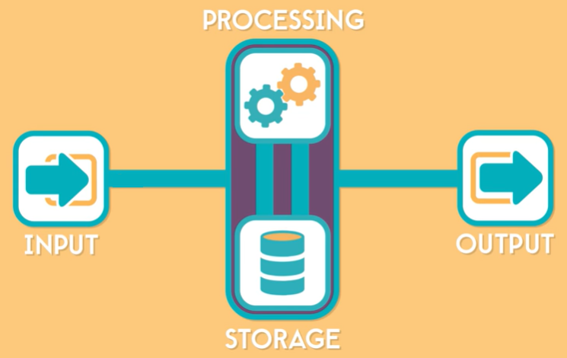
What makes a computer, a computer?

Slide 4
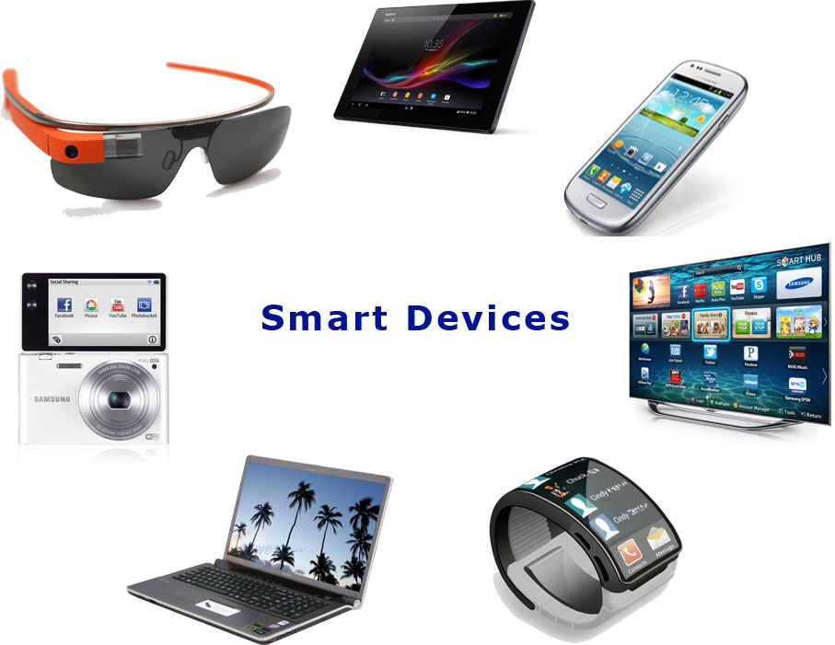
Input > Storage > Processing > Output
This is how any
computing device works!!!

Slide 5
Hardware

Slide 6
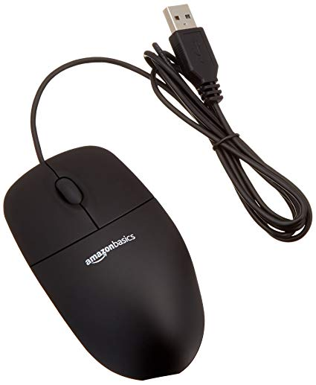
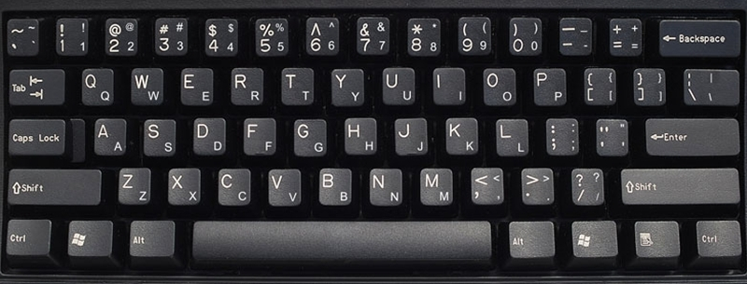
Input devices

Slide 7
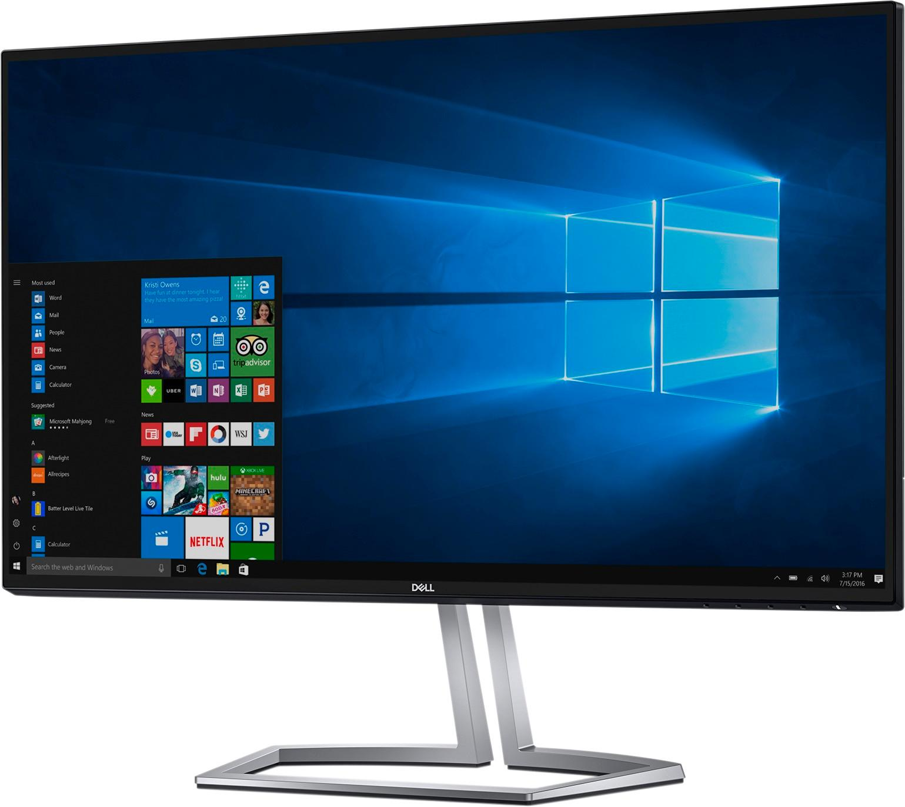
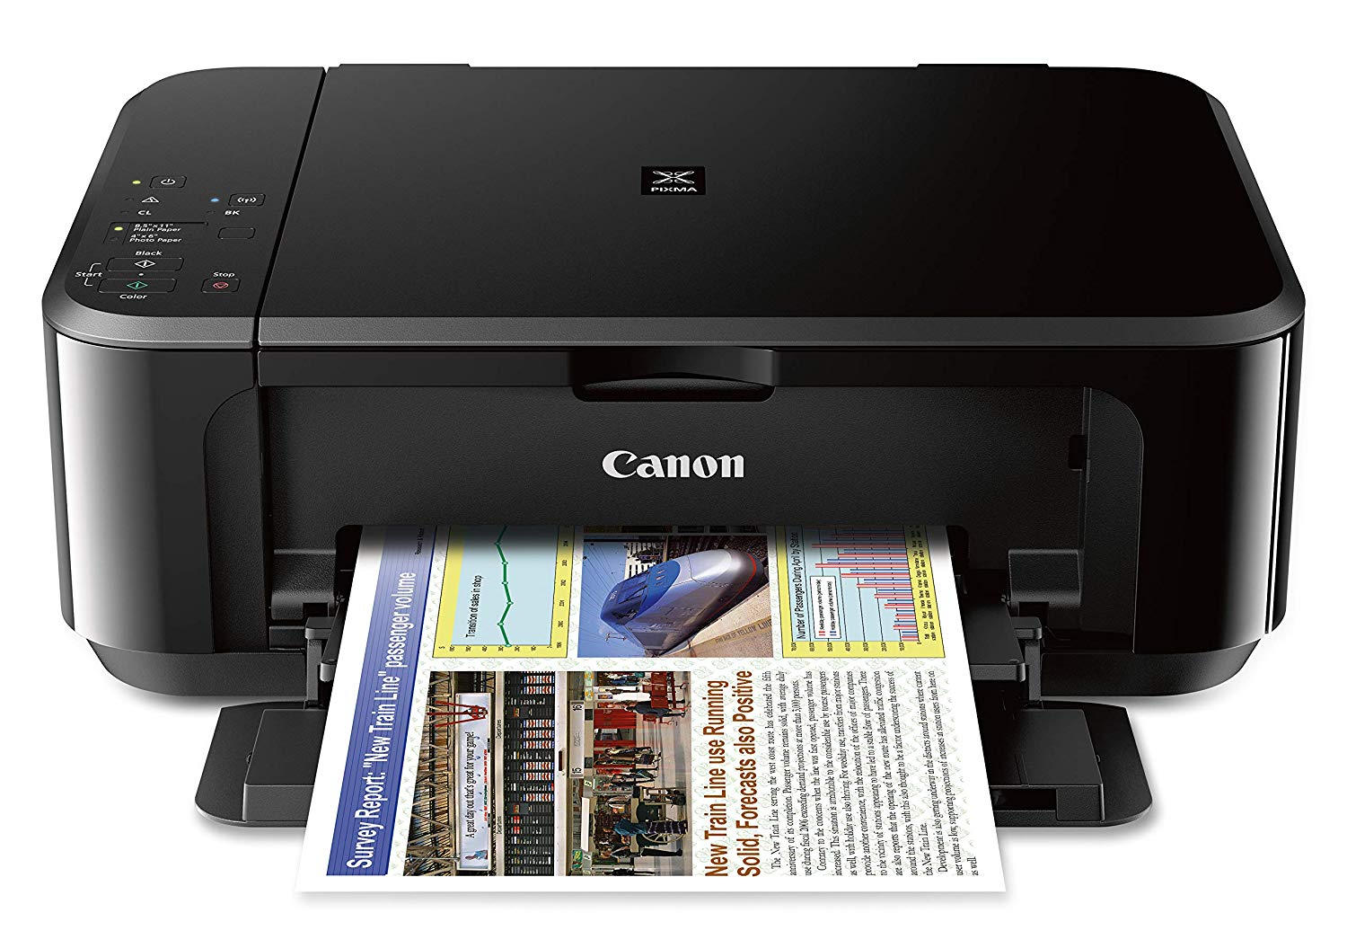
Output devices

Slide 8
Any more input/output devices?
Think about anything that a smartphone, tab etc. may contain

Slide 9
Inside a computer

Slide 10
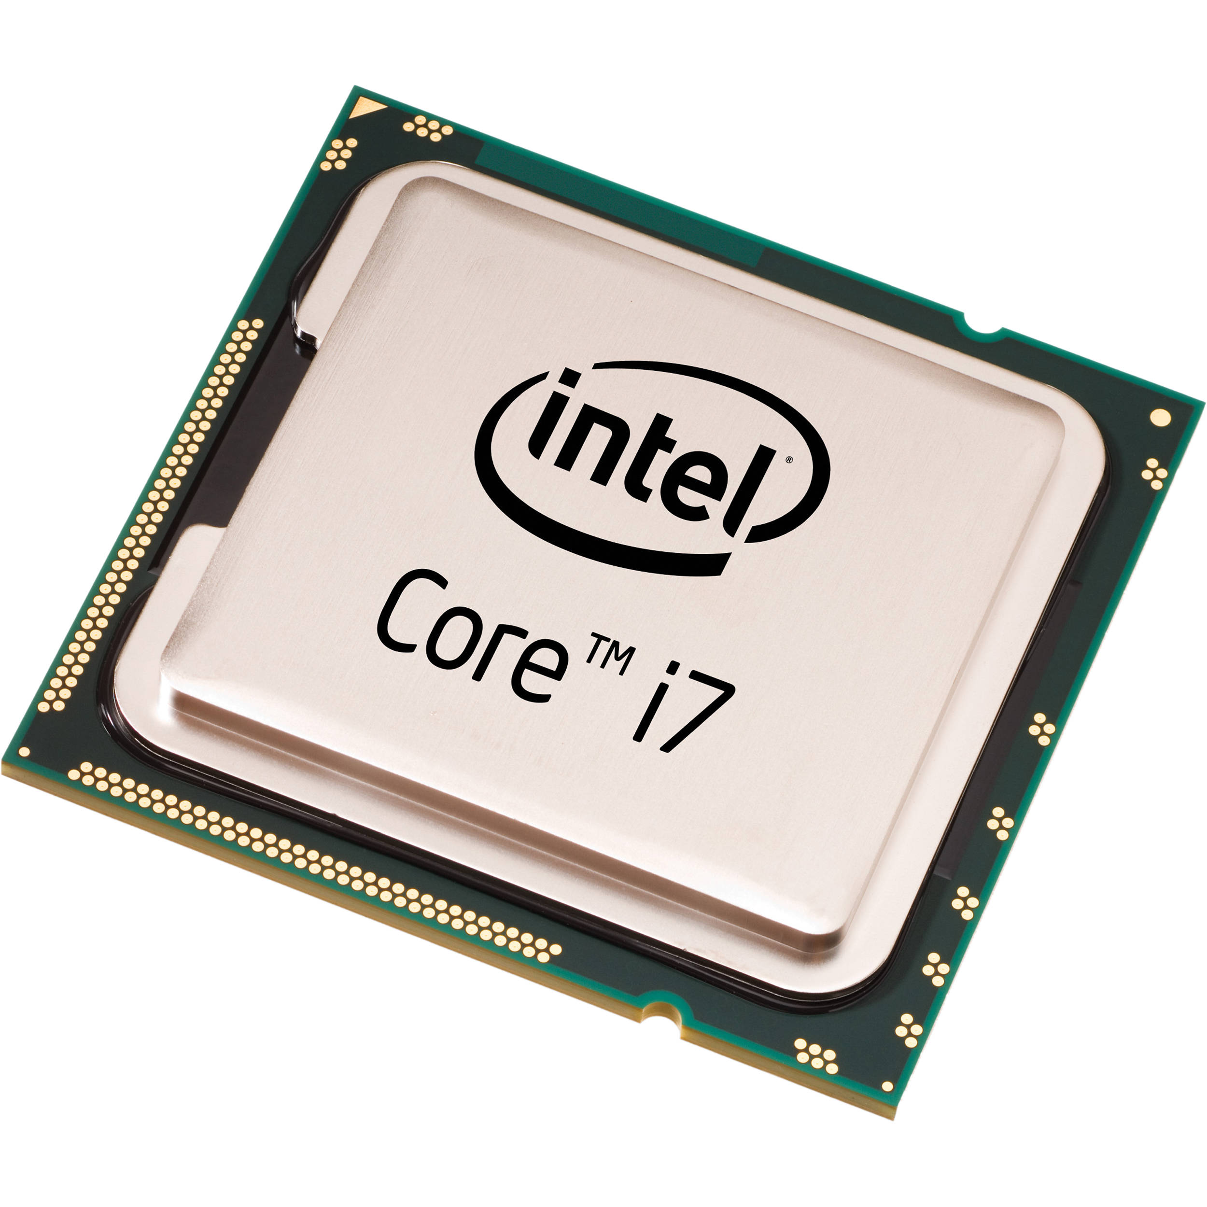
Processor (or CPU)
Central Processing Unit
The brain of computer
Executes instructions
Performs all the calculations/processing
The fastest component of a computer
Processor speed 2.4 GHz = capability to execute 2.4 billion operations per second

Slide 11
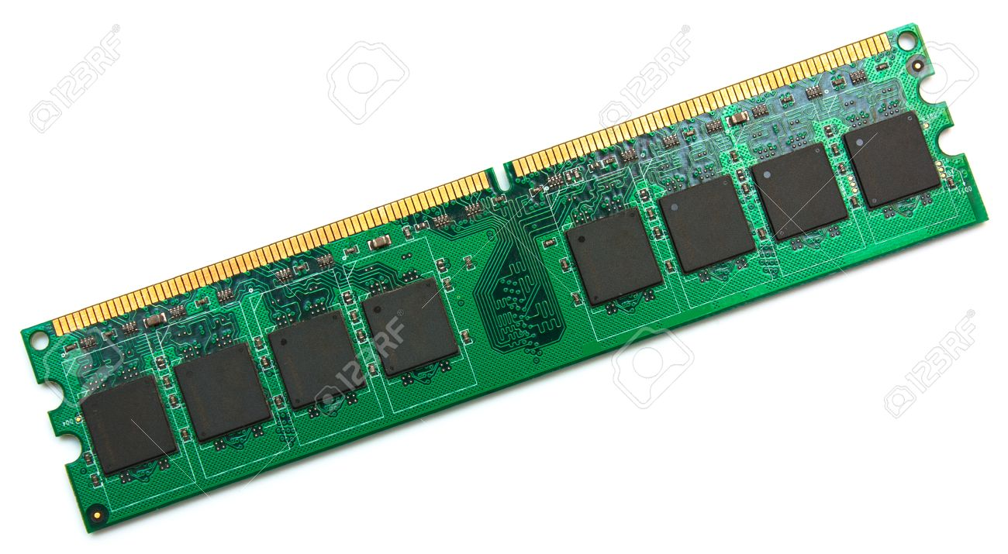
Main memory: RAM
Random Access Memory
Stores programs and data
Volatile: Data is lost when powered off
Small capacity
Faster access to data

Slide 12
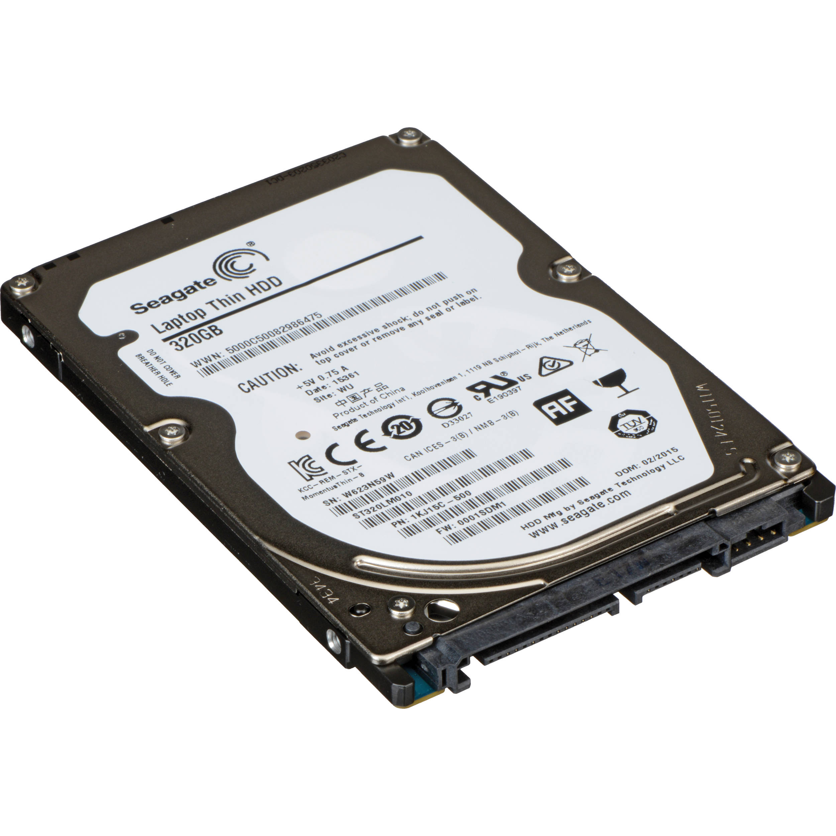
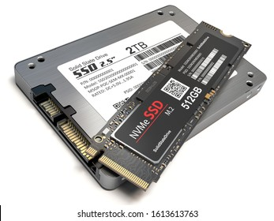
Internal storage: Hard Disk and SSD
Hard disk
Data is stored in an array of magnetic disks
Disks need to be rotated for data read/write
SSD: Solid State Drive
Data is stored in an array of flash memories
No mechanical components
Stores programs and data
Non-volatile: Data is retained even if powered off
Large capacity
Slower access to data

Slide 13

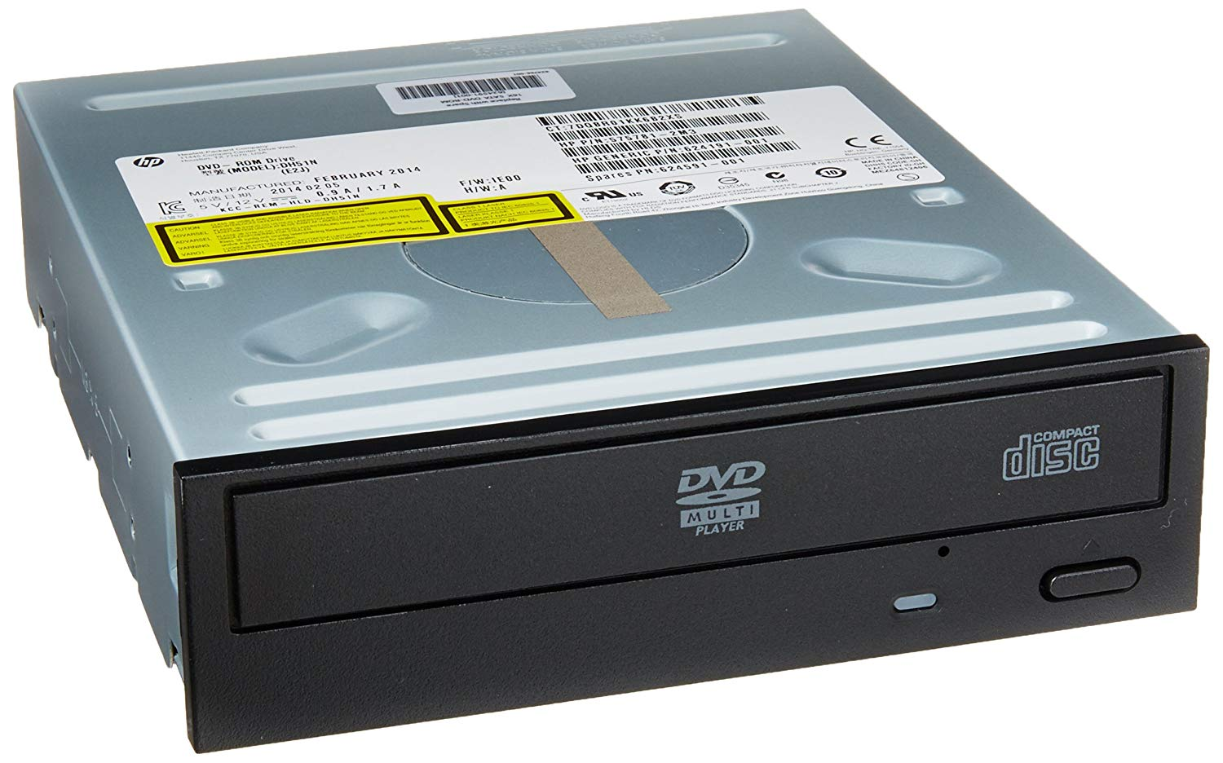
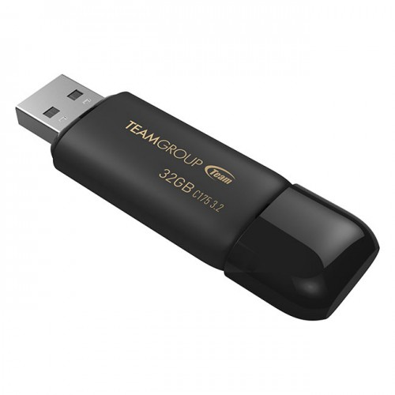
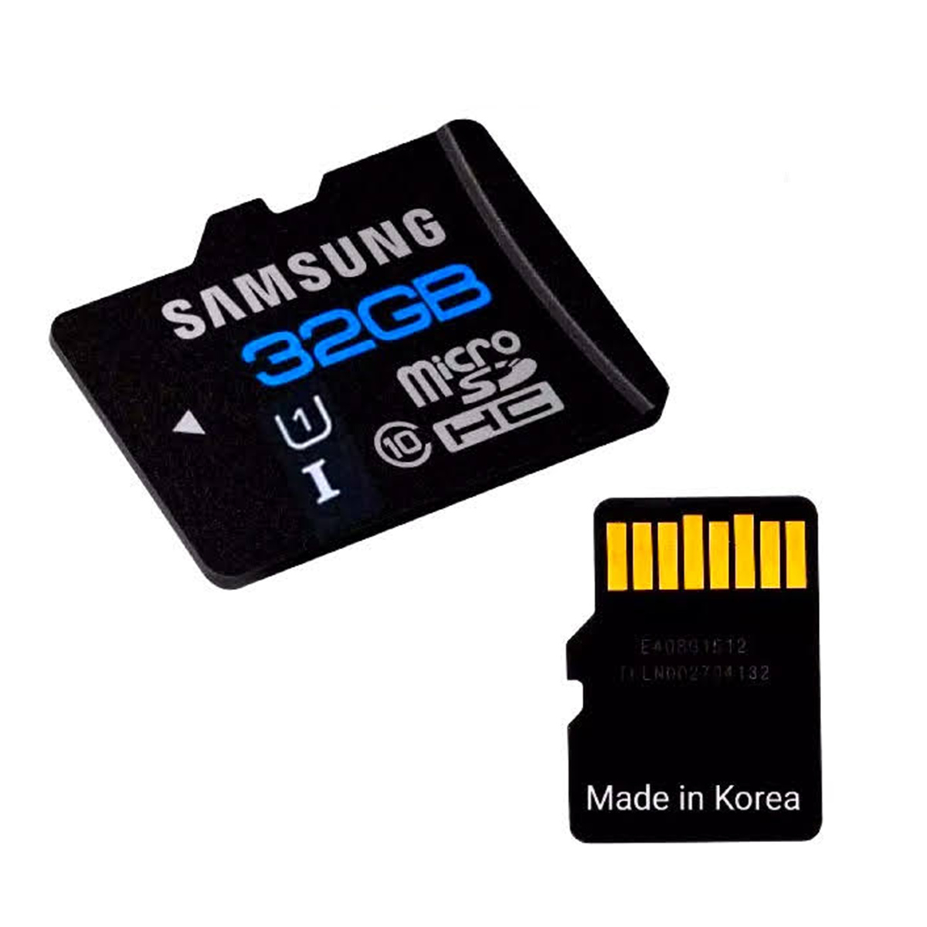
Portable storage: CD/DVD/Bluray, flash drives/sd cards
CD/DVD/Blu-ray: Optical disks, data read by lasers
Flash drives/SD cards: Makes use of flash memory
Stores program and data
Non-volatile: Data is retained even if powered off
Smaller capacity
Slower access to data
Widely used for portability

Slide 14
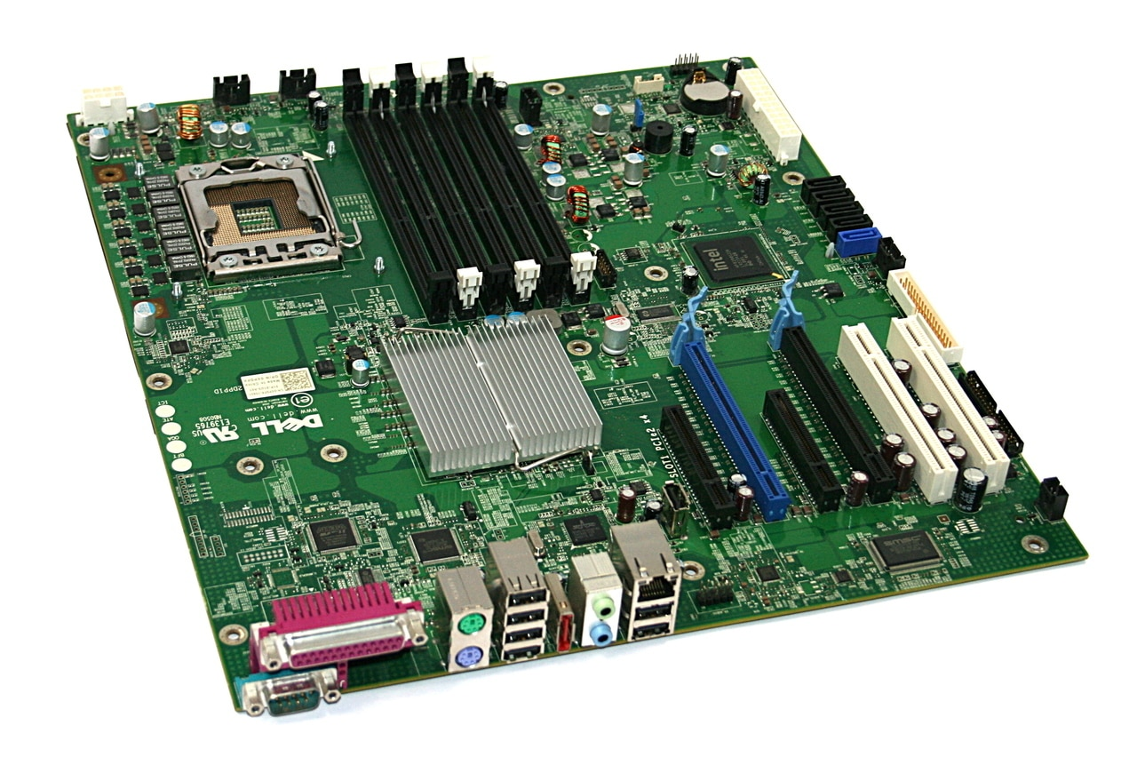
Motherboard
The backbone of a computer
All components are connected to it
Provides data path between components

Slide 15
Software

Slide 16
What is software?
A set of instructions that tells a computer to do a specific task
Software tells the computer where to take input from, how to process it, and how to present the result to the user
All these things happen behind the scene (abstraction)

Slide 17
Three types of software
Software
Operating System
Application Program
Programming Software

Slide 18

Operating system
Manages hardware and software resources
Communicates with the hardware
Allocates memory to software
Provides common services for programs (e.g. network connectivity, peripherals etc.)
Example: Windows, Linux, MacOS, iOS, Android

Slide 19



Application program
Any program that is suited for real life tasks (browsing, writing, playing games etc.)
Google Chrome, Microsoft Word, Microsoft PowerPoint
.exe (Windows) or .app (Mac) file
Runs on top of operating systems
Depends on operating system for resources
That is why you cannot run a .exe file in Mac, or a .app file in Windows

Slide 20
Programming software
Helps write, debug and execute programs, thus creating software
Useful for developers, but not used by normal users
Example: GCC, Java, PHP, Python, Visual Studio, Codeblocks, Netbeans, Android Studio

Slide 21
How software runs
Instructions of the software are stored in storage
Whenever a software runs, its instructions are loaded in the memory
Operating system allocates space for each program
If the software requires further data, they are also loaded in the memory
Example: When you open a text file in Notepad, the contents of the file is loaded in the memory
The CPU controls the execution of instructions
Control unit
The CPU processes and manipulates data when required
Arithmetic and Logic Unit (ALU)

