Slide 1
Number Systems
CSE 1110: Introduction to Computer Systems
Course teacher: Mohmmad Ali

Slide 2
Number systems
Systems of writing numbers
Numbers comprise of digits, and the number of available digits define a number system
Base of a number system – number of available digits
We use decimal number system, containing 10 digits (0 to 9)
Computer uses binary number system, containing only 2 digits (0 and 1 – known as binary digits or bits)
Two more frequently used number systems – octal (base 8), hexadecimal (base 16, A-F after 9)

Slide 3
Why binary?
Major computer components (CPU, RAM etc.) are made of transistors
A transistor is an electronic switch
Has two states – on (1) and off (0)
This is why a computer understands the language of 1’s and 0’s only
Binary number system
Every instruction of a computer is encoded in binary
Every data is also encoded in binary
Computer stores and manipulates these data in binary format

Slide 4
Why octal and hexadecimal?
Even a small number requires quite a few bits in binary system
The decimal number 93 is 1011101 in binary
Converting decimal into binary is troublesome
We will learn in a while
Octal and hexadecimal are simplified binary numbers, so conversion is fairly easy
We will also learn in a while

Slide 5
Numbers in different systems
Decimal | Binary | Octal | Hexadec.
0 | 0 | 0 | 0
1 | 1 | 1 | 1
2 | 10 | 2 | 2
3 | 11 | 3 | 3
4 | 100 | 4 | 4
5 | 101 | 5 | 5
6 | 110 | 6 | 6
7 | 111 | 7 | 7
8 | 1000 | 10 | 8
9 | 1001 | 11 | 9
Decimal | Binary | Octal | Hexadec.
10 | 1010 | 12 | A
11 | 1011 | 13 | B
12 | 1100 | 14 | C
13 | 1101 | 15 | D
14 | 1110 | 16 | E
15 | 1111 | 17 | F
16 | 10000 | 20 | 10
17 | 10001 | 21 | 11
18 | 10010 | 22 | 12
19 | 10011 | 23 | 13

Slide 6
bytes and larger units
8 bits together – a byte
A number of bytes together – a word
Usually 4 or 8 bytes, depending on the processor, computer architecture etc.
Kilobyte – 1024 bytes
Megabyte – 1024 kilobytes
Gigabyte – 1024 megabytes
Terabyte – 1024 gigabytes
Why 1024 instead of 1000?

Slide 7
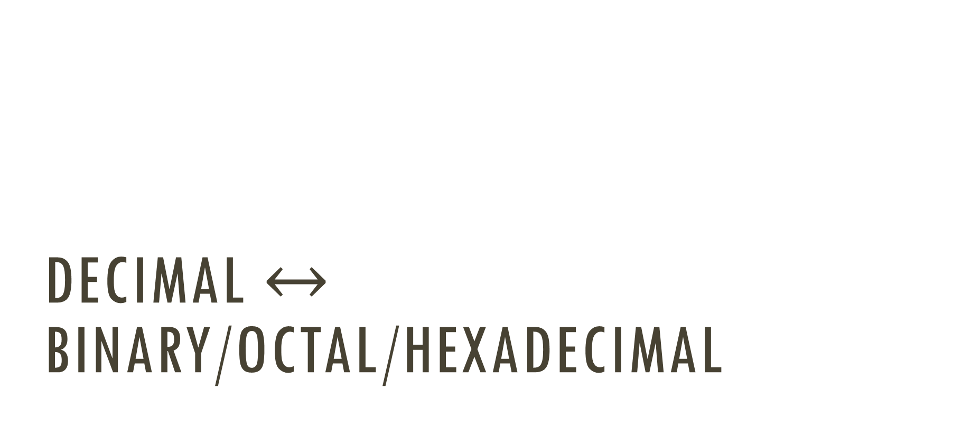
Decimal $↔$ binary/octal/hexadecimal

Slide 8

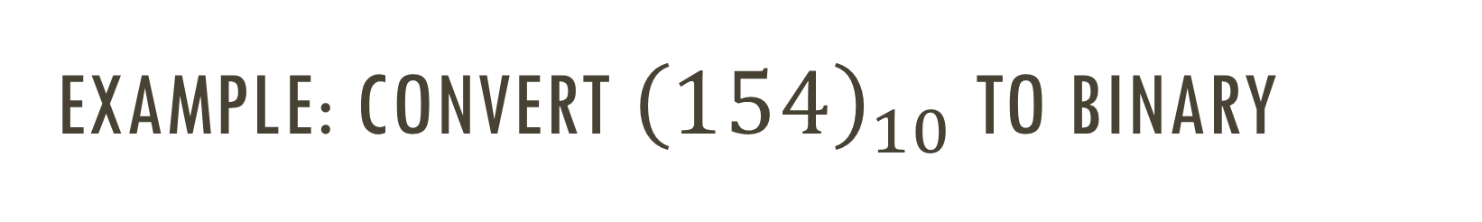
Example: Convert ${\left(154\right)}_{10}$ to binary
Quotient
Remainder
2
154
2
77 0
$${\left(154\right)}_{10}={\left(10011010\right)}_{2}$$
2
38 1
2
19 0
2
9 1
2
4 1
2
2 0
2
1 0
0 1

Slide 9


Example: Convert ${\left(0.625\right)}_{10}$ to binary
Integer
Fraction
-
.625
x2
1
.250
x2
$${\left(0.625\right)}_{10}={\left(0.101\right)}_{2}$$
0
.500
x2
1
.000

Slide 10

Merging these two
To convert ${\left(154.625\right)}_{10}$ to binary –
Divide the number into integer and fraction part, i.e. ${\left(154\right)}_{10}$ and ${\left(0.625\right)}_{10}$
Convert them individually to binary
Join them up
${\left(154.625\right)}_{10}={\left(10011010.101\right)}_{2}$

Slide 11
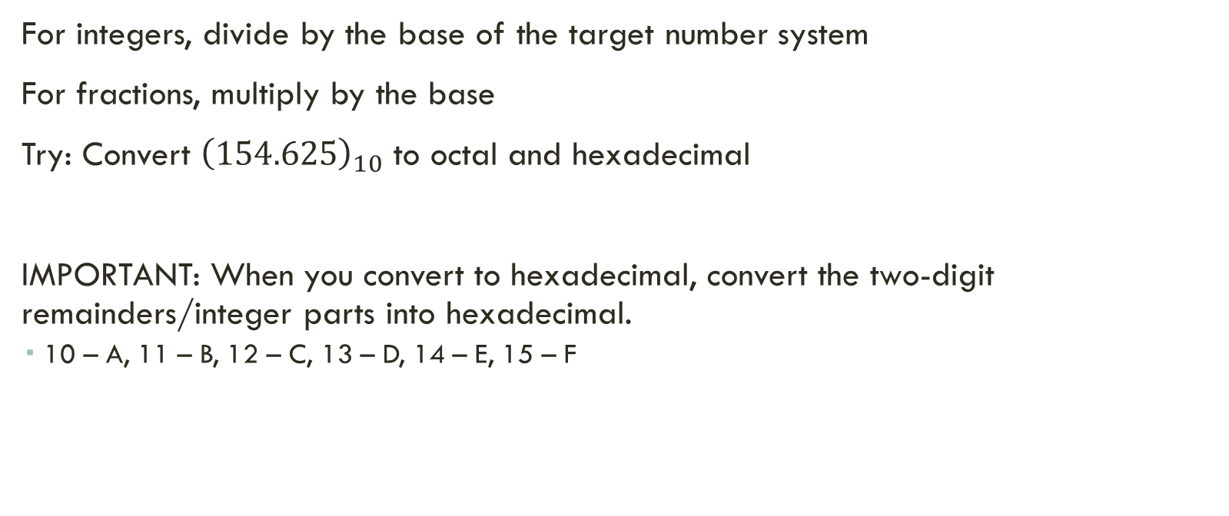
Same way for octal and hexadecimal
For integers, divide by the base of the target number system
For fractions, multiply by the base
Try: Convert ${\left(154.625\right)}_{10}$ to octal and hexadecimal
IMPORTANT: When you convert to hexadecimal, convert the two-digit remainders/integer parts into hexadecimal.
10 – A, 11 – B, 12 – C, 13 – D, 14 – E, 15 – F

Slide 12

Reverse action: Binary to Decimal
Multiply each bit with the place value of its place value, and sum the results
Place values –
$$2^{6}$$ | $$2^{5}$$ | $$2^{4}$$ | $$2^{3}$$ | $$2^{2}$$ | $$2^{1}$$ | $$2^{0}$$
$$2^{−1}$$ | $$2^{−2}$$ | $$2^{−3}$$ | $$2^{−4}$$

Slide 13
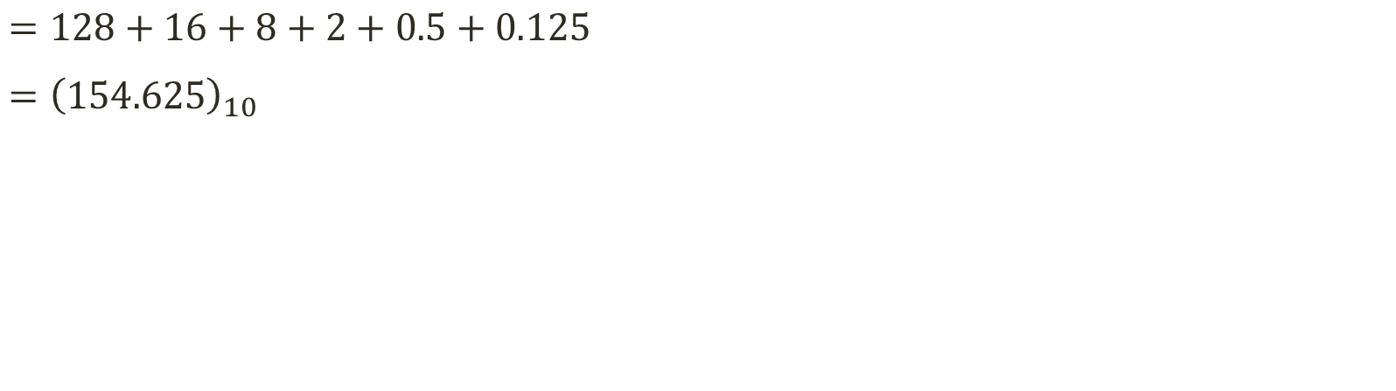

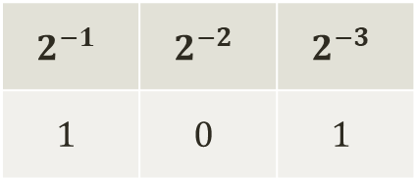
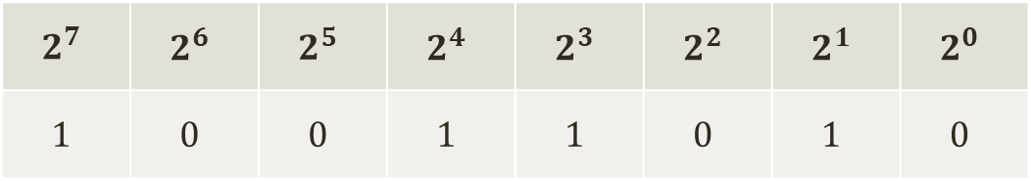
Convert ${\left(10011010.101\right)}_{2}$ to decimal
$$2^{7}$$ | $$2^{6}$$ | $$2^{5}$$ | $$2^{4}$$ | $$2^{3}$$ | $$2^{2}$$ | $$2^{1}$$ | $$2^{0}$$
$$1$$ | $$0$$ | $$0$$ | $$1$$ | $$1$$ | $$0$$ | $$1$$ | $$0$$
$$2^{−1}$$ | $$2^{−2}$$ | $$2^{−3}$$
$$1$$ | $$0$$ | $$1$$
$=128+16+8+2+0.5+0.125$
$={\left(154.625\right)}_{10}$

Slide 14
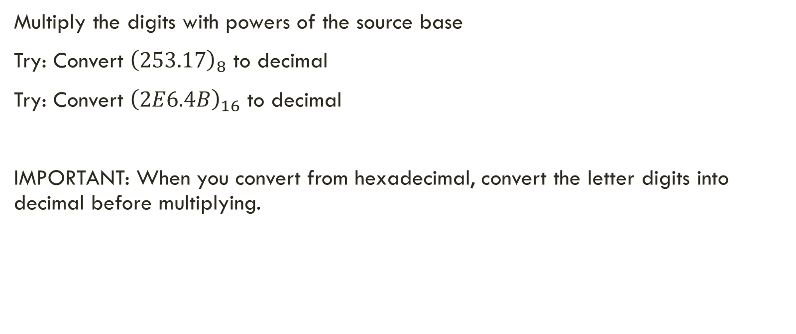
Same way for octal and hexadecimal
Multiply the digits with powers of the source base
Try: Convert ${\left(253.17\right)}_{8}$ to decimal
Try: Convert ${\left(2E6.4B\right)}_{16}$ to decimal
IMPORTANT: When you convert from hexadecimal, convert the letter digits into decimal before multiplying.

Slide 15
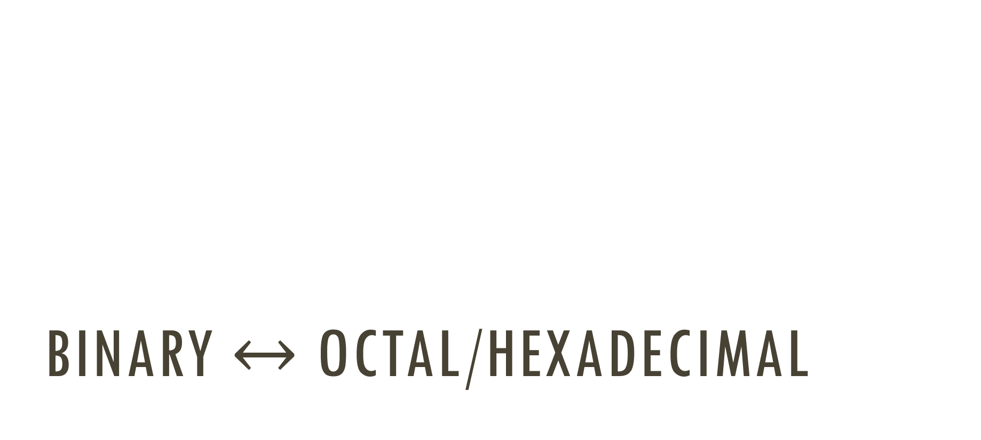
Binary $↔$ Octal/Hexadecimal

Slide 16






Binary to octal
Group the bits into groups of 3, and convert each group into an octal digit
${\left(10110101.1111\right)}_{2}={\left(?\right)}_{8}$
$$010 110 101 . 111 100$$
Grouped from the right
Grouped from the left
Padding by 0 for grouping
Padding by 0 for grouping
$$2$$
$$6$$
$$5$$
$$7$$
$$4$$
$$∴{\left(10110101.1111\right)}_{2}={\left(265.74\right)}_{8}$$

Slide 17



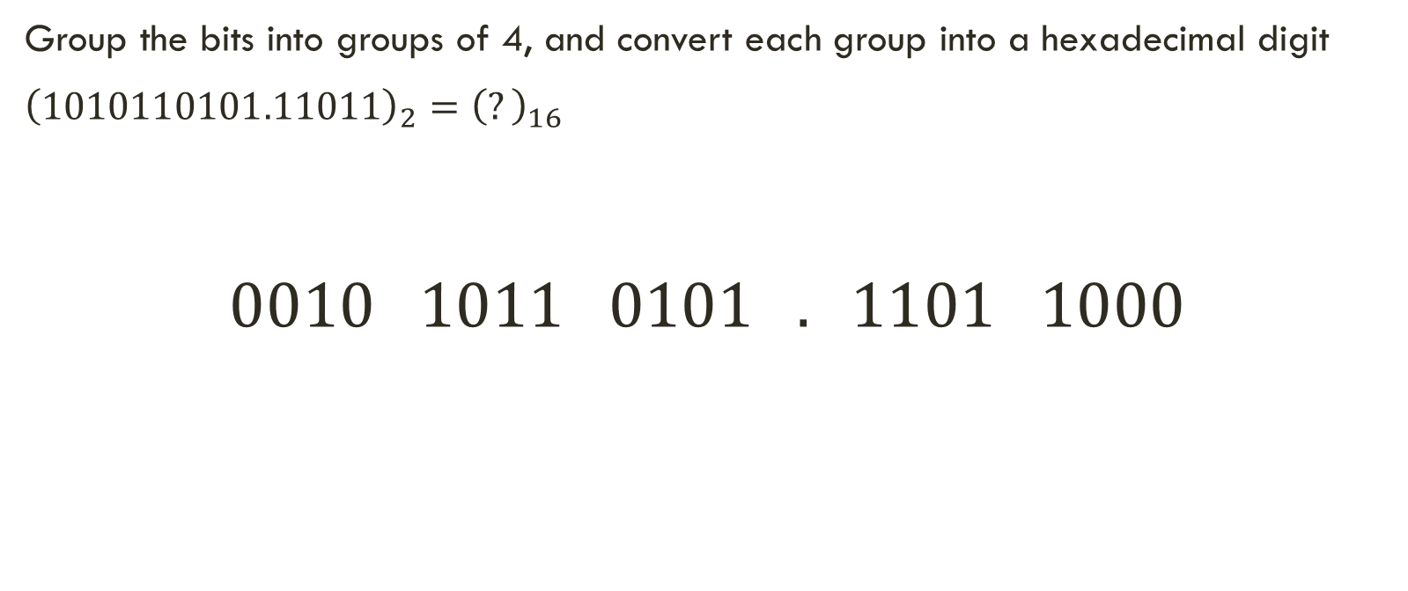


Binary to hexadecimal
Group the bits into groups of 4, and convert each group into a hexadecimal digit
${\left(1010110101.11011\right)}_{2}={\left(?\right)}_{16}$
$$0010 1011 0101 . 1101 1000$$
$$2$$
$$B$$
$$5$$
$$D$$
$$8$$
$$∴{\left(1010110101.11011\right)}_{2}={\left(2B5.D8\right)}_{16}$$

Slide 18
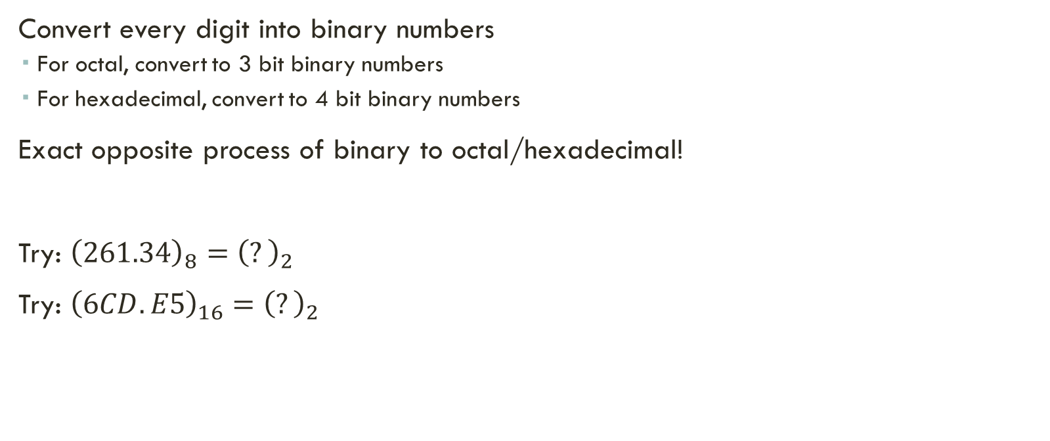
Octal/hexadecimal to binary
Convert every digit into binary numbers
For octal, convert to 3 bit binary numbers
For hexadecimal, convert to 4 bit binary numbers
Exact opposite process of binary to octal/hexadecimal!
Try: ${\left(261.34\right)}_{8}={\left(?\right)}_{2}$
Try: ${\left(6CD.E5\right)}_{16}={\left(?\right)}_{2}$

Slide 19
Basic binary addition

Slide 20
Adding two binary numbers
0101 + 0111 = 1100
0101 + 1011 = 10000
0111 + 0011 = 1010
How is it done?
Watch carefully …

Slide 21
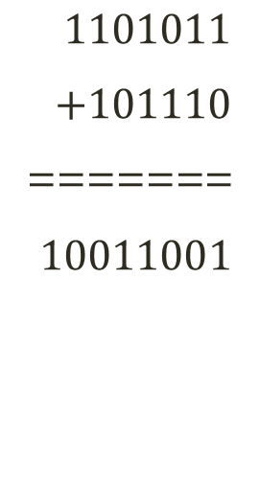
Adding two binary numbers
$1101011$
$+101110$
=======
$10011001$
1
1
1
1
1
1
1
0
1
0
1
1
+
1
0
1
1
1
0
1
0
0
1
1
0
0
1

