Slide 1
Representing Data
CSE 1110 – Introduction to Computer Systems
Course teacher: Mohmmad Ali

Slide 2
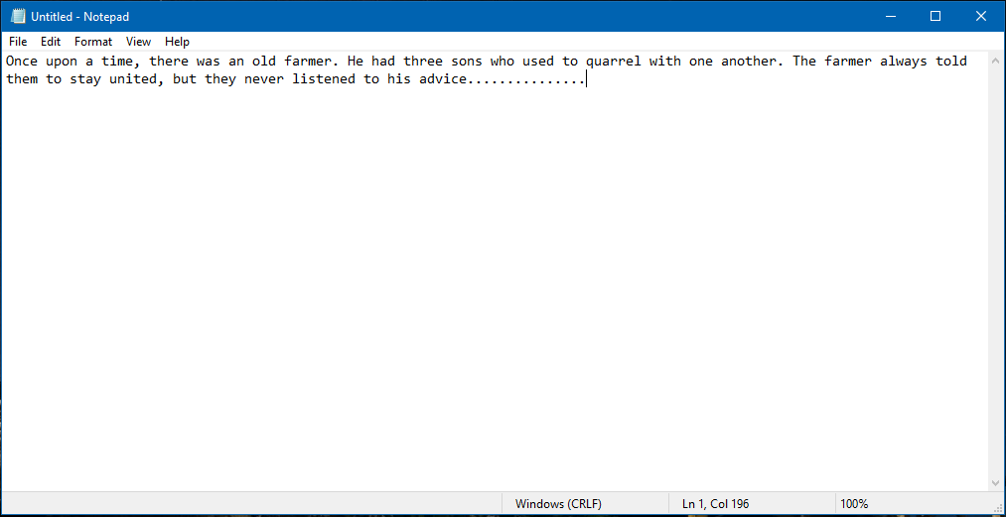
Representing Texts

Slide 3
Text file
A text, or a string, is a collection of characters
Any symbol that can be written is called a character
Letters
Digits
Punctuation marks
Special characters
Whitespaces!
New lines!!

Slide 4
Representing characters in binary
Every character has its own unique binary code
When we write a text, the computer stores these binary codes in the exact order of our writing
Can we code the characters as we wish?

Slide 5
ASCII code
American Standard Code for Information Interchange
Used to represent English and Roman characters
Size: 7 bits
How many total characters?
Extended ASCII
8 bits
First 128 codes are same as ASCII
The remaining codes represent even more characters

Slide 6
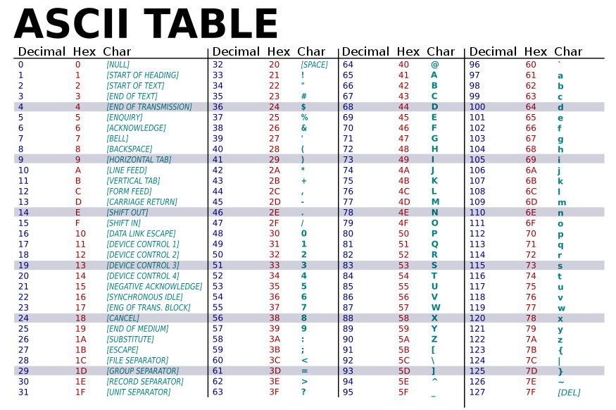

Slide 7
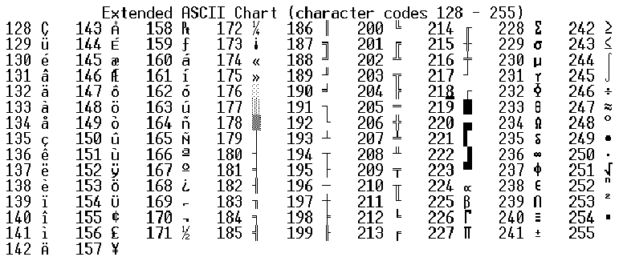

Slide 8
Unicode
A standard code that contains characters from a vast variety of languages
Usually 1 to 6 bytes
Variable size!!!
Texts we see nowadays are usually Unicode
The first 256 characters are the same as ASCII
Backward compatibility

Slide 9
Once upon a time
O n c e _ 01001111 01101110 01100011 01100101 00100000
u p o n _ 01110101 01110000 01101111 01101110 00100000
a _ 01100001 00100000
t i m e 01110100 01101001 01101101 01100101

Slide 10

Construction of a text file
A text file (of ASCII encoding) contains the ASCII values of each characters in that file, sequentially
If a text file contains $n$ characters, its size is $n$ bytes

Slide 11
Once upon a time
O n c e _ 01001111 01101110 01100011 01100101 00100000
u p o n _ 01110101 01110000 01101111 01101110 00100000
a _ 01100001 00100000
t i m e 01110100 01101001 01101101 01100101
The size of this file is 16 bytes

Slide 12
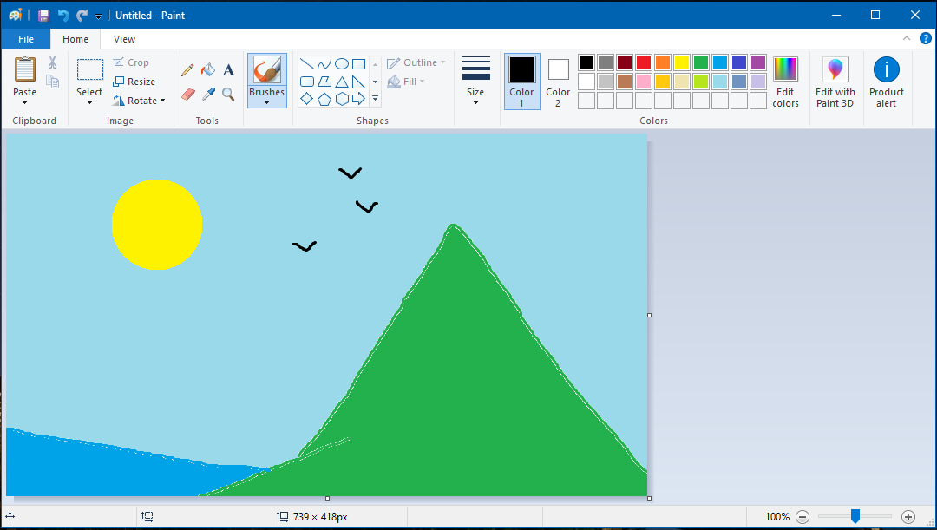
Representing Images

Slide 13
How does a computer show its contents in a monitor?

Slide 14
Basic mechanism of monitor
A monitor contains a lot of small blocks named pixels (picture elements)
Each pixel is illuminated with some color
The pixels are so small that we cannot separate it from the others
How many pixels are there in the projector screen?
Hint: What is the resolution of the screen?

Slide 15
Drawing an image

Slide 16
How to represent color?

Slide 17
Coloring a pixel
Remember physics class?
Colors
Basic colors
How many basic colors?
Every pixel has three color components – Red, Green and Blue
1 byte space for each color – 3 bytes for each pixel
These colors are mixed to get all the colors
24 bit color scheme

Slide 18
Different colors
Color | R | G | B | Hex code
Red | 255 | 0 | 0 | #ff0000
Blue | 0 | 0 | 255 | #0000ff
Green | 0 | 255 | 0 | #00ff00
Yellow | 0 | 255 | 255 | #00ffff
Pink | 255 | 0 | 255 | #ff00ff
Purple | 138 | 43 | 226 | #8a2be2
Black | 0 | 0 | 0 | #000000
White | 255 | 255 | 255 | #ffffff

Slide 19
Hex code
RGB(138, 43, 226)
Convert to Hexadecimal
8a
2b
e2
Hex code: #8a2be2

Slide 20
Size of an image file
Image file resolution: 24x10
File size = ?

Slide 21
Size of an image file
Image resolution = 24x10
Total number of pixels = 240
3 bytes for each pixel
Total size = 240x3 = 720B

Slide 22
Try yourself
What is the size of an image file of resolution 1000x800?

Slide 23
Try yourself
An image file contains the flag of Bangladesh. If its width is 1500 pixels, what is the size of the file?

