Slide 1
How Internet Works
CSE 1110 – Introduction to Computer Systems
Course teacher: Mohmmad Ali

Slide 2
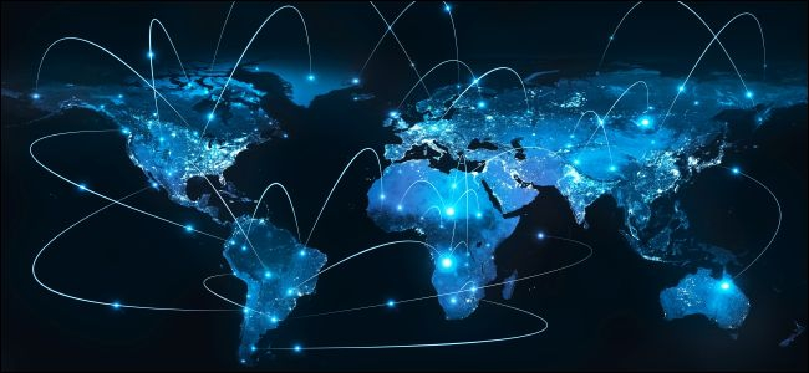
The biggest network

Slide 3
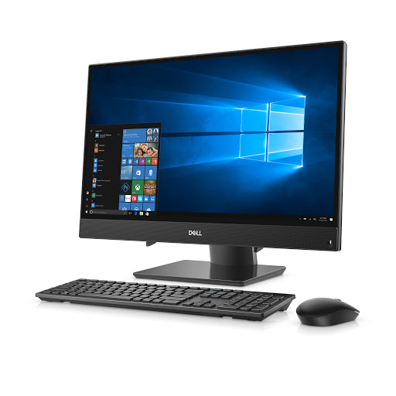
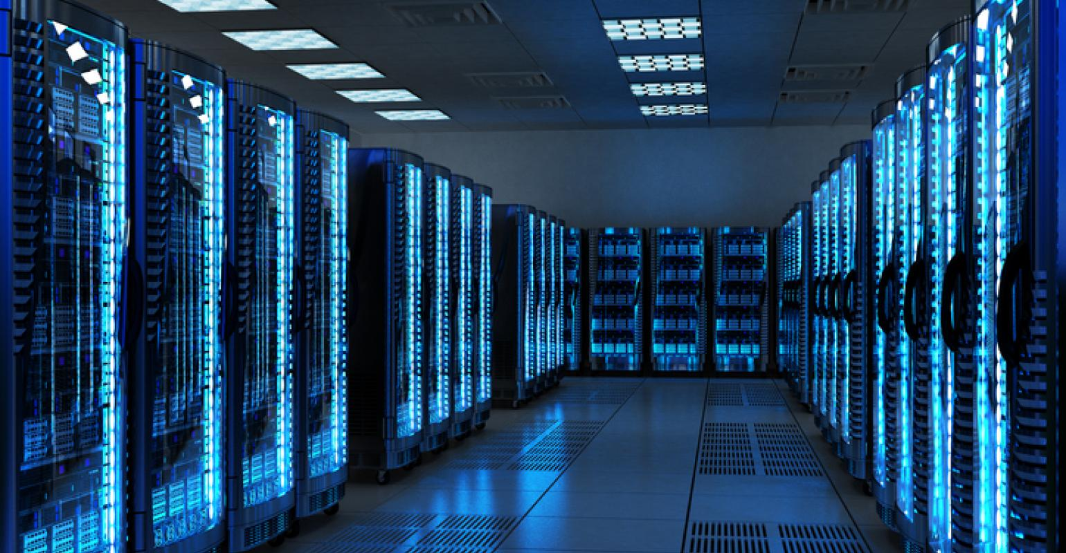
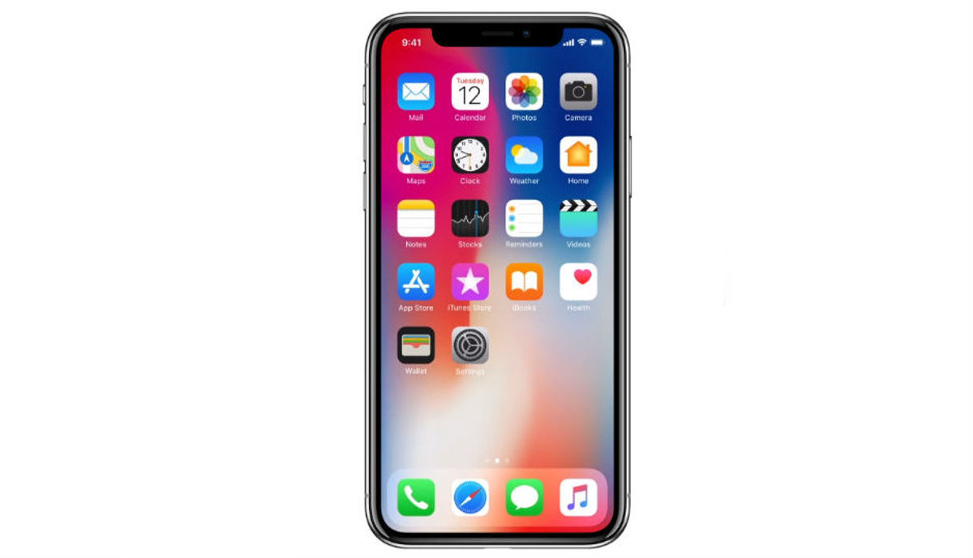
Connects all these

Slide 4
How internet works
All computers, smartphones, servers etc. are connected to this network
This network contains different types of links
Wired link
Wireless link
Optical fiber link
Satellite link

Slide 5
How internet works
When you enter “www.facebook.com” in your browser, you are requesting Facebook to show you your homepage
This request travels from your PC/phone, over the internet, to Facebook’s server
Facebook processes this request, gathers data, and sends you the reply over the internet

Slide 6
How internet works
Your request
Facebook’s response

Slide 7

Networking devices
Internet is a complex network, containing many paths
Networking devices in the internet determine which way to go to find Facebook’s server
Like railway junctions!!!
Example networking devices: switches, routers

Slide 8
IP addresses
Every single entity in the internet has a unique address called the IP address
Sample IP address: 192.178.54.15
The Facebook homepage request is sent from your PC/phone to Facebook’s IP address
Facebook’s response is sent to your PC/phone’s IP address

Slide 9
Quick quiz: What is the IP address of facebook.com?
I don’t know either :P

Slide 10
Domain Name Server (DNS)
When you enter “www.facebook.com” in your browser, the first request goes to a Domain Name Server (DNS)
In response, DNS sends your browser the IP address of Facebook’s server
Now the browser knows where to send your request
How do you know the IP address of a DNS server?
Provided by your ISP

Slide 11
Domain Name Server (DNS)
Website | IP address*
… | …
facebook.com | 234.123.46.159
google.com | 159.147.201.4
uiu.ac.bd | 124.128.185.24
… | …
DNS works like a telephone directory
*These IP addresses are imaginary, and possibly do not represent any real website

Slide 12


1. What is Facebook’s IP address?
Internet
2. Facebook’s IP address is ***.***.***.***
DNS
You
3. Send me my homepage
4. Here is your homepage
Facebook

