Slide 1
Image Acquisition & Mounting

Slide 2
Image Acquisition

Slide 3
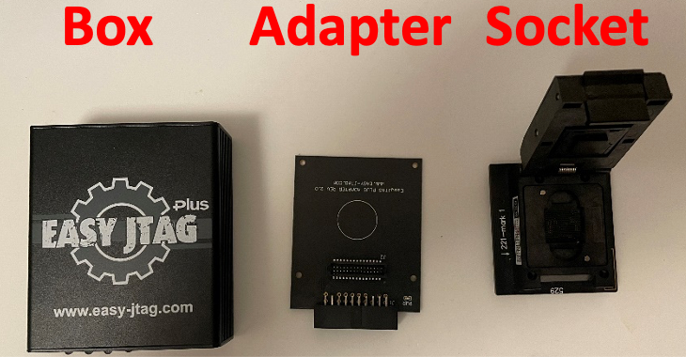
Image Acquisition Steps
Place the eMMC in the socket
Connect the socket to adapter on BGA 153 slot
Connect adapter to the box
Plug the box cable to laptop’s USB port
Open Easy JTAG Tool on computer

Slide 4
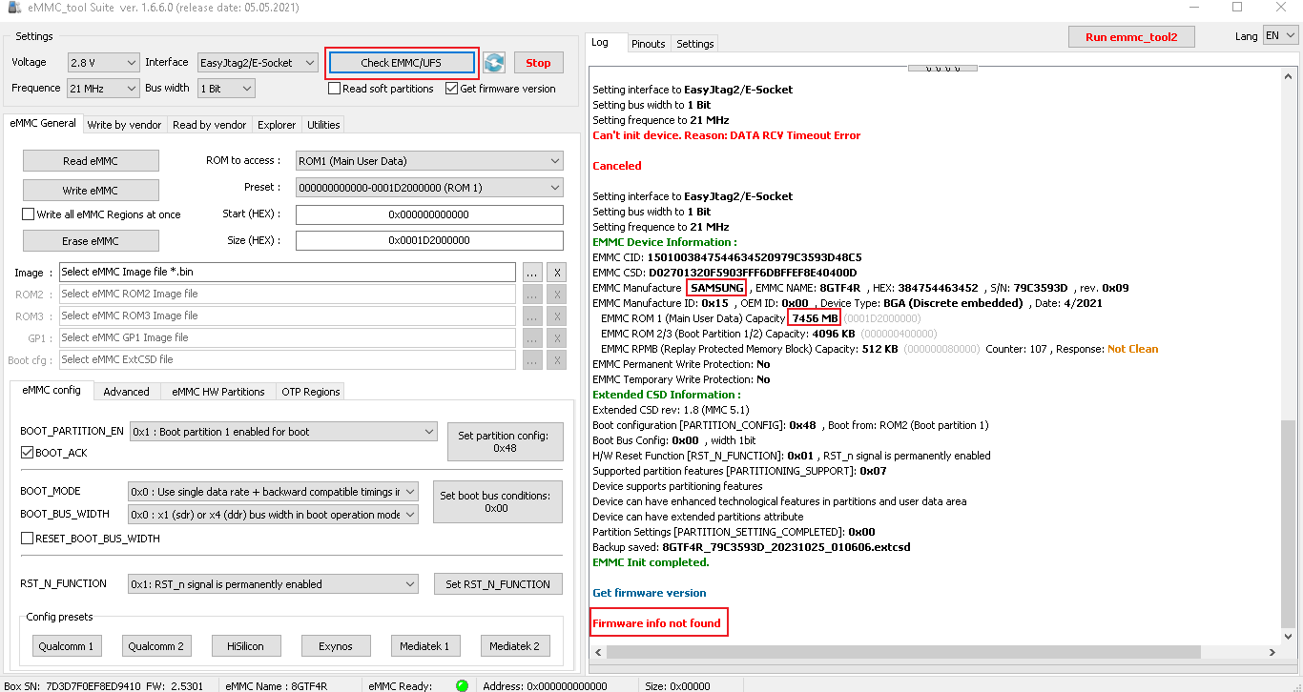
1. Click to check eMMC
eMMC is not readable
Probably needs cleaning
To remove glue on pins

Slide 5
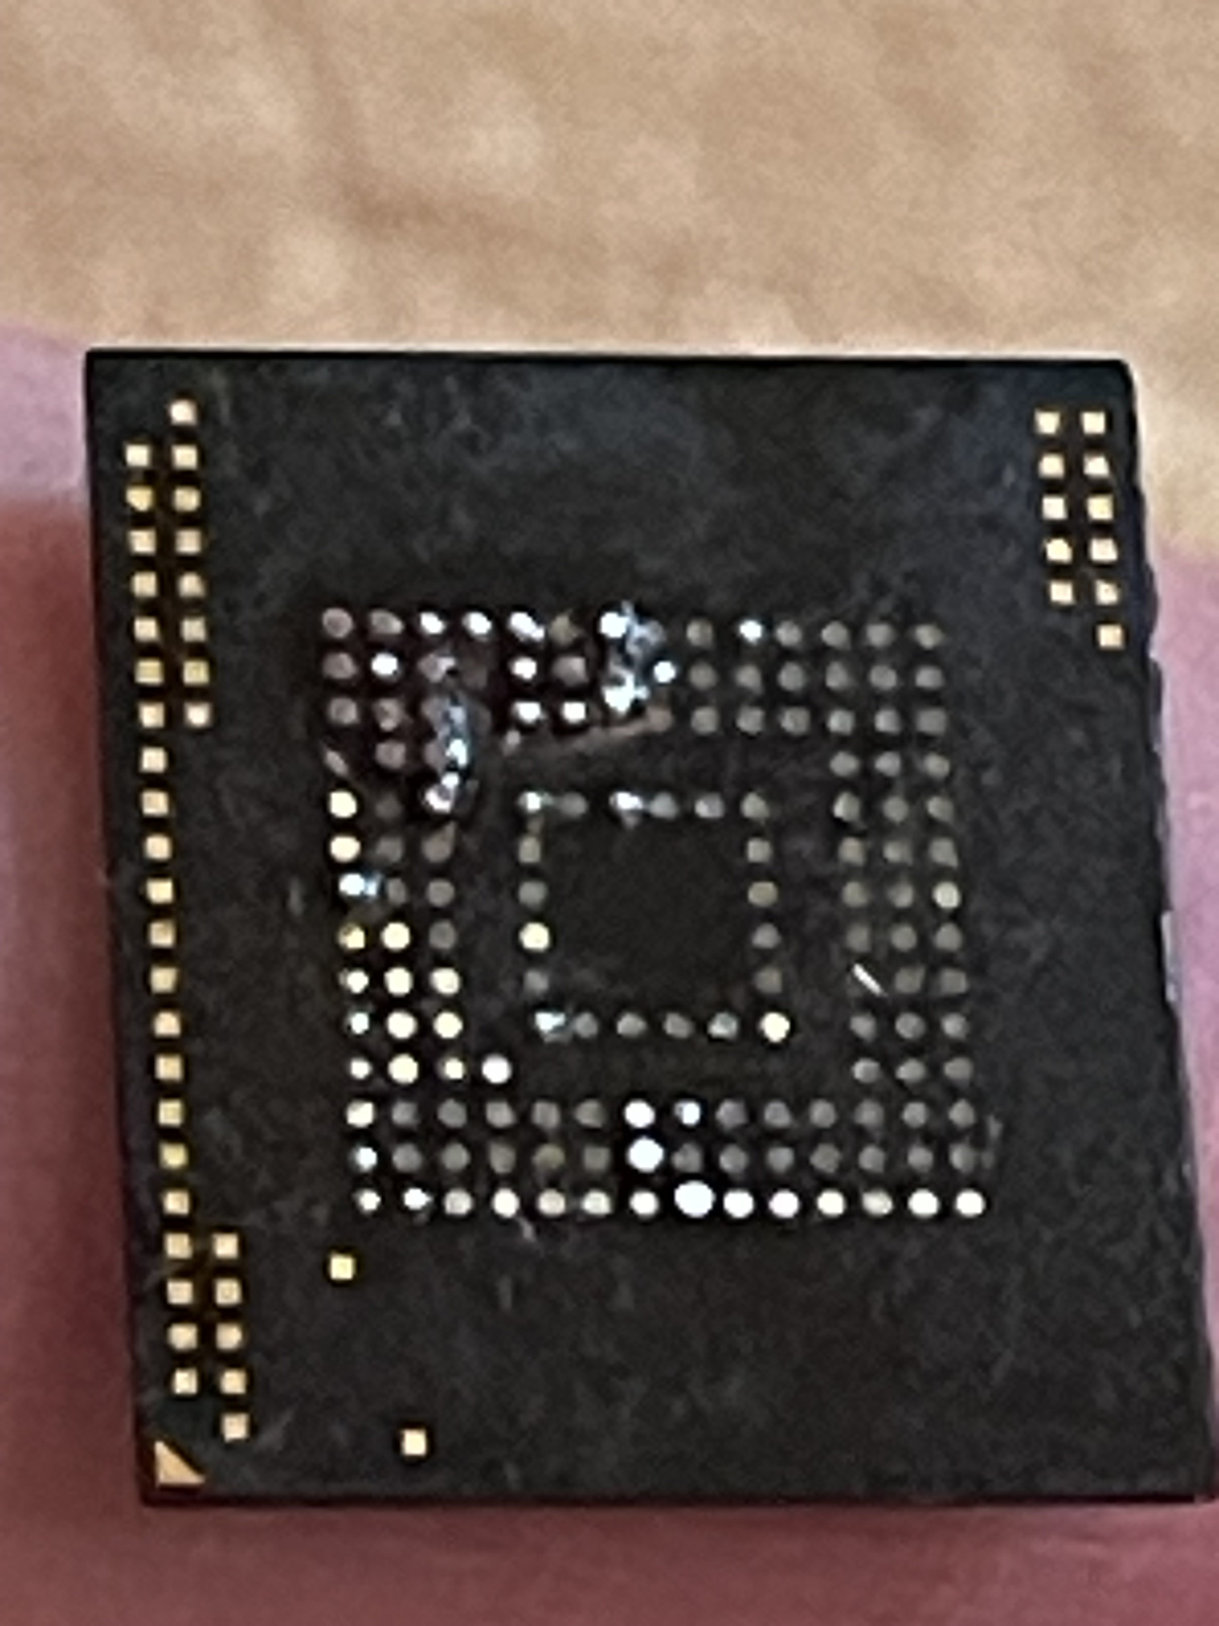
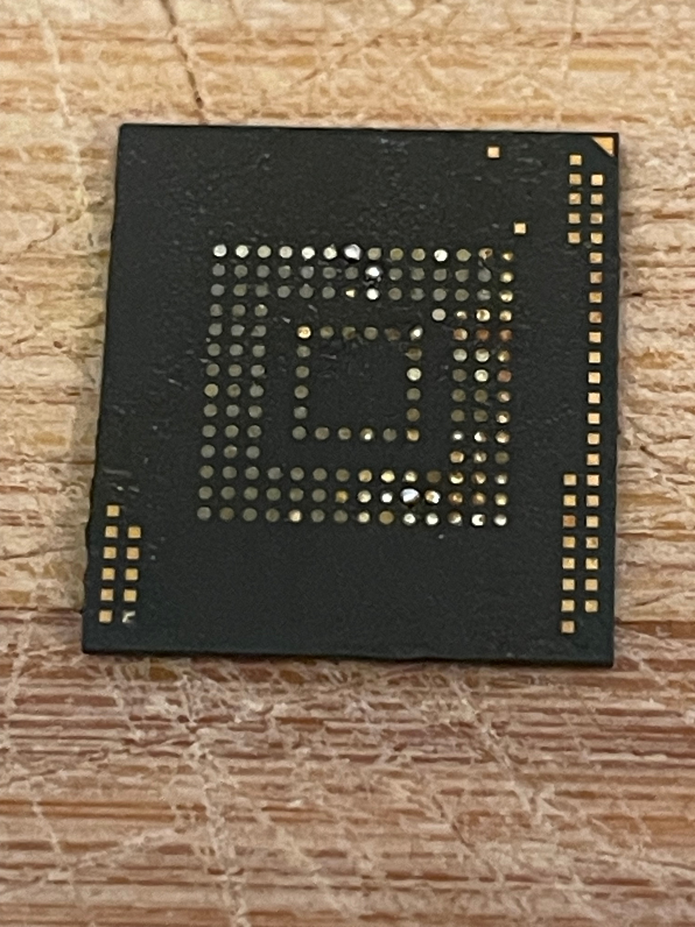
eMMC Needs Cleaning
Pins on eMMC are not readable due to glue so needs cleaning
Apply flux and clean with solder iron at 200 Celsius
After
Cleaning

Slide 6
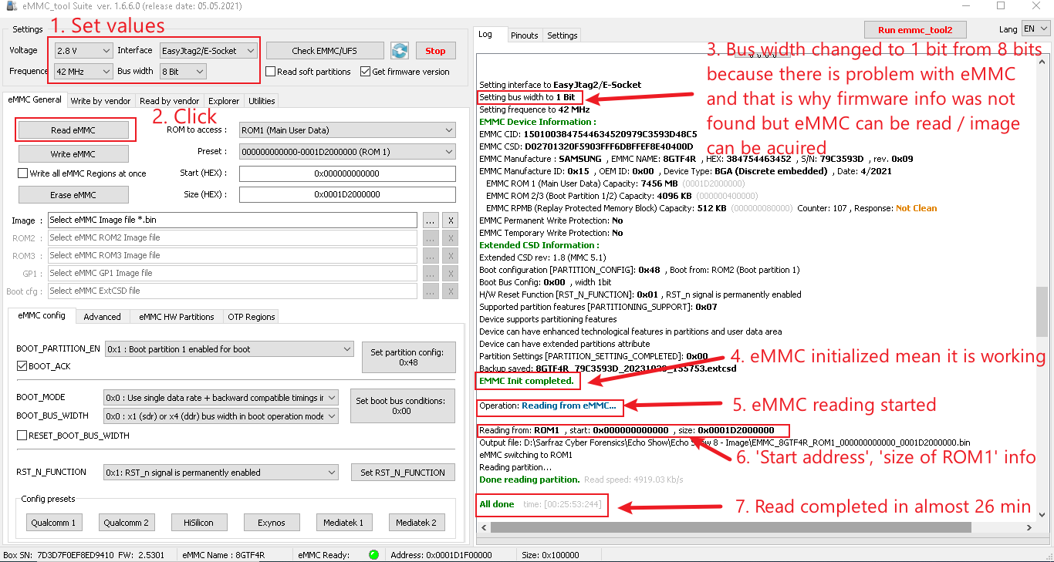
Image Acquisition After Cleaning
Image Acquisition from Device eMMC using East JTAG
Follow the steps to acquire a disk image of eMMC of the Echo Show device

Slide 7
Image Downloading

Slide 8
Download Image from Link (Archived/Zipped)
The acquired image has been uploaded to the cloud
The image can be downloaded from the following link:
https://miya.teracloud.jp/share/11d1e631cf6f8456

Slide 9
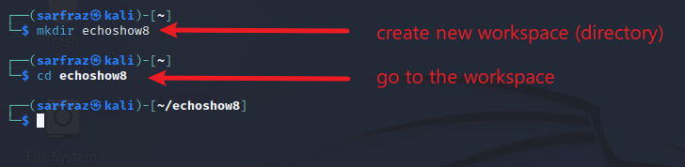
Create Workspace
Create workspace / new directory
List the downloaded file
The location of the image file can be different in your case
In this case, the image file is on the host computer & being accessed on the VM through a shared folder

Slide 10
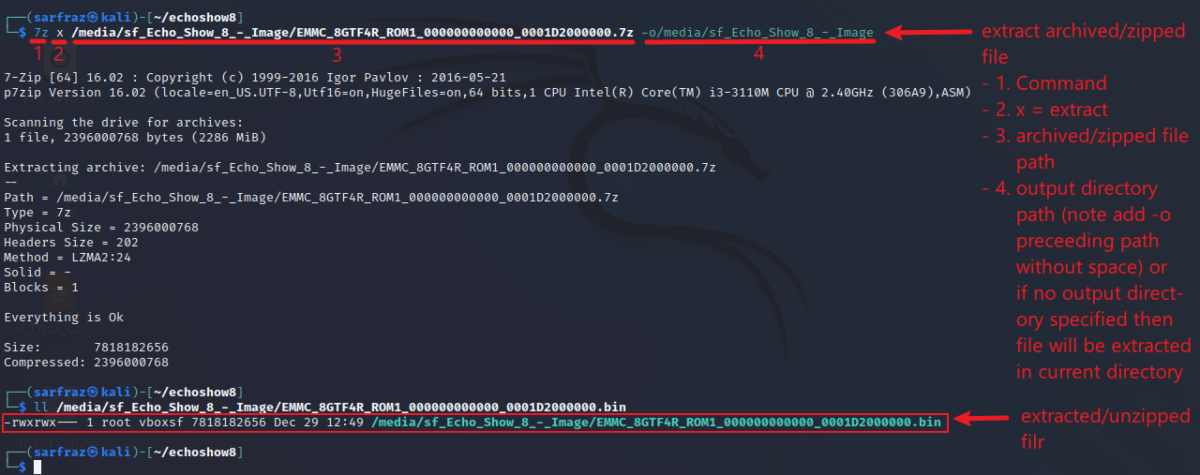
Unzip the file
Extract/Unzip the file

Slide 11
Image Verification

Slide 12
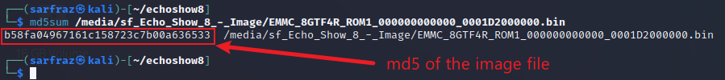
Image File Verification
Verification of file hash (checking file integrity)
The MD5 of the original image file is b58fa04967161c158723c7b00a636533
The calculated md5 of the downloaded image should match

Slide 13
Image Mounting

Slide 14
Block and Loop Devices
Block Device
A storage device that supports reading and writing data in fixed-size blocks.
These blocks are typically 512 bytes or larger.
Examples: Hard drives, SSDs, USB drives, and disk images.
Loop Device
A pseudo-device that makes a file accessible as a block device.
In simpler terms, it allows a file (such as a disk image) to be treated as a block device.
Loop devices are often used for mounting disk images, allowing the system to interact with the contents of the file as if it were a physical disk.

Slide 15
The Mounting Process Explained
Disk images are essentially files that contain a representation of an entire file system.
However, the OS treats them as regular files initially.
To interact with this file system within the disk image, it must be associated with a block device.
Loop devices acts as the bridge between the file system in the disk image and the OS.
By setting up the disk image as a loop device, the OS can treat it as if it were a physical device.
Thus, mount disk image to a directory and access its contents as if it were a separate disk.

Slide 16
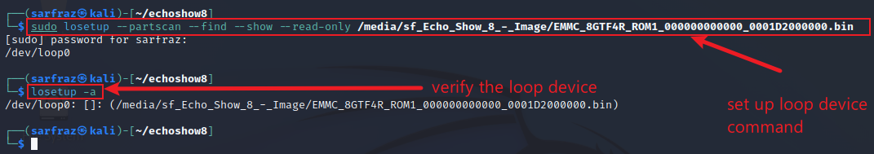
Setup Loop Device
Create mount point, setup loop device & verify loop device
The loop device has been set up at loop0
sudo: root privilege
losetup: Command to set up loop devices.
--partscan: This option tells losetup to scan partitions on the device.
--find: This option instructs losetup to find the first available loop device automatically.
--show: This option makes losetup display the name of the loop device it finds.
--read-only: This option sets up the loop device as read-only.

Slide 17
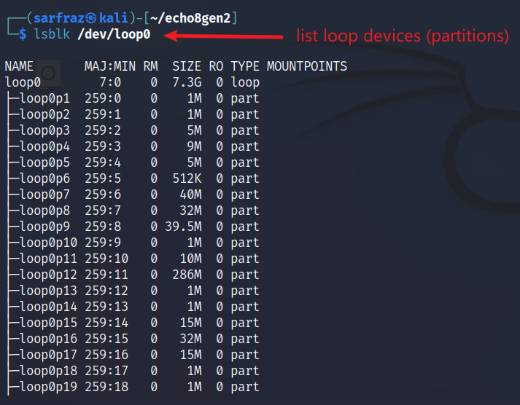

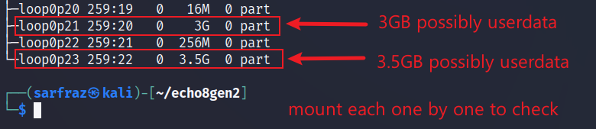
Check Partition Numbers of Block Devices
List block devices

Slide 18
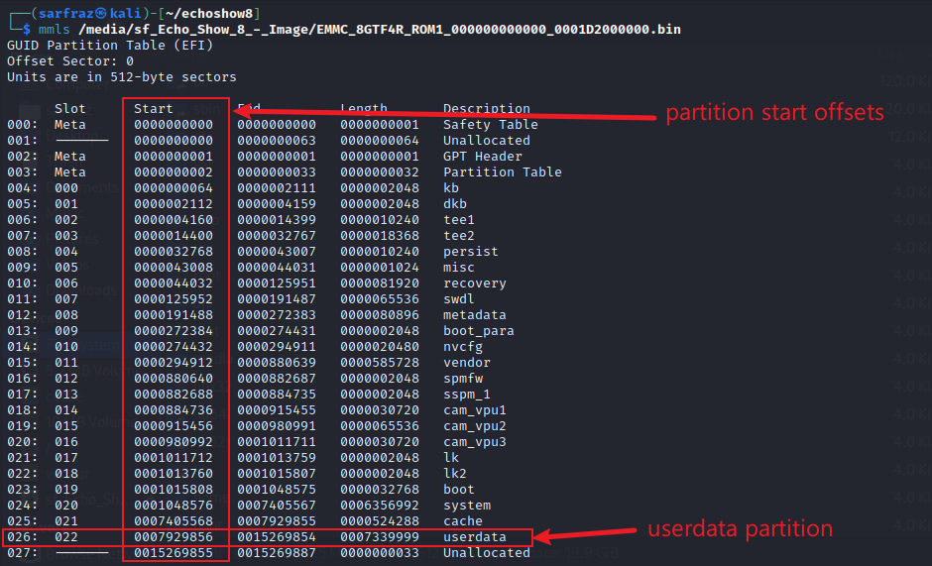
Check Partitions Layout of Image
List partitions of Image
(mmls (lsblk (Partition
output) output) Name)
020 p21 System Partition
022 p23 Userdata Partition

Slide 19
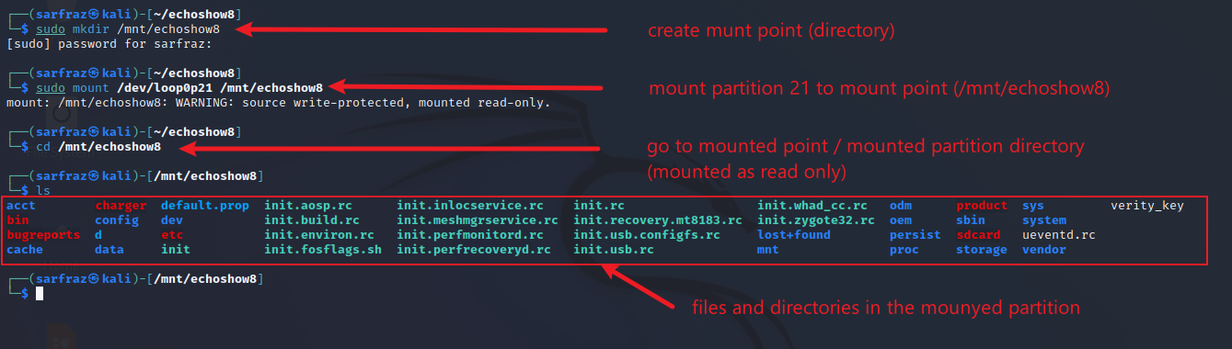
Mount System Partition (p21)
Mount loop device, go to mount point

Slide 20
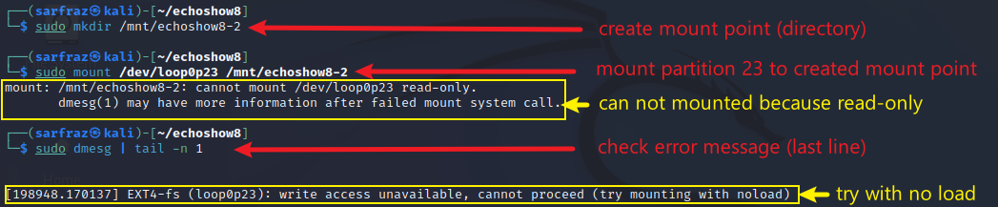
Mount Userdata Partition (p23)
Mount loop device, go to mount point
The noload option refers to a mount option that prevents the kernel from loading the journal of the file system.
The journal (in file systems such as ext3 and ext4) keeps track of changes to the file system for faster recovery in case of a system crash or unexpected shutdown.
Using noload is necessary when dealing with forensic analysis where you want to examine the file system without making any modifications.

Slide 21
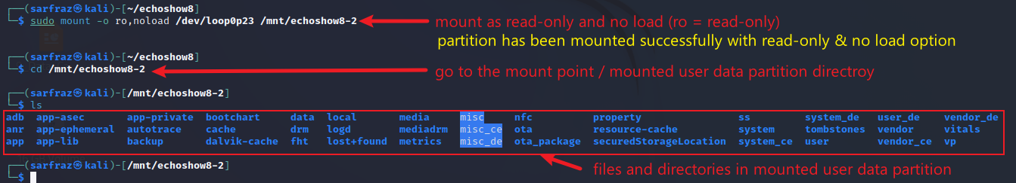
Mount Userdata Partition (p23)
Mount loop device, go to mount point

