Slide 1
GALE@SLU
Math & Science with Adruino
Dr. Lady – Gifted Education Specialist / Leadership Consultant
Mr. Snyder – Degrees in Engineering & Mathematics from Notre Dame; First Robotics FTC Mentor (LHS); First Robotics FLL Mentor (CMS); First Robotics Head Mentor: Cyber Ducks

Slide 2
func sieve( var N ) var PrimeArray as array of size N initialize PrimeArray to all true for i from 2 to N for each j where i divides j, j from i + 1 to N set PrimeArray( j ) = false PrimeArray(x) is true if x is a prime number.

Slide 3
int lightPin = 0;
int ledPin = 9
void loop()
{
int lightLevel = analogRead(lightPin);
lightLevel = map(lightLevel, 0, 900, 0, 255);
lightLevel = constrain(lightLevel, 0, 255 analogWrite(ledPin, lightLevel);
}

Slide 4
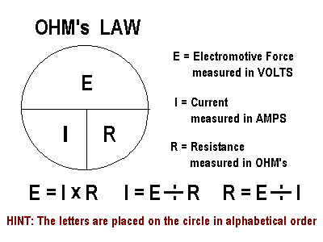
http://phet.colorado.edu/sims/ohms-law/ohms-law_en.html

Slide 5
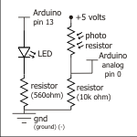

Slide 7
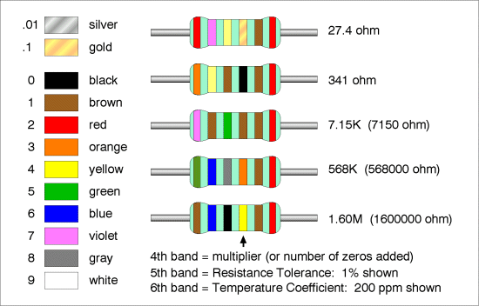

Slide 8
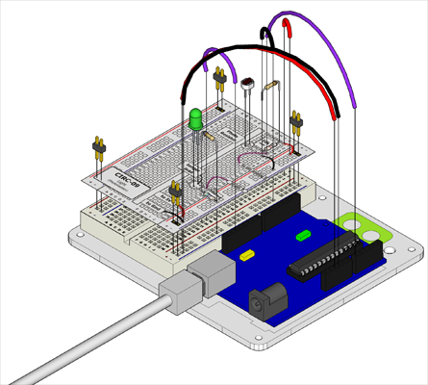
http://www.oomlout.com/oom.php/products/ardx/circ-09

