Slide 1
BRAIN STROKE PREDICTION
MINI PROJECT
REGULAVALASA TEJASWI : 19331A05E2.
BHASKARA RAO LINGALA : 20331A0518.
CHERUKURI.ASHIK : 20331A0534.
CH. AMMI REDDY : 20331A0542.

Slide 2
PROBLEM STATEMENT:
Using Machine learning algorithms be used to accurately predict the likelihood of an individual experiencing a stroke based on their demographic information, lifestyle habits, medical history, and other risk factors.

Slide 3
ABSTRACT:
Brain stroke can damage a person's ability to move, think, see, or communicate etc.
Suffering from brain stroke has been rapidly increasing due to excessive smoking, high blood pressure, high cholesterol and cardiovascular diseases.
Prediction of brain stroke at preliminary stage is important for better treatment.
It is more useful to the Health Department and also the medical expert system used in remote areas.
A brain stroke is a condition that causes brain injury by blocking off blood flow to the brain.
The main objective of this work is to use classification algorithms like Decision Tree, Naïve Bayes, Artificial Neural Networks to determine whether or not a person is at risk of having a brain stroke.

Slide 4
INTRODUCTION:
The brain is the most complex part of the human body. This three-pound organ is the seat of intelligence, interpreter of the senses, initiator of body movement, and controller of behavior.
Stroke is a major worldwide health issue and a leading cause of death and morbidity in affluent countries, as well as in poor and middle-income countries.
Brain Stroke is a non-communicable infection that is liable for around 11% of total deaths. Brain Stroke is the fourth significant reason for death in India.
For each decade of life after age 55, your chance of having a stroke more than double. There are two sub-types of brain stroke disease, namely ischemic stroke and hemorrhage stroke.
Ischemic stroke is generally caused by a blockage in a blood vessel. While hemorrhage stroke is caused by bleeding in brain tissue.

Slide 5
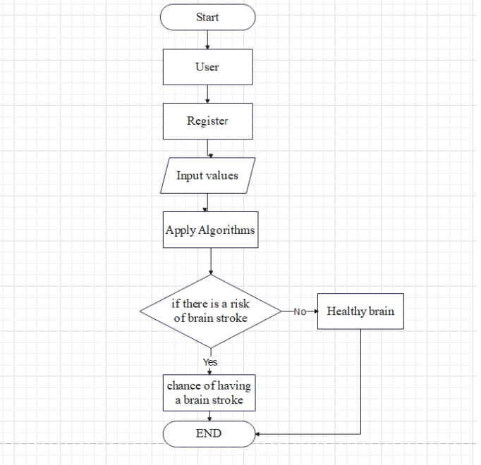
FLOWCHART DIAGRAM:

Slide 6
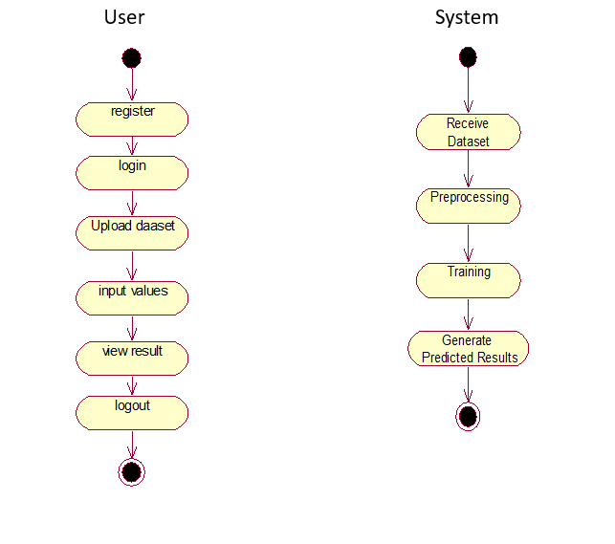
ACTIVITY DIAGRAM:

Slide 7
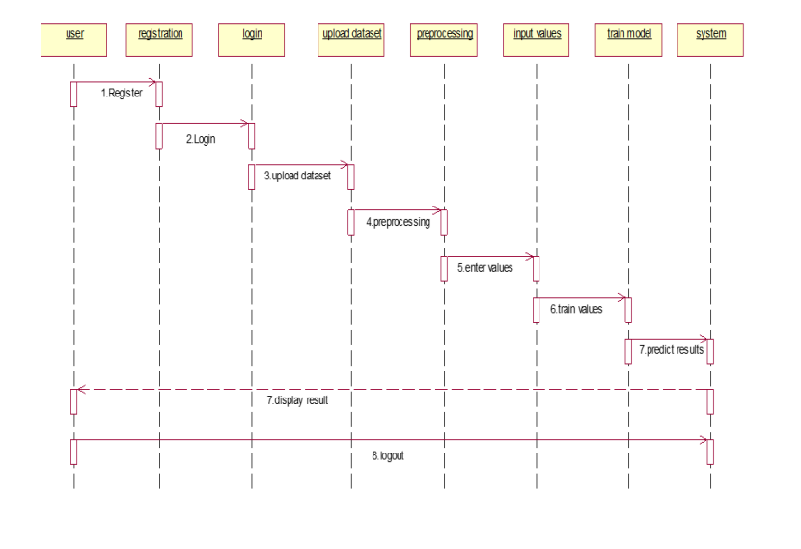
SEQUENCE DIAGRAM:

Slide 8
METHODOLOGY:
The following machine learning algorithms can be used :
GaussianNB
BernoulliNB
Logistic Regression
Random Forest Classifier
Support Vector Machine
Decision Tree Classifier
Kneighbors Classifier
Neural Nets
Gradient Boosting Classifier

Slide 9
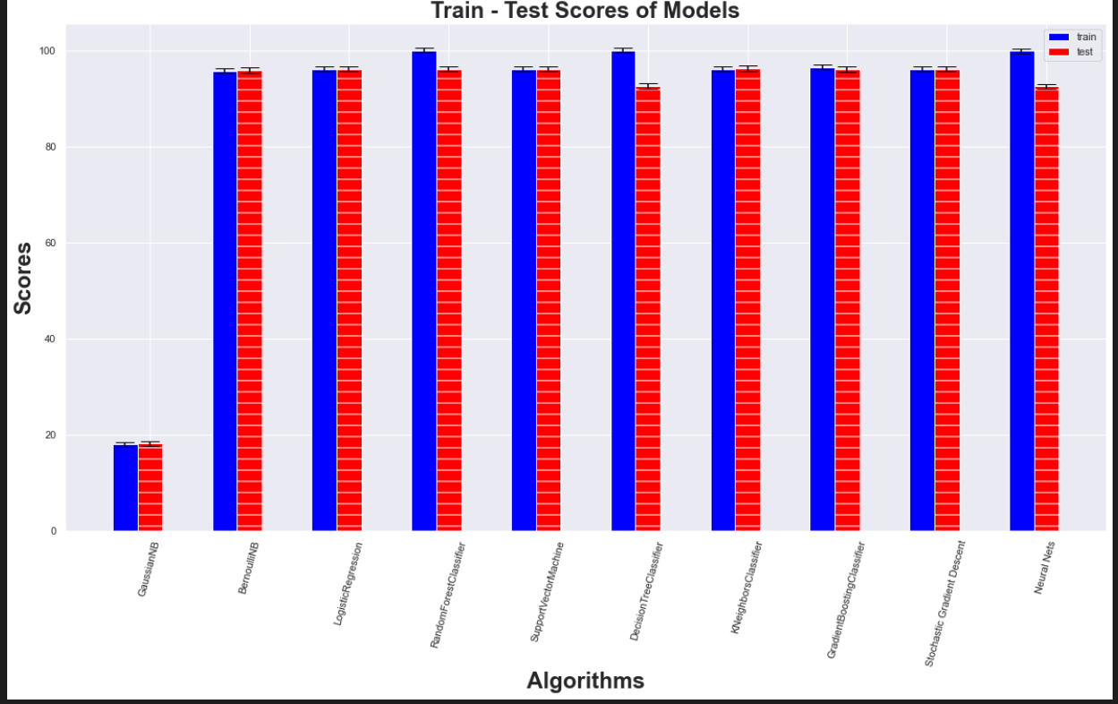

Slide 10
DECISION TREE ALGORITHM
Decision tree (DT) is a supervised learning technique. It is a tree-structured classifier, where internal nodes represent the features of a dataset, branches represent the decision rules and each leaf node represents the outcomes.
It is a graphical representation for getting all possible solutions to a problem/decision based on given conditions
Decision Node
Decision Node
Decision Node
Leaf Node
Leaf Node
Leaf Node
Decision Node

Slide 11
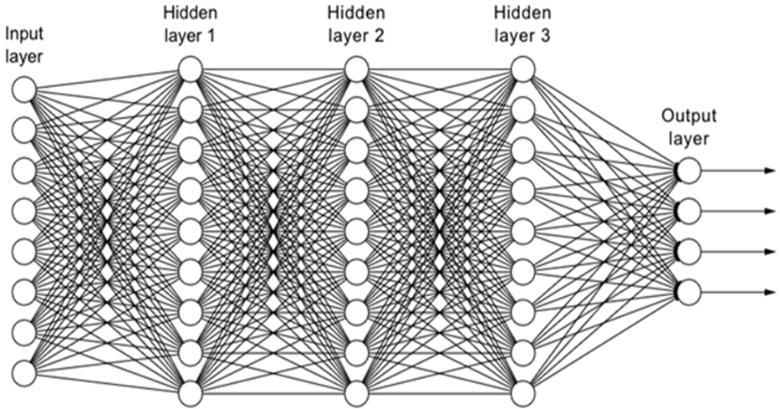
ARTIFICIAL NEURAL NETWORK
An Artificial Neural Network (ANN) is another tool used in machine learning. As its name suggests, ANN is a system inspired by the human brain system and replicates the learning system of the human brain.
Artificial neural networks are comprised of a node layers, containing an input layer, one or more hidden layers and an output layer.
The ANN uses a technique called back propagation to adjust the outcome with the expected result or class.

Slide 12
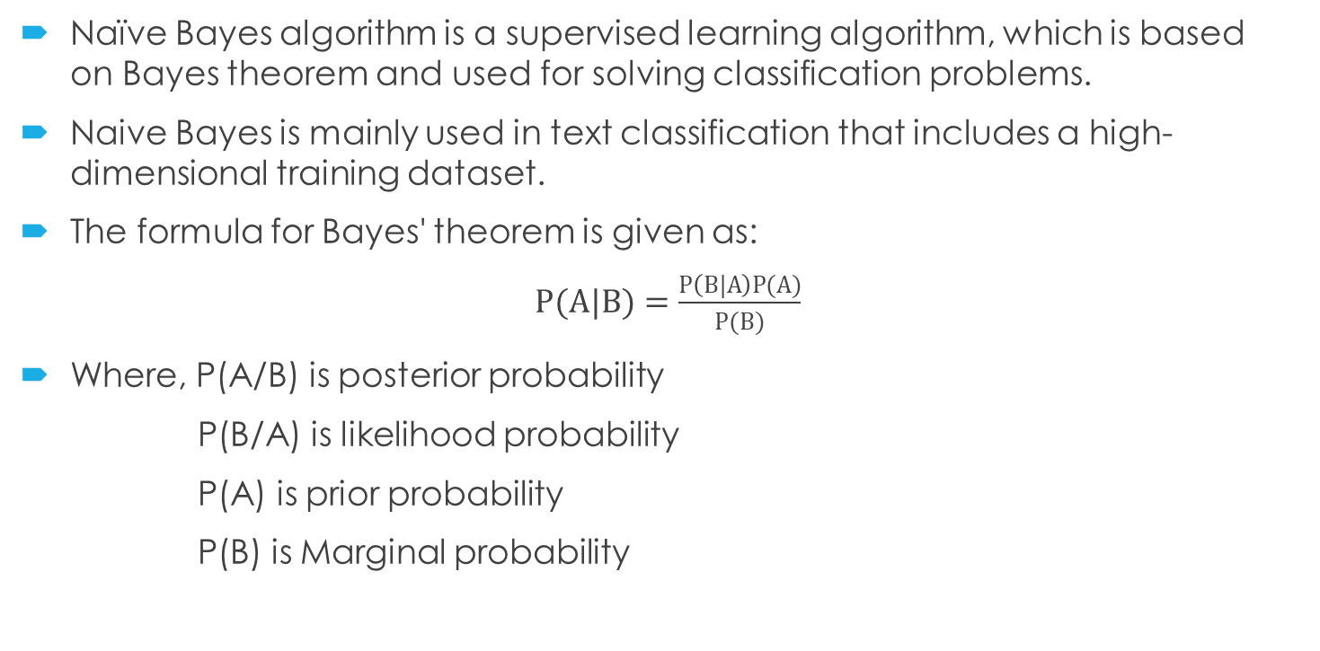
NAÏVE BAYES ALGORITHM
Naïve Bayes algorithm is a supervised learning algorithm, which is based on Bayes theorem and used for solving classification problems.
Naive Bayes is mainly used in text classification that includes a high-dimensional training dataset.
The formula for Bayes' theorem is given as:
$P(A|B)=\frac{P\left(B|A\right)P(A)}{P(B)}$
Where, P(A/B) is posterior probability
P(B/A) is likelihood probability
P(A) is prior probability
P(B) is Marginal probability

Slide 13
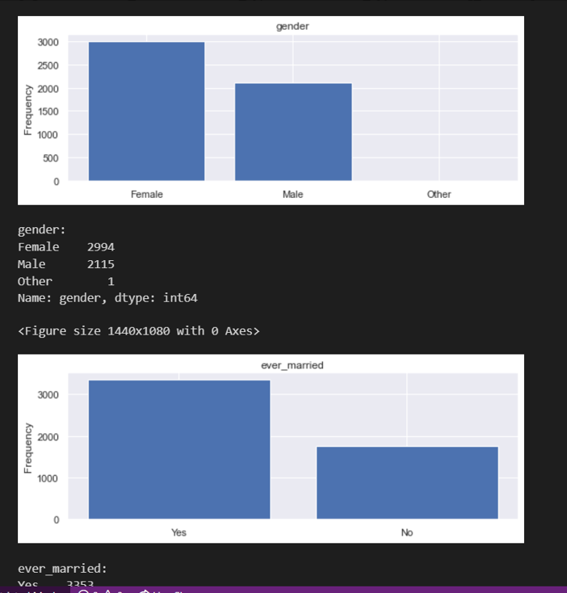
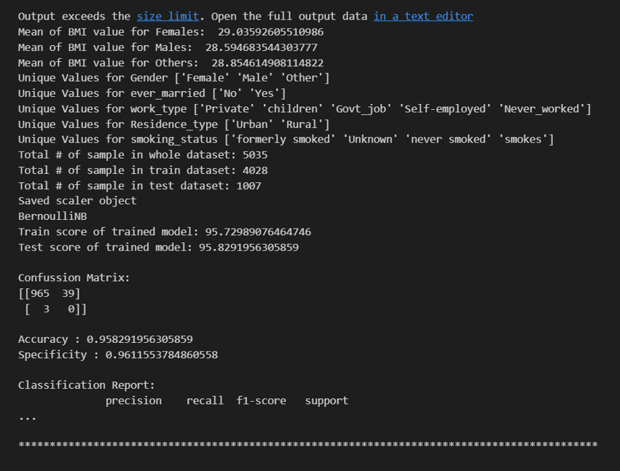
DATA TRAINING:

Slide 14
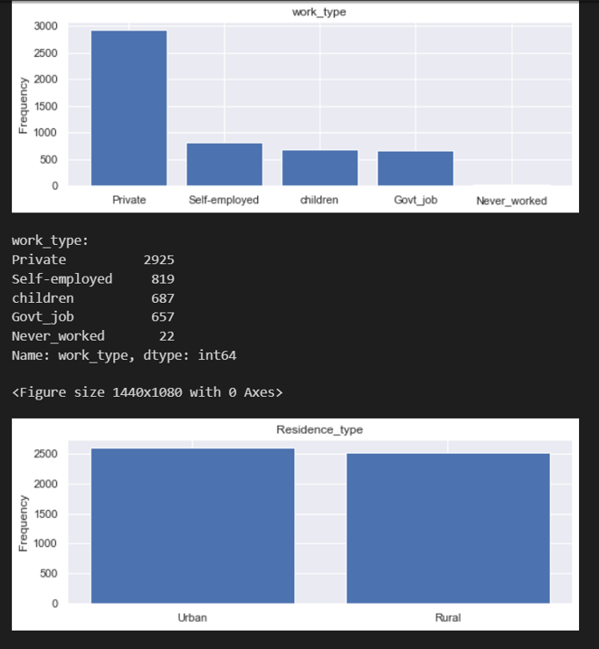
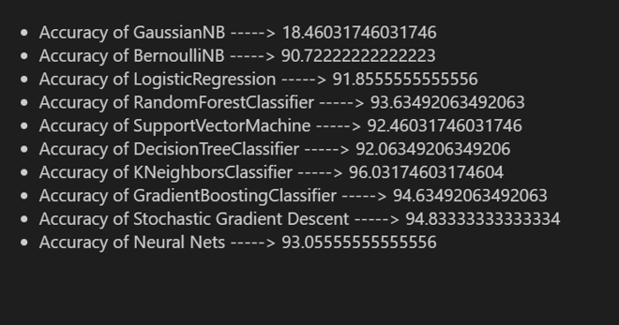

Slide 15
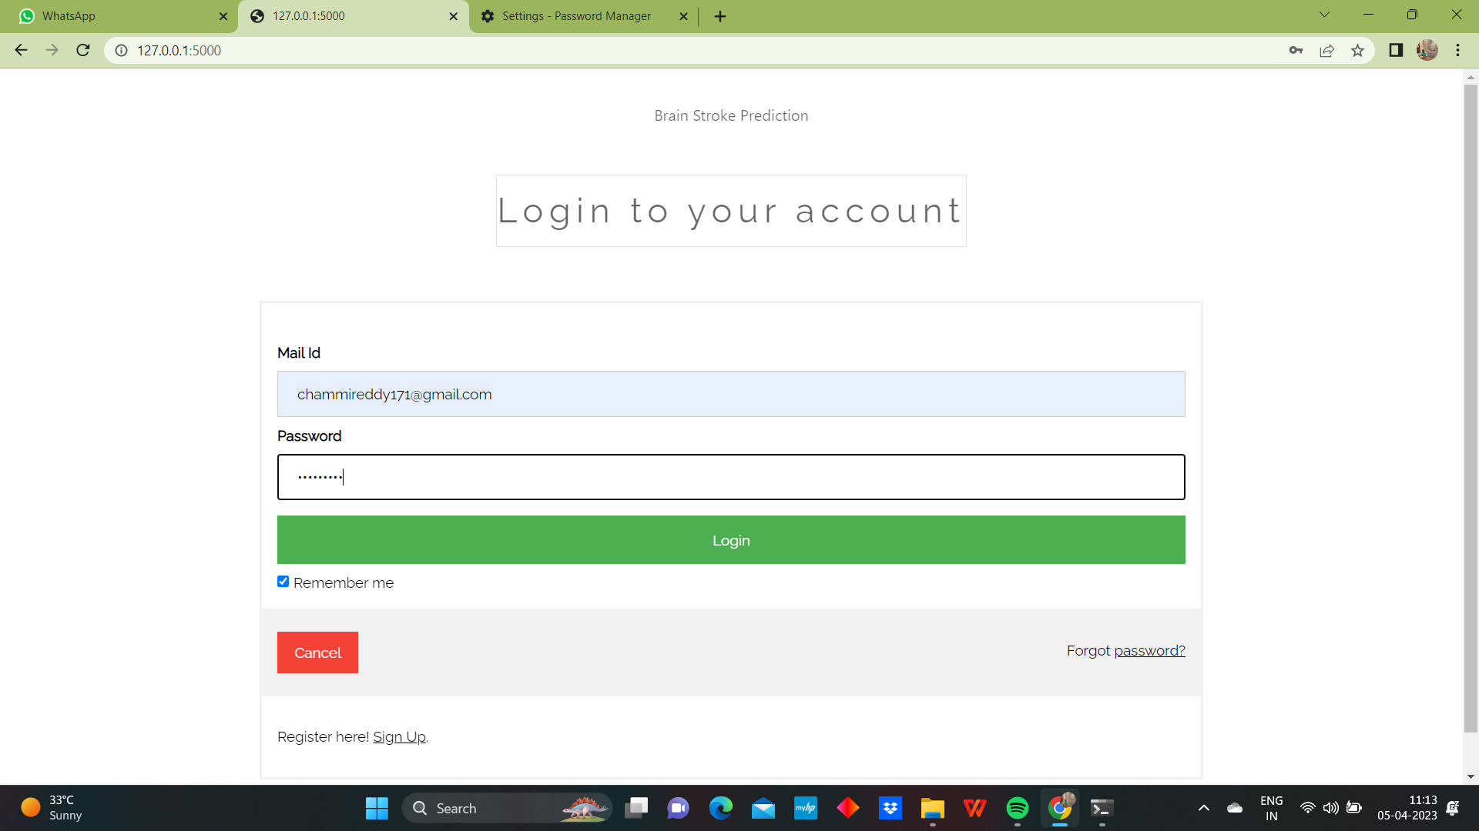
RESULTS LOGIN PAGE:

Slide 16
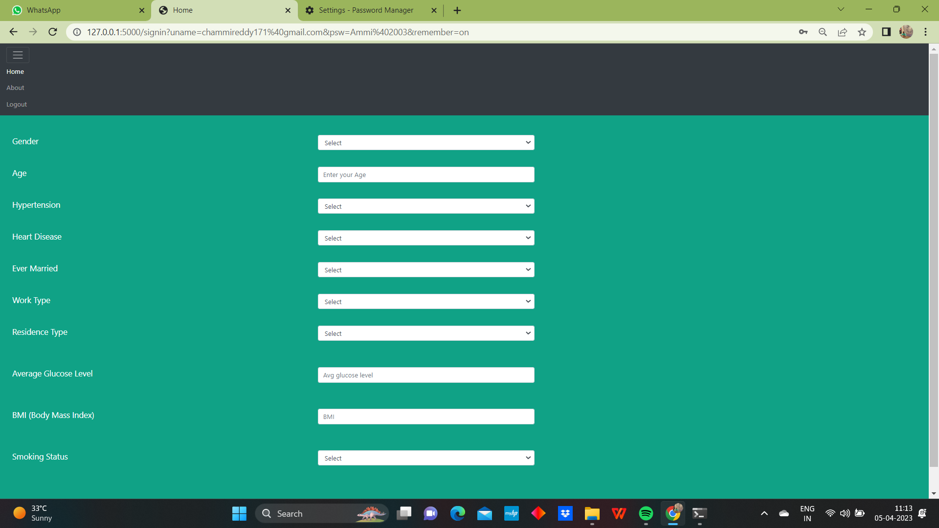
HOME PAGE:

Slide 17
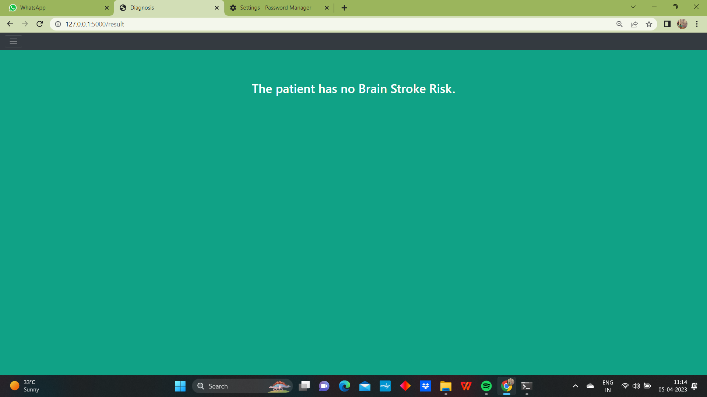
OUTPUT: IF PATIENT DOESN’T HAVE BRAIN STROKE

Slide 18
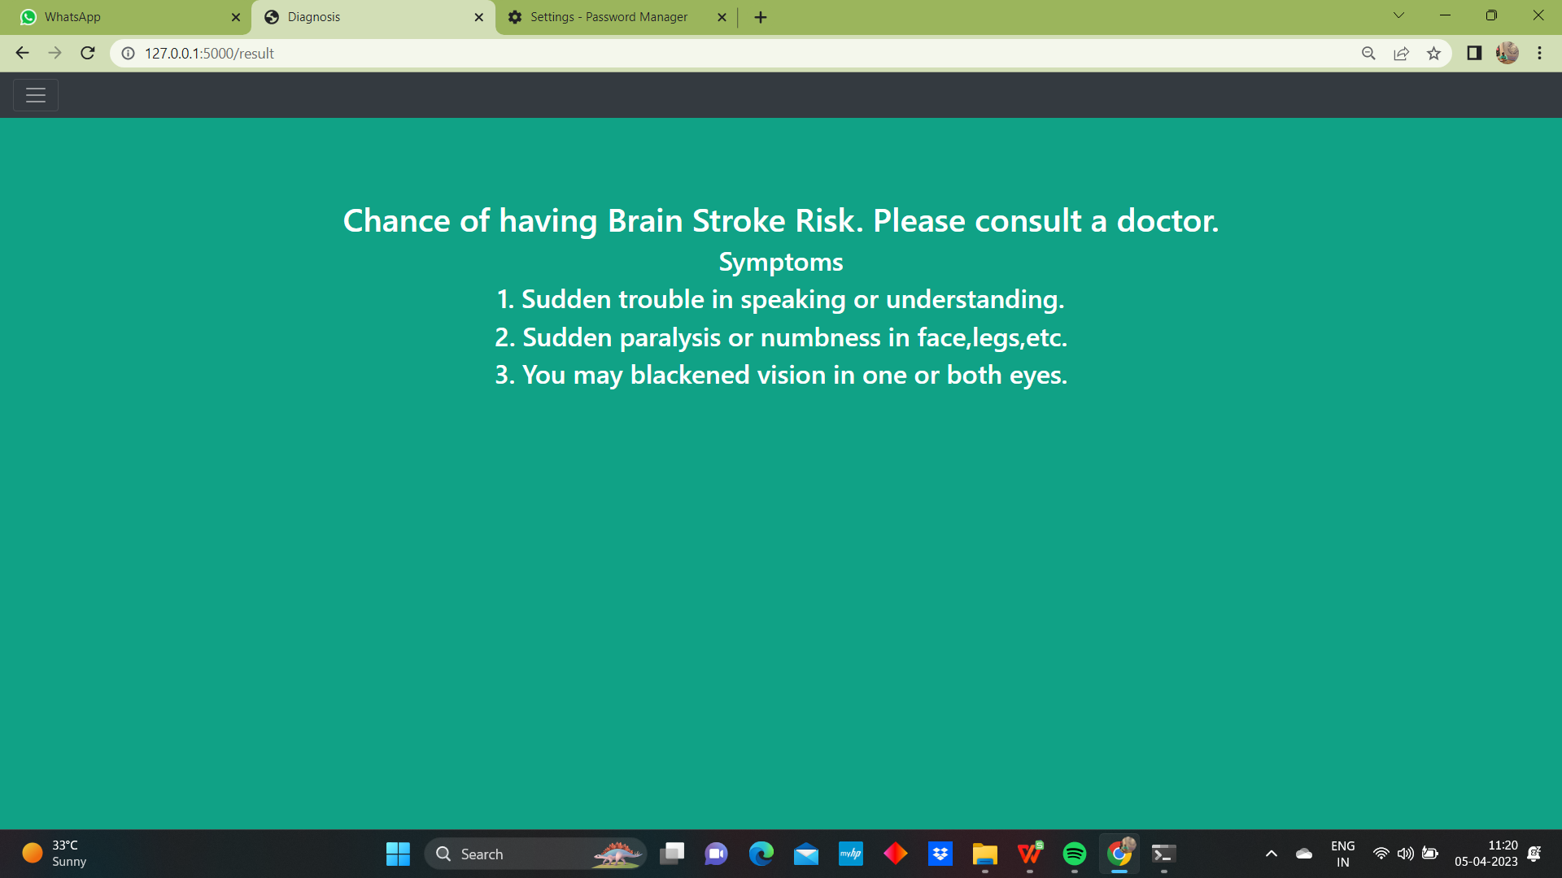
IF PATIENT HAVE BRAIN STROKE

Slide 19


