Slide 1


Open Source Project
Language C++, Python
GitHub Repository: https://github.com/kactus2/kactus2dev
OS: Linux, Windows, MAC OS
Enrico Ubaldino

Slide 2
What’s?
It is a set of tools for designing embedded products on FPGAs. The goal is to have a «neutral» tool to achieve easier reusability and integration of IP HW and SW.
The instrument is based on the IEEE 1685 IP-XACT standard.

Slide 3
IP-XACT
IP-XACT is an XML format, developed by the SPIRIT consortium and approved as IEEE1685 that describes Very-Large-Scale-Integration (VLSI) HW IP blocks to enable automated configuration and integration via tools.
IEEE 1685 "IP-XACT" standardizes component and design descriptions and the overall process. It is used as a standard to communicate with multiple suppliers because it is independent of the design language or tool used (precisely because it is XML and there are no predefined tags).
Notes:
Metadata: descrizione strutturale formale del componente indipendente dal fornitore del component

Slide 4
What you can do with Kactus2
Package IPs for reuse and exchange
Import your existing IPs as IP-XACT components
Create new IP-XACT components and generate their HDL module headers
Reuse IP-XACT files from any standard compatible vendor
Reuse the IPs in your designs and connect them with wires and busses
Create HW designs with hierarchy
Create multilevel hierarchies, where a design has multiple sub-designs
Configure component instances in designs, including the sub-designs
Use generator plugins to create HDL with wiring and parameterization
Integrate HW and SW
Use memory designer to preview memory maps and address spaces in your hierarchy
Package software to IP-XACT components and map them to hardware
Generate makefiles that build executables with rules defined in IP-XACT components.

Slide 5
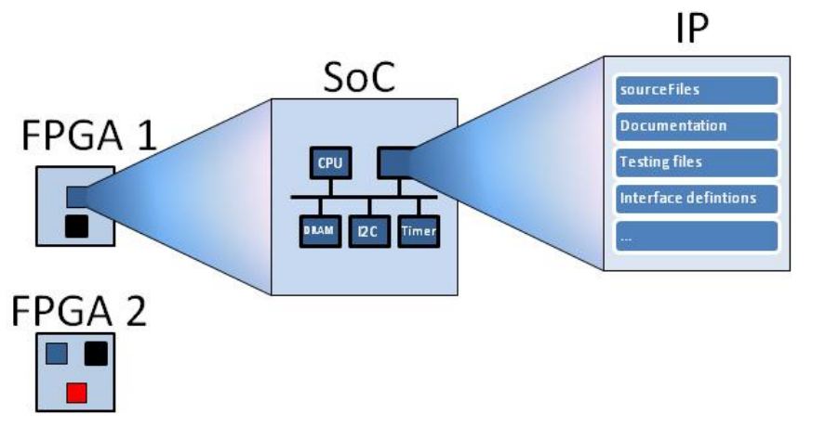
Why?
Today digital systems, also for the diffusion of SoCs, are increasingly large and complex consisting of several IP-Cores that are difficult to integrate and transportability because traditionally developed in different HDL description languages.
These HW-SW projects contain thousands of files that require adequate management to track changes and keep the code in a compile state.
Just consider that a change in one part of the code could damage others to understand that it is a necessary tool to manage dependencies between IP modules and to create new ones.
Notes:
La libreria può essere gestita meglio quando le dipendenze tra i blocchi IP sono documentate e in questo modo è possibile mostrare chiaramente agli utenti le dipendenze tra i componenti e come un singolo componente è costituito da sotto-componenti.

Slide 6
Standard
The standard includes 7 types of IP-XACT formats:
Component describes a single component in the library. For example the interfaces and files for the component are listed here;
Design contains a hierarchical design which consists of the components instantiated in this design. It is a kind of textual block diagram of the system;
Design configuration defines the configurations used in a hierarchical design;
Bus definition contains the general information of a hardware bus;
Abstraction definition defines the logical signals and attributes of a hardware bus;
Generator chain defines a group of scripts that can be used e.g. for automatic configuration of a component;
Abstractor is used to combine designs from different abstraction levels.

Slide 7
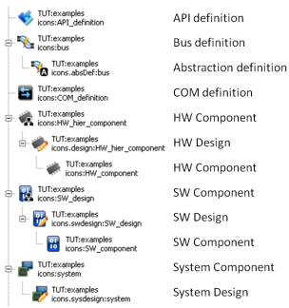
VLNV-identifier
Each document creates individual objects in the library. Each object can be uniquely identified by the VLNV identifier formed by the tuple: {Vendor, Library, Name and Version}.

Slide 8
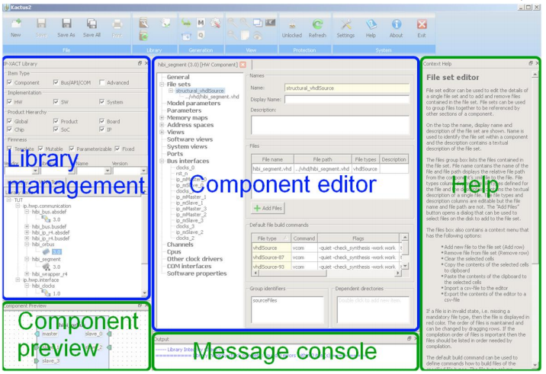
Kactus2 tool

Slide 9
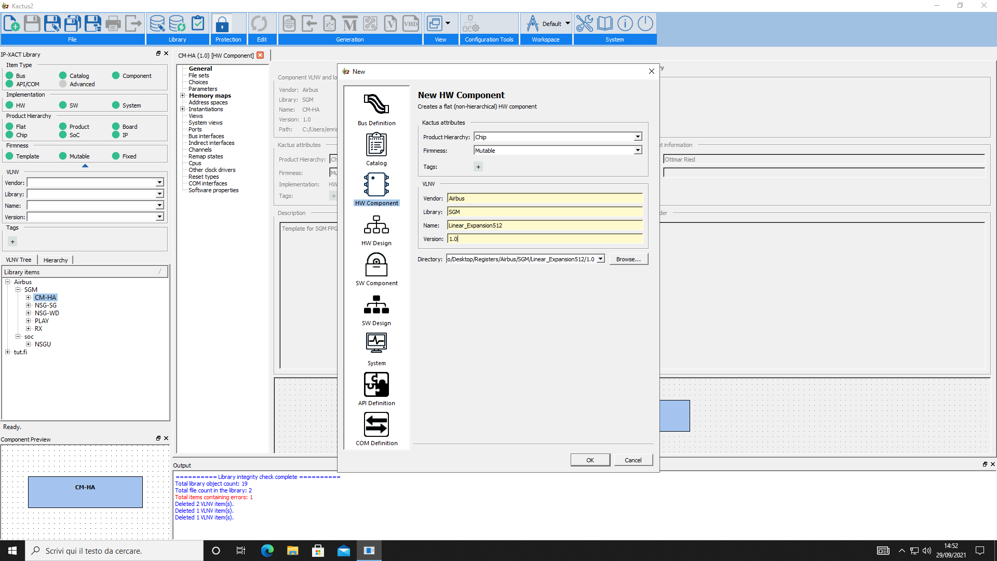
Create HW Component

Slide 10
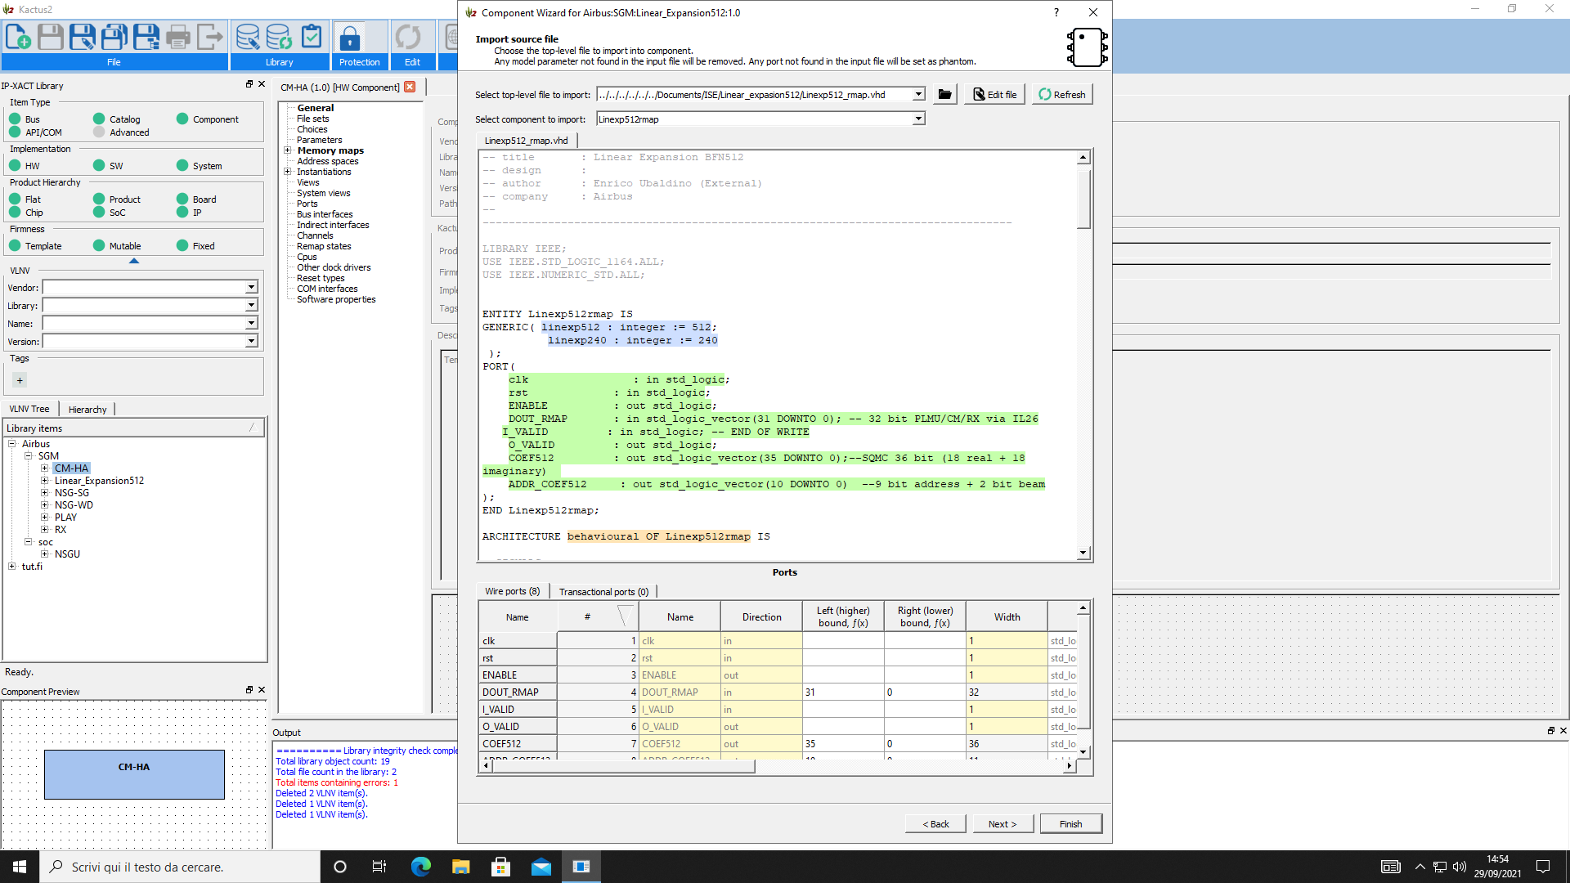
Create HW Component

Slide 11
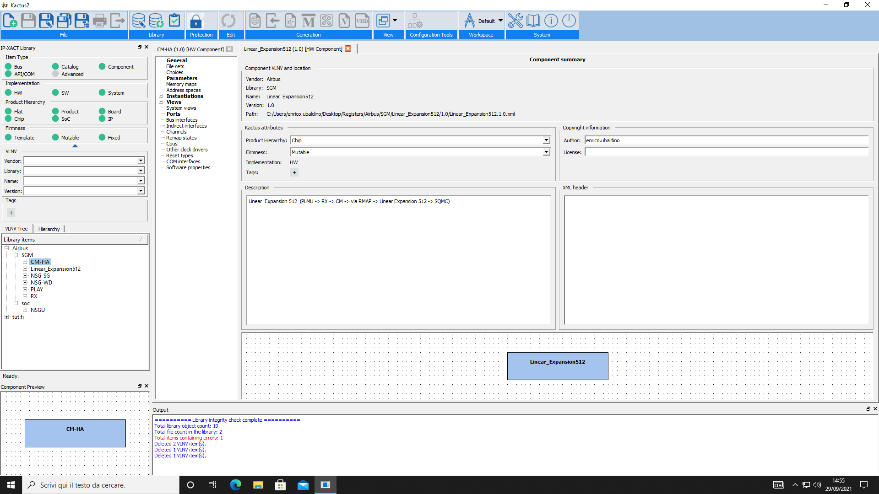
Create HW Component

Slide 12
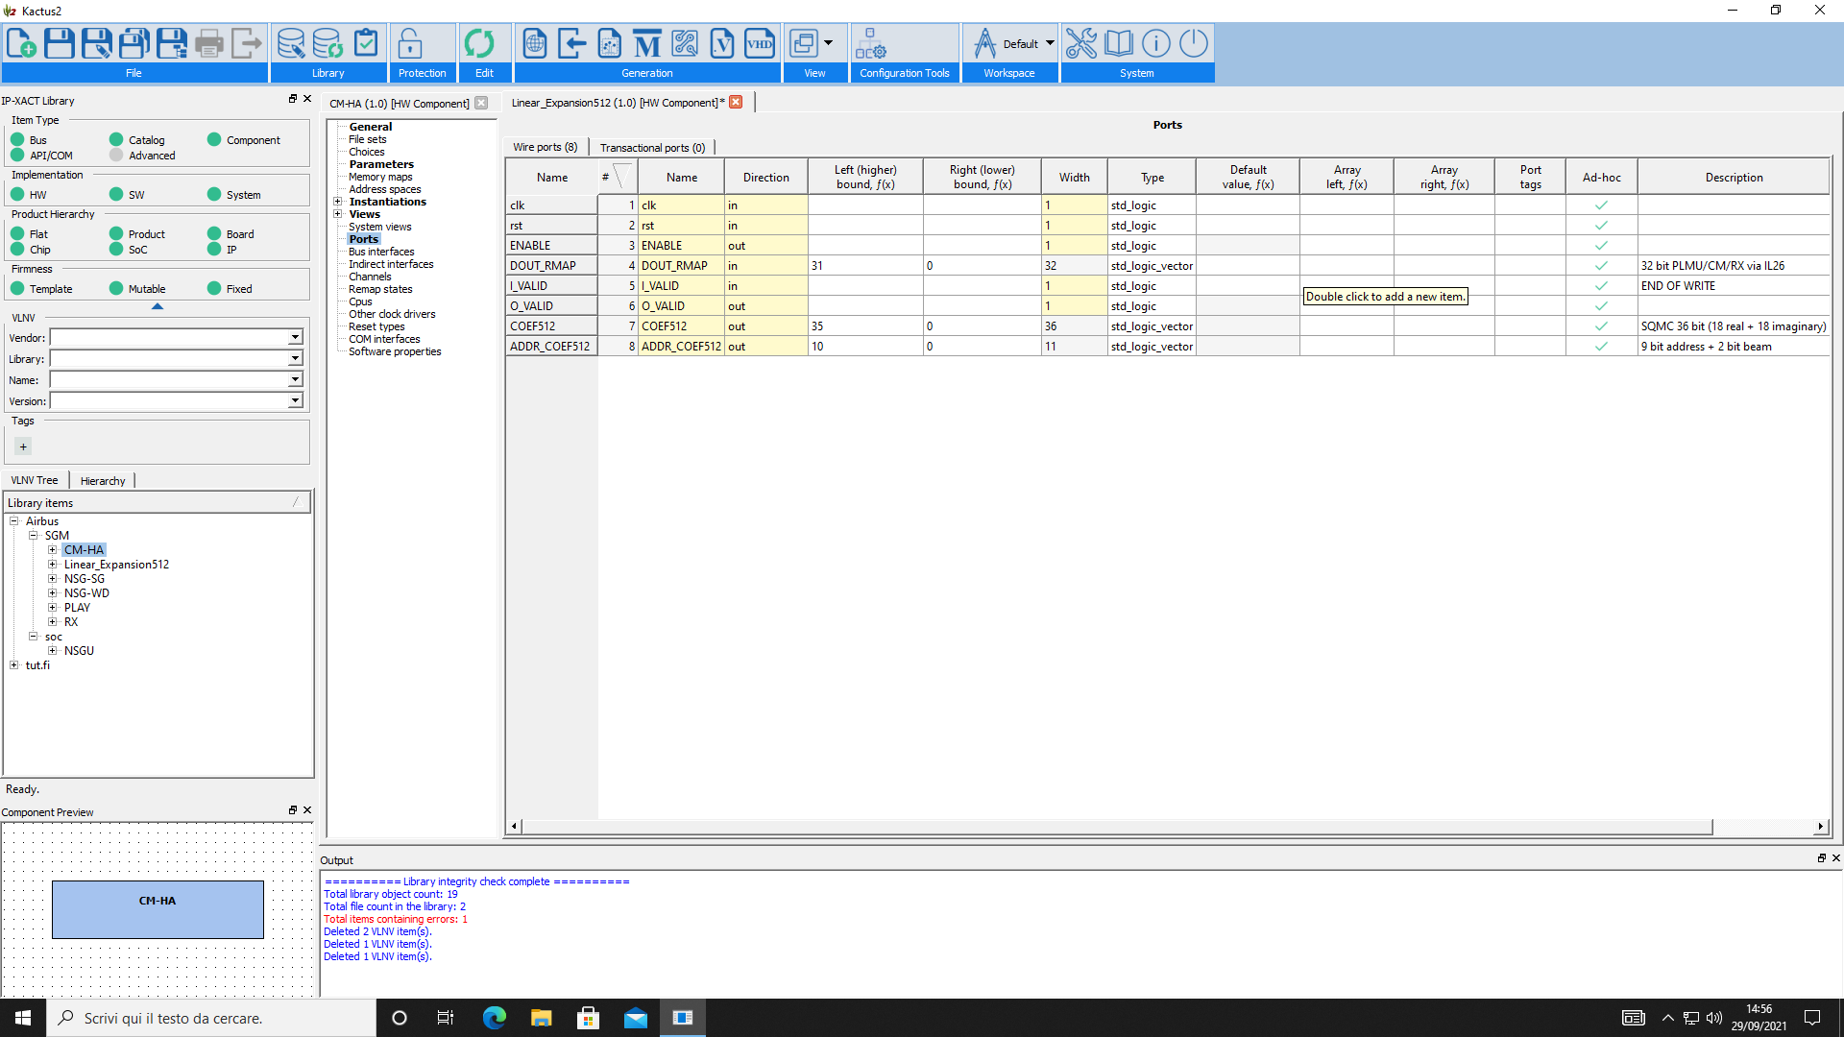
Create HW Component

Slide 13
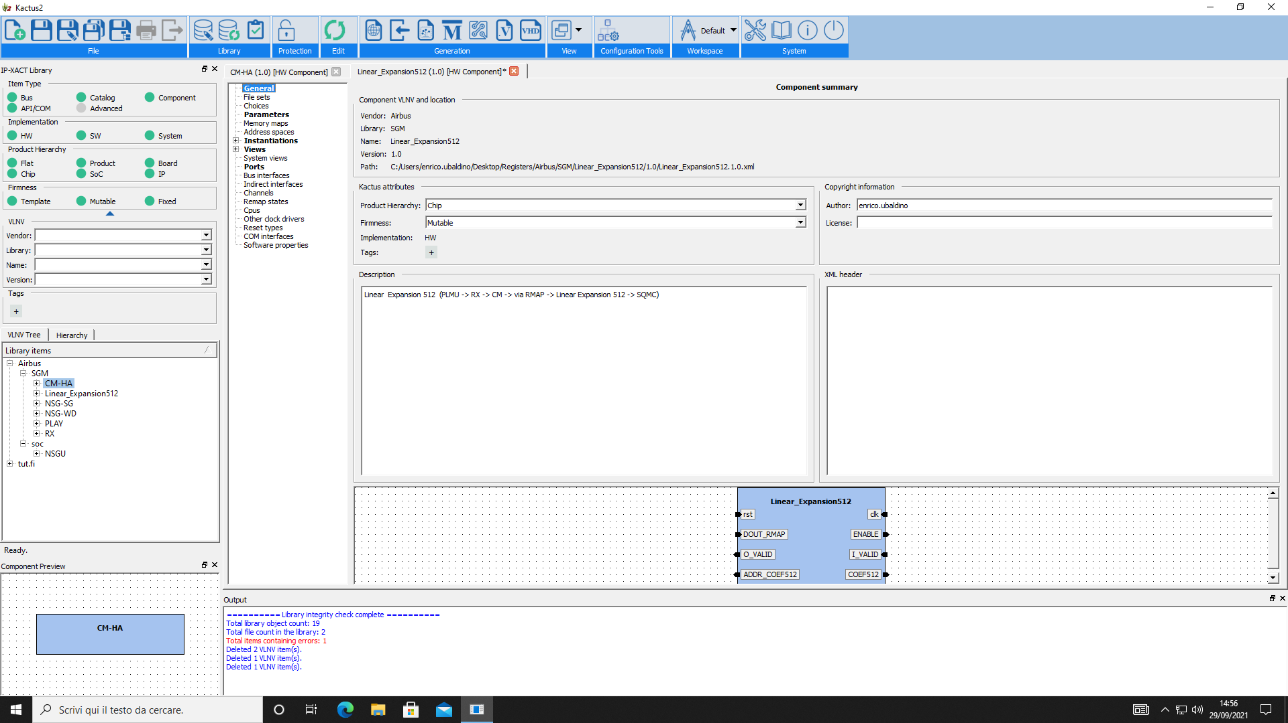
Create HW Component

Slide 14
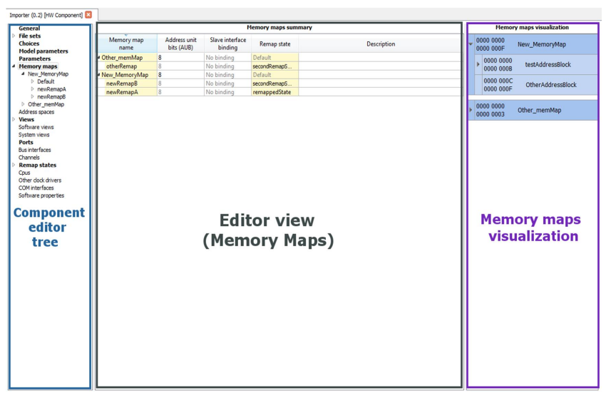
Memory map

Slide 15
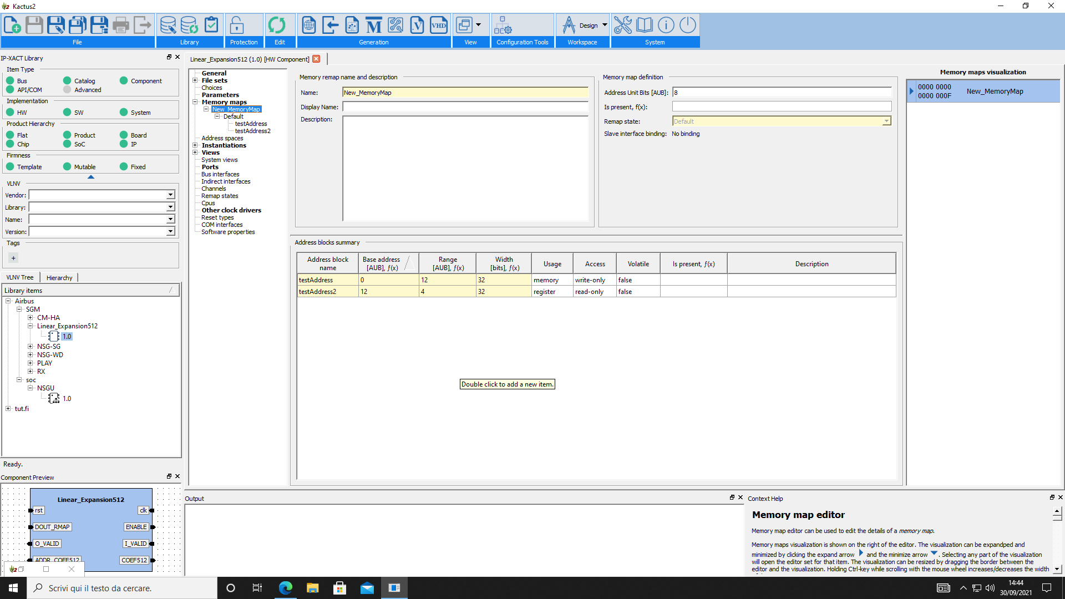
Memory map
Notes:
L’editor memory map è usato per modificare il contenuto della mappa di memoria di un component.
AUB(address unit bit) definisce la quantità di bit di dati per gli incrementi degli indirizzi. Di default le mappe sono indirizzabili in byte quindi AUB è multiplo di 8bit.
La slave interface binding è il collegamento tra l’interfaccia slave che è stata associata e il memory map per accedervi (può essere fatta tramite bus).
Usage serve a specificare l’utilizzo del blocco indirizzi (ROM,RAM,Registri,Reserved).
Access specifica come vi si accedere al blocco (R,W, RW).
Address Spaces: Descrive lo spazio indirizzabile visto dalle interfacce bus con modalità interfaccia del master. Questo può essere usato per descrivere l'indirizzo spazio visto da una CPU tramite interfaccia bus.
Memory maps: Descrive l'area indirizzabile vista attraverso le interfacce bus con modalità interfaccia slave.

Slide 16
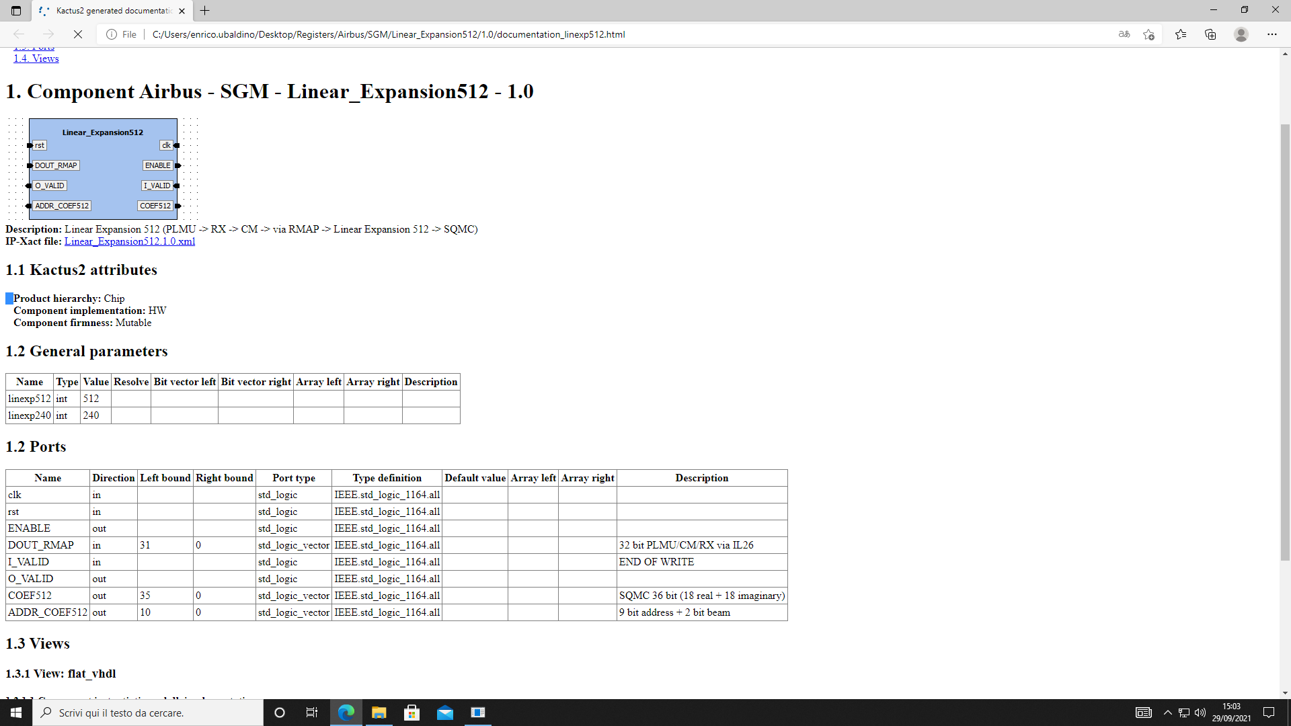
Create Documentation
Just click on the Generate Documentation button in the top pane under the Generation category

