Slide 1

Xilinx Libraries
Enrico Ubaldino

Slide 2
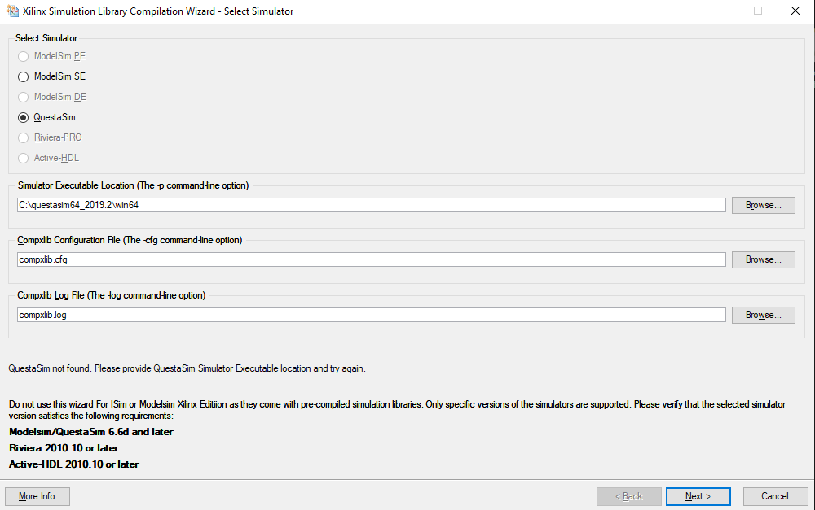
Xilinx Simulation Library Compilation Wizard – ISE 13.2

Slide 3
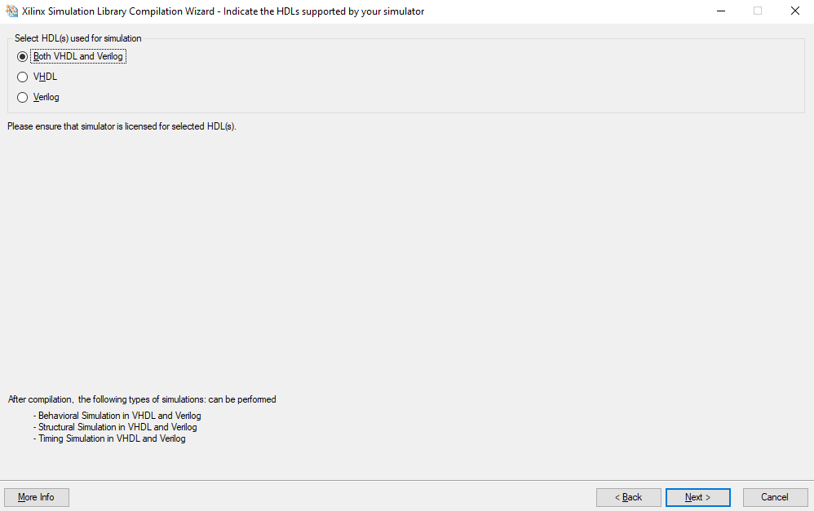
Xilinx Simulation Library Compilation Wizard – ISE 13.2

Slide 4
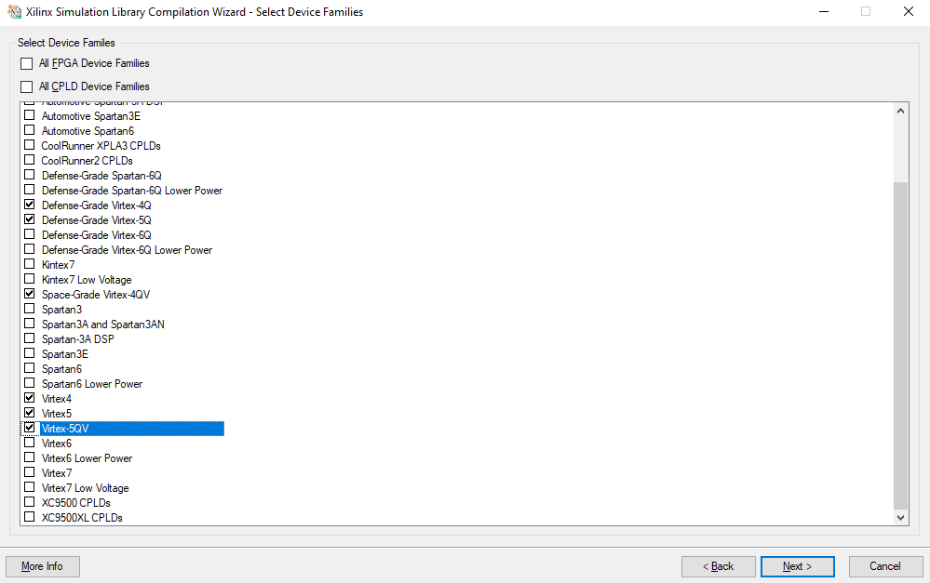
Xilinx Simulation Library Compilation Wizard – ISE 13.2

Slide 5
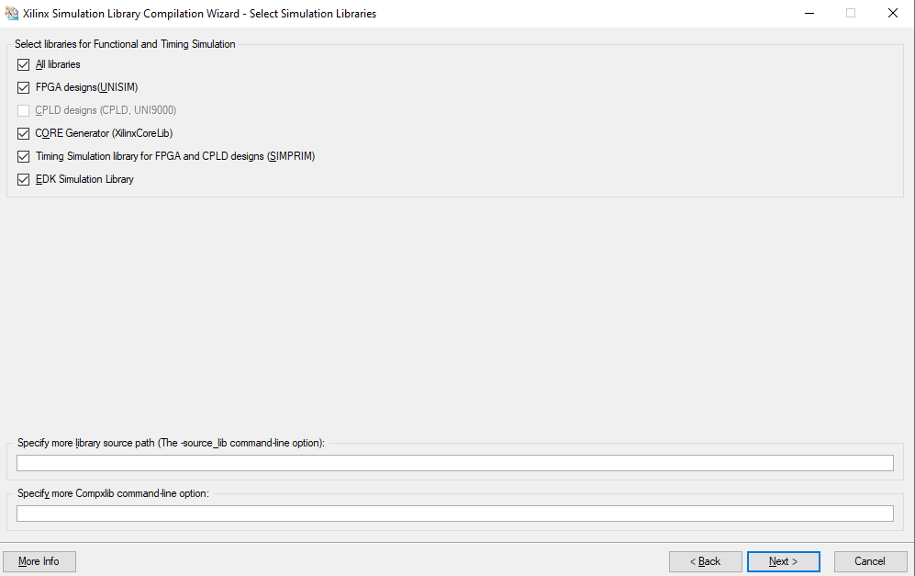
Xilinx Simulation Library Compilation Wizard – ISE 13.2

Slide 6
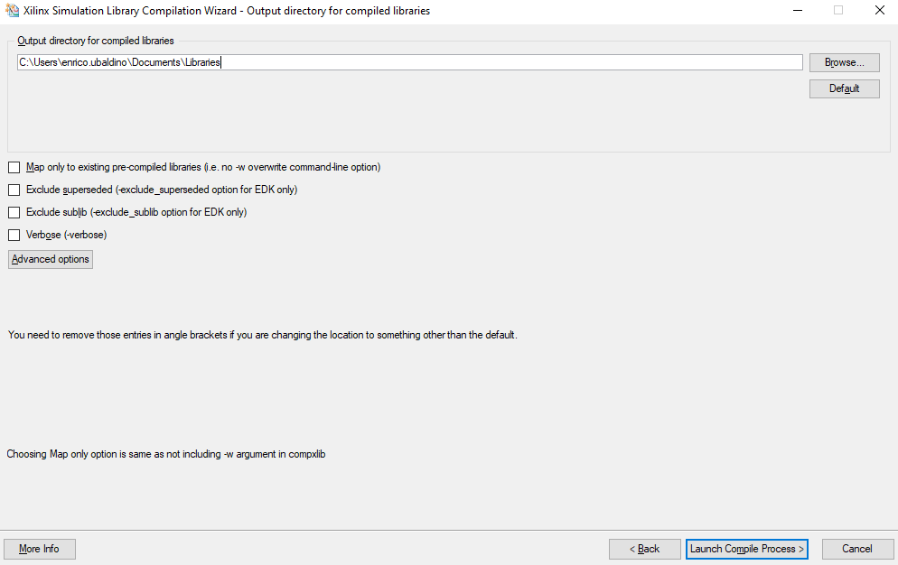
Xilinx Simulation Library Compilation Wizard – ISE 13.2

Slide 7
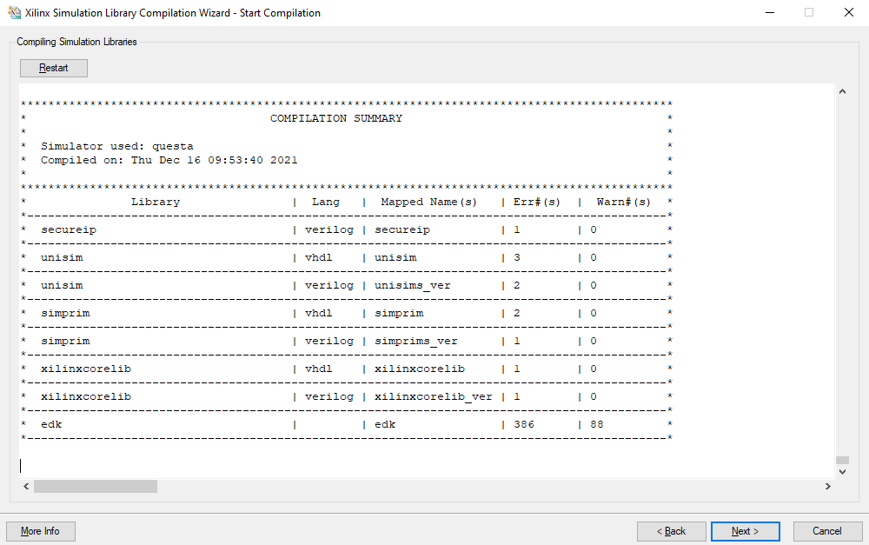
Xilinx Simulation Library Compilation Wizard – ISE 13.2

Slide 8
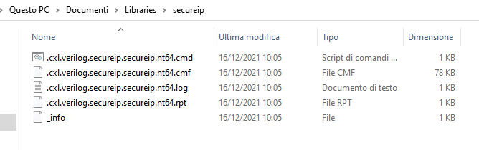
Xilinx Simulation Library Compilation Wizard – ISE 13.2
The compilation file maybe different respect which expected by QuestaSim

Slide 9
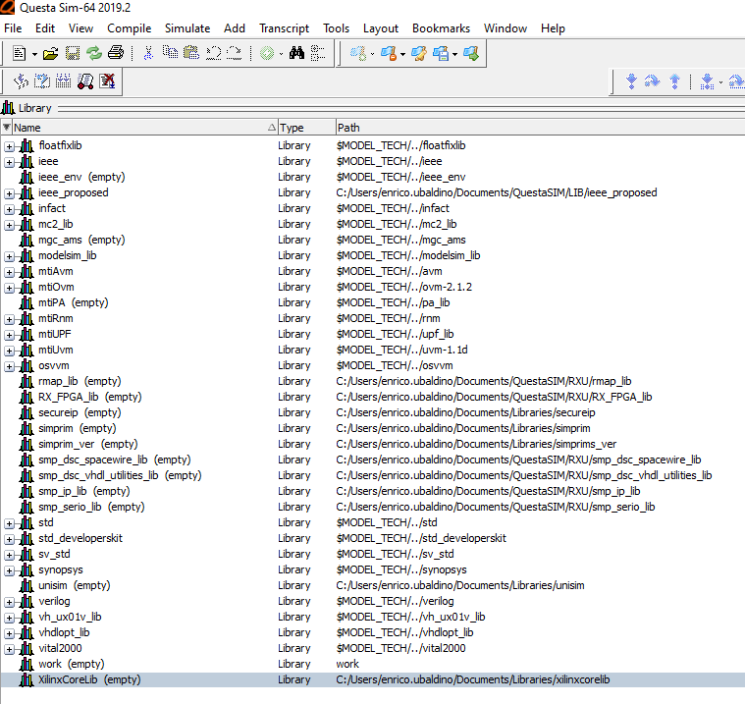
Xilinx Simulation Library Compilation Wizard – ISE 13.2
In fact, after mapping the new libraries in QuestaSim they are empty.
(Windows OS)

Slide 10
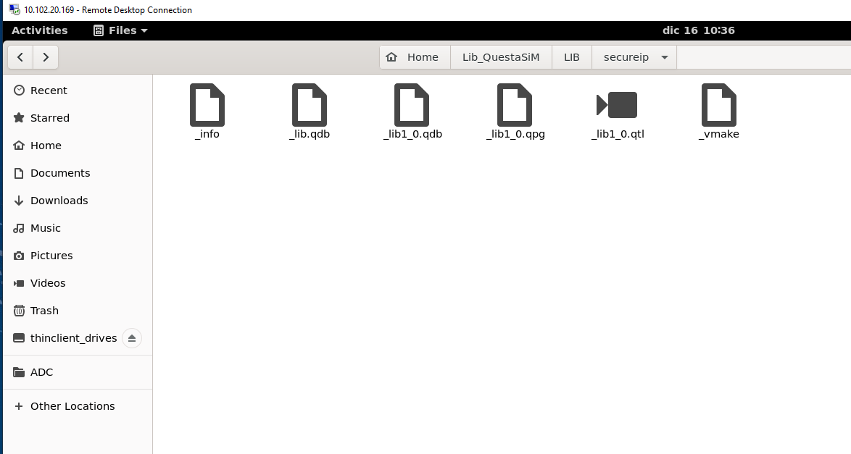
Xilinx Simulation Library Compilation Wizard – VIVADO
Then we have compiled the libraries with Xilinx Vivado and the generated files are in accord with expected format.
(libraries read correctly even in Linux OS)

Slide 11
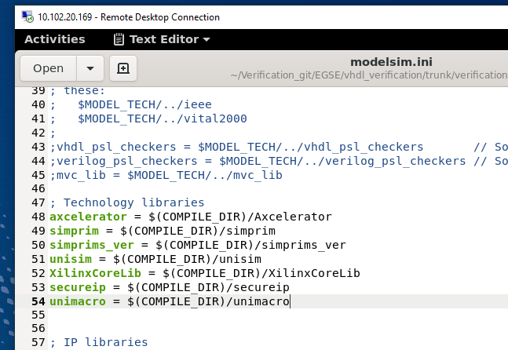
Xilinx Simulation Library Compilation Wizard – LINUX
Add libraries in modelsim.ini

Slide 12
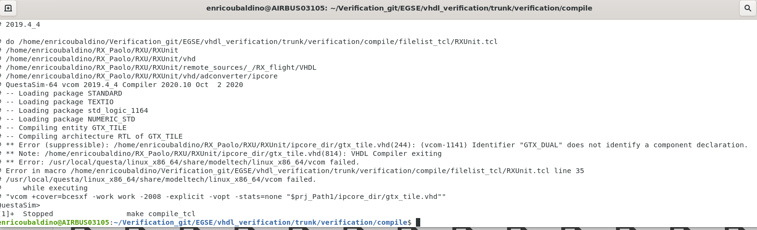
Xilinx Library – GTX - LINUX
At the moment of "make compile" we have an error into the component GTX DUAL

Slide 13
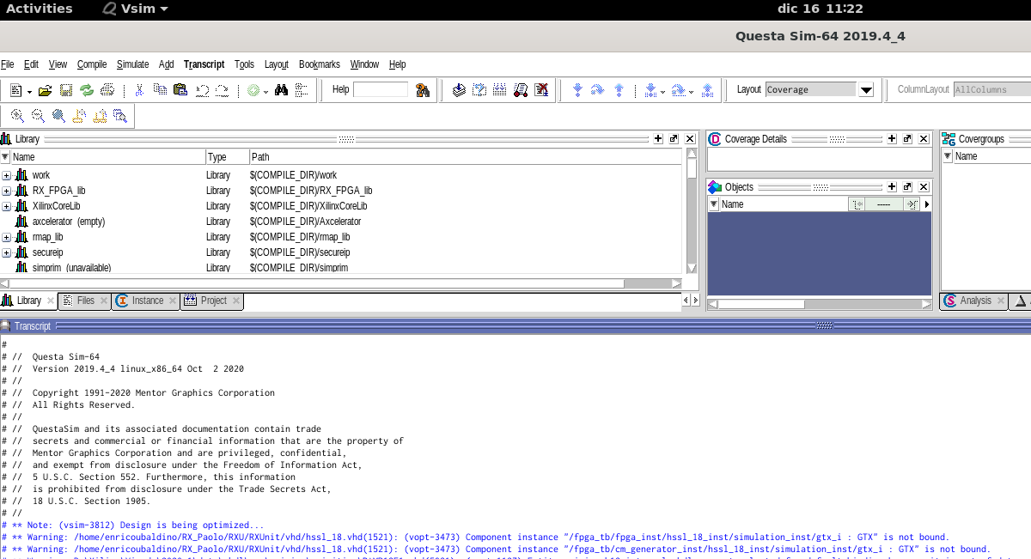
Xilinx Library – GTX - LINUX

Slide 14
Xilinx Library – GTX - LINUX
I skipped some errors when compiling the GTX_DUAL component manually in the unisim library but it remains GTX_DUAL_FAST not bound.
I also tried to run the simulation with the following command but the same errors result:
vsim –voptargs=+acc –L secureip work.testbench

Slide 15
Xilinx Library – GTX - LINUX
At the moment of "make compile" we have an error into the component GTX DUAL. As if it’s not seen in the waiting library.
I skipped some errors when compiling the GTX_DUAL component manually in the unisim library but it remains GTX_DUAL_FAST not bound.
I also tried to run the simulation with the following command but the same errors result:
vsim –voptargs=+acc –L secureip work.testbench

