Slide 1

Enrico Ubaldino

Slide 2
What’s?
Questa SIM is a verification and simulation tool for VHDL, Verilog, SystemVerilog, SystemC, and mixed-language designs. By default, Questa SIM optimizations are automatically performed on all designs.
Questa SIM Code Coverage gives you graphical and report file feedback on which executable statements, branches, conditions, and expressions in your source code have been executed.
Enrico Ubaldino

Slide 3
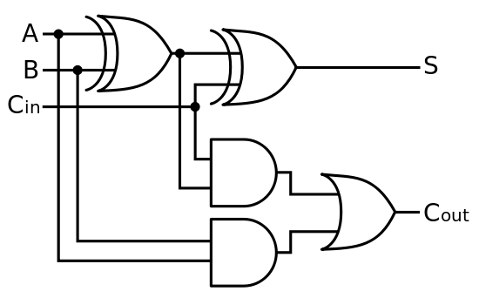
Example Fulladder
Enrico Ubaldino

Slide 4
VHDL Code FUlladder
Library IEEE;
Use IEEE.std_logic_1164.all;
Entity FullAdder is
Port (
A, B, Cin : in std_logic;
S, Cout : out std_logic );
End FullAdder;
Architecture bev of FullAdder is
begin
S <= A xor B xor Cin;
Cout <= (A and B) or ((A xor B) and Cin);
--Cout <= (A nand B) nand (C nand (A xor B)); --DeMorgan
End bev;
Enrico Ubaldino

Slide 5
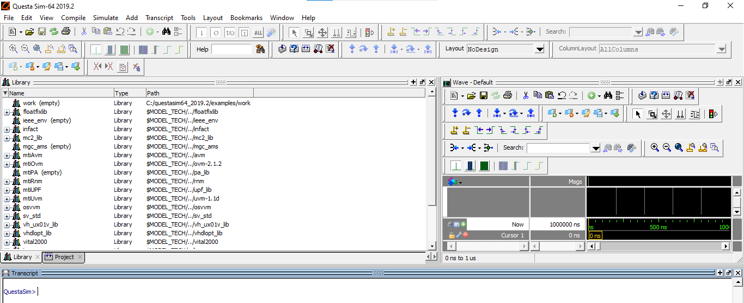
New project
File/New ->Project
Enrico Ubaldino

Slide 6
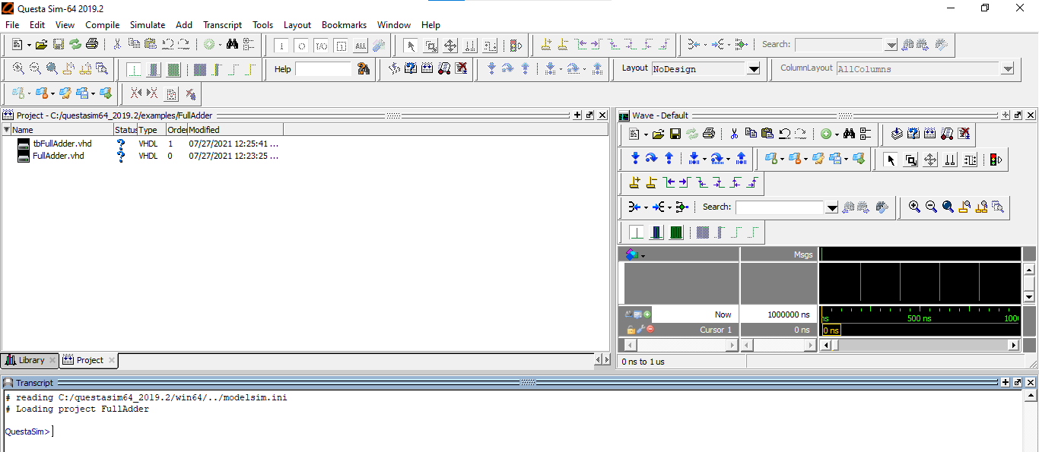
Load sources file

Slide 7
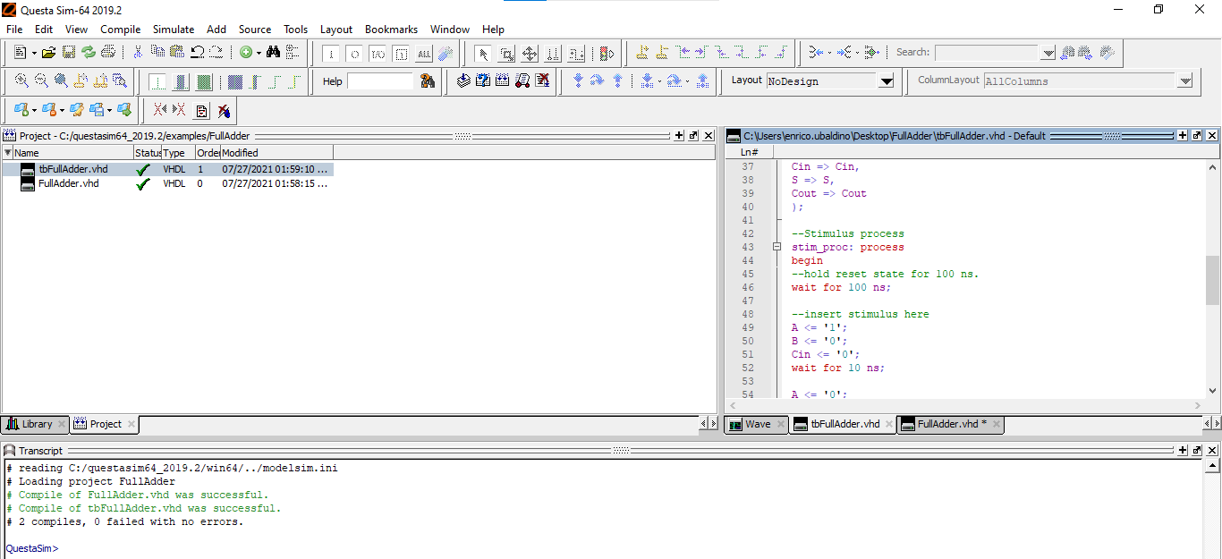
Compile all
vcom –work «file.vhd» for VHDL sources

Slide 8
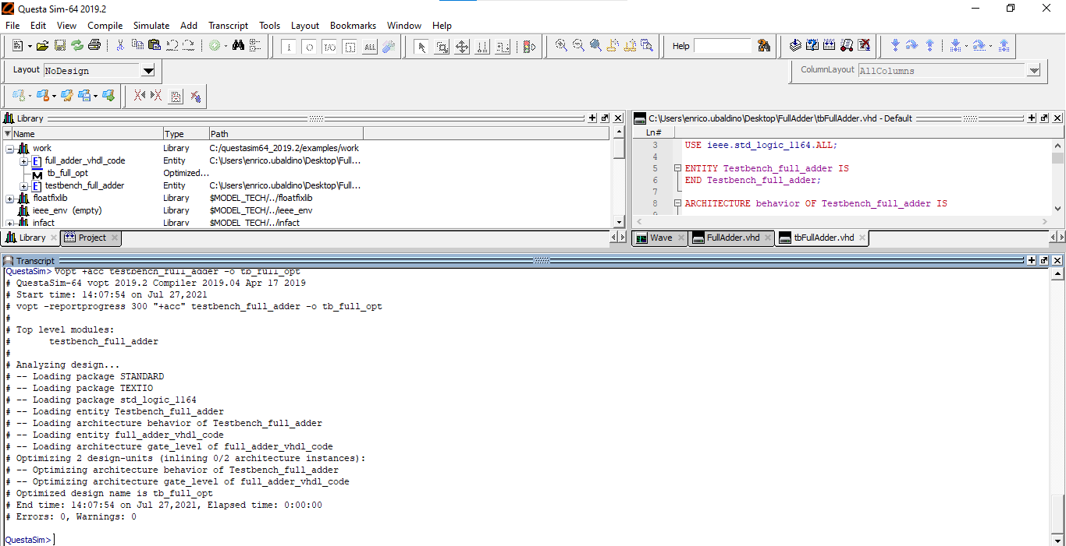
optimize
vopt +acc «name testbench» –o «name testbench opt»
Enrico Ubaldino

Slide 9
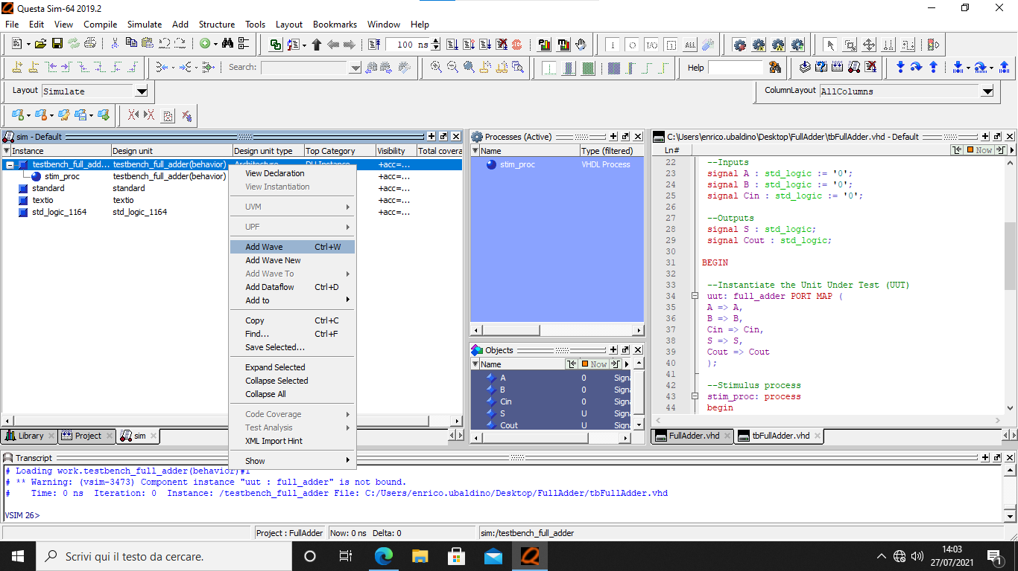
Simulation & Add wave
vsim «name testbench opt»

Slide 10
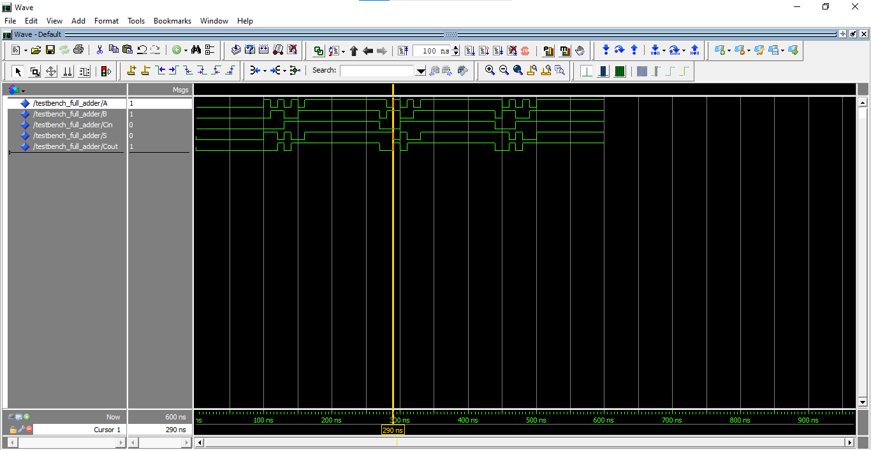
Tb waveform
run 600 ns
Enrico Ubaldino

Slide 11
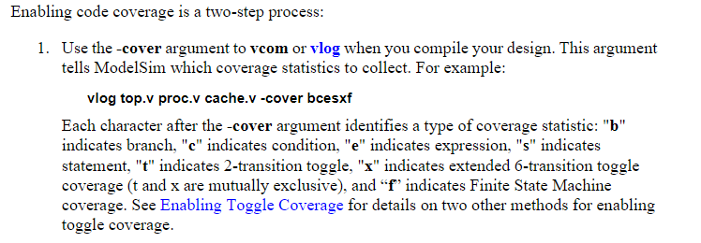
Coverage typeS
Enrico Ubaldino

Slide 12
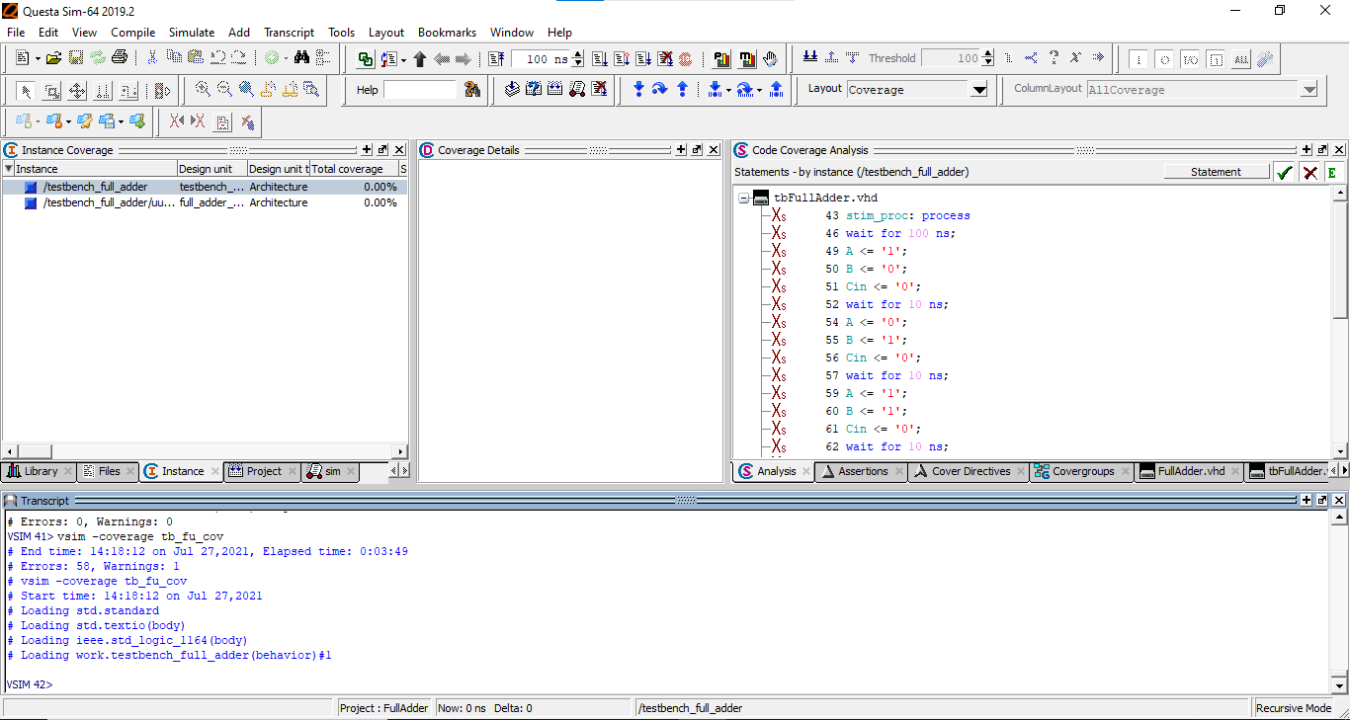
Coverage
vopt +cover=bcesxf «name test» –o «name test opt for cov»
vsim –coverage «name test opt for cov»
Enrico Ubaldino

Slide 13
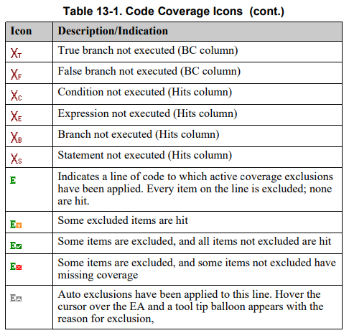
Code coverage icons
Enrico Ubaldino

Slide 14
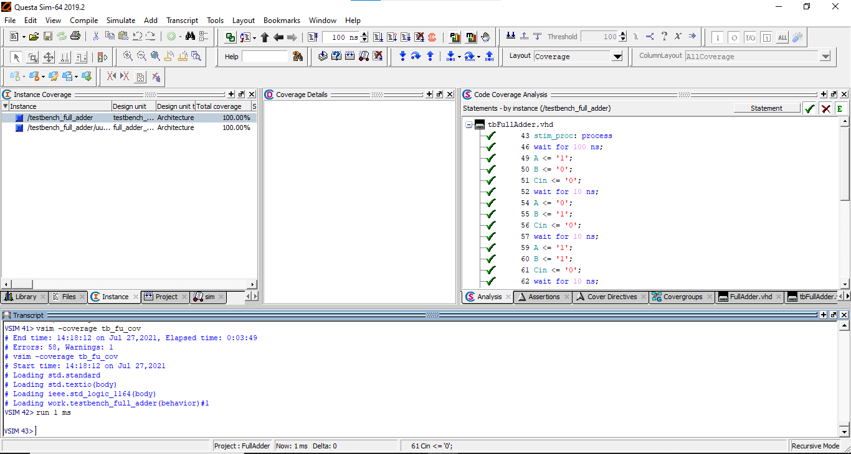
Code coverage 100%
run 1 ms or you can force signal state with wave editor or by command e.g
force SW 2#01000001 2# binary radix
Enrico Ubaldino

Slide 15
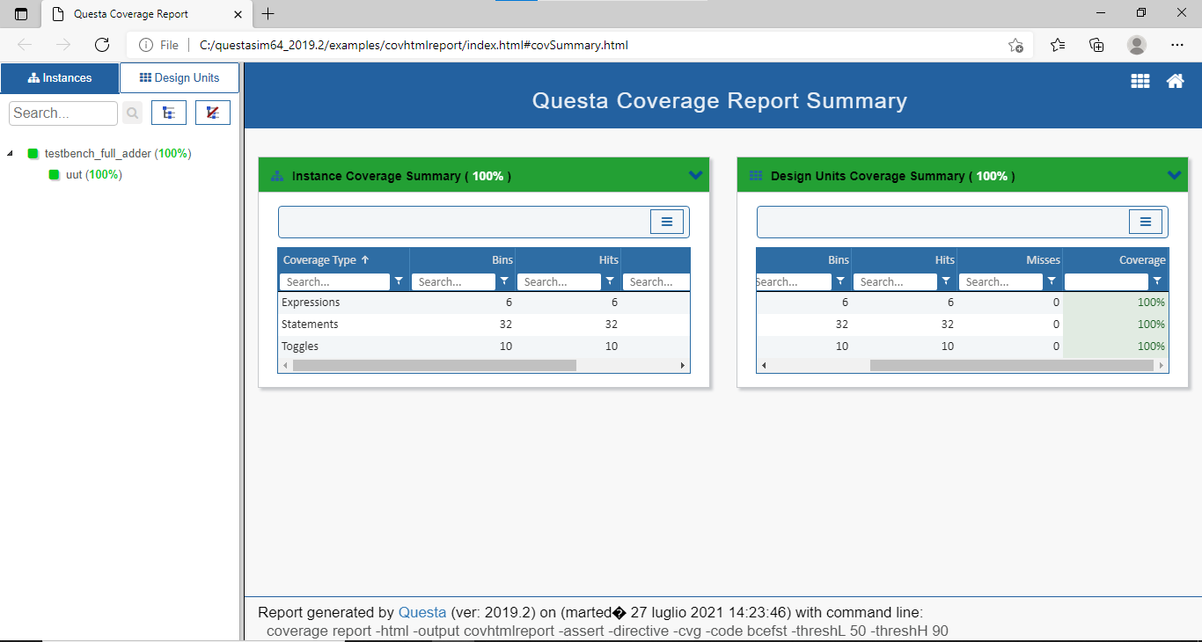
Html coverage report
Enrico Ubaldino
Tools/Coverage Report -> HTML

Slide 16
Ucdb coverage report
coverage save name.ucdb
A database developed by Mentor Graphics for capture of code coverage, functional coverage, and other metrics together in one place for post-regression analysis and reporting. Forms the basis of the UCIS industry standard in development in Accellera.
Enrico Ubaldino

Slide 17
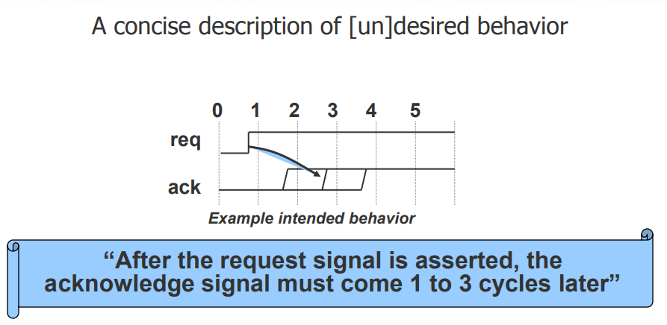
What is an Assertion?
Enrico Ubaldino

Slide 18
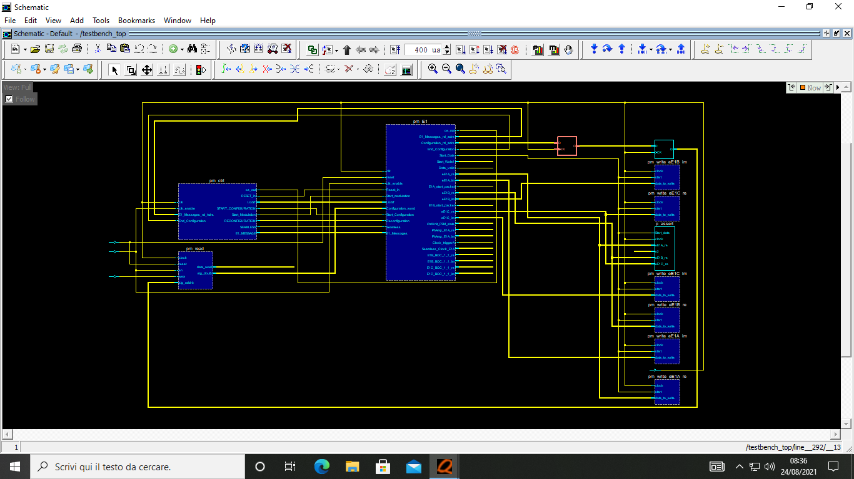
Schematic
vsim –debugDB «testbench» then click on View/Schematic
Enrico Ubaldino

Slide 19
Close simulation
Quit –sim or Simulate/ End simulation
Enrico Ubaldino

Slide 20
Power analisys
Vcd2wlf file1.vcd file2.wlf open file .wlf
power add nsg_noctrl_tb/DUT/*
run 500us
power report -all -bsaif powerNSG.saif
vcd file powerNSG.vcd
vcd add nsg_noctrl_tb/DUT/*
coverage report -output reportpower.txt -srcfile=* -detail -all -annotate -assert -directive -cvg -pa -code t
Enrico Ubaldino

Slide 21
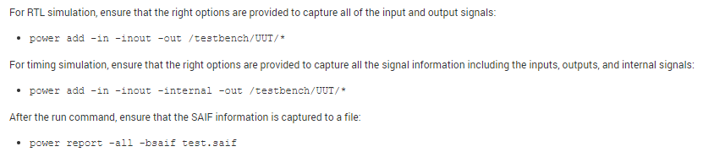
Power analisys
I recommend monitoring internal signals
power add -ports -internal -r nsg_noctrl_tb/DUT/linexp_gen/* START REG
power report -all -bsaif power_analysis_NSG_SG_linexp.saif STOP REG
Enrico Ubaldino

