Slide 1
Protocol “layers”
Networks are complex,
with many “pieces”:
hosts
routers
links of various media
applications
protocols
hardware, software
Question:
is there any hope of organizing structure of network?
…. or at least our discussion of networks?

Slide 2
Organization of air travel
ticket (purchase)
baggage (check)
gates (load)
runway takeoff
airplane routing
ticket (complain)
baggage (claim)
gates (unload)
runway landing
airplane routing
airplane routing
a series of steps

Slide 3
Layering of airline functionality
ticket (purchase)
baggage (check)
gates (load)
runway (takeoff)
airplane routing
ticket (complain)
baggage (claim
gates (unload)
runway (land)
airplane routing
ticket
baggage
gate
takeoff/landing
airplane routing
airplane routing
airplane routing
departure
airport
intermediate air-traffic
control centers
arrival
airport
layers: each layer implements a service
via its own internal-layer actions
relying on services provided by layer below

Slide 4
Internet protocol stack
application: supporting network applications
FTP, SMTP, HTTP
transport: process-process data transfer
TCP, UDP
network: routing of datagrams from source to destination
IP, routing protocols
link: data transfer between neighboring network elements
Ethernet, 802.111 (WiFi)
physical: bits “on the wire”
application
transport
network
link
physical

Slide 5
Why layering?
dealing with complex systems:
explicit structure allows identification, relationship of complex system’s pieces
layered reference model for discussion
modularization eases maintenance, updating of system
change of implementation of layer’s service transparent to rest of system
e.g., change in gate procedure doesn’t affect rest of system

Slide 6
ISO/OSI reference model
presentation: allow applications to interpret meaning of data, e.g., encryption, compression, machine-specific conventions
session: synchronization, checkpointing, recovery of data exchange
Internet stack “missing” these layers!
these services, if needed, must be implemented in application
application
presentation
session
transport
network
link
physical

Slide 7

Encapsulation
source
message
M
application
transport
network
link
physical
segment
H_{t}
M
H_{t}
datagram
H_{n}
H_{n}
H_{t}
M
frame
H_{l}
H_{n}
H_{t}
M
link
physical
switch
destination
H_{n}
H_{t}
M
network
link
physical
M
application
transport
network
link
physical
H_{l}
H_{n}
H_{t}
M
H_{n}
H_{t}
M
H_{t}
M
H_{n}
H_{t}
M
H_{l}
H_{n}
H_{t}
M
router

Slide 8

Multiple Access Links and Protocols
Two types of “links”:
point-to-point
PPP for dial-up access
point-to-point link between Ethernet switch and host
broadcast (shared wire or medium)
old-fashioned Ethernet
upstream HFC
802.11 wireless LAN
humans at a
cocktail party
(shared air, acoustical)
shared wire (e.g.,
cabled Ethernet)
shared RF
(e.g., 802.11 WiFi)
shared RF
(satellite)

Slide 9
Multiple Access protocols
single shared broadcast channel
two or more simultaneous transmissions by nodes: interference
collision if node receives two or more signals at the same time
multiple access protocol
distributed algorithm that determines how nodes share channel, i.e., determine when node can transmit
communication about channel sharing must use channel itself!
no out-of-band channel for coordination

Slide 10
Ideal Multiple Access Protocol
Broadcast channel of rate R bps
1. when one node wants to transmit, it can send at rate R.
2. when M nodes want to transmit, each can send at average rate R/M
3. fully decentralized:
no special node to coordinate transmissions
no synchronization of clocks, slots
4. simple

Slide 11
MAC Protocols: a taxonomy
Three broad classes:
Channel Partitioning
divide channel into smaller “pieces” (time slots, frequency, code)
allocate piece to node for exclusive use
Random Access
channel not divided, allow collisions
“recover” from collisions
“Taking turns”
nodes take turns, but nodes with more to send can take longer turns

Slide 12
Channel Partitioning MAC protocols: TDMA
TDMA: time division multiple access
access to channel in "rounds"
each station gets fixed length slot (length = pkt trans time) in each round
unused slots go idle
example: 6-station LAN, 1,3,4 have pkt, slots 2,5,6 idle
6-slot
frame
1
3
4
1
3
4

Slide 13

Channel Partitioning MAC protocols: FDMA
FDMA: frequency division multiple access
channel spectrum divided into frequency bands
each station assigned fixed frequency band
unused transmission time in frequency bands go idle
example: 6-station LAN, 1,3,4 have pkt, frequency bands 2,5,6 idle
time
frequency bands
FDM cable

Slide 14
Code Division Multiple Access (CDMA)
used in several wireless broadcast channels (cellular, satellite, etc) standards
unique “code” assigned to each user; i.e., code set partitioning
all users share same frequency, but each user has own “chipping” sequence (i.e., code) to encode data
encoded signal = (original data) X (chipping sequence)
decoding: inner-product of encoded signal and chipping sequence
allows multiple users to “coexist” and transmit simultaneously with minimal interference (if codes are “orthogonal”)

Slide 15
CDMA Encode/Decode
channel output Z_{i,m}
Z_{i,m}= d_{i}.c_{m}
data
bits
d₀ = 1
1
1
1
1
1
d₁ = -1
1
1
1
-
-
-
-
1
-
-
-
1
-
1
1
1
1
1
sender
1
1
slot 1
channel
output
slot 0
channel
output
1
1
1
1
1
code
1
1
-
-
-
1
-
1
1
1
-
-
-
1
-
1
1
1
slot 1
slot 0
M
D_{i} = Σ Z_{i,m}.c_{m}
m=1
M
received
input
1
1
1
1
1
1
1
1
d₀ = 1
-
-
-
-
1
-
-
-
1
-
1
1
1
1
1
1
d₁ = -1
1
slot 1
channel
output
slot 0
channel
output
1
1
1
1
1
code
1
1
-
-
-
1
-
1
1
1
-
-
-
1
-
1
1
1
receiver
slot 1
slot 0

Slide 16
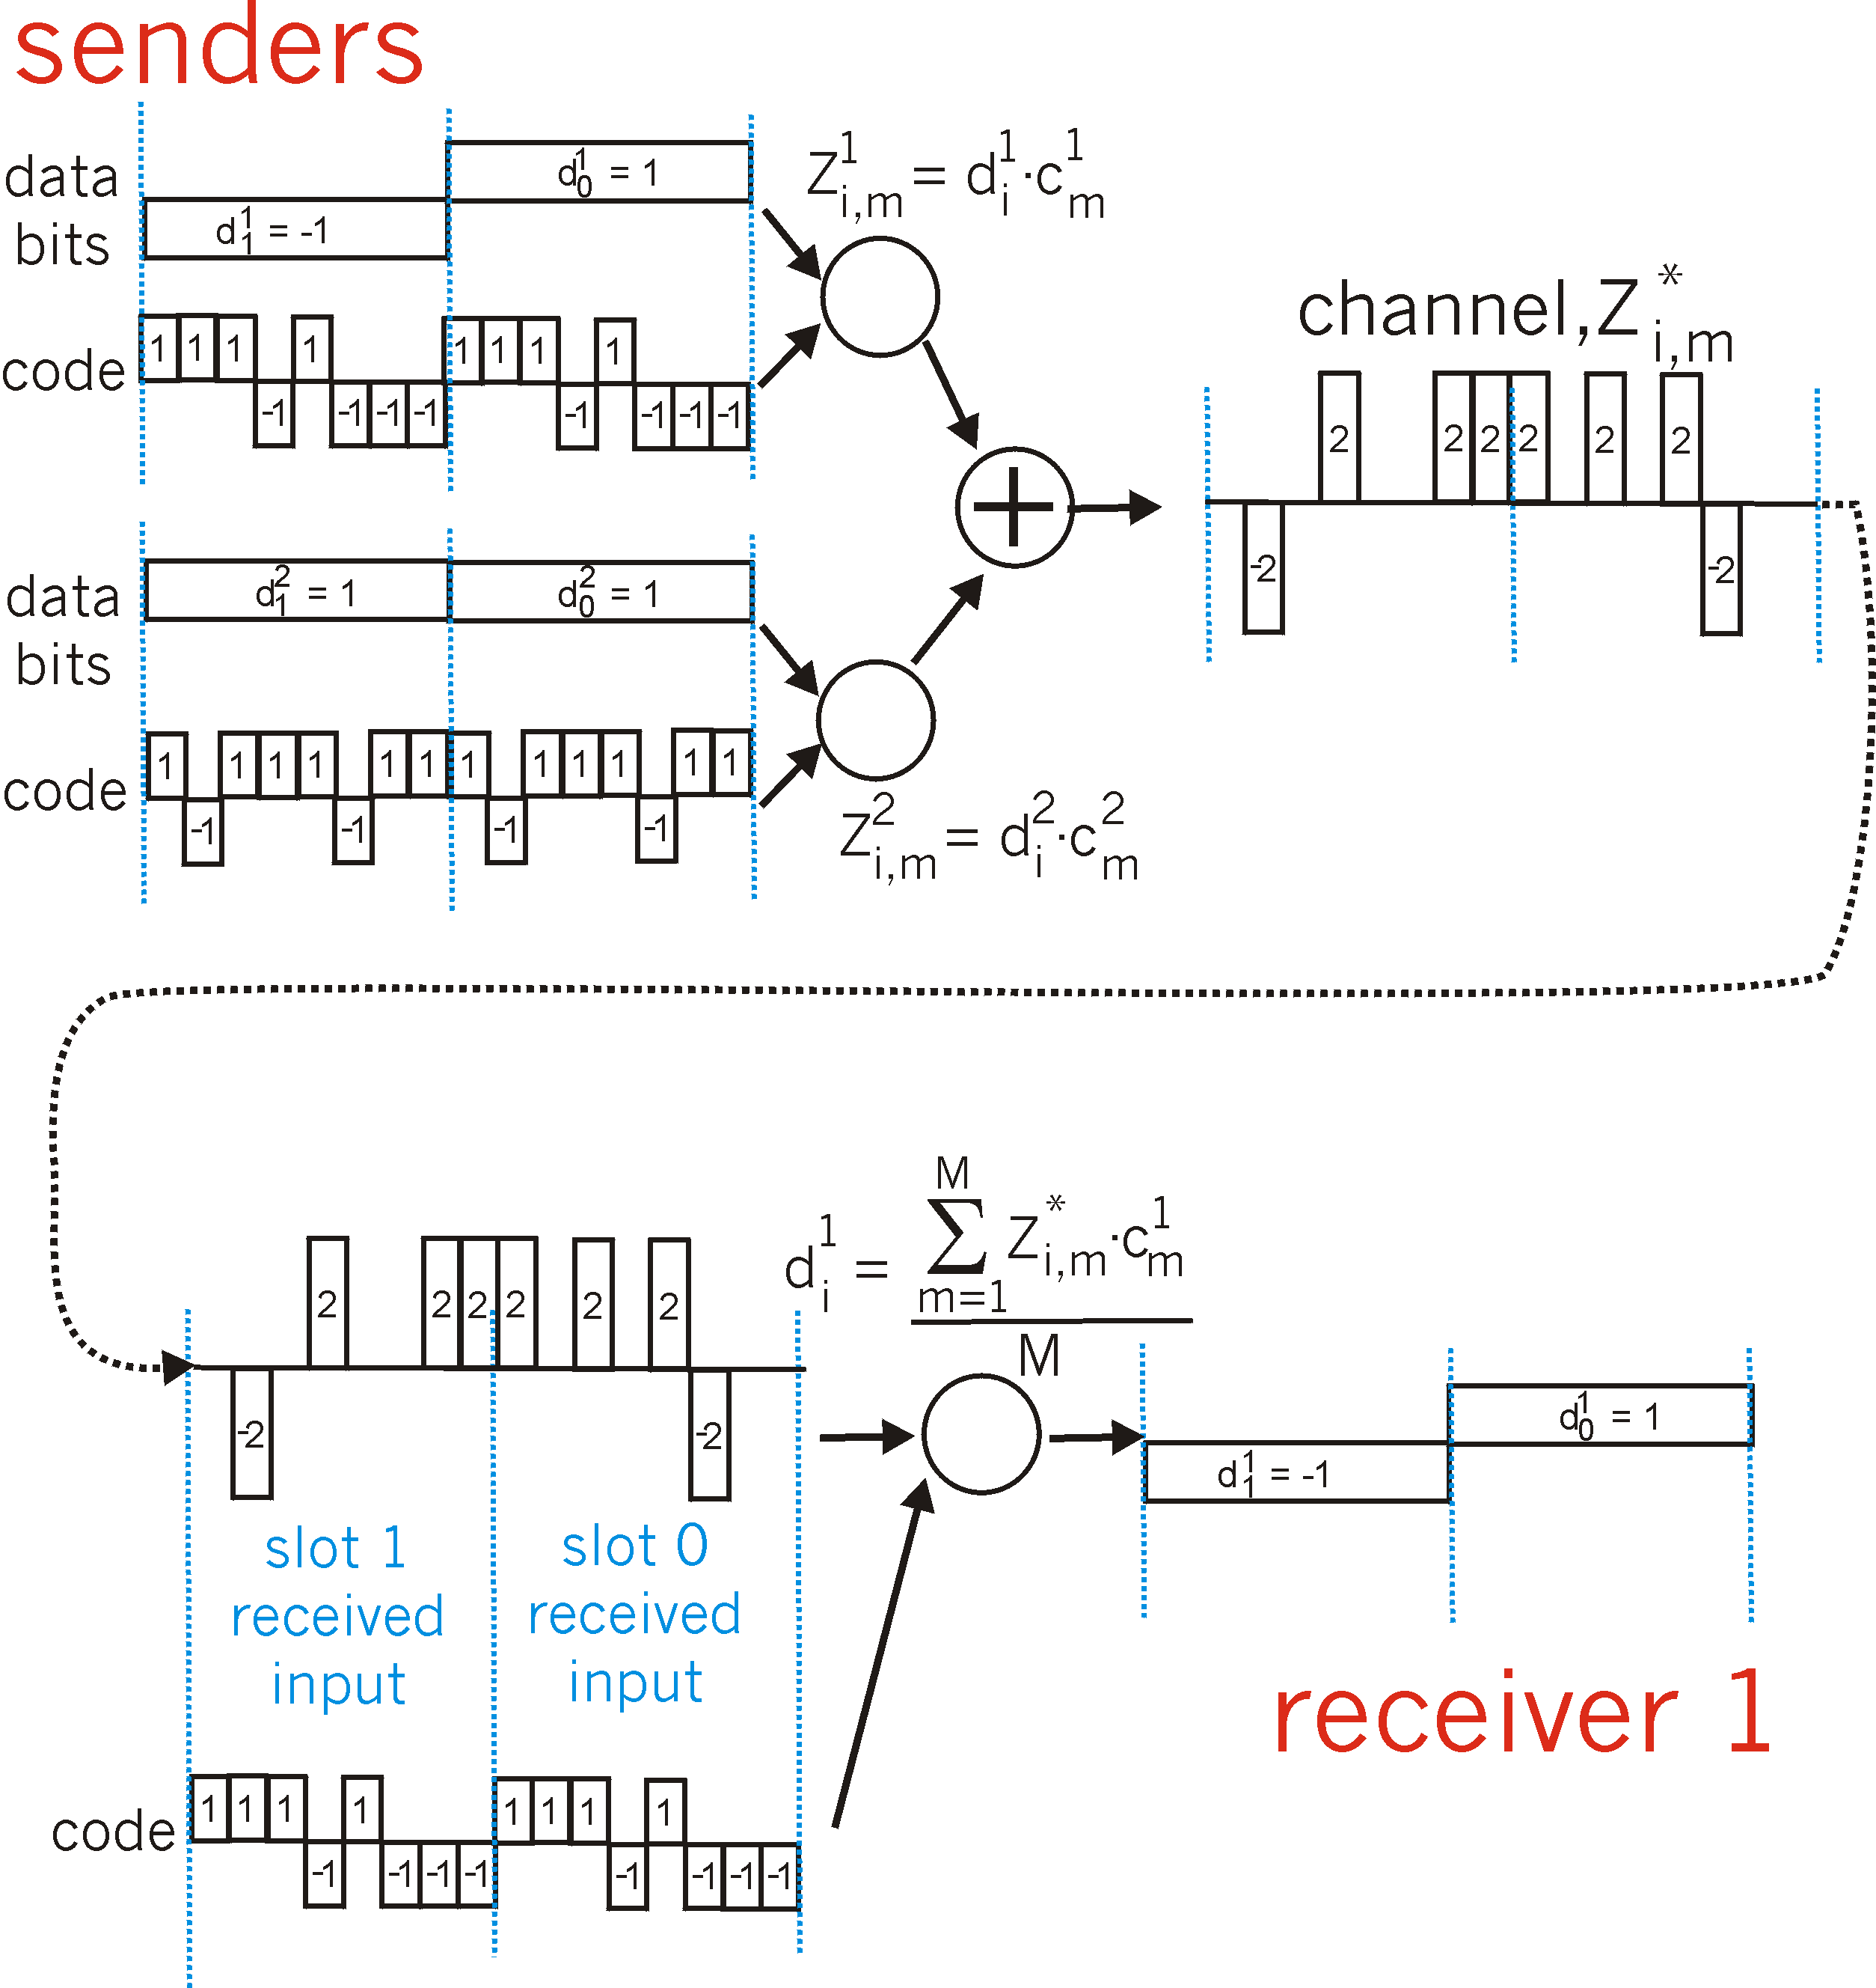
CDMA: two-sender interference

Slide 17
Random Access Protocols
When node has packet to send
transmit at full channel data rate R.
no a priori coordination among nodes
two or more transmitting nodes ➜ “collision”,
random access MAC protocol specifies:
how to detect collisions
how to recover from collisions (e.g., via delayed retransmissions)
Examples of random access MAC protocols:
slotted ALOHA
ALOHA
CSMA, CSMA/CD, CSMA/CA

Slide 18
Slotted ALOHA
Assumptions:
all frames same size
time divided into equal size slots (time to transmit 1 frame)
nodes start to transmit only slot beginning
nodes are synchronized
if 2 or more nodes transmit in slot, all nodes detect collision
Operation:
when node obtains fresh frame, transmits in next slot
if no collision: node can send new frame in next slot
if collision: node retransmits frame in each subsequent slot with prob. p until success

Slide 19
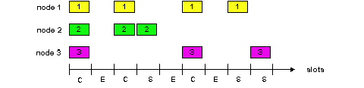
Slotted ALOHA
Pros
single active node can continuously transmit at full rate of channel
highly decentralized: only slots in nodes need to be in sync
simple
Cons
collisions, wasting slots
idle slots
nodes may be able to detect collision in less than time to transmit packet
clock synchronization

Slide 20
Slotted Aloha efficiency
Efficiency : long-run fraction of successful slots (many nodes, all with many frames to send)
max efficiency: find p* that maximizes Np(1-p)^{N-1}
for many nodes, take limit of Np*(1-p*)^{N-1} as N goes to infinity, gives:
Max efficiency = 1/e = .37
suppose: N nodes with many frames to send, each transmits in slot with probability p
prob that given node has success in a slot = p(1-p)^{N-1}
prob that any node has a success = Np(1-p)^{N-1}
At best: channel
used for useful
transmissions 37%
of time!
!

Slide 21
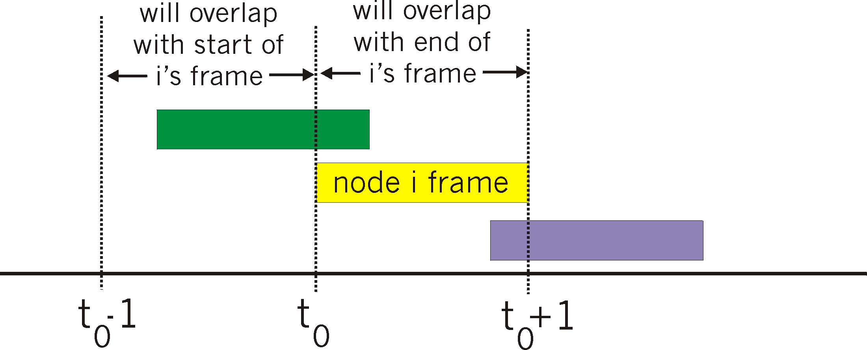
Pure (unslotted) ALOHA
unslotted Aloha: simpler, no synchronization
when frame first arrives
transmit immediately
collision probability increases:
frame sent at t₀ collides with other frames sent in [t₀-1,t₀+1]

Slide 22
Pure Aloha efficiency
P(success by given node) = P(node transmits) .
P(no other node transmits in [p₀-1,p₀] .
P(no other node transmits in [p₀-1,p₀]
= p . (1-p)^{N-1 .} (1-p)^{N-1}
= p . (1-p)^{2(N-1)}
… choosing optimum p and then letting n -> infty ...
^{= 1/(2e) = .18}
even worse than slotted Aloha!

Slide 23
CSMA (Carrier Sense Multiple Access)
CSMA: listen before transmit:
If channel sensed idle: transmit entire frame
If channel sensed busy, defer transmission
human analogy: don’t interrupt others!

Slide 24
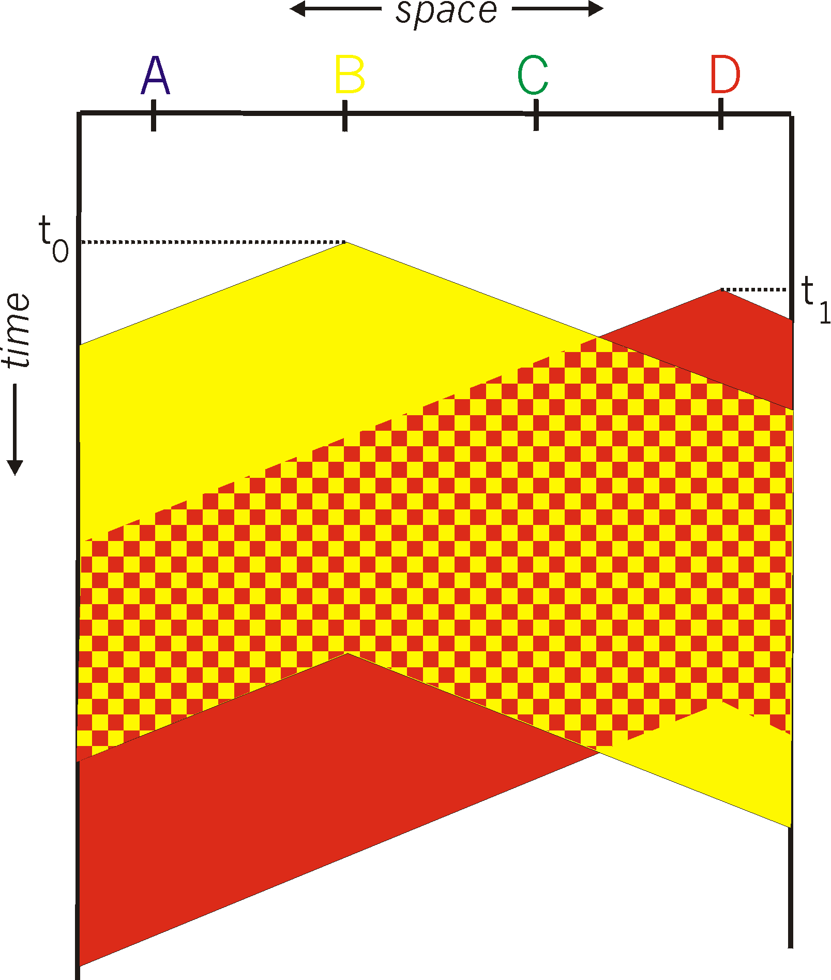
CSMA collisions
spatial layout of nodes
collisions can still occur:
propagation delay means
two nodes may not hear
each other’s transmission
collision:
entire packet transmission
time wasted
note:
role of distance & propagation delay in determining collision probability

Slide 25
CSMA/CD (Collision Detection)
CSMA/CD: carrier sensing, deferral as in CSMA
collisions detected within short time
colliding transmissions aborted, reducing channel wastage
collision detection:
easy in wired LANs: measure signal strengths, compare transmitted, received signals
difficult in wireless LANs: received signal strength overwhelmed by local transmission strength
human analogy: the polite conversationalist

Slide 26
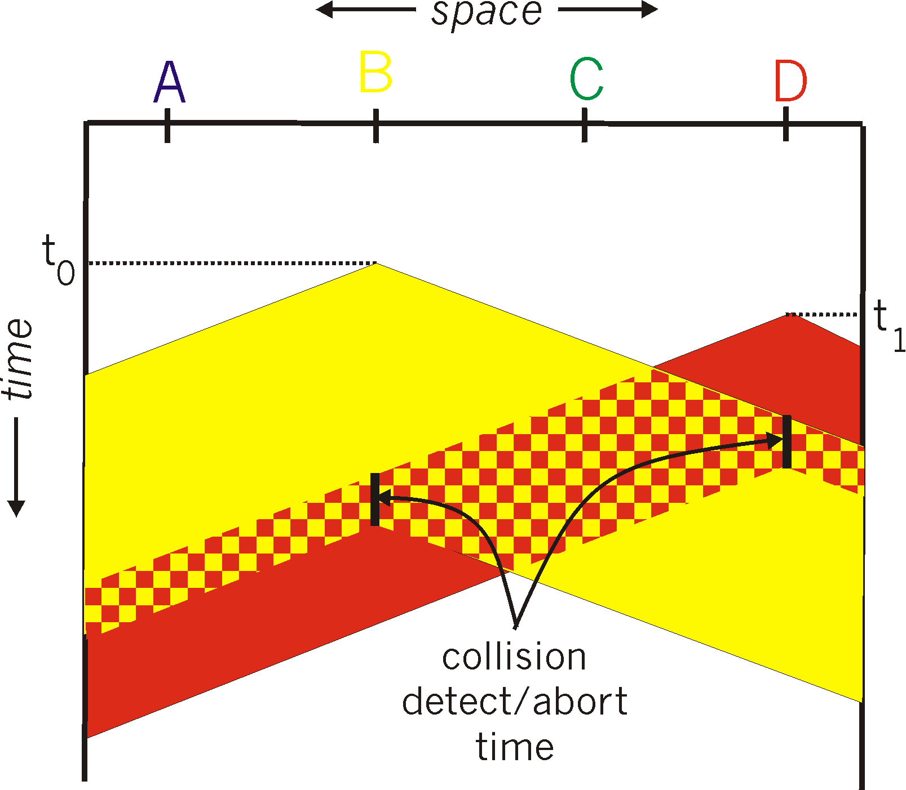
CSMA/CD collision detection

Slide 27
“Taking Turns” MAC protocols
channel partitioning MAC protocols:
share channel efficiently and fairly at high load
inefficient at low load: delay in channel access, 1/N bandwidth allocated even if only 1 active node!
random access MAC protocols
efficient at low load: single node can fully utilize channel
high load: collision overhead
“taking turns” protocols
look for best of both worlds!

Slide 28
“Taking Turns” MAC protocols
Polling:
master node “invites” slave nodes to transmit in turn
typically used with “dumb” slave devices
concerns:
polling overhead
latency
single point of failure (master)
data
poll
master
data
slaves

Slide 29
“Taking Turns” MAC protocols
Token passing:
control token passed from one node to next sequentially.
token message
concerns:
token overhead
latency
single point of failure (token)
T
(nothing
to send)
T
data

Slide 30
Summary of MAC protocols
channel partitioning, by time, frequency or code
Time Division, Frequency Division, Code Division
random access (dynamic),
ALOHA, S-ALOHA, CSMA, CSMA/CD
carrier sensing: easy in some technologies (wire), hard in others (wireless)
CSMA/CD used in Ethernet
CSMA/CA used in 802.11
taking turns
polling from central site, token passing
Bluetooth, FDDI, IBM Token Ring

