Slide 1
OFDMA Networks (Physical and MAC)
By Dr. Mohamad Awad

Slide 2
Outline
Wireless channel impairments and their effect on wireless communication
Channel modeling
Sounding technique
OFDM as a solution
OFDMA as an improved solution
MIMO-OFDMA
Conclusion

Slide 3
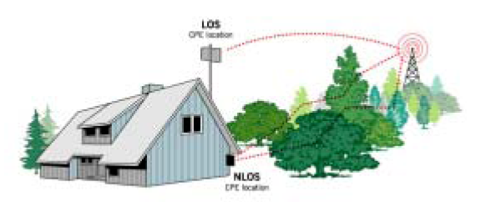
Propagation Mechanisms in wireless channels
Three propagation mechanisms in two types of propagation channels
Reflection
Diffraction
Scattering
Indoor wireless channel
Outdoor wireless channel
Transmitter
Receiver

Slide 4
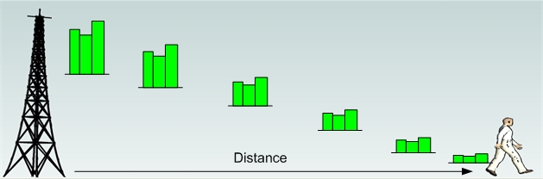
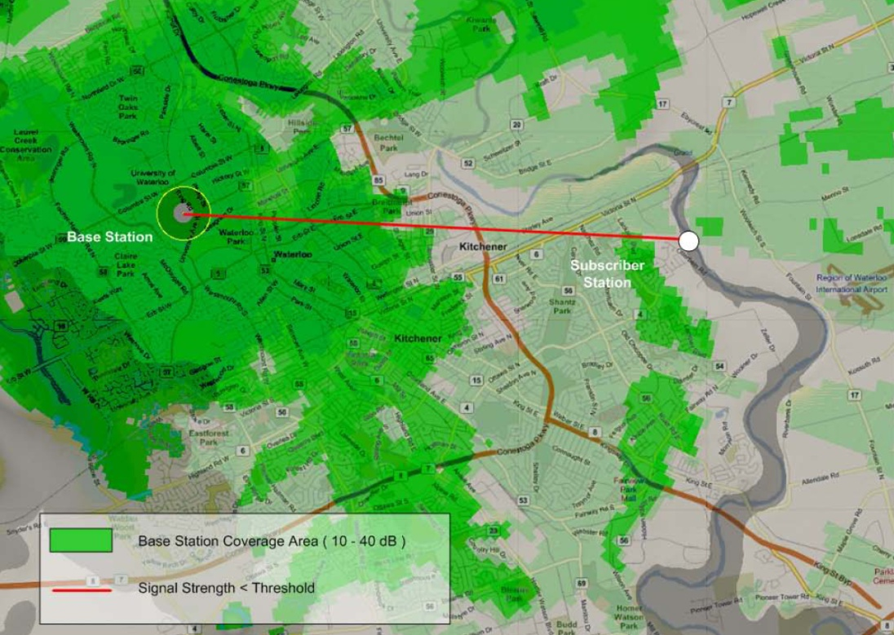
Large Scale Fading
Topographic and elevation data were obtained from Natural
resources Canada.

Slide 5
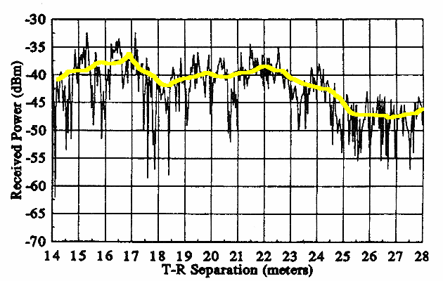
Large-Scale Fading Vs. Small-Scale Fading
Large-Scale Fading
Partly- Coherent Summation of 2 multipaths
Coherent Summation of 2 multipaths
Im
Im
Incoherent Summation of 2 multipaths
Small-Scale Fading
Im
Re
Received Power
Re
Re
Transmitter – Receiver Separation
Figure taken from :”Wireless communication, principle and practice” by T. S. Rappaport

Slide 6
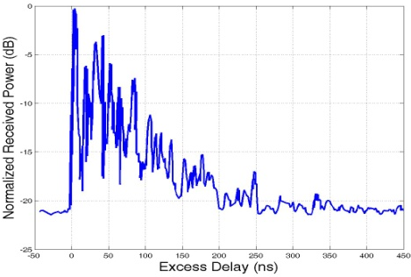
Channel-Sounding
?
Propagation mechanisms:
- Reflection.
Diffraction.
Scattering.
Measurement setting:
- frequency.
- line-of-sight vs no-line-of-sight.
- environment.
- transmitter - Receiver separation.
- human presence.
- floor Area.
- extent of Clutters.
- detection Threshold.
power
Channel Impulse Response Power
time
Transmitter
Receiver
Propagation Channel

Slide 7

Channel Impulse-Response
Total number of multipaths
n-th multipath amplitude
Normalized Received Power (dB)
Receiver Detection
Threshold
excess delay
n-th multipath excess delay
Excess Delay (ns)

Slide 8
Review: Convolution
http://www.jhu.edu/signals/convolve/

Slide 9
Frequency-Flat Vs. Frequency-Selective Fading
Transmitted Signal
Channel
Received Signal
Time Dispersion and ISI
ISI
No Time Dispersion
T_{s} @ Tx
T_{s} @ Tx
@ Rx
time
time
T_{s} <<
T_{s} >>
Frequency-Selective Fading
Frequency-Flat Fading
Bw
B_{s} @ Tx
B_{w}
B_{s} @ Rx
B_{s} @ Tx
Frequency
B_{s} @ Rx
Frequency
B_{s} >> B_{w}
B_{s} << B_{w}

Slide 10
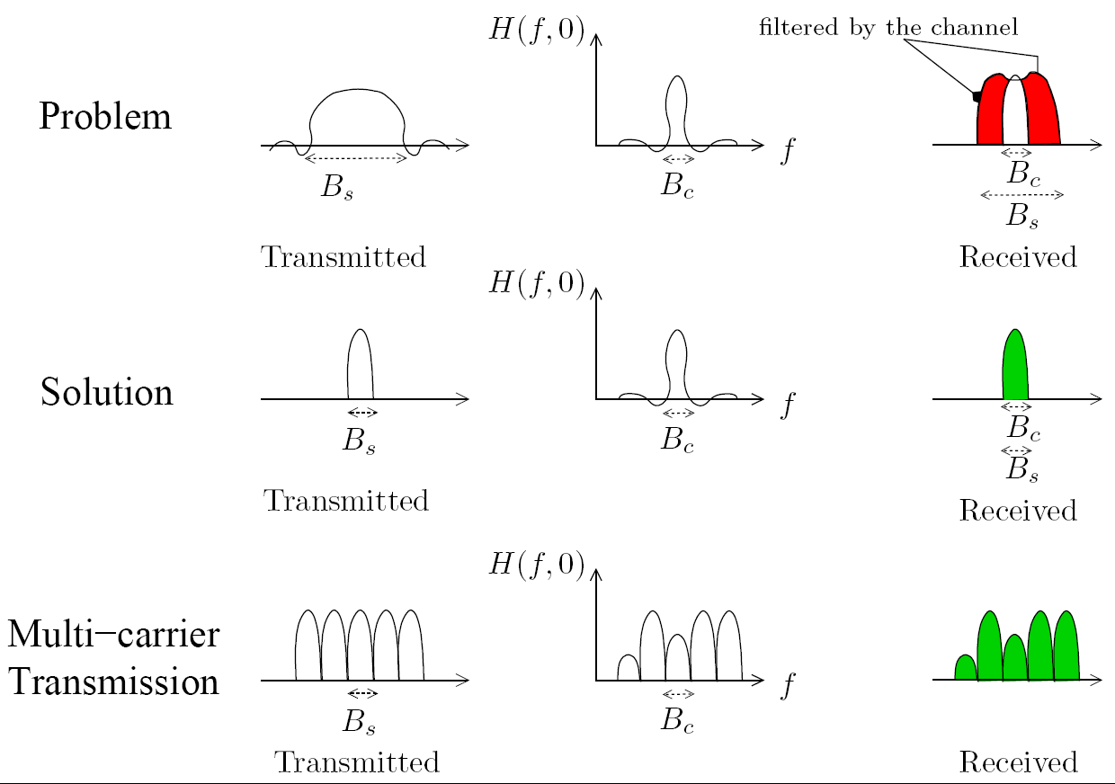
Multicarrier Transmission

Slide 11
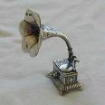
History of Multicarrier transmission
A principle for multi-channel transmission over a bandlimited channel was proposed in 1966 !!
Why did take that long to be implemented?
DFT !
Combine ?

Slide 12
What is OFDM?
Orthogonal Frequency Division Multiplexing
Method to multiplex many “narrowband” signals into an aggregate “wideband” data stream
Normally, the subcarriers would need sufficient separation to avoid adjacent channel interference
OFDM uses orthogonal (1/T_{sym}) subcarrier spacing to maintain subcarrier separation

Slide 13
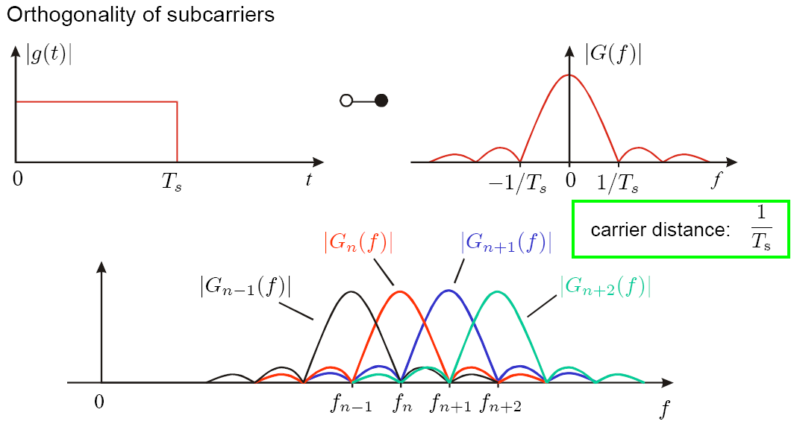
Orthogonality

Slide 14
Orthogonal Carrier Spacing
1/T_{sym}
1.2
1
0.8
0.6
0.4
0.2
0
-0.2
-0.4
0
5
10
15
20
25
30

Slide 15
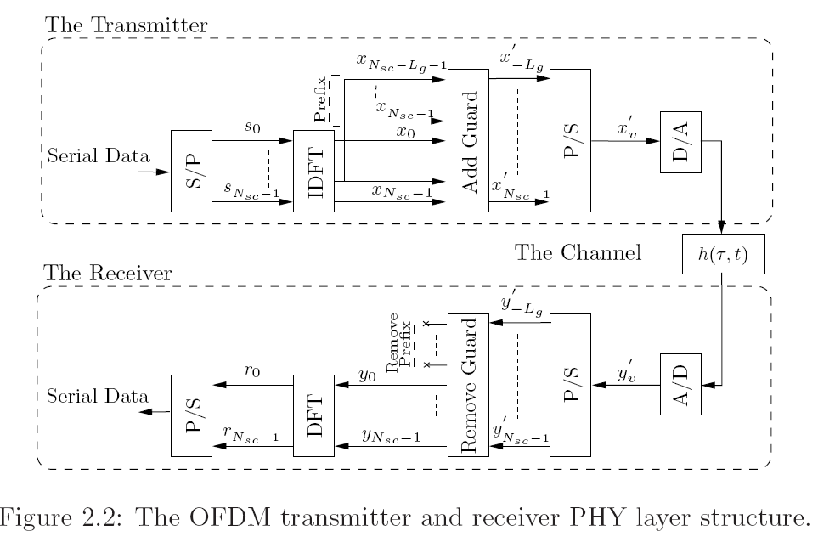
OFDM System Model

Slide 16
OFDM-TDMA MAC
Frequency
User 1
1.2
Sub-1
User 2
1
0.8
Sub-2
0.6
Sub-3
User 3
0.4
0.2
Sub-4
User 4
0
-0.2
Sub-5
-0.4
0
5
10
15
20
25
30
Time
Easy implementation
Simple resource allocation
Low processing requirement
Low signaling overhead (channel gain)
Advantages
High latency, # users large
In-effecient power usage
In-effecient in frequency utilization
Disadvantages

Slide 17
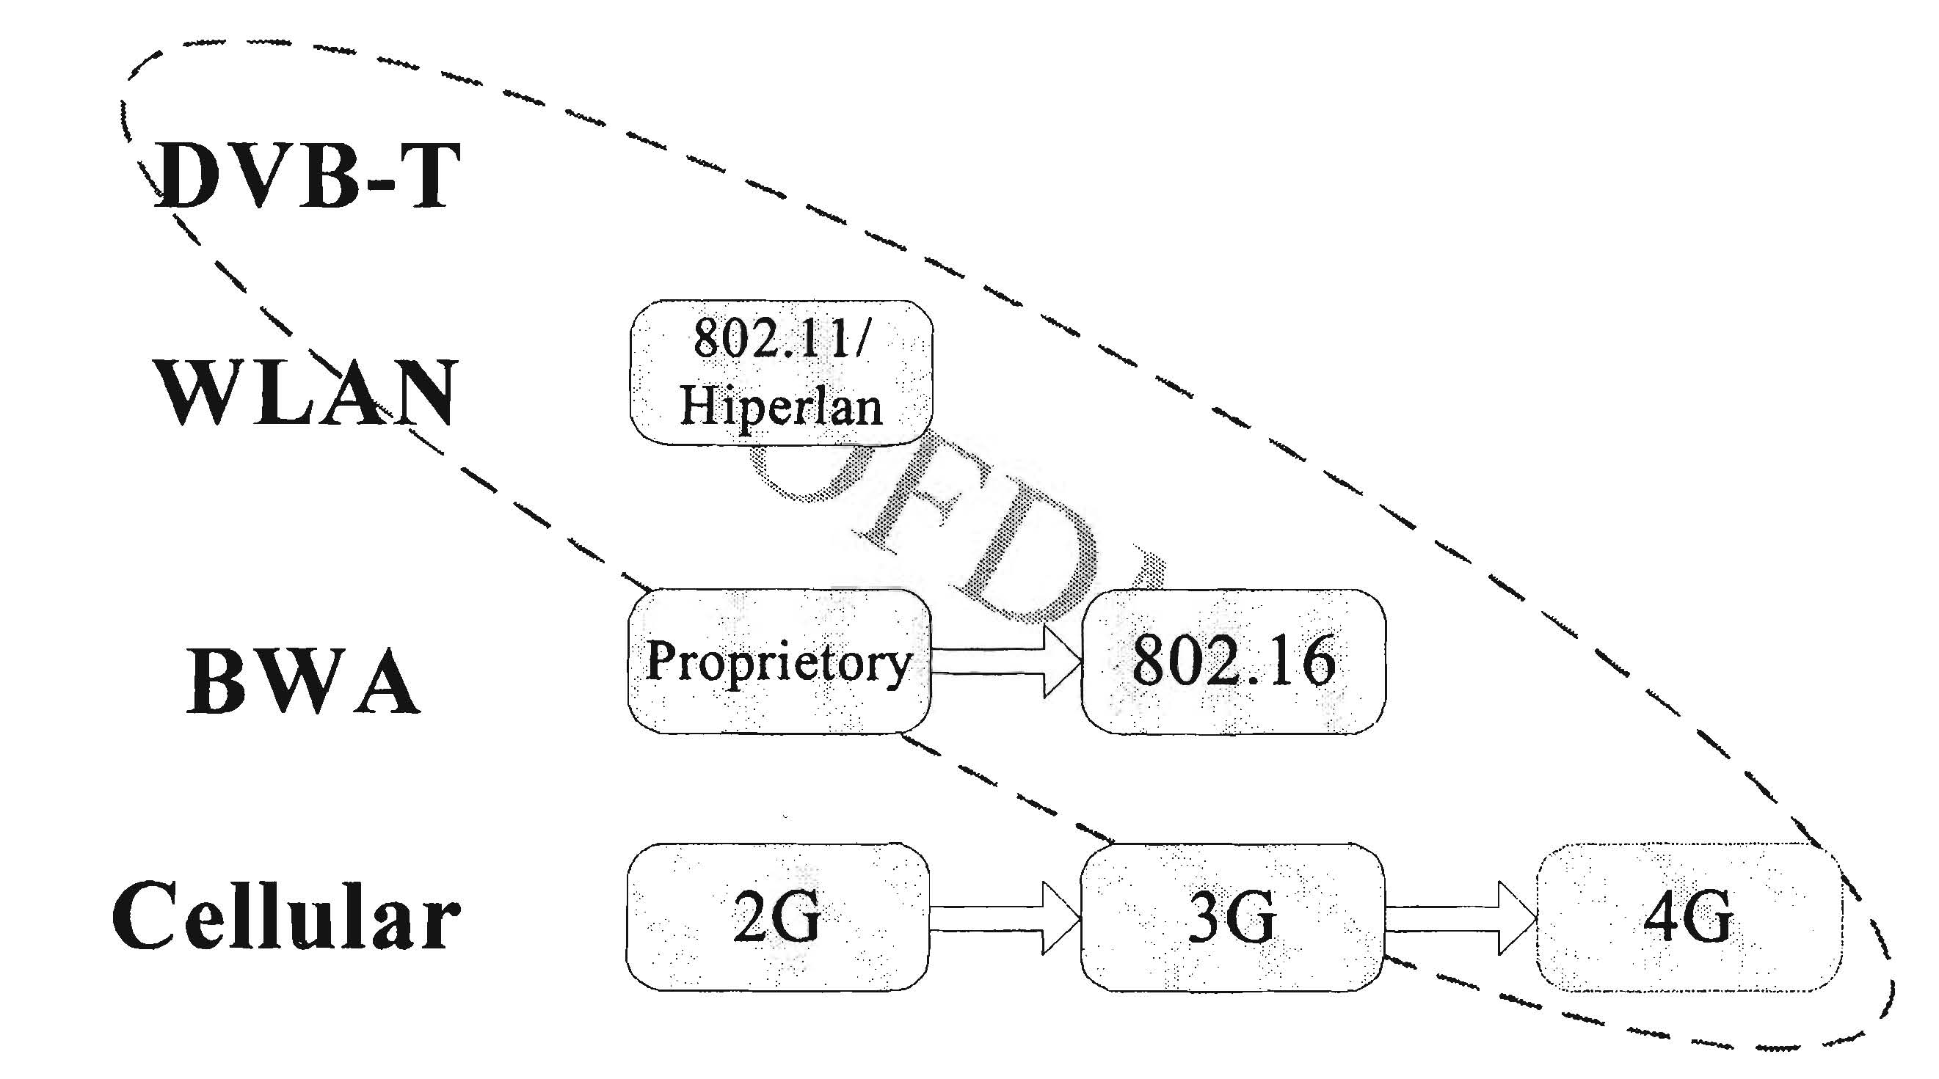
Applications

Slide 18
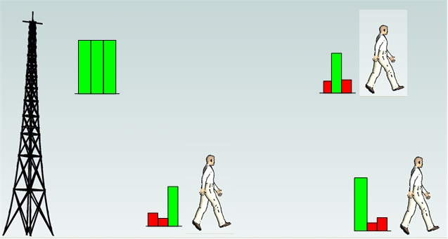
Multi-user diversity

Slide 19
Time Varying Channel
The channel is generally time varying due to:
User changes location.
Object gets between the transmitter and receiver (bus)
τ_{ex}
Transmitter
Time
τ_{ex}
τ_{ex}

Slide 20
OFDMA
Orthogonal Frequency Division Multiple Access.
A subcarrier is exclusively assigned to a user.
Exploits multiuser diversity.
Dynamic subcarrier assignment
High latency, # users large
In-effecient power usage
In-effecient in frequency utilization
Disadvantages of OFDM
Frequency
User 1
Sub-1
Sub-2
User 2
Sub-3
User 3
Sub-4
Sub-5
User 4
Time

Slide 21

OFDMA Resource Allocation
Internet
Channel gain
QoS (rate, dropping rate, etc..)
Base Station ( BS )
Maximize Throughput
Assign power < Max
Each subcarrier is exclusively assigned
Guarantee QoS
Time
New
gains
Freq
Allocated subcarriers
Trans Power
User # 1
User # 2

Slide 22
OFDMA MAC
Frequency
User 1
Sub-1
Sub-2
User 2
Sub-3
User 3
Sub-4
Sub-5
User 4
Time
Advantages
Simple implementation
Resource allocation flexibility
Adaptation to channel characteristics (adaptive scheme)
Better BER performance (adaptive scheme)
Disadvantages
Complicated Res. Alocation
Signaling overhead (adaptive scheme)

Slide 23
Space Diversity
D
Two antennas separated by several wavelengths will not generally experience fades at the same time
“Space Diversity” can be obtained by using two receiving antennas and switching instant-by-instant to whichever is best
Signal received by Antenna 1
Signal received by Antenna 2
Combined Signal

Slide 24
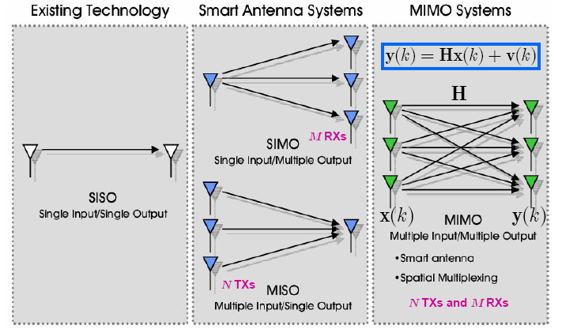
MIMO systems

Slide 25
MIMO
Basic idea of MIMO: Improve quality (BER) and/or data
rate (bits/sec) by using multiple TX/RX antennas
Core scheme of MIMO: space-time coding (STC)
Two main functions of STC: diversity & multiplexing

Slide 26
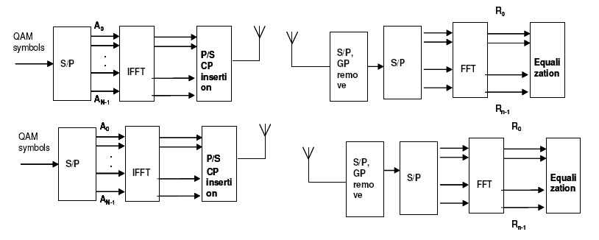
MIMO - OFDMA

Slide 27
Conclusion
Wireless channel suffers from large scale fading and small scale fading
After modeling the channel, communication systems are matched to the channel.
OFDMA is one of advanced technologies to overcome the wireless channel impairments.
OFDMA can be combined with MIMO to improve performance .

Slide 28
Questions
????????????????????????????????????????????????????????????????????????????????????????????????????????????????????????????????????????????????????????????????????????????????????????????????????????????????????????????????????
????????????????????????????????????????????????????????????????????????????????????????????????????????????????????????????????????????????????????????????????????????????????????????Questions???????????????????????????????
????????????????????????????????????????????????????????????????????????????????????????????????????????????????????????????????????????????????????????????????????????????????????????????????????????????????????????????????????
????????????????????????????????????????????????????????????????????????????????????????????????????????????????????????????????????????????????????????????????????????????????????????????????????????????????????????????????????

