Slide 1



AI Legal Chatbot
(Release 1)

Slide 2
Presentation Overview
Overall Architecture
Microservice approach
Natural Language Processing
Using an NLP Pipeline to analyze user messages
Rasa AI
Machine Learning
Data Processing and Feature Extraction (Unsupervised Learning)
Model Training and making predictions (Supervised Learning)
Demonstration

Slide 3
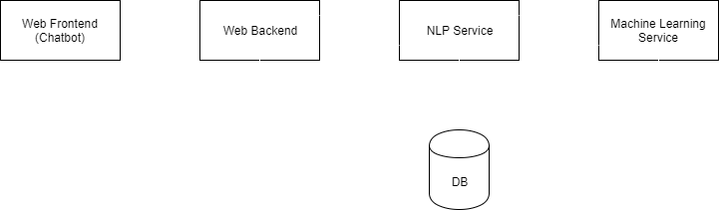
Overall Architecture

Slide 4
Natural Language Processing
Takes Natural Language (like English) and predicts 2 things:
The intent of the user (what they wanted to say)
Entities out of the user’s message (amount of money, time, date, etc)
Library Used: Rasa.AI
Allows us to modularly assemble different components for a customized output
Pipeline of various NLP techniques
Tokenization, Entity extraction, Intent Classification
Open source and therefore permanent and flexible

Slide 5


Natural Language Processing
Framework
RASA Natural Language Understanding
Basic Flow
Bot asks question:
“Are you a student?”
User answers:
“I study at Concordia University”
NLU System generates confidence for answer
Fact: is_student
True - confidence 90%
False - confidence 10%
training data
is_student
I study at ___
I’m a graduate student
.
.
I’m not a student
I dropped out of school
.
.
T
F
RASA
Intents
True
90%
False
10%

Slide 6
Problem!
Inexperienced in the domain of law.
Too much data to physically inspect
Lack of french potency on the team.
How do we solve this problem?

Slide 7
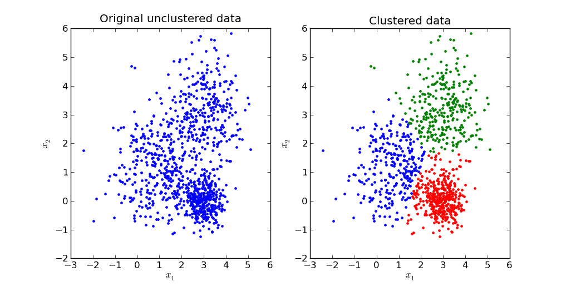
Machine Learning - Clustering
Clustering groups similar data points together.
Clusters serve as visual aid to narrow down important topics.
Clusters allow for the creation of formatted data

Slide 8
Data Processing
Words can be expressed as vectors. → Sentence can be expressed as a the mean of these vectors. (Word2Vec)
Vectors are “machine readable”
Compare similarity between vectors to cluster them via unsupervised machine learning.
Post-processing → Tag clusters with human readable labels (Regex).
Generate precedent vector(s) to feed the supervised machine learning

Slide 9
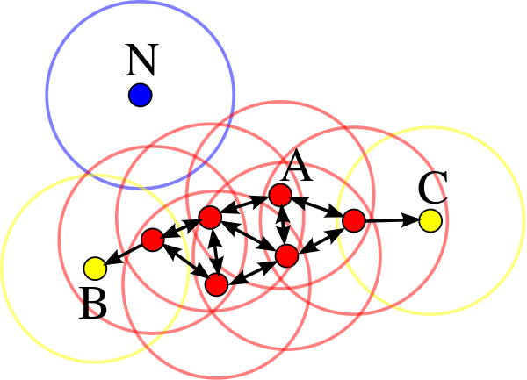
Machine Learning - Clustering
Algorithm Used: HDBSCAN (Ester et al. 96)
Algorithm is a variant of DBSCAN
Pros:
No need to specify number of clusters
Scales well with the number of data points
Does not attempt to classify noise
Clusters are coherent (see example)
Cons:
Number of clusters are very high (>3000) for our dataset
Either multiple clusters for the same fact, or multiple facts per cluster

Slide 10
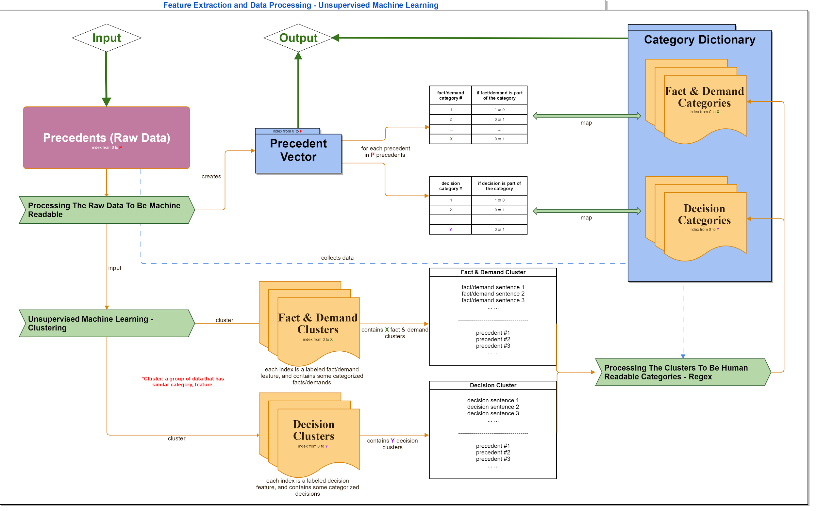

Slide 11
Machine Learning - Current extracted facts
Approximately 50 facts that we have extracted from cases:
Examples:
Tenant_has_bad_payment_habits
Tenant_has_damaged_rental
Tenant_rent_not_paid_more_3_weeks
Apartment_is_infested
etc

Slide 12
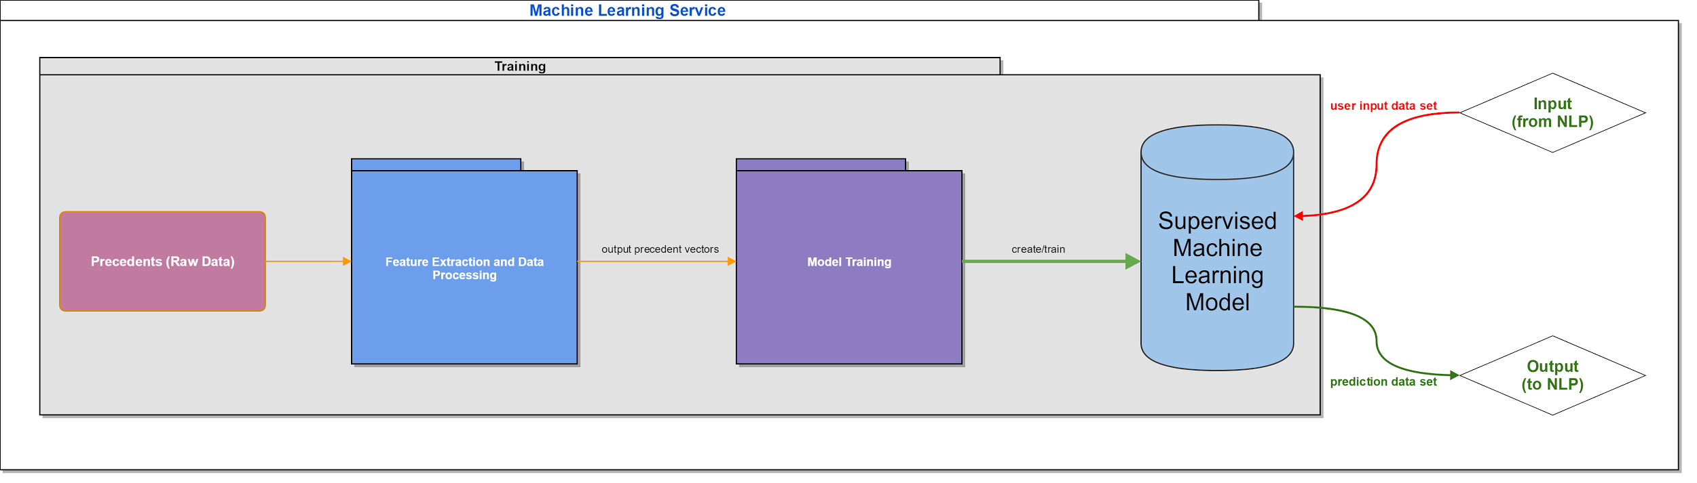
Machine Learning - Pipeline

Slide 13

Machine Learning - Supervised learning
Formatted data is fed into the supervised machine learning algorithm
Result of machine learning can predict a result based on a user’s input
More data → Better!! :)

Slide 14
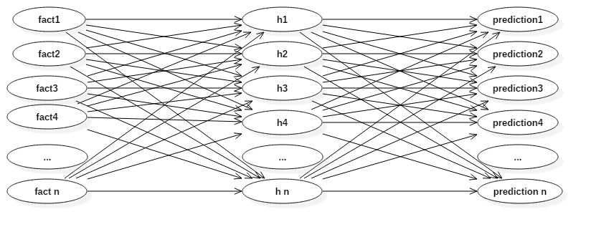
Initial Supervised Learning
Multilayer Perceptron

Slide 15
Initial Supervised Learning
Multilayer Perceptron
Pros:
Hidden layers help system “understand” nuances between facts
Efficient Implementations exist as open source libraries
Predicted outcomes with a high accuracy; Test accuracy: 94%
Cons:
No direct relation between a given fact and the prediction it makes (Required for explaining the legal reasoning to users)

Slide 16
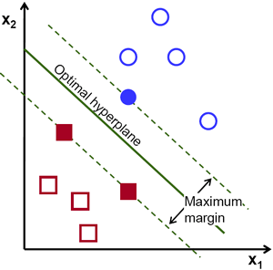
Updated Supervised Learning
Support Vector Machine
Relies on finding the best hyperplane, in this case line that “best” separates the different classes

Slide 17
Updated Supervised Learning
Support Vector Machine
Pros:
Easy to understand the reasoning applied to predict an outcome
Works great with our dataset, with a test accuracy of 96% and F1 Score of ~95 %
Cons:
Less nuanced in its prediction, which may increase error for more complex outcome predictions

Slide 18
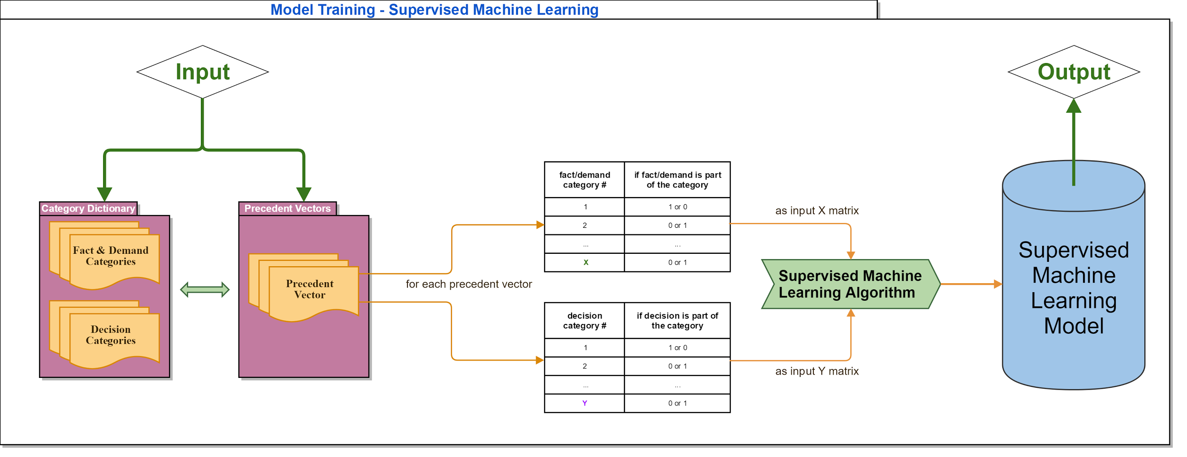

Slide 19

Demo time!

