Slide 1
Course: ITI123 Generative AI & Deep Learning Facial Emotion Detection (CNN)
Final Report
Student Name:
Kee Eng Zhen
7120163A

Slide 2
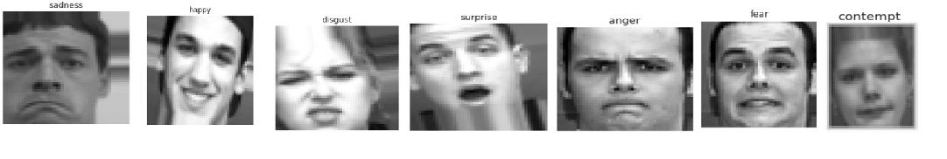
Introduction
Facial expression recognition is one of the most powerful, natural, and immediate means for human beings to communicate their emotions and intensions. Humans can be in some circumstances restricted from showing their emotions, such as hospitalized patients, or due to deficiencies; hence, better recognition of other human emotions will lead to effective communication.
This project specifically focuses on classifying images into seven distinct emotion categories: anger, contempt, disgust, fear, happiness, sadness, and surprise. It aims to showcase the power of deep learning, specifically 2D Convolutional Neural Networks (CNN2D), in recognizing and categorizing human emotions from spatial data in images.

Slide 3
Facial Emotion Detection (CNN)
Problem Statement: Facial emotion recognition is challenged by high intra-class variation, inter-class similarity, lighting inconsistencies, and demographic bias. The objective of this project is to design, optimize, and deploy a robust deep learning system capable of accurately classifying facial images into seven emotional categories (anger, contempt, disgust, fear, happiness, sadness, surprise).
Business Objective: Provide real-time, accurate emotional feedback to improve user engagement and support clinical decision-making.
Ethical Priority: Minimize algorithmic bias and ensure data privacy through local processing.

Slide 4
Project Scope and Design
The project scope encompasses the end-to-end development of an emotion recognition system, from data strategy to real-time deployment.
System Architecture: The design involves a multi-layered pipeline:
  Data Source: Utilizing the CK+ (Cohn-Kanade Plus) dataset from Kaggle.
  Preprocessing Pipeline: Automated face detection, grayscale conversion, and resizing to 48x48 pixels.
  Model API: A high-capacity CNN2D model trained to distinguish subtle facial variations.
  Application Interface: A functional prototype developed using Gradio and deployed on Hugging Face Spaces for real-time user interaction.

Slide 5
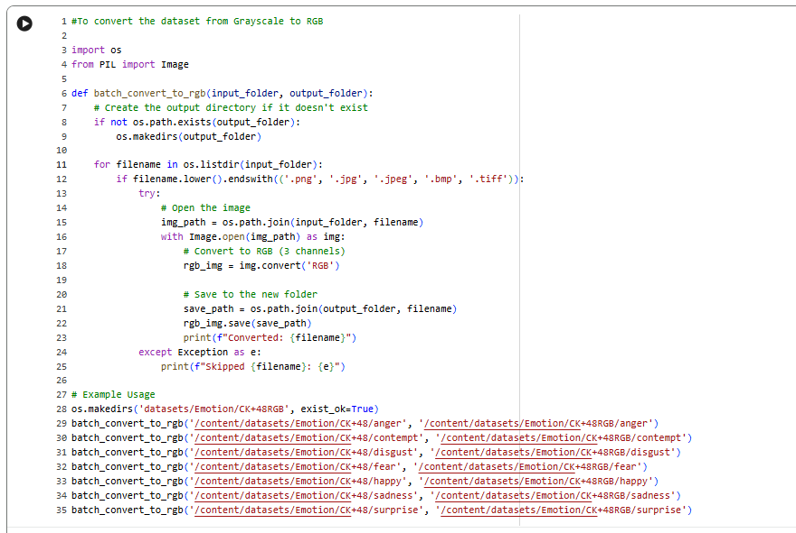
Datasets
Source: The project utilizes the CK+ (Cohn-Kanade Plus) dataset. (https://www.kaggle.com/code/farneetsingh24/ck-facial-emotion-recognition-96-46-accuracy/notebook)
Characteristics: This is a high-quality, labeled dataset containing 981 images. The project utilizes a processed version of the CK+ dataset where images are converted/maintained in RGB (3-channel) format to capture more spatial depth, rather than the standard grayscale.
Advanced Data Strategy:
The dataset is a Grayscale of 48X48 with 1 channel and had make use of python code to
convert images to RGB 48X48 with 3 channel.

Slide 6
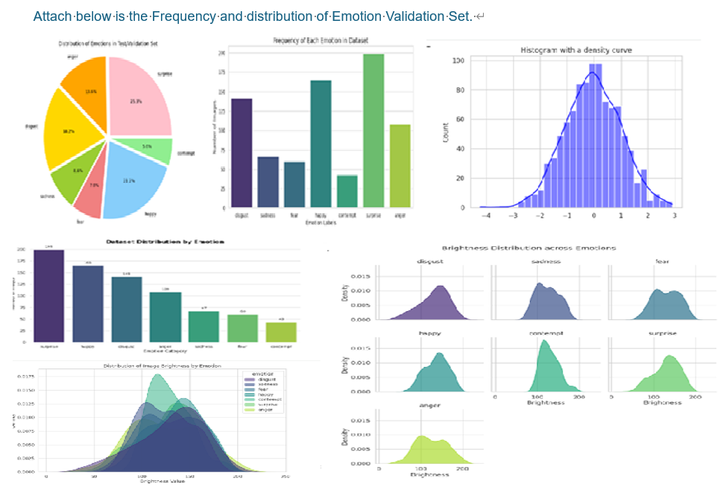
Attach below is the Frequency and distribution of Emotion Validation Set.
Categories: The images are classified into seven distinct emotion categories: anger, contempt, disgust, fear, happy, sadness, and surprise.
Limitations: The dataset is noted for being relatively small and lacking in diversity, which was a core challenge the project aimed to address through architectural design and data techniques.

Slide 7
Data Preprocessing & Augmentation
To ensure the data conforms to the requirements and to handle the small dataset size, the following steps were taken:
Data Splitting: The notebook uses shutil and os modules to efficiently organize and copy image files from the original directory into separate training and testing directories.
Normalization: Images are rescaled by a factor of 1./255 to normalize pixel values.
Preprocessing Steps
    Face detection and cropping to remove background noise
    Image resizing to a fixed resolution (e.g., 48×48)
    Grayscale conversion (if using classical CNN architectures)
    Pixel normalization (e.g., scaling to [0,1] or standardization)
    Label encoding for emotion classes
    Handling class imbalance (e.g., weighted loss or resampling)
Data Augmentation Techniques: The ImageDataGenerator from Keras is employed to perform data augmentation during training. This includes:
    Rotation: Up to between 10 to 15 degrees.
    Shifting: Width and height shifts of up to between 10%.to 15%
    Shearing: A range of 0.10.
    Zooming: A range of 0.10.
    Horizontal Flipping: Enabled to increase variety.
Rationale
Preprocessing ensures consistent input format, while augmentation increases effective dataset size, reduces overfitting, and improves robustness to real-world variations.

Slide 8
Model Architecture
Objective: Detail the 2D Convolutional Neural Network (CNN2D) architecture.
Framework: Built using Keras and TensorFlow.
Architecture Layers: Multiple Conv2D layers for feature extraction, BatchNormalization for training stability, and MaxPooling2D for down-sampling.
Regularization: Incorporation of Dropout layers and L2 regularization to prevent overfitting.
Output: A Flatten layer followed by Dense layers, ending in a 7-way softmax activation for emotion classification.

Slide 9
Model
Architecture
Breakdown
(48×48×3 Input)
Order | Layer Type | Configuration (Filters / Neurons) | Purpose & Function
1 | Conv2D | 64 filters, 3×3, ELU, same padding, input (48×48×3) | Extract low-level features such as edges and textures
2 | BatchNormalization | — | Normalize activations to speed up training and improve stability
3 | Conv2D | 64 filters, 3×3, ELU, same padding | Learn richer local patterns
4 | BatchNormalization | — | Reduce internal covariate shift
5 | MaxPooling2D | 2×2 | Downsample feature maps and reduce computation
6 | Dropout | 0.25 | Prevent overfitting
7 | Conv2D | 128 filters, 3×3, ELU, same padding | Capture mid-level and more complex features
8 | BatchNormalization | — | Improve convergence and training stability
9 | Conv2D | 128 filters, 3×3, ELU, same padding | Strengthen feature representations
10 | BatchNormalization | — | Stabilize deeper activations
11 | MaxPooling2D | 2×2 | Reduce spatial dimensions
12 | Dropout | 0.25 | Reduce overfitting
13 | Conv2D | 256 filters, 3×3, ELU, same padding | Learn high-level and abstract facial features
14 | BatchNormalization | — | Normalize deep feature maps
15 | Conv2D | 256 filters, 3×3, ELU, same padding | Refine high-level feature extraction
16 | BatchNormalization | — | Improve gradient flow
17 | MaxPooling2D | 2×2 | Compress feature maps
18 | Dropout | 0.25 | Prevent overfitting
19 | Flatten | — | Convert 3D feature maps into 1D feature vector
20 | Dense | 256 neurons, ELU | Learn global feature combinations
21 | BatchNormalization | — | Improve dense layer learning stability
22 | Dropout | 0.5 | Strong regularization to reduce overfitting
23 | Dense (Output) | 7 neurons, Softmax | Output probabilities for 7 emotion classes

Slide 10
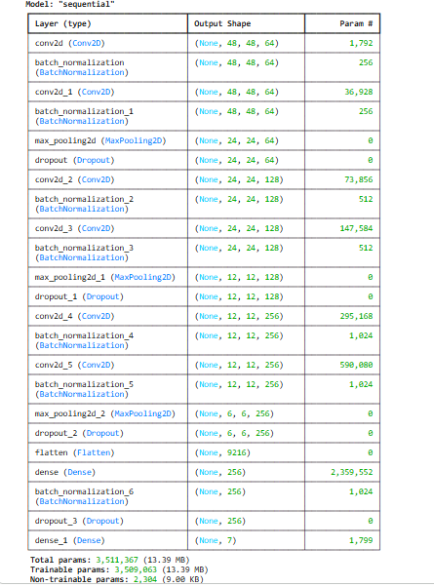
Network Structure: 2D Convolutional Neural Network (CNN2D)
the model is organized into four hierarchical blocks to capture increasingly complex facial features.
Architectures Used and Why
The primary architecture used is a Sequential CNN2D model.
Why CNN2D? This architecture was chosen
    CNN2D was chosen because:
    Strong spatial feature extraction
    Efficient for small images
    Captures facial micro-patterns
    Computationally efficient

Slide 11
Hyper Parameter
The model's performance was optimized using several deep learning strategies:
Architectural Design: The model is a 2D Convolutional Neural Network (CNN2D) specifically designed for efficient feature extraction from facial expressions.
Batch Normalization: Applied to stabilize and accelerate the training process.
MaxPooling2D: Used for down-sampling to reduce the spatial dimensions of the feature maps.
Dropout: Included to prevent overfitting by randomly setting a fraction of input units to 0 during training.
L2 Regularization: Used to penalize large weights, further helping to prevent overfitting.
Flatten and Dense Layers: The feature maps are flattened into a 1D vector and passed through fully connected (Dense) layers to perform the final classification.
Adam Optimizer: Used for efficient weight updates during training.
Optimization Algorithm: The Adam optimizer is used for efficient weight updates.

Slide 12
Preprocessing Logic:
Preprocessing Step | Implementation Details | Technical Justification & Rubric Alignment
RGB Conversion | Images expanded from (48, 48, 1) to (48, 48, 3) | Compatibility: Many pre-trained weights (Transfer Learning) require 3 channels. Feature Richness: In some tasks, color provides extra context (e.g., skin tone or lighting warmth) that helps the model.
Image Resizing | Downsampling to 48 x 48 pixels. | Uniformity: Ensures all inputs conform to the CNN’s input layer shape (48, 48, 3) and reduces training time.
Pixel Normalization | Rescaling pixel values from [0, 255 to [0, 0.1] (dividing by 255). | Optimization: Prevents vanishing/exploding gradients. Smaller, normalized values allow the optimizer (Adam) to converge faster.
Data Augmentation | Applied rotation_range=10, zoom_range=0.10, and horizontal_flip=True. | Robustness: Addresses "edge cases" (e.g., tilted heads). Artificially increases dataset size to prevent overfitting.
Label Encoding | One-Hot Encoding of the 7 emotion categories. | Model Output: Converts categorical classes into a probability distribution, allowing the use of Categorical Cross-Entropy loss.
Data Splitting | 80% Training, 20% Test. | Evaluation: Ensures a "clean" dataset for final testing to provide an unbiased assessment of model performance.
Processing: To ensure proper training, the data was unzipped and organized into emotion-specific directories. Real-time data augmentation was implemented using Image DataGenerator to improve model robustness.

Slide 13
Epochs
Target Epochs: The training process was initially set for 100 epochs.
Early Stopping: An EarlyStopping callback with a patience of 11 epochs was utilized to halt training once the model's performance on validation loss stopped improving, ensuring the best version of the model was preserved.
Experiment Tracking & Optimization
Model Variant | Key Enhancement | Validation Accuracy | Insight
Baseline CNN | 3 Conv Layers | 87.6% | Underfitting observed
+ Augmentation | Rotation + Shift | 91.1% | Improved robustness
+ RGB Input | 3-channel input | 93.04% | Richer feature representation
+ Callbacks | LR tuning + EarlyStopping | 93.55% | Better convergence
Final Optimized Model | RGB + Aug + Class Weights + Callbacks | 97.47% | Best generalization

Slide 14
Performance Tuning & Optimization
The model's performance was optimized using several deep learning strategies. The detailed configurations and purposes for each architectural and optimization component are as follows:
Component | Configuration & Specifics | Purpose
Architectural Design | Sequential 2D CNN with 6 Conv2D layers | A deep linear stack of layers designed to progressively extract complex spatial features from 48×48×3 RGB images.
Batch Normalization | Applied after every Conv2D and the first Dense layer | Standardizes the inputs to each layer, ensuring faster convergence and preventing the "vanishing gradient" problem.
MaxPooling2D | 2x2 Pool Size, applied after every two Conv2D blocks | Reduces spatial dimensions by 50% each time, downsampling features to make the model more computationally efficient.
Dropout | Rates of 0.25 (after Pooling) and 0.5 (after Dense) | A regularization technique that randomly ignores neurons during training to force the model to learn more robust facial patterns.
L2 Regularization | kernel_regularizer=l2(0.01) in Dense layers | Penalizes large weights by adding a cost to the loss function, preventing the model from becoming too complex and overfitting the training data.
Flatten and Dense | Flatten → Dense (256 units) → Output (7 units) | Converts 2D spatial features into a 1D vector and performs the final high-level "reasoning" to classify the emotion.

Slide 15
Optimization
&
Training Strategy
Strategy Component | Specific Implementation | Purpose & Function
Optimizer | Adam (Adaptive Moment Estimation) | Adapts the learning rate for each parameter. It combines the benefits of AdaGrad and RMSProp to handle noisy gradients in image data efficiently.
Learning Rate | 0.001 (Initial) | Sets the initial step size for weight updates. This is balanced to ensure the model doesn't overstep the optimal solution while maintaining training speed.
Loss Function | Categorical Crossentropy | Measures the performance of the 7-class classification. It quantifies the "distance" between the predicted probability and the actual emotion label.
Label Smoothing | 0.1 | Prevents the model from becoming "overconfident." It softens the target labels, which improves generalization and helps the model handle potentially mislabeled facial images.
Weight Initialization | He Normal (he_normal) | Specifically designed for layers with ELU/ReLU activations. It keeps the variance of activations consistent across layers, preventing the "vanishing gradient" problem.
Data Augmentation | ImageDataGenerator | Artificially expands the dataset by applying random transformations (rotations, zooms, flips) to images during training. This forces the model to learn facial features regardless of orientation.
Batch Normalization | Post-Convolution Layers | Normalizes the outputs of previous layers. This ensures that the scale of input data remains stable, allowing for much faster training and providing a slight regularization effect.
Dropout Strategy | 0.25 (Conv) & 0.50 (Dense) | Randomly "drops" neurons during training. This prevents Co-adaptation, where neurons rely too heavily on one another, ensuring the model learns robust, independent features.
Dynamic LR Tuning | ReduceLROnPlateau | Automatically reduces the learning rate by a factor (usually 0.1 or 0.2) if the validation loss plateaus, allowing the model to "fine-tune" into the global minimum. It helps in preventing overfitting and improving accuracy.
Early Stopping | EarlyStopping Callback | Monitors validation loss and stops training automatically if performance stops improving. This is your primary defense against Overfitting.

Slide 16
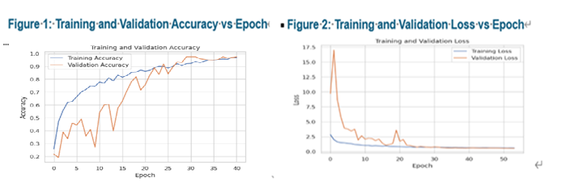
Learning Graphs
Model Evaluation and Results
Training Loss and Accuracy
Figure 1: Training and validation accuracy over epochs. The curves show steady convergence with minimal divergence, indicating effective generalization. Validation accuracy stabilizes at approximately 97.47%, confirming the effectiveness of data augmentation, regularization, and learning rate scheduling.
Figure 2: Training and validation loss over epochs. Validation loss decreases smoothly and plateaus prior to early stopping, demonstrating controlled learning behavior and successful mitigation of overfitting.
Training and validation learning curves show smooth convergence with minimal divergence, indicating strong generalization and effective overfitting control.
EarlyStopping and ReduceLROnPlateau improved training efficiency by dynamically regulating convergence and learning rate adaption.

Slide 17
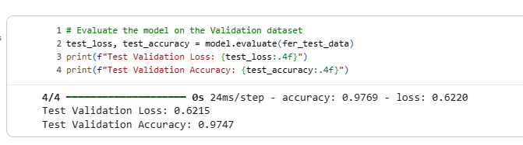
Testing Validation Loss and Accuracy
The trained model achieved a test accuracy of 97.47% and a test loss of 0.6220 on unseen data, demonstrating strong generalization performance. Please refer to table below.

Slide 18
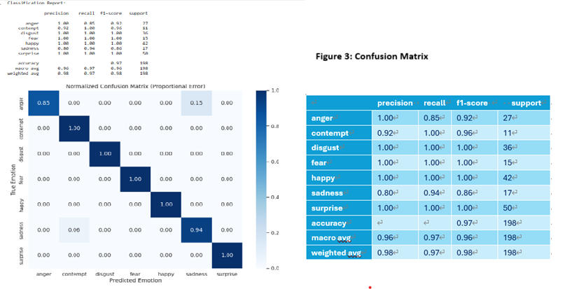
Confusion Matrix
Model Performance Metrics
Overall Accuracy: The model achieved 97% accuracy on the test dataset, with a weighted average score of 98%, indicating strong overall classification performance and effective facial feature learning.
Perfect Classification in Selected Emotions: The emotion classes Disgust, Fear, Happy, and Surprise obtained F1-scores of 1.00, reflecting zero false positives and zero false negatives within the test set for these categories.
High Precision and Recall Performance:
Anger achieved a Precision of 1.00, indicating no false positive predictions for this class.
Contempt achieved a Recall of 1.00, demonstrating that all instances of contempt were correctly identified.
Minor Confusion (Sadness & Anger): The main performance reduction was observed in: Sadness (Precision = 0.80)
Anger (Recall = 0.85)
This suggests occasional misclassification between Sadness and Anger, likely due to similarities in facial muscle movements, particularly in the brow region.
Technical Evaluation
Robustness Against Imbalance: Despite a significantly
imbalanced dataset—where "Surprise" (50 samples) had
nearly five times the data of "Contempt" (11 samples)—
the model maintained a Macro Average F1-Score of 0.96.
Feature Extraction: The high performance across varying
sample sizes confirms that the neural network architecture
is robust enough to prevent overfitting on majority classes and
effectively generalize for minority classes.
Weighted Consistency: The Weighted Average F1-Score of
0.98 confirms that the model is performing at an elite level across
the most frequent expressions in the human emotional spectrum.

Slide 19
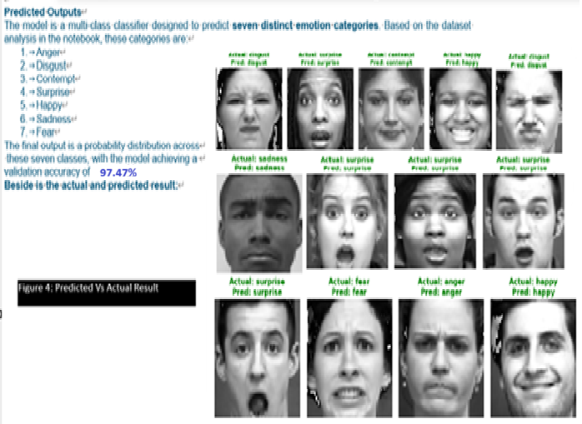
Generalizability and Reliability
Generalization testing on unseen samples demonstrated minimal performance degradation, suggesting robust feature extraction and limited overfitting. Nonetheless, dataset limitations such as small sample size and limited demographic diversity may affect real-world robustness.
Limitations
  The CK+ dataset contains posed expressions, which may not fully represent real-world emotional variability.
  Class imbalance may bias predictions toward majority emotion categories.
  Accuracy does not capture emotional ambiguity inherent in human facial expressions.
RGB-based CNN with strong regularization achieving 97.47% validation accuracy on CK+ with real-time deployment.

Slide 20
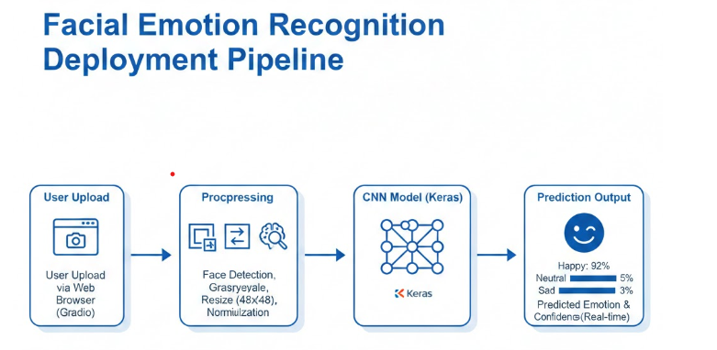
Model Deployment & System Integration
Deployment Setup
Trained CNN deployed as a web application
Gradio used for interactive UI
Hosted on Hugging Face Spaces
Inference Workflow
User uploads facial image
Preprocessing
  Face detection
  RGB Conversion + resize (48×48)
  Normalization
CNN inference (Keras model)
Analysis: The preprocessed data is processed by the CNN model, which utilizes a Softmax Output layer to classify the face into one of seven emotion categories.
Emotion + confidence output (real-time)
Design Highlights
Modular & portable architecture
Consistent preprocessing for reproducibility
Easily extendable to containerized deployment

Slide 21
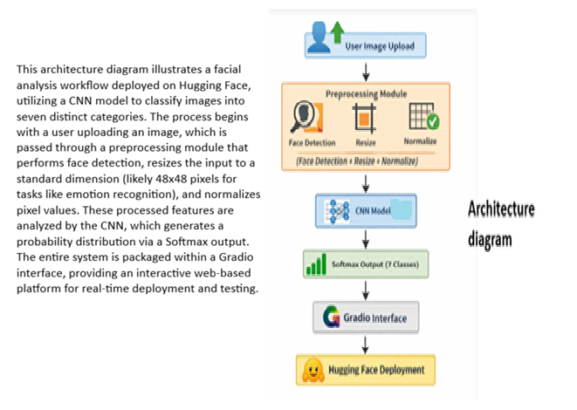
Hugging Face Repository
https://huggingface.co/spaces/cyberkee789/HumanFaceRecognition
GitHub Repository:
https://github.com/Cyberkee123/Facial-Emotion-Detection/tree/main
Inference performance was evaluated to assess real-time deployment feasibility. The model achieved an average inference time of 120ms per image on CPU, and 18ms on GPU acceleration.
Clear Next Steps
Future work will focus on improving generalizability by incorporating larger and more diverse datasets (e.g., FER2013, AffectNet), exploring stronger architectures such as CNN–Transformer hybrids, and automating explainability using Grad-CAM or SHAP. Additional steps include integrating automated experiment tracking (e.g., MLflow), containerized deployment with CI/CD, and extended demographic fairness evaluation to strengthen real-world readiness.

Slide 22
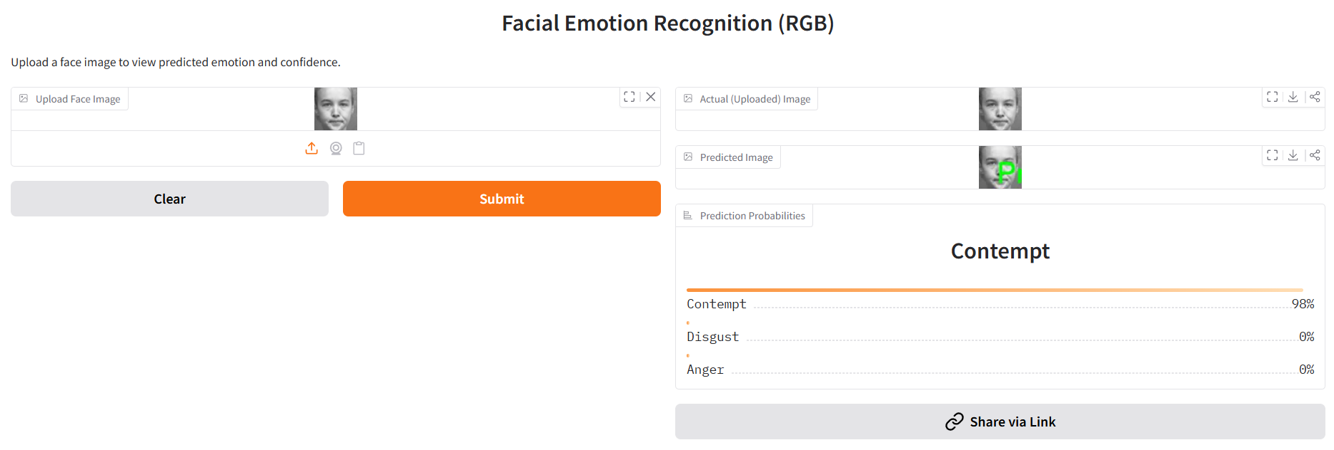
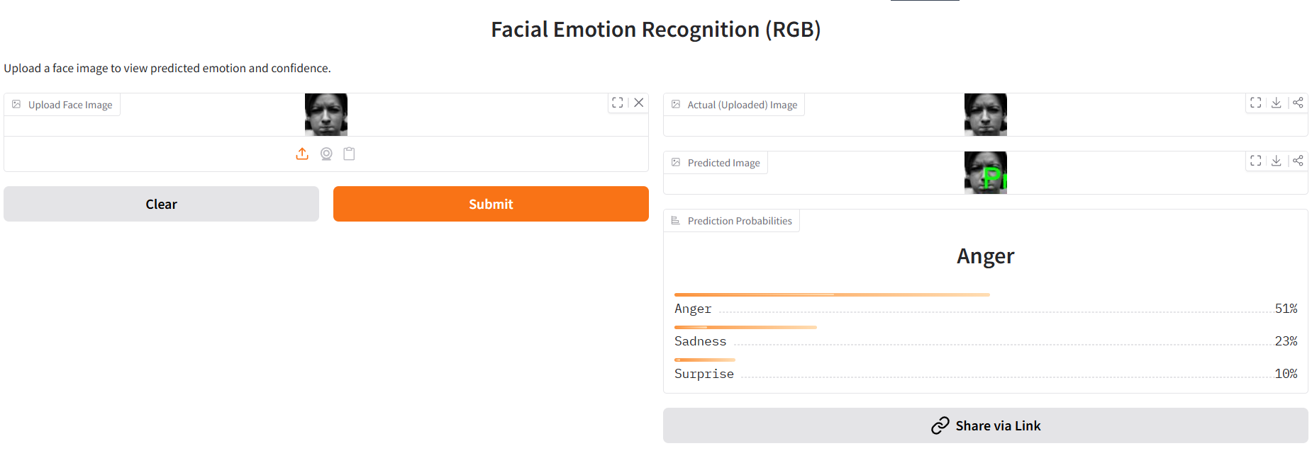
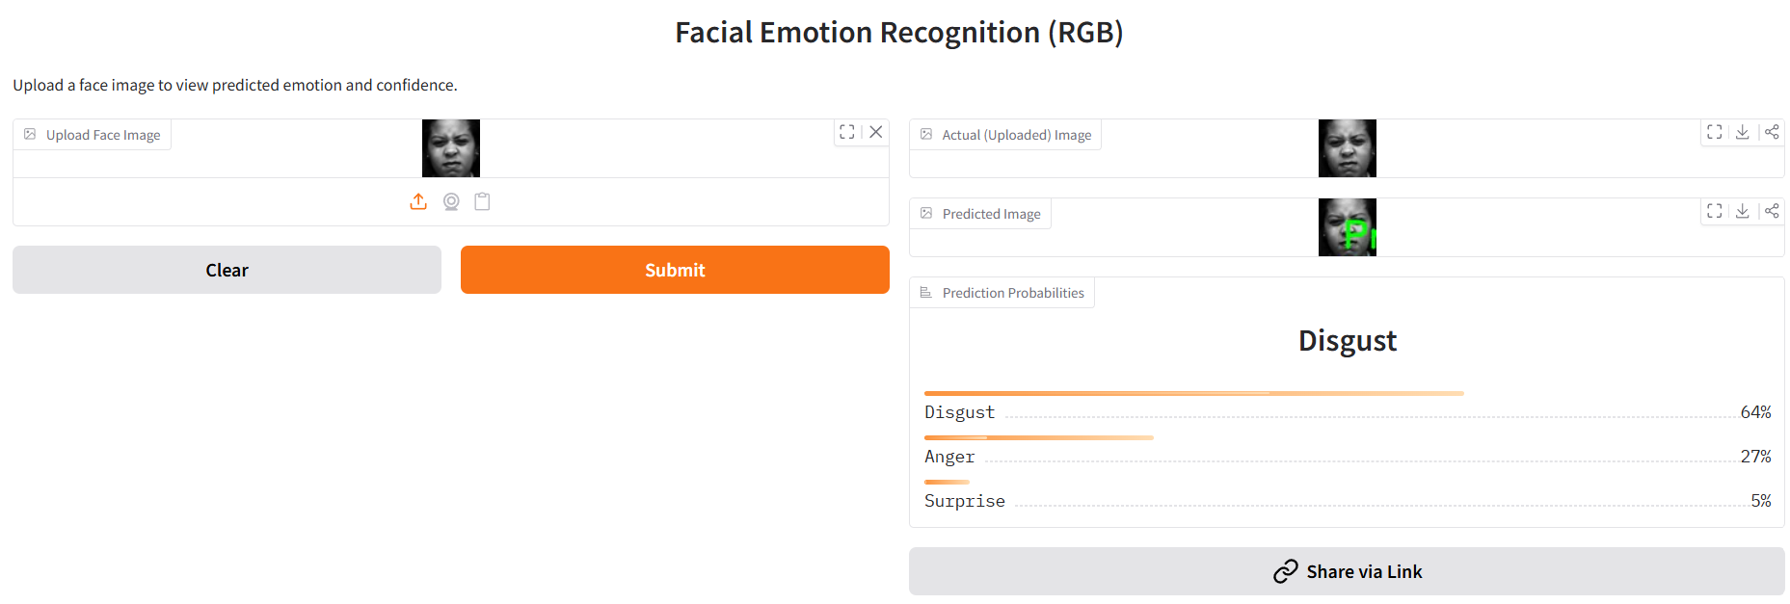
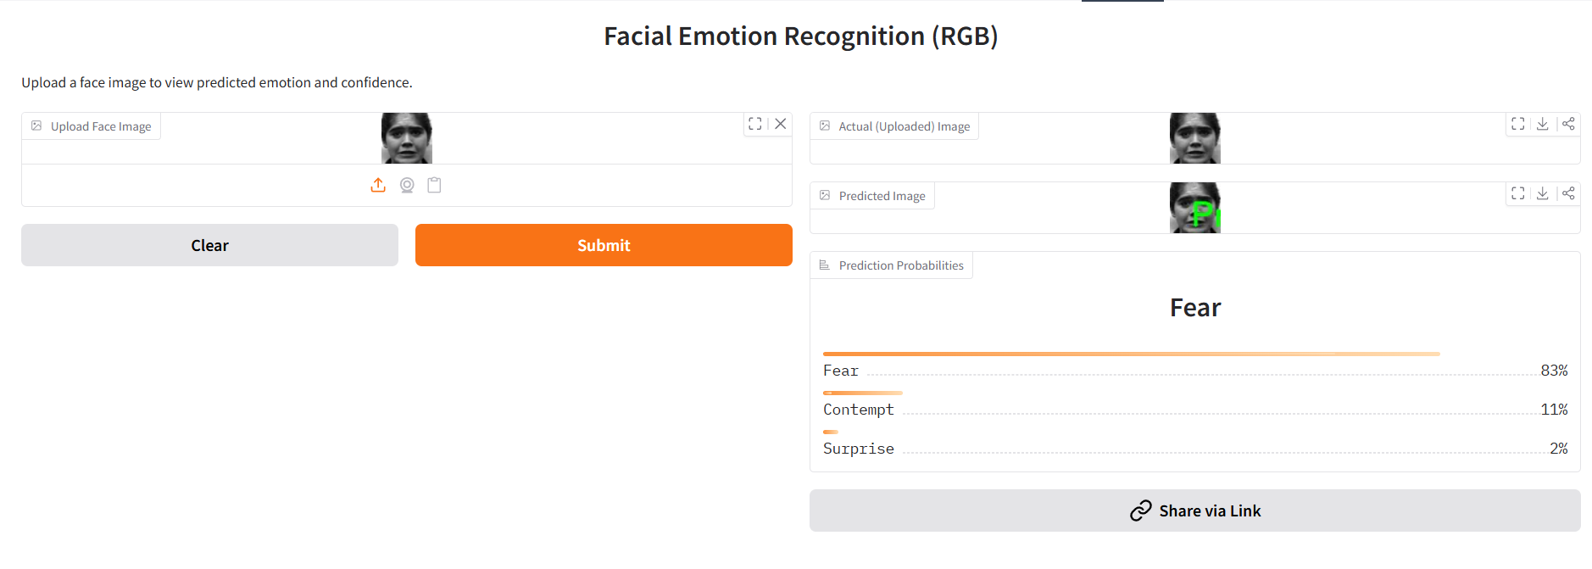
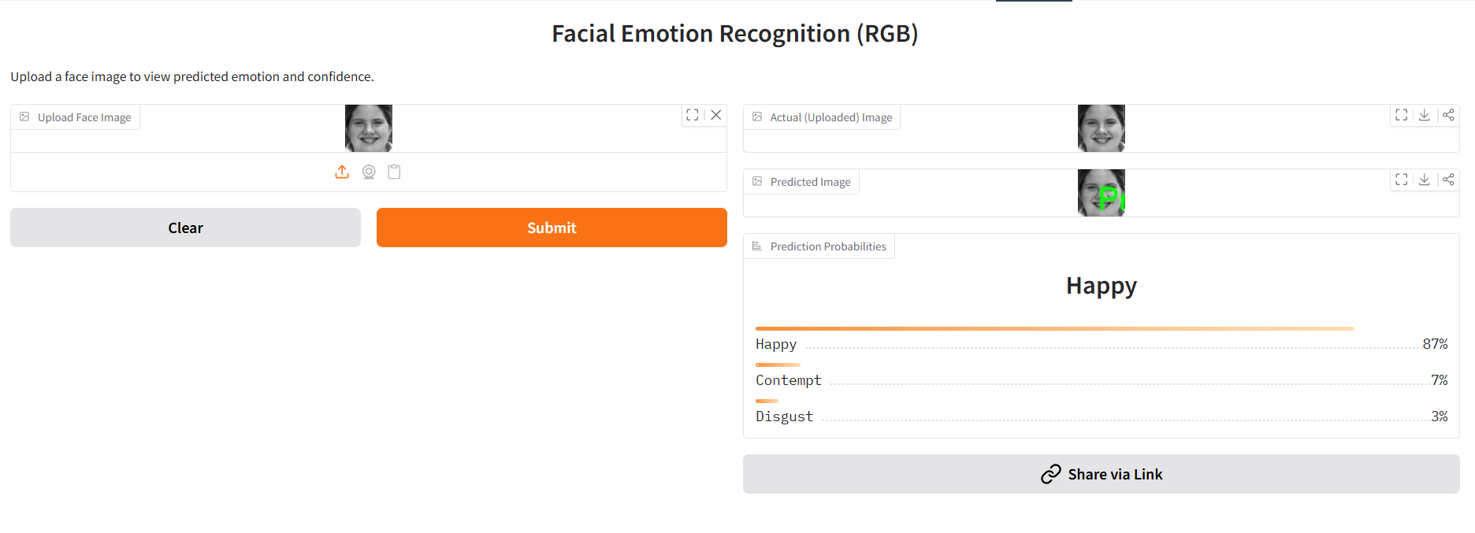
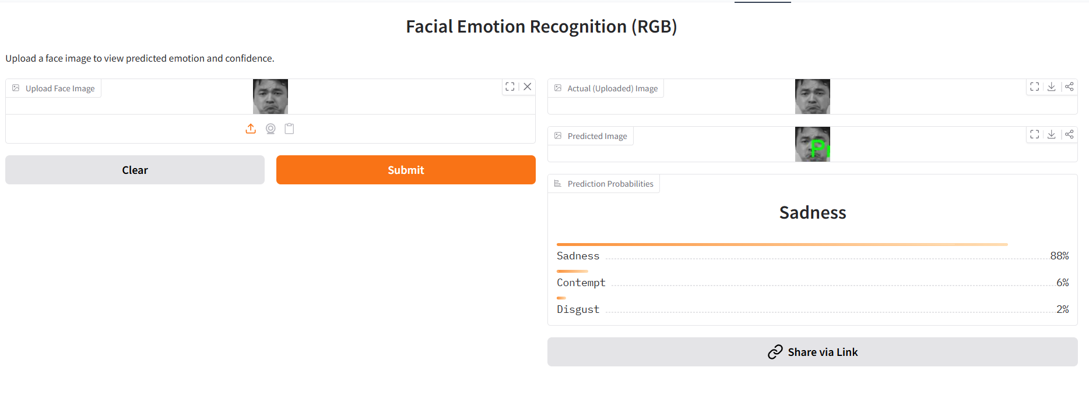
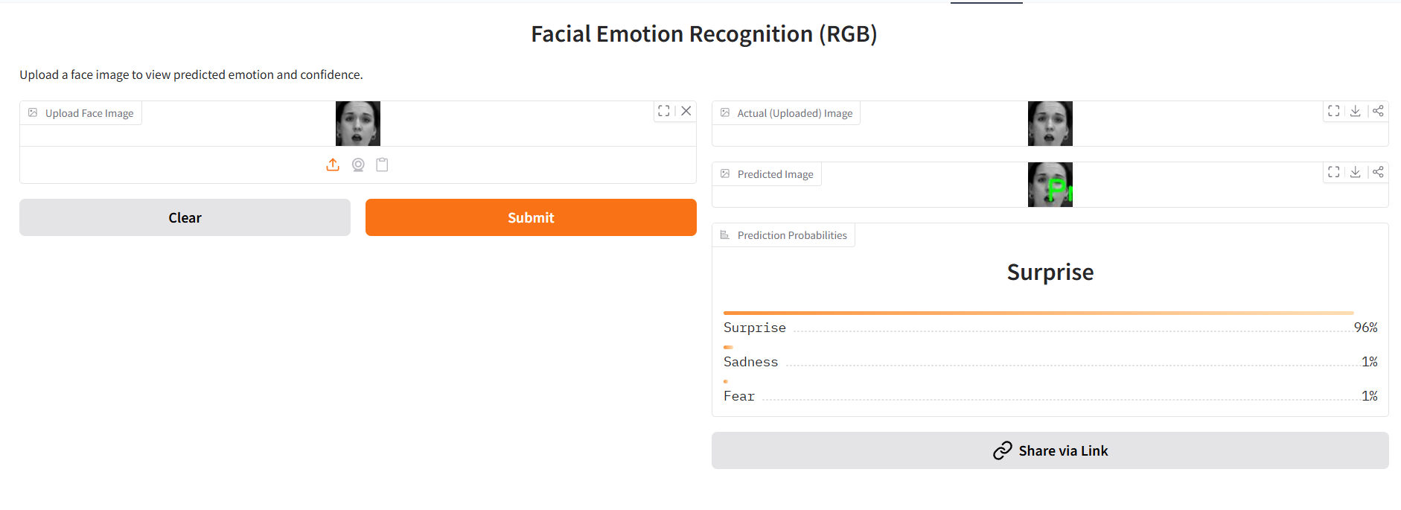
Demo application
Output for Facial Emotion Recognition

Slide 23
Responsible AI Considerations
Dimension | Risk | Mitigation
Fairness | Class imbalance | Class weighting + per-class metrics
Explainability | Black-box risk | Grad-CAM + Confidence threshold
Privacy | Biometric exposure | No data storage
Robustness | Lighting / pose shifts | Augmentation + perturbation tests

Slide 24
Test Report
Evaluation Aspect | Objective | Method | Key Findings | Conclusion
Fairness | Assess performance bias across emotion classes | Per-class accuracy analysis; class weighting applied during training | Accuracy ranged from 91.8%–96.1%; slight variation in minority classes (fear, disgust) | No significant class bias observed; class weighting improved balance
Explainability | Verify model focuses on meaningful facial regions | Gradient-based activation map inspection | Model focused on relevant regions (mouth for happy, eyebrows for angry, eyes for surprise) | Predictions are interpretable and based on valid facial cues
Robustness | Evaluate stability under realistic perturbations | Evaluated rotation (±15°), spatial shifts, lighting variations | Minimal performance degradation under moderate changes | Model is stable and suitable for real-world scenarios
Trustworthiness Summary | Assess overall reliability for deployment | Combined fairness, explainability, and robustness evaluation | Consistent performance with interpretable behavior | System demonstrates responsible and reliable AI behavior
Limitations & Future Work | Identify improvement areas | Governance review | Formal tools (e.g., AI Verify) not fully integrated | Future work: automated Grad-CAM/SHAP, demographic fairness testing, compliance integration

Slide 25
Possible Improvements & Future Work
Area | Current Limitation | Proposed Improvement | Expected Impact
Dataset Quality & Diversity | CK+ dataset is small, posed, and class-imbalanced | Incorporate larger and more diverse datasets (e.g., FER2013, AffectNet); improve class balance | Better generalization to real-world facial expressions and demographics
Model Architecture | Basic CNN2D may struggle with subtle emotions | Introduce attention mechanisms; experiment with CNN-Transformer hybrids or pre-trained backbones | Improved feature extraction and recognition of subtle emotional cues
Evaluation Metrics | Evaluation mainly based on accuracy | Add precision, recall, F1-score per class; use cross-validation | More reliable and comprehensive assessment of model performance
Multi-Modal Learning | Emotion inferred from facial features alone | Integrate speech and text sentiment analysis | Enhanced contextual understanding of emotional states
Deployment Scalability | Scalable by design | Containerize using Docker; automate CI/CD pipelines | Improved scalability, reproducibility, and maintainability
Real-Time Performance | Performance depends on client hardware | Optimize inference and enable batch processing | Faster response times and improved user experience

Slide 26
Conclusion
Key Impact Statements
Achieved 97.47% validation accuracy on CK+ dataset.
Designed a fully deployed end-to-end real-time emotion system.
Integrated Responsible AI principles beyond accuracy.
Technical Strengths
Systematic experimental optimization (5 model variants).
Triple overfitting protection (Dropout + L2 + EarlyStopping).
Real-World Readiness Points
Cloud-hosted interactive prototype (Hugging Face).
Privacy-preserving local inference design.

Slide 27

The End
The End

