Slide 1
Automated ML Application for IDS And System Administration.
_{By}
_{Adithya E S – 312418104005}
_{JAVED AKHTAR Z - 312418104056}
Under the guidance of

Slide 2
MACHINE LEARNING
Machine Learning is a branch of Artificial Intelligence, concerns the construction and study of systems that can learn from data. The goal of ML is to build computer systems that can adapt and learn from their experience.

Slide 3
AUTOMATION
Automation is the use of technology to accomplish a task with as little human interaction as possible. In computing, automation is usually accomplished by a program, a script or batch processing.

Slide 4
System Administration
System administration refers to the management of one or more hardware and software systems in an IT environment.
The task is performed by a system administrator who monitors system health, monitors and allocates system resources like disk space, performs backups, provides user access, manages files, user accounts and logs, monitors system security and performs many other functions.

Slide 5
Current challenges
Time is not on their side
Finding time to do everything is one of the greatest challenges faced by a sys-admin.
It’s hard to work around the users (are unpredictable). Doing the work without impacting the users is hard.
Need for a Centralized Management
Centralized management becomes an issue with increasing mobilization and infrastructure in the workforce.
Keeping everything running smoothly

Slide 6
OBJECTIVE
The main objective of this project is to develop a GUI Application for System Administration along
with an Intrusion Detection Model for the network.
This includes:
Secure login method for sys-admin – To limit the admin access.
An interactive Graphical User Interface – For simple interaction.
An Intrusion Detection System model using Machine Learning.
Automation of various tasks like log generation, dataset creation, model training, system health monitoring, signature scanning etc.

Slide 7
PROBLEM STATEMENT
To develop an application to reduce the workload of a system-administrator by performing some tasks using Python which the Sys-admin has to do on a daily basis. And to train a ML model for Network Intrusion Detection using the NSL-KDD dataset (containing 42 features), which is a dataset for Network based Intrusion Detection.

Slide 8
INTRUSION DETECTION SYSTEMS (IDS)
An Intrusion Detection System is a wall of defense to confront the attacks of computer systems on the internet.
The main assumption of the IDS is that the behavior of intruders is different from legal users.
There are four main types of IDS: Network intrusion detection system (NIDS), Host-based intrusion detection system (HIDS), Perimeter Intrusion Detection System (PIDS) and VM based Intrusion Detection System (VMIDS).

Slide 9
LITERATURE REVIEW
TITLE - Camera –based drowsiness reference for driver state classification under real driving conditions.
AUTHOR - Fabian Friedrichs; Bin Yang
YEAR - 2010
The performance of the latest eye tracking based in-vehicle fatigue prediction measures are evaluated.
DRAWBACKS - It cannot be detected with bad light conditions and for persons wearing glasses.
TITLE – Design of Real – Time Driver Drowsiness Detection system using Dlib.
AUTHOR –Shruthi Mohanty, Shruthi V Hedge, Supriya Prasad , J . Manikandan.
YEAR – 2019
It is based on Dlib’s shape detector which is used to map the coordinates of the facial landmarks of the input video and drowsiness detection by monitoring the aspects ratios of eyes and mouth.
DRAWBACKS – It is difficult to detect due to wrong or mismatched coordinates along with the unidentified shapes of the faces.
TITLE – Real – Time Driver Drowsiness Detection Systems using Facial features.
AUTHOR – Wanghua . Deng ; Ruoxue Wu
YEAR – 2019
It is based on the detection of drowsiness or fatigue of driver facial status such as blinking , yawning and eye closure duration .
DRAWBACKS – The change of intensity due to lighting conditions , the presence of glass and beard on the face of the person.

Slide 10
IMPLEMENTATION DETAILS
SOFTWARE :
Python 3 with necessary libraries
NSL – KDD Dataset
PyQt – Qt Designer
MySQL/MariaDB database server
Windows 7 or higher
HARDWARE AND ARCHITECTURE :
Laptop with basic hardware
Processor – i3 or i5

Slide 11
Algorithms
A great example of algorithms in action is with automation software. This is because automation works by following set of rules to complete tasks. Those rules form an algorithm.
So, automation software is sometimes made up of many algorithms all working to automate your processes.
Some of the algorithms used for automation:
Encryption Algorithm, Scheduling, Auto-ML, Scripting, IDS Algorithms, File Compression and Hashing Algorithms.
In this project, we will be using Linear Regression and CNN.

Slide 12
Modules
Pyttsx3
SMTP
MySQL
PyAutoGUI
Tkinter, PyQT
CSV

Slide 13
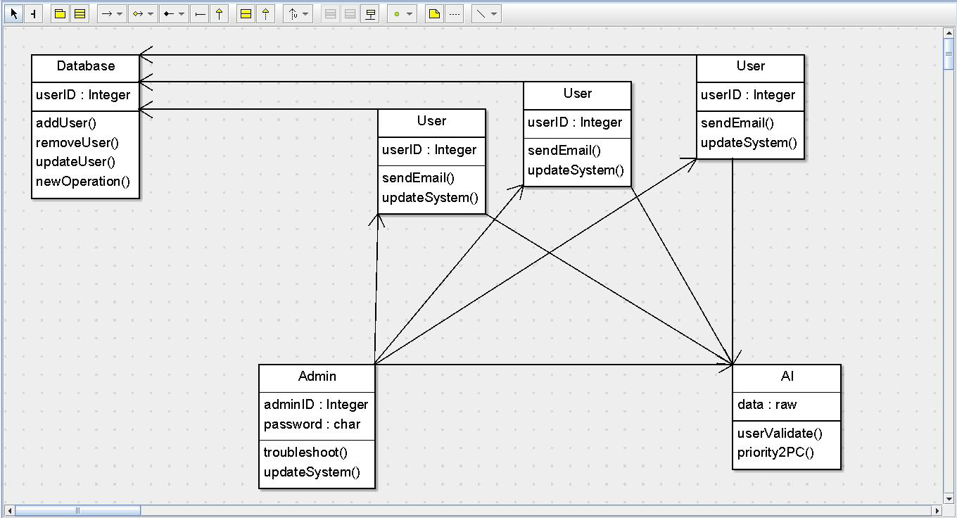

Slide 14
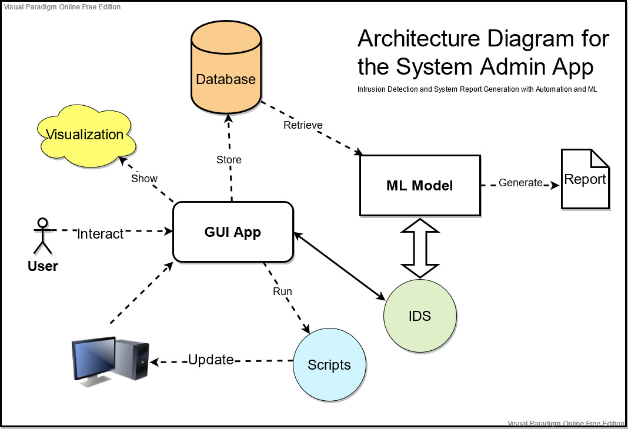

Slide 15
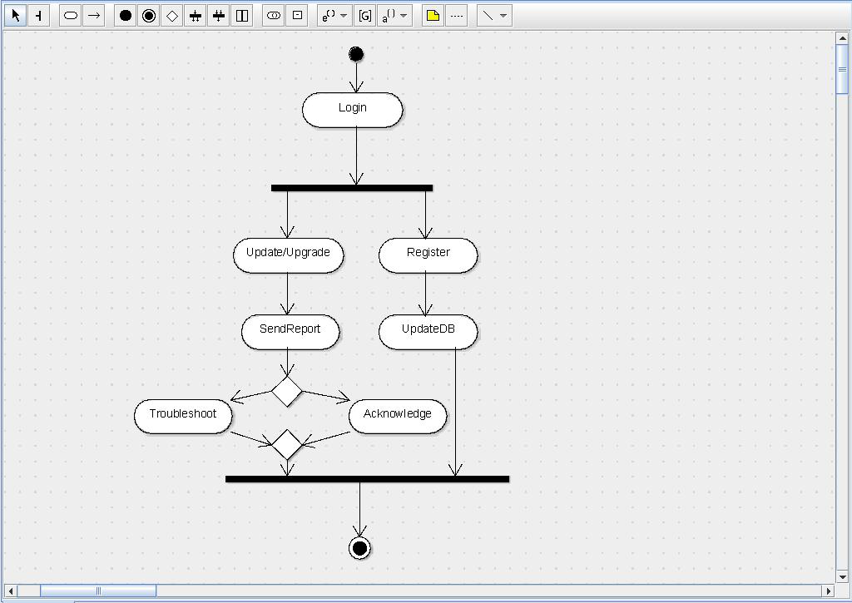

Slide 16
Use of Machine Learning
With anti-malware/anti-virus software machine learning automates detection with the help of datasets involving code paired with a classification of this code. Then it can be trained in an isolated environment with viruses or malware, but also normal programs, to learn by itself what is ok and not ok to allow to run. This allows for the detection of malware that is new or targeted malware, things that traditional anti-malware can struggle with.

Slide 17
Implementation
A GUI will be made available for the front users through which they can login (securely), do their work, and report will be generated automatically and mailed to the administrator everyday.
System health is monitored and details stored in a MySQL database. This can be added to KDD. Intrusion analysis on the generated report keeps everything safe. Regular scanning of files is done to detect signatures of viruses.

Slide 18
Pros & cons
The positives of a machine learning anti-malware solution would be that you have a system that can, if trained properly, stop many future malware/viruses without need constant updates or management. The downsides are the time it can take to train the algorithm and the resources required. The time it takes to train an algorithm is not something you can find a reliable source on however estimate a couple of weeks to get the solution ready for deployment at least. False positives can only be reduced.

Slide 19
References
KołaczekG,WarzyńskiA.(2018). Intrusion detection systems vulnerability on adversarial examples. 2018 Innovations in Intelligent Systems and Applications (INISTA). IEEE
MatinLM,Rahardjo B (2019) Malware Detection Using Honeypot and Machine Learning. 2019 7th International Conference on Cyber and IT Service Management (CITSM). IEEE
Interaction of Automation Visibility and Information Quality in Flight Deck Information Automation, 2017
Design and Analysis of Multimodel-Based Anomaly Intrusion Detection Systems in Industrial Process Automation. 2015
Machine Learning and System Administration

Slide 20
THANK YOU ….

