Slide 1
M365 Defender Integrations
Noah Taylor CSA-E Security

Slide 2








Microsoft 365 Defender Integrations
Defender for Endpoint
Defender for Cloud Apps
Defender for Office
Defender for cloud
Defender for Identity
Microsoft 365 Defender
Microsoft Sentinel

Slide 3
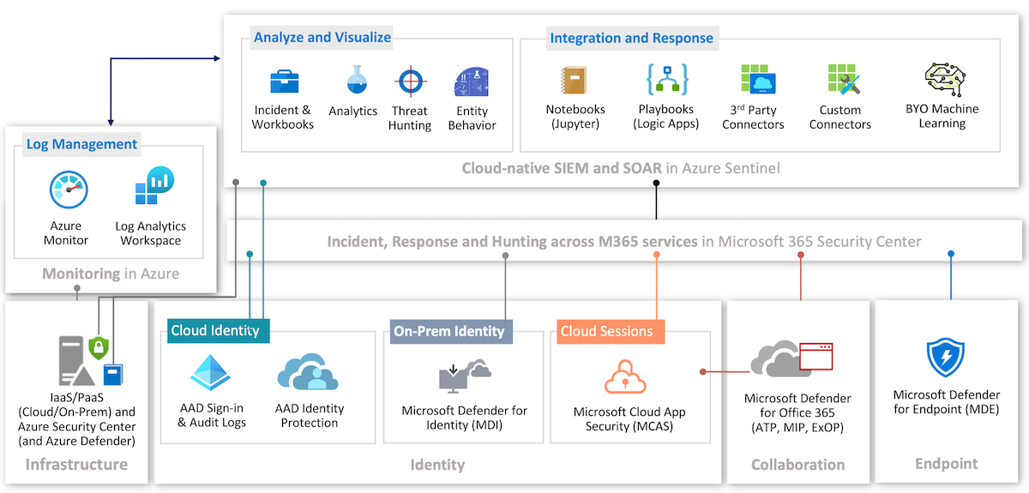

Slide 4
Microsoft Defender for Endpoint
Microsoft Defender for Endpoint
Delivering endpoint security for all your devices.
Coverage that works across platforms—from iOS and Android to Linux and macOS to Windows and network devices.
Industry-leading threat protection backed by global threat intelligence, proven with MITRE attack results.
Built in AI and automation help identify vulnerabilities and threats while enabling rapid response.
Natively integrates with Microsoft 365 Defender, enabling a full XDR solution for all your assets.
Comprehensive capabilities
Threat and vulnerability management
Attack surface reduction
Next-generation protection
Endpoint detection and response
Auto investigation and remediation
Microsoft threat experts

Slide 5


Defender for Endpoint Integrations (MDE)
Defender for cloud
Defender for Cloud Apps
Defender for Office
Defender for Identity
MS Information Protection
Microsoft Intune
Microsoft Sentinel
Defender for Endpoint
The MDCA integration with MDE extends Cloud Discovery, enables device-based investigation, and Shadow IT discovery, making use of network traffic information to see cloud apps and services being accessed.
MDI integration sends behavioral signals to MDE, tracking reconnaissance, lateral movement, credential access, and persistence attack techniques.
Defender for Cloud (DfC) works with MDE to provide threat protection on Servers, allowing for automated onboarding, integration of DfC and MDE alerts and recommendations, and server investigation in the Security portal.
With MDO integrating with MDE, we can view device details and alerts from Threat Explorer. MDE will be able to query Office 365 data, and link back to Threat Explorer
Information Protection is integrated with Microsoft Defender for Endpoint, enforcing DLP policy and sending alerts to the security portal.
MDE Alerts and Incidents are sent to Microsoft Sentinel, and a bi-directional sync can be implemented for status and closing of these incidents across MDE and Sentinel.
Microsoft 365 Defender

Slide 6
Microsoft Defender for Identity
Microsoft Defender for Identity
Protect on-premises identities with cloud intelligence.
Proactive identity posture assessments highlight misconfigurations or strays from best practice to help bolster defenses.
Built-in detections, mapped to MITRE techniques, enable SecOps to detect threats with high confidence in real time.
User investigation priority score combines data from cloud and on-premises to highlight users at the highest risk.
Integration with Microsoft 365 Defender delivers full XDR capabilities, enabling advanced hunting and comprehensive automatic remediation.
Comprehensive capabilities
Proactive identity security posture assessments
Real-time analytics and data intelligence
User investigation priority
Automatic response to compromised identities

Slide 7
Defender for Identity Integrations (MDI)
Defender for Cloud Apps
Defender for Identity
Defender for Endpoint
Microsoft Sentinel
Microsoft 365 Defender
MDCA integrates with MDI to provide user entity behavioral analytics (UEBA) across both cloud and on-premises. After enabling MDI integration, you'll be able to see on-premises activities for all the users in your organization. You will also get advanced insights on your users that combine alerts and suspicious activities across environments. Additionally, alerts from Defender for Identity will appear on the Defender for Cloud Apps policies page.
Seamless integration with Microsoft Defender for Endpoint provides another layer of enhanced security by additional detection and protection against advanced persistent threats on the operating system. MDI integration sends behavioral signals to MDE, tracking reconnaissance, lateral movement, credential access, and persistence attack techniques.
The MDI integration with Microsoft Sentinel allows us to enable centralized monitoring of alerts and discovery data, automating security procedures.

Slide 8
Microsoft Defender for Office 365
Microsoft Defender for Cloud Apps
Protect all your files and data in the cloud
Identify cloud apps and services
More than 16,000 cloud apps and services from our catalog and custom apps.
Understand risk and usage patterns
Assess across risk factors, compliance and regulatory certifications, industry standards, and recommended best practices. Also see traffic data, app categories, top users, and machine-based investigation through Defender for Endpoint.
Take control
See the apps in your environment through sanctioned or unsanctioned categories, onboard apps to Azure AD, and block apps natively through Zscaler or Microsoft Defender for Endpoint.

Slide 9

Defender for Cloud Apps Integrations (MDCA)
MS Information Protection
Azure AD Identity Protection
Defender for Endpoint
Defender for Identity
Defender for Cloud Apps
Microsoft Sentinel
Microsoft 365 Defender
MDCA discovery relies on cloud traffic logs being forwarded to it from enterprise firewall and proxy servers. Microsoft Defender for Endpoint integrates with Defender for Cloud Apps by collecting and forwarding all cloud app networking activities, providing unparalleled visibility to cloud app usage. Since the network activity is collected directly from the endpoint, it's available whether the device is on or off corporate network providing device context.
MDCA integrates with MDI to provide user entity behavioral analytics (UEBA) across both cloud and on-premises. After enabling MDI integration, you'll be able to see on-premises activities for all the users in your organization. You will also get advanced insights on your users that combine alerts and suspicious activities across environments. Additionally, alerts from Defender for Identity will appear on the Defender for Cloud Apps policies page.
MDCA integrates with Azure Active Directory Identity Protection to provide user entity behavioral analytics (UEBA) across a hybrid environment. Enabling Identity Protection integration, you'll be able to see alerts for all the users in your organization.
MDCA lets you automatically apply sensitivity labels from Microsoft Purview Information Protection. With it, we can apply sensitivity labels as a governance action to files that match specific policies, view all classified files in a central location, and quantify exposure of sensitive data over your cloud applications
The MDCA integration with Microsoft Sentinel allows us to enable centralized monitoring of alerts and discovery data, automating security procedures, and correlating between cloud-based and on-premises events.

Slide 10
Microsoft Defender for Office 365
Microsoft Defender for Office 365
Protect all of Office 365 against threats.
Built-in protection for email and collaboration tools that maximizes user productivity, simplifies administration, and reduces total cost of ownership.
Native AI and automation deliver the most continuously improved prevention, detection, and automation capabilities in the industry.
Rich integration with Microsoft 365 Defender enables full XDR capabilities to provide a comprehensive threat protection.
Secure enterprise
Prevention
Detection
Investigation and hunting
Response and remediation
Awareness and training
Secure posture

Slide 11
Defender for Office Integrations (MDO)
Microsoft Sentinel
Defender for Office
Defender for Endpoint
Microsoft 365 Defender
Integrating MDE and MDO will allow us to view device details and MDE alerts from Threat Explorer. MDE will be able to query Office 365 data while threat hunting as well as link back to Threat Explorer. It enables security operations to monitor and quickly act on at risk devices or users. Being able to track devices potentially affected by malicious email messages.
We can connect MDO to Sentinel through a data connector, sending incidents, alerts, and raw data to be able to threat hunt and track potential threats.

Slide 12


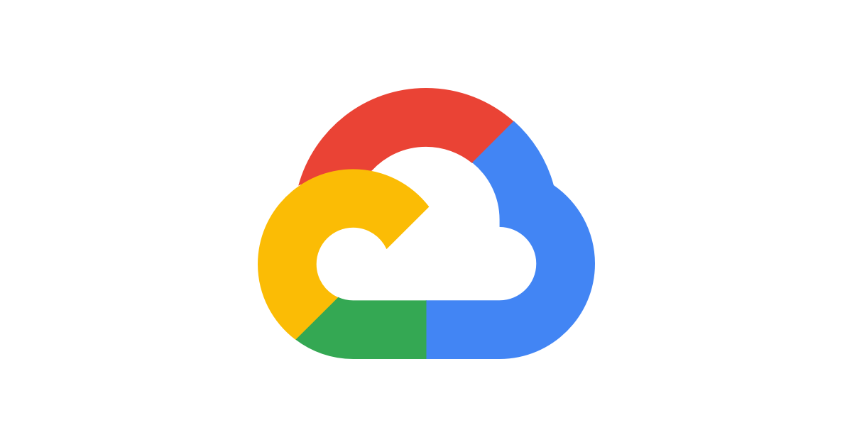

Defender for Cloud Integrations (DfC)
AWS
On-Prem
GCP
Microsoft Sentinel
Defender for cloud
Defender for Endpoint
Microsoft 365 Defender
Integrating with MDE provides comprehensive protection, making use of MDE to improve threat detection on servers. In addition, it provides automated onboarding and allows for server monitoring through the security portal single pane of glass.
Using Azure Arc we can connect servers from on-prem, AWS, and GCP into DfC, allowing integration of physical and virtual servers in your hybrid environments. Providing cloud benefits like you get with Azure resources, like tags, RBAC, MDE onboarding, alerts, compliance, and many more.
Connecting Defender for Cloud to Sentinel allows us to stream security alerts from DfC to Sentinel for the security team to view, analyze, and respond. Alert synchronization also allows the security team to close an alert and it will sync that status change between the two services.

