Slide 1
SVG & Raphaël . Js http://raphaeljs.com
By: Andrey and Ariful

Slide 2
Scalable Vector Graphics

Slide 3
7 Elements
rect
circle
ellipse
line
polyline
polygon
path

Slide 4
Attributes
alignment-baseline
baseline-shift
clip
clip-path
clip-rule
color
color-interpolation
color-interpolation-filters
color-profile
color-rendering
cursor
direction
display
dominant-baseline
enable-background
fill
fill-opacity
fill-rule
filter

Slide 5
Format - DOM
<svg version="1.1" xmlns="http://www.w3.org/2000/svg">
<rect x="0" y="0" width="320" height="200" fill="#ccc"/>
<ellipse cx="160" cy="100" rx="50" ry="80" fill="#fc0"/>
<circle cx="160" cy="100" r="50" fill="#000"/>
<line x1="160" y1="100" x2="50" y2="80" stroke="#fff"/>
<polyline points="10, 110, 10, 120, 20, 120, 20, 130, 30, 130,30, 140" stroke="#00f" fill="none" stroke-width="5"/>
<path d="M10,10C50,10 20,40 100,50L120,60l0,30
30,0-40,20L10,10z" fill="none" stroke="#f00" stroke-width="4"/>
</svg>

Slide 6
Path Syntax
M10,10C50,10 20,40
100,50L120,60l0,30
30,0-40,20z

Slide 7
Vector Icons from Paths
http://raphaeljs.com/icons/
To
http://www.freevectorsdaily.com/infographic-vector-kit-free-download/

Slide 8
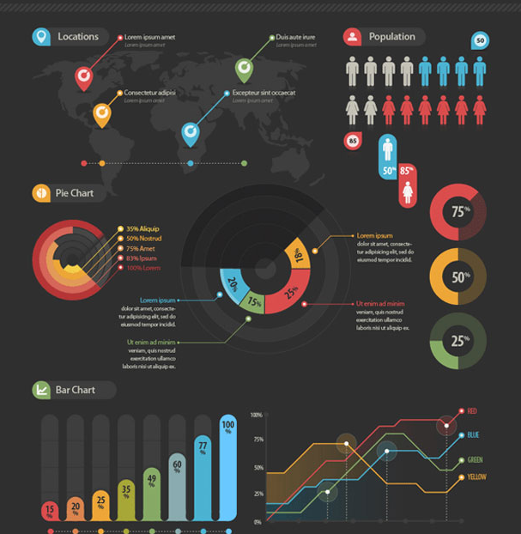

Slide 9
Easy Paths Plotting
M278.939,132.632l-0.641-0.853l0.183-1.97l-0.975,0.091l-0.92-0.092l-0.506,0.415l-0.526,0.234l-0.541,0.053l-0.939-0.271l-1.049,0.468l-0.813-0.833l-0.938-0.272l-0.851,0.631l-0.67,0.614l-1.083,0.106l-0.904,0.09l-0.108,0.741l0.288,1.068l0.722-0.073l-0.651,0.795l-0.129,0.559l-1.049,0.47l-0.757-0.291l-0.433-0.688l-0.651,0.794l-0.651,0.795l-0.309,0.578l-0.688,0.433l-0.47-1.049l-0.069-0.723l-0.435-0.688l-0.415-0.507
l-0.631-0.85l-1.121-0.254l-1.643-0.021l-0.577-0.309l-0.761-0.29l-0.722,0.071l-0.235-0.524l-0.903,0.089l-1.41,0.504l-1.3-0.237l-1.321-0.416l-0.541,0.053L250,132.249l-1.104-0.073l-0.073,1.102l-0.722,0.072l0.053,0.543l-0.869,0.449l-53.113-0.052l-0.002,0.043v45.292l0.08-0.038l1.109-0.168l1.834,0.86l1.024-0.723l1.748,0.305l2.12,0.248l1.73,1.44l0.492,2.009l1.092,0.971l0.045-0.953l1.055-0.539l0.98,0.232l1.721,0.119l1.008,0.413l0.604,2.748l1.444,2.054l1.138,0.018l1.619,0.701l1.973,1.783l0.379,1.268l1.277,0.943l1.619,0.701l1.295-0.195l-0.223-1.481l0.471-0.638l0.741-0.11l0.823,
0.444l1.85-0.28l1.434,0.729l0.925-0.139l1.223,0.571l1.164,0.204l0.658-0.666l0.896-
0.327l1.037,0.603l1.961,0.461l1.451-0.408l1.083-0.354l0.74-0.111l0.711-0.295l0.899-0.326l1.433,0.73l-0.204,1.168l0.566,1.235l0.722,1.028l0.354,1.082l-0.178,1.349l8.182,4.065l1.721,0.121l0.873,0.643h0.513l-0.213,0.64l0.112-0.336l0.227,0.167l0.939-0.471l-0.213-1.704l0.427-0.212h0.425l-0.425-1.065l-0.853-0.213l0.426-0.853l-0.426-1.064l0.426,0.214l0.427-1.491l0.851-3.406l-0.213-2.131l0.426-1.277h-0.426l1.065-0.852l-0.64-0.853l0.854,0.213l1.703-4.046l1.49-0.428l-0.641-1.275l0.641-0.214v0.853l0.424-0.214l-0.424-1.276l-0.426,0.213l0.213-0.426l-0.854-0.213l1.49-0.64l0.427-1.491l-0.427-0.639l0.64-0.215v-1.489l1.703-1.703l-0.638-0.214l1.063-0.213l-1.276-0.426l1.489-0.213l0.214-1.064l-0.64,0.426l-0.427-0.426l0.64,0.213l-0.213-0.639l0.64,0.426l0.213-1.704v-0.212l-0.427,0.425v-0.639l-0.213,0.214l-0.213-0.641l0.64,0.427l0.
213-1.064v0.853l0.852-0.426l0.214-1.064l-0.427-0.427h0.854l0.637-1.703l-0.637,0.853l-0.214-0.853h0.638v-0.853l0.213,0.853l0.854-1.491l-0.213-0.426h0.427v0.64l2.556-1.491l-0.853-0.213l-0.853,0.639l-0.213-0.213l0.426-0.426l-0.213-0.426l0.853,0.426l0.638-0.426l0.215,0.426l0.853-1.277l1.489-0.853l0.214-1.702l-0.64-0.215v0.428l-0.852-0.428h1.064l0.213-1.49l1.49-1.277l1.918-6.176l-0.213-4.26l1.489-3.834l0.213-0.639l0.64-3.62l-0.64-0.426l0.64,0.213l-0.213-0.853l1.703-3.193h-0.426l0.426-0.214L278.939,132.632zM261.268,143.072h-0.215l-0.213-0.639l0.641-0.214L261.268,143.072z

Slide 10
Additional Support
CSS2/3 and beyond
Masking & Clipping
Filters

Slide 11
Filters
feBlend
feColorMatrix
feComponentTransfer
feComposite
feConvolveMatrix
feDiffuseLighting
feDisplacementMap
feFlood
feGaussianBlur
feImage
feMerge
feMergeNode
feMorphology
feOffset
feSpecularLighting
feTile
feTurbulence
feDistantLight
fePointLight
feSpotLight
feFuncR
feFuncG
feFuncB
feFuncA

Slide 12
What is Raphael?
Think of what is
Jquery to JavaScript,
and apply it to
Raphael for SVG.
The concept will be similar.
Robust coding, compatibility and scalability

Slide 13
Raphael SVG Desktop Browser Support
All except IE6

Slide 14
Mobile SVG Support
Almost All Smart Phones, and Tablets,
With exception of Android 2.x Version, if you used with native browser.

Slide 15
What we did …
Thank you
Andrey and Ariful

