Slide 1

Employment Insights: Exploring Salary Dynamics Across Industries
Analyzing Salaries, Industries and Remote Work for Strategic Insights.

Slide 2
Group Members
Group Leader | Moses Agbe
Presenter 1 | Mercy Duru
Presenter 2 | Godwin Stephen
Member | Onogwu Godwin Ameh
Member | Muhammad Dauda

Slide 3

Introduction
Understanding salary dynamics, industry benchmarks, and remote work impact is crucial for professionals and organizations.
The Data-driven insights reveal the intricate interplay between job titles, trends, and remote work arrangements.

Slide 4

Mission
To provide employers of professional technical skills with data on global salary range for data professionals in small, medium and large organisations.

Slide 5

01
Objectives

Slide 6

Objectives
Understanding salary trends.
Exploring relationships between job titles and salaries.
Examining patterns in company size and location.

Slide 7
02
Data Cleaning and Preprocessing

Slide 8
Outcome
We found no blank cells in the dataset.
We found no duplicate data in the dataset.
3. A total of 607 unique data

Slide 9
03
INSIGHTS

Slide 10
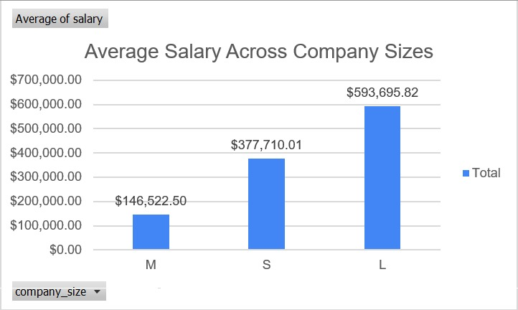
Annual Average Salary Across Company Sizes

Slide 11
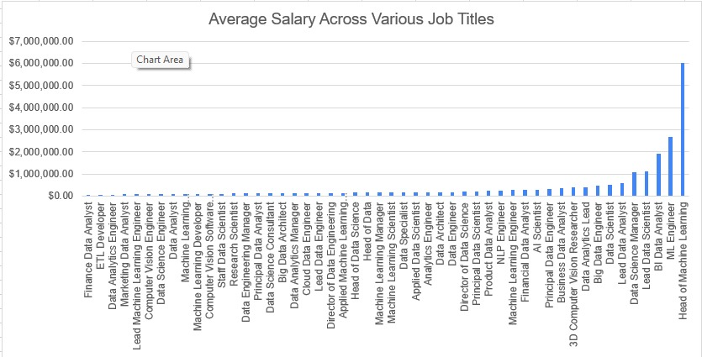
Average Salary Across Various Job Titles

Slide 12
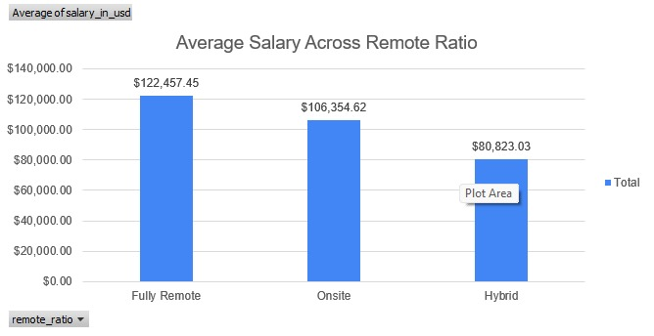
Average Salary Across Remote Ratio

Slide 13
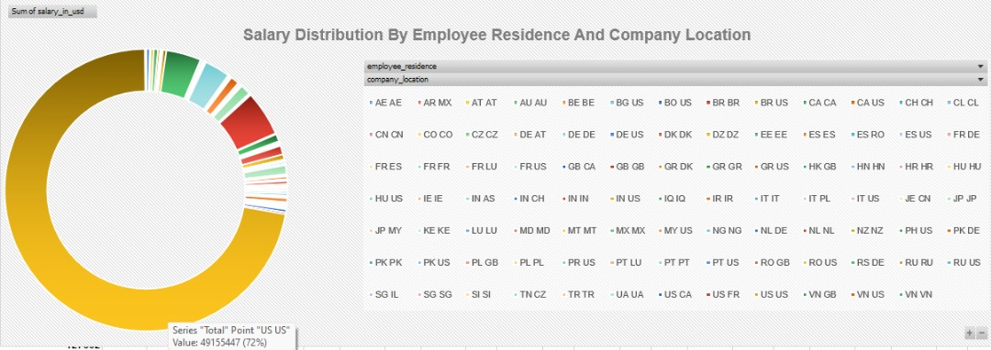
Sales Distribution By Employee Residence And Company Location

Slide 14
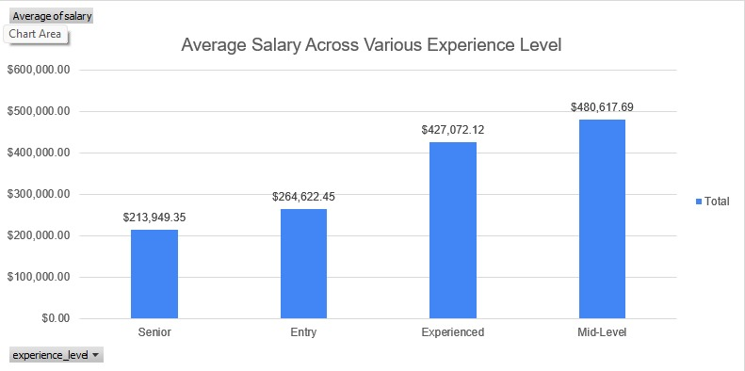
Average Salary Across Various Experience Level

Slide 15
Data Derivation
From the data below we can deduce that;
Larger companies pay higher salaries.
Data Science Manager, Lead Data Scientists, BI Data Analyst, ML Engineer and Heads of Machine Learning earn very well compared to other Data professions.
Remote workers earn a higher salary compared to hybrid and onsite workers.
Employees living and working in the US are seen to receive higher salaries
Mid level experienced employees are seen to have higher average salary across the various profession.

Slide 16

Conclusion And Recommendation
The future of work for data professionals is going remote and employees should be willing to embrace the remote work culture both for local and international opportunities as it has proven to yield financial benefits.
Investments should go into companies to bring them up to large scale, so they can accommodate more employees as they are seen to be able to create more revenue.

Slide 17
Questions??

Slide 18

Thank You!!

