Slide 1
Nigerian Higher Education Unveiled : Insights from Data Analysis
A Comprehensive Analysis of the Nigerian Higher Institution Establishment Trends

Slide 2
Group Members
Group Leader | Moses Agbe
Presenter 1 | Mercy Duru
Presenter 2 | Godwin Stephen
Member | Onogwu Godwin Ameh
Member | Muhammad Dauda

Slide 3
Introduction
In this presentation, we'll explore key insights from our analysis of higher education institutions in Nigeria, focusing on ownership types, establishment trends, and their implications.

Slide 4
Mission
To provide The Ministry of Education adequate data for development, renovation and institution establishment trends.

Slide 5
Objectives
01
02
Identify Ownership Trends
Analyze the distribution of ownership types (state, federal, private) among higher education institutions in Nigeria to identify trends and patterns in ownership dynamics.
Explore Establishment Patterns
Investigate the establishment trends of Nigerian higher education institutions over time, examining variations across ownership types and categories to understand how the sector has evolved.

Slide 6
01
Data Cleaning and Preprocessing

Slide 7

Outcome
Made further research and populated blank cells found in the dataset with accurate data.
We removed 2 duplicate data using the remove duplicate function in the Data Tab and 1046 unique values remained.

Slide 8
02
INSIGHTS

Slide 9
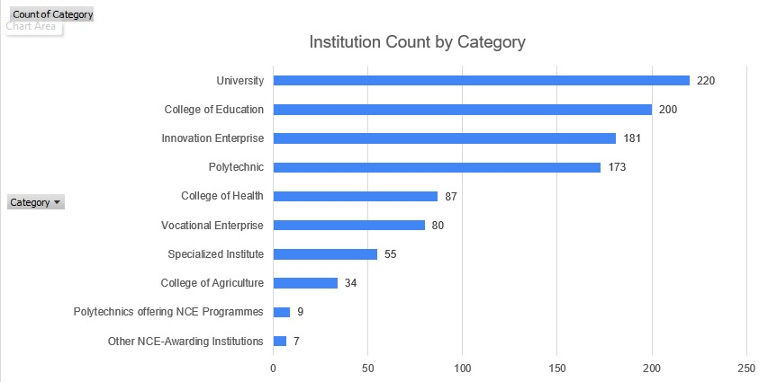
Institution Count By Category

Slide 10
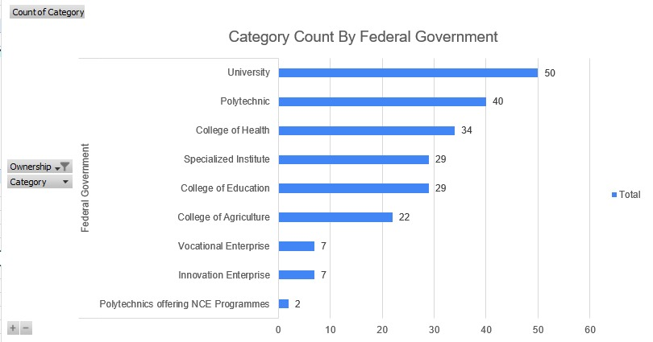
Institution Count (Federal Government)

Slide 11
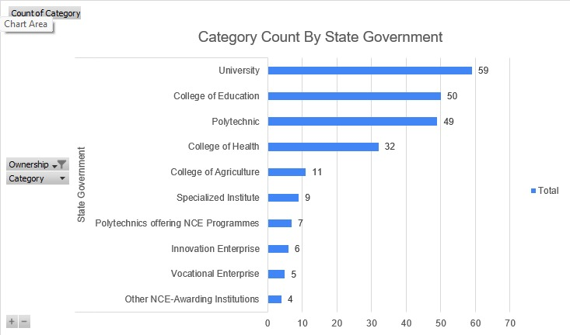
Institution Count (State Government)

Slide 12
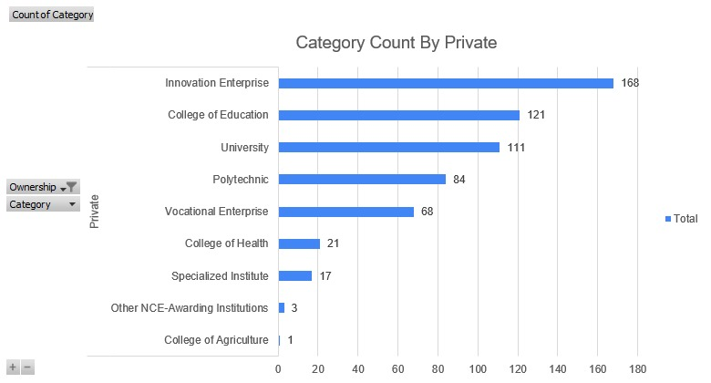
Institution Count (Private)

Slide 13
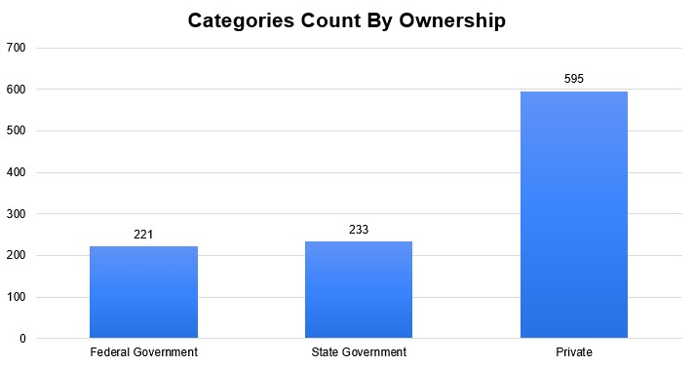
Categories Count By Ownership

Slide 14
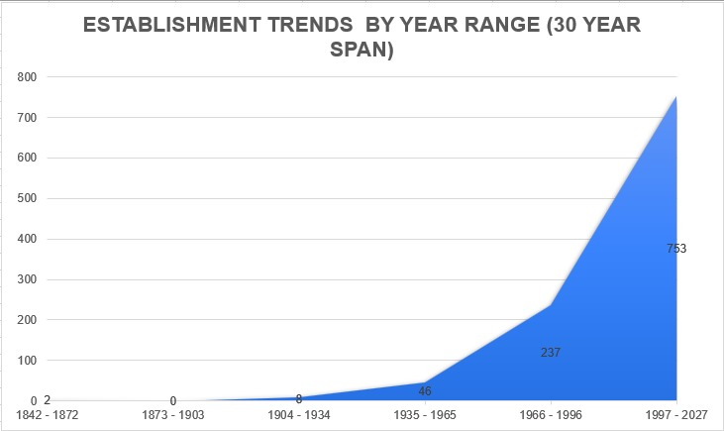
Institution Establishment Trend

Slide 15
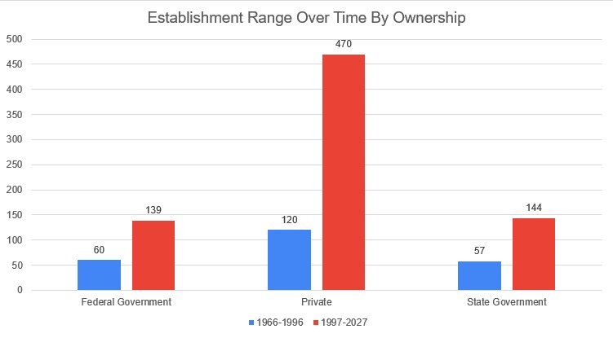
Institution Establishment Range by Ownership

Slide 16
Data Derivatives
From the above data we can derive that:
Nigeria experienced a significant shift in raising tertiary educational structures nationwide from the year 1966 which is 6 years after the independence and 3 years after Nigeria became a republic with an upward slope afterwards.
The private sector has been a great contributor to establishing institutions in Nigeria with a staggering number of 595 as opposed 221 and 233 from the federal and state government respectively.
In Nigeria, we have more Universities(220) and College of Education(200) than any other institution type.

Slide 17
Report to The Ministry of Education
The following schools were established between the year 1842 - 1934, and we suggest more standard development and renovation in these institutions;
Federal College of Education (Technical), Asaba
Federal College of Education, Kano
Federal College of Education (Special), Oyo
College of Education, Gindiri
College of Education, Hong
Tai Solarin College of Education, Ijebu-Ode
College of Education, Ikere-Ekiti
Ebonyi State College of Education, (T) Ikwo
College of Education, Warri
FCT College of Education, Zuba

Slide 18
Conclusion And Recommendation
As regards data from national development in the education sector, the government should award and encourage the private sector on their great feats.
Going forward, data on fees and general standard of operation in these institutions should be obtained.

Slide 19
Questions?

Slide 20

THANK YOU!

