Slide 1
TypeScript Workshop
16/11/2016

Slide 2

Code Dojo Some Principles
Communicate
with your partner, be a pair, with the group
Code is design
No design talk without code, no code without talking
Slow down
No due date, no delivery, no tricks
Learning
Open-minded, from others
Challenge yourself
don’t be reluctant to try something new
Notes:
29/04/2013

Slide 3


Some tools (optionals)
JetBrains Resharper (R#)
Productivity tool
Third hand of the developer
Must have for safe refactoring
Ncrunch
Continuous testing tool
Increase speed and feedback of unit testing
TDD without knowing

Slide 4


Some tips
Talk
Baby steps
Red Green Refactor
Talk
Switch pilot as much as possible
(Listen)

Slide 5

WELCOME TO

Slide 6
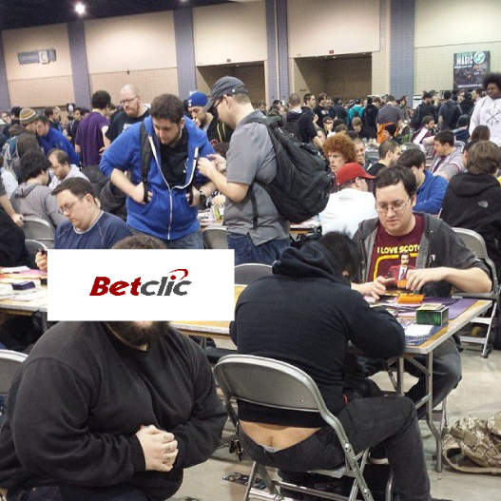
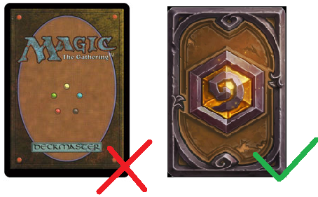



Trading Card Game
The boss saw you play your card game.
Due to the success they want to make their own card game to sell to the costumer.
So they choose to copy, the most successfull, intelligent, strategic, fun and awesome trading card game of all time : Magic!
Hopefully we are Hackerz so we hack the game but due to a tfs merge issue we broke everything in the process… So you have to rebuild it and improve it !
For the people living in the a cave : https://fr.wikipedia.org/wiki/Hearthstone:_Heroes_of_Warcraft

Slide 7

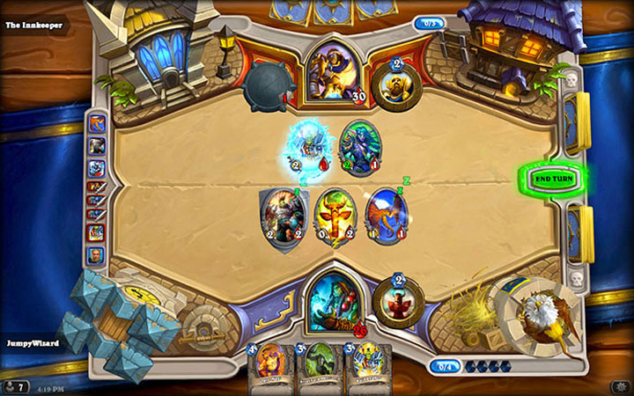
The rules :
Each player have 30 life points
When your opponent player reach 0 point you win ! If you drop below 0 you loose !
You start your mana pool at 1 each turn your mana pool increase by one
When you play a card the cost of the card consume your mana. You mana is refill each turn (and mana pool increase by 1)
Each turn you can play as many card as you want as long as you don’t cross the mana pool limit.
You have 2 type of card. Attack and Heal. The attack card deal the same amount as the cost of the card and the heal card heal you by 3 points.
You start with 20 card in Deck and draw 3 card to your hand. Each turn you draw a card from your deck to your hand and if you have more than 5 card in your hand the card you draw is DISCARDED.
That’s a lot of rules but this is more easy as it sounds

Slide 8
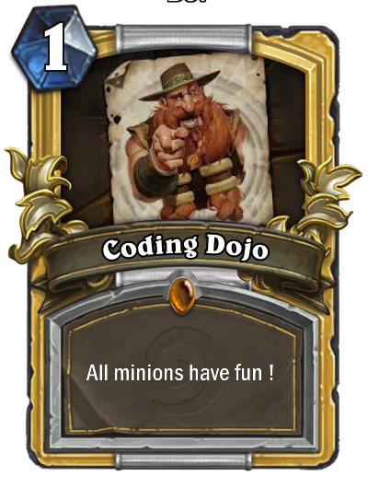
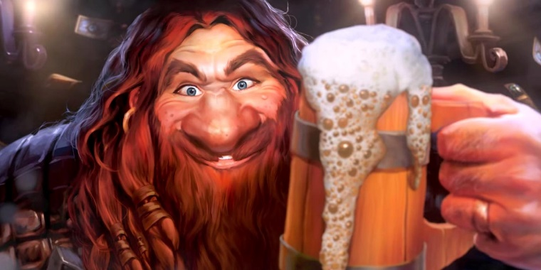
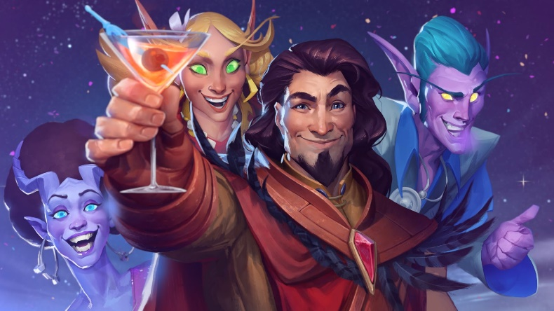
Coding Dojo : Hearthstone
You have a readme file in your setup to help you and a demo to see the result expekted (pun intended)
You have 2 hours
Don’t hesitate to ask questions !
Have fun !

