Slide 1
CPU
brain of the computer

Slide 2
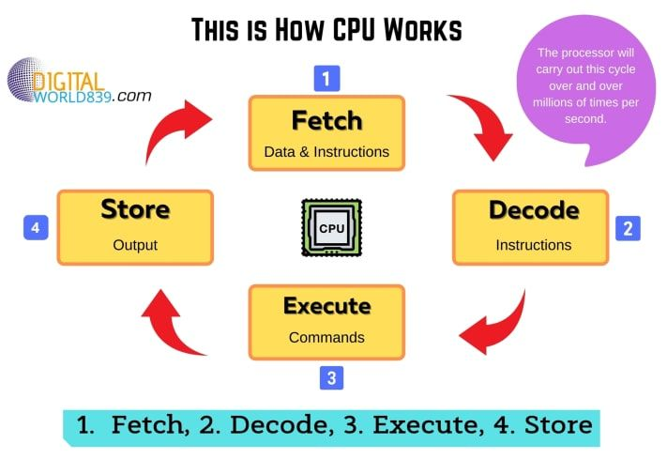
How a CPU works?
Working of CPU

Slide 3
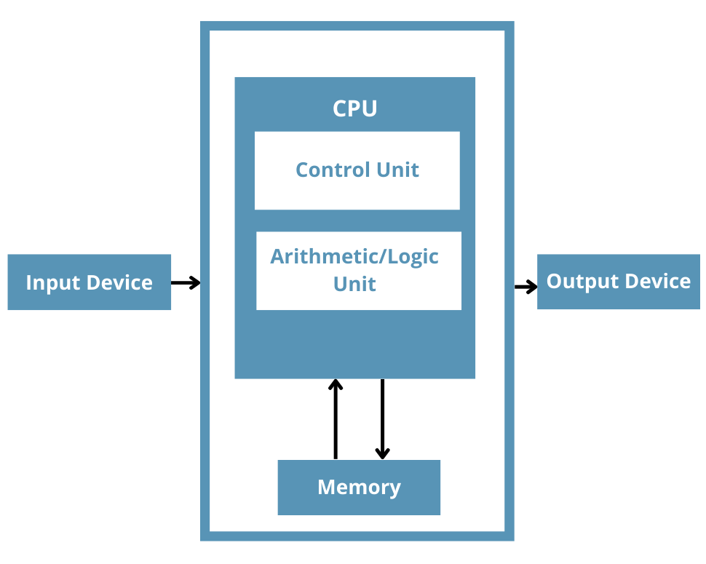
Major components in CPU:

Slide 4
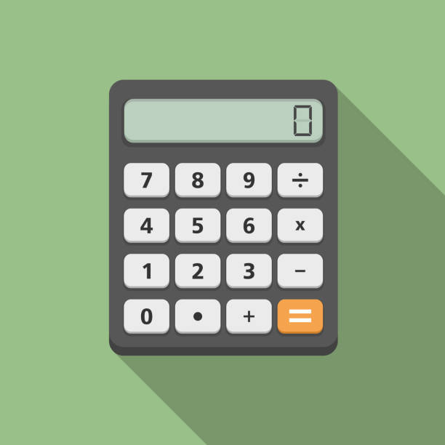
Arithmetic Logic Unit (ALU)
The ALU is responsible for performing arithmetic (addition, subtraction, multiplication, division) and logical (AND, OR, NOT) operations on data.
It executes arithmetic and logical instructions fetched from memory or the CPU's instruction pipeline.

Slide 5

Control Unit (CU)
Ex: Event Organizers
Manages the execution of instructions by coordinating the activities of the CPU's components.
It fetches instructions from memory, decodes them, and directs the ALU, registers, and other components to execute the instructions.

Slide 6
Instruction Register (IR) - Holds the current instruction
Program Counter (PC) - Memory address of the next instruction
Instruction Decoder: Interpreting the binary instructions fetched from memory and decoding them into control signals
Execution Unit (EU): Conjunction with the Control Unit to perform operations specified by decoded instructions.

Slide 7
Memory Unit:
Main Memory (RAM): It temporarily holds data, program instructions, and intermediate results during program execution.

Slide 8

Registers
Small, high-speed memory units located within the CPU.
Store data temporarily during processing and serve as storage for operands, addresses, and intermediate results.

Slide 9

Cache Memory
High-speed memory located within the CPU.
Stores frequently accessed data and instructions to reduce memory access latency and improve overall system performance.

Slide 10

Memory Controller: Hardware component responsible for managing the flow of data between the CPU and main memory.
Memory Bus: Facilitates the transfer of data and instructions between the CPU and memory units, allowing for efficient data access and retrieval.

