Slide 1



Slide 2
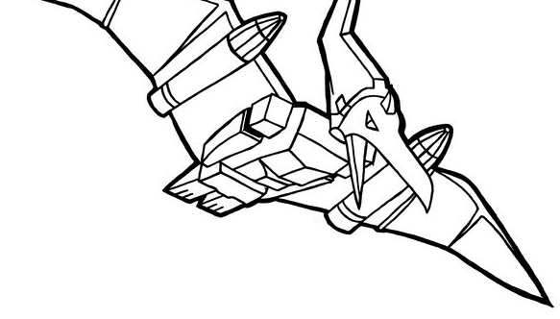
The prospect of AI:
globally and in HK
We are entering the age of strong AI (or AGI, artificial general intelligence)
In China, AGI researchers and companies are still nearly non-existent.
This may have to do with Chinese culture’s aversion to innovation and originality
and the rigid structure of China’s higher education system
One question is whether China should develop its own advanced
technology or collaborate with other nations.
This question becomes acute in view of the current US-China conflict
Hong Kong is China’s window to the outside world, uniquely positioned to
foster international collaboration on frontier AI research
As entry-point we choose the legal market

Slide 3

Competitive advantage
Last year we also applied to this programme, but at that time we were
still in the “blue-sky research” stage
This year has seen significant breakthrough, where our theory has yielded
algorithms, algorithms led to successful proof-of-concept code, and
we are confident to deliver commercializable software within 3-6 months
Many local AI startups borrow other people’s technology, with in-house
R&D at an insignificant level
Our original research provides the framework for long-term development
with virutally no end in sight... which is like a seed that may lead to
exponential growth
If successful, our company will provide jobs for the vast untapped
talent pool of China’s AI researchers, students, amateurs

Slide 4
Dinosaurgames.me

