Slide 1

Author: YKY (Yan King Yin)
Paper: AGI from the perspectives of categorical logic and algebraic geometry
Contents of this talk:
How does “No Free Lunch” guide us to accelerate AGI ?
Basics of categorical logic
Predicate logic as fibration

Slide 2
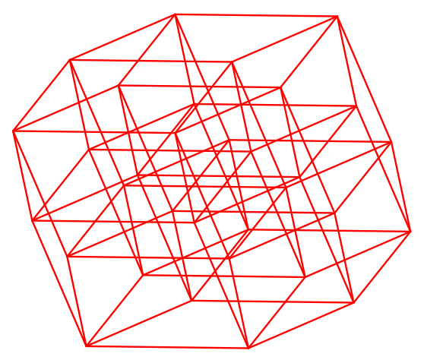
In deep learning, our hypothesis space = neural networks = parameter space = weight space =
It looks like this:
Imagine a loss function as sitting above this space; We seek to minimize it by gradient descent.

Slide 3
Gradient descent can keep going down for a long time as there are millions of dimensions.
The explanation of why gradient descent is so efficient in high dimensions is probably very difficult, as it hinges on the P =? NP problem.

