Slide 1
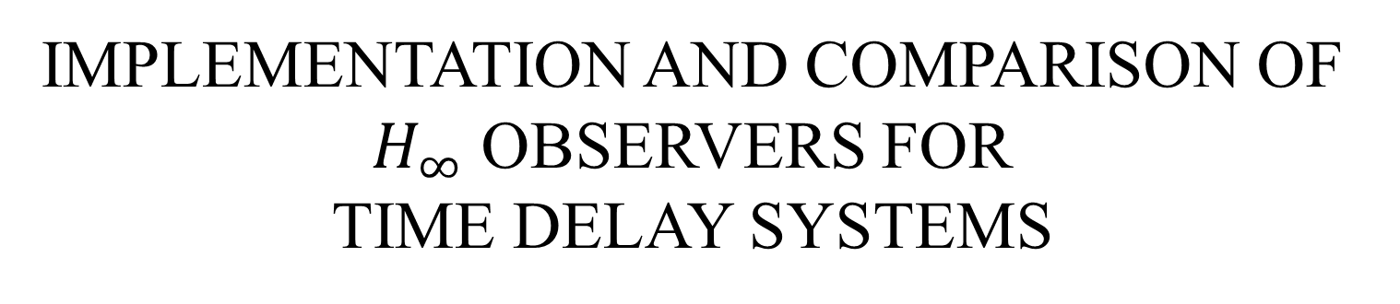
IMPLEMENTATION AND COMPARISON OF $H_{∞}$ OBSERVERS FOR TIME DELAY SYSTEMS
Rushabh Talati
Committee:
Dr. Matthew Peet, Chair
Dr. Spring Berman
Dr. Daniel Rivera

Slide 2
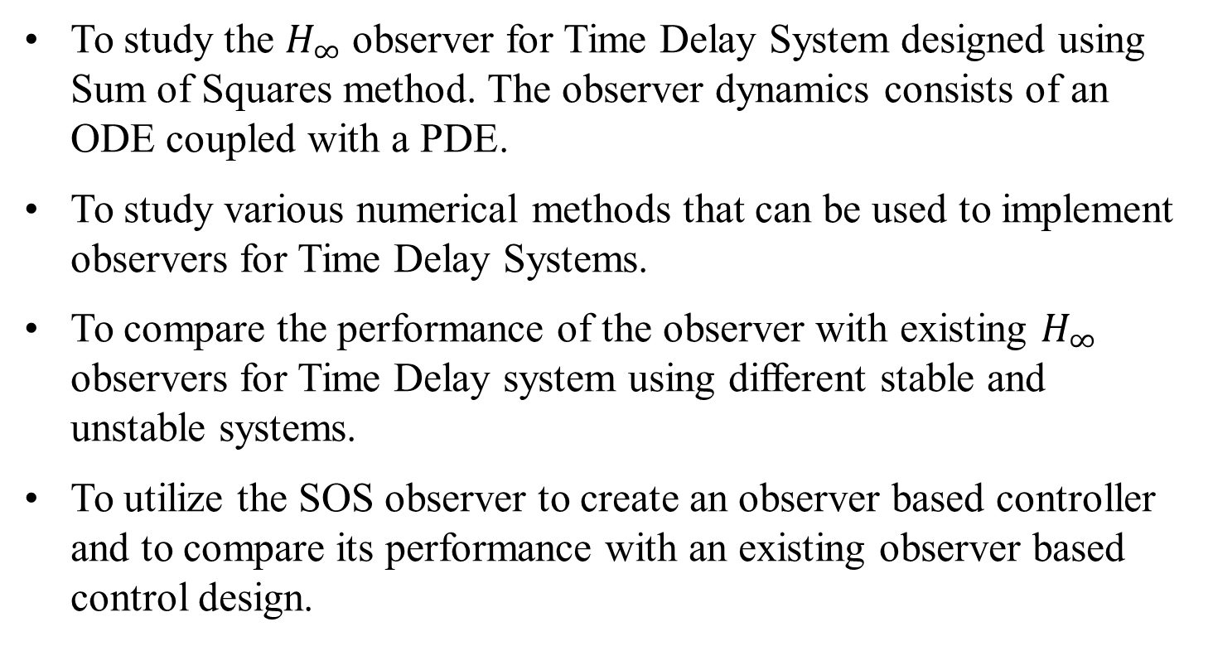
Motivation
To study the $H_{∞}$ observer for Time Delay System designed using Sum of Squares method. The observer dynamics consists of an ODE coupled with a PDE.
To study various numerical methods that can be used to implement observers for Time Delay Systems.
To compare the performance of the observer with existing $H_{∞}$ observers for Time Delay system using different stable and unstable systems.
To utilize the SOS observer to create an observer based controller and to compare its performance with an existing observer based control design.

Slide 3
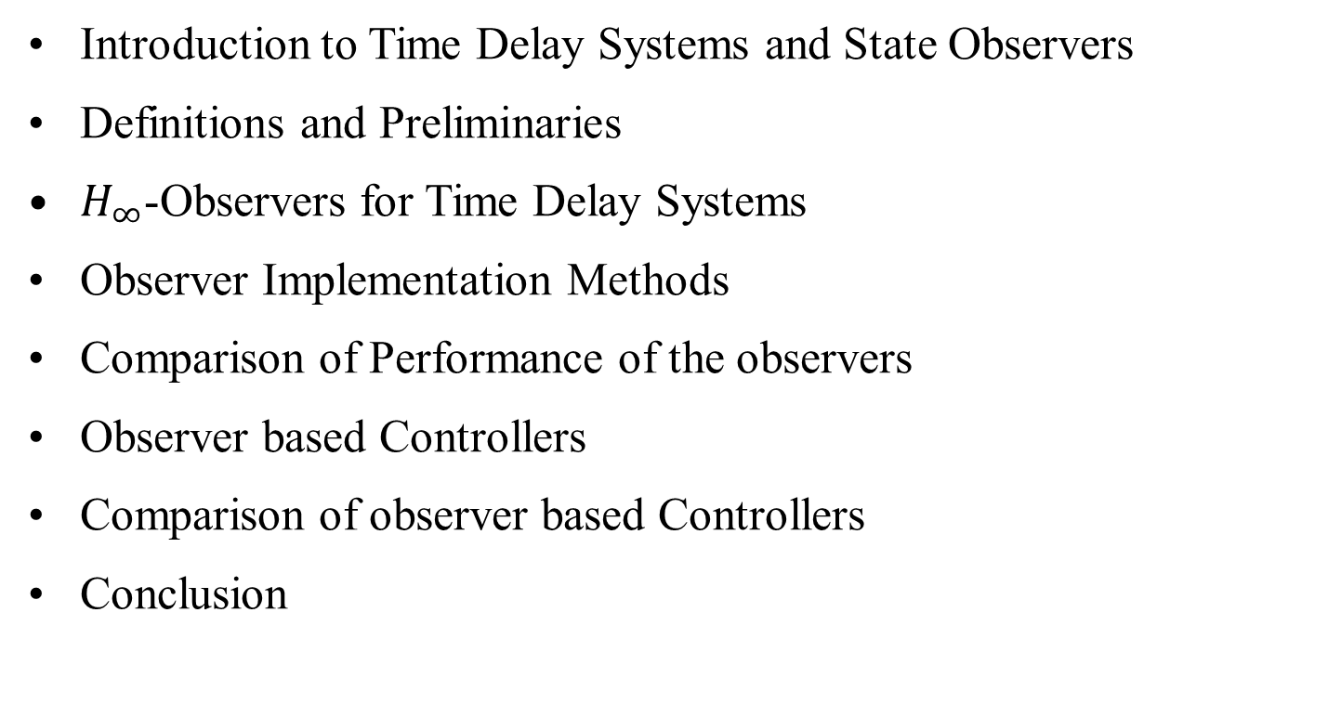
Outline
Introduction to Time Delay Systems and State Observers
Definitions and Preliminaries
$H_{∞}$-Observers for Time Delay Systems
Observer Implementation Methods
Comparison of Performance of the observers
Observer based Controllers
Comparison of observer based Controllers
Conclusion

Slide 4
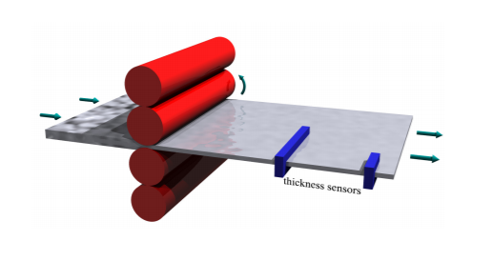
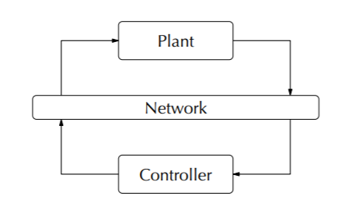
Time Delay System
Delays often appear in many physical systems,
Measurement delays
Actuation delays
In steel rolling, thickness can be measured at some distance from rolls which leads to measurement delay.
Creating and executing control decisions take time which leads to actuation delay.

Slide 5
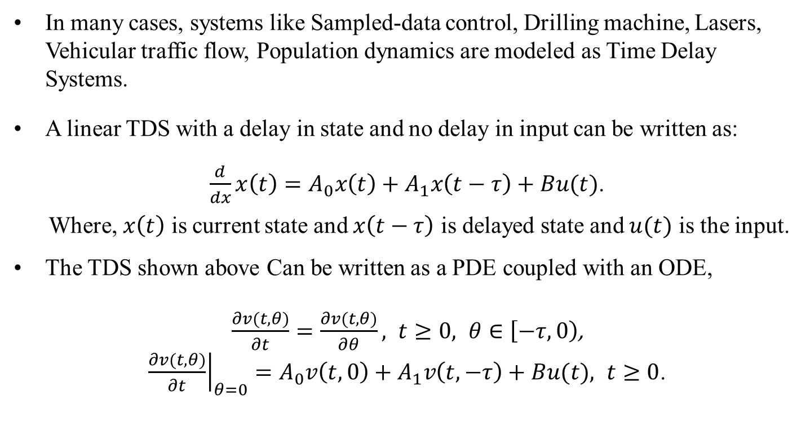
Time Delay System
In many cases, systems like Sampled-data control, Drilling machine, Lasers, Vehicular traffic flow, Population dynamics are modeled as Time Delay Systems.
A linear TDS with a delay in state and no delay in input can be written as:
$\frac{d}{dx}x\left(t\right)=A_{0}x\left(t\right)+A_{1}x\left(t−τ\right)+Bu(t)$.
Where, $x\left(t\right)$ is current state and $x\left(t−τ\right)$ is delayed state and $u(t)$ is the input.
The TDS shown above Can be written as a PDE coupled with an ODE,
$\frac{∂v(t,θ)}{∂t}=\frac{∂v(t,θ)}{∂θ}, t≥0, θ∈\left[−τ, 0\right)$, ${\left.\frac{∂v(t,θ)}{∂t}\right|}_{θ=0}=A_{0}v\left(t,0\right)+A_{1}v\left(t,−τ\right)+Bu(t), t≥0$.

Slide 6
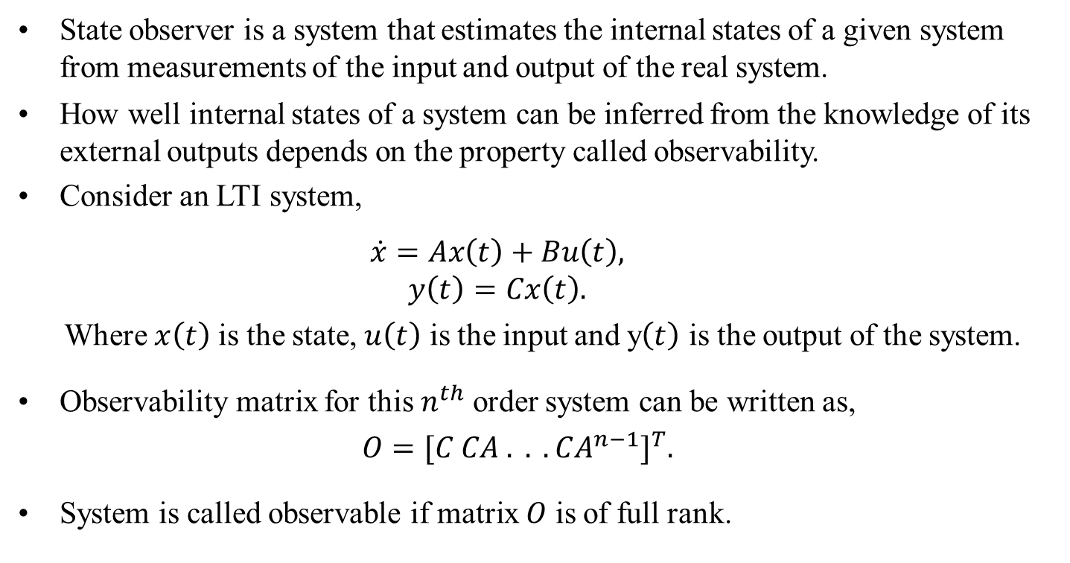
State Observers
State observer is a system that estimates the internal states of a given system from measurements of the input and output of the real system.
How well internal states of a system can be inferred from the knowledge of its external outputs depends on the property called observability.
Consider an LTI system,
$$\dot{x}=Ax\left(t\right)+Bu\left(t\right), \\ y\left(t\right)=Cx\left(t\right).$$
Where $x\left(t\right)$ is the state, $u\left(t\right)$ is the input and y$\left(t\right)$ is the output of the system.
Observability matrix for this $n^{th}$ order system can be written as,
$$O={[C CA . . .CA^{n−1}]}^{T}.$$
System is called observable if matrix $O$ is of full rank.

Slide 7
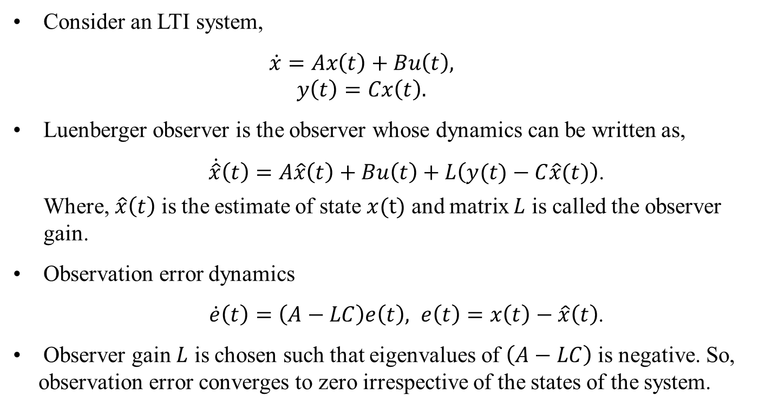
Luenberger Observer for LTI Systems
Consider an LTI system,
$$\dot{x}=Ax\left(t\right)+Bu\left(t\right), \\ y\left(t\right)=Cx\left(t\right).$$
Luenberger observer is the observer whose dynamics can be written as,
$\dot{\hat{x}}\left(t\right)=A\hat{x}\left(t\right)+Bu\left(t\right)+L\left(y(t)−C\hat{x}(t)\right)$.
Where, $\hat{x}\left(t\right)$ is the estimate of state $x(t)$ and matrix $L$ is called the observer gain.
Observation error dynamics
$\dot{e}\left(t\right)=\left(A−LC\right)e\left(t\right), e\left(t\right)=x\left(t\right)−\hat{x}\left(t\right)$.
Observer gain $L$ is chosen such that eigenvalues of $\left(A−LC\right)$ is negative. So, observation error converges to zero irrespective of the states of the system.

Slide 8
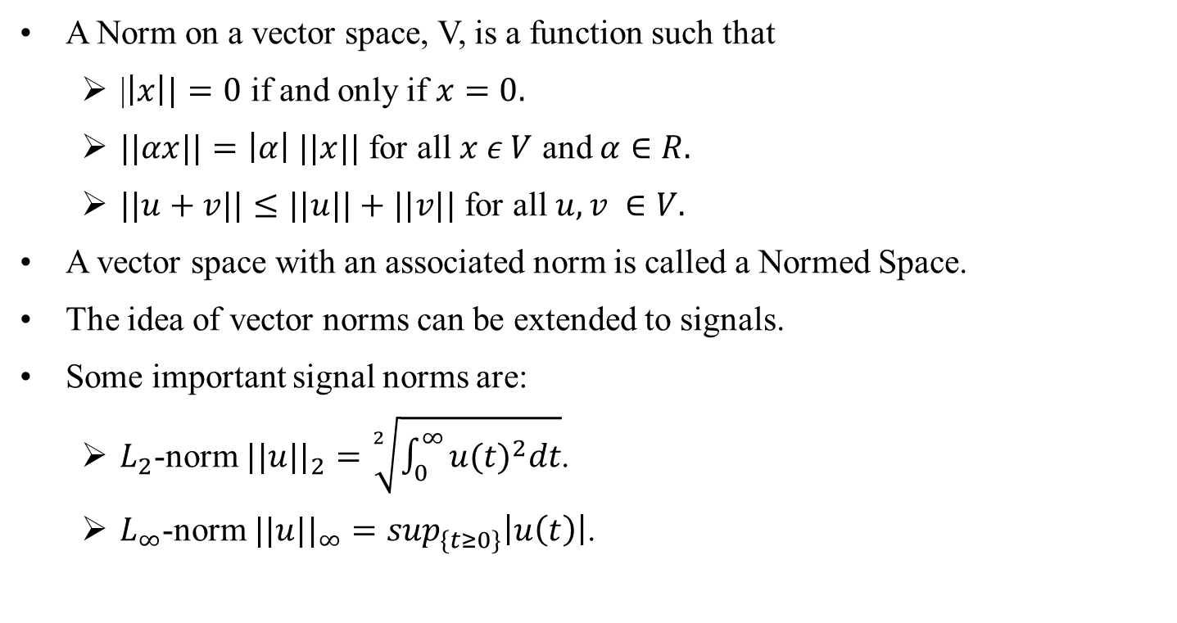
Signal Norms
A Norm on a vector space, V, is a function such that
|$\left|x\right||=0$ if and only if $x=0.$
$||αx||=\left|α\right| ||x||$ for all $x ε V$ and $α∈R.$
$||u+v||≤||u||+||v||$ for all $u, v ∈V.$
A vector space with an associated norm is called a Normed Space.
The idea of vector norms can be extended to signals.
Some important signal norms are:
$L_{2}$-norm ${||u||}_{2}=\sqrt[2]{\int_{0}^{∞}{{u(t)}^{2}dt}}$.
$L_{∞}$-norm ${||u||}_{∞}=\sup_{\{t≥0\}}\left|u\left(t\right)\right|$.

Slide 9
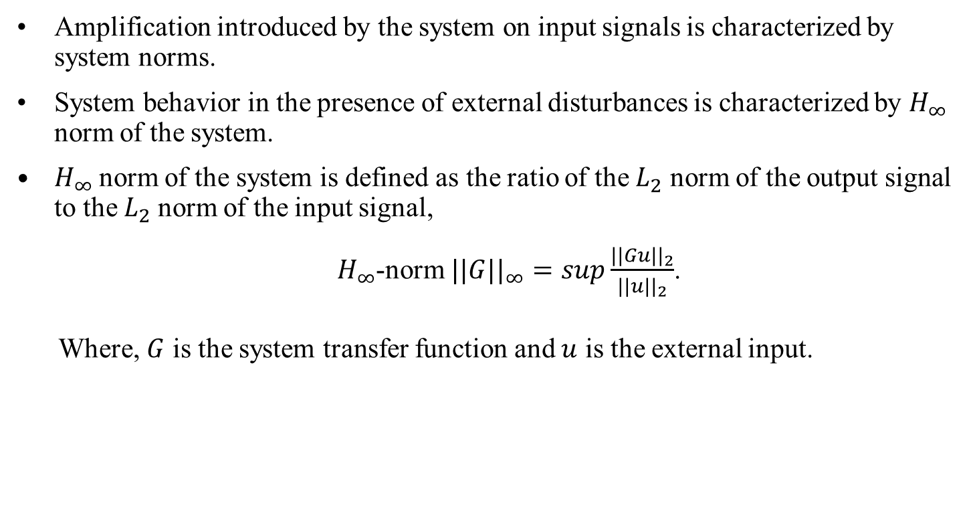
System Norms
Amplification introduced by the system on input signals is characterized by system norms.
System behavior in the presence of external disturbances is characterized by $H_{∞}$ norm of the system.
$H_{∞}$ norm of the system is defined as the ratio of the $L_{2}$ norm of the output signal to the $L_{2}$ norm of the input signal,
$H_{∞}$-norm ${||G||}_{∞}=sup\frac{{||Gu||}_{2}}{{||u||}_{2}}$.
Where, $G$ is the system transfer function and $u$ is the external input.

Slide 10
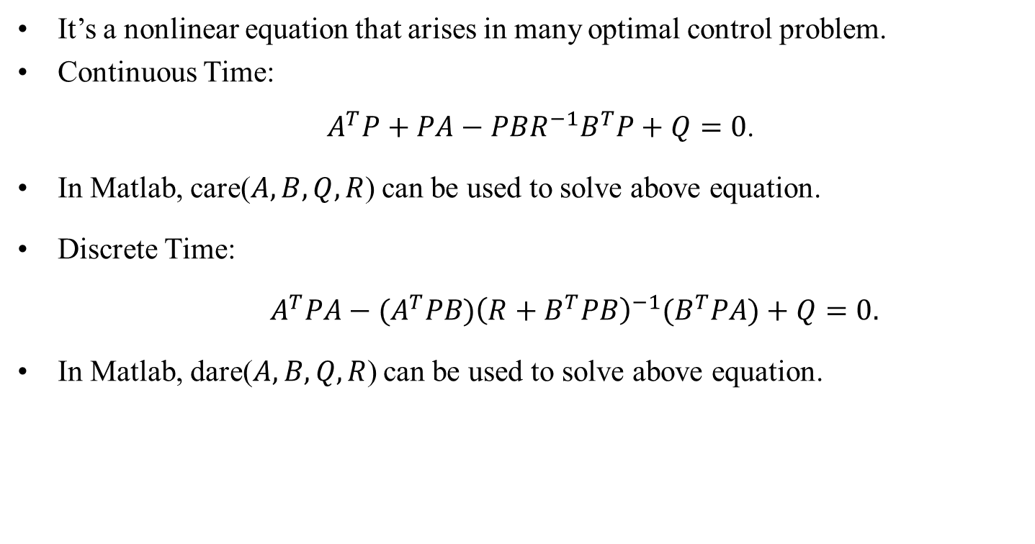
Algebraic Riccati Equations
It’s a nonlinear equation that arises in many optimal control problem.
Continuous Time:
$A^{T}P+PA−PBR^{−1}B^{T}P+Q=0$.
In Matlab, care($A, B, Q, R$) can be used to solve above equation.
Discrete Time:
$A^{T}PA−(A^{T}PB){\left(R+B^{T}PB\right)}^{−1}(B^{T}PA)+Q=0.$
In Matlab, dare($A, B, Q, R$) can be used to solve above equation.

Slide 11
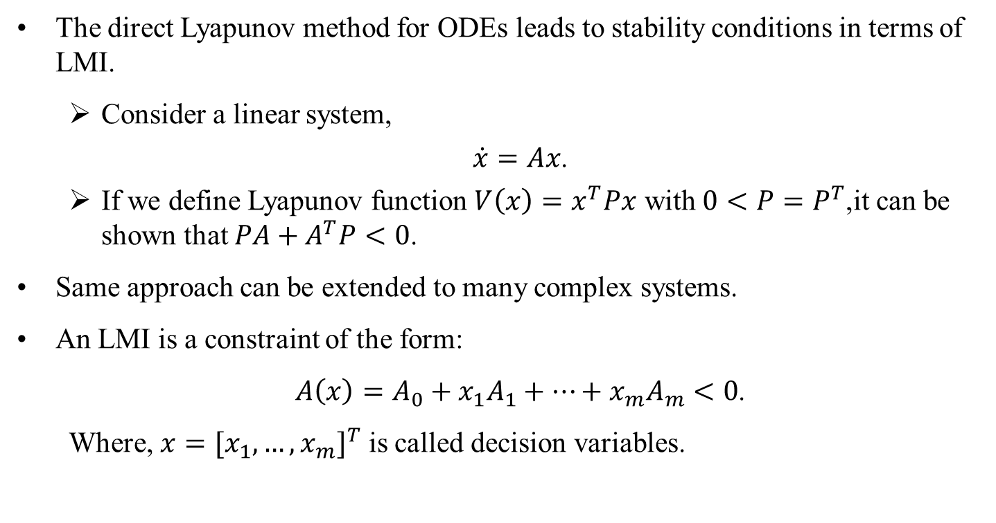
Linear Matrix Inequalities
The direct Lyapunov method for ODEs leads to stability conditions in terms of LMI.
Consider a linear system,
$\dot{x}=Ax$.
If we define Lyapunov function $V\left(x\right)=x^{T}Px$ with $0<P=P^{T}$,it can be shown that $PA+A^{T}P<0$.
Same approach can be extended to many complex systems.
An LMI is a constraint of the form:
$A\left(x\right)=A_{0}+x_{1}A_{1}+…+x_{m}A_{m}<0$.
Where, $x={[x_{1},…,x_{m}]}^{T}$ is called decision variables.

Slide 12
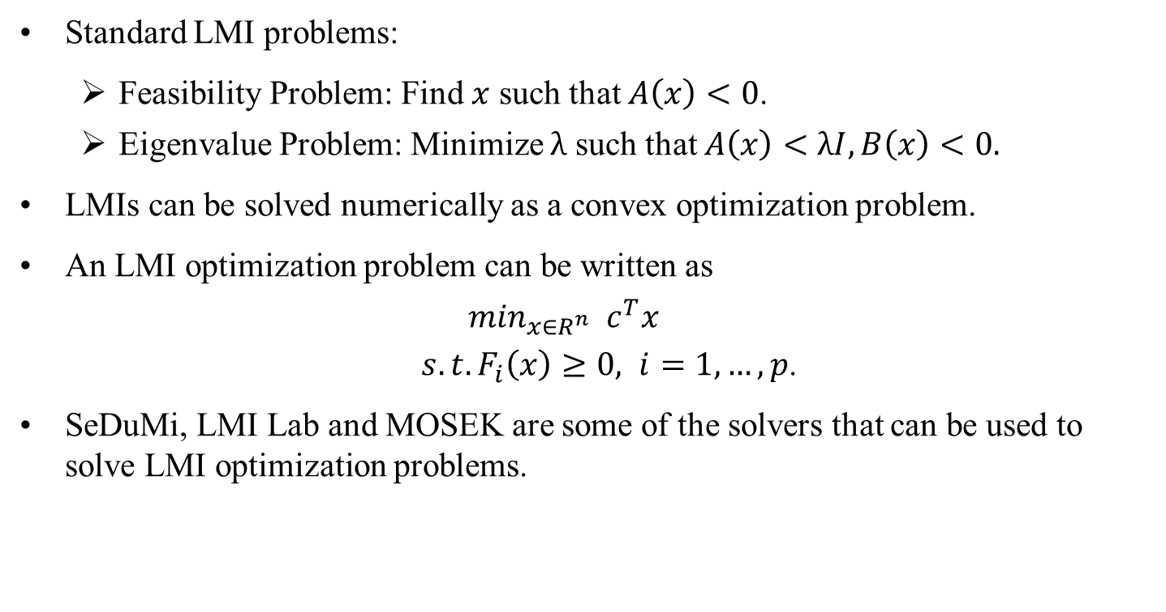
Linear Matrix Inequalities
Standard LMI problems:
Feasibility Problem: Find $x$ such that $A\left(x\right)<0$.
Eigenvalue Problem: Minimize $λ$ such that $A\left(x\right)<λI, B\left(x\right)<0.$
LMIs can be solved numerically as a convex optimization problem.
An LMI optimization problem can be written as
$$\min_{x∈R^{n}} c^{T}x$$ $s.t. F_{i}\left(x\right)≥0, i=1,…,p$.
SeDuMi, LMI Lab and MOSEK are some of the solvers that can be used to solve LMI optimization problems.

Slide 13
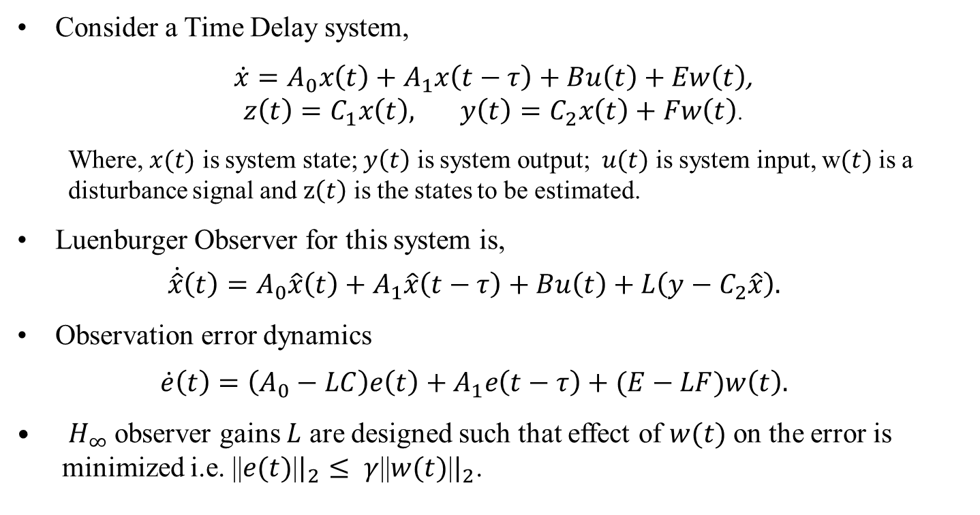
$H_{∞}$-Observers for Time Delay Systems
Consider a Time Delay system,
$\dot{x}=A_{0}x\left(t\right)+A_{1}x\left(t−τ\right)+Bu\left(t\right)+Ew\left(t\right)$, $z\left(t\right)=C_{1}x\left(t\right), y\left(t\right)=C_{2}x\left(t\right)+Fw\left(t\right)$.
Where, $x(t)$ is system state; $y\left(t\right)$ is system output; $u(t)$ is system input, w$(t)$ is a disturbance signal and $z\left(t\right)$ is the states to be estimated.
Luenburger Observer for this system is,
$$\dot{\hat{x}}\left(t\right)=A_{0}\hat{x}\left(t\right)+A_{1}\hat{x}\left(t−τ\right)+Bu\left(t\right)+L\left(y−C_{2}\hat{x}\right).$$
Observation error dynamics
$$\dot{e}\left(t\right)=\left(A_{0}−LC\right)e\left(t\right)+A_{1}e\left(t−τ\right)+(E−LF)w\left(t\right).$$
$H_{∞}$ observer gains $L$ are designed such that effect of $w(t)$ on the error is minimized i.e. ||$e(t)$|$|_{2}$ $≤ γ$||$w(t)$|$|_{2}$.

Slide 14
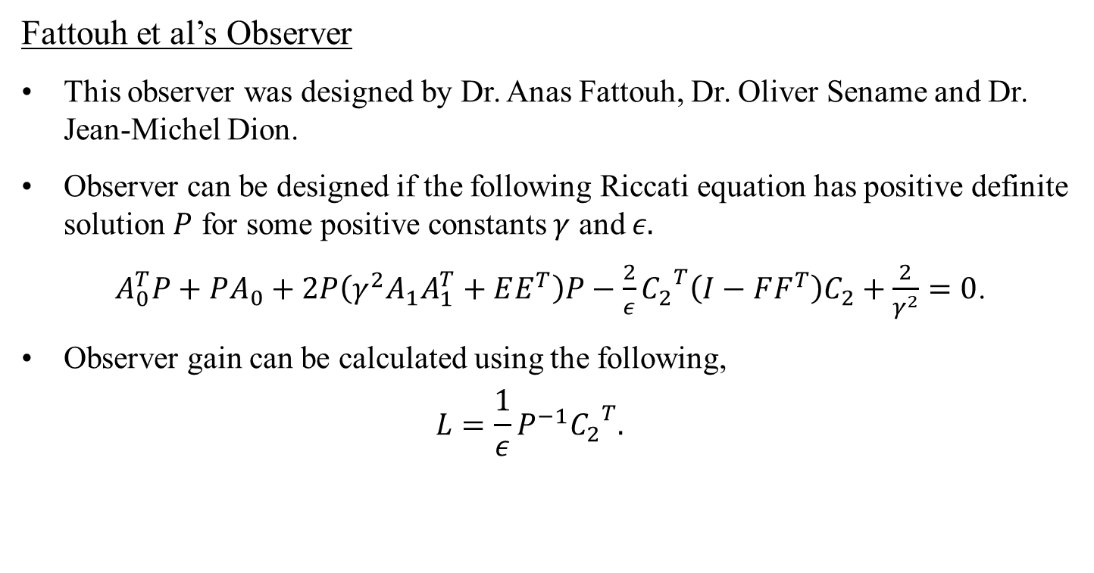
$H_{∞}$-Observers for Time Delay Systems
Fattouh et al’s Observer
This observer was designed by Dr. Anas Fattouh, Dr. Oliver Sename and Dr. Jean-Michel Dion.
Observer can be designed if the following Riccati equation has positive definite solution $P$ for some positive constants $γ$ and $ε.$
$A_{0}^{T}P+PA_{0}+2P\left(γ^{2}A_{1}A_{1}^{T}+EE^{T}\right)P−\frac{2}{ε}{C_{2}}^{T}\left(I−FF^{T}\right)C_{2}+\frac{2}{γ^{2}}=0$.
Observer gain can be calculated using the following,
$$L=\frac{1}{ε}P^{−1}{C_{2}}^{T}.$$

Slide 15
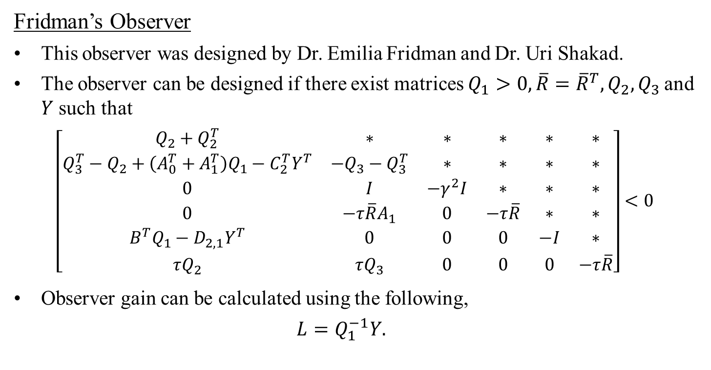
$H_{∞}$-Observers for Time Delay Systems
Fridman’s Observer
This observer was designed by Dr. Emilia Fridman and Dr. Uri Shakad.
The observer can be designed if there exist matrices $Q_{1}>0, \overline{R}={\overline{R}}^{T}, Q_{2}, Q_{3}$ and $Y$ such that
$$\left[\begin{matrix}Q_{2}+Q_{2}^{T} & ∗ & ∗ & ∗ & ∗ & ∗ \\ Q_{3}^{T}−Q_{2}+\left(A_{0}^{T}+A_{1}^{T}\right)Q_{1}−C_{2}^{T}Y^{T} & −Q_{3}−Q_{3}^{T} & ∗ & ∗ & ∗ & ∗ \\ 0 & I & −γ^{2}I & ∗ & ∗ & ∗ \\ 0 & −τ\overline{R}A_{1} & 0 & −τ\overline{R} & ∗ & ∗ \\ B^{T}Q_{1}−D_{2,1}Y^{T} & 0 & 0 & 0 & −I & ∗ \\ τQ_{2} & τQ_{3} & 0 & 0 & 0 & −τ\overline{R}\end{matrix}\right]<0$$
Observer gain can be calculated using the following,
$$L=Q_{1}^{−1}Y.$$

Slide 16
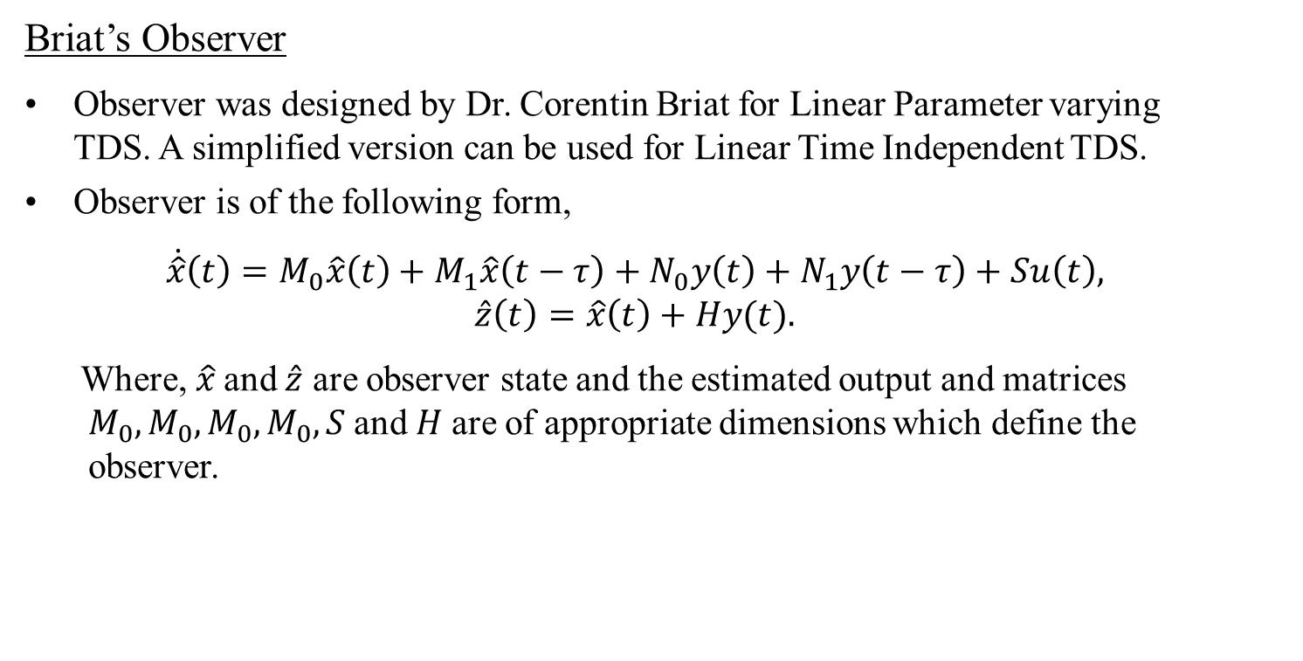
$H_{∞}$-Observers for Time Delay Systems
Briat’s Observer
Observer was designed by Dr. Corentin Briat for Linear Parameter varying TDS. A simplified version can be used for Linear Time Independent TDS.
Observer is of the following form,
$$\dot{\hat{x}}\left(t\right)=M_{0}\hat{x}\left(t\right)+M_{1}\hat{x}\left(t−τ\right)+N_{0}y\left(t\right)+N_{1}y\left(t−τ\right)+Su\left(t\right), \\ \hat{z}\left(t\right)=\hat{x}\left(t\right)+Hy(t).$$
Where, $\hat{x}$ and $\hat{z}$ are observer state and the estimated output and matrices $M_{0},M_{0}, M_{0},M_{0}, S$and$H$ are of appropriate dimensions which define the observer.

Slide 17
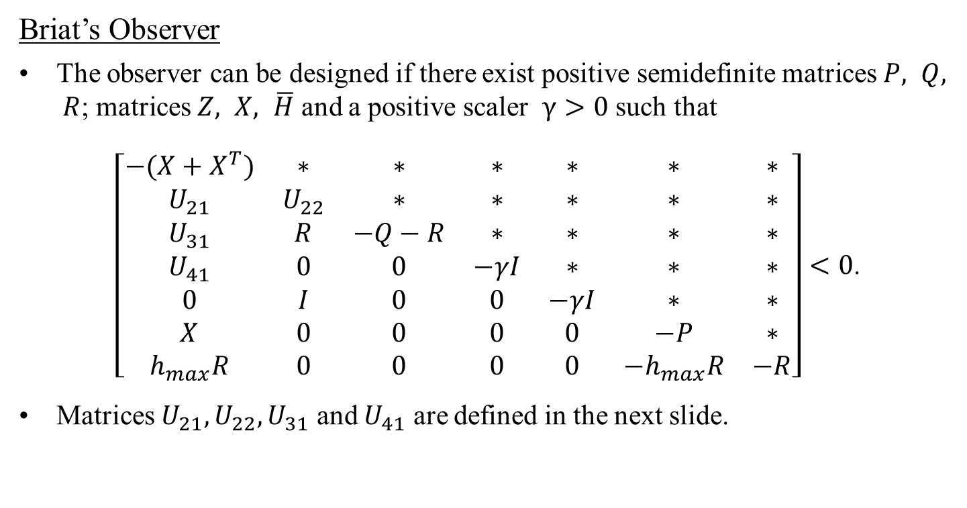
$H_{∞}$-Observers for Time Delay Systems
Briat’s Observer
The observer can be designed if there exist positive semidefinite matrices $P, Q, R$; matrices $Z, X, \overline{H}$ and a positive scaler $γ>0$ such that
$\left[\begin{matrix}−(X+X^{T}) & ∗ & ∗ & ∗ & ∗ & ∗ & ∗ \\ U_{21} & U_{22} & ∗ & ∗ & ∗ & ∗ & ∗ \\ U_{31} & R & −Q−R & ∗ & ∗ & ∗ & ∗ \\ U_{41} & 0 & 0 & −γI & ∗ & ∗ & ∗ \\ 0 & I & 0 & 0 & −γI & ∗ & ∗ \\ X & 0 & 0 & 0 & 0 & −P & ∗ \\ h_{max}R & 0 & 0 & 0 & 0 & −h_{max}R & −R\end{matrix}\right]<0$.
Matrices $U_{21},U_{22},U_{31}$ and $U_{41}$ are defined in the next slide.

Slide 18
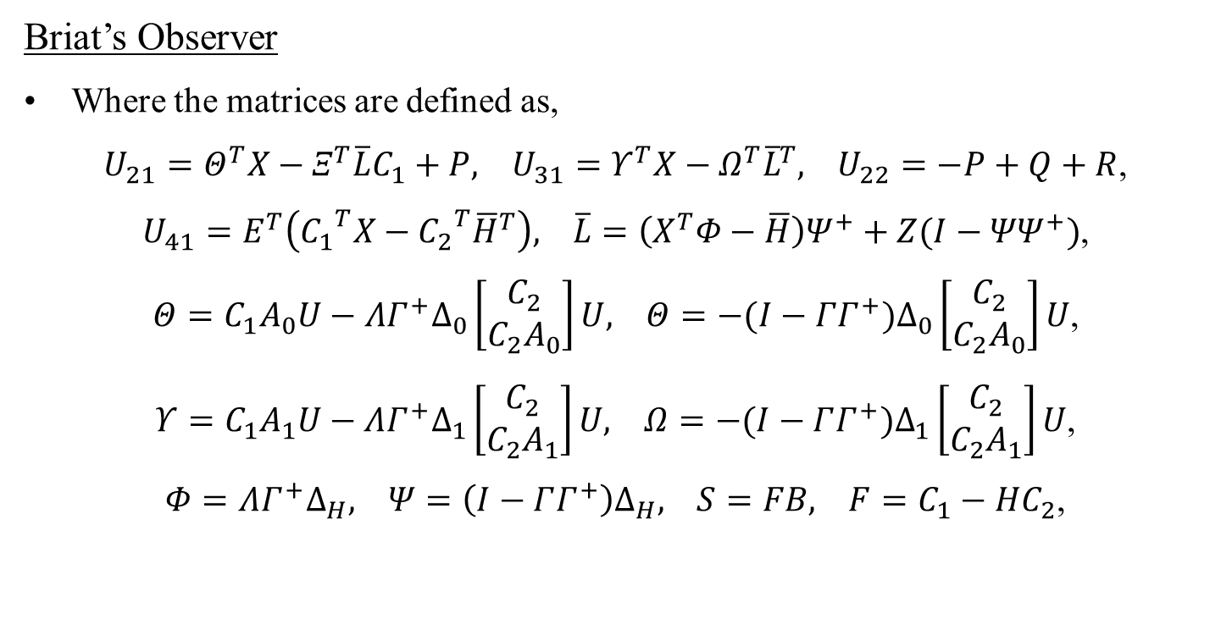
$H_{∞}$-Observers for Time Delay Systems
Briat’s Observer
Where the matrices are defined as,
$U_{21}=Θ^{T}X−Ξ^{T}\overline{L}C_{1}+P, U_{31}=Υ^{T}X−Ω^{T}{\overline{L}}^{T}, U_{22}=−P+Q+R$,
$U_{41}=E^{T}\left({C_{1}}^{T}X−{C_{2}}^{T}{\overline{H}}^{T}\right), \overline{L}=\left(X^{T}Φ−\overline{H}\right)Ψ^{+}+Z(I−{ΨΨ}^{+})$,
$Θ=C_{1}A_{0}U−ΛΓ^{+}∆_{0}\left[\begin{matrix}C_{2} \\ C_{2}A_{0}\end{matrix}\right]U, Θ=−(I−ΓΓ^{+})∆_{0}\left[\begin{matrix}C_{2} \\ C_{2}A_{0}\end{matrix}\right]U$,
$Υ=C_{1}A_{1}U−ΛΓ^{+}∆_{1}\left[\begin{matrix}C_{2} \\ C_{2}A_{1}\end{matrix}\right]U, Ω=−(I−ΓΓ^{+})∆_{1}\left[\begin{matrix}C_{2} \\ C_{2}A_{1}\end{matrix}\right]U$,
$Φ=ΛΓ^{+}∆_{H}, Ψ=\left(I−ΓΓ^{+}\right)∆_{H}, S=FB, F=C_{1}−HC_{2}$,

Slide 19
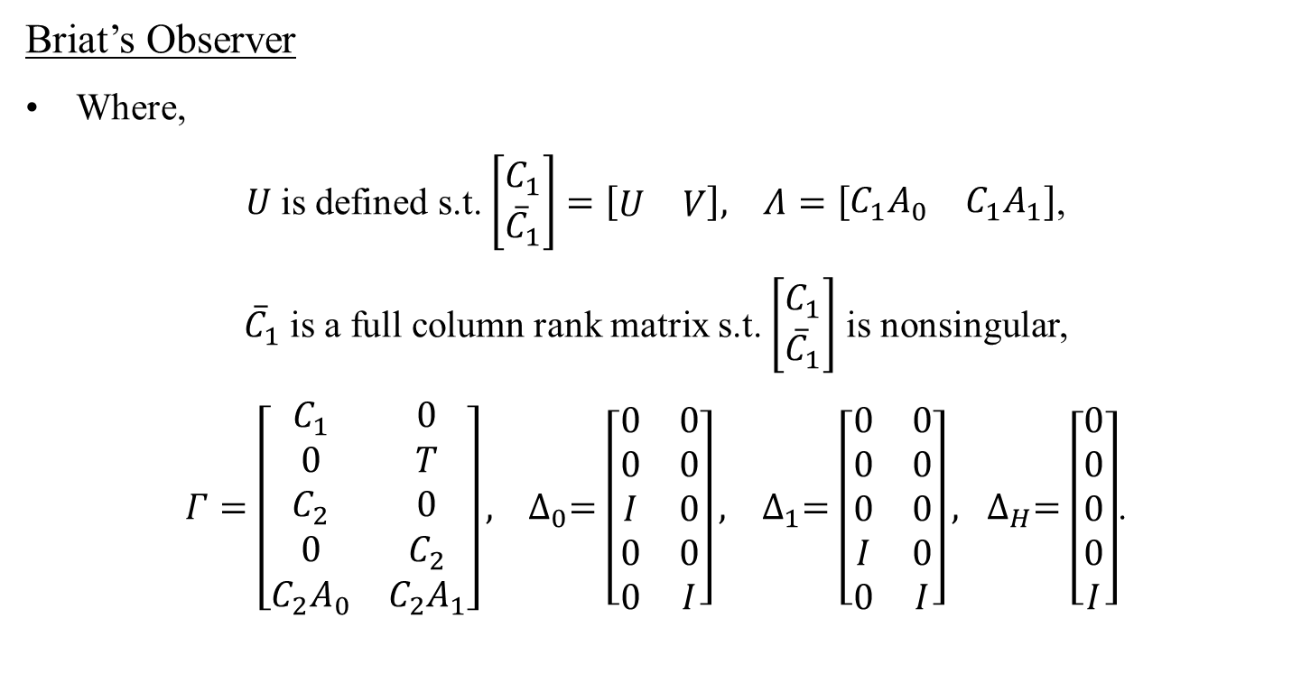
$H_{∞}$-Observers for Time Delay Systems
Briat’s Observer
Where,
$U$ is defined s.t. $\left[\begin{matrix}C_{1} \\ {\overline{C}}_{1}\end{matrix}\right]=\left[\begin{matrix}U & V\end{matrix}\right], Λ=\left[\begin{matrix}C_{1}A_{0} & C_{1}A_{1}\end{matrix}\right]$,
${\overline{C}}_{1}$ is a full column rank matrix s.t. $\left[\begin{matrix}C_{1} \\ {\overline{C}}_{1}\end{matrix}\right]$ is nonsingular,
$Γ=\left[\begin{matrix}C_{1} & 0 \\ 0 & T \\ C_{2} & 0 \\ 0 & C_{2} \\ C_{2}A_{0} & C_{2}A_{1}\end{matrix}\right], ∆_{0}=\left[\begin{matrix}0 & 0 \\ 0 & 0 \\ I & 0 \\ 0 & 0 \\ 0 & I\end{matrix}\right], ∆_{1}=\left[\begin{matrix}0 & 0 \\ 0 & 0 \\ 0 & 0 \\ I & 0 \\ 0 & I\end{matrix}\right], ∆_{H}=\left[\begin{matrix}0 \\ 0 \\ 0 \\ 0 \\ I\end{matrix}\right]$.

Slide 20

$H_{∞}$-Observers for Time Delay Systems
Briat’s Observer
Observer gains can be calculated using following equations.
$L= X^{−1}\overline{L}$,
$∇=ΛΓ^{+}−L(I−ΓΓ^{+})$,
Where, $∇=[M_{0} M_{h} K_{0} K_{h} H]$ and
$N_{0}=K_{0}+M_{0}H$,
$N_{h}=K_{h}+M_{h}H$,
$S=FB$.

Slide 21
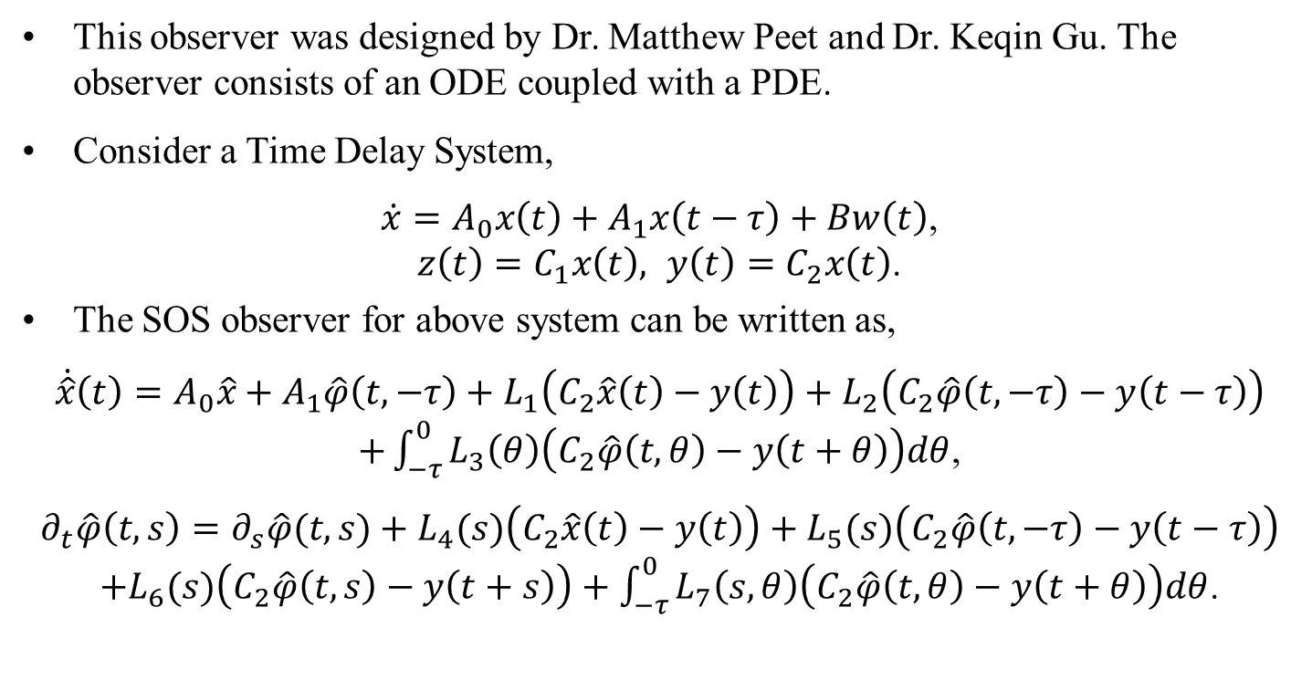
Observer for TDS using SOS
This observer was designed by Dr. Matthew Peet and Dr. Keqin Gu. The observer consists of an ODE coupled with a PDE.
Consider a Time Delay System,
$\dot{x}=A_{0}x\left(t\right)+A_{1}x\left(t−τ\right)+Bw\left(t\right)$, $z\left(t\right)=C_{1}x\left(t\right), y\left(t\right)=C_{2}x\left(t\right)$.
The SOS observer for above system can be written as,
$$\dot{\hat{x}}\left(t\right)=A_{0}\hat{x}+A_{1}\hat{φ}\left(t, −τ\right)+L_{1}\left(C_{2}\hat{x}\left(t\right)−y\left(t\right)\right)+L_{2}\left(C_{2}\hat{φ}\left(t, −τ\right)−y\left(t−τ\right)\right)$$ $+\int_{−τ}^{0}{L_{3}\left(θ\right)\left(C_{2}\hat{φ}\left(t, θ\right)−y\left(t+θ\right)\right)dθ}$,
$$∂_{t}\hat{φ}\left(t,s\right)=∂_{s}\hat{φ}(t,s)+L_{4}(s)\left(C_{2}\hat{x}\left(t\right)−y\left(t\right)\right)+L_{5}(s)\left(C_{2}\hat{φ}\left(t, −τ\right)−y\left(t−τ\right)\right)$$ $+L_{6}(s)\left(C_{2}\hat{φ}\left(t, s\right)−y\left(t+s\right)\right)+\int_{−τ}^{0}{L_{7}\left(s,θ\right)\left(C_{2}\hat{φ}\left(t, θ\right)−y\left(t+θ\right)\right)dθ}$.

Slide 22
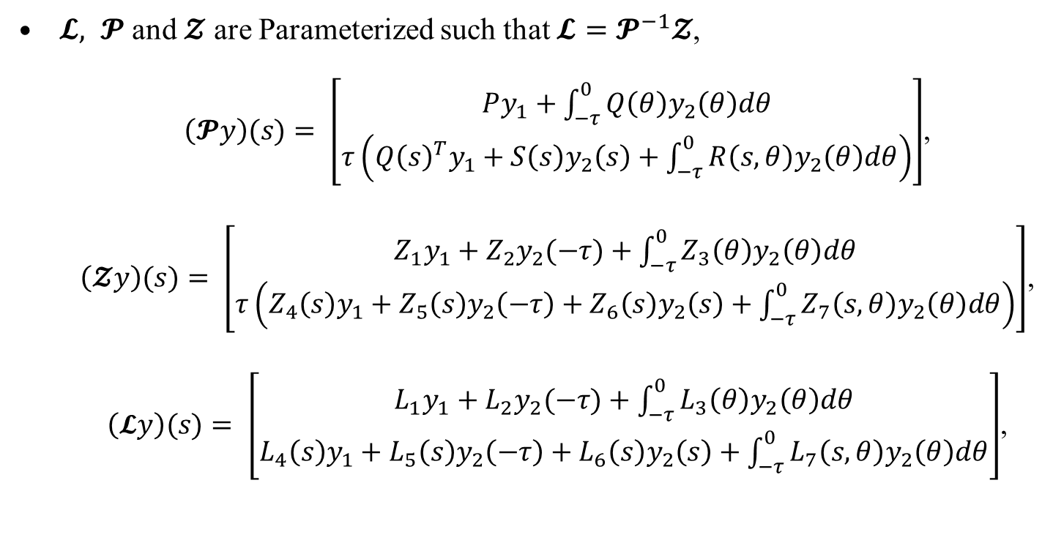
Observer for TDS using SOS
$𝓛, 𝓟$ and $𝓩$ are Parameterized such that $𝓛=𝓟^{−1}𝓩$,
$\left(𝓟y\right)(s)= \left[\begin{matrix}Py_{1}+\int_{−τ}^{0}{Q\left(θ\right)y_{2}\left(θ\right)dθ} \\ τ\left({Q\left(s\right)}^{T}y_{1}+S\left(s\right)y_{2}\left(s\right)+\int_{−τ}^{0}{R\left(s,θ\right)y_{2}\left(θ\right)dθ}\right)\end{matrix}\right]$,
$\left(𝓩y\right)(s)= \left[\begin{matrix}Z_{1}y_{1}+Z_{2}y_{2}(−τ)+\int_{−τ}^{0}{Z_{3}\left(θ\right)y_{2}\left(θ\right)dθ} \\ τ\left(Z_{4}\left(s\right)y_{1}+Z_{5}\left(s\right)y_{2}\left(−τ\right)+Z_{6}\left(s\right)y_{2}\left(s\right)+\int_{−τ}^{0}{Z_{7}\left(s,θ\right)y_{2}\left(θ\right)dθ}\right)\end{matrix}\right]$,
$\left(𝓛y\right)(s)= \left[\begin{matrix}L_{1}y_{1}+L_{2}y_{2}(−τ)+\int_{−τ}^{0}{L_{3}\left(θ\right)y_{2}\left(θ\right)dθ} \\ L_{4}\left(s\right)y_{1}+L_{5}\left(s\right)y_{2}\left(−τ\right)+L_{6}\left(s\right)y_{2}\left(s\right)+\int_{−τ}^{0}{L_{7}\left(s,θ\right)y_{2}\left(θ\right)dθ}\end{matrix}\right]$,

Slide 23
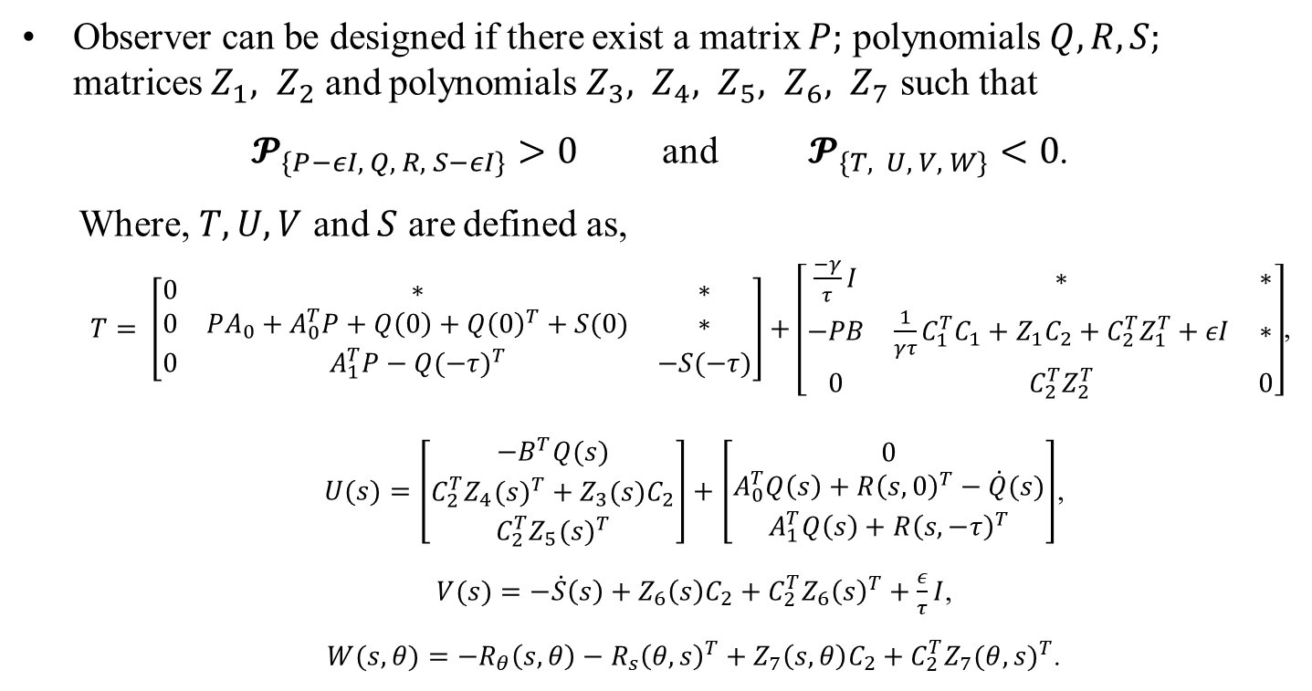
Observer for TDS using SOS
Observer can be designed if there exist a matrix $P;$ polynomials $Q, R, S;$ matrices $Z_{1}, Z_{2}$ and polynomials $Z_{3}, Z_{4}, Z_{5}, Z_{6}, Z_{7}$ such that
$𝓟_{\{P−εI, Q, R, S−εI\}}>0$ and $𝓟_{\{T, U, V, W\}}<0$.
Where, $T, U, V$ and $S$ are defined as,
$T= \left[\begin{matrix}0 & ∗ & ∗ \\ 0 & PA_{0}+A_{0}^{T}P+Q\left(0\right)+{Q\left(0\right)}^{T}+S(0) & ∗ \\ 0 & A_{1}^{T}P−{Q(−τ)}^{T} & −S(−τ)\end{matrix}\right]+\left[\begin{matrix}\frac{−γ}{τ}I & ∗ & ∗ \\ −PB & \frac{1}{γτ}C_{1}^{T}C_{1}+Z_{1}C_{2}+C_{2}^{T}Z_{1}^{T}+εI & ∗ \\ 0 & C_{2}^{T}Z_{2}^{T} & 0\end{matrix}\right]$,
$U(s)=\left[\begin{matrix}−B^{T}Q(s) \\ C_{2}^{T}{Z_{4}(s)}^{T}+Z_{3}(s)C_{2} \\ C_{2}^{T}{Z_{5}(s)}^{T}\end{matrix}\right]+\left[\begin{matrix}0 \\ A_{0}^{T}Q\left(s\right)+{R\left(s,0\right)}^{T}−\dot{Q}(s) \\ A_{1}^{T}Q\left(s\right)+{R\left(s,−τ\right)}^{T}\end{matrix}\right]$,
$V(s)=−\dot{S}\left(s\right)+Z_{6}\left(s\right)C_{2}+C_{2}^{T}{Z_{6}\left(s\right)}^{T}+\frac{ε}{τ}I$,
$W(s,θ)=−R_{θ}\left(s,θ\right)−{R_{s}\left(θ, s\right)}^{T}+Z_{7}\left(s, θ\right)C_{2}+C_{2}^{T}{Z_{7}(θ,s)}^{T}$.

Slide 24
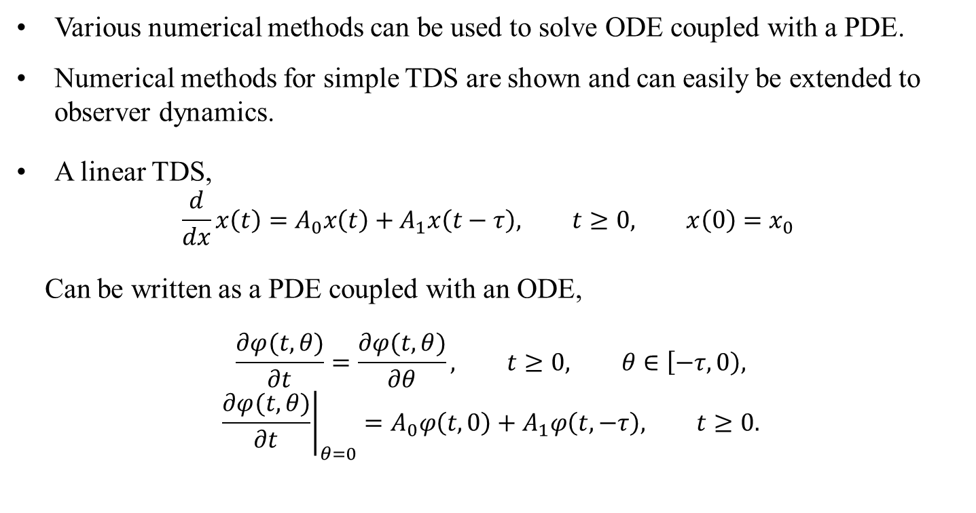
Observer Implementation Methods
Various numerical methods can be used to solve ODE coupled with a PDE.
Numerical methods for simple TDS are shown and can easily be extended to observer dynamics.
A linear TDS,
$$\frac{d}{dx}x\left(t\right)=A_{0}x\left(t\right)+A_{1}x\left(t−τ\right), t≥0, x\left(0\right)=x_{0}$$
Can be written as a PDE coupled with an ODE,
$$\frac{∂φ(t,θ)}{∂t}=\frac{∂φ(t,θ)}{∂θ}, t≥0, θ∈\left[−τ, 0\right), \\ {\left.\frac{∂φ(t,θ)}{∂t}\right|}_{θ=0}=A_{0}φ\left(t,0\right)+A_{1}φ\left(t, −τ\right), t≥0.$$

Slide 25
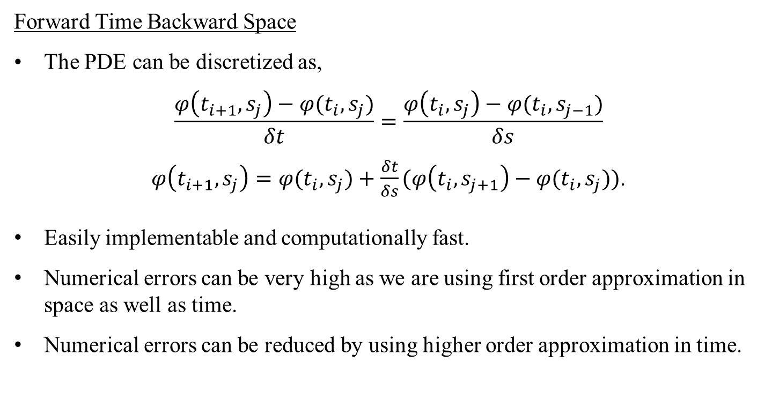
Observer Implementation Methods
Forward Time Backward Space
The PDE can be discretized as,
$$\frac{φ\left(t_{i+1},s_{j}\right)−φ(t_{i},s_{j})}{δt}=\frac{φ\left(t_{i},s_{j}\right)−φ(t_{i},s_{j−1})}{δs}$$ $φ\left(t_{i+1},s_{j}\right)=φ(t_{i},s_{j})+\frac{δt}{δs}(φ\left(t_{i},s_{j+1}\right)−φ(t_{i},s_{j}))$.
Easily implementable and computationally fast.
Numerical errors can be very high as we are using first order approximation in space as well as time.
Numerical errors can be reduced by using higher order approximation in time.

Slide 26
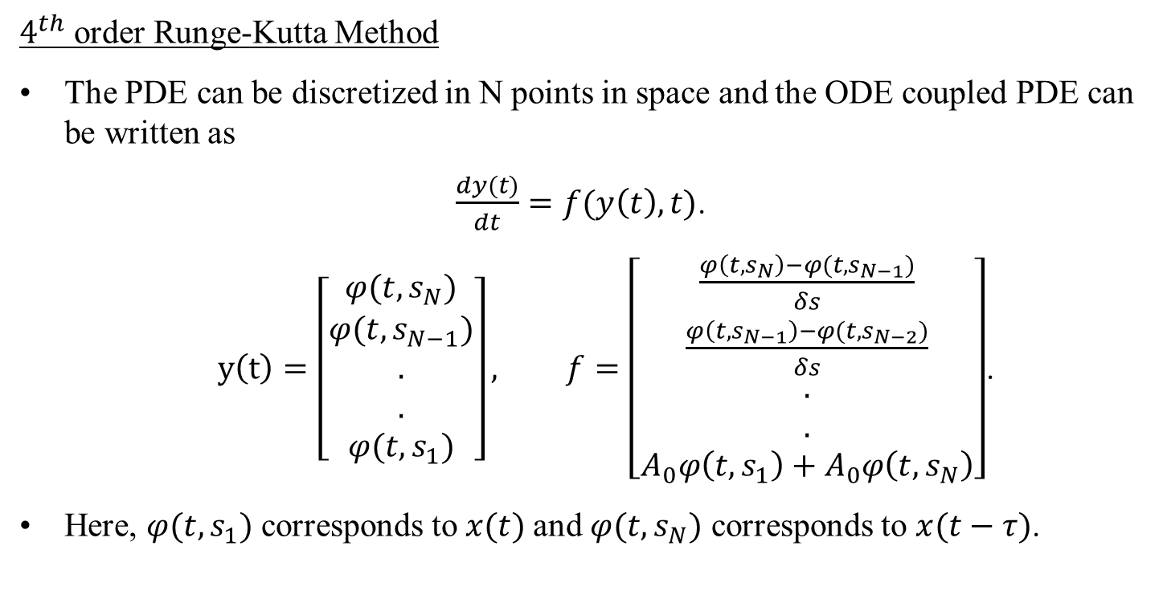
Observer Implementation Methods
$4^{th}$ order Runge-Kutta Method
The PDE can be discretized in N points in space and the ODE coupled PDE can be written as
$\frac{dy(t)}{dt}=f(y\left(t\right),t)$.
$y\left(t\right)=\left[\begin{matrix}φ(t, s_{N}) \\ φ(t, s_{N−1}) \\ . \\ . \\ φ(t, s_{1})\end{matrix}\right], f=\left[\begin{matrix}\frac{φ\left(t, s_{N}\right)−φ(t, s_{N−1})}{δs} \\ \frac{φ\left(t, s_{N−1}\right)−φ(t, s_{N−2})}{δs} \\ . \\ . \\ A_{0}φ\left(t, s_{1}\right)+A_{0}φ\left(t, s_{N}\right)\end{matrix}\right]$.
Here, $φ(t, s_{1})$ corresponds to $x(t)$and $φ(t, s_{N})$ corresponds to $x(t−τ)$.

Slide 27
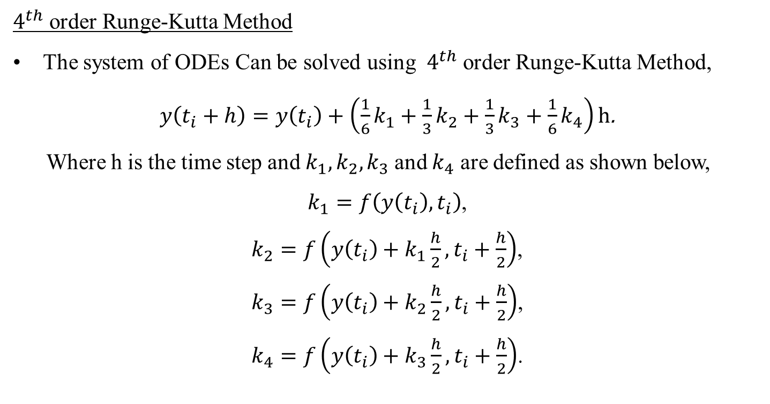
Observer Implementation Methods
$4^{th}$ order Runge-Kutta Method
The system of ODEs Can be solved using $4^{th}$ order Runge-Kutta Method,
$y\left(t_{i}+h\right)=y\left(t_{i}\right)+\left(\frac{1}{6}k_{1}+\frac{1}{3}k_{2}+\frac{1}{3}k_{3}+\frac{1}{6}k_{4}\right)h$.
Where h is the time step and $k_{1},k_{2},k_{3}$ and $k_{4}$ are defined as shown below,
$k_{1}=f\left(y\left(t_{i}\right),t_{i}\right)$,
$k_{2}=f\left(y\left(t_{i}\right)+k_{1}\frac{h}{2},t_{i}+\frac{h}{2}\right)$,
$k_{3}=f\left(y\left(t_{i}\right)+k_{2}\frac{h}{2},t_{i}+\frac{h}{2}\right)$,
$k_{4}=f\left(y\left(t_{i}\right)+k_{3}\frac{h}{2},t_{i}+\frac{h}{2}\right)$.

Slide 28
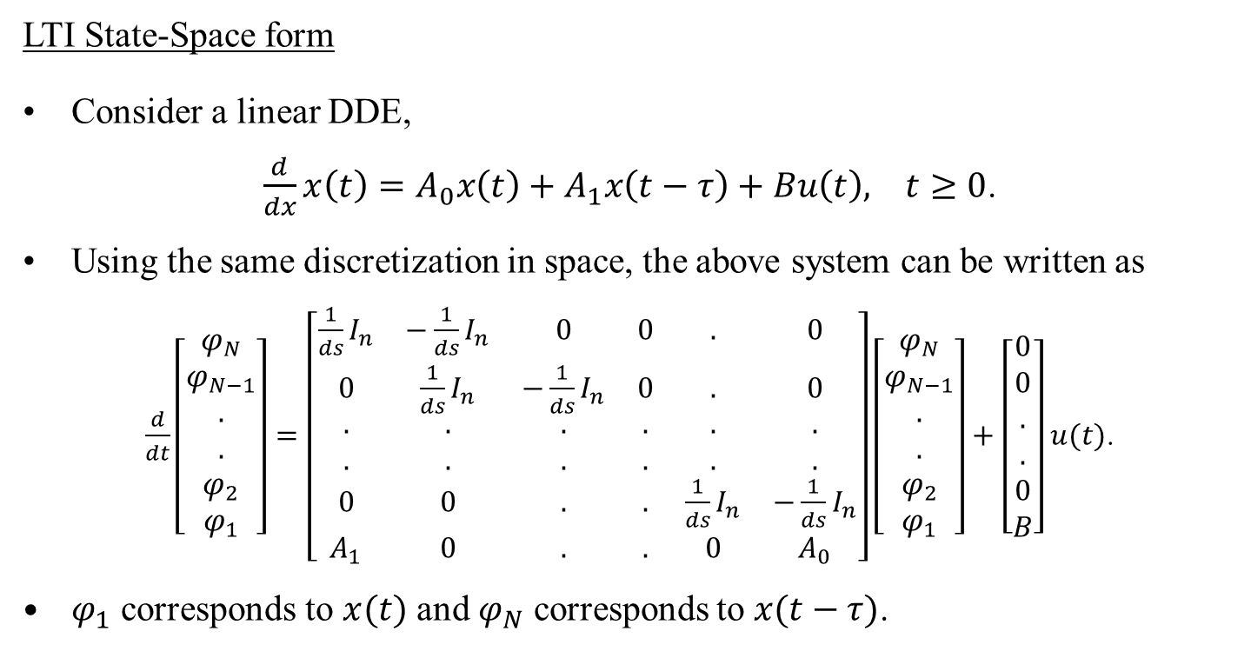
Observer Implementation Methods
LTI State-Space form
Consider a linear DDE,
$\frac{d}{dx}x\left(t\right)=A_{0}x\left(t\right)+A_{1}x\left(t−τ\right)+Bu\left(t\right), t≥0$.
Using the same discretization in space, the above system can be written as
$\frac{d}{dt}\left[\begin{matrix}φ_{N} \\ φ_{N−1} \\ . \\ . \\ φ_{2} \\ φ_{1}\end{matrix}\right]=\left[\begin{matrix}\frac{1}{ds}I_{n} & −\frac{1}{ds}I_{n} & 0 & 0 & . & 0 \\ 0 & \frac{1}{ds}I_{n} & −\frac{1}{ds}I_{n} & 0 & . & 0 \\ . & . & . & . & . & . \\ . & . & . & . & . & . \\ 0 & 0 & . & . & \frac{1}{ds}I_{n} & −\frac{1}{ds}I_{n} \\ A_{1} & 0 & . & . & 0 & A_{0}\end{matrix}\right]\left[\begin{matrix}φ_{N} \\ φ_{N−1} \\ . \\ . \\ φ_{2} \\ φ_{1}\end{matrix}\right]+\left[\begin{matrix}0 \\ 0 \\ . \\ . \\ 0 \\ B\end{matrix}\right]u(t)$.
$φ_{1}$ corresponds to $x(t)$ and $φ_{N}$ corresponds to $x(t−τ)$.

Slide 29
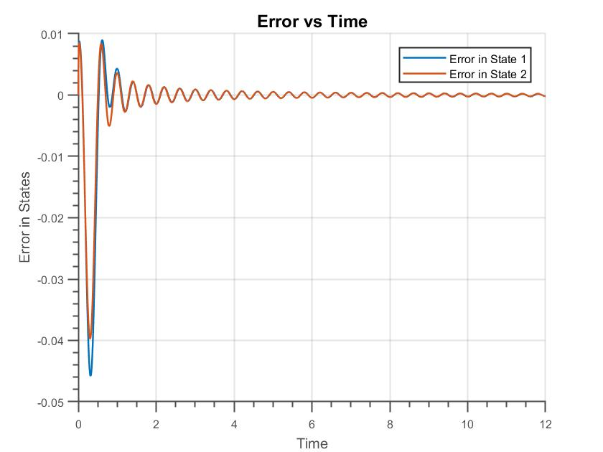

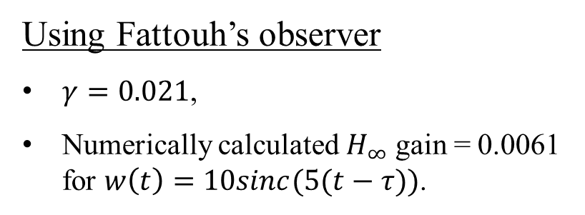
Comparison of the Performance of the Observers
Consider an unstable system,
$$\dot{x}\left(t\right)=\left[\begin{matrix}−3 & 4 \\ 2 & 0\end{matrix}\right]x\left(t\right)+\left[\begin{matrix}0 & 0 \\ 1 & 0\end{matrix}\right]x\left(t−0.3\right)+\left[\begin{matrix}1 \\ 1\end{matrix}\right]w\left(t\right), y\left(t\right)=\left[\begin{matrix}0 & 7\end{matrix}\right]x\left(t\right).$$
Using Fattouh’s observer
$γ=0.021$,
Numerically calculated $H_{∞}$ gain = 0.0061 for $w\left(t\right)=10sinc(5(t−τ))$.

Slide 30
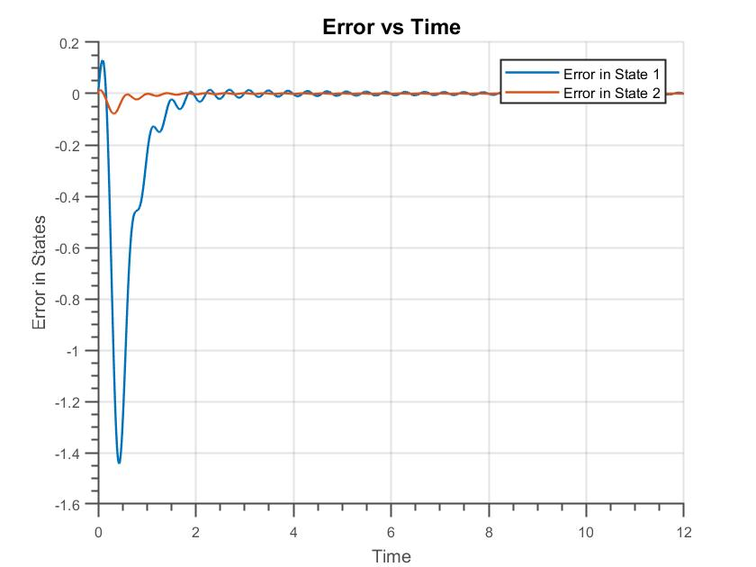
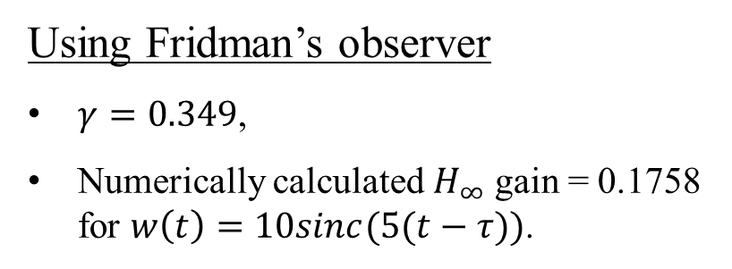
Comparison of the Performance of the Observers
Consider an unstable system,
$$\dot{x}\left(t\right)=\left[\begin{matrix}−3 & 4 \\ 2 & 0\end{matrix}\right]x\left(t\right)+\left[\begin{matrix}0 & 0 \\ 1 & 0\end{matrix}\right]x\left(t−0.3\right)+\left[\begin{matrix}1 \\ 1\end{matrix}\right]w\left(t\right), y\left(t\right)=\left[\begin{matrix}0 & 7\end{matrix}\right]x\left(t\right).$$
Using Fridman’s observer
$γ=0.349$,
Numerically calculated $H_{∞}$ gain = 0.1758 for $w\left(t\right)=10sinc(5(t−τ))$.

Slide 31
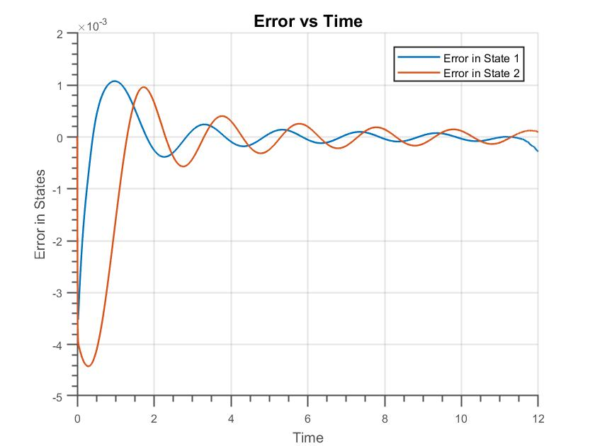
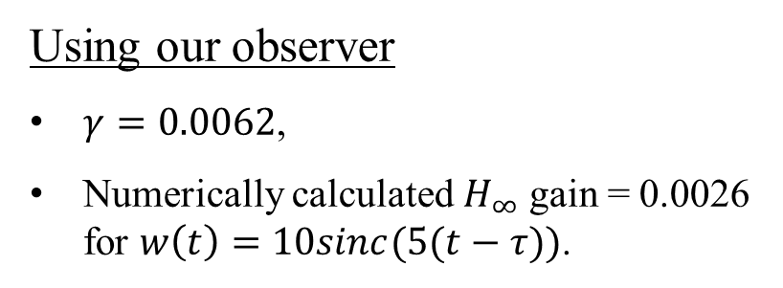
Comparison of the Performance of the Observers
Consider an unstable system,
$$\dot{x}\left(t\right)=\left[\begin{matrix}−3 & 4 \\ 2 & 0\end{matrix}\right]x\left(t\right)+\left[\begin{matrix}0 & 0 \\ 1 & 0\end{matrix}\right]x\left(t−0.3\right)+\left[\begin{matrix}1 \\ 1\end{matrix}\right]w\left(t\right), y\left(t\right)=\left[\begin{matrix}0 & 7\end{matrix}\right]x\left(t\right).$$
Using our observer
$γ=0.0062$,
Numerically calculated $H_{∞}$ gain = 0.0026 for $w\left(t\right)=10sinc(5(t−τ))$.

Slide 32
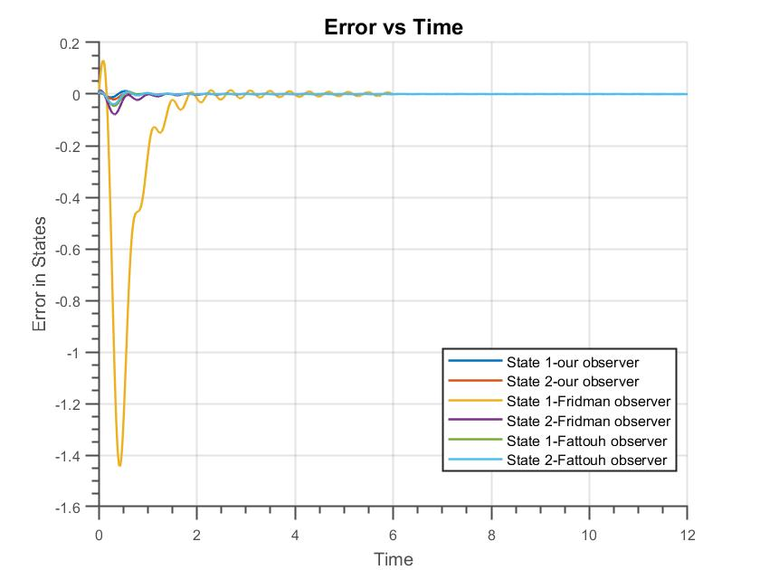

Comparison of the Performance of the Observers
Consider an unstable system,
$$\dot{x}\left(t\right)=\left[\begin{matrix}−3 & 4 \\ 2 & 0\end{matrix}\right]x\left(t\right)+\left[\begin{matrix}0 & 0 \\ 1 & 0\end{matrix}\right]x\left(t−0.3\right)+\left[\begin{matrix}1 \\ 1\end{matrix}\right]w\left(t\right), y\left(t\right)=\left[\begin{matrix}0 & 7\end{matrix}\right]x\left(t\right).$$
Comparison of the state estimation errors

Slide 33
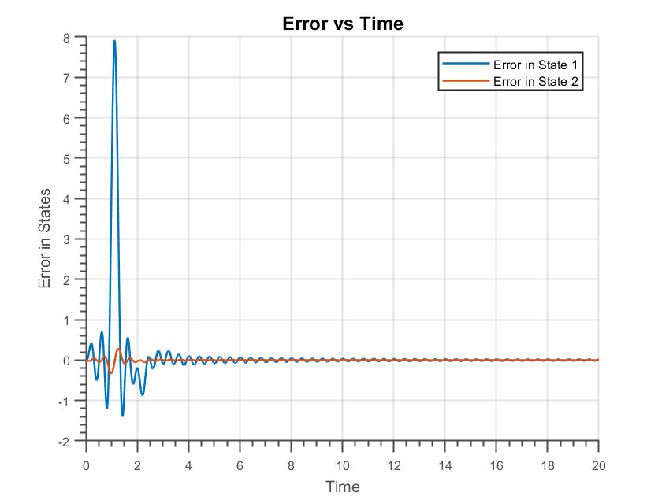
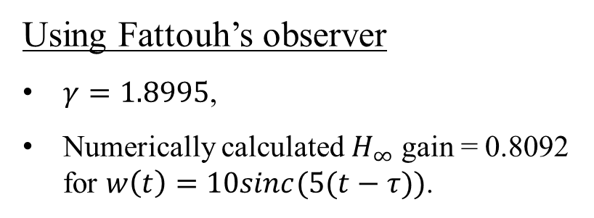

Comparison of the Performance of the Observers
Consider an unstable system,
$$\dot{x}\left(t\right)=\left[\begin{matrix}0 & 0 \\ 1 & 1\end{matrix}\right]x\left(t\right)+\left[\begin{matrix}−\frac{π}{2} & 0 \\ 0 & 0\end{matrix}\right]x\left(t−1\right)+\left[\begin{matrix}1 \\ 1\end{matrix}\right]w\left(t\right), y\left(t\right)=\left[\begin{matrix}0 & 1\end{matrix}\right]x\left(t\right).$$
Using Fattouh’s observer
$γ=1.8995$,
Numerically calculated $H_{∞}$ gain = 0.8092 for $w\left(t\right)=10sinc(5(t−τ))$.

Slide 34
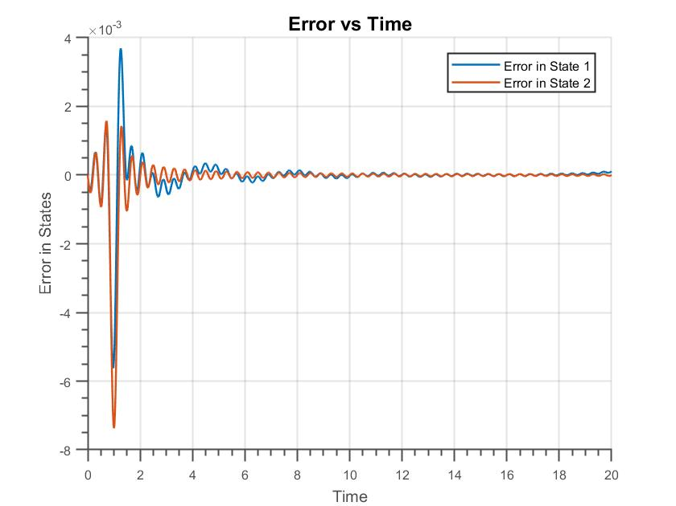
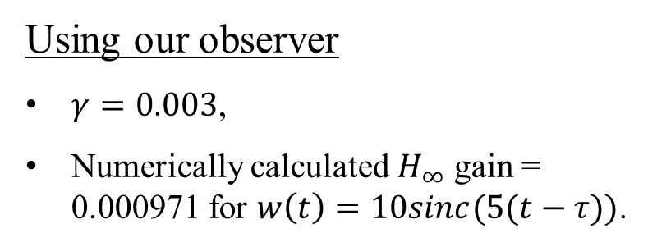
Comparison of the Performance of the Observers
Consider an unstable system,
$$\dot{x}\left(t\right)=\left[\begin{matrix}0 & 0 \\ 1 & 1\end{matrix}\right]x\left(t\right)+\left[\begin{matrix}−\frac{π}{2} & 0 \\ 0 & 0\end{matrix}\right]x\left(t−1\right)+\left[\begin{matrix}1 \\ 1\end{matrix}\right]w\left(t\right), y\left(t\right)=\left[\begin{matrix}0 & 1\end{matrix}\right]x\left(t\right).$$
Using our observer
$γ=0.003$,
Numerically calculated $H_{∞}$ gain = 0.000971 for $w\left(t\right)=10sinc(5(t−τ))$.

Slide 35
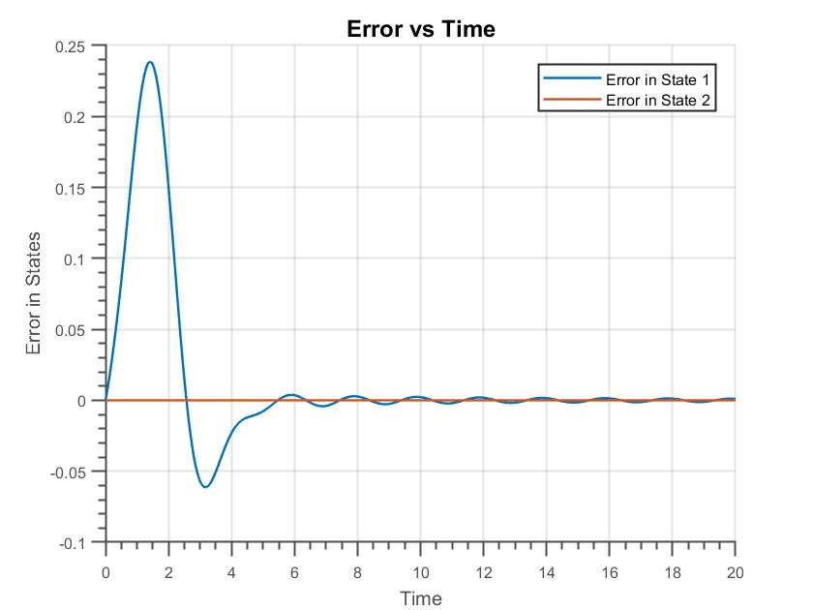
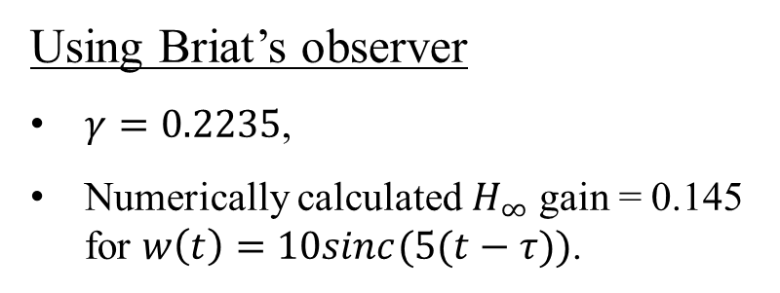

Comparison of the Performance of the Observers
Consider a stable system,
$$\dot{x}\left(t\right)=\left[\begin{matrix}0 & 1 \\ −2 & −3\end{matrix}\right]x\left(t\right)+\left[\begin{matrix}0 & 0.1 \\ −0.2 & −0.3\end{matrix}\right]x\left(t−1\right)+\left[\begin{matrix}1 \\ 1\end{matrix}\right]w\left(t\right), y\left(t\right)=\left[\begin{matrix}0 & 1\end{matrix}\right]x\left(t\right).$$
Using Briat’s observer
$γ=0.2235$,
Numerically calculated $H_{∞}$ gain = 0.145 for $w\left(t\right)=10sinc(5(t−τ))$.

Slide 36
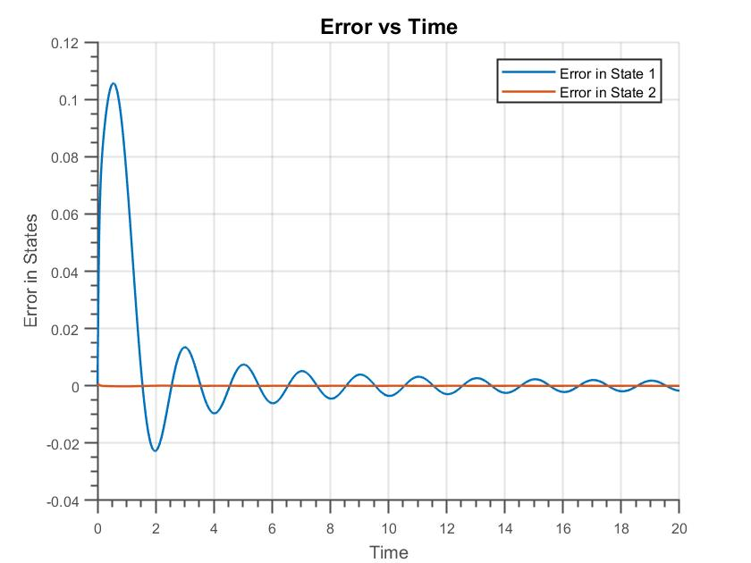
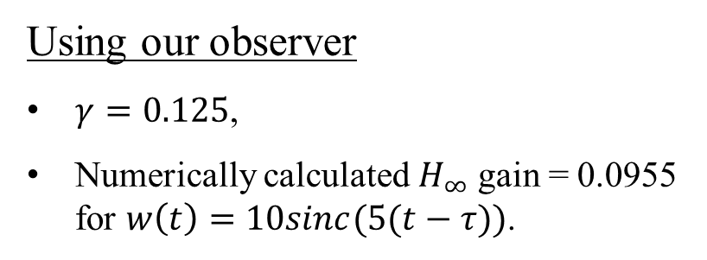
Comparison of the Performance of the Observers
Consider a stable system,
$$\dot{x}\left(t\right)=\left[\begin{matrix}0 & 1 \\ −2 & −3\end{matrix}\right]x\left(t\right)+\left[\begin{matrix}0 & 0.1 \\ −0.2 & −0.3\end{matrix}\right]x\left(t−1\right)+\left[\begin{matrix}1 \\ 1\end{matrix}\right]w\left(t\right), y\left(t\right)=\left[\begin{matrix}0 & 1\end{matrix}\right]x\left(t\right).$$
Using our observer
$γ=0.125$,
Numerically calculated $H_{∞}$ gain = 0.0955 for $w\left(t\right)=10sinc(5(t−τ))$.

Slide 37
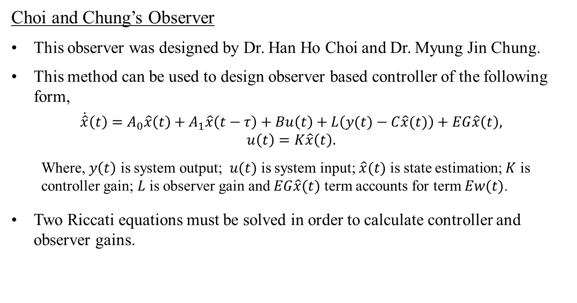
Observer based Controllers for Time Delay Systems
Choi and Chung’s Observer
This observer was designed by Dr. Han Ho Choi and Dr. Myung Jin Chung.
This method can be used to design observer based controller of the following form,
$$\dot{\hat{x}}\left(t\right)=A_{0}\hat{x}\left(t\right)+A_{1}\hat{x}\left(t−τ\right)+Bu\left(t\right)+L\left(y(t)−C\hat{x}(t)\right)+EG\hat{x}\left(t\right), \\ u\left(t\right)=K\hat{x}\left(t\right).$$
Where, $y\left(t\right)$ is system output; $u(t)$ is system input; $\hat{x}(t)$ is state estimation; $K$ is controller gain; $L$ is observer gain and $EG\hat{x}(t)$ term accounts for term $Ew(t)$.
Two Riccati equations must be solved in order to calculate controller and observer gains.

Slide 38
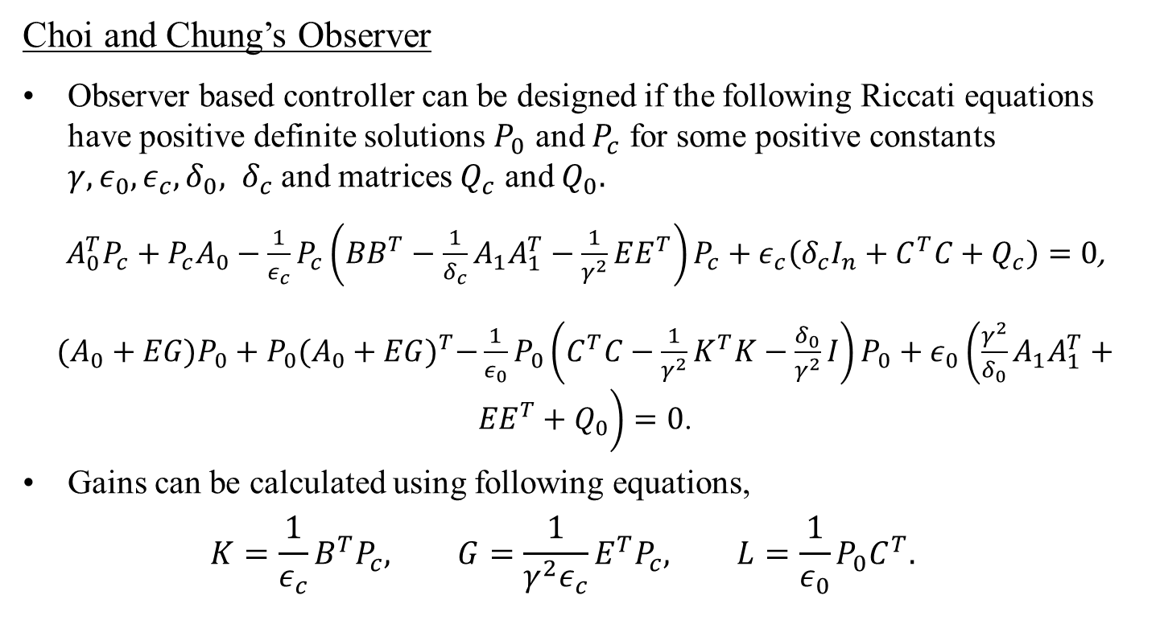
Observer based Controllers for Time Delay Systems
Choi and Chung’s Observer
Observer based controller can be designed if the following Riccati equations have positive definite solutions $P_{0}$ and $P_{c}$ for some positive constants $γ, ε_{0},ε_{c},δ_{0}, δ_{c}$ and matrices $Q_{c}$ and $Q_{0}.$
$A_{0}^{T}P_{c}+P_{c}A_{0}−\frac{1}{ε_{c}}P_{c}\left(BB^{T}−\frac{1}{δ_{c}}A_{1}A_{1}^{T}−\frac{1}{γ^{2}}EE^{T}\right)P_{c}+ε_{c}\left(δ_{c}I_{n}+C^{T}C+Q_{c}\right)=0$,
$(A_{0}+EG)P_{0}+P_{0}{(A_{0}+EG)}^{T}−\frac{1}{ε_{0}}P_{0}\left(C^{T}C−\frac{1}{γ^{2}}K^{T}K−\frac{δ_{0}}{γ^{2}}I\right)P_{0}+ε_{0}\left(\frac{γ^{2}}{δ_{0}}A_{1}A_{1}^{T}+{EE}^{T}+Q_{0}\right)=0$.
Gains can be calculated using following equations,
$$K=\frac{1}{ε_{c}}B^{T}P_{c}, G=\frac{1}{γ^{2}ε_{c}}E^{T}P_{c}, L=\frac{1}{ε_{0}}P_{0}C^{T}.$$

Slide 39

Observer based Controllers for Time Delay Systems
Peet’s Observer
Observer based controller for Peet’s observer can be written as,
$$\dot{\hat{x}}\left(t\right)=A_{0}\hat{x}+A_{1}\hat{∅}\left(t, −τ\right)+Bu\left(t\right)+L_{1}\left(C_{2}\hat{x}\left(t\right)−y\left(t\right)\right)+L_{2}\left(C_{2}\hat{∅}\left(t, −τ\right)−y\left(t−τ\right)\right)$$ $+\int_{−τ}^{0}{L_{3}\left(θ\right)\left(C_{2}\hat{∅}\left(t, θ\right)−y\left(t+θ\right)\right)dθ}$,
$$∂_{t}\hat{∅}\left(t,s\right)=∂_{s}\hat{∅}(t,s)+L_{4}(s)\left(C_{2}\hat{x}\left(t\right)−y\left(t\right)\right)+L_{5}(s)\left(C_{2}\hat{∅}\left(t, −τ\right)−y\left(t−τ\right)\right)$$ $+L_{6}\left(s\right)\left(C_{2}\hat{∅}\left(t, s\right)−y\left(t+s\right)\right)+\int_{−τ}^{0}{L_{7}\left(s,θ\right)\left(C_{2}\hat{∅}\left(t, θ\right)−y\left(t+θ\right)\right)dθ}$,
$u(t)=K\hat{x}(t)$.
Where controller gain can be calculated by solving following Riccati equation,
$A_{0}^{T}P_{c}+P_{c}A_{0}−\frac{1}{ε_{c}}P_{c}\left(BB^{T}−\frac{1}{δ_{c}}A_{1}A_{1}^{T}−\frac{1}{γ^{2}}EE^{T}\right)P_{c}+ε_{c}\left(δ_{c}I_{n}+C^{T}C+Q_{c}\right)=0$,
$K=\frac{1}{ε_{c}}B^{T}P$.

Slide 40



Comparison of Observer based Controllers
Using Choi and Chung’s observer
Consider an unstable system,
$\dot{x}\left(t\right)=\left[\begin{matrix}−3 & 4 \\ 2 & 0\end{matrix}\right]x\left(t\right)+\left[\begin{matrix}0 & 0 \\ 1 & 0\end{matrix}\right]x\left(t−0.3\right)+\left[\begin{matrix}1 \\ 1\end{matrix}\right]w\left(t\right), y\left(t\right)=\left[\begin{matrix}0 & 7\end{matrix}\right]x\left(t\right)$,
$γ=1.489$ and Numerically calculated $H_{∞}$ gain = 0.3838 for $w\left(t\right)=10sinc(0.5(t−τ))$.
Notes:
0.0233

Slide 41



Comparison of Observer based Controllers
Using our observer
Consider an unstable system,
$\dot{x}\left(t\right)=\left[\begin{matrix}−3 & 4 \\ 2 & 0\end{matrix}\right]x\left(t\right)+\left[\begin{matrix}0 & 0 \\ 1 & 0\end{matrix}\right]x\left(t−0.3\right)+\left[\begin{matrix}1 \\ 1\end{matrix}\right]w\left(t\right), y\left(t\right)=\left[\begin{matrix}0 & 7\end{matrix}\right]x\left(t\right)$,
$γ=0.66261$ for the controller, $γ=0.00625$ for the observer and Numerically calculated $H_{∞}$ gain = 0.1419 for $w\left(t\right)=10sinc(0.5(t−τ))$.
Notes:
0.0023 0.3628

Slide 42

Conclusion
Different $H_{∞}$ observers for Time Delay Systems are studied and methods to implement these observers are illustrated.
Simulations of error dynamics for various stable and unstable systems are presented and the data shows that the observer designed using SOS method outperforms existing observers.
For some of the systems we considered, other methods to calculate observer gains were infeasible. However, we were able to calculate observer gains for all the systems we tested on using the SOS method.
Sub-optimal observer based state feedback system is also generated and simulated using the SOS observer. The simulation results show that the closed loop system converges very quickly, and the observer can be used to design full state-feedback closed loop system.

Slide 43
Thank You

