Slide 1

OWASP Project:
Automated Threats to Web Applications
Project Leaders: Colin Watson & Tin Zaw
AppSec USA Project Summit, 2018
#badbots

Slide 2
Agenda
What is Automated Threats project?
How to use the Ontology
What’s New with Version 1.1?
Countermeasure classes
Expansion of possible symptoms
Automated Threats Illustrated
Countermeasures Explained
Project Roadmap

Slide 3
WHAT IS THIS PROJECT ABOUT?
OWASP Automated Threats to Web Applications

Slide 4



All high and medium vulnerabilities eliminated, OWASP Top 10 covered, and the S-SDLC ticking along nicely
You need to buy our “DoesItAll” product as a service offering for that
Wait! My Ops team is battling against attacks all the time
Information Security
Operations
Vendor Sales Rep
Problem Definition

Slide 5
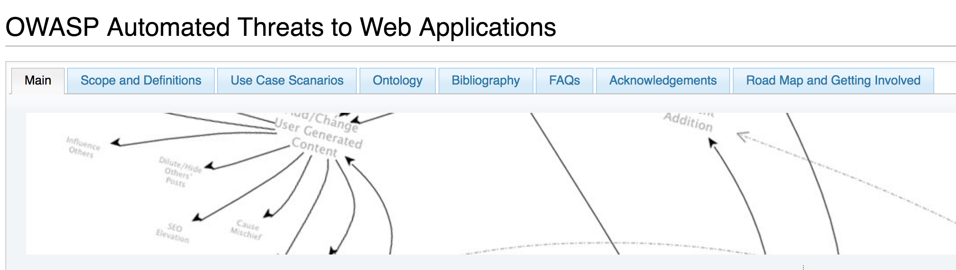
https://www.owasp.org/index.php/OWASP_Automated_Threats_to_Web_Applications

Slide 6
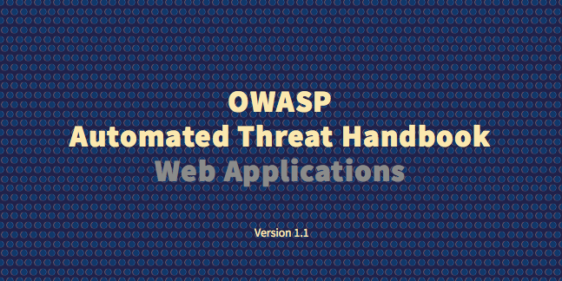
The Automated Threats Handbook

Slide 7
Contributors
Colin Watson – Founder and Co-leader
Tin Zaw – Co-leader
Contributors
Jason Chan,
Mark Hall,
Andrew van der Stock
Roland Weber
Vendors

Slide 8
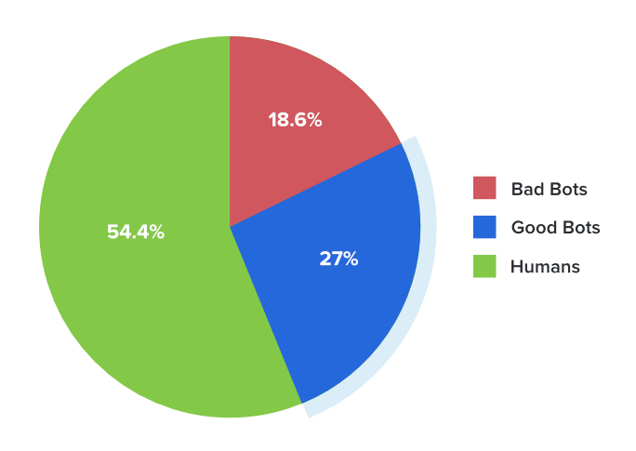
Good Bots, Bad Bots
Good Bots
Search engine crawlers
API access
Health checks
Bad Bots
OWASP Automated
Threats (OATs!)

Slide 9
Introducing … OATs
OWASP Automated Threats
Ontology of Unwanted Automation
Not Vulnerabilities
Not Top 10 or Top 20
“OWASP 20” or “20 OATs”
#badbots

Slide 10
Twenty OATs – The Complete List
Account Aggregation | Expediting
Account Creation | Fingerprinting
Ad Fraud | Footprinting
CAPTCHA Bypass | Scalping
Carding | Scraping
Card Cracking | Skewing
Cashing Out | Sniping
Credential Cracking | Spamming
Credential Stuffing | Token Cracking
Denial of Service | Vulnerability Scanning

Slide 11
GREAT! HOW DO I USE IT?
Use Case Scenarios

Slide 12
Defining application development security requirements
Security Architect
Use Case Scenario 1
Notes:
Ecommerce, payments.
Build in anti-automation by naming threat events using the ontology.
Use these in the Functional Design Document.
Development houses respond to the call for bids use the ontology to focus their answers to these requirements.
-
Scenario: Defining application development security requirements
Functional design document
Specifies that the website’s payment functions must not be susceptible to named threat events
The requirements are specified in terms of the handbook, rather than particular product or service categories
Development houses responding to the call for bids use the ontology to focus their answers to these aspects appropriately
NEXT
---
Cinnaminta SpA intends to build and launch a new multi-lingual and multi-currency e-commerce website. The development will be outsourced and Cinnaminta has been working on the functional design document. Among many other requirements, the application security specification requires that the website must not include any vulnerabilities identified in PCI DSS v3.1 Requirement 6.5, nor any other vulnerabilities that could affect the protection of payment cardholder data. Cinnaminta specifies that the website’s payment functions must not be susceptible to the threat events OAT-001 Carding or OAT-010 Card Cracking, as defined in the OWASP Automated Threat Handbook. In addition, the application must interact with the company’s existing fraud detection system to counter OAT-012 Cashing Out. The requirements are specified in terms of these threat events, rather than particular product or service categories. Development houses responding to the call for bids use the ontology to focus their answers to these aspects appropriately.

Slide 13

Sharing intelligence within a sector with peers
CISO
Use Case Scenario 2
Notes:
Group of companies in an industry vertical’s Cyber Intelligence Sharing Centre
Information from members aggregated and shared, defined according to terms in the ontology.
Consistency in naming leading to increased threat awareness.
-
Scenario: Sharing intelligence within a sector
Data aggregation in a Cyber Intelligence Sharing Center
Automation attacks are classified according to the threat events defined in the OWASP Automated Threat Handbook
Improve service levels for customers using systems run by companies in the CISC
NEXT
---
Unlimited Innovations Inc develops and supports patient-facing software solutions to a range of healthcare providers, many of which participate in the National Health Service Cyber Intelligence Sharing Center (NHS-CISC). Unlimited Innovations already builds continuous monitoring capabilities into its software and decides to provide an optional enhancement so that customers could choose to share their misuse event data with each other, to benefit from the combined threat intelligence. Rather than sharing large quantities of low-level data, Unlimited Innovations aggregates information and broadcasts validated and categorised threat data amongst the participating organisations. Automation attacks are classified according to the threat events defined in the OWASP Automated Threat Handbook so that each receiving party understands the nature of the threat. Even organisations that do not want to take part in this information sharing can benefit, since their own categorised information is made available to internal business management in the form of an easy-to-comprehend monitoring dashboard. The information gathered can also be fed into their other business information management systems to help improve patient service.

Slide 14

Exchanging threat data between CERTs
Security Analyst
Use Case Scenario 3
Notes:
Computer Emergency Response Teams already have common data formats for sharing data.
Application threats may not be defined adequately.
If information could be richer, such as tagging event information with the threat event names defined in the ontology, would add context to data shared.
-
Scenario: Exchanging threat data between CERTs
Sharing of local information can contribute to worldwide prevention of cyber attacks
Sparsity of application-specific data it receives, and also the classification of that data
Tag threat events using the OWASP Automated Threat Handbook, in order to add greater context to existing solutions being used for threat data exchange
NEXT
---
National Computer Emergency Response Teams (CERTs) recognise that sharing of local information can contribute to worldwide prevention of cyber attacks. Despite advances in cooperation between CERTs, anything to increase continuity and interoperability, such as standards for data exchange, is encouraged. CERT Zog is concerned about the sparsity of application-specific data it receives, and also the classification of that data. It has a particular concern about attacks and breaches that affect sectors defined in Zog’s 2015 national cyber security strategy. CERT Zog and its neighbour CERT Tarset agree to tag threat events using the OWASP Automated Threat Handbook, in order to add greater context to existing solutions being used for threat data exchange between them. The programme also collects sector metadata, so that all organisations within these can benefit from the centralised intelligence.

Slide 15

Enhancing application penetration test findings
Penetration Test Lead
Use Case Scenario 4
Notes:
Application pen test findings.
Common Vulnerability Scoring System (CVSS) versions 2 and 3 by First. Maybe also weaknesses referenced with Mitre’s Common Weakness Enumeration (CWE).
Mew section – how vulnerabilities identified – and combinations – might be exploited by automation.
Added value
-
Scenario: Enhancing application penetration test findings
Use handbook to explain the automation-related threats
The individual vulnerabilities were scored as normal using CVSSv2 and v3, the matching CWEs identified, and mitigations in place documented
Help create a new section in the executive summary that explains how combinations of the issues found could lead to automation threats and the possible technical and business impacts
Additional value to pen test clients
NEXT
---
Specialist application security penetration testing firm Cherak Industries Pte Ltd works primarily for financial services companies in the banking and insurance sectors, and is looking to expand its business throughout Asia. Cherak has some innovative pen test result reporting systems which integrate with client software fault and vulnerability tracking systems, and it actively looks for methods to provide additional value to its clients. Cherak has identified that pen test clients would benefit from help in understanding the effects of combinations of vulnerabilities, especially design flaws, and has decided to utilise the OWASP Automated Threat Handbook to define and explain the automation-related threats. The individual vulnerabilities were scored as normal using CVSSv2 and v3, the matching CWEs identified, and mitigations in place documented. In addition, Cherak uses the threat events defined in the OWASP Automated Threat Handbook to help create a new section in the executive summary that explains how combinations of the issues found could lead to automation threats and the possible technical and business impacts. For example, an assessment for one client had identified weaknesses in authentication so that there is a risk of OAT-008 Credential Stuffing. The defined identifier was provided to the client, so its technical staff could refer to additional information on the OWASP website.

Slide 16

Specifying service acquisition needs
Purchasing Manager
Use Case Scenario 5
Notes:
Automated threats – IT ops spending too much time dealing with effects. Cleaning up data, resetting customer accounts, providing extra capacity during attacks
Automation causing instabilities / Negative feedback from customers.
Buying team and IT colleagues. Define and quantify issues against ontology (frequency, magnitude).
Invitation to Tender (ITT) and go to marketplace to source solutions.
-
Scenario: Specifying service acquisition needs
IT operations team are spending too much time dealing with the effects of automated misuse, such as cleaning up data, resetting customer accounts and providing extra capacity during attacks
Unwanted automation is also causing some instabilities leading to negative feedback from customers
Go out to the security marketplace to identify, assess and select products or services that might help address these automation issues for all its websites
Buying team works with their information technology colleagues to write the detailed requirements in an Invitation to Tender (ITT) document
This describes the types of attacks its web applications are receiving, their frequency of occurrence and their magnitudes. These are defined according
NEXT
---
Falstone Paradise Inc is concerned about malicious use of their portfolio of hotel and resort websites. The majority of the websites use a shared application platform, but there are some unique applications and a large number of other micro-sites, some of which use generic content management systems such as Wordpress and Drupal. Falstone Paradise has identified that its IT operations team are spending too much time dealing with the effects of automated misuse, such as cleaning up data, resetting customer accounts and providing extra capacity during attacks. Furthermore, the unwanted automation is also causing some instabilities leading to negative feedback from customers. Therefore Falstone Paradise decides to go out to the security marketplace to identify, assess and select products or services that might help address these automation issues for all its websites. Their buying team works with their information technology colleagues to write the detailed requirements in an Invitation to Tender (ITT) document. This describes the types of attacks its web applications are receiving, their frequency of occurrence and their magnitudes. These are defined according to the OWASP Automated Threat Handbook, so that vendors do not misunderstand the requirements, and each vendor’s offering can be assessed against the particular automation threat events of concern.

Slide 17
Characterizing vendor services
Vendor Sales Rep
Use Case Scenario 6
Notes:
Lastly, from the vendors perspective.
New solution, difficulty explaining. Maybe does not fit nicely into a conventional product category or magic segment.
Define capabilities using the ontology’s terminology. Provides greater clarity and a shared language for discussions with customers.
-
Scenario: Characterising vendor services
New solution
Difficulty explaining it in the marketplace
Does not fit into any conventional product category
Use the terminology and threat events listed in the OWASP Automated Threat Handbook to define their product’s capabilities
Provides greater clarity about their offering, and also demonstrate how their product can be used to replace more than one other conventional security device
NEXT
---
Better Best Ltd has developed an innovative technology to help gaming companies defend against a range of automated threats that can otherwise permit cheating and distortion of the game, leading to disruption for normal players. The solution can be deployed on premises, but is also available in the cloud as a service. But Better Best is finding difficulty explaining its solution in the market place, especially since it does not fit into any conventional product category. Better Best decide to use the terminology and threat events listed in the OWASP Automated Threat Handbook to define their product’s capabilities. They hope this will provide some clarity about their offering, and also demonstrate how their product can be used to replace more than one other conventional security device. Additionally, Better Best writes a white paper describing how their product has been successfully used by one of their reference customers Hollybush Challenge Games to protect against OAT-006 Expediting, OAT-005 Scalping, OAT-016 Skewing and OAT-013 Sniping.

Slide 18
SO, WHAT’S NEW?
As of September, 2018

Slide 19
What’s new in v1.1
(Published late 2016)
Introduction of 14 countermeasure classes
Authentication
Instrumentation
Reputation
Etc.
Application of generic countermeasures to specific threats
More threat specific symptoms

Slide 20
What’s new in v1.2 (in draft)
(As of September, 2017)
Changes to OWASP Automated Threats
OAT-021 Denial of Inventory (new!)
OAT-009 CAPTCHA Bypass -> CAPTCHA Defeat
Refining Countermeasures
Better matching Threats and Countermeasures
Fixing typos and type setting errors

Slide 21
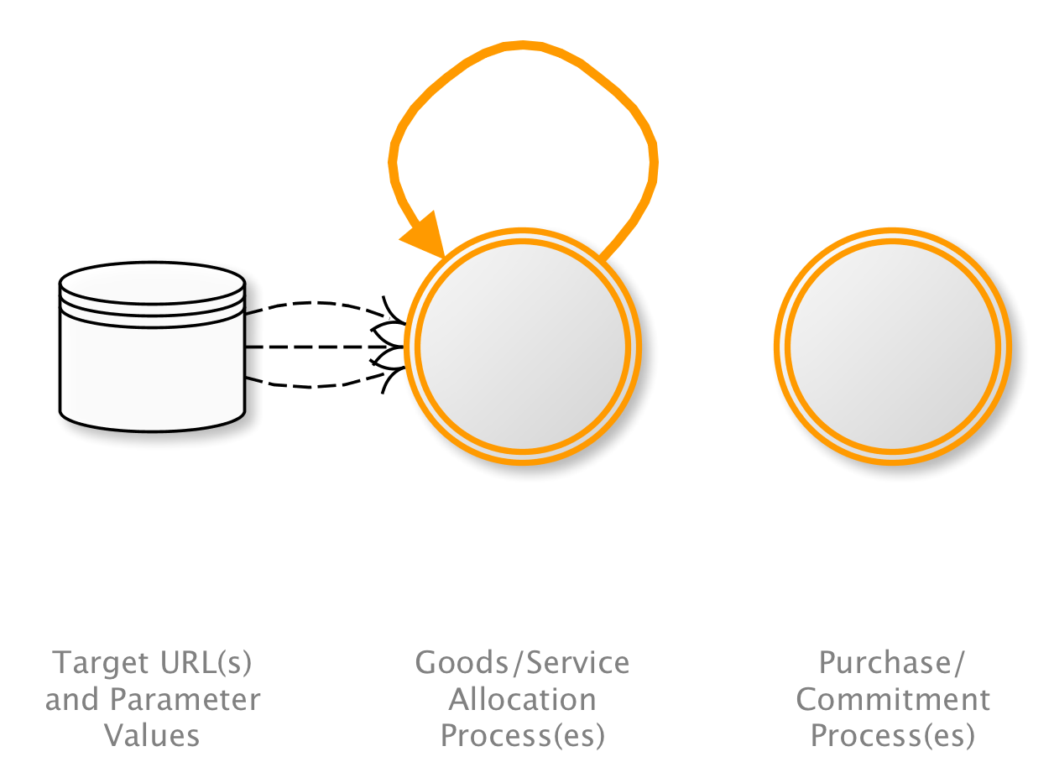
OAT-021 Denial of Inventory
Deplete goods or services stock without ever completing the purchase or committing to the transaction.
Other Names and Examples:
Hoarding; Hold all attack; Inventory depletion; Inventory exhaustion; Stock exhaustion
OAT-007 Credential Cracking
Notes:
Brute force, dictionary (word list) and guessing attacks used against authentication processes of the application to identify valid account credentials. This may utilise common usernames or passwords, or involve initial username evaluation.
The use of stolen credential sets (paired username and passwords) to authenticate at one or more services is OAT-008 Credential Stuffing.
(all)
Many users/Application owner
Authentication credentials

Slide 22
Project Review
(Held November, 2016)
Type of Project:
Documentation
Purpose of Review:
Incubator to Lab
Overall Status:
On Track: Project is progressing quite well.
Reviewers:
Matt Tesauro, Igor Andriushchenko, Gabriel
Current Status: Lab

Slide 23
WHAT’S NEXT?
OWASP Automated Threats Handbook Version 1.2

Slide 24
Forward Looking Statements
Version 1.2 in the works
Refinement of countermeasures
Additional OATs?
Target: Late 2017
Presentations
At a conference near you?
Lab to Flagship
Goal: AppSec Europe June, 2018

Slide 25
Funds and Usage
Corporate Sponsor
Verizon
Any other?
Funds in the bank
$2000
Usage
Graphic designer
Design tools
Travel (if needed)

Slide 26
LET’S WALK THROUGH SOME EXAMPLES
OWASP Automated Threats

Slide 27
Example 1: Account Takeover
Business problem
An attacker takes over an account of a legitimate user
Technical threats
OAT-007 – Credential Cracking
OAT-008 – Credential Stuffing

Slide 28
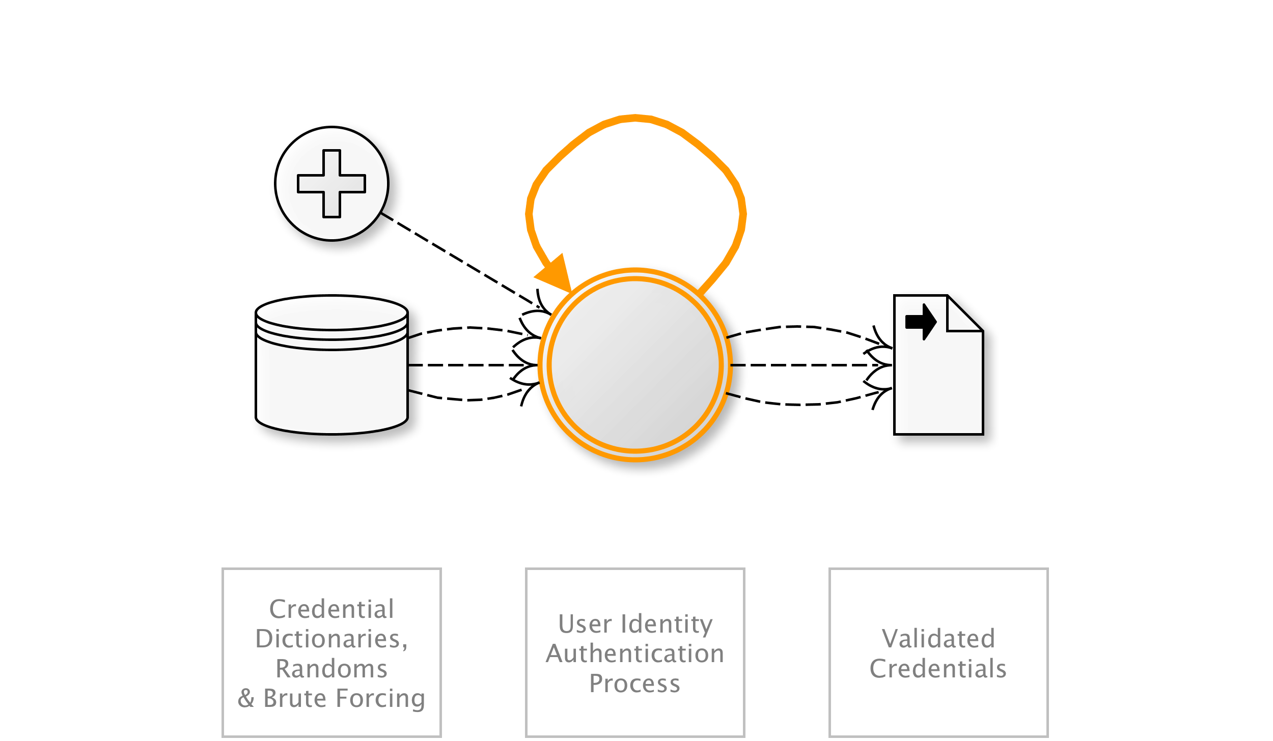
OAT-007 Credential Cracking
Identify valid login credentials by trying different values for usernames and/or passwords.
AKA Brute-force attacks against sign-in; Brute forcing log-in credentials; Brute-force password cracking; Cracking login credentials; Password brute-forcing; Password cracking; Reverse brute force attack; Username cracking; Username enumeration
OAT-007 Credential Cracking
Notes:
Brute force, dictionary (word list) and guessing attacks used against authentication processes of the application to identify valid account credentials. This may utilise common usernames or passwords, or involve initial username evaluation.
The use of stolen credential sets (paired username and passwords) to authenticate at one or more services is OAT-008 Credential Stuffing.
(all)
Many users/Application owner
Authentication credentials

Slide 29
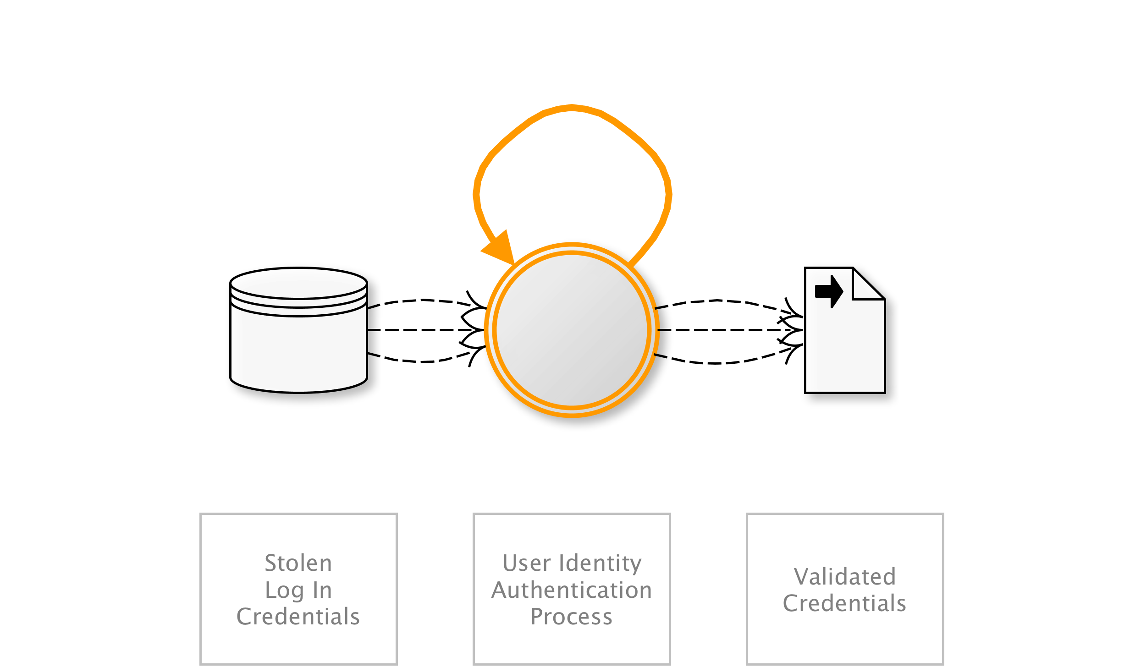
OAT-008 Credential Stuffing
Mass log in attempts used to verify the validity of stolen username/password pairs.
AKA Account checker attack; Account checking; Account takeover; Account takeover attack; Login Stuffing; Password list attack; Password re-use; Stolen credentials; Use of stolen credentials
OAT-008 Credential Stuffing
Notes:
Lists of authentication credentials stolen from elsewhere are tested against the application’s authentication mechanisms to identify whether users have re-used the same login credentials. The stolen usernames (often email addresses) and password pairs could have been sourced directly from another application by the attacker, purchased in a criminal marketplace, or obtained from publicly available breach data dumps.
Unlike OAT-007 Credential Cracking, Credential Stuffing does not involve any brute-forcing or guessing of values; instead credentials used in other applications are being tested for validity.
Entertainment/Financial/Government/Retail/Social networking
Many users/Application owner
Authentication credentials
NEXT
---

Slide 30
Example 2: Credit Card Abuse
Business problem
My credit card chargeback rate and transaction costs are high
Technical threats
OAT-001 – Carding
OAT-010 – Card Cracking
OAT-012 – Cashing Out

Slide 31
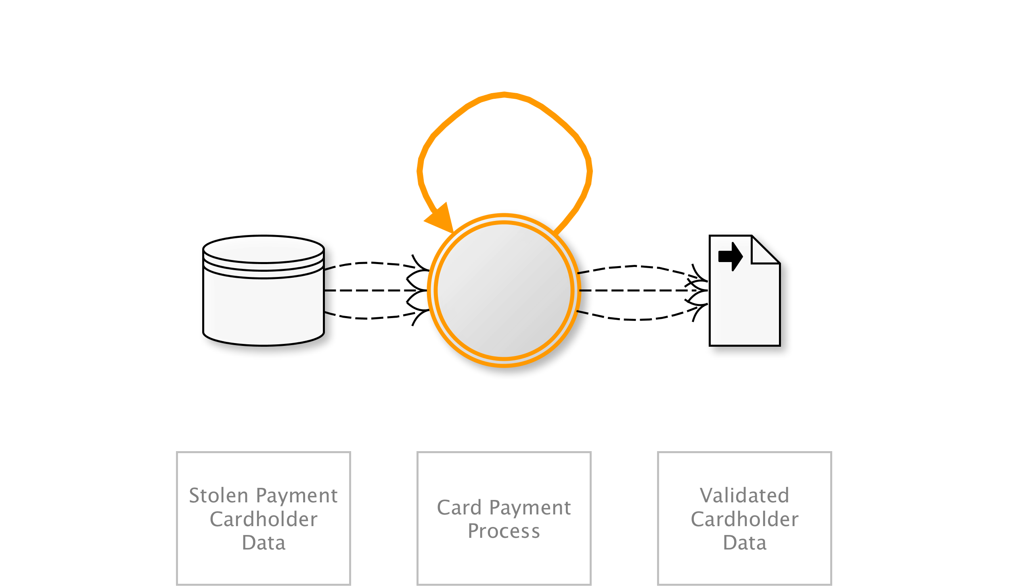
OAT-001 Carding
Multiple payment authorisation attempts used to verify the validity of bulk stolen payment card data.
AKA Card stuffing; Credit card stuffing; Card verification
OAT-001 Carding
Notes:
Lists of full credit and/or debit card data are tested against a merchant’s payment processes to identify valid card details. The quality of stolen data is often unknown, and Carding is used to identify good data of higher value. Payment cardholder data may have been stolen from another application, stolen from a different payment channel, or acquired from a criminal marketplace.
When partial cardholder data is available, and the expiry date and/or security code are not known, the process is OAT-010 Card Cracking instead. The use of stolen cards to obtain cash or goods is OAT-012 Cashing Out.
Entertainment/Retail
Many users/Application owner/Third parties
Payment cardholder data
NEXT
---

Slide 32
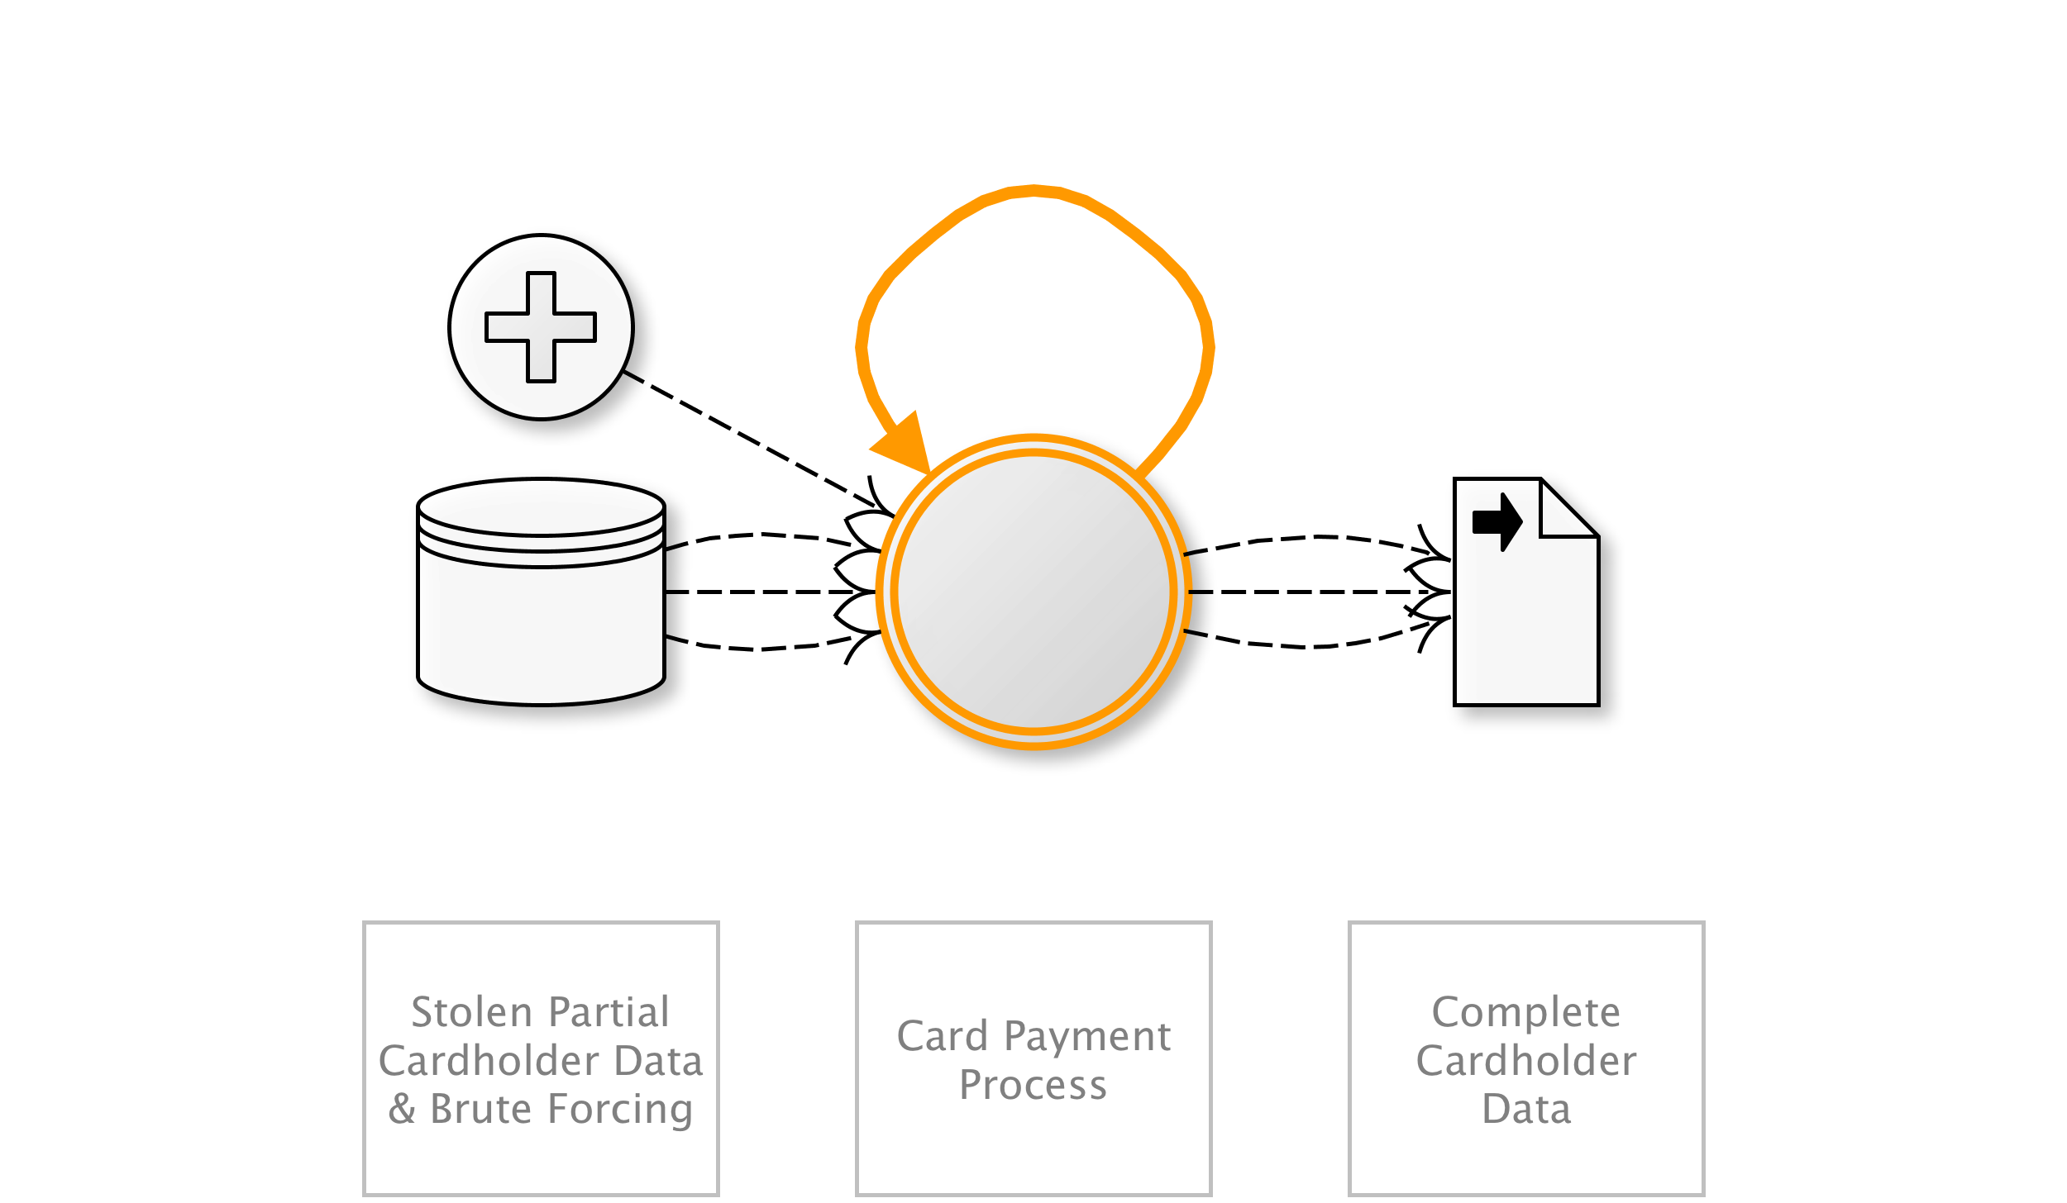
OAT-010 Card Cracking
Identify missing start/expiry dates and security codes for stolen payment card data by trying different values.
AKA Brute forcing credit card information; Card brute forcing; Credit card cracking
OAT-010 Card Cracking
Notes:
Look at a handful. Each ID, name, short summary, diagram and other names/examples.
Brute force attack against application payment card processes to identify the missing values for start date, expiry date and/or card security code (CSC), also referred to in many ways, including card validation number 2 (CVN2), card validation code (CVC), card verification value (CV2) and card identification number (CID).
When these values are known as well as the Primary Account Number (PAN), OAT-001 Carding is used to validate the details, and OAT-012 Cashing Out to obtain goods or cash.
Retail
Many users/Application owner/Third parties
Payment cardholder data
NEXT
---

Slide 33
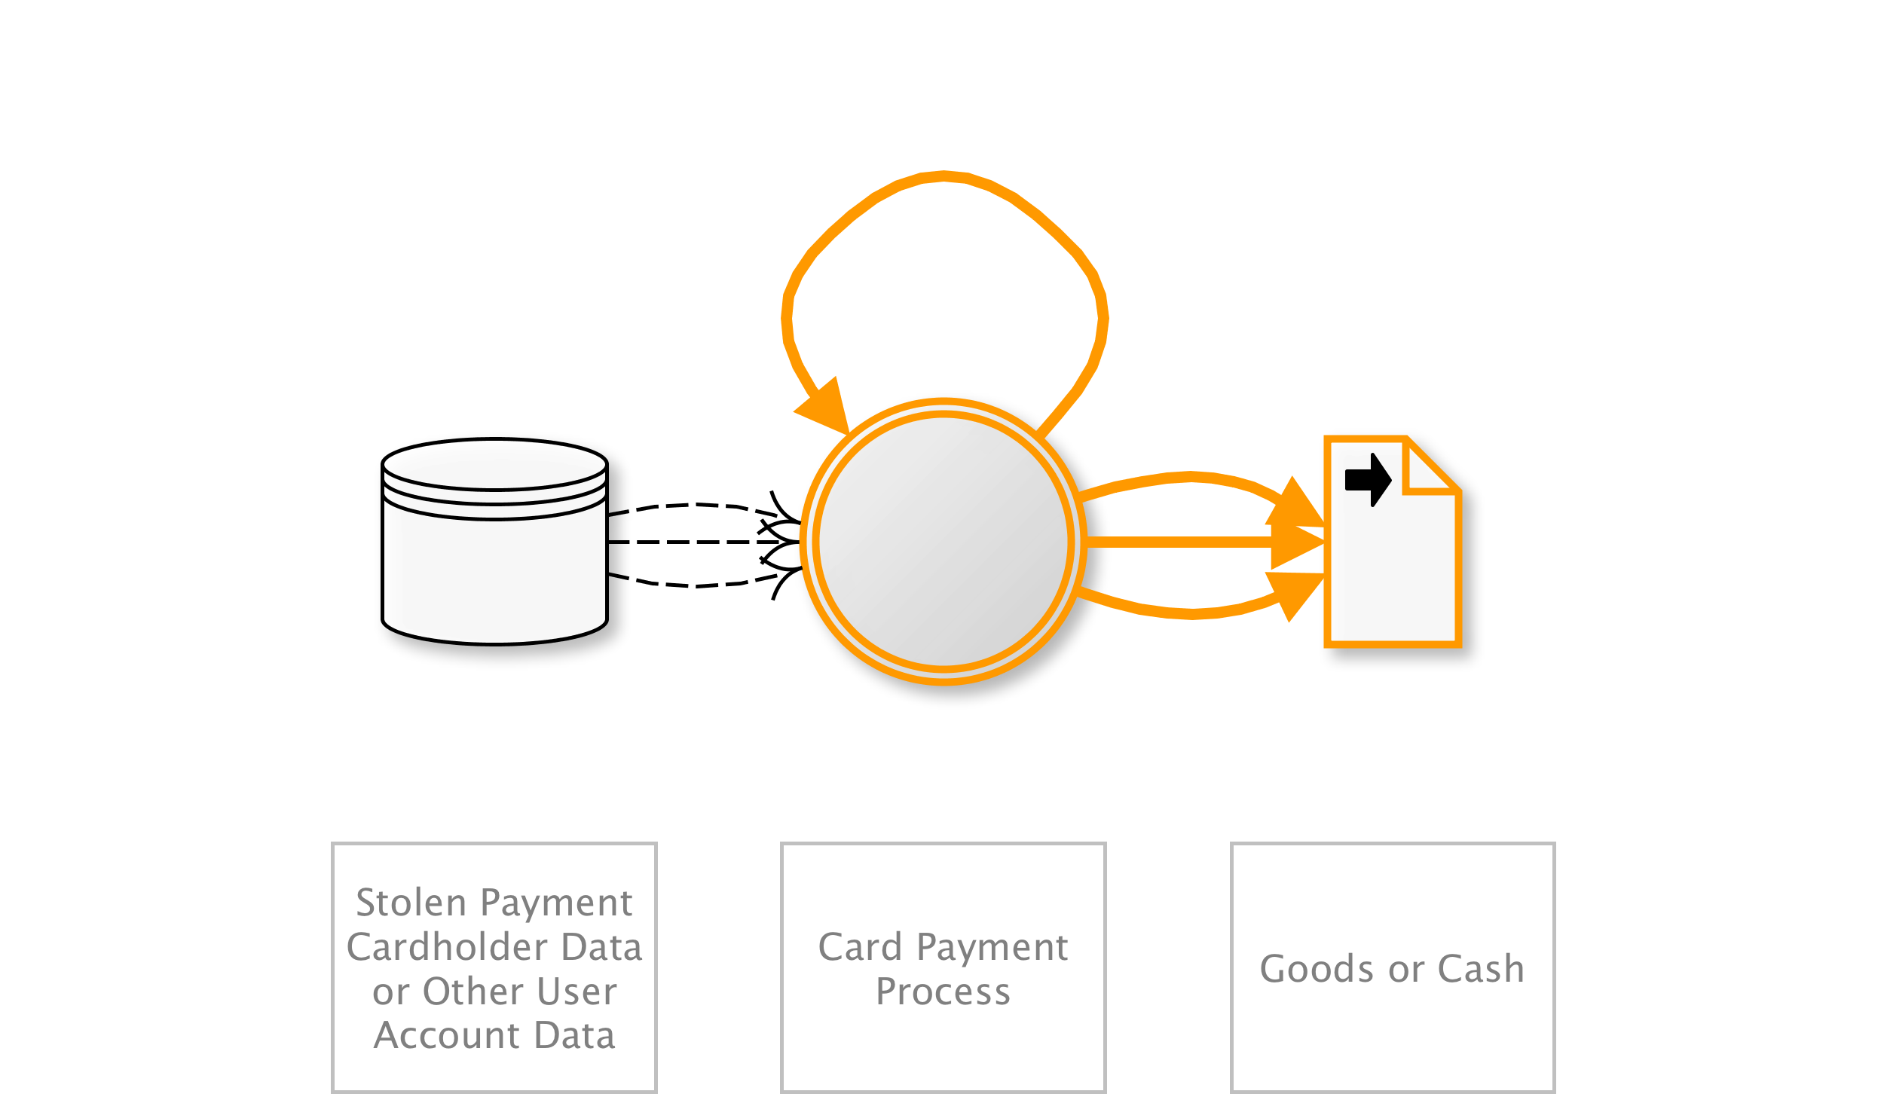
OAT-012 Cashing Out
Buy goods or obtain cash utilising validated stolen payment card or other user account data.
AKA Money laundering; Online credit card fraud; Online payment card fraud; Refund fraud; Stolen identity refund fraud (SIRF)
OAT-012 Cashing Out
Notes:
Obtaining currency or higher-value merchandise via the application using stolen, previously validated payment cards or other account login credentials. Cashing Out sometimes may be undertaken in conjunction with product return fraud. For financial transactions, this is usually a transfer of funds to a mule’s account. For payment cards, this activity may occur following OAT-001 Carding of bulk stolen data, or OAT-010 Card Cracking, and the goods are dropped at a reshipper’s address. The refunding of payments via non-financial applications (e.g. tax refunds, claims payment) is also included in Cashing Out.
Obtaining other information of value from the application is instead OAT-011 Scraping.
Entertainment/Financial/Government/Retail
Many users/Application owner/Third parties
Authentication credentials/Payment cardholder data/Other financial data

Slide 34
Example 3: E-Commerce Stats Skewed
Business problem
My e-commerce stats must be skewed – click to purchase ratio is way off compared to historic data
Technical threats
OAT-003 Ad Fraud
OAT-016 Skewing

Slide 35
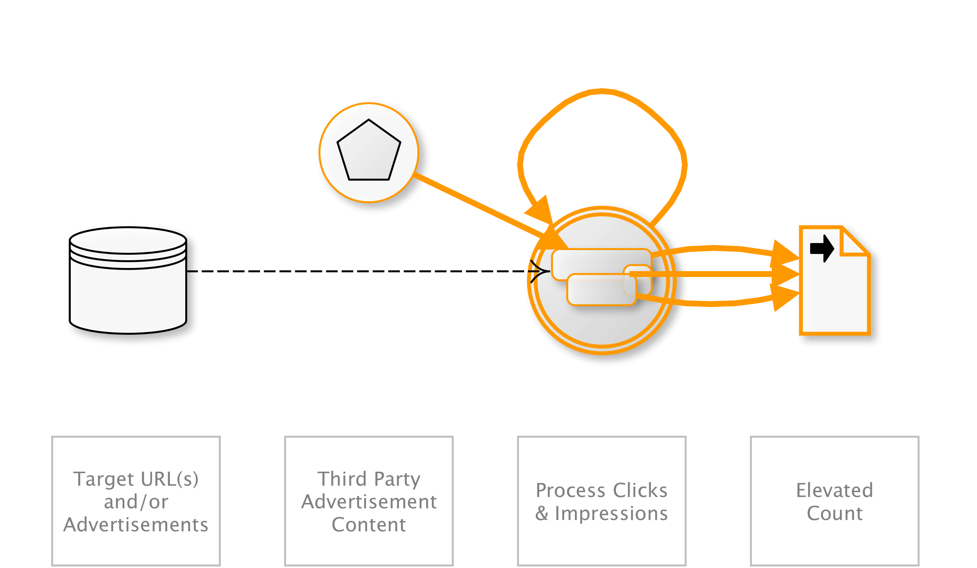
OAT-003 Ad Fraud
False clicks and fraudulent display of web-placed advertisements.
AKA Advert fraud; Adware traffic; Click bot; Click fraud; Hit fraud; Impression fraud; Pay per click advertising abuse; Phoney ad traffic
OAT-003 Ad Fraud
Notes:
Falsification of the number of times an item such as an advert is clicked on, or the number of times an advertisement is displayed. Performed by owners of web sites displaying ads, competitors and vandals.
See OAT-016 Skewing instead for similar activity that does not involve web-placed advertisements.
Entertainment/Financial/Health/Retail/Technology/Social networking
Application owner/Third parties
Other business data

Slide 36
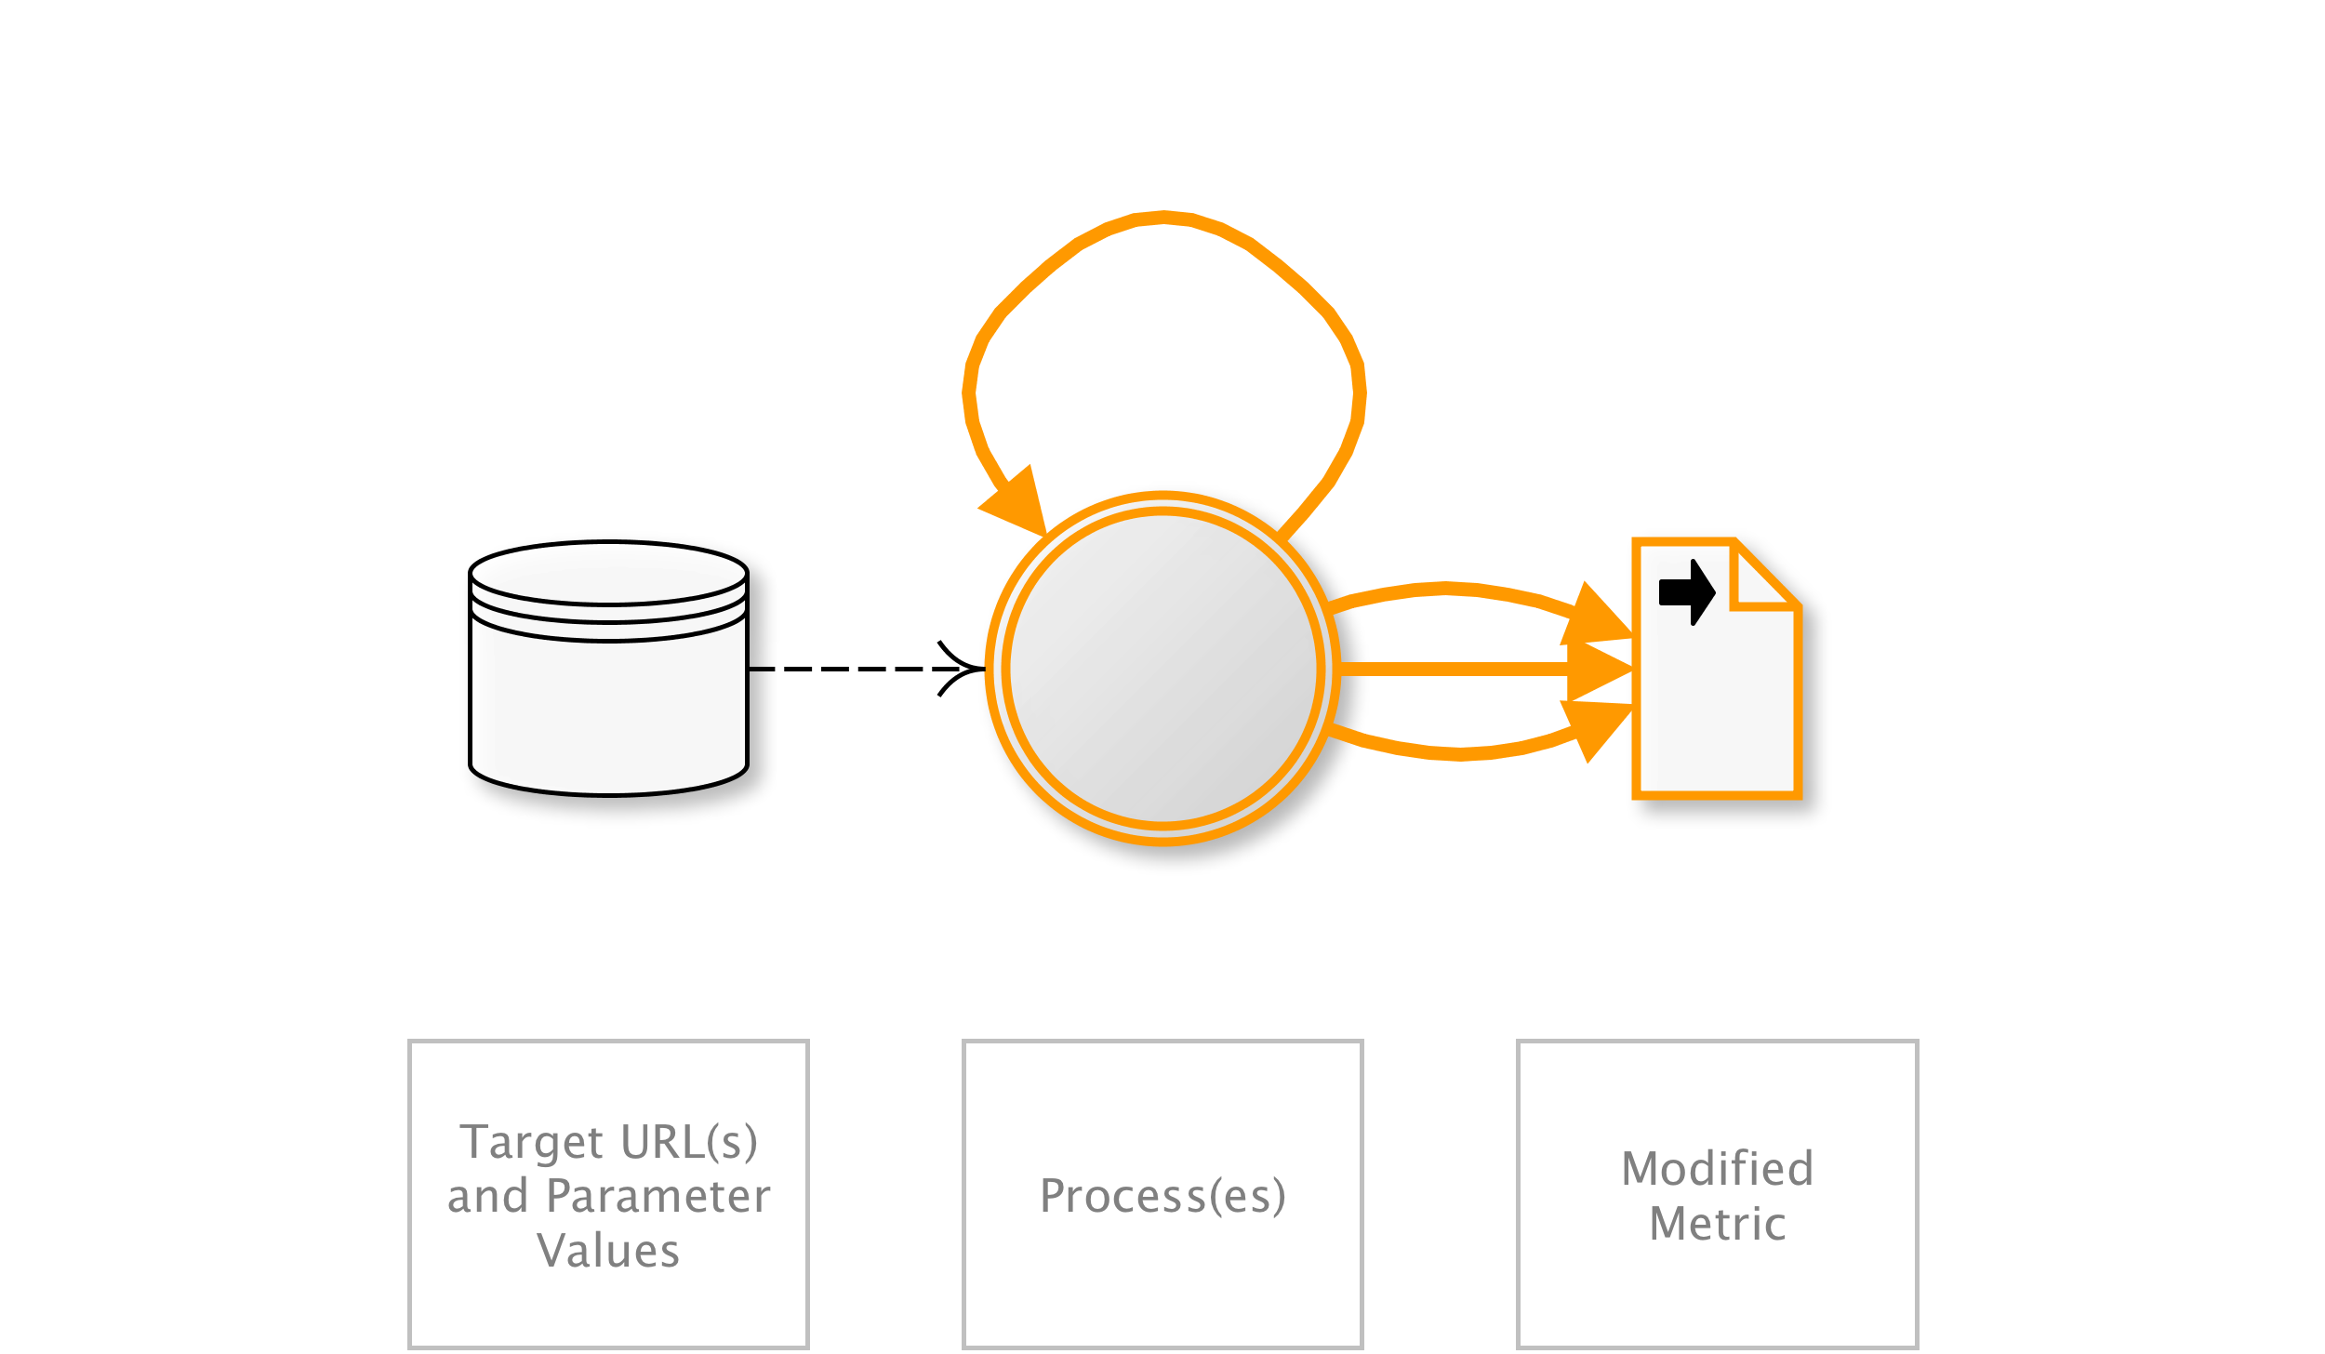
OAT-016 Skewing
Repeated link clicks, page requests or form submissions intended to alter some metric.
AKA Biasing KPIs; Boosting friends, visitors, and likes; Click fraud; Election fraud; Hit count fraud; Market distortion; Metric and statistic skewing; Page impression fraud; Poll fraud; Poll skewing; Poll/voting subversion; Rating/review skewing; SEO; Stock manipulation; Survey skewing
OAT-016 Skewing
Notes:
Automated repeated clicking or requesting or submitting content, affecting application-based metrics such as counts and measures of frequency and/or rate. The metric or measurement may be visible to users (e.g. betting odds, likes, market pricing, visitor count, poll results, reviews) or hidden (e.g. application usage statistics, business performance indicators). Metrics may affect individuals as well as the application owner, e.g. user reputation, influence others, gain fame, or undermine someone else’s reputation.
For malicious alteration of digital advertisement metrics, see OAT-003 Ad Fraud instead.
(all)
(all)
Other personal data/Other business data/Public information

Slide 37
Example 4: Stress on Infrastructure
Business problem
Infrastructure experiences spikes in CPU, memory and network load, occasionally crashing JVMs
Technical threats
OAT-015 – Denial of Service
OAT-014 – Vulnerability Scanning

Slide 38
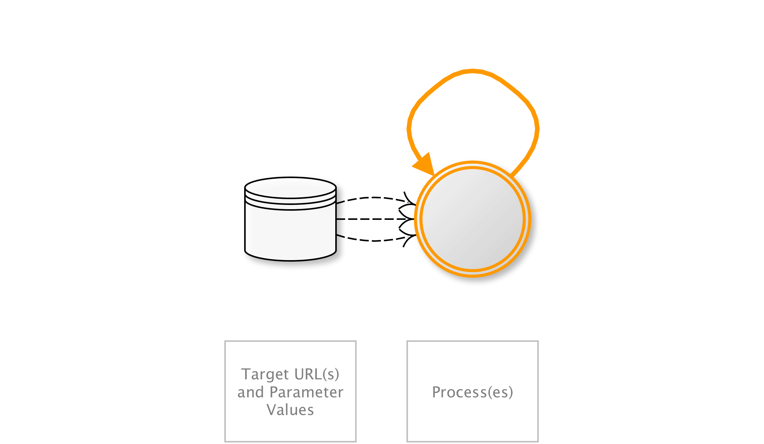
OAT-015 Denial of Service
Target resources of the application and database servers, or individual user accounts, to achieve denial of service (DoS).
AKA Account lockout; App layer DDoS; Asymmetric resource consumption (amplification); Business logic DDoS; Cash overflow; Forced deadlock; Hash DoS; Inefficient code; Indexer DoS; Large files DoS; Resource depletion, locking or exhaustion; Sustained client engagement
OAT-015 Denial of Service
Notes:
Usage may resemble legitimate application usage, but leads to exhaustion of resources such as file system, memory, processes, threads, CPU, and human or financial resources. The resources might be related to web, application or databases servers or other services supporting the application, such as third party APIs, included third-party hosted content, or content delivery networks (CDNs). The application may be affected as a whole, or the attack may be against individual users such as account lockout.
This ontology’s scope excludes other forms of denial of service that affect web applications, namely HTTP Flood DoS (GET, POST, Header with/without TLS), HTTP Slow DoS, IP layer 3 DoS, and TCP layer 4 DoS. Those protocol and lower layer aspects are covered adequately in other taxonomies and lists.
Entertainment/Financial/Government/Retail/Technology/Social networking
Few individual users/Many users/Application owner
NA

Slide 39
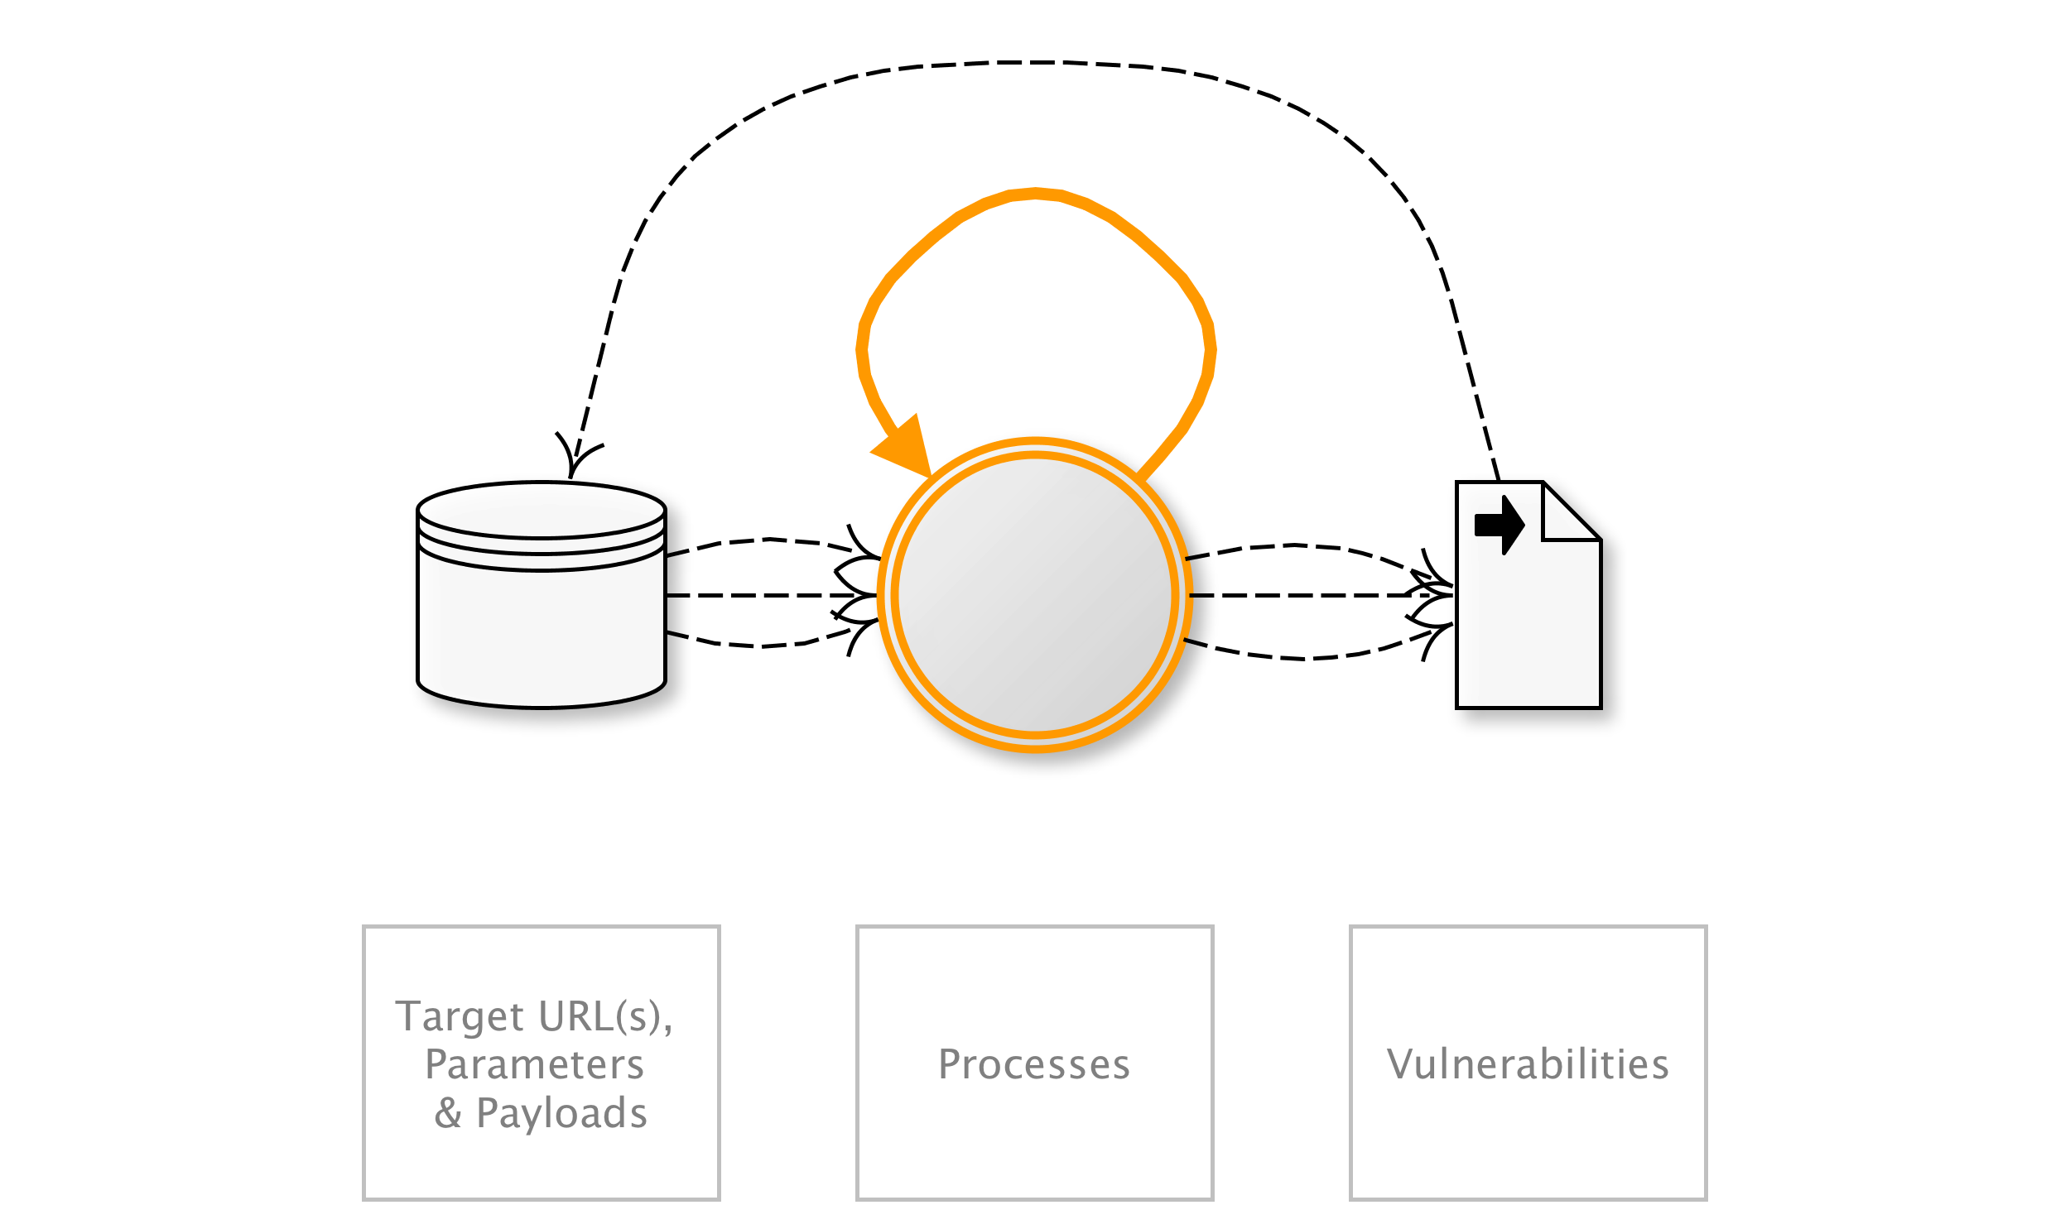
OAT-014 Vulnerability Scanning
Crawl and fuzz application to identify weaknesses and possible vulnerabilities.
AKA Active/Passive scanning; Application-specific vulnerability discovery; Identifying vulnerable content management systems (CMS) and CMS components; Known vulnerability scanning; Malicious crawling; Vulnerability reconnaissance
OAT-014 Vulnerability Scanning
Notes:
Systematic enumeration and examination of identifiable, guessable and unknown content locations, paths, file names, parameters, in order to find weaknesses and points where a security vulnerability might exist. Vulnerability Scanning includes both malicious scanning and friendly scanning by an authorised vulnerability scanning engine. It differs from OAT-011 Scraping in that its aim is to identify potential vulnerabilities.
The exploitation of individual vulnerabilities is not included in the scope of this ontology, but this process of scanning, along with OAT-018 Footprinting, OAT-004 Fingerprinting and OAT-011 Scraping often form part of application penetration testing.
(all)
Application owner
Other business data/Public information

Slide 40
Example 5: Goods in Wrong Hands
Business problem
I can’t sell my goods to the customers I intend to sell to
Technical threats
OAT-005 – Scalping
OAT-013 – Sniping

Slide 41
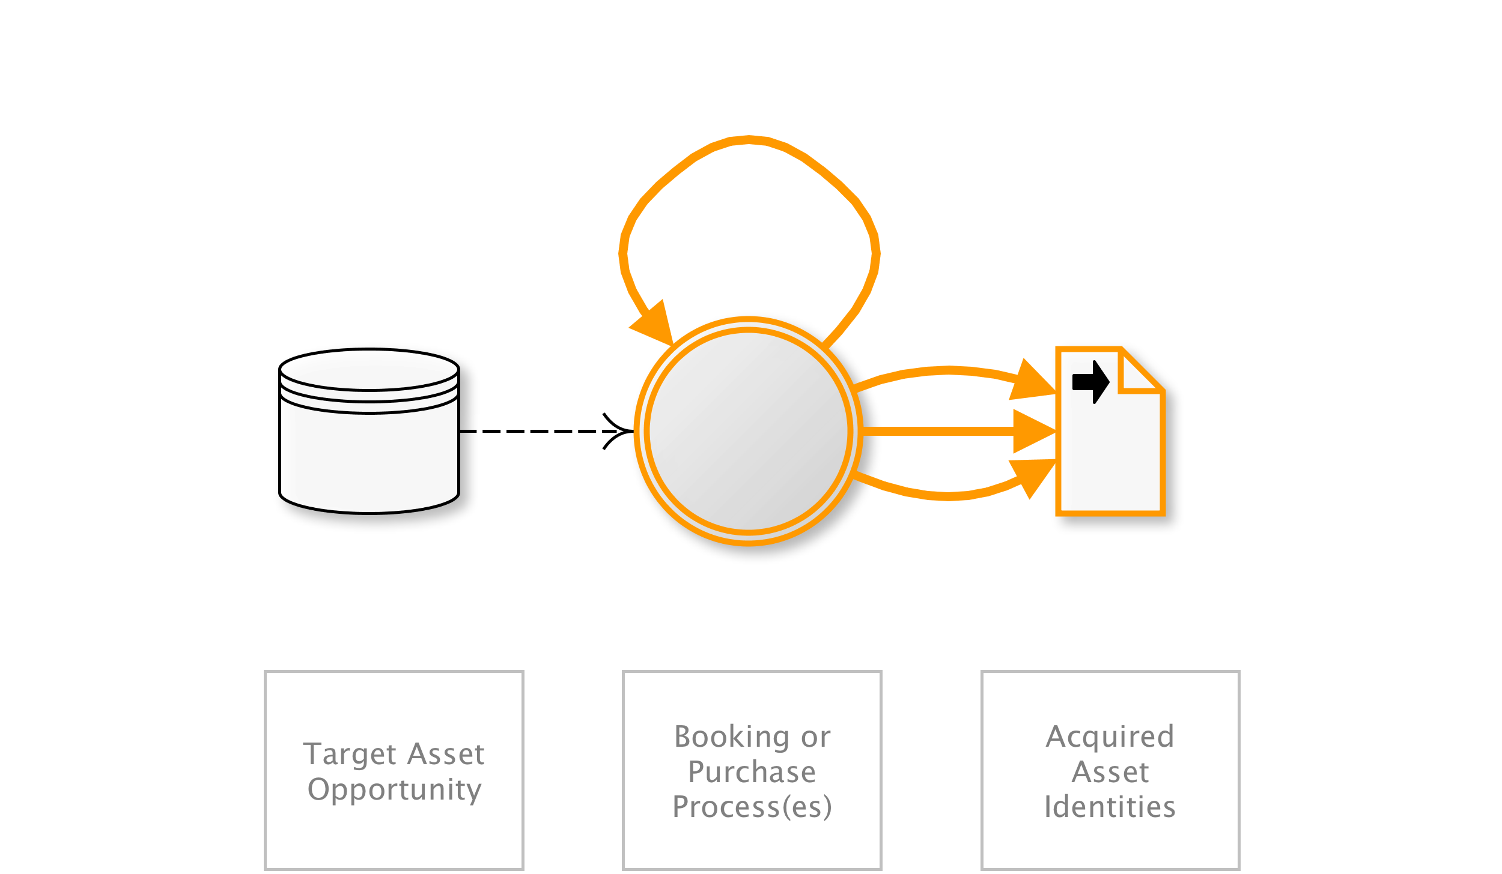
OAT-005 Scalping
Obtain limited-availability and/or preferred goods/services by unfair methods.
AKA Bulk purchase; Purchase automaton; Purchase bot; Restaurant table/hotel room reservation speed-booking; Queue jumping; Sale stampede; Ticket resale; Ticket scalping; Ticket touting
OAT-005 Scalping
Notes:
Mass acquisition of goods or services using the application in a manner that a normal user would be unable to undertake manually.
Although Scalping may include monitoring awaiting availability of the goods or services, and then rapid action to beat normal users to obtain these, Scalping is not a “last minute” action like OAT-013 Sniping, nor just related to automation on behalf of the user such as in OAT-006 Expediting. This is because Scalping includes the additional concept of limited availability of sought-after goods or services, and is most well known in the ticketing business where the tickets acquired are then resold later at a profit by the scalpers/touts. This can also lead to a type of user denial of service since the goods or services become unavailable rapidly.
Entertainment/Financial/Retail
Many users/Application owner
-
NEXT
---

Slide 42
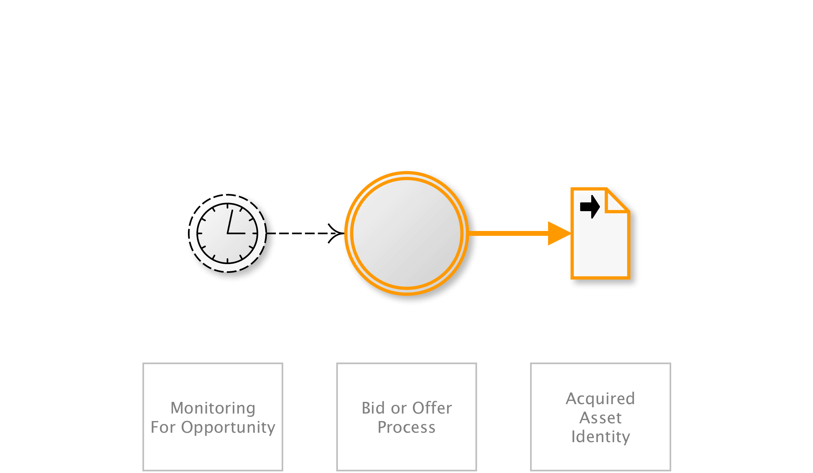
OAT-013 Sniping
Last minute bid or offer for goods or services.
AKA Auction sniping; Bid sniper; Front-running; Last look; Last minute bet; Timing attack
OAT-013 Sniping
Notes:
The defining characteristic of Sniping is an action undertaken at the latest opportunity to achieve a particular objective, leaving insufficient time for another user to bid/offer. Sniping can also be the automated exploitation of system latencies in the form of timing attacks. Careful timing and prompt action are necessary parts. It is most well known as auction sniping, but the same threat event can be used in other types of applications. Sniping normally leads to some dis-benefit for other users, and sometimes that might be considered a form of denial of service.
In contrast, OAT-005 Scalping is the acquisition of limited availability of sought-after goods or services, and OAT-006 Expediting is the general hastening of progress.
Entertainment/Financial/Retail
Few individual users/Application owner/Third parties
Other financial data/Other business data
I hope that gives you a flavour for the threat events – all are detailed in the handbook. I’d like to illustrate how these relate to some better-known classifications....
NEXT
---

Slide 43
COUNTERMEASURES
New in Version 1.1

Slide 44
14 Countermeasure Classes
Value | Authentication
Requirements | Rate
Testing | Monitoring
Capacity | Instrumentation
Obfuscation | Contract
Fingerprinting | Response
Reputation | Sharing
Notes:
In no particular order
Not evaluating their efficacy or effectiveness
Only classifying and documenting what’s there

Slide 45
Countermeasures in SDLC Phases
SDLC Phases
Builder
Defender
Builder
Ability (willing and able) to make changes to the source code
Defender
Must work around the existing system

Slide 46
Countermeasures Types
Prevent
Not allow the threat to have a negative effect
Usually for Builders (but also for business, e.g., contracts)
Detect
Identify the threat is in action
Prevent threat from reaching the system or limit the negative effect
Recover
Focuses on limiting loss after threat has reached the system

Slide 47
Countermeasure: Rate
Set upper and/or lower and/or trend thresholds, and limit number and/or rate of usage per user, per group of users, per IP address/range, per device id/fingerprint, etc. Also limitation of value per event/transaction. Also includes use of queuing systems, user-prioritization functionality, and randomization of asset allocation.

Slide 48
Countermeasure: Rate
SDLC phases
Builder, Defender
Countermeasure type
Prevent, Detect, Recover
Applicability
All OATs except Ad Fraud and Fingerprinting

Slide 49
Countermeasure: Fingerprinting
Consider identifying and restricting automated usage by automation identification techniques. Utilize user agent string, and/or HTTP request format (e.g. header ordering), and/or HTTP header anomalies (e.g. HTTP protocol, header inconsistencies), and/or device fingerprint content to determine whether a user is likely to be a human or not.

Slide 50
Countermeasure: Fingerprinting
SDLC phases
Builder, Defender
Countermeasure type
Prevent, Detect, Recover
Applicability
All OATs, including Fingerprinting

Slide 51
Countermeasure: Capacity
Build adequate capacity so that any permitted and possible unwanted automated usage do not affect normal usage/performance.

Slide 52
Countermeasure: Capacity
SDLC phases
Builder, Defender
Countermeasure type
Prevent, Detect, Recover
Applicability
Denial of Service

Slide 53
Countermeasure: Contract
Require users not to undertake automated attacks against the application through terms & conditions, contracts, and guidance. Understand contractual restrictions imposed by other parties on the application (e.g. service level agreements, financial credit).

Slide 54
Countermeasure: Contract
SDLC phases
Builder, Defender
Countermeasure type
Prevent, Detect, Recover
Applicability
Most OATs except Fingerprinting, Footprinting, and Cashing out

Slide 55
Countermeasure: Sharing
Share information about automated attacks with others in same sector, with trade organizations, OWASP community, and with national CERTs.

Slide 56
Countermeasure: Sharing
SDLC phases
Builder, Defender
Countermeasure type
Prevent, Detect, Recover
Applicability
All OATs!

Slide 57
Let’s update the risk assessment, after
reviewing our threat event detection capabilities and possible additional mitigations based on the OWASP Automated Threat Handbook
We are seeing a growth in OAT-020 Account Aggregation, as defined in the OWASP Automated Threat Handbook
We have a new cloud service that complements your own mitigations for OAT-020
We can raise OAT-020 at the next Cyber Intelligence Sharing Group
Yes, marketing have some data about customer disengagement that supports this
What new products or services might help?
Information Security
Operations
Vendor Sales Rep
Problem Definition Revisited

Slide 58


Colin Watson lives on an island off the coast of Europe called the United Kingdom and is founder and co-leader of the OWASAP Automated Threats to Web Applications project. He is also a co-leader for the OWASP Cornucopia security requirements card game and the OWASP Snakes & Ladders application security awareness board games. Colin has a degree in chemical engineering from Heriot-Watt University in Edinburgh, and a Masters in Computation from the University of Oxford.
Acknowledgements

Slide 59

Tin Zaw lives in sunny southern California and is co-leader of the OWASAP Automated Threats to Web Applications project. He was a president of OWASP Los Angeles chapter from 2000 to 2003. He currently works at Verizon as Director of Security Solutions helping its customers secure their web properties. Tin holds an MS degree in Computer Science and an MBA from University of Southern California.
Acknowledgements

Slide 60
Thank you!

