Slide 1

ReactJS Bootcamp
presents
An Introduction to the JS pre-requisites for learning ReactJS

Slide 2
What is Javascript?
JavaScript is a scripting or programming language that allows you to implement complex features on web pages. It is basically the logic behind every web page.

Slide 3
What is console?
A console is a developer tool provided by the web browser, in which we can see the output of our JS code and what action the code is actually performing. Unlike CSS and HTML, output of JS is not displayed in the main body of this web browser.

Slide 4
What are tags in HTML?
HTML tags are like keywords which defines that how web browser will format and display the content. With the help of tags, a web browser can distinguish between an HTML content and a simple content. HTML tags contain three main parts: opening tag, content and closing tag. But some HTML tags are unclosed tags.
< tag content >

Slide 5
How to link a .js file?
01.
By writing the js code in the <script> tag
02.
By linking a .js file in the .html file using the <script src=“”> tag

Slide 6
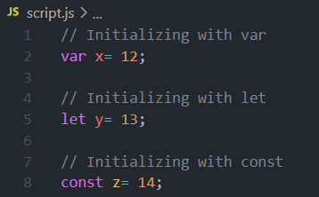
How to initialize variables in Javascript?
using
var
using
let
using
const

Slide 7
How to display outputs in Javascript?
01
02
.innerHTML
document.write()
03
04
windows.alert()
console.log()

Slide 8
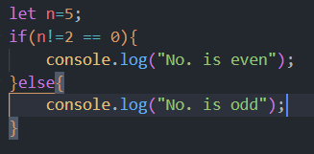
If-else in Javascript
The if-else is a conditional statement to perform different actions for different decisions. If is used for a block of statements if the condition is true, and else is used for a block of statements if the condition is false.

Slide 9
For loop in Javascript
The for statement creates a loop with 3 optional expressions:
for (expression 1; expression 2; expression 3) { // code block to be executed }
Expression 1 is executed (one time) before the execution of the code block.
Expression 2 defines the condition for executing the code block.
Expression 3 is executed (every time) after the code block has been executed.

Slide 10
Arrays, Objects and Functions
Array
Objects
Functions
An object is an entity which have some properties and performs certain methods/functions.
A JavaScript function is a block of code designed to perform a particular task.
Array is a list of items, or a collection of items.

Slide 11
For of, For in, and map()
01.
For of
For of loop is used to return the value of elements of an array.
02.
For in
For in loop is used to return the key/index of elements of an array.
03.
map()
map() is an array function, which iterates the array and creates a new array from calling a function for every array element.

Slide 12
Events and Event Listener
01.
Events
JavaScript's interaction with HTML is handled through events that occur when the user or the browser manipulates a page.
02.
Event listener
Event handlers are the JavaScript code that invokes a specific piece of code when a particular action happens on an HTML element.

Slide 13
Synchronous vs Asynchronous
In synchronous programming, all the steps of a program, or lines of a
program are executed sequentially. That means, if one line of code
hasn't completed it's execution, the next line cannot start executing.
But Asynchronous condition is just the opposite of synchronous.
The execution will not happen in the orthodox manner.

Slide 14
Promises and async/await
01.
Promises
A promise is a proxy value/object whose data is not known to us in the present but will be known to us in the future.
02.
Async / await
The keyword async before a promise makes the function return a promise. The keyword await makes a function wait for a promise, until it resolves.

Slide 15
API
API is the acronym for Application Programming Interface, which
is a software intermediary that allows two applications to talk
to each other. Each time you use an app like Facebook,
send an instant message, or check the weather on your phone,
you’re using an API.

Slide 16
Thank You!

