Slide 1

MendMyTools: Cloud Ticket System
A Dockerized FastAPI + Next.js repair-ticket pipeline on AWS · Cloud Computing Project
Industry / Domain
Enterprise Manufacturing & IT
Use Case
Employees raise repair tickets; specialists fix them; admins govern queues and SLAs.
Business Need
Shared email inboxes lose repair context and hide technician accountability.
Target Users
Members (employees), Specialists (technicians), Admins.
Cloud Objective
Deploy a scalable, reliable, measurable ticketing pipeline with SLA & TTR tracking.
Team
Devashish Chaudhry (24A12RES230)
Devansh Ranjan (24A12RES227)
Ranjan Kumar (24A12RES1044)
GitHub: https://github.com/Cyberogh/MendMyTools

Slide 2
Shared Inboxes Break at Scale
SECTION 2 · INDUSTRY PROBLEM & PROPOSED SOLUTION
2
Current process / pain point
Repairs requested over email and chat.
Context is lost between threads; no owner, no status, no SLA clock.
Problem: no single, auditable record of who fixed what, and how fast.
Proposed cloud pipeline
One ticket system: intake, routing, comments, close, rating and reopen.
Role-based access (Member / Specialist / Admin) over JWT.
Runs as Docker containers on AWS EC2 with health checks and monitoring.
→
~75%
99.5%
< 500 ms
Key assumptions & constraints
~50 concurrent users, < 10 GB data
Budget ≤ ₹2,000 / month
Single region (ap-southeast-2), single EC2 host
Latency target 500 ms at P95; no compliance regime assumed
faster triage*
availability SLA
P95 API response
*Estimated target (not measured). To validate with pilot data.

Slide 3
Measurable SLA, RTO and TTR Targets
SECTION 3 · SLA & TTR DEFINITION
3
Metric | Target | Measured by
Availability SLA | 99.5% | benchmark_sla.py + Docker healthchecks
Response SLA | P95 < 500 ms | benchmark_sla.py (50 users, 500 requests)
Recovery objective (RTO) | < 2 minutes | measure_ttr.py (crash → HTTP 200)
Data-loss objective (RPO) | 0 min on container crash; ≤ 24 h on instance loss | Postgres volume; daily EBS snapshot (planned)
TTR target | < 2 min, detection → restoration | measure_ttr.py
S1 Critical API or DB down
S2 High Degraded; P95 > 500 ms
S3 Medium One feature failing
S4 Low Cosmetic / minor
How SLA violations are detected and reported
1) Docker healthcheck (every 15 s) marks the backend unhealthy. 2) CloudWatch alarm on CPU / status check (planned) → email via SNS.
3) benchmark_sla.py prints MET / NOT MET against 99.5% and 500 ms. 4) Incidents are logged by severity S1–S4.

Slide 4
Request-to-Response Flow on AWS
SECTION 4 · END-TO-END CLOUD PIPELINE
4
A
D
B
A
C
Users / Client
Browser over HTTPS
DNS / Load Balancer
Route 53 / ALB or reverse proxy
Application
Next.js :3000 → FastAPI :8000 (JWT)
Docker Container
Compose: frontend, backend, Postgres
AWS Infrastructure
EC2 + EBS + VPC / Security Group
Monitoring / SLA
CloudWatch + healthchecks
The response returns along the same path: PostgreSQL → FastAPI → Next.js → browser.
A
SLA metrics
B
Logging
C
Monitoring
D
Failure recovery
benchmark_sla.py measures latency, throughput and availability at the application edge.
Container logs via docker logs; CloudWatch Logs agent planned.
CloudWatch EC2 metrics (CPU, network, credits); Docker healthchecks (15 s, 30 s, 5 s).
restart: unless-stopped respawns the backend; entrypoint re-runs migrations.

Slide 5
Tech Stack: TypeScript, Python and PostgreSQL
SECTION 4 · TECHNOLOGY STACK
4
Frontend
TypeScript + React 19
Next.js 16 (standalone, port 3000)
Tailwind CSS 4 + shadcn UI
Axios, TanStack Query, Zod
Backend
Python 3.12
FastAPI on Uvicorn (port 8000)
SQLAlchemy 2 + Alembic migrations
Pydantic validation
Database
PostgreSQL 16 (container)
Runs on the same EC2 host
Docker volume on EBS disk
SQLite fallback for local dev
Server & infrastructure
AWS EC2 t3.micro · Ubuntu 24.04 · ap-southeast-2
Docker Compose: frontend, backend, db
CloudWatch metrics + Docker healthchecks
Security
bcrypt password hashing; JWT (HS256, 120 min)
Role-based access: Admin / Specialist / Member
Non-root containers; secrets from .env; Security Group

Slide 6
Seven AWS Services, Each With a Reason
SECTION 5 · AWS SERVICES USED
5
Category | Service | Why it was selected | Role in MendMyTools
Compute | EC2 t3.micro | Full control for Docker Compose; cheapest fit for 3 containers | Hosts frontend, backend and Postgres
Storage | EBS gp3 volume | Block storage that survives instance restarts | Persists the Postgres volume
Networking | VPC + Security Group | Network isolation and port control | Inbound: 22 (SSH) and 3000 (app)
Monitoring | CloudWatch | Native metrics, logs and alarms | CPU, network, CPU credits, status checks
Security | IAM | Least privilege, no root keys on the server | No root keys; CloudWatch / ECR role planned
Registry (planned) | Amazon ECR | Versioned, private image storage next to EC2 | Stores backend and frontend images
Secrets (planned) | Secrets Manager | Keeps credentials out of code and images | Holds SECRET_KEY and DB password

Slide 7
Three Containers, One Reproducible Stack
SECTION 6 · DOCKER & CONTAINERIZATION
6
Frontend · mendmytools-frontend
Base: node:20-alpine
3 stages: deps → build → runner
Next.js standalone, port 3000
Runs as non-root user nextjs
wget healthcheck every 30 s
Backend · mendmytools-backend
Base: python:3.12-slim
2 stages: builder → runtime
Port 8000, runs as appuser
entrypoint.sh: wait for DB → alembic upgrade → uvicorn
curl healthcheck /docs every 15 s
Database · mendmytools-db
Image: postgres:16-alpine
Port 5432
Volume: mendmytools_postgres_data
pg_isready healthcheck every 5 s
Backend waits until DB is healthy
Networking & data
Compose bridge network; frontend reaches backend at http://backend:8000. Data lives on a named volume.
Image registry
Images are built locally with docker compose build. Amazon ECR is planned for the AWS deployment.
Why containers
Portability: same image everywhere. Isolation: one process per container. Reproducibility: one command rebuilds it.

Slide 8
AWS Nitro VM Hosts Lightweight Containers
SECTION 7 · VIRTUALIZATION & CLOUD INFRASTRUCTURE
7
AWS Nitro hypervisor
Virtualization layer & OS
Hypervisor (Nitro) + container runtime (Docker) on Linux.
EC2 t3.micro · Ubuntu 24.04 · 2 vCPU · 1 GB RAM · gp3 EBS
Container vs VM
VM: hardware isolation and the OS boundary. Containers: fast start, small size, one process each.
Docker Engine (shares the host Linux kernel)
Next.js
FastAPI
Postgres
Resource allocation
2 vCPU, 1 GB RAM, gp3 EBS disk; inbound ports 22 and 3000.
Three containers share one kernel.
Scalability strategy
Vertical: resize EC2 (t3.micro → t3.small). Horizontal: more backend containers (stateless JWT). Auto Scaling Group: future.

Slide 9
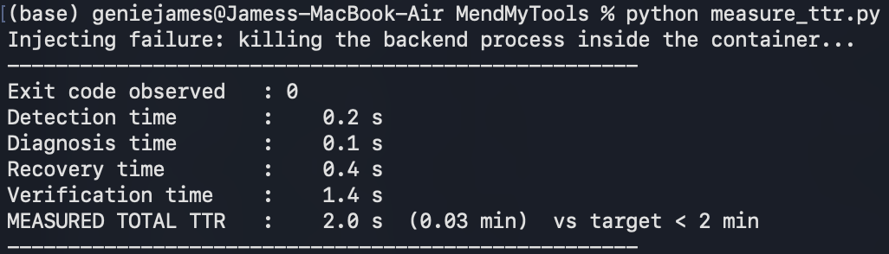
Detect, Diagnose, Recover, Verify
SECTION 8 · RELIABILITY, MONITORING & TTR WORKFLOW
8
1 Detection
Docker notices the backend process exit; healthcheck on /docs (15 s) confirms.
2 Diagnosis
docker inspect exit code + docker logs.
3 Recovery
restart: unless-stopped respawns the container; entrypoint re-runs migrations.
4 Verification
HTTP 200 from /docs and the API root.
→
→
→
Measured: 0.2 s
Measured: 0.1 s
Measured: 0.4 s
Measured: 1.4 s
Incident trigger
Backend process killed inside the container; measured locally, re-run on EC2.
TTR = Detection + Diagnosis + Recovery + Verification
Output of measure_ttr.py (local run)
Target TTR: < 2 min | Measured TTR: 2.0 s (0.03 min)

Slide 10
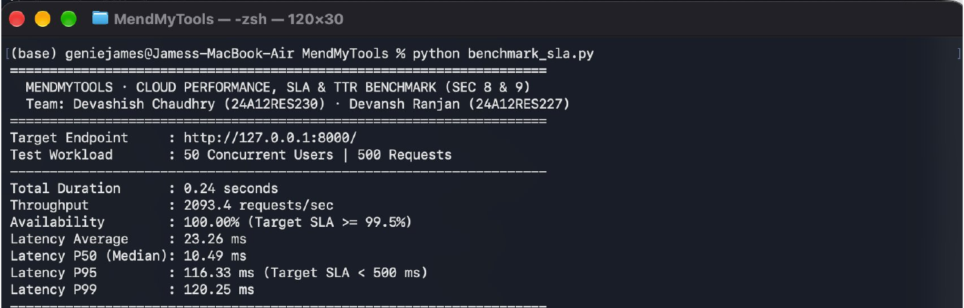
2,093 Requests per Second, P95 116 ms
SECTION 9 · PERFORMANCE & SLA TESTING
9
2,093.4
100.00%
116.33 ms
requests / sec
availability observed
P95 latency
Test summary
Workload: 50 concurrent users, 500 requests, GET / on 127.0.0.1:8000
Failure injection: backend crash, TTR observed 2.0 s (Sec 8)
SLA result: MET (99.5% and < 500 ms)
Run locally on a MacBook Air, not on EC2. Re-run on the EC2 host for final numbers.

Slide 11
Security Basics and ~₹1,400 / Month
SECTION 10 · SECURITY & COST CONSIDERATIONS
10
IAM
Least privilege; no root keys on the server. App roles enforced by API (JWT).
Network
VPC + Security Group limit inbound traffic. Postgres (5432) is not exposed to the internet.
Cost item (estimated) | Basis | ₹ / month
Compute | t3.micro, ≈ $0.0132/h × 730 h | 848
Storage | EBS gp3, ~20 GB ≈ $1.8 | 160
Database | Postgres container on same EC2 | 0
Network | Public IPv4 $3.65 + ≤100 GB out free | 321
Monitoring | CloudWatch basic + ~1 GB logs | 50
Total (24×7) |  | ≈ 1,380
Secrets
Loaded from .env (git-ignored), not in images. Secrets Manager planned for AWS.
Data protection
In transit: HTTPS planned (ACM). At rest: EBS encryption option. Passwords: bcrypt.
Optimization
Scheduled shutdown (12 h/day): ≈ ₹950. 1-year reserved: compute ≈ 30–40% lower. Move to t3.small only if 1 GB RAM becomes a bottleneck.
Estimate: ap-southeast-2 (Sydney), ₹88/USD, on-demand. Verify in AWS Pricing Calculator.

Slide 12
Docker Build, Failure and Recovery
SECTION 11 · DEMONSTRATION & DEPLOYMENT EVIDENCE
11
Build & start
cp .env.example .env
docker compose up -d --build
docker compose ps
Failure injection
docker kill mendmytools-backend
docker compose ps -a
Recovery
docker start mendmytools-backend
docker compose ps
BEFORE: all three containers up, database healthy
FAILURE: backend Exited (137), others unaffected
RECOVERY: backend Up again, health check restarting
Note: docker kill counts as a manual stop, so the restart was done with docker start. Automatic recovery after a real crash is timed in Sec 8.

Slide 13
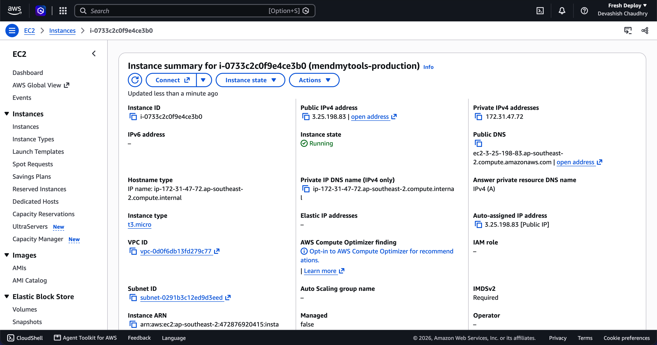
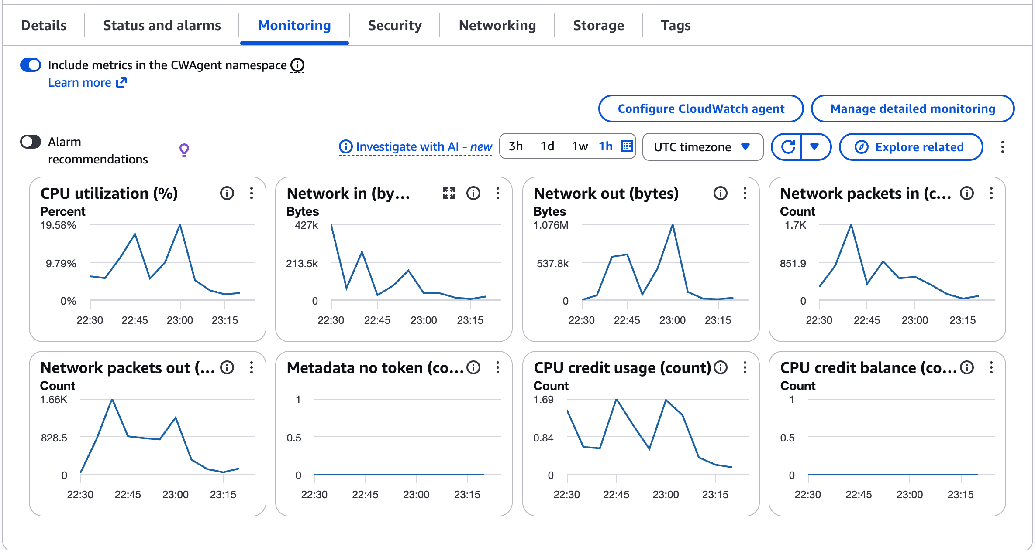
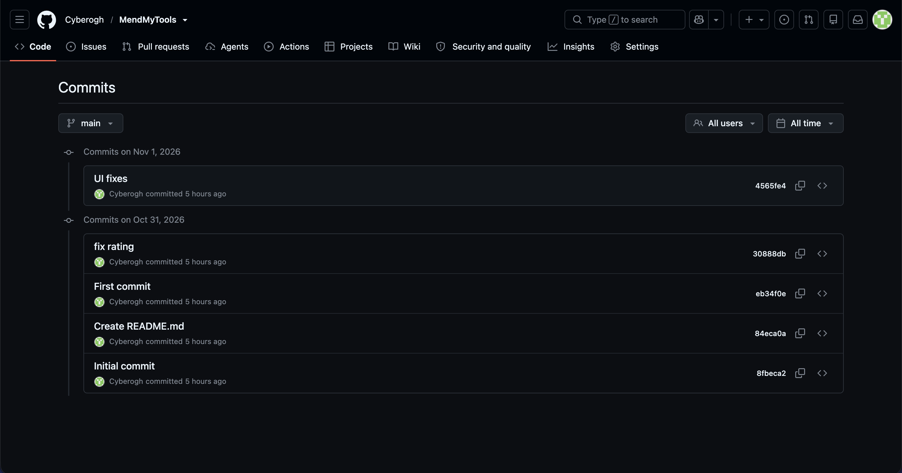
Deployment and Ownership Evidence
SECTION 11 · DEMONSTRATION & DEPLOYMENT EVIDENCE
11
EC2 instance mendmytools-production: Running (t3.micro, ap-southeast-2)
CloudWatch metrics for the instance (CPU, network, CPU credits)
Live application URL
http://3.25.198.83:3000
Hosted on AWS EC2 (Docker Compose)
Demo login: admin@mendmytools.com / admin123
Repository: https://github.com/Cyberogh/MendMyTools
GitHub commit history, Cyberogh/MendMyTools

Slide 14
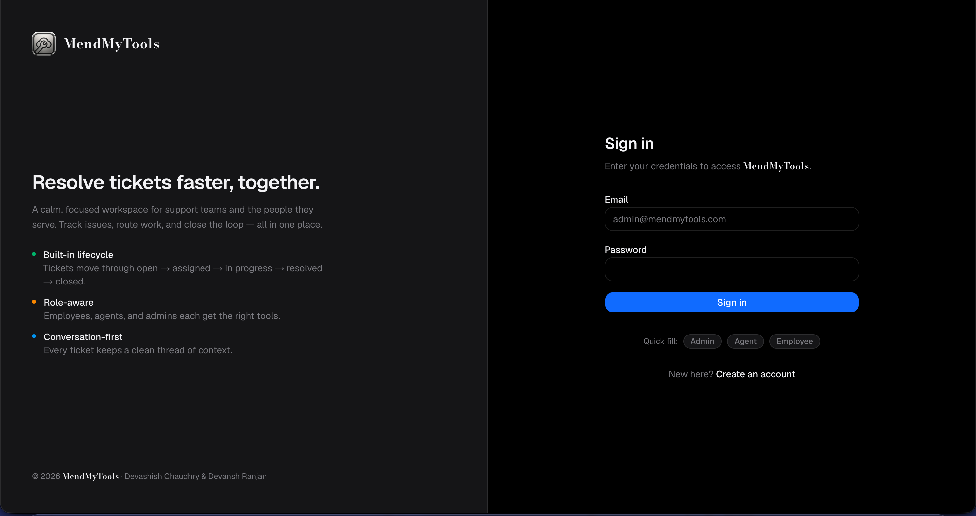
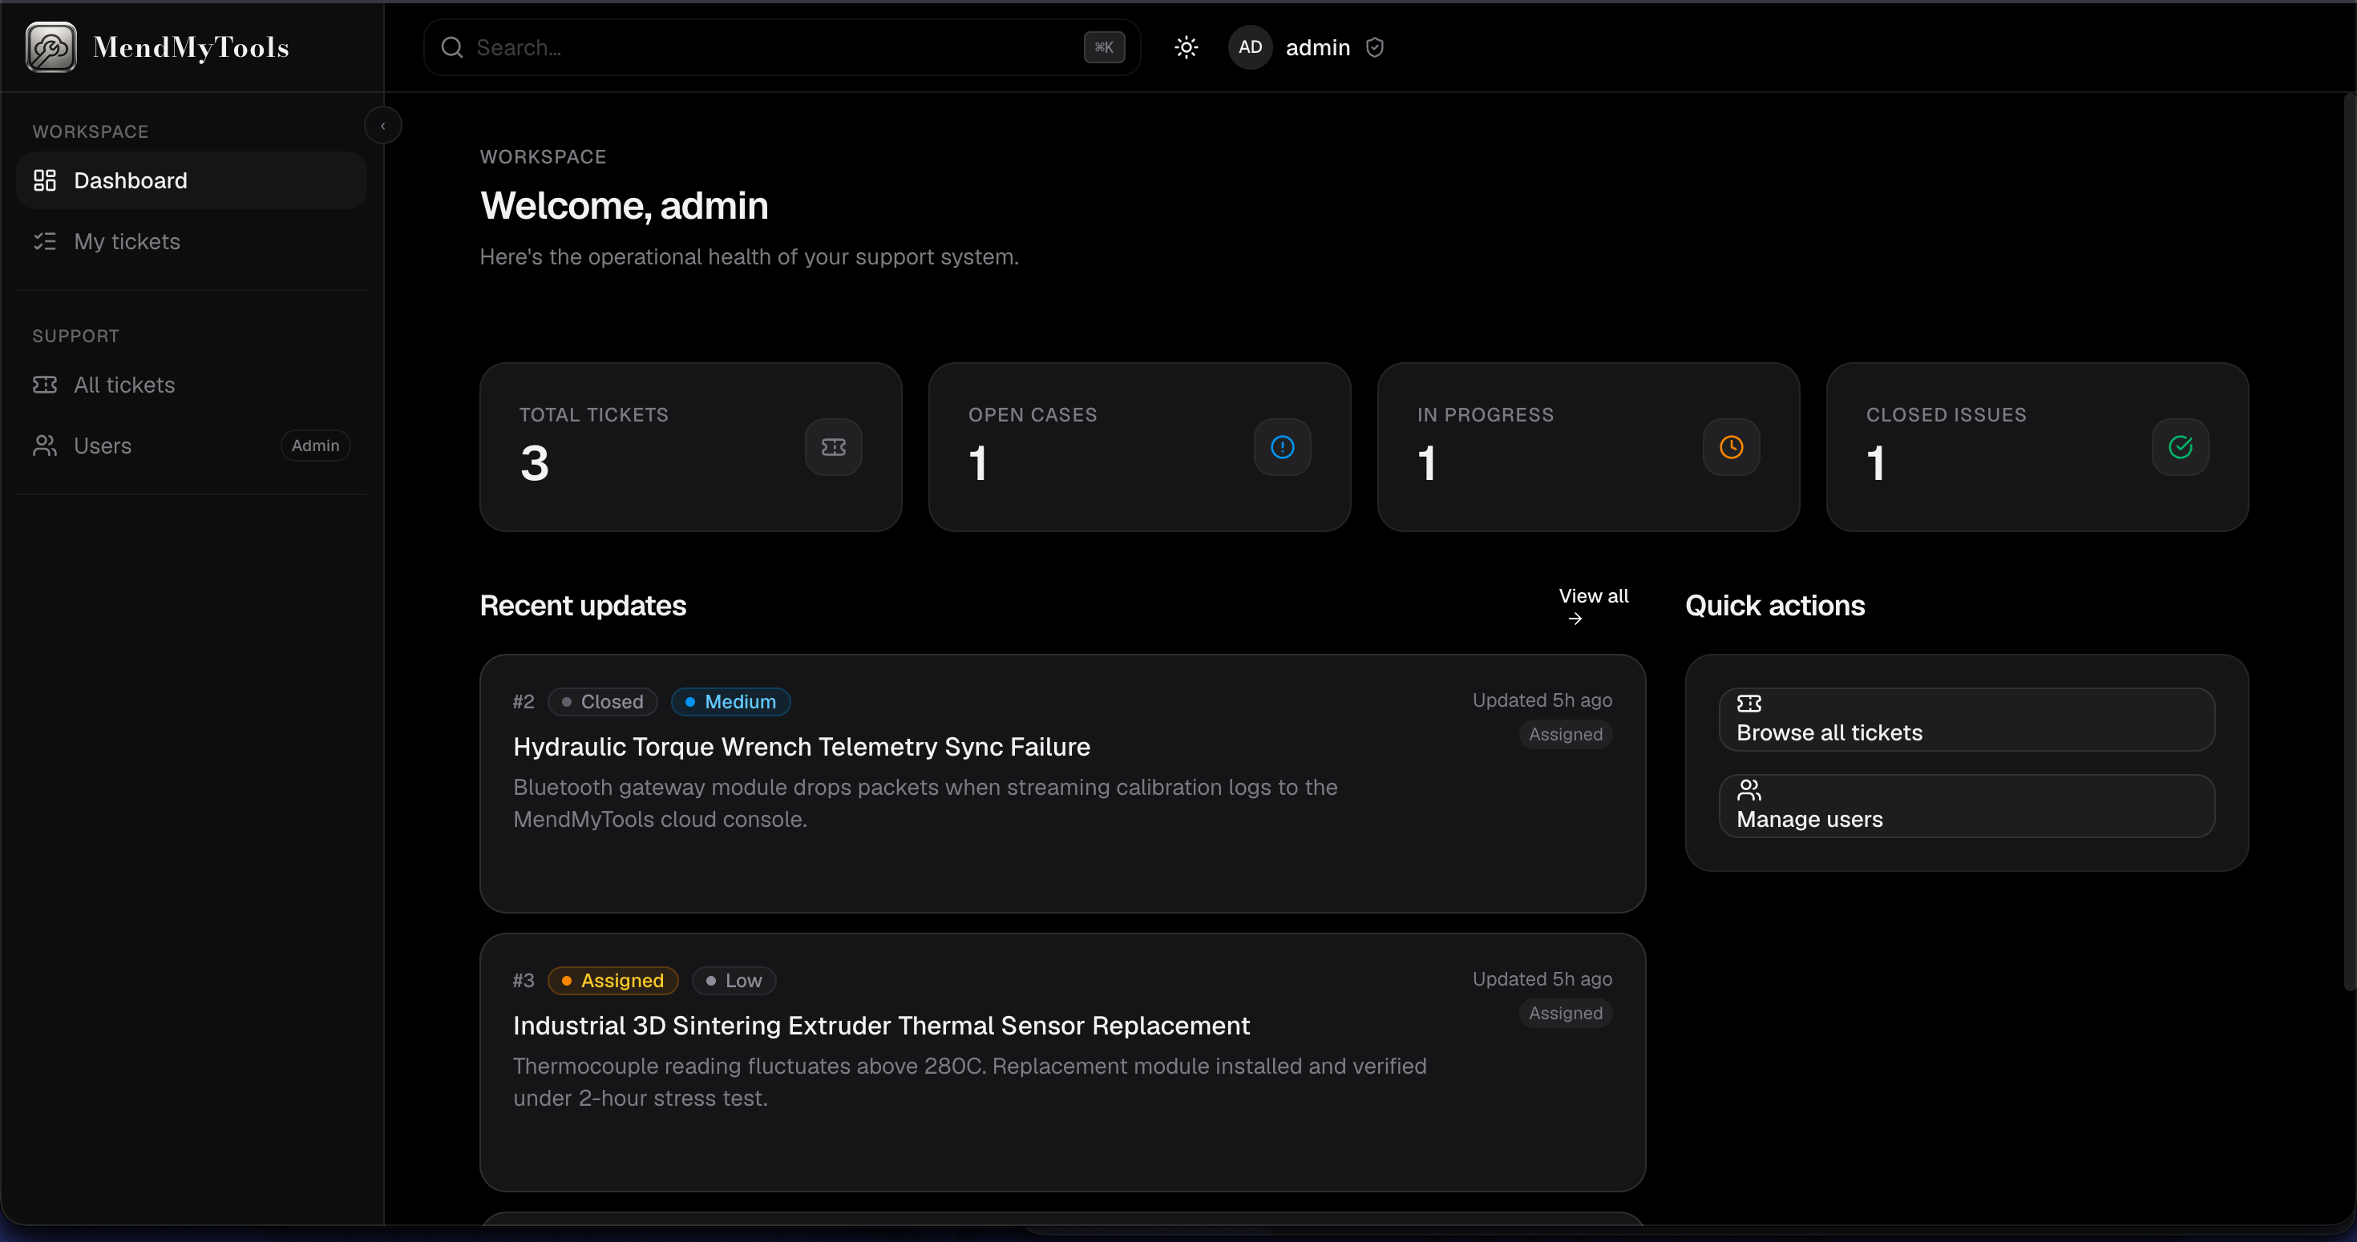
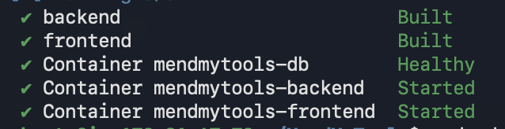
Live Application on AWS
SECTION 11 · DEMONSTRATION & DEPLOYMENT EVIDENCE
11
Login page served from http://3.25.198.83:3000
Admin dashboard with live tickets
Deployment
ap-southeast-2 (Sydney) · t3.micro · Ubuntu 24.04
Public IP 3.25.198.83 · Docker Compose stack
docker compose up -d --build on the EC2 server

Slide 15
Targets Met, With Honest Limits
SECTION 12 · RESULTS & KEY FINDINGS
12
Measure | Target | Observed
Availability | ≥ 99.5% | 100.00% (500 / 500 OK)
P95 latency | < 500 ms | 116.33 ms
Throughput | n/a | 2,093.4 req/s
TTR | < 2 min | 2.0 s (measure_ttr.py)
Reliability & cloud benefits
Container crash handled by restart policy and verified by health checks. Benefits: portability, repeatable deploys, operational visibility.
Functional outcome
Ticket create, assign, comment, close, rate and reopen; three roles; Docker Compose stack with Postgres, migrations and health checks.
Limitations
Benchmark ran locally on GET /, not on EC2.
Single host, no load balancer or multi-AZ yet.
Alarms, ECR and Secrets Manager are planned.

Slide 16
From Prototype to Industry-Ready
SECTION 13 · CONCLUSION & FUTURE WORK
13
Conclusion
A containerized FastAPI + Next.js + Postgres pipeline replaces shared inboxes.
SLA targets met in testing; TTR measured against a 2-minute target.
Designed for AWS EC2 with CloudWatch, IAM and EBS.
Business extension
Add SSO, email/SMS alerts and SLA dashboards; multi-tenant per department; integrate with asset and inventory systems.
Kubernetes / EKS
CI/CD pipeline
Terraform (IaC)
Serverless alerts
Advanced observability
Multi-region
Learning outcomes: AWS + Docker + virtualization + SLA/TTR + cloud deployment.

Slide 17
Evaluation Checklist
SECTION 14 · EVALUATION CHECKLIST
14
Clear industry use case and problem statement
Done
End-to-end cloud architecture
Done
At least 3–5 relevant AWS services with justification
Done
Dockerized application
Done
Virtualization / VM / container infrastructure explained
Done
Explicit SLA metrics and measurable targets
Done
TTR defined and experimentally measured
Done
Failure / recovery scenario demonstrated
Done
Monitoring / logging evidence
Done
Performance, security and cost discussion
Done
Working demo + repository / documentation
Done

