Slide 1
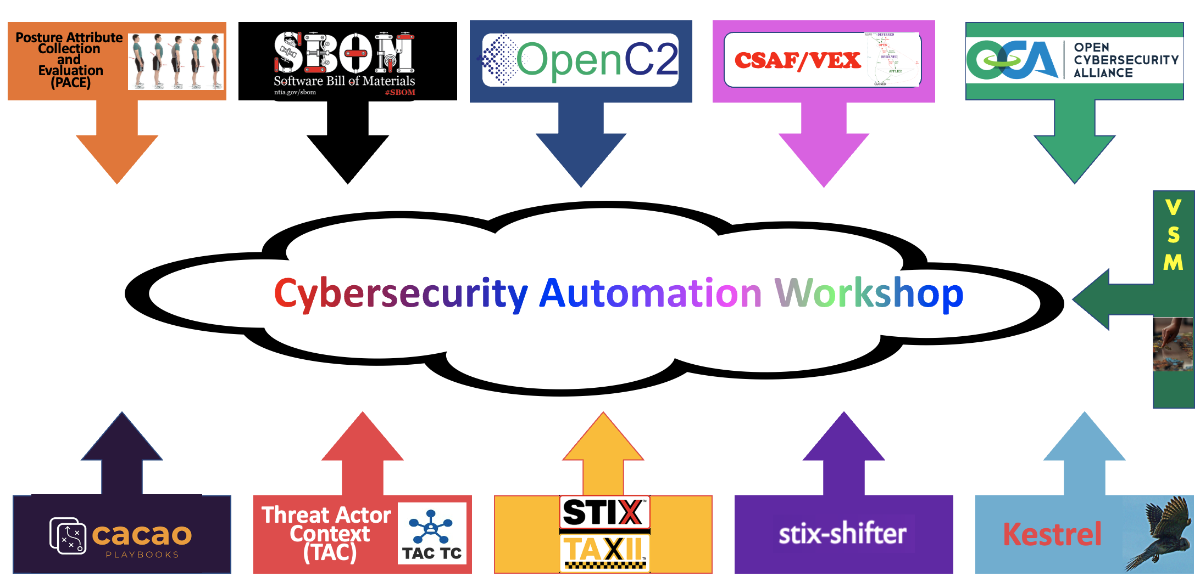
By Chuck Brooks

Slide 2
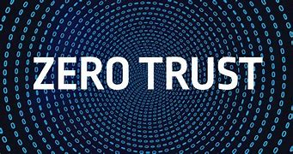
AUTOMATING ZERO TRUST
By Chuck Brooks

Slide 3
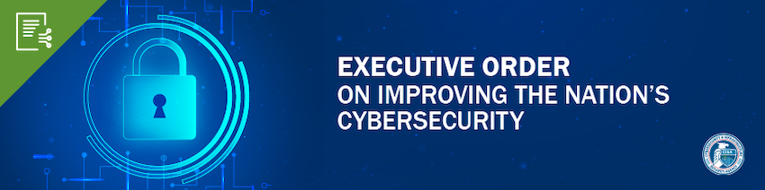
Executive Order 14028 states that “Prevention, detection, assessment, and remediation of cyber incidents is essential to national and economic security” and establishes requirements for Federal Information Systems, including:
(Sec. 3) Modernizing Federal Government Cybersecurity
advance toward Zero Trust Architecture
accelerate use of secure cloud services
streamline access to cybersecurity data
(Sec. 4) Enhancing Software Supply Chain Security
provide purchasers a Software Bill of Materials
(Sec. 6) Standardizing Federal Government’s Playbook for Responding to Cybersecurity Vulnerabilities and Incidents
(Sec. 7) Improving Detection of Cybersecurity Vulnerabilities and Incidents

Slide 4

CYBERSECURITY CHALLENGES

Slide 5
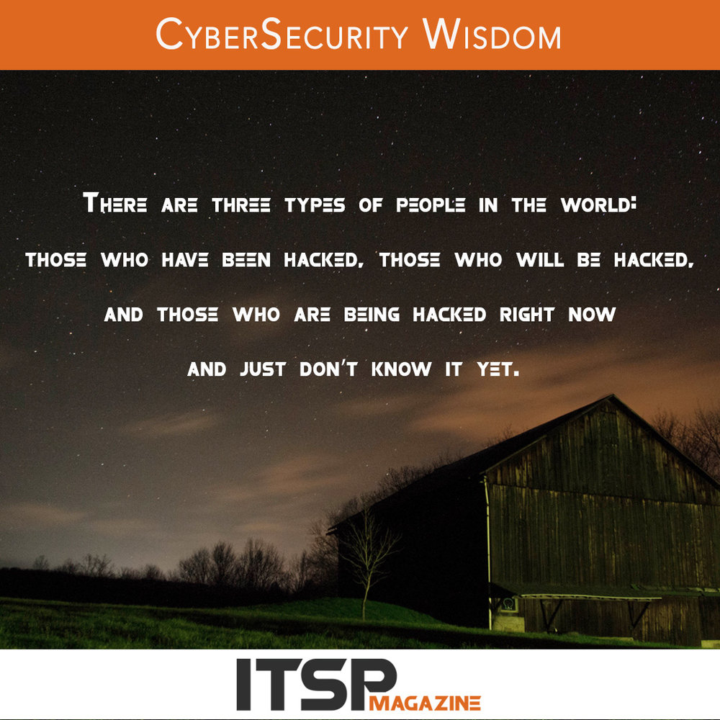
CYBERSECURITY CHALLENGES
The Internet was not built for security, yet we have made it the backbone of virtually all private-sector and government operations, as well as communications.

Slide 6
CYBERSECURITY CHALLENGES
Significant increase in the size of the “attack surface” provided Digital Transformation and remote work.
Internet of Things will vastly expand attack surface and capabilities of hackers
Security investments continue to be driven by persistent threats, policy remedies, workforce shortages, and technological innovation inside and outside security areas.
Disruptive technologies like AI, 5G, IoT, and cloud computing bring operational shifts that drive new security requirements.
Security teams cite this complexity as one of their largest challenges. Forced to rely on dozens of vendors and disconnected security products, the average security team is using 25 to 49 tools from up to 10 different vendors

Slide 7
CYBERSECURITY CHALLENGES
Greater collaboration among cybercriminals (and nation threat actors) leveraging the underground market, while partnering and purchasing hacking-as-a-service, re-usable hacking kits. Also sharing of tools on dark web websites and forums.
Hidden hacker forums and access to the underground vulnerabilities database enable criminals of various levels of expertise to launch sizable attacks. Accessibility and expansion of such forums are likely for 2022.
Consolidation of smaller hacker affiliates into larger hacker criminal families for a wide mix of attacks, including exploit kits, and malware, as well as other services such as money laundering and making malware undetectable.
In 2022, a qualified cybersecurity worker shortage will continue to pose major challenges for both the public and private sectors

Slide 8

Meeting Cybersecurity Challenges Via Automation
There is a scarcity of trained cybersecurity professionals and the demand for them is expected to grow. Automation can help fill gaps.
The expanding connectivity of the Internet has increased cyber vulnerabilities The numbers of IoT devices coming online provides more targets for cyber criminals and increases the lethality of DDoS attacks.
Cybersecurity criminals are automating their own attacks (with increasing success). They are sharing tools available on the Dark Web
Compliance requirements corresponding to cyber-risk management mandates such as Zero Trust

Slide 9

Benefits of Cybersecurity Automation
Architecture and Engineering: a shift of technology to automation will enable the cybersecurity team to focus on designing and actualizing strategies such as cyber hygiene and zero-trust networks within an entity.
Remediation Activities: after deficiencies have been identified, it is easy for the organization’s security team to identify the most repeatable activities within the businesses’ environment, leading to less vulnerability.
Development and engineering of automation: automation is an integral part of the cybersecurity program and requires specially dedicated resources to be comprehensively designed and implemented.
Automation and Integration in Cybersecurity - CyberExperts.com

Slide 10

The Automation Toolchest can utilize horizon scanning technologies, analytics, audits, incident alert tools, diagnostics, and even self-repairing software.
Automation is also valuable in enhancing existing cybersecurity architecture.
Promising will be the benefits derived from artificial intelligence and machine learning. These technologies can provide for more efficient decision making by prioritizing and acting on data, especially across larger networks with many users and variables.
Collaboration and Coordination via Open Source:
Open Source Platforms allow for the evolutionary, optimal and secure integration of new tech and new applications into existing infrastructure. Open-source collaboration has many proven advantages including greater engagement by developers, which leads to more productivity, flexibility, and cutting-edge innovation at lower costs.

Slide 11
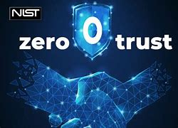
WHAT IS ZERO TRUST
NIST defines Zero Trust as a security architecture that does not automatically trust user accounts based on their physical or network location.
Zero trust (ZT) is the term for an evolving set of cybersecurity paradigms that move defenses from static, network- based perimeters to focus on users, assets, and resources. A zero-trust architecture (ZTA) uses zero trust principles to plan industrial and enterprise infrastructure and workflows. Zero trust assumes there is no implicit trust granted to assets or user accounts based solely on their physical or network location

Slide 12

BASIC ZERO TRUST TENETS
The castle itself no longer exists in isolation as it once did
Assume that the network is hostile and threats from inside and outside the network exist.
Don’t base network trust on a network’s location.
Authenticate and authorize every device, user and network.

Slide 13
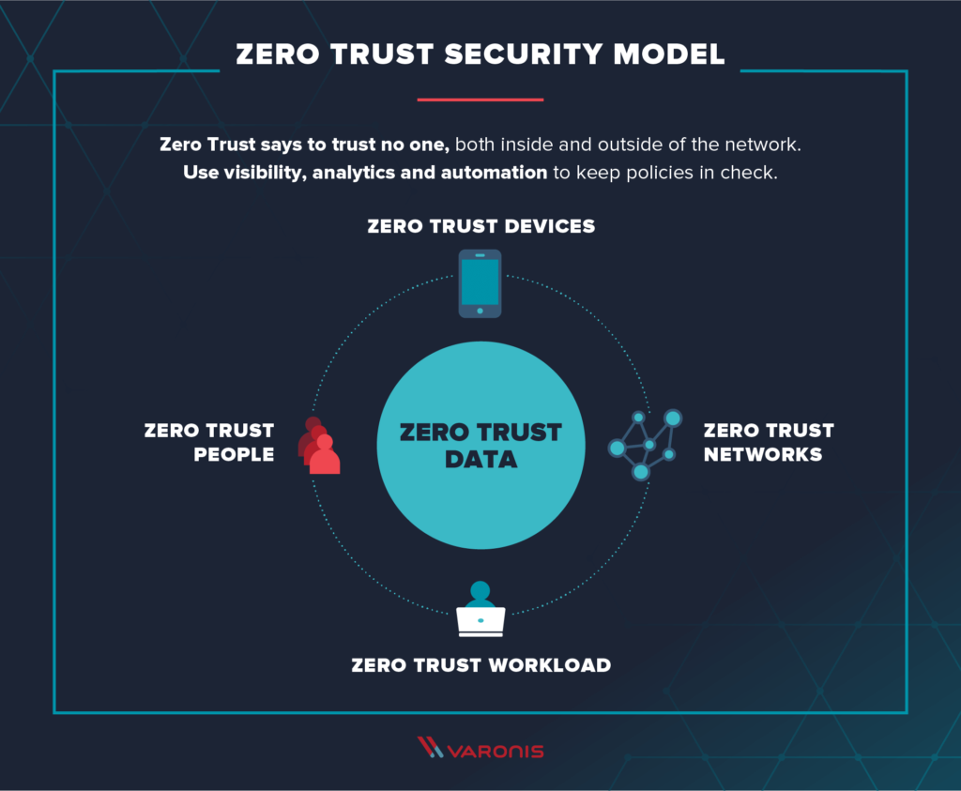
WHAT IS ZERO TRUST

Slide 14
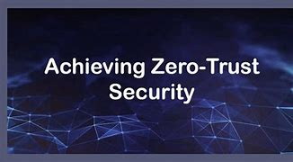
ZERO TRUST TRENDING IN GOV
Zero Trust is one of the key elements of President Joe Biden’s May 12 executive order on government-wide cybersecurity.
Over the last three months, CISA, along with OMB, rolled out the draft zero trust strategy, the draft cloud security technical reference architecture and the draft zero trust maturity model.
A Zero Trust pilot is being undertaken as a joint effort with The U.S. Cyber Command, the Defense Information Systems Agency, and the National Security Agency where they are lab testing various technologies.
The Defense Information Systems Agency intends next month to award a contract for its Thunderdome zero-trust architecture and to begin implementing a prototype within six months

Slide 15

ZERO TRUST COMPONENTS
Micro-segmentation – Involves setting up granular security zones within the network.
Enhanced identity governance — Relies on the identity of users and other factors to calculate the level of confidence in the authentication process.
Network infrastructure and software defined perimeters — The policy administrator (PA) functions as a network controller responsible for setting up and reconfiguring the network based on decisions by the policy engine.
Device agent/gateway-based deployment — An example of this architecture is having an agent installed on an enterprise asset to coordinate connections to that asset, as well as a resource sitting in front of the asset that prevents the asset from communicating with anything other than the gateway.

Slide 16

EMERGING TECH
TOOLS FOR ZERO TRUST
Cloud Computing and Edge Computing
Automation and Adaptive Networks
Machine Learning/Artificial intelligence
Real-time Analytics and Predictive Analytics
IoT
5G
Super-computing and Quantum-computing
Biometrics and Authentication Technologies
Cryptography/Encryption/Stenography

Slide 17

ZERO TRUST TECHNOLOGIES
Multi-Factor Authentication — Forces users to confirm their identity in more than one way before allowing them access to applications and systems
Security Monitoring — Audits network activity to spot threats to resources
Privileged Access Management (PAM) — Helps manage accounts with elevated permissions to critical resources and controls use of those accounts
Device Security Controls — Reduce the risk posed by devices via firewalls, antivirus software, and interface constraints
Encryption -- Future Quantum Resistant

Slide 18

Cybersecurity – Automation AI, Machine Learning
Automated network security and self-encrypting drives to protect critical infrastructure in all categories
“Real time" horizon scanning and monitoring of networks
Automatic updating of defense framework layers (network, payload, endpoint, firewalls and anti-virus)
Diagnostic and forensics analysis

Slide 19

Cybersecurity – Automation AI, Machine Learning
Threat Detection (Spam and Phishing)
Malware Identification
AI and machine learning could help on the identity management by cross-checking the veracity of data across multiple fragmented databases
Categorize Attacks
Adapt To Evolving Risks

Slide 20
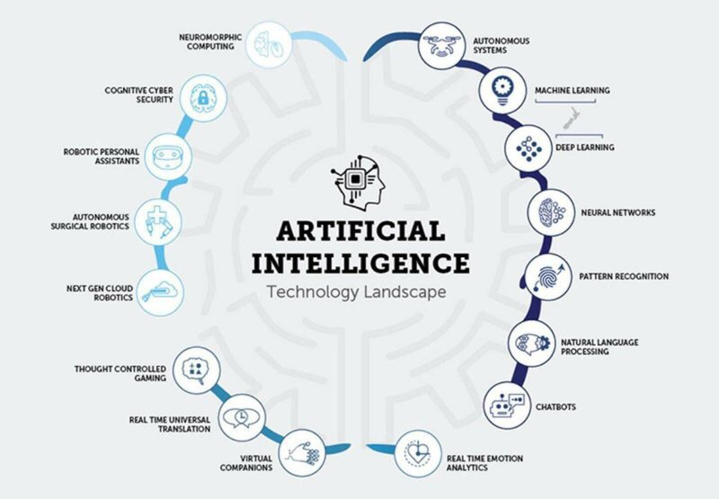

Slide 21

Collaboration and Cooperation

Slide 22
Collaboration: Public Private Partnerships
A higher level of public-private collaboration is needed to address the growing cyber-threat landscape through Public-Private Partnerships,” “The global threat actors targeting critical infrastructure are terrorists, criminals, hackers, organized crime, malicious individuals, and, in some cases, adversarial nation-states.
Addressing the threats requires incorporating a robust calculated security strategy of public and private sector partnering based on layered vigilance and protections, readiness and resilience.
Phishing, malware ransomware, and denial of service attacks are means and methods hackers are using to attack both government and industry assets. Some of the specific cybersecurity areas a government public private partnership could collaborate to defend against those threats include: threat intelligence, data security, browser security, cloud security, container security, endpoint protection, identity, access management and authentication, mobility, and IoT Security. Cybersecurity awareness and training should also be part of the PPP equation.
By Chuck Brooks Public and Private Sector Partnerships Addressing COVID-19 Are A Model for Cybersecurity - CyberTheory

Slide 23
Posture Attribute Collection and Evaluation (PACE) project
Creating production-ready code that evaluates the posture assessment of computing resources using a communication fabric which will allow organizations to use this information in zero-trust architecture decisioning.
PACE will deliver community-maintained code that will arm operators with an interoperable out-of-the-box solution that monitors risk and threat exposure, reducing integration costs and redundancy while increasing resiliency.

Slide 24

SBOM

Slide 25
What Is An SBOM ?
According to the National Telecommunications and Information Administration (NTIA), A “Software Bill of Materials” (SBOM) is effectively a nested inventory, a list of ingredients that make up software components. Or more specifically, A SBOM is a “formal record containing the details and supply chain relationships of various components used in building software. These components, including libraries and modules, can be open source or proprietary, free or paid, and the data can be widely available or access-restricted.”
SBOMs can accrue to both software suppliers and consumers. They include: Identifying and avoiding known vulnerabilities, Quantifying and managing licenses, Identifying both security and license compliance requirements, Enabling quantification of the risks inherent in a software package, Managing mitigations for vulnerabilities (including patching and compensating controls for new vulnerabilities), Lower operating costs due to improved efficiencies and reduced unplanned and unscheduled work. sbom_faq_-_20201116.pdf (ntia.gov)

Slide 26
Use cases for SBOM
Transparency into software provenance and pedigrees
continuous security risk assessment,
Access control and sharing with customer who can access and what data can be seen,
Threat intelligence data correlation
Software composition license analysis and policy enforcement
Software component end of life monitoring
SCRM - Supply Chain Risk Management and supply chain screening,
Dmitry Raidman is CTO, Cybeats
Bolstering Cybersecurity Risk Management With SBOMS (forbes.com)

Slide 27
SBOM And the Executive Order
The EO requires NTIA to produce three proposed minimum elements that should go into any SBOM:
Data fields (such as supplier name, component name, version of the component, and more)
Operational considerations (such as frequency of SBOM generation, depth of the dependency tree, access to SBOM data, and more)
Support for automation (making sure the data can be produced at scale and consumed at scale using three different data formats already standardized, including three leading file formats known as SPDX, CycloneDX, and SWID).

Slide 28

Zero Trust Use cases for SBOM
SBOMs can allow for discovery and mitigation of software security risks early in the production cycle.
By identification and attestation of software package components up front, SBOM can help assess unknown risks, and transition them to known risks.
It is still early in the cycle of SBOM adaptation but more transparency and accountability for software security and optimization is a good thing for both the public and private sectors

Slide 29


Slide 30

Chuck Brooks LinkedIn Profile: https://www.linkedin.com/in/chuckbrooks/ Chuck Brooks on Twitter: @ChuckDBrooks

Slide 31
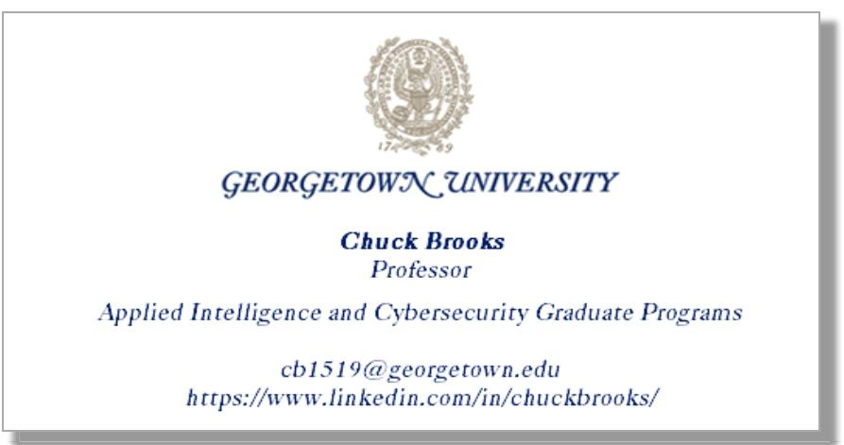
Chuck Brooks LinkedIn Profile: https://www.linkedin.com/in/chuckbrooks/ Chuck Brooks on Twitter: @ChuckDBrooks

