Slide 1

Project Title - Seasonal Agriculture Performance Analysis
Data Analysis Using Python​
AICTE STU ID : STU6a5e637ff1bdb1784570751
Kesheka Puwanesh
SRM Institute of Science and Technology

Slide 2

PROBLEM STATEMENT
Agricultural activities are influenced by seasonal variations in environmental conditions, farming practices, resource availability and market conditions. As a result, agricultural performance may differ from one season to another.
However, raw agricultural data does not clearly explain how agricultural performance changes across seasons or what patterns can be observed in different seasonal conditions.
The problem is to analyze the given agricultural dataset and investigate seasonal differences in agricultural performance by identifying meaningful patterns, trends, relationships and variations within the available data.

Slide 3
PROJECT DESCRIPTION
This project analyzes 4,000 agricultural records to study performance across different seasons, crops, irrigation methods and states.
The analysis includes data cleaning, missing value handling, statistical analysis and visualization.
Key factors such as yield, production, revenue, profit, rainfall and water usage are compared to identify important patterns and relationships.
The project also includes state-wise, crop-wise and state-crop profitability analysis to support better agricultural planning.

Slide 4
WHO ARE THE END USERS?
Farmers – to understand crop and seasonal performance.
Agricultural planners – to support seasonal and resource planning.
Agricultural organizations– to compare performance across crops and regions.
Researchers and analysts – to study agricultural patterns and trends.
Government and policy planners – to support data-based agricultural decisions.

Slide 5

TECHNOLOGY USED
Programming Language
Python
Libraries
Pandas
NumPy
Matplotlib
Seaborn
SciPy
Platform
Google Colab
Jupyter Notebook

Slide 6
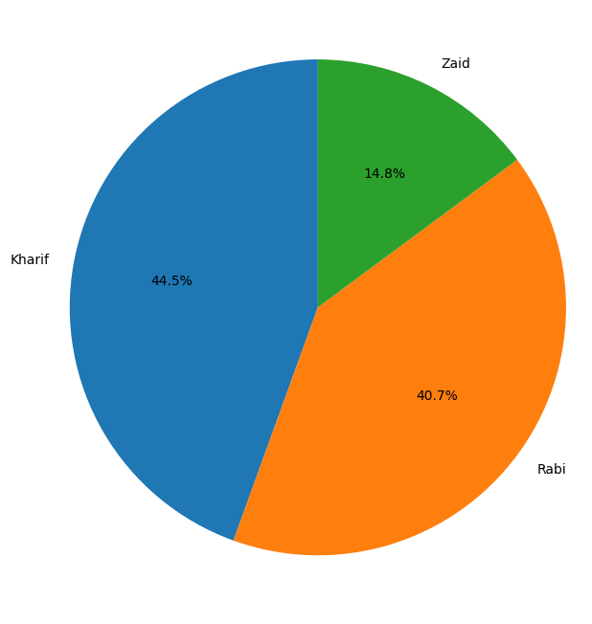
RESULTS
Distribution of Records by Season
The dataset contains records from Kharif, Rabi and Zaid seasons.
Kharif has the largest share of records.
Zaid has the smallest share of records.

Slide 7
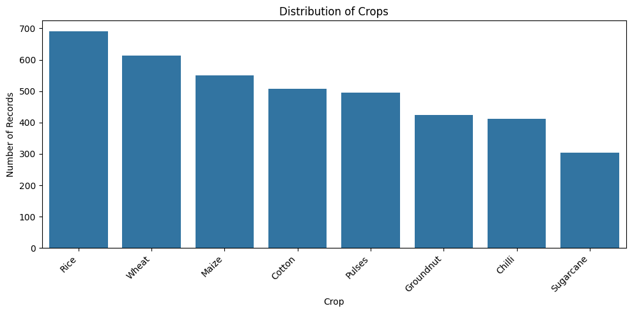
RESULTS
Crop Distribution
Rice has the highest number of records in the dataset.
Wheat and Maize also have a relatively large number of records.
Sugarcane has the lowest number of records among the crops.

Slide 8
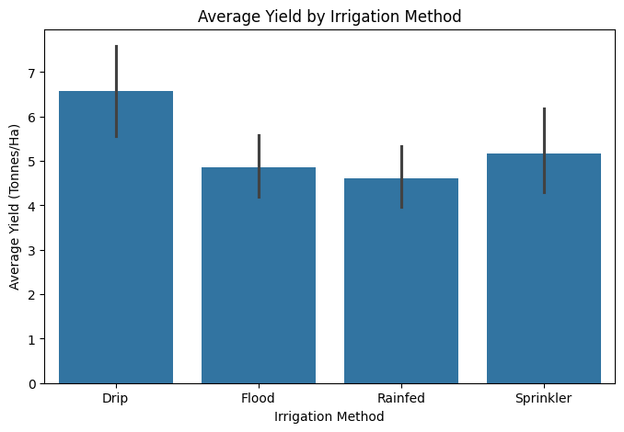
RESULTS
Irrigation Performance
Drip irrigation has the highest average yield.
Sprinkler has a higher average yield than Flood and Rainfed.
Rainfed has the lowest average yield among the four methods.

Slide 9
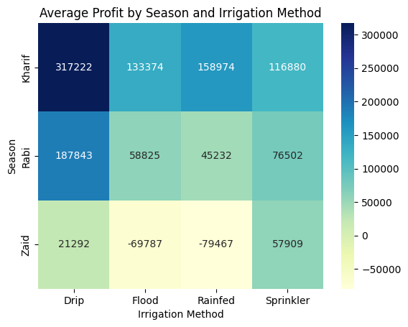
RESULTS
Profitability Analysis
Kharif shows the highest profit across the irrigation methods.
Zaid has much lower profitability, with some irrigation methods showing negative profit.
Drip irrigation shows the highest average profit overall, especially during Kharif.

Slide 10
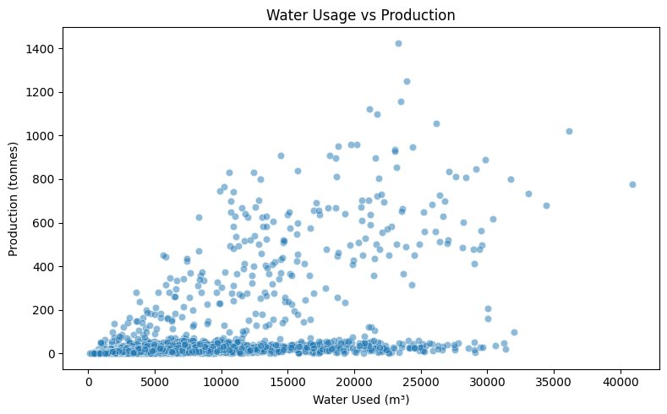
RESULTS
Water Usage And Production
Water usage and production show a moderate positive relationship.
The correlation between water usage and production is approximately 0.52.
This indicates that higher water usage is generally associated with higher production in the dataset, but it does not prove causation.

Slide 11
FUTURE SCOPE
Extend the analysis using more years of agricultural data.
Include weather forecasts and real-time environmental data.
Build predictive models for crop yield and profitability.
Develop an interactive dashboard for easier analysis.
Include more regions and crops for broader comparison.

Slide 12
GitHub LINK
https://github.com/CyberskyKC/Seasonal-Agriculture-Performance-Analysis.git

Slide 13
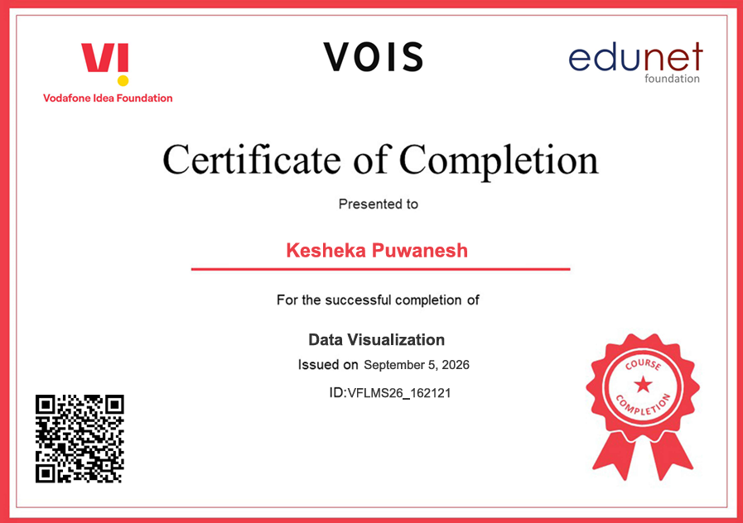
VOIS Course completion certificate - Course name- Data Visualization

Slide 14
THANK YOU
.
.

