Slide 1
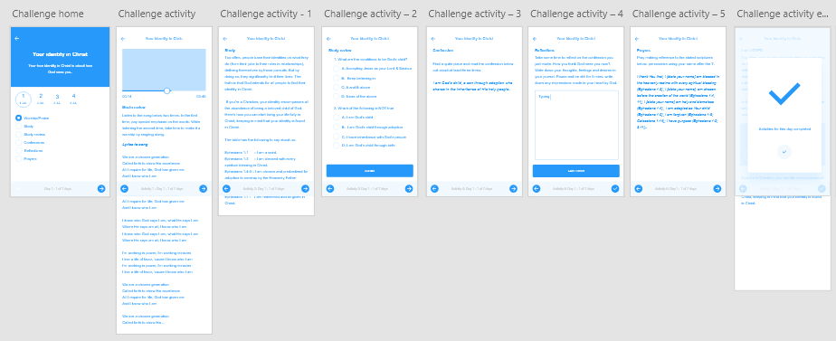
2
4
3
2
2
1
1- Video view & text view – worship/praise
2 – Text view – Study, confession, prayers
3 – Text view & Text input view – meditate (journal)
4 – Quiz view – study review

Slide 2
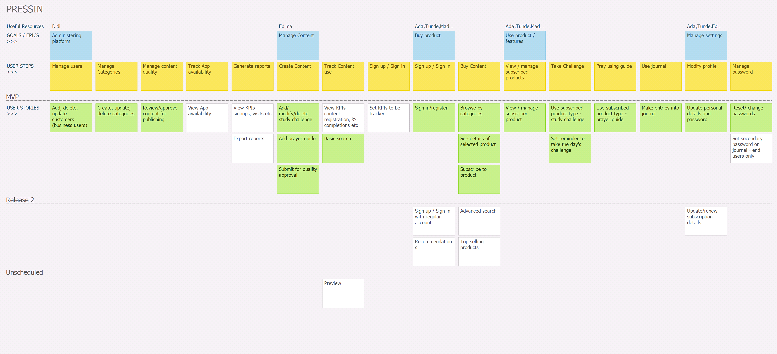

Slide 3
