Slide 1


Multimodal Deepfake Detection Using Audio-Visual Fusion Networks
Presented By: Divyanshu Ranjan | Roll No: CSEDS/2022/026
Sakshi Priya | Roll No: CSEDS/2022/051
Shubham Raj | Roll No: CSEDS/2022/054
Under the Guidance of: Ms. Dipannita Basu, Assistant Professor
Department of Computer Science and Engineering (Data Science)
Haldia Institute of Technology
Notes:
1

Slide 2

Presentation Outline
01
02
Aim & Objectives
System Architecture
Research goals and scope
Overall framework design
03
04
Image-Based Detection
Video-Based Detection
Pipeline and results
Pipeline and results
05
06
Audio-Based Detection
Multimodal Fusion
Pipeline and results
Feature-level fusion mode
07
08
User Interface & Deployment
Conclusion & Future Scope
UI Outputs
Outcomes and roadmap
Notes:
2

Slide 3
Aim & Objectives
Aim: To design and implement a robust multimodal deepfake detection system capable of identifying synthetic media by analyzing combined audio-visual cues.
1
Image Detection
Detect deepfake images using EfficientNet-B4 and facial landmarks
2
Video Detection
Detect deepfake videos using temporal feature analysis
3
Audio Detection
Detect spoofed audio using Log-Mel spectrograms
4
Feature Fusion
Perform feature-level fusion of all modalities
5
Improved Accuracy
Outperform single-modality detection systems
6
Final Prediction
Generate unified Real/Fake classification
Notes:
3

Slide 4
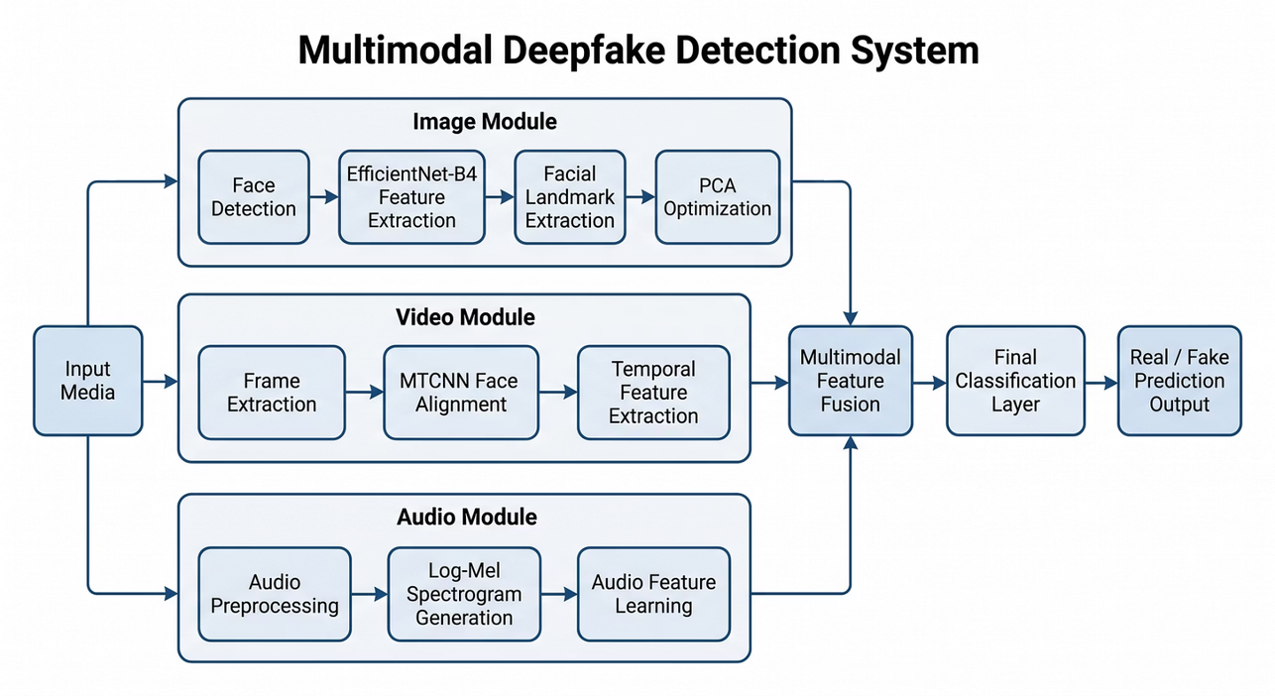
System Architecture
The system is designed using a modular architecture consisting of three independent branches for image, video, and audio analysis. Each branch performs modality-specific preprocessing and feature extraction to identify manipulation artifacts. The generated feature embeddings are normalized and concatenated through a feature-level fusion mechanism, allowing the model to leverage complementary information from all modalities. The fused feature vector is then passed to the final classifier to generate a robust real-or-fake prediction with improved detection accuracy.
EfficientNet-B4
MTCNN
TensorFlow
PyTorch
Scikit-Learn
Librosa
Notes:
4

Slide 5
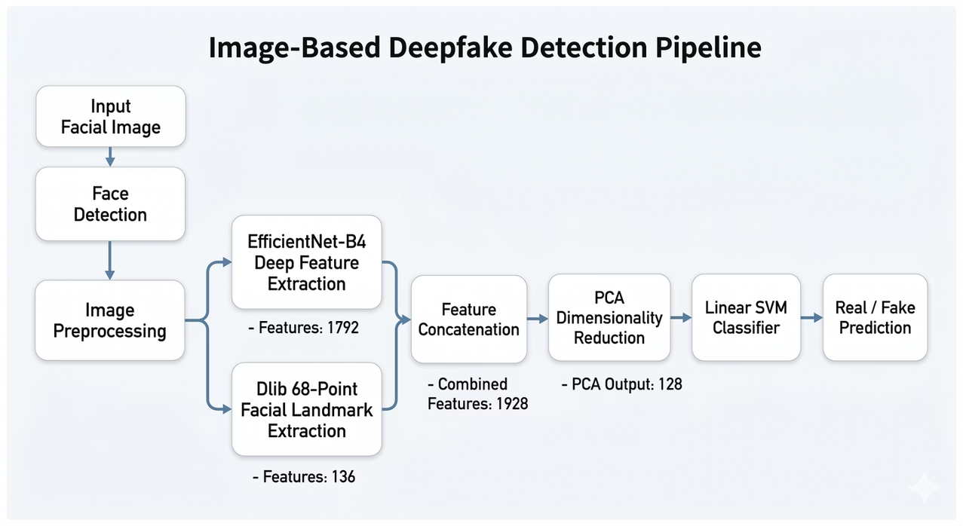

Image-Based Deepfake Detection
Pipeline Stages
Preprocessing
Face detection, cropping, resize to 380×380, data augmentation
Feature Extraction
EfficientNet-B4 (1792 features) + Dlib 68 landmarks (136 features)
Feature Engineering
Concatenation + PCA reduction (1928 → 128 dimensions)
Classification
Linear SVM → Real/Fake prediction
Notes:
5

Slide 6
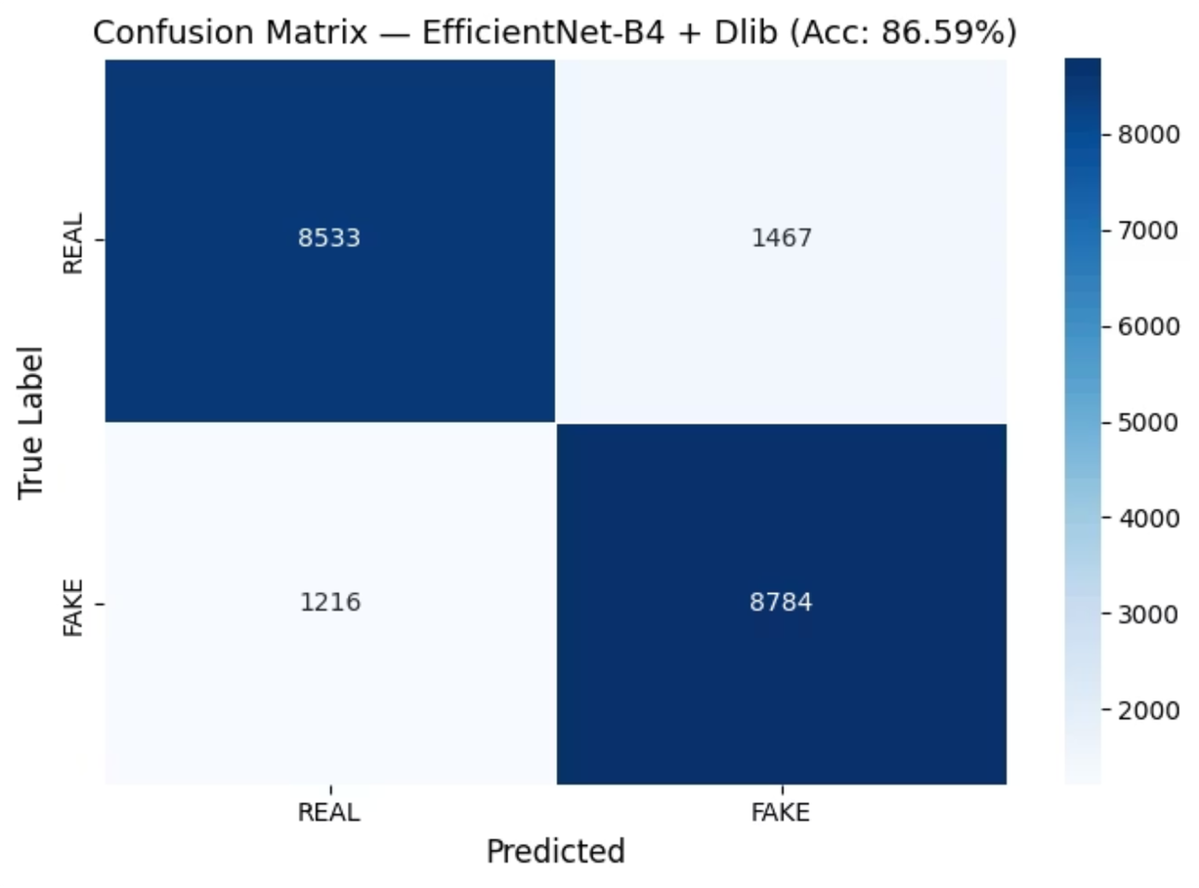
Image Model Performance
Performance Metrics
Accuracy: 86.59%
Strong overall performance on image deepfake detection.
Key Findings
Excellent fake image detection capability across test samples
PCA reduced computational complexity significantly
Landmark fusion improved robustness against geometric manipulations
Notes:
6

Slide 7
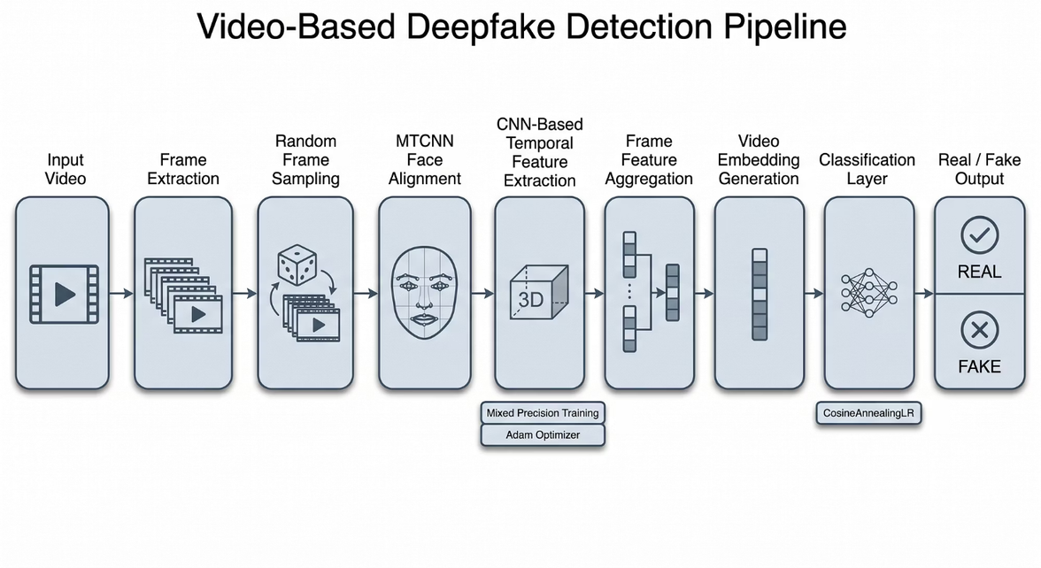
Video-Based Deepfake Detection
Detection Pipeline
01
Frame Extraction
Sample frames from input video
02
MTCNN Face Alignment
Align and normalize detected faces
03
Temporal Feature Learning
Analyze motion and consistency across frames
04
Deep Video Embeddings
Encode temporal patterns into feature vectors
05
Classification
Real/Fake prediction
Notes:
7

Slide 8
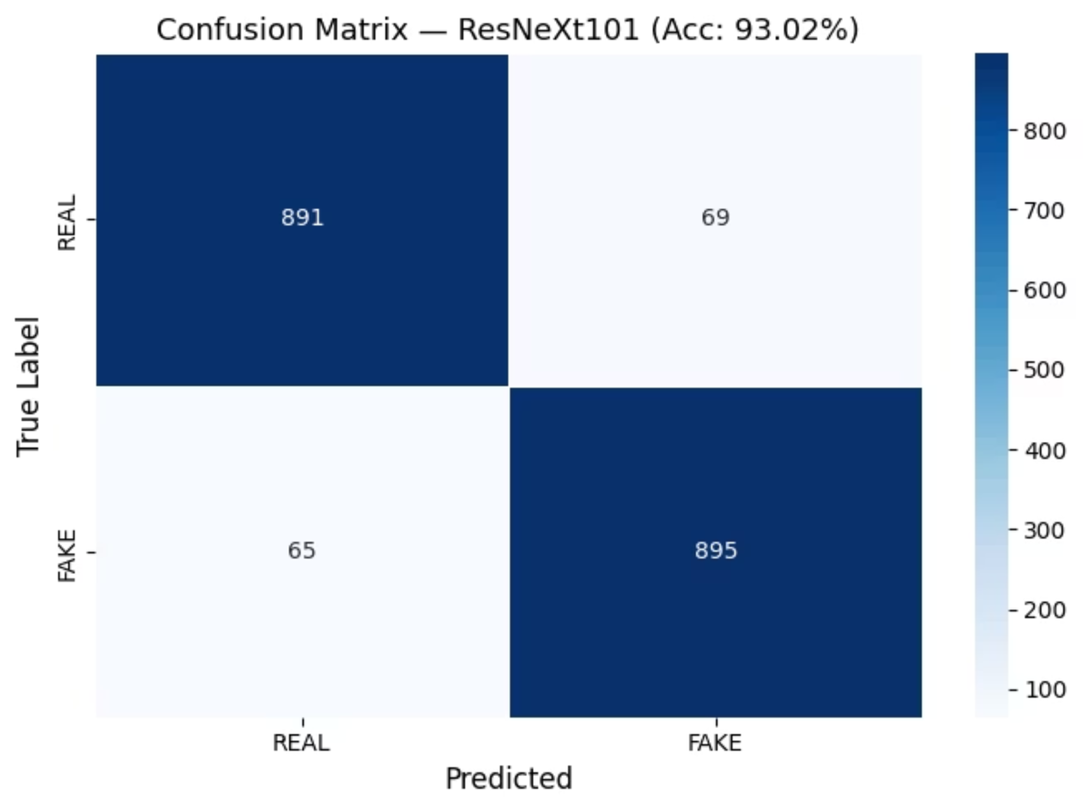
Video Model Performance
Performance Metrics
Accuracy: 93.02%
Strong overall performance on video deepfake detection.
Observations
Strong temporal artifact detection across video samples
Outperforms the image-only model by 6-7%
Effective against advanced video deepfake techniques
Notes:
8

Slide 9
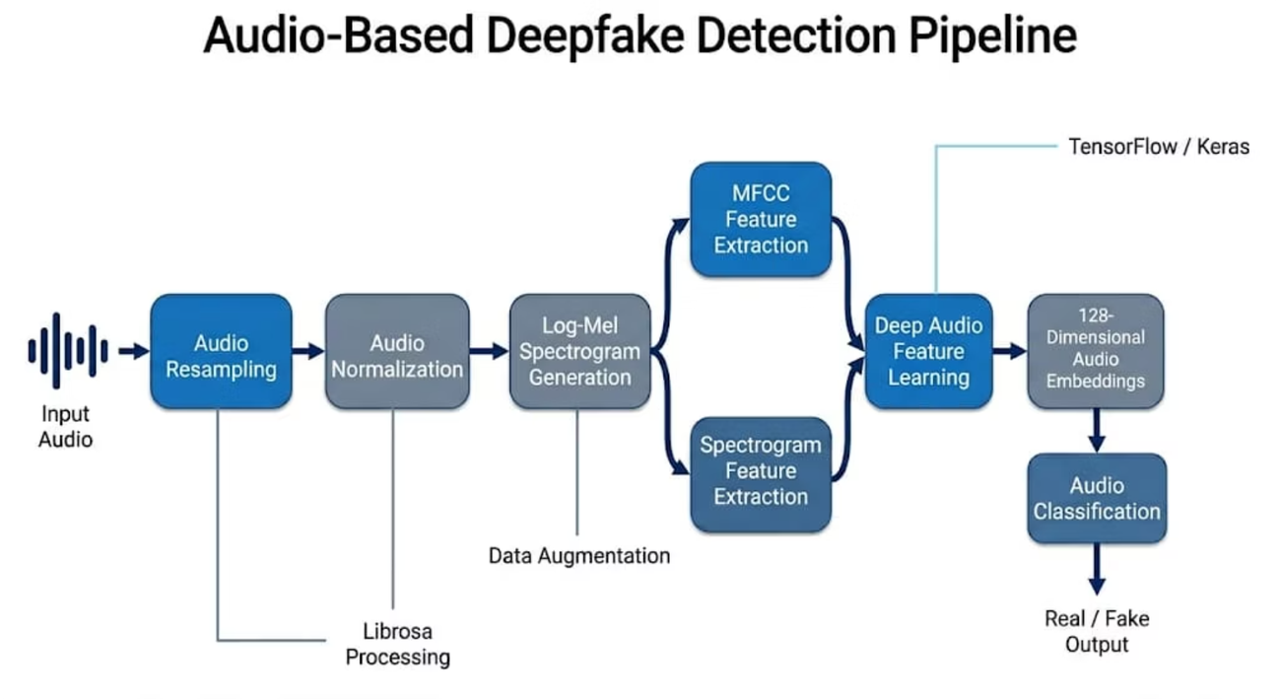
Audio-Based Deepfake Detection
Detection Pipeline
Preprocessing
Resampling → Noise reduction → Normalization
Log-Mel Spectrogram
Generate time-frequency representation of audio
Deep Feature Learning
MFCC features, spectrogram patterns, acoustic signatures
Classification
TensorFlow/Keras classifier → Real/Fake prediction
Notes:
9

Slide 10
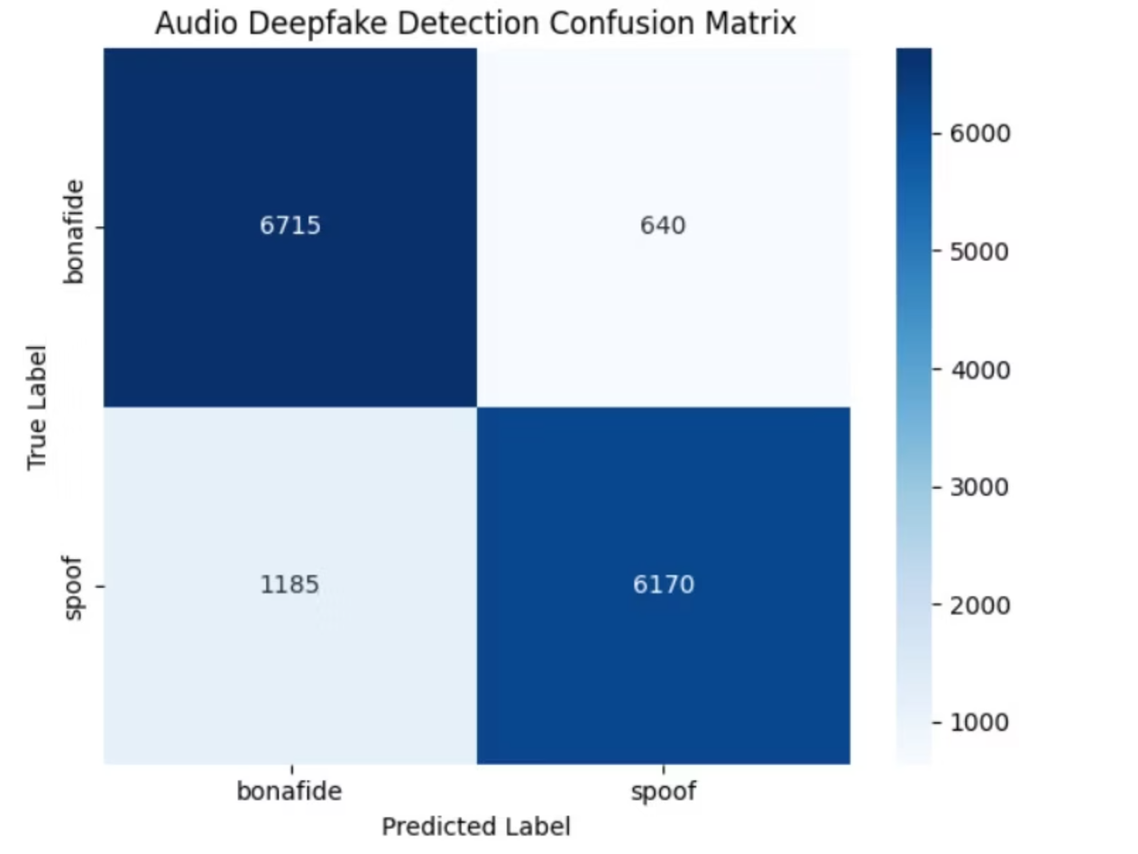
Audio Model Performance
Performance Metrics
Accuracy: 87.59%
Strong overall performance on audio deepfake detection.
Findings
Effective spoof speech detection on test data
Spectrograms capture subtle voice synthesis artifacts
Good generalization on unseen audio samples
Notes:
10

Slide 11
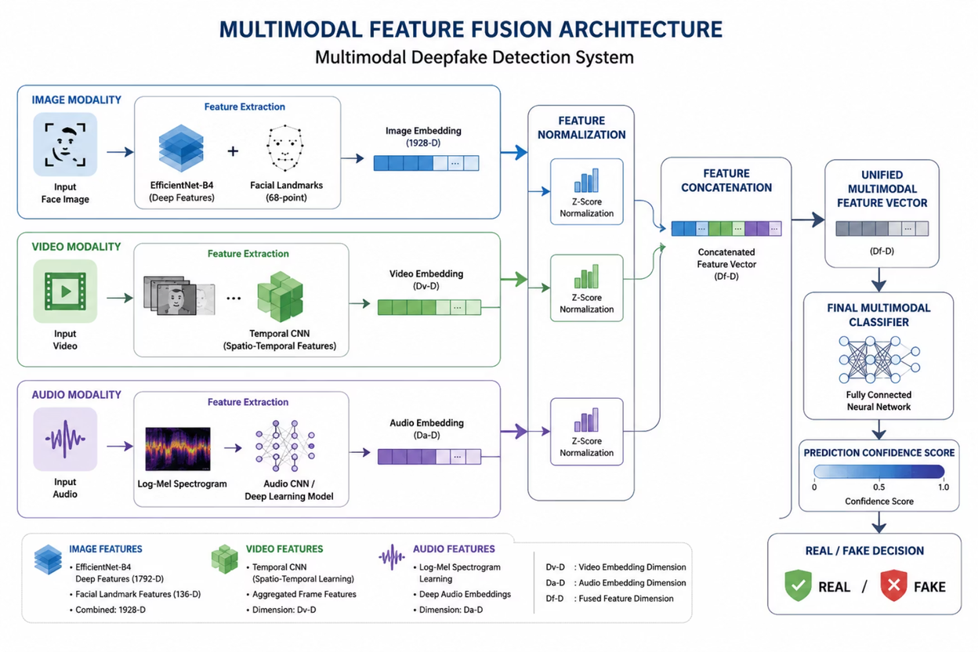
Multimodal Fusion Model
Classifier Used:
Fully Connected Neural Network
Benefits:
Utilizes visual, temporal, and acoustic information simultaneously for comprehensive analysis.
More robust against sophisticated deepfake generation techniques by identifying subtle inconsistencies across modalities.
This fusion architecture combines features from different modalities to make a robust deepfake prediction, leveraging the strengths of each data type.
Notes:
11

Slide 12
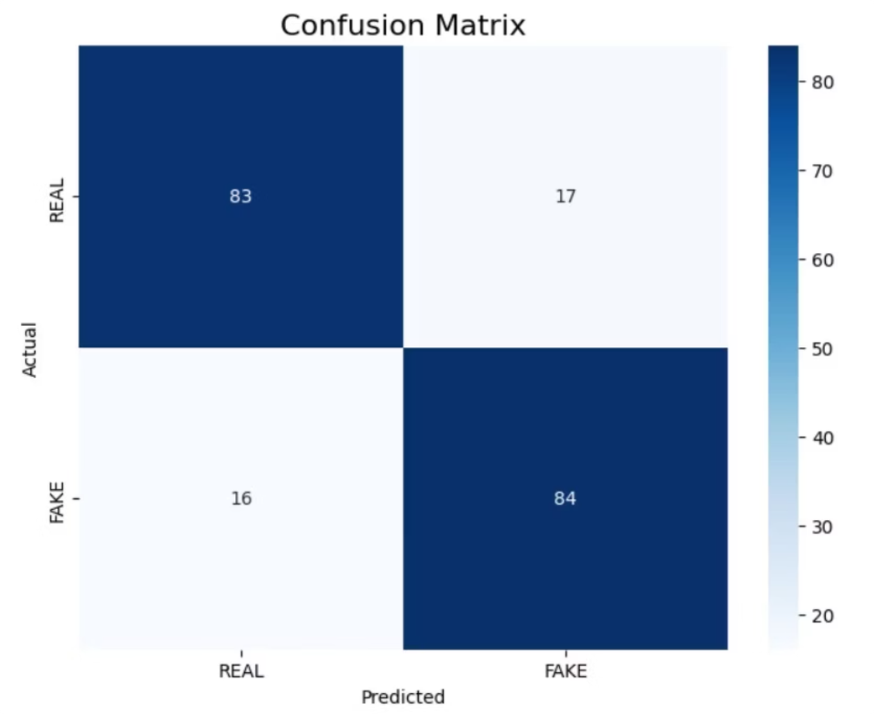
Multimodal Model Performance
Performance Metrics
Accuracy: 83%
Key Observation
Multimodal fusion provides more comprehensive analysis and robustness.
Combines strengths of all modalities (image, video, audio) for comprehensive analysis.
Robust against complex deepfake generation techniques.
Notes:
12

Slide 13
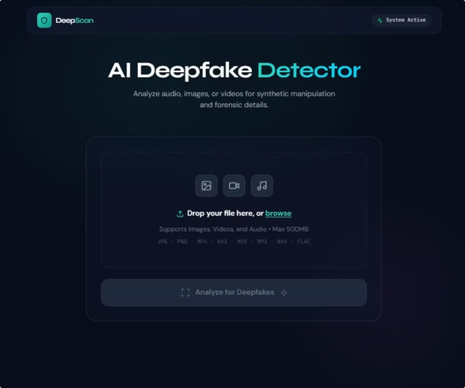
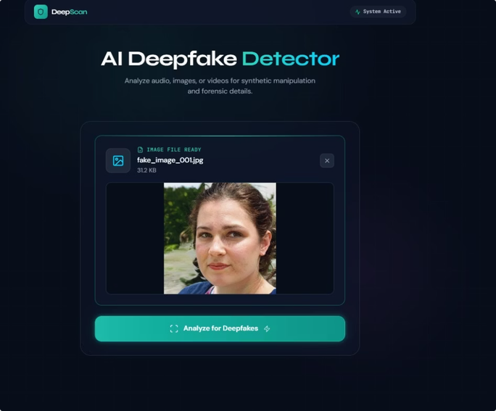
User Interface and System Deployment
The system aims to provide a simple and interactive platform for real-time deepfake detection across image, video, and audio modalities.
Frontend Features
User-friendly web interface
Support for Image, Video and Audio uploads
Real-time prediction workflow
Responsive and easy-to-use design
Backend Processing
Automatic preprocessing of uploaded media
Execution of modality-specific detection models
Feature extraction and classification
Prediction generation with confidence score
Deployment Architecture
User Upload → Preprocessing → Detection Model → Classification Engine → Prediction Output
Key Advantages
Easy accessibility
Fast prediction generation
Scalable deployment architecture
Supports multiple media formats
Notes:
13

Slide 14
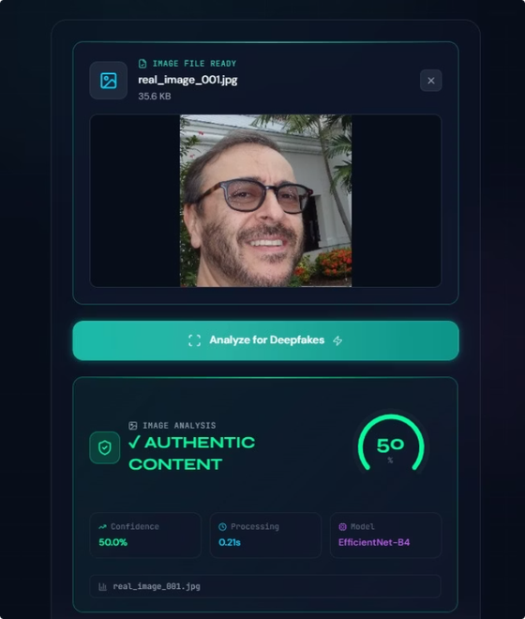
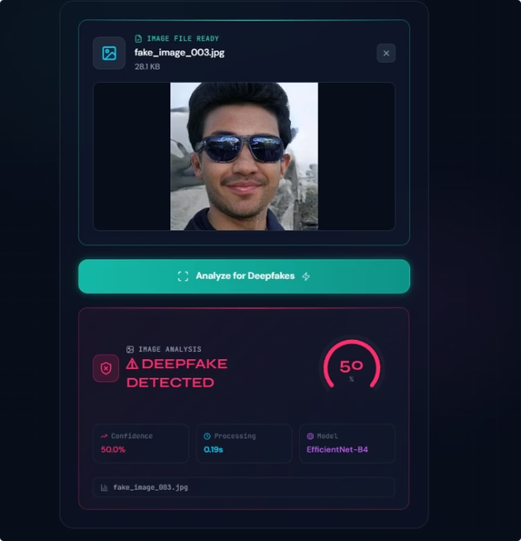
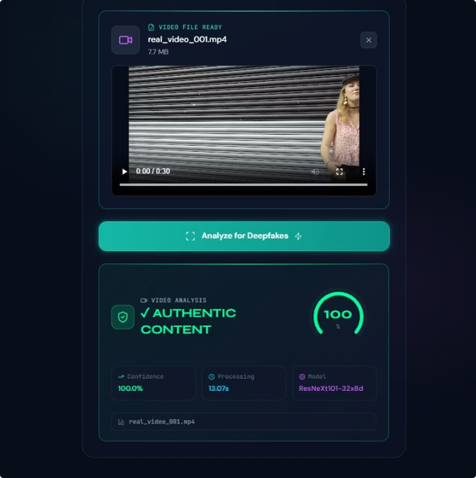
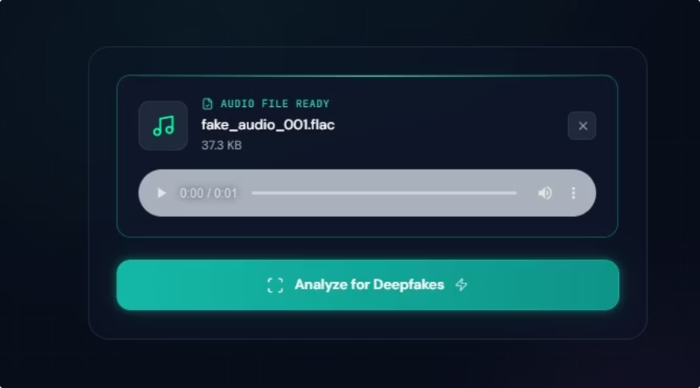
System Demonstration
Notes:
14

Slide 15
Conclusion & Future Scope
Key Accomplishments
Future Roadmap
Developed independent image, video, and audio detection pipelines.
Real-time live detection for immediate analysis.
Explore Transformer-based multimodal fusion for enhanced accuracy.
Successfully implemented feature-level fusion techniques.
Multimodal approach significantly outperformed individual models.
Improve cross-dataset generalization for broader applicability.
Develop mobile and web deployment solutions for accessibility.
Achieved high reliability in comprehensive deepfake detection.
Integrate detection of emerging deepfake generation techniques.
Notes:
15

Slide 16

Thank You
Notes:
16

