Slide 1
WIRELESS MAYHEM WITH PYTHON

Slide 2
INTRODUCTION
These types of attacks are often characterized as complex and well-organized, meaning that they are likely to have been planned and executed by experienced individuals or groups.
Wireless attacks can be particularly dangerous if they are targeted specifically at a particular organization or infrastructure, as they have the potential to cause significant damage.
Even a small, seemingly insignificant script can still be used to cause harm to a company's infrastructure.

Slide 3
THE ICEMAN AND THE ATTACKS OF THE HOTEL WIRELESS NETWORK
In 2007 the iceman aka Max Ray Butler was arrested for the sale of tens of thousands of credit card account information.
He obtained this information by using a technique called "sniffing," which involves intercepting unencrypted packets of data as they are transmitted over a network.
He was able to do this by using high-quality antennae to intercept communications from hotels and nearby wireless access points.
This highlights how even unencrypted data can be vulnerable to interception and how the use of high-quality equipment can help attackers to gain access to sensitive information.

Slide 4
PREREQUISITES AND LABS
In order to understand more about the practicality of the attacks and the mechanism of the whole setup we will need to take certain measures and establish a certain boundaries.
Hawking Hi-Gain USB Wireless-150N Network Adapter with Range Amplifier
Various different softwares will be needed in order to achieve the required results.

Slide 5
PREREQUISITES AND LABS
Explanation of the above passage:
This statement is discussing the process of investigating and understanding the details of wireless attacks and the technology used to carry them out.
The speaker suggests that in order to gain a deeper understanding of these types of attacks, certain measures and boundaries need to be established.
They mention a specific piece of equipment, the "Hawking Hi-Gain USB Wireless-150N Network Adapter with Range Amplifier," which is a device that can be used to amplify and extend the range of wireless signals.
The statement also notes that different software tools will be required in order to achieve the desired results.
This suggests that the process of investigating wireless attacks is complex and requires a variety of specialized tools and techniques.

Slide 6
SCAPY
https://scapy.net/
It is a packet manipulation program
It can decode packets of a lot of various protocols, we will use it to scan, trace routing, probing and discovering networks.
It also performs very well at a lot of other specific tasks that most other tools can’t handle, like sending invalid frames, injecting your own 802.11 frames, combining techniques (VLAN hopping+ARP cache poisoning, VOIP decoding on WEP encrypted channel)

Slide 7
SCAPY
Explanation of the above passage:
This statement is discussing a specific software program called a "packet manipulation program."
This type of program is used to analyze and manipulate the packets of data that are sent and received over a network.
It can decode packets from a variety of different protocols, which allows it to be used for a variety of different tasks, such as scanning, tracing routing, probing and discovering networks.
The statement also notes that the program is particularly well-suited to handling specific tasks that other tools may not be able to handle, such as sending invalid frames, injecting custom 802.11 frames, and combining different techniques (such as VLAN hopping and ARP cache poisoning, and VOIP decoding on WEP encrypted channel).
Overall, this statement highlights the versatility and capabilities of this packet manipulation program as a powerful tool for investigating and analyzing network traffic.

Slide 8
WIRELESS CAPTURE WITH SCAPY
We need to make sure that the system is in monitor mode use iwconfig wlan0 to establish a network to test on
Airmon-ng start wlan0 will enable monitor mode on wireless interfaces
We need to define a function pktPrint() which is a simple if else condition where we check whether the packet has 802.11 Beacon, 802.11 Probe Response, a TCP packet or DNS traffic.

Slide 9
WIRELESS CAPTURE WITH SCAPY
Explanation of the above passage:
This statement is describing a process for testing a wireless network. The first step is to use the "iwconfig" command to establish a network to test on.
The next step is to use the "airmon-ng" command to enable "monitor mode" on the wireless interface (wlan0).
The final step is to define a function called "pktPrint()" which is a conditional statement that checks if the packet is one of several types: 802.11 Beacon, 802.11 Probe Response, a TCP packet, or DNS traffic.
This function is likely used to filter and analyze network traffic during the testing process.

Slide 10
BLUETOOTH PACKAGES TO TEST BLUETOOTH ATTACKS
To perform certain bluetooth based attacks we need various libraries, here we will use the python bindings to the Linux Bluez Application Programming Interface(API) and the obexftp API.
Use “sudo apt-get install” to install the same.
To perform these attack we also need a system to test it on, the book recommends us a Campbridge Silicon Radio (CSR) chipset.
We will be using SENA Parani UD100 Bluetooth USB Adapter.
Run “hciconfig” to discover the various bluetooth devices.

Slide 11
BLUETOOTH PACKAGES TO TEST BLUETOOTH ATTACKS
Explanation of the above passage:
This statement is describing a process for performing certain bluetooth-based attacks using a specific set of tools and libraries.
The process requires the use of "python bindings to the Linux Bluez Application Programming Interface (API)" and the "obexftp API."
These libraries can be installed using the "sudo apt-get install" command. The process also requires a device to test the attacks on, specifically, a "Campbridge Silicon Radio (CSR) chipset."
The specific device recommended for this purpose is the "SENA Parani UD100 Bluetooth USB Adapter." To discover the various Bluetooth devices in the environment, the command "hciconfig" is used. This command is likely used to identify and connect to target devices for the purpose of testing the attacks.

Slide 12
PASSIVE SNIFFING OF WIRELESS SECRETS
Since the year 2001, a team named Wall of Sheep has set up a booth at the annual DEFCON.
The team passively listens for everything which is unencrypted and soon as it discovers something they display on the big screen infront of everyone.
The team has added another project called Peekaboo, which carves out images from the wireless traffic itself.

Slide 13
PASSIVE SNIFFING OF WIRELESS SECRETS
Explanation of the above passage:
This statement is describing a team named "Wall of Sheep" that has been active since 2001.
The team sets up a booth at the annual DEFCON conference, where they passively listen for unencrypted traffic. As soon as they discover something, they display it on a big screen for everyone to see.
The team has also added a project called "Peekaboo" which specifically carves out images from wireless traffic.
The goal of Wall of Sheep is likely to raise awareness about the importance of encryption and the dangers of transmitting sensitive information unencrypted. The Peekaboo project is likely to demonstrate the potential risks of transmitting images over unencrypted wireless networks.

Slide 14
REGULAR EXPRESSIONS TO SNIFF CREDIT CARD INFORMATION
One of the major factors of any functional algorithm of a computer program is the computational ability of the program.
To map out effective and efficient programing logics we use something called regular expressions which is a major block of the subject of Theory of Computation.
Now an attacker will try matching the strings using various regular expressions for credit card numbers.
The trends which are followed by certain companies while assigning the credit card numbers actually help the attackers a lot as they can use it to their advantage by writing the script accordingly.

Slide 15
REGULAR EXPRESSIONS TO SNIFF CREDIT CARD INFORMATION
Explanation of the above passage:
This statement is discussing the importance of computational ability in the design of a computer program, specifically in relation to regular expressions and the theory of computation.
Regular expressions are a way to specify patterns in text, which can be used to match, search, and manipulate text efficiently.
Regular expressions are also a powerful tool for attackers, for example, to identify patterns in credit card numbers, which can be used to extract credit card numbers from unstructured data.
Attacker can use the regular expression to match the strings using various regular expressions for credit card numbers.
The patterns used by certain companies in assigning credit card numbers can also be used by attackers to their advantage, by writing scripts that specifically target those patterns.

Slide 16
SNIFFING HOTEL GUESTS
Whenever we visit a hotel, it has got its own Wi-Fi network which is not encrypted most of the times.
The author visited a hotel and he had to enter his last name and Room number to use the Wi-Fi and connect to the web, he noticed that the browser was sending back an unencrypted HTTP page back to the server which included both the last name and the provided room number.
We use simple python sniffer which will filter out TCP packets and forward all other packet to procedure named findGuest().

Slide 17
SNIFFING HOTEL GUESTS
Explanation of the above passage:
This statement is describing a situation where the author visits a hotel and notices that the hotel's Wi-Fi network is not encrypted.
To connect to the wifi, the author is prompted to enter their last name and room number.
The author then observes that the browser is sending an unencrypted HTTP page back to the server, which includes both the last name and room number provided. To capture this kind of information, the author is using a simple python sniffer script to filter out TCP packets and forward all other packets to a function called "findGuest()".
The sniffer script is likely capturing network traffic and searching for specific information such as last name and room number, which are being transmitted in clear text.
This is likely to demonstrate the lack of security in the hotel's wifi network and the potential risks of transmitting personal information over unencrypted networks.

Slide 18
SNIFFING HOTEL GUEST (CONT.)
The function will check for any personal information by extracting all the raw components of the request and analyzing the contents.
The above information is violating a huge number of federal, state and national laws.
Extremely dangerous and efficient for people who know what they are doing.

Slide 19
SNIFFING HOTEL GUEST (CONT.)
Explanation of the above passage:
This statement is describing a function, likely called "findGuest()" that is used to check for personal information in network traffic.
The function extracts all the raw components of the request, meaning it looks at the raw data of the request, and analyzes the contents.
The statement also notes that this kind of information collection is violating a huge number of federal, state, and national laws.
It is also mentioned that it is extremely dangerous and efficient for people who know what they are doing.
This highlights the importance of data protection and the risks of exposing personal information, as well as the legal implications of data collection without consent.

Slide 20
WIRELESS KEYLOGGER
We are basing our keylogger on the basis of the google search engine real time recommendation. The way your browser sends a number of HTTP requests based on the speed of the internet connection and the number of words you are trying to search.
Similarly we will copy the contents of the packets to another packet named payload. Simply we will check if it is a GET request simply construct a regular expression to find the current suggested string and to encode spaces we will use ‘+’ or ‘%20’.

Slide 21
WIRELESS KEYLOGGER
Explanation of the above passage:
This statement is describing a process for creating a keylogger that is based on the Google search engine real-time recommendation feature.
The idea is that the keylogger will work by copying the contents of packets sent by the user's browser, specifically when the user is making a search on Google.
The keylogger works by analyzing the number of HTTP requests sent by the browser, and the number of words being searched, in order to copy the contents of the packets to another packet named "payload".
The keylogger will check if the packet is a GET request, and then construct a regular expression to find the current suggested search string.
To encode spaces in the search string, the keylogger will use the characters '+' or '%20'. This means that the keylogger is capturing the keystrokes of the user and the search queries made by the user and sending it to another packet for further analysis.
This kind of keylogger can be used for malicious purposes to steal sensitive information from the user.

Slide 22
SNIFFING FTP CREDENTIALS
We know that whenever we come across any FTP server we can breach the login by just adding anonymous as the username or they can easily intercept the user credentials.
To intercept the credentials we scan for two specific strings, first one is any string which has ‘USER’ in the string and the other one has ‘PASS’ as the preceding word in the order.
The above creds are worthless without the IP address hence we will write simple regular expression to capture the above two strings and the IP address of the user or the system.

Slide 23
SNIFFING FTP CREDENTIALS
Explanation of the above passage:
This statement is describing a process for intercepting login credentials of an FTP server.
The process is based on the idea that many FTP servers can be easily breached by simply adding "anonymous" as the username.
To intercept the credentials, the process involves scanning for two specific strings: one that has "USER" in the string and the other one that has "PASS" as the preceding word in the order.
The reason for this is that these strings are commonly used in the login process of an FTP server.
Once the strings are captured, the IP address of the user or system is captured by writing a regular expression.
This process is likely used to intercept login credentials of an FTP server without the user's knowledge or consent.

Slide 24
LISTENING FOR 802.11 PROBE REQUESTS
So what are 802.11 Probe Requests, basically when your phone or computer boots up and tries to connect to a specific network it sends out 802.11 requests to search for previously connected networks.
We are designing an function name ‘sniffProbe()’ we will check if it has any sort of layer.

Slide 25
LISTENING FOR 802.11 PROBE REQUESTS
Explanation of the above passage:
This statement is describing a process for identifying and capturing "802.11 Probe Requests" which are network packets sent by devices like phones or computers when they boot up and try to connect to a specific network.
These requests are sent out to search for previously connected networks. To capture these requests, a function called "sniffProbe()" is being designed which will check if the packet has any sort of layer.
This function is likely used to capture and analyze the 802.11 Probe Requests packets that are being sent by devices in the network.
This can be used to identify the devices that are trying to connect to the network, and the networks they are trying to connect to.
This information can be useful in security assessments, troubleshooting, and network monitoring.

Slide 26
DISCOVERING HIDDEN 802.11 NETWORKS
To discover the same we need to wait for it to match the frequency and codes with the same.
Now the 802.11 Probe requests will contain the name of the network and will search it.

Slide 27
DISCOVERING HIDDEN 802.11 NETWORKS
Explanation of the above passage:
This statement is describing a process for discovering and identifying 802.11 Probe Requests.
The process involves waiting for the request to match the frequency and codes of the network the device is trying to connect to.
Once the request is captured, it will contain the name of the network that the device is trying to connect to.
The process searches for the name of the network to identify the device and the network it is trying to connect to.
This process is used to identify the devices that are trying to connect to a specific network and the name of the network they are trying to connect to.
This information can be useful in identifying the devices connected to the network and can also be used to track the network usage and identify any suspicious activity.

Slide 28
INTERCEPTING AND SPYING ON UAVS
The US government were astonished to figure out the use of SkyGrabber to intercept the UAV feeds.
It is used to intercept the unencrypted satellite television data and send it over an encrypted channel to the user or the administrator.

Slide 29
INTERCEPTING AND SPYING ON UAVS
Explanation of the above passage:
This statement is describing a tool called SkyGrabber, which is used to intercept unencrypted satellite television data.
It was of concern to the US government as it was used to intercept feeds from Unmanned Aerial Vehicles (UAVs), also known as drones.
SkyGrabber captures unencrypted data from satellite television and sends it over an encrypted channel to the user or administrator.
This allows the user or administrator to view the satellite television data without needing to be authorized to access the feed.

Slide 30
INTERCEPTING THE TRAFFIC AND DISSECTING THE PROTOCOL
First Things First let's understand how and my phone communicate so initially will have to place our wireless adaptor in monitor mode now we learn that you have an iPhone create an Ad-Hoc wireless network between each other.
A simple tcpdump will ensure UDP traffic resulting from the UAV is headed towards the phone on udp port number 5555 in this example
Now we parse out the navigation traffic by running a simple python script.
If we keep on intercepting the traffic, we will eventually come to conclusion that the number of commands the drone can execute is limited and can be manipulated.

Slide 31
INTERCEPTING THE TRAFFIC AND DISSECTING THE PROTOCOL
Explanation of the above passage:
This statement is describing a process for intercepting wireless traffic between a phone and an Unmanned Aerial Vehicle (UAV) also known as a drone.
The process begins by placing a wireless adapter in monitor mode, which allows the adapter to passively listen to all wireless traffic in the area.
To communicate with the UAV, an Ad-Hoc wireless network is created between the phone and the UAV.
To capture the traffic, a simple TCP dump is used to ensure that UDP traffic resulting from the UAV is headed towards the phone on a specific UDP port number (in this example 5555).
This captured traffic is then parsed out by running a simple python script. By intercepting the traffic, the author is able to conclude that the number of commands the drone can execute is limited and can be manipulated.

Slide 32
CRAFTING 802.11 Frames with Scapy
But limiting ourselves to the predetermined commands is not feasible hence we will try to forge our own commands and duplicate some of the commands from the predetermined settings.
We have added the emergency land method which when initiated will kill every process and stop everything in it’s way.

Slide 33
CRAFTING 802.11 Frames with Scapy
Explanation of the above passage:
This statement is describing a process for creating and sending custom commands to a UAV.
The process starts by identifying that the number of commands that the UAV can execute is limited and can be manipulated, but limiting to the predetermined commands is not feasible.
To overcome this limitation, the process involves trying to forge new commands and duplicate some of the commands from the predetermined settings.
An example of this is the addition of an "emergency land method" which, when initiated, will kill every process and stop everything in its way.
This new command is not part of the predetermined settings of the UAV and allows the user to have more control over the UAV.
This process likely used to gain more control over the UAV and to perform more advanced maneuvers than the ones provided by the manufacturer.

Slide 34
DETECTING FIRESHEEP
This tool was invented by Eric Butler which had the potential to take over a huge number of unsuspecting social media accounts.
It passively listens on wireless cards for HTTP cookies.
Now let’s say the user does not use any secure encryption to protect their session the attacker will use the cookie to reuse in the further event.
Eric made a simple two click mechanism to do the same.

Slide 35
DETECTING FIRESHEEP
Explanation of the above passage:
This statement is describing a tool, invented by Eric Butler, that has the potential to take over many unsuspecting social media accounts.
The tool is called Firesheep and it passively listens on wireless cards for HTTP cookies.
When a user connects to a wireless network and doesn't use any secure encryption to protect their session, the attacker can use the cookies to reuse in further events.
Eric Butler made the tool easy to use by creating a simple two-click mechanism to perform the attack.
This means that the user can easily intercept and steal cookies from unencrypted wireless connections, allowing the attacker to take over the user's social media account without the user's knowledge or consent.
This kind of attack is called session hijacking, and it is a serious security concern.

Slide 36
HERD THE SHEEP – CATCHING WORDPRESS COOKIE FOR REUSE
Similar to the ‘firesheep’, ‘herd the sheep’ parse the wordpress HTTP session that contain these session cookie.
We will filter by TCP port 80 and whenever we see a cookie content matching the entity to be searched for we will show the contents of the cookie on the screen.

Slide 37
HERD THE SHEEP – CATCHING WORDPRESS COOKIE FOR REUSE
Explanation of the above passage:
This statement is describing a tool, similar to Firesheep, called "Herd the Sheep" which is used to parse WordPress HTTP sessions and intercept session cookies.
The tool filters the traffic by TCP port 80 and whenever it sees a cookie content matching the entity to be searched for, it will show the contents of the cookie on the screen.
This means that the tool is looking for specific cookies transmitted over port 80, likely the default port used by web servers, and displaying their contents when they are found.
This tool is likely used to intercept session cookies and use them to gain unauthorized access to a user's account.
This tool is similar to Firesheep and both are used to intercept cookies from unencrypted wireless connections, allowing the attacker to take over the user's account without the user's knowledge or consent.

Slide 38
BLUETOOTH RECON USING PYTHON
To interact and handle bluetooth module we use PyBluez Python module.
There is an inbuilt package named discover_devices() to return an array of MAC addresses, further we use lookup_name() function to search for the name using the string searching method.
Furthermore we can make arrays to identify the devices which are already scanned and the devices which are new to the scene.

Slide 39
BLUETOOTH RECON USING PYTHON
Explanation of the above passage:
This statement is describing the use of the PyBluez Python module to interact and handle Bluetooth modules.
The PyBluez module includes an inbuilt package called "discover_devices()" which returns an array of MAC addresses of the devices that are in range and can be discovered.
The statement also mention that the PyBluez module has a function called "lookup_name()" which can be used to search for the name of a device using the MAC address by implementing a string searching method.
Furthermore, the statement suggests that it is possible to create arrays to identify the devices that have already been scanned and the devices that are new to the scene.
This means that the script can keep track of the devices that have already been discovered and the devices that are new. This process is likely used for discovering and identifying nearby Bluetooth devices, which can be useful for security assessments, troubleshooting, and network monitoring.

Slide 40
INTERCEPTING WIRELESS TRAFFIC TO FIND BLUETOOTH ADDRESSES
The method in previous slide will only discover devices which are discoverable on the network.
We write a simple python script to discover 802.11 frame with an MAC address that matches the first three bytes of the desired device.
WE need to discover the 802.11 of the wireless Radio of the device and then we need to further construct the MAC address of the Bluetooth radio by just incrementing the 802.11 WiFi address by 1.

Slide 41
INTERCEPTING WIRELESS TRAFFIC TO FIND BLUETOOTH ADDRESSES
Explanation of the above passage:
This statement is describing a method for discovering devices on a network that are not in "discoverable" mode.
The method involves writing a simple python script to discover 802.11 frames with a MAC address that matches the first three bytes of the desired device.
The process first involves discovering the 802.11 of the wireless radio of the device, then it constructs the MAC address of the Bluetooth radio by incrementing the 802.11 WiFi address by 1.
This is a way to discover the devices which are not in discoverable mode.

Slide 42
INTERCEPTING WIRELESS TRAFFIC TO FIND BLUETOOTH ADDRESSES
This process is likely used for discovering devices on a network that are not in discoverable mode, which can be useful for security assessments, troubleshooting, and network monitoring.
It is also used to detect devices that have been deliberately configured to not be discoverable, which can be an indication of malicious intent.
Please note that the method described here is not reliable, it's just a technique that can be used to infer the MAC address of the Bluetooth device by just incrementing the WiFi address by 1. This method is not guaranteed to work and might not be even legal in some jurisdictions.

Slide 43
SCANNING BLUETOOTH RFCOMM CHANNELS
RFCOMM emulates RS232 serial ports over bluetooth L2CAP protocol.
RFCOMM connections appear very similar to TCP socket connections and in order to connect we need to construct a RFCOMM bluetooth type soket and pass the connect() function.
We might be able to figure out the open ports but not the functionality of the same for that we will use bluetooth Service Discovery Protocol.

Slide 44
SCANNING BLUETOOTH RFCOMM CHANNELS
Explanation of the above passage:
This statement is describing the use of the Bluetooth protocol called "RFCOMM" which emulates RS232 serial ports over the L2CAP protocol.
RFCOMM connections appear very similar to TCP socket connections, to connect to the device you need to construct a RFCOMM Bluetooth type socket and pass the connect() function.
This allows the script to connect to the device as if it were connecting to a serial port over a wired connection. The statement also mentions that while this method can be used to figure out open ports on a device, it cannot determine the functionality of those ports. To determine the functionality of the open ports, the script uses the Bluetooth Service Discovery Protocol (SDP).
The Bluetooth Service Discovery Protocol is used to discover the services and characteristics of nearby Bluetooth devices. This allows the script to determine the functionality of the open ports on the device. This process is likely used for discovering and identifying the services and characteristics of nearby Bluetooth devices, which can be useful for security assessments, troubleshooting, and network monitoring.

Slide 45
BLUETOOTH SERVICE DISCOVERY PROTOCOL
The SDAP is a usage scenario describing the functionality a Service Discovery Application (SrvDscApp) should provide to an end user on a local device (LocDev) so that user can discover services on a Remote Device (RemDev). The SDAP doesn't specify an API that will provide this functionality, but suggests primitives that can be mapped to an API.
Certain functions like find_service() returns an array of records which has the vital informations.

Slide 46
BLUETOOTH SERVICE DISCOVERY PROTOCOL
Explanation of the above passage:
This statement is describing the Bluetooth Service Discovery Application Profile (SDAP) which is a usage scenario that describes the functionality that a Service Discovery Application (SrvDscApp) should provide to an end user on a local device (LocDev) so that the user can discover services on a Remote Device (RemDev).
The SDAP doesn't specify an API that will provide this functionality, but it suggests primitives that can be mapped to an API.
The statement mentions that one of the functions provided by the SDAP is the "find_service()" function, which returns an array of records that contain vital information about the services available on a remote device.

Slide 47
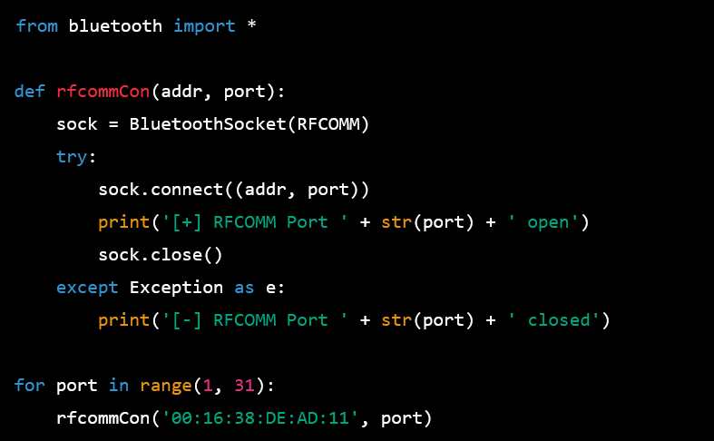
BLUETOOTH SERVICE DISCOVERY PROTOCOL

Slide 48
BLUETOOTH SERVICE DISCOVERY PROTOCOL
The code is a Python script that performs a Bluetooth port scan on a device with the Bluetooth address "00:16:38:DE:AD:11". The purpose of the script is to determine which RFCOMM ports on the device are open.
The script defines a function rfcommCon that takes two arguments: the Bluetooth address of the device and a port number. The function creates a Bluetooth socket using the BluetoothSocket function from the bluetooth module, with the socket type set to RFCOMM. The function then tries to connect to the device on the specified port using the connect method of the socket. If the connection is successful, the function prints a message indicating that the port is open. If an exception is raised during the connection attempt, the function prints a message indicating that the port is closed.
The script then uses a for loop to iterate over all the port numbers from 1 to 30, calling the rfcommCon function for each port and printing the results of the scan.

Slide 49
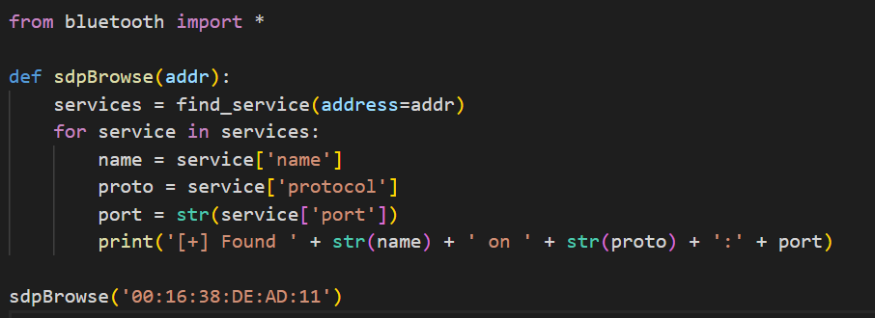
BLUETOOTH SERVICE DISCOVERY PROTOCOL

Slide 50
Taking Over a Printer with Python ObexFTP
This code is using the bluetooth library to browse for services offered by a Bluetooth device with address '00:16:38:DE:AD:11'.
The sdpBrowse function takes the address of the device and uses the find_service function from the bluetooth library to find the services offered by the device. For each service found, the function extracts the service name, protocol, and port and prints the information to the console.
Finally, the function is called with the device address '00:16:38:DE:AD:11'.

Slide 51
Taking Over a Printer with Python ObexFTP
Let's continue our attack against the printer. We have discovered that it offers OBEX Object Push on RFCOMM Port 2, so we will use obexftp to connect to the printer.
Our goal is to send an image file, named /tmp/ninja.jpg, from our attacker workstation to the printer. If the file transfer is successful, the printer will start printing a picture of a ninja.
This is an exciting demonstration of our capabilities, but in the next section, we will use this methodology to carry out more potent attacks against phones that offer Bluetooth services.

Slide 52
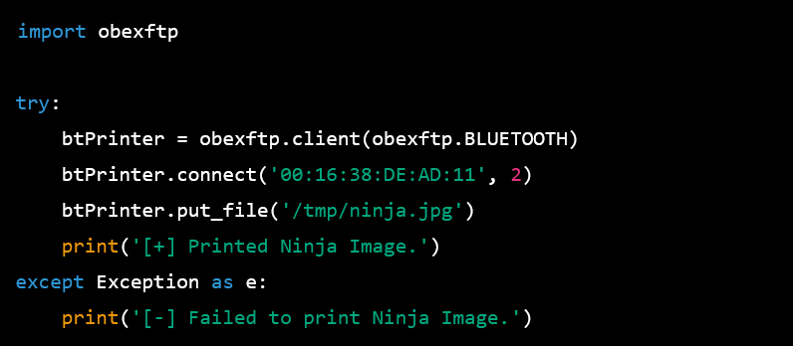
Taking Over a Printer with Python ObexFTP

Slide 53
BlueBugging a Phone with Python
This code uses the obexftp library to connect to a Bluetooth device with the specified MAC address, 00:16:38:DE:AD:11 on channel 2. The put_file() function is then used to send the file /tmp/ninja.jpg to the device.
The code is surrounded by a try-except block, which is used to catch any exceptions that might occur during the process of sending the file. If there is an error, a message indicating that the image failed to print will be printed. If the image is sent successfully, a message indicating that the image was printed will be displayed.

Slide 54
BlueBugging a Phone with Python
In this section, we will demonstrate a recent attack vector that targets Bluetooth enabled phones, commonly referred to as the BlueBug attack. This attack exploits the vulnerability of an unauthenticated and unsecured connection on a phone to steal sensitive information or issue commands to the device. The attack leverages the RFCOMM channel to send AT commands, allowing the attacker to remotely control the phone, potentially reading and writing SMS messages, gathering personal information, or forcing dialing a 1-900 number.
For instance, a Nokia 6310i phone (with firmware version 5.51 or earlier) was vulnerable to the BlueBug attack as it allowed connection to its RFCOMM channel 17 without any authentication. An attacker could simply scan for open RFCOMM channels, find the open channel 17 and connect to it, then issue AT commands to dump the phonebook.
To replicate this attack in Python, we need to import the Python bindings for the Bluez API. After identifying the target address and the vulnerable RFCOMM port, we establish a connection to the unauthenticated and unencrypted port. Using the created connection, we can issue commands such as "AT +CPBR= 1" to extract the first contact from the phonebook. Repeating this command with incrementing values allows the attacker to steal the entire phonebook.

Slide 55
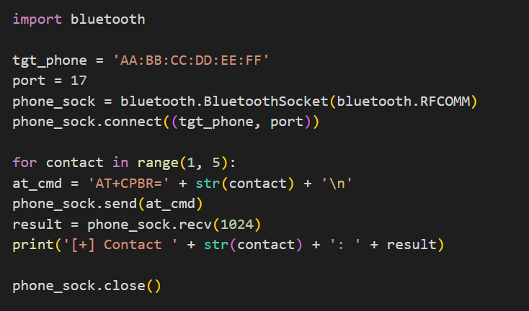
BLUETOOTH SERVICE DISCOVERY PROTOCOL

Slide 56
BLUETOOTH SERVICE DISCOVERY PROTOCOL
Running our attack against a vulnerable phone, we can dump the first five con­tacts in the phone. Less The code is written in Python and implements a Bluetooth attack known as BlueBug. The attack targets a vulnerable Bluetooth enabled phone and issues AT commands over the RFCOMM channel to control the phone and steal its information.
The code begins by importing the "bluetooth" module and setting the target phone's address and the port it is listening on (port 17). A Bluetooth socket is then created using the RFCOMM protocol, and the socket is connected to the target phone.

Slide 57
BLUETOOTH SERVICE DISCOVERY PROTOCOL
The code then loops through a range of numbers (1 to 5), representing contacts in the phone's address book. For each iteration, an AT command is constructed and sent to the phone, which requests the details of a specific contact (e.g. AT+CPBR=1). The response from the phone is received and stored in the "result" variable. The code then prints the contact number and the result.
Finally, the socket is closed to end the connection. This code demonstrates the basic structure of the BlueBug attack, which allows an attacker to steal information from a vulnerable Bluetooth enabled phone. fifteen lines of code and we can remotely steal a phonebook over Bluetooth. Outstanding!

