Slide 1
Antivirus Evasion with Python

Slide 2
Contents
Working with Python Ctypes
Anti-Virus Evasion using Python
Building Win32 Executable using Pyinstaller
Utilizing HTTPLib to GET/POST HTTP Requests
Interacting with an Online Virus Scanner

Slide 3
Contents
Explanation of the above passage:
"Working with Python Ctypes" refers to using the Ctypes library in Python to interact with C libraries and call C functions from Python code.
"Anti-Virus Evasion using Python" refers to using Python to evade detection by anti-virus software. This can be done by modifying the code or using techniques such as code obfuscation.
"Building Win32 Executable using Pyinstaller" refers to using the Pyinstaller library in Python to create a standalone executable file for Windows 32-bit systems.
"Utilizing HTTPLib to GET/POST HTTP Requests" refers to using the HTTPLib library in Python to send HTTP GET and POST requests to web servers.
"Interacting with an Online Virus Scanner" refers to using Python to send files to an online virus scanner service and retrieve the scan results.

Slide 4
Working with Python Ctypes :
ctypes is a foreign function library for Python. It provides C compatible data types, and allows calling functions in DLLs or shared libraries. It can be used to wrap these libraries in pure Python.
ctypes exports the cdll, and on Windows windll and oledll objects, for loading dynamic link libraries.
You load libraries by accessing them as attributes of these objects. cdll loads libraries which export functions using the standard cdecl calling convention, while windll libraries call functions using the stdcall calling convention. oledll also uses the stdcall calling convention, and assumes the functions return a Windows HRESULT error code. The error code is used to automatically raise an OSError exception when the function call fails.

Slide 5
Working with Python Ctypes :
The ctypes library in Python is a foreign function library that allows interaction with C libraries and dynamic link libraries (DLLs) in a Python program. It provides C compatible data types, such as integers and strings, and allows Python code to call functions in DLLs or shared libraries. It can be used to wrap these libraries in pure Python, meaning that the functionality of the library can be used in a Python script without the need for a separate C program.
ctypes exports the cdll, windll, and oledll objects, which are used to load dynamic link libraries. The cdll object is used to load libraries that export functions using the standard cdecl calling convention, while the windll object is used to load libraries that call functions using the stdcall calling convention. The oledll object also uses the stdcall calling convention and assumes that the functions return a Windows HRESULT error code. If the function call fails, the error code is used to automatically raise an OSError exception. This allows the developer to handle errors and exceptions more easily.

Slide 6
Examples :
Windows:
>>> from ctypes import *
>>> print(windll.kernel32)
<WinDLL 'kernel32', handle ... at ...>
>>> print(cdll.msvcrt)
<CDLL 'msvcrt', handle ... at ...>
>>> libc = cdll.msvcrt
>>>
Linux
>>> cdll.LoadLibrary("libc.so.6")
<CDLL 'libc.so.6', handle ... at ...>
>>> libc = CDLL("libc.so.6")
>>> libc
<CDLL 'libc.so.6', handle ... at ...>
>>>

Slide 7
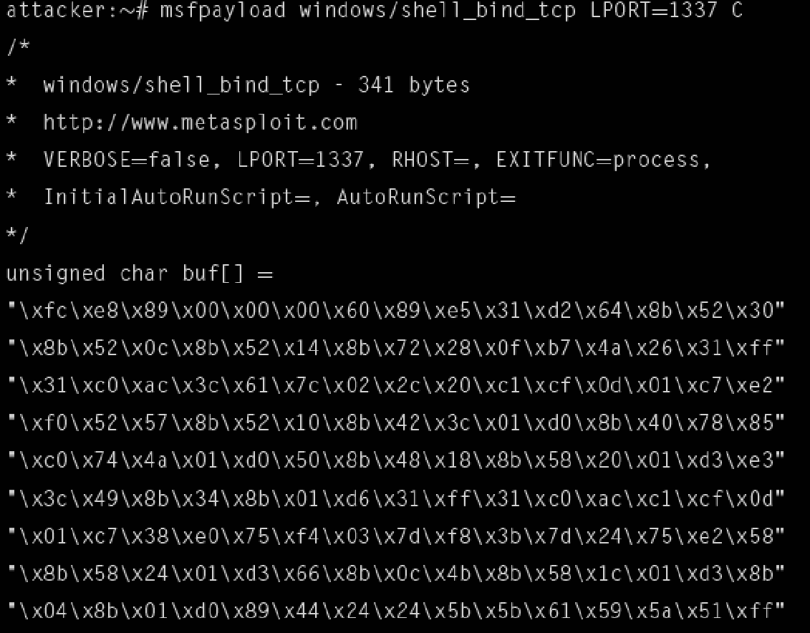
Anti-Virus Evasion using Python
Metasploit Framework :
Windows bindshell binds cmd.exe process to aTCP port of our choosing allows attacker to remotely connect to a machine and issue commands that interact with the cmd exe process execute script of c-style where python allows importing foriegn function libraries which allow to interact data types for c programming language.
after defining variable to store shellcode , simply cast it as a function and execute it .
script at this point will execute on a windows machine with python inerpreter installed and before compiling our script , it is necessary to run the configure.py script bundled with pyinstaller

Slide 8
Anti-Virus Evasion using Python
The Metasploit Framework is an open-source penetration testing tool that allows users to exploit vulnerabilities in systems and gain unauthorized access. One of the features of the Metasploit Framework is the ability to create a Windows bindshell, which binds the cmd.exe process to a TCP port of the attacker's choosing. This allows the attacker to remotely connect to a machine and issue commands that interact with the cmd.exe process, allowing them to execute arbitrary code on the target system.
In this context, the use of python is to import foreign function libraries which allows to interact with data types for C programming language. The script creates a variable to store shellcode and then casts it as a function and execute it. The script will execute on a windows machine with python interpreter installed.
It is also necessary to run the configure.py script bundled with pyinstaller before compiling the script. Pyinstaller is a tool used to package python applications into standalone executables, which can then be easily distributed and run on other systems without the need for a python interpreter. The configure.py script is used to configure the build settings for the executable.

Slide 9
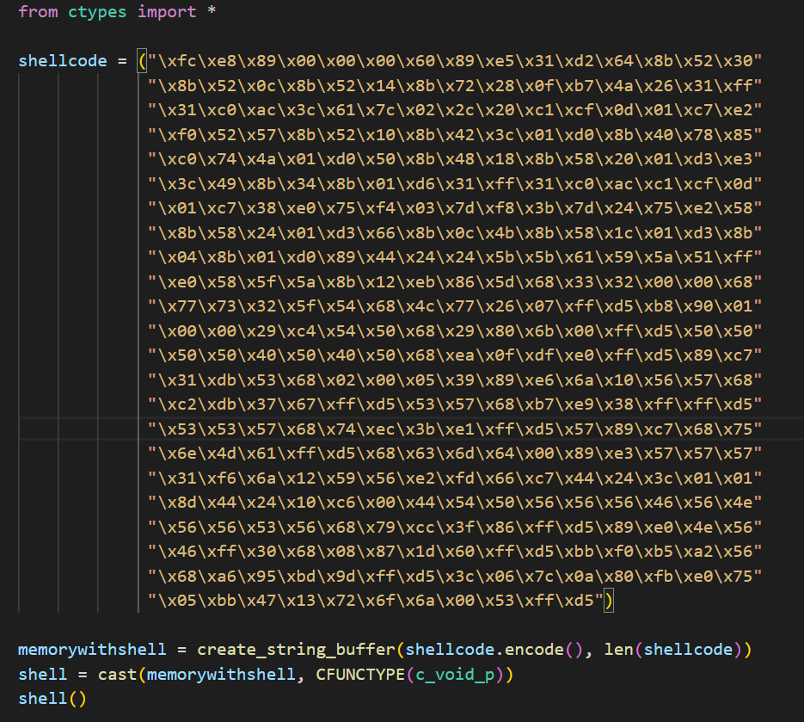

Slide 10
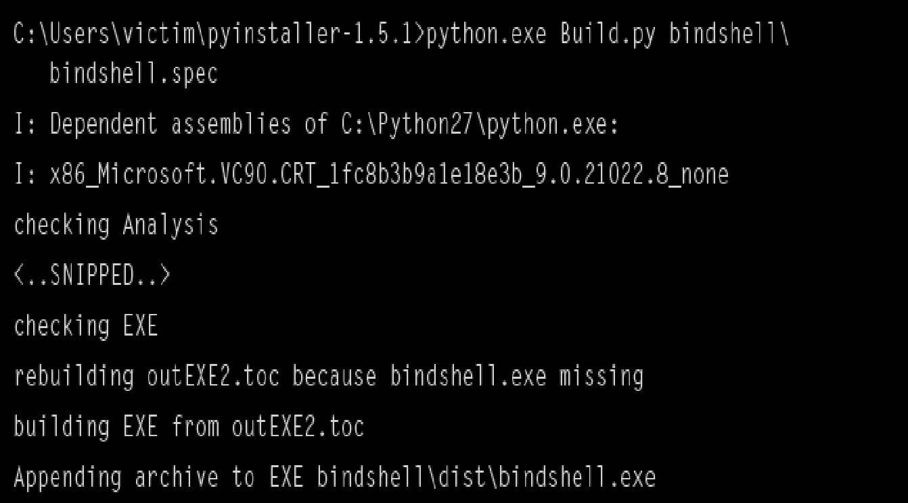
Code :

Slide 11
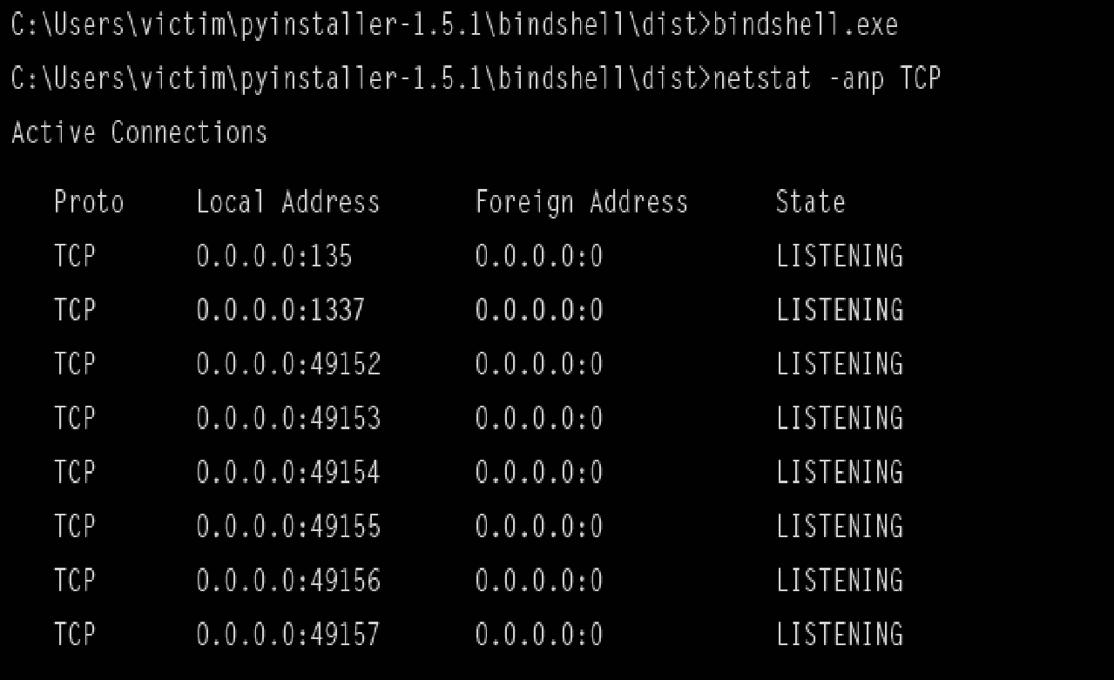
Buillding Win32 Executable using Pyinstaller
Then , spec file built we can instruct pyinstaller to build an executable for redistribution to our victims . pyinstaller creates an executable named bindshell.exe in bindshell\dist\ directory and now redistribute this executable to any windows 32-bit victim
After running executable on a victim, we see that TCP port 1337 is listening

Slide 12
Buillding Win32 Executable using Pyinstaller
This passage is describing the process of using a tool called PyInstaller to take a Python script (in this case, a script that creates a "bind shell" on a victim's machine) and turn it into an executable file (named "bindshell.exe") that can be easily distributed to Windows 32-bit victims.
The executable, when run on a victim's machine, will start a listener on TCP port 1337, allowing the attacker to remotely connect to the victim's machine.

Slide 13
Verifying Evasion
Now , we will use service vscan.novirusthanks.org to scan our executable .It provides a web page interface to upload suspect files and scan them against 14 different antivirus engines .
Capturing a tcpdump of the interaction with web page interface gives us a good starting point for our python script . HTTP header includes s setting for the boundary that surronds the file contents and it require this header and theseparameters in order to submit file .
Now writing quick python function utilizing the httplib that takes the file name as parameter and after opening file and reading contents , it creates a connection to vscan.novirusthanks.org and post th header and data parameters . page returns a response that refers to the loation page containing the analysis of the uploaded file

Slide 14
Verifying Evasion
This passage is describing a process of using a website service called vscan.novirusthanks.org to scan a previously-created executable file for any potential viruses or malware. The service provides a web page interface for uploading files and scanning them using 14 different antivirus engines.
The author captures a record (tcpdump) of the interaction with the web page interface and uses it as a starting point for a Python script. The script uses the httplib library to create a connection to the vscan.novirusthanks.org website, post the header and data parameters, and upload the executable file.
The website returns a response with a location page containing the analysis of the uploaded file.

Slide 15
Verifying Evasion
Examining the returned location field from vscan.novirusthanks.org , we see serverconstructs returned page from site + file + md5sumfile(contents) + bae64(filenem)
The page contains some javascript to print a message saying that scanning fileand reload the page until a full analysis page is readypage returns an HTTP status code 302 which redirects to site + /analysis/ + md5sumfile (file contents) + / + base64(filename) new page simply swaps word file for analysis in the URL
First , our script connects to the file page , which returns a scanning in progrss message. Once this page returns an HTTP 302 redirect to our analysis page , regularexpression to read the detection rate and then replace the CSS code with blank stringthen print detection rate string to the screen

Slide 16
Verifying Evasion
This passage is describing a process of analyzing the response received from the vscan.novirusthanks.org website after uploading an executable file for scanning. The returned location field is found to contain a page constructed from the website URL, the file, the MD5 hash of the file contents, and the base64 encoded filename.
The page contains javascript that displays a message saying that the file is being scanned and will reload the page until a full analysis page is ready.
The page returns an HTTP status code 302, which redirects to a new page that contains the analysis of the file. The new page URL is constructed from the website URL, the MD5 hash of the file contents, and the base64 encoded filename.
The script uses regular expressions to read the detection rate of the uploaded file and replaces the CSS code with a blank string. Lastly, it prints the detection rate string to the screen.

Slide 17
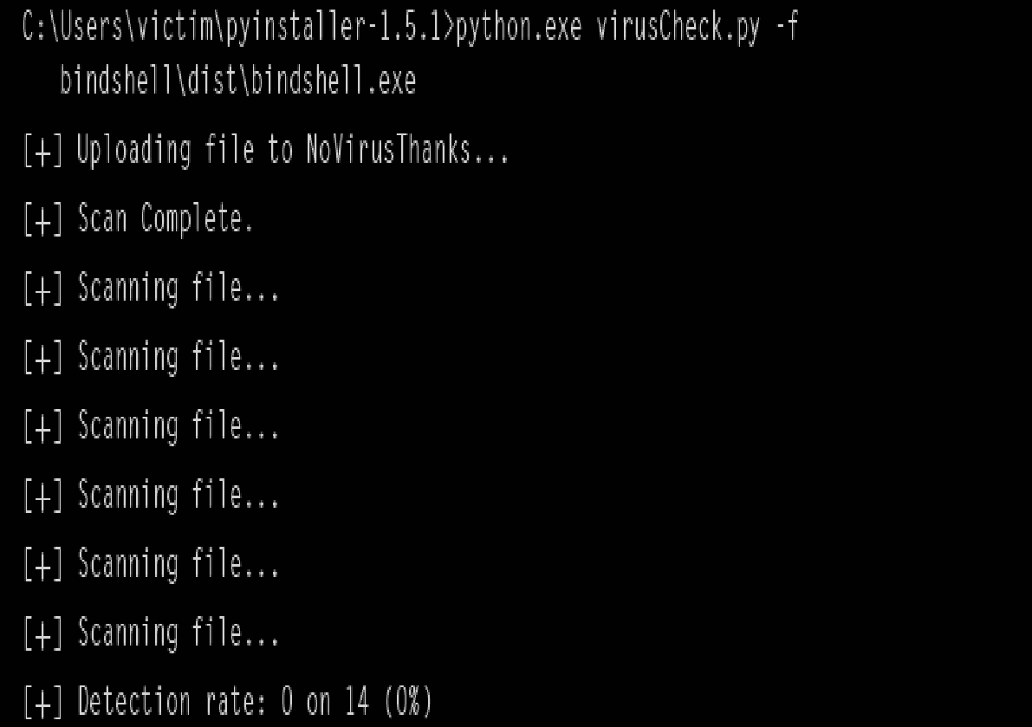
Verifying Evasion
Addding some option parsing we now have script capable of uploading file,scanning it using the site service and printing the detection rate
Now test malicious exe to verify an antivirus program can successfully detect it builded a windows TCP bindshell that binds TCP port 1337 using default meatasploit encoder
It wiil encode it into standard windows exe .Results are 10 out of 14 antivirus engines detect file as malicious
Finally running viruscheck.py script against our python script compiled exe we can upload it to site and see 14 out of 14 antivirus engines failed to detectit as malicious

Slide 18
Verifying Evasion
This passage is describing the process of creating a script that is capable of uploading a file to the vscan.novirusthanks.org website, scanning it for malware, and printing the detection rate. The script is also capable of handling command line options.
The author then tests the script by using a malicious executable file, specifically a windows TCP bind shell that binds TCP port 1337 using a standard Metasploit encoder, encoding it into a standard windows executable.
The results showed that 10 out of 14 antivirus engines detected the file as malicious. Finally, the author uses the script to test the script itself against a compiled version of a python script. The results showed that 14 out of 14 antivirus engines failed to detect it as malicious.

Slide 19
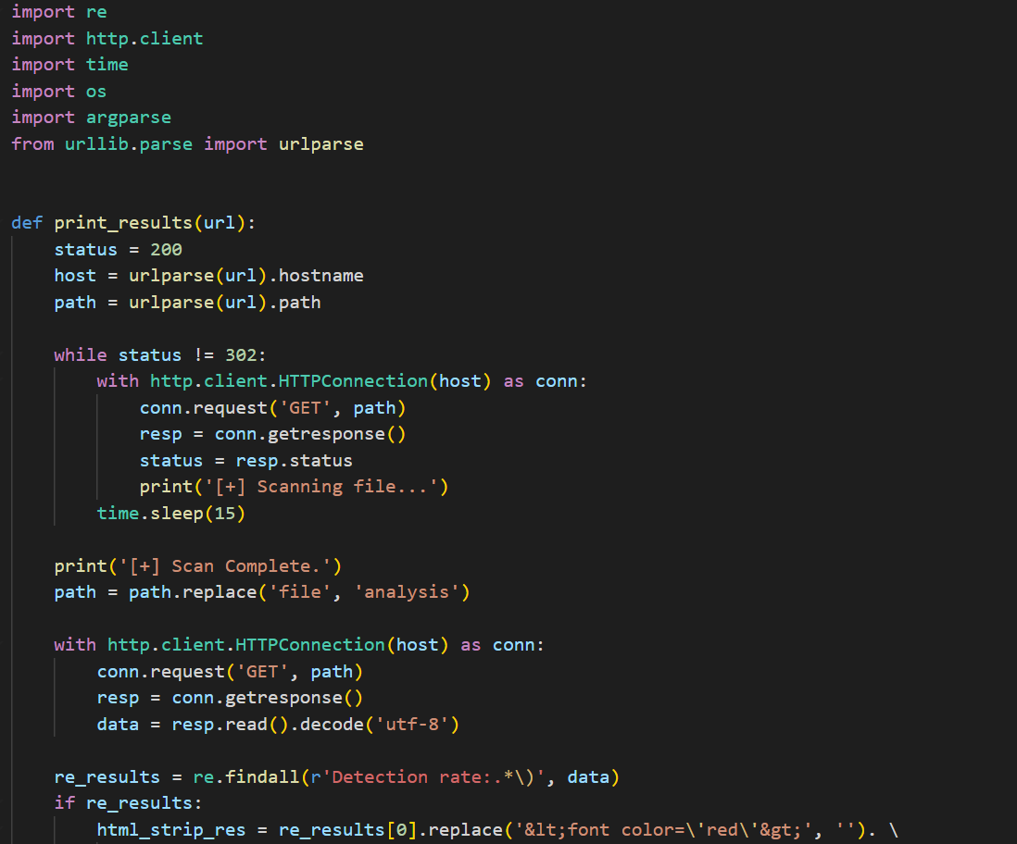

Slide 20
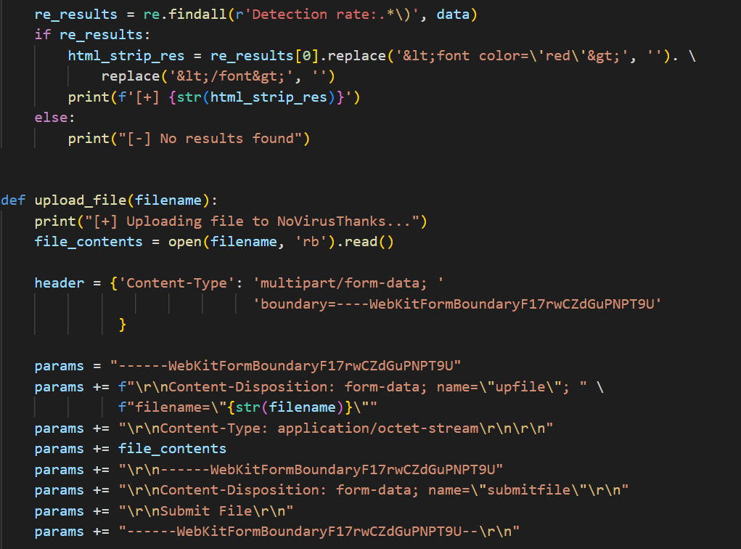

Slide 21
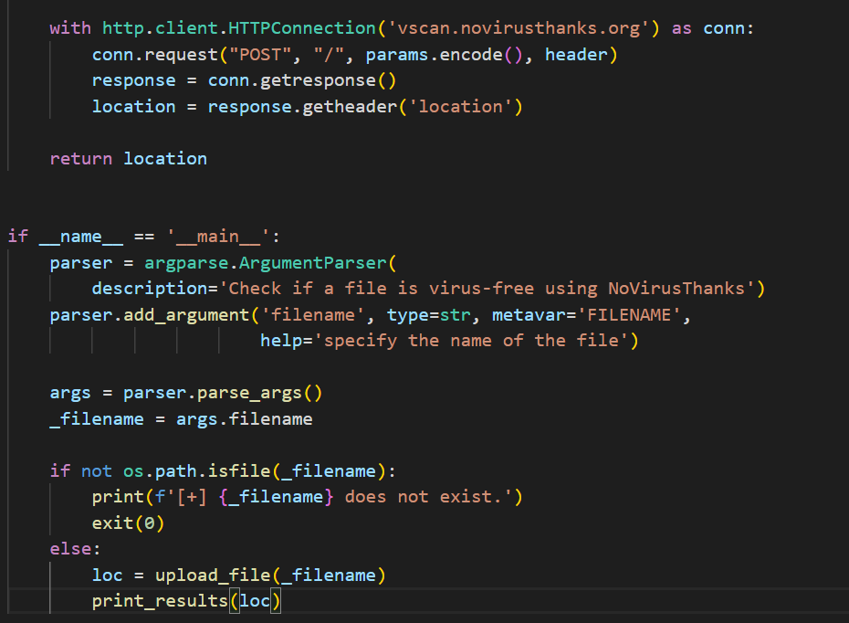

Slide 22
Thank You!

