Slide 1
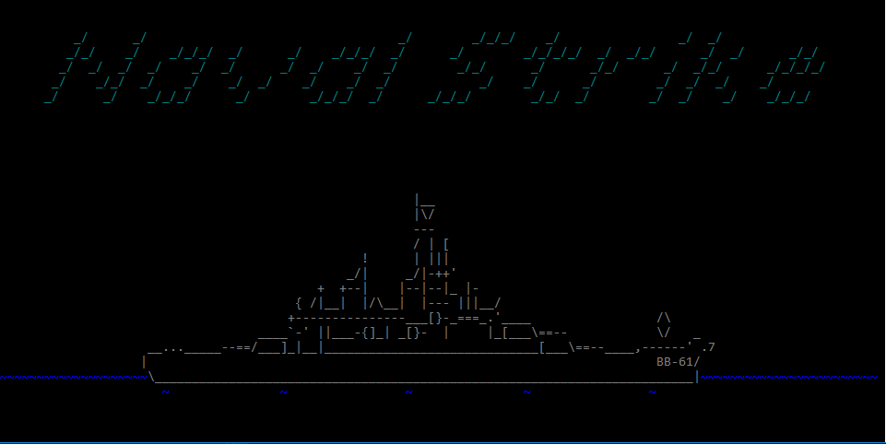
NAVAL STRIKE
A BATTLESHIP GAME
By: Erik English, Tristan Ludwig, and chuck curtis

Slide 2
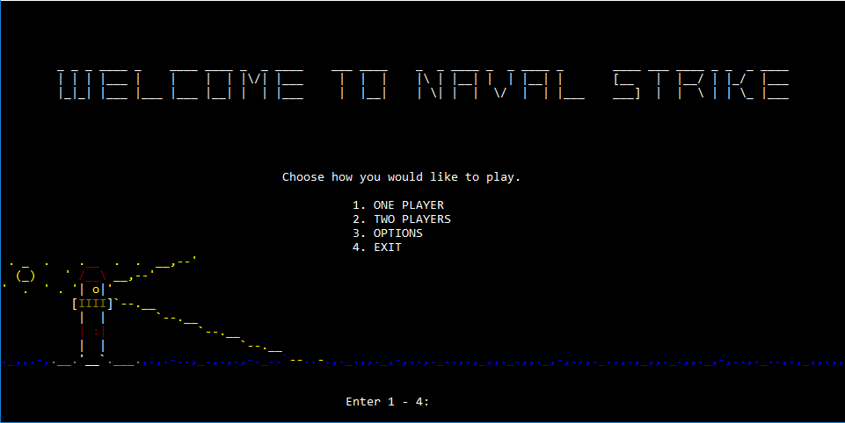
DESCRIPTION
Our game is based off of battleship, though it’s unique in a few ways
There are two separate modes -Single Player -Two Player
Single Player: Sets the user against a preset board with a limited number of “Missiles” at their disposal
Two Player allows one person to set the board that the next user will then try to play against
Plays very similar to battleship, with some added flair

Slide 3
Single-Player
The user is given a set numbered board to play against -This board is 1 of 10 presets within the program -The number given to the user is random -User can replay a specific board by choosing the board number in the “Options” menu
The user then has 50 (by default) guesses to sink all 5 ships. -(User can change # of guesses in “Options”)
If the user sinks all of the ships, a victory screen will display
Otherwise, a “Mission Failed” screen will display
The user will then be asked if they would like to restart the game and play again

Slide 4
Two-Player
Player 1 is provided with a blank board that they then place their ships on -Destroyer -Submarine -Cruiser -Battleship -Aircraft Carrier
User then Determines ship placement and direction (Up, Down, Left, Right) and confirms placements
Player 2 is then presented with a blank board that they will use to guess where player 1 placed their ships
If they guess all spaces correctly, they win. If they exhaust the amount of guesses given to them, they lose

Slide 5
Demo Time!

Slide 6
Trials and Tribulations
WEEK 1 > Allowing the user to place a ship into more than one spot on the board without needing the user to type out each specific coordinate (17 in total). > Also had to make sure the user didn’t put one ship’s coordinates in the wrong spot (2-space ship placed into A1 & C1 rather than A1& B1). > How to create random boards in single-player mode
WEEK 2 > Recognizing when a ship has been sunk > Not allowing the user to place a ship in a space that already contains a ship > How to implement sound

Slide 7
Trials and Tribulations (cont.)
WEEK 3 > How to implement a “difficulty” option by adding or subtracting the amount of guesses the user is allowed. > How to give the user the ability to manually choose which board they play on in single-player mode > Finishing the “HP” system to know when a ship has been sunk
WEEK 4 > Game finished last week, simply adding some finishing touches > Sounds fully implemented > Final user-friendly additions

Slide 8
Important Code
Refresh function > Longest chunk of code > Held most of the code used for Two-player mode, ship placement checks, and valid/invalid input checks
Preset boards > Rather than creating a function to randomly place coordinates on the board, there are instead 10 boards that were pre-made, and the program chooses a random number between 1-10 and uses that board preset
Hertz Sound vs. WAV Sound > Attempted to create music using system hertz, as demonstrated in the main menu. However, opted to use WAV files instead.

Slide 9
Thank You!

