Slide 1
KESHAUN
PORT SCANNER

Slide 2
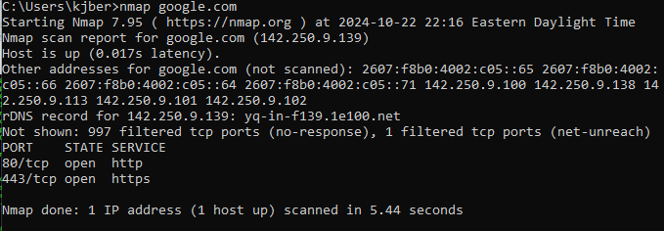
Port Scanning
def portScanner
# To identify open or closed ports on a network
def purpose
# Identifies security vulnerabilities and network services
def importance
# Critical for pen testing and network monitoring
def nmap
# Powerful tool for network discovery and auditing
def main
nextSlide()

Slide 3
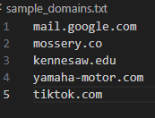



Port Scanner
def input
# A txt file containing a list of domains and sub domains generated by subfinder
def nmap_portscan
# Using the imported nmap library, we scan each domain to retrieve the host IP, status and open ports
# The results will be exported to the function caller
def output
# The output will be a csv file that will be structured as: domain -> host IP address, status, ports
def customizability
# Customizabile port range to isolate testing
def main
nextSlide()

Slide 4
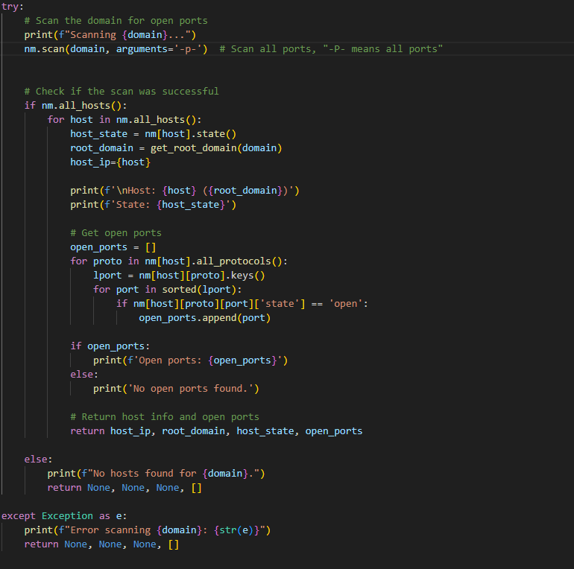
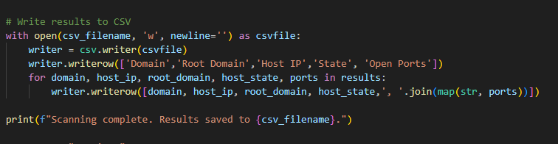
Port Scanner major Code
Nmap setup and port scanning
import nmap
scan_ports()
nmap.PortScanner
nm.scan(domain, arguments=‘-p-’)
Reading domains and storing results
sample_domains.txt
open_ports[] <- scan_ports(domain)
CSV output
results[] <- domain, ip, status, open_ports[]
writer.writerow([domain, ‘,’.join(map(str, ports))]

