Slide 1
Network Densification: Challenges & Opportunities in enabling 5G
Submitted by – Vaibhav Agrawal (16UEC118)
Submitted to – Prof. Ranjan Gangopadhyay

Slide 2
Introduction
The proliferation of mobile communication devices has been the driving force of the ever-increasing demand for data-on-the-go. Many predict the continuation of this trend for several years to come, perhaps growing by several folds in this decade.
One forecasted challenge is the ability of future networks to cost-effectively support a 1000-fold increase in traffic demand. Network densification is widely recognized as a key mechanism to manage this demand.
Also, one of the primary ways 5G network technology will be accomplished is through network densification. While densification will be imperative to 5G network success, there are questions around what network densification is, why it is important, and how network operators will implement this strategy.
So, let’s first of all understand about the evolution in mobile generation tech from 0G to 5G.

Slide 3
Evolution of MOBILE GENERATION TECHNOLOGIES
Zero-Generation Systems (0G) / PRE-CELLULAR technology:0Generation technology, which is designed former to the cellular system is also identified as Mobile Radio Telephone Systems. Generally, it uses analog carriers and provides only half duplex transmission. It comprises of various techniques such as AMTS, MTS, MTD, Norwegian for OLT, push to talk and improved mobile telephone service (IMTS).
First-Generation Systems (1G): 1G technology is a very basic voice analog phone system using circuited switched technology for the transmission of radio signals. All voice calls get Frequency modulated to higher frequency of 150MHz transmitted with FDMA technology in the frequency band of 824-894 MHz with channel capacity of 30 KHz, which was based on a technology called advance mobile phone service (AMPS) or total access communication system (TACS). similar technologies which can support 1G are Nordic mobile telephone (NMT) standard, Radio com 2000 (RC 2000) standard, C-450 standard, etc.

Slide 4
Second Generation Systems (2G): Mobile wireless system was dubbed after the invention and execution of 2G which permits data and voice services together such as SMS, MMS and e-mail with high capacity and coverage. It follows completely digital multiple accessing techniques called TDMA and CDMA standards. All the discussions were numerically encoded and thus it provides greater security. It avails the frequency band of 850-8900MHz and uses the technologies like GSM, PDC, iDEN, IS-136 or NADC with TDMS process and IS-95 with CDMA process. GSM technology uses 8 channels in a single carrier with a net rate of 13Kbps.
Third Generation Systems (3G): 3G technology usually referred as UMTS is found to be 3 times better than GSM, so called 3GSM with maximum date rate of 8Mbps. It assigns low data rate channel for voice calls and large data rate channel for video calls. To frame the International standard for 3G cellular networks, ITU signed the IMT 200 in the year 1999. Thereby the 3G was supported by 2 main technologies UMTS and CDMA2000 with the support of 3GPP and 3GPP2 respectively.
Fourth Generation Systems (4G): 4G technology is established to incorporate the major requirements such as quality of service (QoS) and data rate. This is done by small applications such as MMS, Video chat, HDTV, digital video broadcasting (DVB) and wireless mobile broadband access (WMBA) etc. It is attracted by the property of inter-operability between various networks. For a stationary user –server it provides 1Gbps data rate and for a moving user it offers 1-100 Mbps data rate.

Slide 5
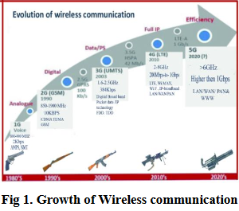
Fifth Generation Systems (5G): To increase coverage, spectral efficiency, data rate, security and signalling efficiency and to reduce latency we must find a new technology beyond 4G and is called as 5G technology descendant of 4G called LTE Advance (LTE-A) which supports FDD mode and TDD mode. Thus, 5G offers 1Gbps data rate and allow us to experience a real wireless world –wireless world wide web (WWWW). It follows all IP model to provide inter-operability between all networks and uses packet switching rather than circuit switching.

Slide 6
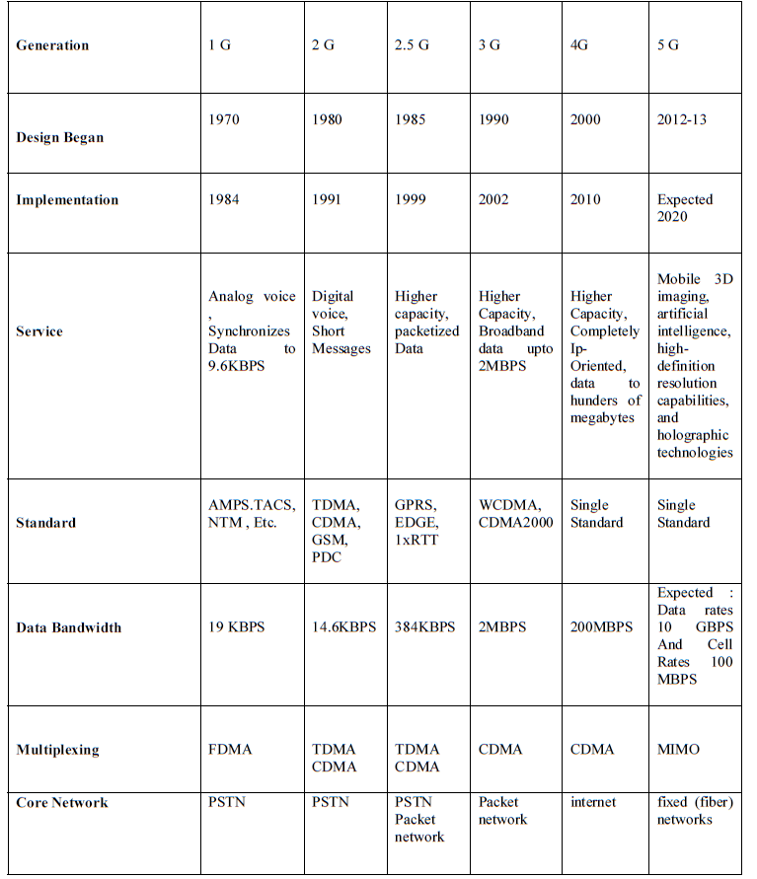
Table 1: Comparative Study of Mobile Technologies
Reference - International Journal of Advanced Research in Electronics and Communication Engineering (IJARECE) Volume 4, Issue 3, March 2015

Slide 7
What is network densification?
Successful 5G implementation will certainly depend on network densification, which is increasing available network capacity through adding more cell sites including radio access networks, macro sites, in-building wireless and small cell deployments. The optimal locations for network densification will be near urban areas and large venues where there are higher numbers of digital users.
Why is network densification important for 5G success?
Network densification is important for 5G as digital users continue to demand faster speeds and higher connectivity. Networks must be able to deliver speeds 10 times faster than 4G while maintaining optimal connectivity. As digital services evolve, such as remote surgeries and autonomous cars, these offerings will ultimately rely on higher connectivity and faster speeds that 5G networks will provide.
What are some ways to achieve network densification?
Some of the primary ways to achieve network densification include increasing the number of antennas and small cell sites as well as upgrading to sector-splitting and massive multiple input/multiple output (MIMO) technologies.

Slide 8
CHALLENGES
When seeing the spatial aspect of network densification; particularly the challenges and opportunities associated with increasing the number of cells in an area in order to increase capacity. Early cell densification was achieved by deploying more macro BSs(i.e., macro cellular densification). The goal was to increase user capacity and achieve wider coverage.
A network incorporating different cell sizes is known as a Heterogeneous Network (hereafter HetNet). HetNets became the trend in spatial network densification allowing home users the ability to purchase small cell BSs and install them in indoor environments where received signal is weak.
However, the higher number of randomly deployed cells in HetNets carries with it many challenges such increased power consumption, overhead of transmitted signals, interference and overhead on the backhaul.

Slide 9
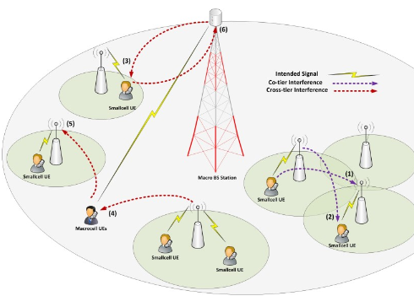
A. Interference management
Managing interference in HetNets remains one of the most challenging problems facing network densification. Problems intensify when BSs of different coverage footprints, access schemes, and transmission powers share the same licensed frequency spectrum.
We will focus our discussion on a two-tier HetNet, composed of a macro base-station (MBS) tier and a small cell base-stations (SCBS) tier.
SCBS are often privately deployed by home users or enterprises to enhance coverage and capacity in indoor areas where macro cell coverage is weak. A SCBS would connect to the cellular network via a backhaul which is a broadband communication link such as digital Link subscriber (DSL).
Fig 2: Different cases of inter and intra tier interference
in uplink and downlink scenarios

Slide 10
Interference in such two-tier HetNets can be categorized into two types.
1)Co-tier Interference
Co-tier interference, also known as intra-tier interference, it describes the interference between BSs belonging to the same tier in the network. The main cause for this type of interference is due to the fact that SCBSs are of ten deployed randomly in high density at small distances of separation. Given that no orthogonal sub-channels allocation is used, SCBSs will interfere with each other when sharing the same spectrum band. Fig. 1. Case (1) shows uplink co-tier interference of small cell user equipment (UE) interfering with a nearby SCBS. Case (2) illustrates downlink co-tier interference of an SCBS interfering with a nearby small cell UE.
2)Cross-tier Interference
Cross-tier interference, also known as inter-tier interference, describes interference occurring between network elements belonging to different tiers. Such interference arises due to mainly two factors: the large difference between transmission powers employed by each tier and the asymmetric path-loss and coverage offered by each tier.
Fig. 1 Case (3) illustrates downlink cross-tier interference between an MBS and a nearby small cell UE. Case (4) shows downlink interference from an SCBS with a macro cell edge user. Case (5) shows uplink cross-tier interference occurs when a macro UE is at the cell edge and needs to transmit at high powers to compensate for the high path-loss and shadowing effect. Lastly, case (6) shows uplink cross-tier interference between a small cell UE and a nearby MBS.

Slide 11
B. Energy Efficiency
Energy efficiency (EE) is defined as the ratio of area spectral efficiency to the total consumed power in a network. While network densification is seen as an effective method of increasing system capacity and coverage, such gain comes at the expense of increased power consumption. Challenges facing EE in dense networks can be categorized into three types:
1)Large number of BSs deployment- One of the downsides of densification is large number of BSs and the associated increase of overall power consumption in the area of deployment.
2)Deployment strategy- Authors discuss the impact of the employed access scheme on energy efficiency; it was found that closed access schemes are less energy efficient than open access scheme due to increased interference experienced in the former schemes
3)Operation mechanism- Power control and idle/active schemes profoundly impact network energy efficiency. It was found that the most common energy saving mechanism is dynamic sleeping that deactivates, i.e. puts in idle mode, any small cell with no active users. This process can substantially improve energy efficiency.

Slide 12
C. Handover and mobility management
The handover process in cellular networks enables a UE that is already connected to a serving cell to transfer its connection to a neighbouring cell while maintaining quality of service at an acceptable level. Network densification intensifies the already existing challenges of managing handovers for mobile UEs.
Another factor aggravating the problem occurs when handover decisions are based solely on the received signal strength at the mobile UE (downlink). Since downlink transmission powers for macro and small cells are disproportionate, handovers might be unnecessary performed. Hence, it is required to simultaneously consider both downlink and uplink which could be challenging.
Furthermore, the mobility of UEs traveling at different speeds is a major factor that must be considered in the presence HetNets with large dense deployments of small cells. Triggering suboptimal handovers could occur for high mobile users. Thus, consideration of mobility and received signal strength of users should be included for inter-tier handover decisions.

Slide 13
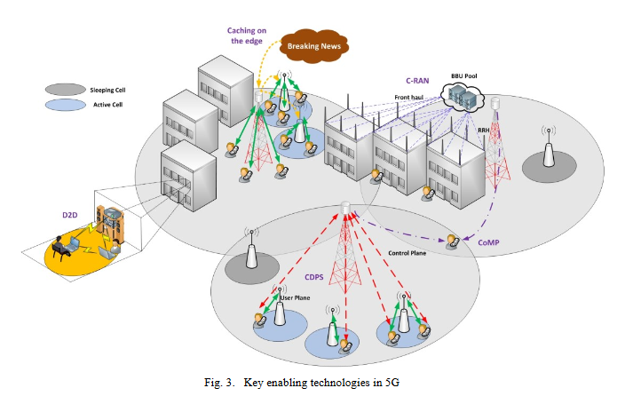
KEY ENABLERS
Implementation of expected new architectures for 5G will provide a needed paradigm shift. By incorporating Self-Organizing Network capabilities powered by big data analysis, many current limitations can be overcome. This can be implemented in a centralized, distributed or hybrid schemes, making use of the data collected at the subscriber level, cell level and core network level and combination of them into a big data analysis unit.
Now, we introduce some of the state-of-art techniques and architectures that are expected to emerge in 5G.

Slide 14
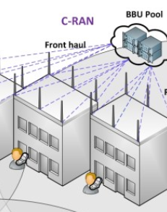
A. C-RAN
It is projected that spatial network densification will be enabled through the ultra-dense deployment of distributed radio antennas. Cloud-based radio access networks (C-RANs) are expected to be the enabler of such densification through the deployment of distributed Remote Radio Heads (RRHs).
C-RAN decouples the baseband processing unit (BBU) from the remote radio head allowing for centralized processing and assignment of radio resources. RRHs are geographically distributed in ultra-density throughout the covered area. Each RRH is connected with the cloud BBU pool via a front-haul which is often a fibre optic cable. Note: This concept is illustrated in Fig 3.
The centralized architecture of C-RAN enables the implementation of advanced clustering schemes and complex coordination mechanisms. These enhance mobility and handovers performance which is crucial for optimizing cell edge data rate.

Slide 15
B. ICIC
Developed techniques to mitigate co-tier and cross-tier interference are referred to as ICIC techniques.
ICIC can be divided into three types :
1) time domain, which relies on coordinating the transmission of subframes between interfering cells, such as the method of almost blank subframes (ABS);
2) spatial domain, such as coordinated multipoint (CoMP) transmission; and
3) frequency domain, such as fractional frequency reuse (FFR)
Joint transmission aims to enhance data rate of cell edge users by coordinating interfering BSs to jointly transmit signals to the victim cell edge UE in a fashion similar to multi user multiple-input multiple-output (MIMO)as shown in Fig. 3.
However, due to its complexity and the overhead strain on the backhaul, CoMP has only been implemented for synchronization and control signals on some selected device.

Slide 16
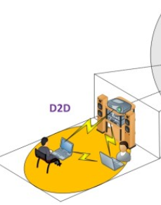
C. D2D communications
Device-to-device (D2D) communications is another approach suggested to solve high-density cellular network challenges. In D2D, each local device directly communicates with other user devices to establish a radio link connection and exchange information as shown in Fig. 3.
D2D communications along with the application of power control algorithms can reduce network interference, latency, and power consumption.
Four different control schemes were suggested by to implement D2D communications:
1)Device relaying with operator controlled link establishment (DR-OC)
2)Direct D2D communication with operator controlled link establishment (DC-OC)
3)Device relaying with device controlled link establishment (DR-DC)
4)Direct D2D communication with device controlled link establishment (DC-DC)

Slide 17
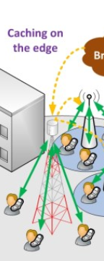
D. Caching
Redundant content, such as a popular internet video, is usually small in number with large file size. Therefore, the concept of storing content that is rated as popular onto intermediate servers will effectively reduce the amount of duplicate transmissions
Caching will also benefit Internet service providers (ISPs) by reducing the amount of inter-and intra-ISP traffic as well as reducing latency in the network. Moreover, reductions in network traffic leads to increased EE and less interference in the network
Important issues for implementing caching mechanisms include:
1) Determining caching storage location, either at the evolved packet core level (EPC) or at the radio access network (RAN) level (i.e. cached content can be stored at eNodeB as shown in Fig. 3);
2) Determining what content should be cached based on measurements such as contents popularity.
3) Selecting appropriate caching policies, which determine how long to store cached content in memory.

Slide 18
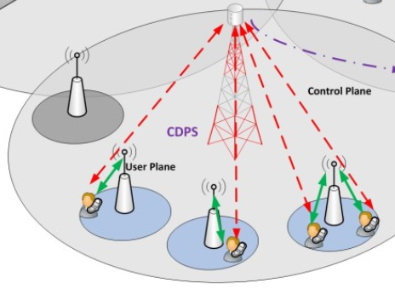
E. CDPS
Current cellular architectures feature a tight coupling of control and data planes. However, as network densification increases this approach proves to be problematic due to the increasing overhead of control signalling, as well as high capacity requirements of the backhaul.
EE also decreases because in many cases a BS with no active users cannot enter idle mode. Instead BS must maintain control signalling. To overcome these problems, Control and Data Plane Separation (CDPS) is suggested for small cells and D2D communications.
In this case macro BSs will maintain providing the synchronization and control signalling to all UEs in range, whether they are served by a macro BS or by a small cell BS.
Small cells BSs are only responsible for providing user plane signalling to their connected UEs. Such a scheme would increase the flexibility needed to implement energy saving schemes as shown in Fig. 3

Slide 19
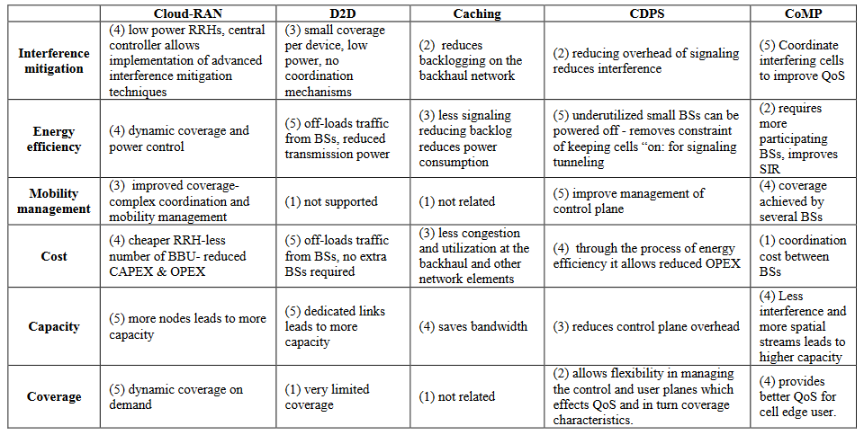
TABLE 2: Comparison between different prospective 5gtechnologies in terms of key performance indicators (kpis), Rankings in terms of positively
improving each kpi are from 1to 5,where 1means method is ineffective and 5means that method is most effective

Slide 20
Conclusion
In this presentation, we have discussed major challenges facing network densification, such as co-tier and cross-tier interference management; energy efficiency; and factors limiting performance for mobile users traveling at various speeds. We examined key-enabling 5Gtechnologies (e.g., cloud-radio access network and user centric clustering mechanism; coordinated multipoint as an inter-cell interference cancellation technic; device-to-device communications; caching; and separation of control and data plane. Each of these is evaluated to demonstrate the part it will play in mitigating the aforementioned challenges.
With reasonable projections on additional spectrum availability, expansion of small-cell deployments, and growth in backhaul infrastructure, we believe that the cellular communication industry is well positioned to meet the 1000x demand this decade. A combination of meaningful enhancements in key areas together with a few novel components can raise the overall user experience to a whole new level, inaugurating a brand new wireless universe that is truly worthy of the 5G designation.

Slide 21
Abbreviation | Full form
AMTS | Advanced Mobile Telephone System
MTD | Mobile Telephony System
FDMA | Frequency Division Multiple Access
NADC | North American Digital Cellular system
UMTS | Universal Mobile Telecommunications Standard
ITU | International Telecommunication Union
BSs | Base Stations
HetNets | Heterogenous Networks
SCBSs | Small Cell Base-stations
UE | User Equipment
EE | Energy Efficiency
CoMP | Coordinated Multipoint
C-RANs | Cloud-based Radio Access Networks
ICIC | Inter-Cell Interference Cancellation

Slide 22

Thank You
“We often take for granted the very things that most deserve our gratitude.”

