Slide 1
Understanding
of the brief
1U Bank Launch Pitch. DDB Lagos, August 2026.
CONFIDENTIAL • PREPARED FOR ONEUTILITY BANK
1U 360 CAMPAIGN PROPOSAL
1
Notes:
Our understanding of the brief for the launch of 1U Bank, Africa's first Utility Bank.

Slide 2
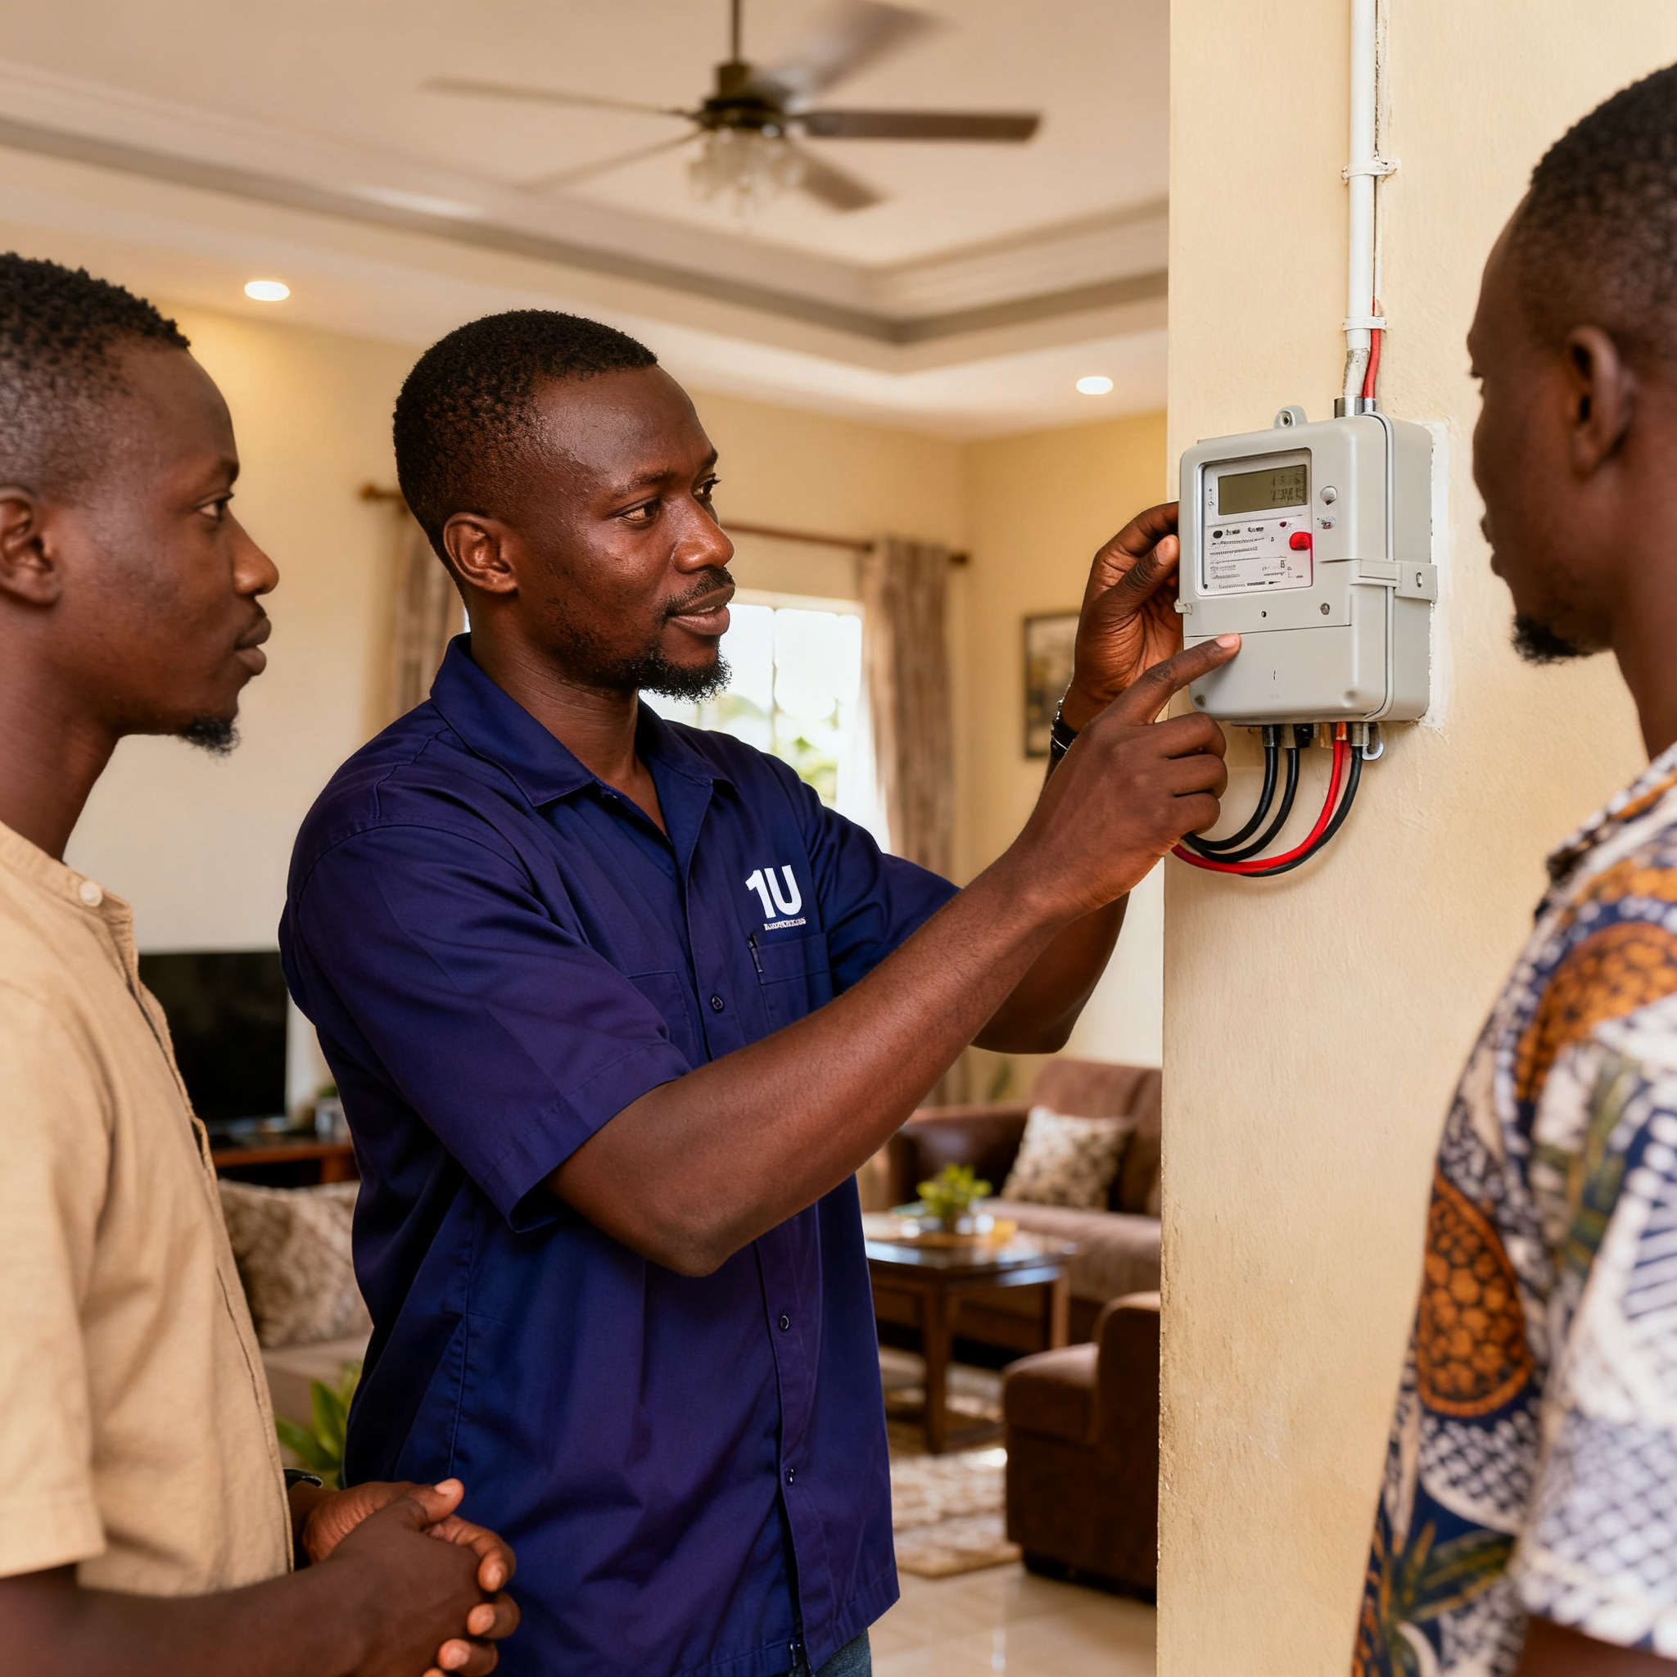
Our understanding of the business
1U intends to serve both sides of the utility economy.
1Utility Bank is introducing Utility Banking, a banking proposition built around the essential services people and businesses depend on, and the organisations and infrastructure that provide them. At the consumer level, its defining product is the Utility Account: an account linked to a customer’s phone number that allows money sent by bank transfer to become airtime, data or other supported utility payments. Around this proposition, 1U intends to provide a broader suite of personal and business banking services, including savings, investments and intelligent security controls. On the institutional side, the bank also intends to finance utility providers, assets, infrastructure and renewable-energy projects.
SIDE ONE
SIDE TWO
The people and businesses that depend on essential services.
The organisations and infrastructure that provide them.
CONFIDENTIAL • PREPARED FOR ONEUTILITY BANK
1U 360 CAMPAIGN PROPOSAL
2
Notes:
1U intends to serve both sides of the utility economy: the people and businesses that depend on essential services, and the organisations and infrastructure that provide them.

Slide 3
Our understanding of the challenge
1U must introduce a new category and earn permission to own it.
The campaign must do more than launch another digital financial product. It must help Nigerians understand what Utility Banking is, why it matters and why they should trust 1U to deliver it. That breaks down into four connected communication tasks.
Explain
Differentiate
Reassure
Convert
Make Utility Banking and the Utility Account immediately understandable.
Establish 1U as neither another fintech nor another traditional bank.
Show the service is secure, dependable and supported by a complete banking ecosystem.
Move people from awareness to a first utility payment, then into repeated use.
Make a new financial category feel familiar, useful and trustworthy from day one.
CONFIDENTIAL • PREPARED FOR ONEUTILITY BANK
1U 360 CAMPAIGN PROPOSAL
3
Notes:
1U must introduce a new category and earn permission to own it. Four communication tasks: explain, differentiate, reassure, convert.

Slide 4

Our understanding of the audience
Different Nigerians, connected by the same everyday reality.
The brief identifies a broad audience: salaried professionals, students, SMEs, traders, gig workers, families, young professionals and digitally confident consumers. Incomes and lifestyles differ. What they share is that money is constantly being assigned to practical responsibilities such as electricity, airtime, data, transport, rent, healthcare, school fees, family support and business needs.
Salaried professionals
Students
SMEs
Market traders
Gig workers
Families
Young professionals
Digital-first consumers
CONFIDENTIAL • PREPARED FOR ONEUTILITY BANK
1U 360 CAMPAIGN PROPOSAL
4
Notes:
Different Nigerians, connected by the same everyday reality. Money constantly assigned to practical responsibilities.

Slide 5



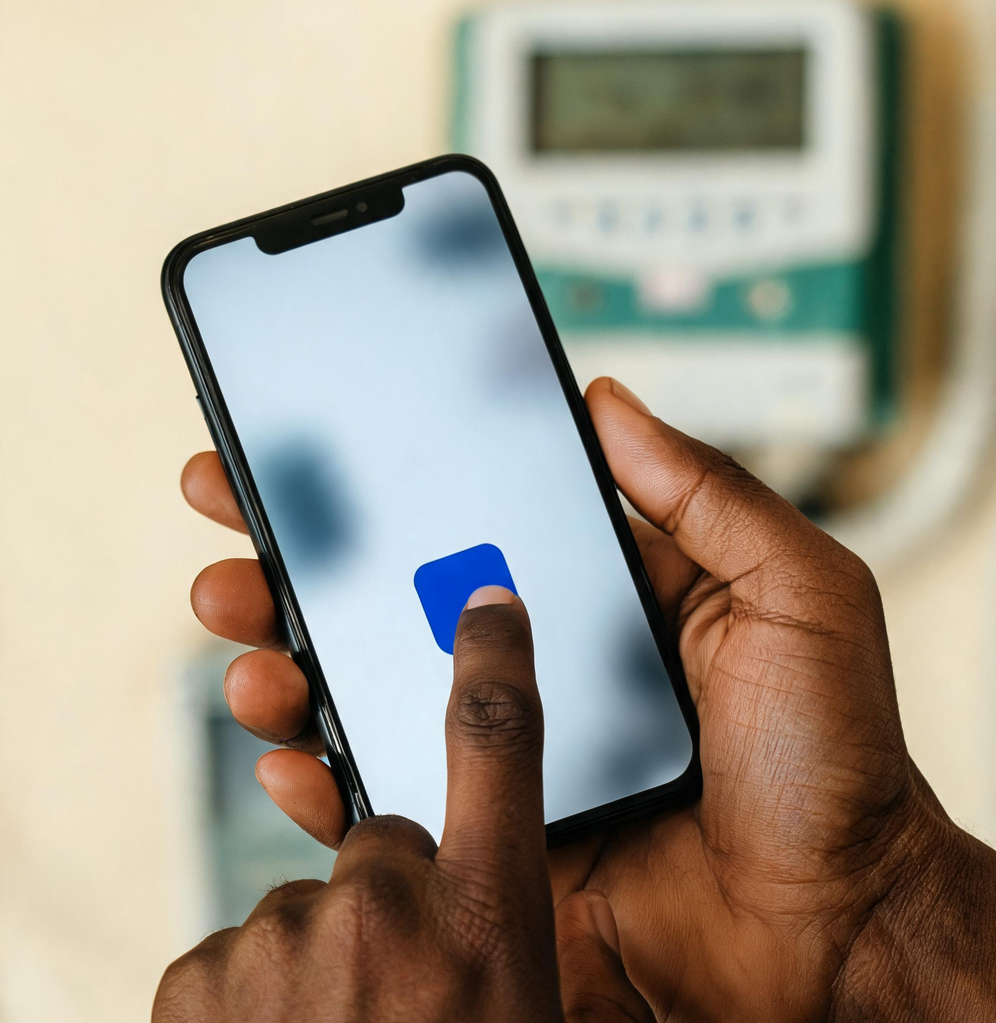

The desired response
From understanding to habit, in five moves.
Expressed in a way that feels human, modern, uncomplicated, trustworthy and distinctly Nigerian.
UNDERSTAND
BELIEVE
FEEL
ACT
CONTINUE
1U is a full-service bank built around everyday financial life.
The Utility Account removes unnecessary steps safely and reliably.
The bank understands how Nigerians actually live.
Use a Utility Account for a first bill payment.
Make 1U part of a regular financial routine.
CONFIDENTIAL • PREPARED FOR ONEUTILITY BANK
1U 360 CAMPAIGN PROPOSAL
5
Notes:
Five things the campaign should make the audience do: understand, believe, feel, act, continue.

Slide 6
Questions for alignment
What we need to know before we finalise the plan.
1.
What is 1U's precise regulatory status, and what licensing language should appear in campaign communications?
9.
Which product should lead communications after Utility Banking: personal banking, business banking, savings, investments or utility financing?
2.
Have “Africa's first Utility Bank,” “automatically part of our network” and “patented innovation” been legally approved as public claims?
10.
What evidence can substantiate trust at launch: transaction success rates, security certifications, reversal policies, service guarantees or banking partnerships?
3.
Which Utility Account functions will be live at launch: airtime, data, electricity, water, television, transport, rent, school fees or others?
11.
What customer support and dispute resolution systems will be available when a utility payment fails or is delayed?
4.
Does every phone number already have a usable Utility Account, or must the owner register and complete KYC before receiving value?
12.
Are there approved launch offers, cashback, referral rewards or transaction incentives?
5.
What happens when money is sent to a phone number belonging to someone who has not registered with 1U?
13.
What media and production budget should guide the proposed campaign scale?
6.
What is the priority conversion event: account registration, completed KYC, first deposit or first utility payment?
14.
What are the confirmed launch date, campaign duration and product readiness milestones?
7.
Which audience should lead the launch? The current target definition covers several groups with different needs and motivations.
15.
Which brand assets, tone of voice rules and mandatory legal disclaimers will agencies receive?
8.
Is the campaign launching nationally or in selected Nigerian states and cities first?
CONFIDENTIAL • PREPARED FOR ONEUTILITY BANK
1U 360 CAMPAIGN PROPOSAL
6
Notes:
The questions we need answered before finalising the campaign, covering regulation, product scope, audience, trust, support, budget and timing.

